Slide 1
Part 3.

Slide 2
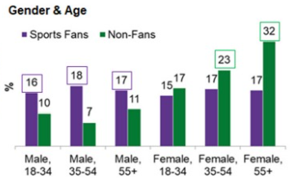
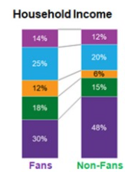
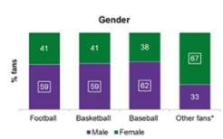

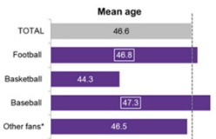
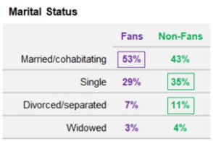
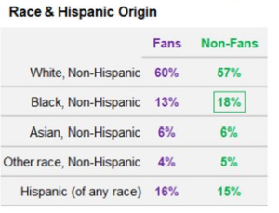
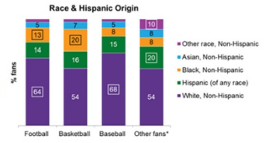
Global Market composition
Sport Fans
NBA Fans
The NBA fanbase predominantly comprises males.
Among the three major sports in the US, NBA fans tend to be younger.
Sports fans primarily consist of younger males.
Sport Fans share is bigger among households with an income less than $100k
The biggest portion of sport fans are married/cohabitating.
White and Hispanics have a higher representation in sport fans population
Compared to the other big three sports, the NBA boasts a significant representation of Black and Hispanic fans.
Source: Mintel, 2019

Slide 3
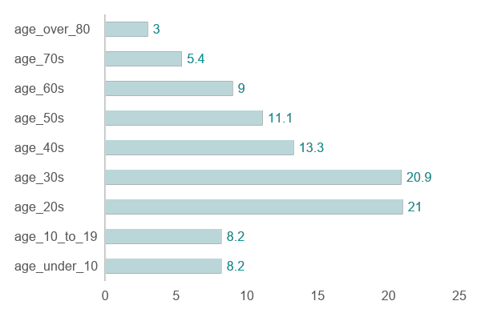
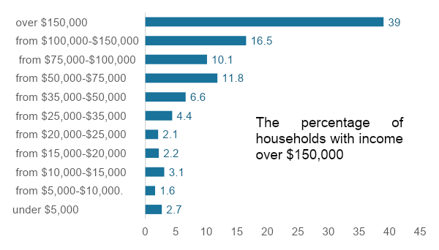
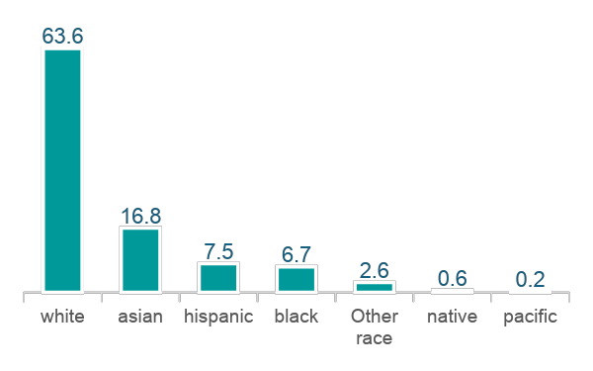

Seattle Market composition
Demographics
Economics
Population by gender
Population by age
Median age
Household income
35.4
39%
48.9%
51.1%
The male population share is higher than the female one.
Population by ethnicity
A little more than 50% of the population are between 20 and 40 years old.
66.6% of Seattle residents have at least 4 years degree.
56.7% of Seattle residents have a Bachelor’s degree in a science and Engineering field.
Families
116,068
63,167
The family size of an average family in Seattle is 2,81 persons.
Median household income.
The median income of individual.
44.5%
40%
Of Seattle population are married
Percentage of households that own (rather than rent) their residence.

Slide 4
Target Segment for NBA - Seattle
Demographics and economics
Name: Jordan Matthews
Age: From 20s to 30s, Adults Gen-Z
Level of education: Bachelor’s Degree or higher.
Family life: Compound or single families.
Household income: over $75,000
Motivations
Engaging in Instagram-worthy experiences while attending stadium events.
Cultivating close relationships with athletes.
Enjoying quality family time together.
They gain information by
Youtube for accesing NBA older footage.
Blogs and websites to follow up recent updates and highlights of the games due to the long lasting season.
Social Media
X

Slide 5
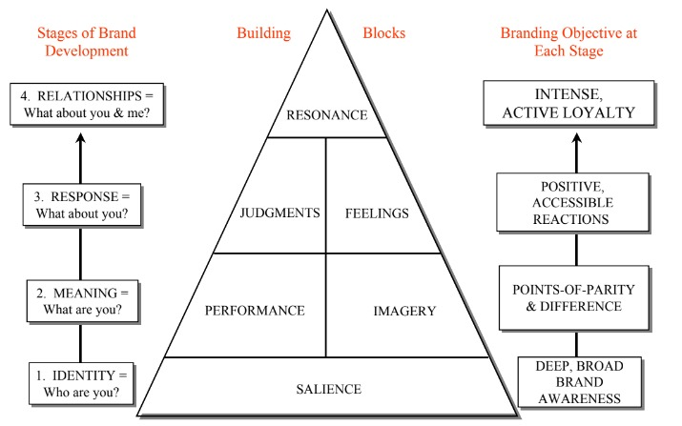
Building Brand Equity
Identity
Customer-based brand equity model pyramid.
Family Ticket Packages: Offer discounted ticket packages specifically tailored for families, including tickets for adults and children, as well as perks such as food vouchers or merchandise discounts.
Family-Friendly Events: Host pre-game or post-game family events at the stadium, such as meet-and-greets with players, interactive games, or photo opportunities with team mascots.
NBA Junior Fantasy League: Develop a simplified fantasy basketball platform specifically designed for children, featuring easy-to-understand scoring systems, player selection processes, and weekly challenges. Incorporate educational elements to help kids learn about basketball strategy, player statistics, and teamwork. Creating fantasy basketball platforms tailored for children can be a great way to engage young NBA fans.
Building strong brands in a modern marketing communications environment Kevin Lane Keller*

Slide 6
Building Brand Equity
Meaning and Response
Customer-based brand equity model pyramid.
Educative information: Produce a short documentary-style video that effectively explains the rules and flow of the game in an informative and inclusive manner, catering to both avid fans and newcomers without being patronizing or overwhelming.
Highlight Exclusivity: Emphasize the exclusivity of team-related merchandise, showcasing limited edition items or unique designs that fans may not be able to find elsewhere. This creates a sense of value and excitement for fans who want to own something special.
Building strong brands in a modern marketing communications environment Kevin Lane Keller*

Slide 7
Building Brand Equity
Relationships
Customer-based brand equity model pyramid.
Social Media Campaigns: Youtube video series of the DIY (Do it Yourself) sponsor by the team athletes.
Open Communication Channels: Establish clear and accessible channels for communication between the league, teams, players, and fans. This could include regular updates via social media, newsletters, and press releases to keep stakeholders informed about important developments.
Building strong brands in a modern marketing communications environment Kevin Lane Keller*

Slide 8
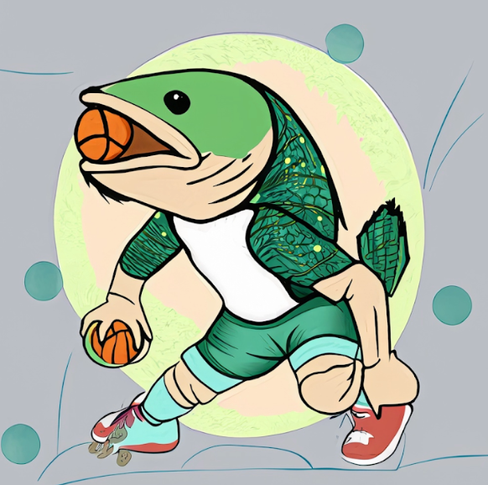
Why Salmon?
Iconic and ecologically important species in the Pacific Northwest, including the waters around Seattle
Salmon are vital to the cultural heritage of Pacific Northwest indigenous peoples, serving as food, in ceremonies, and spiritually significant. Traditional fishing techniques endure across generations.
Adult Gen Z: Enviroment issues are important for them today.
Why Colors?
Green:
Symbolizes sustainability and nature.
Adopted by Seattle NFL, MLS, and WNBA teams.
Nostalgic connection to Supersonics team.
Earth Tones:
Brown and beige evoke nature and sustainability.
Sets team apart from others, like Boston Celtics.

Slide 9
Part 2. Question 3

Slide 10
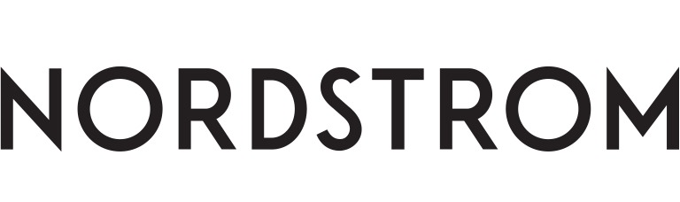
Sponsor for Seattle NBA Team
There are several potential common points between the new Seattle NBA team and Nordstrom that could be leveraged for a sponsorship partnership:
Local Roots
Target Market
Both the new Seattle NBA team and Nordstrom are deeply rooted in the local community. Established in 1901, Nordstrom is a longstanding Seattle institution, while the NBA team is poised to become a vital aspect of the city's identity and culture.
Nordstrom's upscale, fashion-conscious clientele aligns with those likely to attend NBA games. A sponsorship partnership could boost Nordstrom's presence among this demographic, enhancing its brand image as a local sports and culture supporter.
Brand Values
Marketing Opportunities
Nordstrom and the new Seattle NBA team likely share brand values like quality, customer service, and community engagement. A partnership could strengthen these values and foster a positive brand association.
A partnership between the new Seattle NBA team and Nordstrom could provide marketing opportunities like co-branded promotions and exclusive events, driving customer engagement and loyalty. Overall, it could be mutually beneficial, leveraging their shared values and local presence for a strong sponsorship relationship.

Slide 11
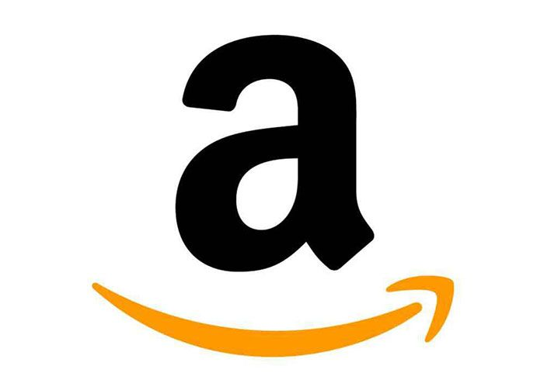

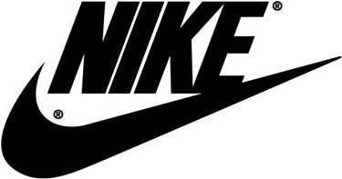
Why not?
While Amazon's presence is significant in Seattle, we are seeking a brand that embodies the same heritage and ownership values as the Salmon mascot of our NBA team. We aim to find a partner that truly resonates with the community's history and identity.
Microsoft is already engaged with the NBA on various fronts, such as using Microsoft Teams for virtual fan experiences and integrating Microsoft Azure into the NBA's data and analytics infrastructure. We prefer not to overlap with this existing connection for the new team.
Nike currently sponsors several NBA teams and serves as the official apparel provider for all NBA teams. To create a unique and fresh alliance, we aim to avoid aligning with a brand that is already heavily involved in sports sponsorships.

Slide 12
Links
Global Market composition - NBA
https://reports.mintel.com/display/919876/?fromSearch=%3Ffreetext%3DMARKETING%2520TO%2520SPORTS%2520FANS%2520US%252C%2520NOVEMBER%25202019%26resultPosition%3D1
Brand Equity
Keller, K. L. (2013). Building strong brands in a modern marketing communications environment. In The evolution of integrated marketing communications (pp. 65-81). Routledge.

