Slide 1



Project Title
SPEECH LANGUAGE DISORDER IDENTIFICATION USING DEEP LEARNING TECHNIQUES
PRESENTED BY GUIDED BY
Snehaa.S
Swathi.B
Venkatesh.V
17D77
Dr.C.S.Kanimozhi selvi
Department of Computer Science and Engineering

Slide 2
PROBLEM STATEMENT & OBJECTIVE
Some people may drag out syllables or may talk breathlessly, or seem tense while trying to speak.
If you clutter, you often speak fast and merge some words together or cut off parts of them. You may sound like you are slurring or mumbling.
Hence, this proposal aims to include a novel and innovative ML based method to help a person to identify their speech language disorder.

Slide 3
EXISTING SYSTEM
Speech therapy is performed by speech-language pathologists (SLPs), who are often referred to as speech therapists.
Therapists use a variety of tools and technologies to assist with evaluation, diagnosis and rehabilitation of individuals both young and old.
These include articulation therapy, language intervention activities, and others depending on the type of speech or language disorder.
There are techniques like Voice Synthesizer, Analytical Software and Tablet Computer are the frequently used tools by the physicians.
To identify the speech disorder, there is no proper tools, or any tools available to identify.

Slide 4
REQUIREMENT SPECIFICATION
HARDWARE REQUIREMENTS:
Processor | DELL
Processor Speed | 1.80 GHz
Hard Disk | 1 TB
RAM | 4 GB
SOFTWARE REQUIREMENTS:
Programming Language | Python 3.5
Software | Anaconda Navigator 1.9.7 (Jupyter Notebook 6.0.3, Spyder 4.1.)
Operating System | Windows 10

Slide 5
MODULES
Data collection
Data Augmentation
Feature Extraction
MFCC
Model Fitting with CNN
Website Development

Slide 6
Speech Disorders
Speech disorders affect a person's ability to produce sounds that create words.
A fluency disorder, which is often referred to as “stuttering”. Primary behaviors of the disorder may include repetitions of sounds, syllables, or whole words; prolongations of single sounds; or blocks of airflow or voicing during speech.
It may sound like you are slurring or mumbling.
Dysarthria often causes slurred or slow speech that can be difficult to understand.
Common causes of dysarthria include nervous system disorders and conditions that cause facial paralysis or tongue or throat muscle weakness.
Certain medications also can cause dysarthria.

Slide 7
Dataset
Voice recording of different people is collected.
Recordings consist of people saying small sentence in tamil.
It is required to convert it to .json format before proceeding.
Each audio data are collected had to be labeled so that the machine learning algorithm can be applied and both input & output data is an important part for pre-processing.

Slide 8
Data Augmentation
Data augmentation in data analysis are techniques used to increase the amount of data by adding slightly modified copies of already existing data or newly created synthetic data from existing data.
It acts as a regularizer and helps reduce overfitting when training a machine learning model.
We had normal recorded audio, we then inserted silent audio in between the ordinal audio to get stuttering dataset.
Reduced the volume and inserted silent audio to get dysarthria dataset.
We then augmented it to get many data.
We have 3 types of data - normal, stuttering, dysarthria.

Slide 9
Feature Extraction MFCC
Mel-frequency cepstral coefficients (MFCC).
The feature count is small enough to force us to learn the information of the audio.
13 parameters are related to the amplitude of frequencies.
It provides us enough frequency channels to analyze the audio.
Frame the audio signal into frames.
For each frame calculate the power spectrum.
Apply the mel scale filter bank to extract the frequency bands.
Apply log filter banks, apply DCT coeff to generate a compressed version of filter banks which give the MFCC.
The data is stored in a separate folder as .json file.

Slide 10
Model Fitting with CNN
We have to pass the output to CNN model.
The process in the CNN model:
The hidden layers- convolution layer, the ReLU layer, and pooling layer- carry out feature extraction by performing different calculations and manipulations.
The input is fed to the convolutional layer that performs the convolution operation.
It results in a convolved map.
The convolved map is applied to a ReLU function to generate a rectified feature map.
The input is processed with multiple convolutions and ReLU layers for locating the features.
Different pooling layers with various filters are used to identify features.
The pooled feature map is flattened and fed to a fully connected layer to get the final output.
Finally, there’s a fully connected layer that gives the final output.

Slide 11
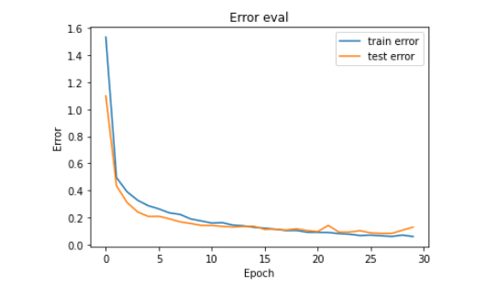
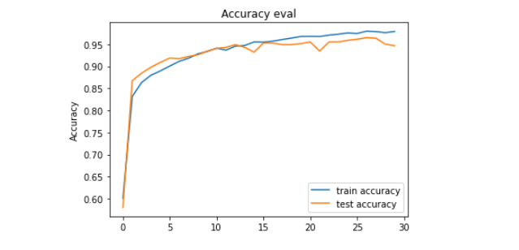
OUTPUT
Epoch

Slide 12
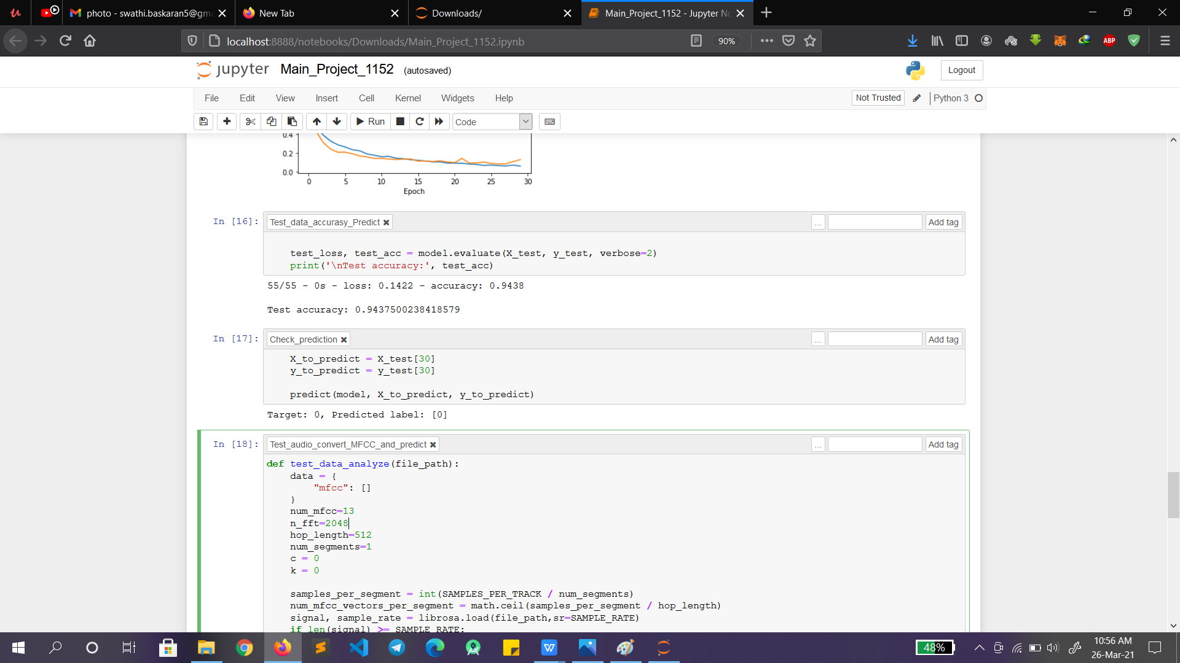
Accuracy was found to be 94%.

Slide 13
Website Development
The main objective of the website is to bring the user an interactive application.
The website was developed using HTML and Python.
The welcome screen prompt will display a sentence in Tamil, then by pressing the record button you can record yourelf reading out the sentence.
The page has a record button, pause button, and a stop button.
The website will predict stuttering, dysarthria, or normal speech.
You can save the recording to your personnel computer, and you can check your progress later.

Slide 14
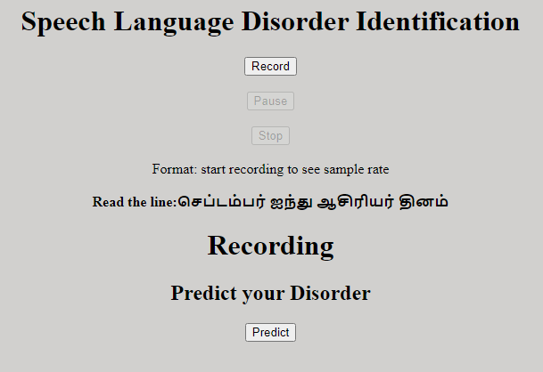
Website Screenshot
a) Screen where audio can be recorded

Slide 15
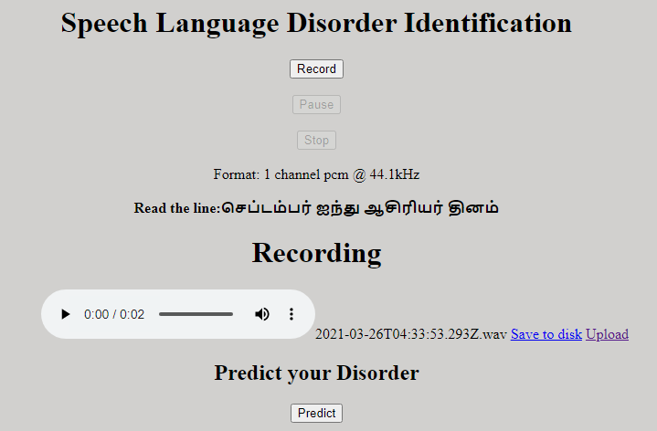
b) Screen where audio recorded can be uploaded and saved

Slide 16
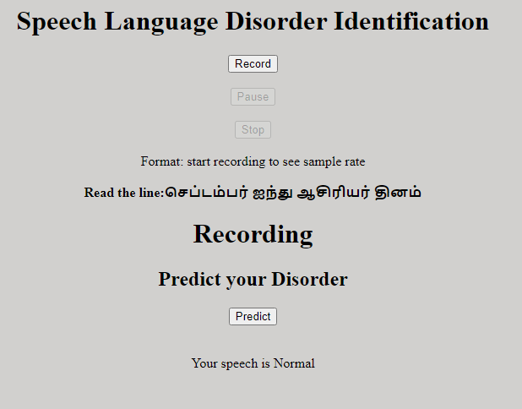
c ) Screen which shows the prediction

Slide 17
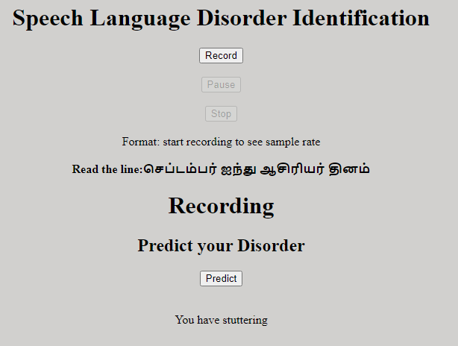
d )Screen which shows the prediction

Slide 18
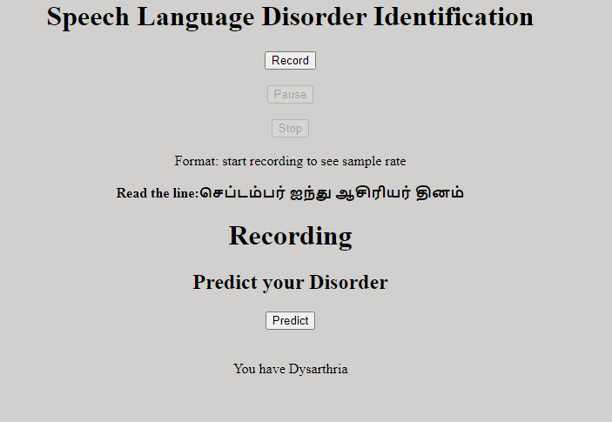
e )Screen which shows the prediction

Slide 19
REFERENCES
Alan Preciado-Grijalva (2018) has developed a system capable of classifying the level of fluency of non-native English speakers using five different machine learning models.
Witsawakiti et al (2006) has described an e-training tool designed to help hearing impaired children learn and practice words in Thai language more correctly. The tool uses speech to overcome the limitations of the traditional face-to-face speech therapy.
Janet M.Beilby (2012) has described about acceptance and commitment therapy for adults who stutter: Psychosocial adjustment and speech fluency.
David Millen (2017) has trained a machine by a machine learning technique for recognizing speech utterance to determine language fluency level of a user.
Robles-Bykbaev et al(2014) have developed an ecosystem of intelligent ICT tools consists of an expert system to support speech and language pathologists, doctors, students, patients and their relatives.

Slide 20
CONCLUSION
Children with communication disorders are affected mentally too.
They become less social, and stay away from public communication.
This may even become a psycological problem.
This app will treat the children in a playful and efficient way.
Children will get competitive because of the 100% display.
“Communication - the human connection - is the key personal and career success”
- Paul J. Meyer
Good communication is never one way!

