Slide 1



Project Title
A Machine learning assisted therapy tool for communication disordered children
PRESENTED BY GUIDED BY
Snehaa.S
Swathi.B
Venkatesh.V
Dr.C.S.Kanimozhi selvi
Department of Computer Science and Engineering

Slide 2
PROBLEM STATEMENT & OBJECTIVE
Therapy tools available in the market focuses only on assisting the therapist, but sometimes that does not provide an efficient way in treating them.
Hence, this proposal aims to include a novel and innovative ML based method in diagnosing the communication disorders.
So this project will help the children to rectify the disorder easily at an early age without spending a lot of money, in an efficient way and fun way.

Slide 3
EXISTING SYSTEM
Speech therapy is performed by speech-language pathologists (SLPs), which are often referred to as speech therapists.
Therapists use a variety of tools and technologies to assist with evaluation, diagnosis and rehabilitation of individuals both young and old.
These include articulation therapy, language intervention activities, and others depending on the type of speech or language disorder.
There are techniques like Voice Synthesizer, Analytical Software and Tablet Computer are the frequently used tools by the physicians.

Slide 4
REQUIREMENT SPECIFICATION
HARDWARE REQUIREMENTS:
Processor | DELL
Processor Speed | 1.80 GHz
Hard Disk | 1 TB
RAM | 4 GB
SOFTWARE REQUIREMENTS:
Programming Language | Python 3.5
Software | Anaconda Navigator 1.9.7 (Jupyter Notebook 6.0.3) Android Studio 3.5.3
Operating System | Windows 10

Slide 5
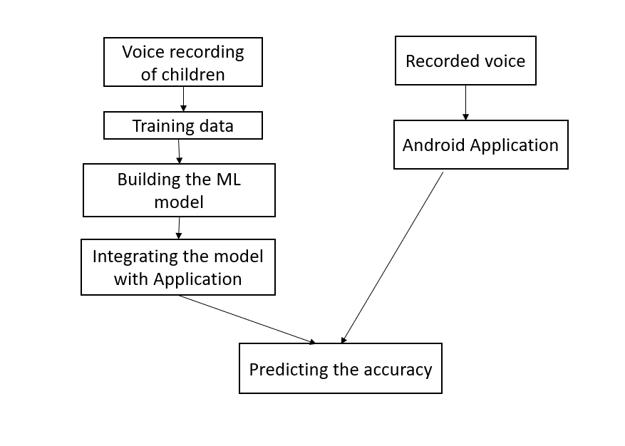
Workflow of the Application

Slide 6
MODULES
Data collection
Building a ML model
Data Preprocessing
Padding
Spectogram
One-hot-encoding
Model Fitting with CNN
Converting the model to tflite model
Integrating Model with application
App Development

Slide 7
DATASET
Voice recording of children aged between 6-14yrs is collected (both disordered and normal audios).
Recordings consist of children saying small words.
Then this audio files are converted into wave forms for data pre-processing.

Slide 8
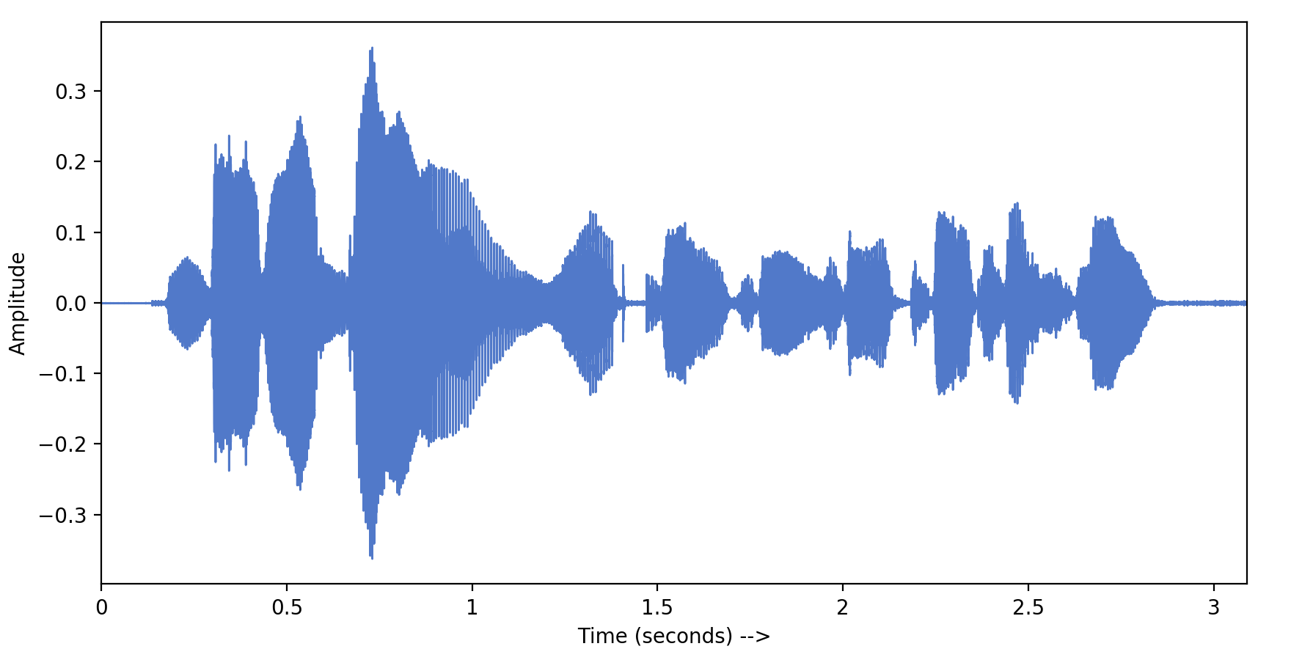
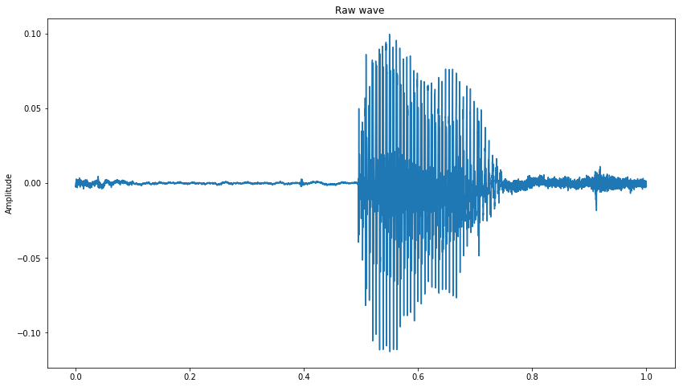
DATA PRE-PROCESSING
Padding
The recorded audios will be of different length.
The audio files need to be trimmed to 1 sec length each.
Padding is done to organise the wave files.

Slide 9
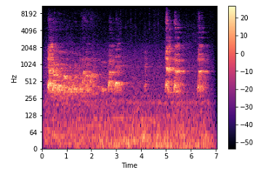
Spectrogram
A spectrogram is a visual way of representing the signal strength or loudness, of a signal over time at various frequencies present in a particular waveform.
A spectrogram is usually depicted as a heat map.
Data is converted into short term Fourier transform.
FFT converts signals such that we can know the amplitude of the given frequency at a given time. Using FFT we can determine the amplitude of various frequencies playing at a given time of an audio signal.
The vertical axis shows frequencies , and the horizontal axis shows the time of the clip.
Features can be obtained from a spectrogram by converting the linear frequency axis, as shown above, into a logarithmic axis. The resulting representation is also called a log-frequency spectrogram.

Slide 10
One-hot encoding
Lot of algorithms cannot work directly with categorical data.
We need a way to convert categorical data into a numerical form and our machine learning algorithm can take in that as input.
That categorical data is defined as variables with a finite set of label values. That most machine learning algorithms require numerical input and output variables. That an integer and one hot encoding is used to convert categorical data to integer data.
A one hot encoding is a representation of categorical variables as binary vectors.
This first requires that the categorical values be mapped to integer values.
Then, each integer value is represented as a binary vector that is all zero values except the index of the integer, which is marked with a 1.

Slide 11
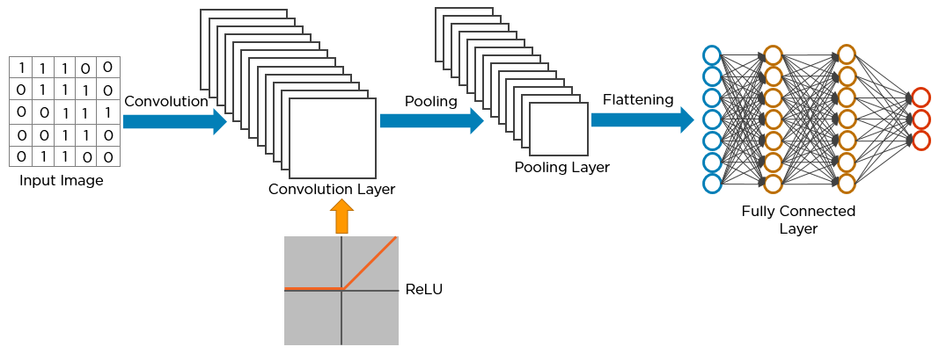
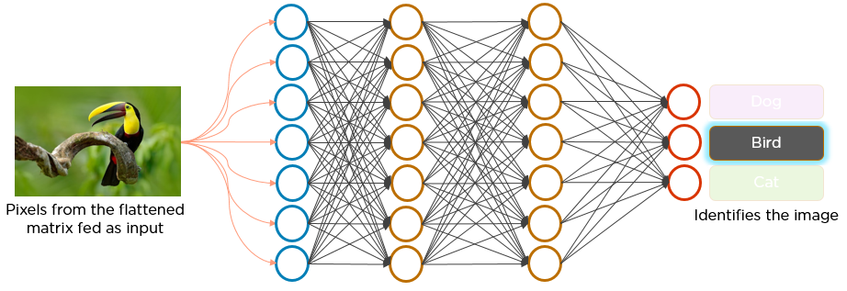
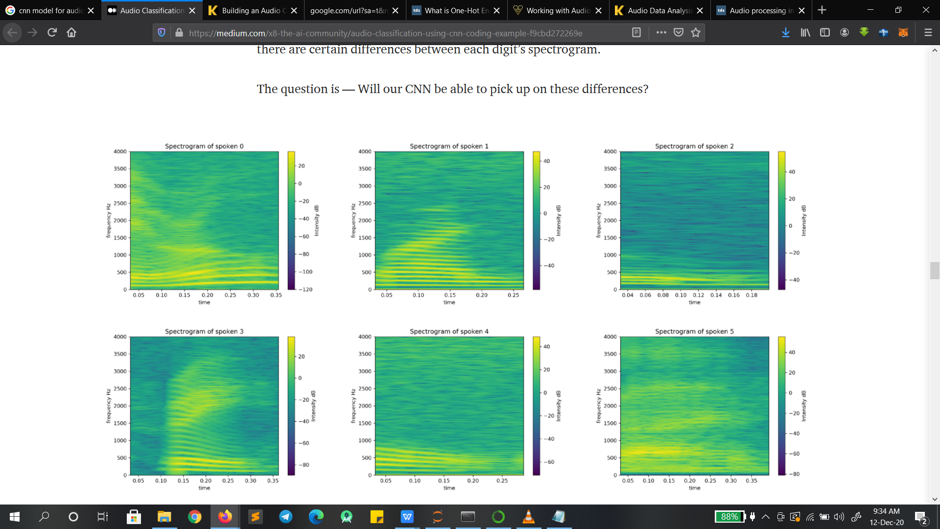
Model Fitting with CNN
B
A
C

Slide 12
Since CNNs are hungry for images, we want to transform the sound into an image.
We have plot the audio signals with respect to time and frequency.
These spectrograms now become an image representation of our spoken words.
We make the network go through 30 epochs.
You want to identify the image of an words, you need to feed the pixels of the image in the form of arrays to the input layer of the neural network.
The hidden layers- convolution layer, the ReLU layer, and pooling layer- carry out feature extraction by performing different calculations and manipulations.
Finally, there’s a fully connected layer that identifies the words.
A
B
C

Slide 13
The process in the CNN model:
The pixels from the image are fed to the convolutional layer that performs the
convolution operation.
It results in a convolved map.
The convolved map is applied to a ReLU function to generate a rectified feature map
The image is processed with multiple convolutions and ReLU layers for locating
the features.
Different pooling layers with various filters are used to identify specific parts of the image.
The pooled feature map is flattened and fed to a fully connected layer to get the
final output.

Slide 14
Convert model to tflite model
As we will deploy our model to a mobile device, we want our model to be as small and as fast as possible.
Quantization is a common technique often used in on-device machine learning to shrink ML models.
By using quantization, we often traded off a bit of accuracy for the benefit of having a significantly smaller model.
Converting models reduces their file size and introduces optimizations with a little
trade-offs.

Slide 15
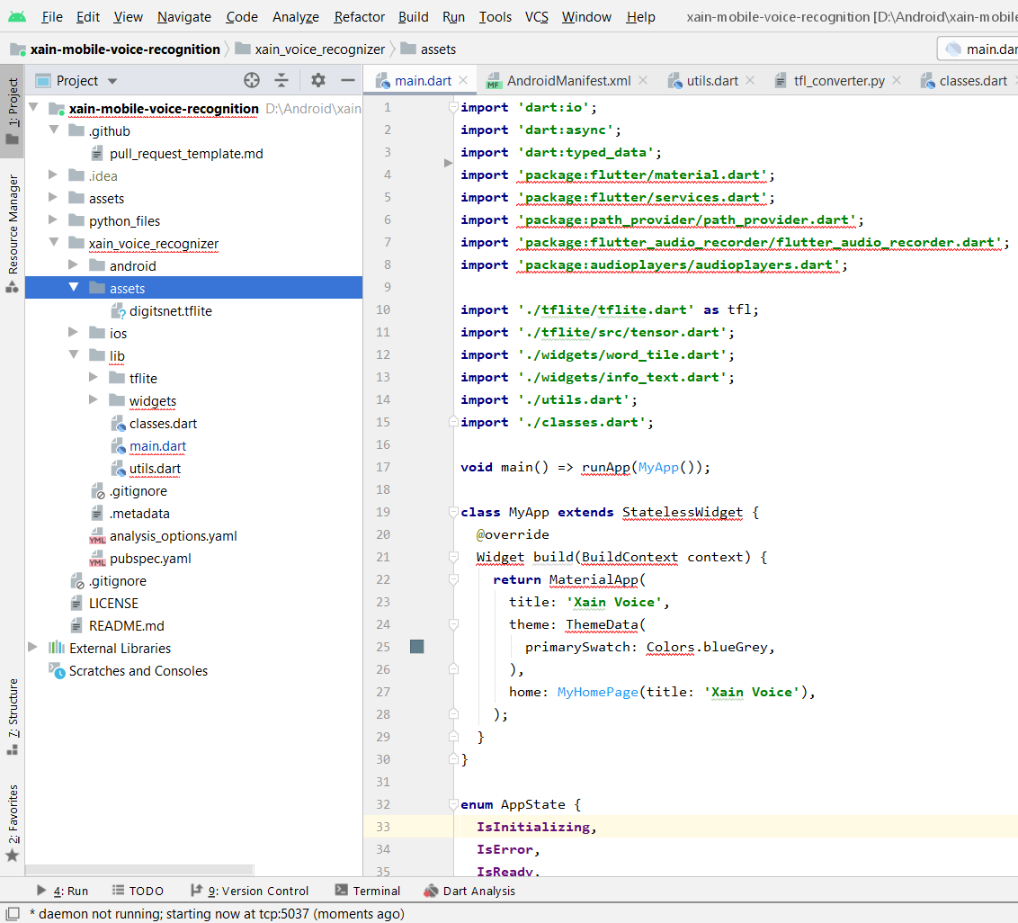
Add tflite file to Android Studio
To add the model, open Android Studio and select
“File -> New Folder -> Assets Folder”.
This should create an assets folder in your app—move the tflite model to this folder.

Slide 16
What do we do in the app?
Record the audio of the child for whom, therapy is needed.
The recorded audio is now compared with the tflite model.
The data is now tested, and the output s printed in the screen.
The percentage of the correct pronounciation is printed and the the pronounciation is compared with the other words, and the percentage is also printed.
So, with the app can help children to speak correctly and clearly.
Children competively will use the app, to get a 100% correct pronounciation.
This is now a efficient way of giving a therapy.

Slide 17
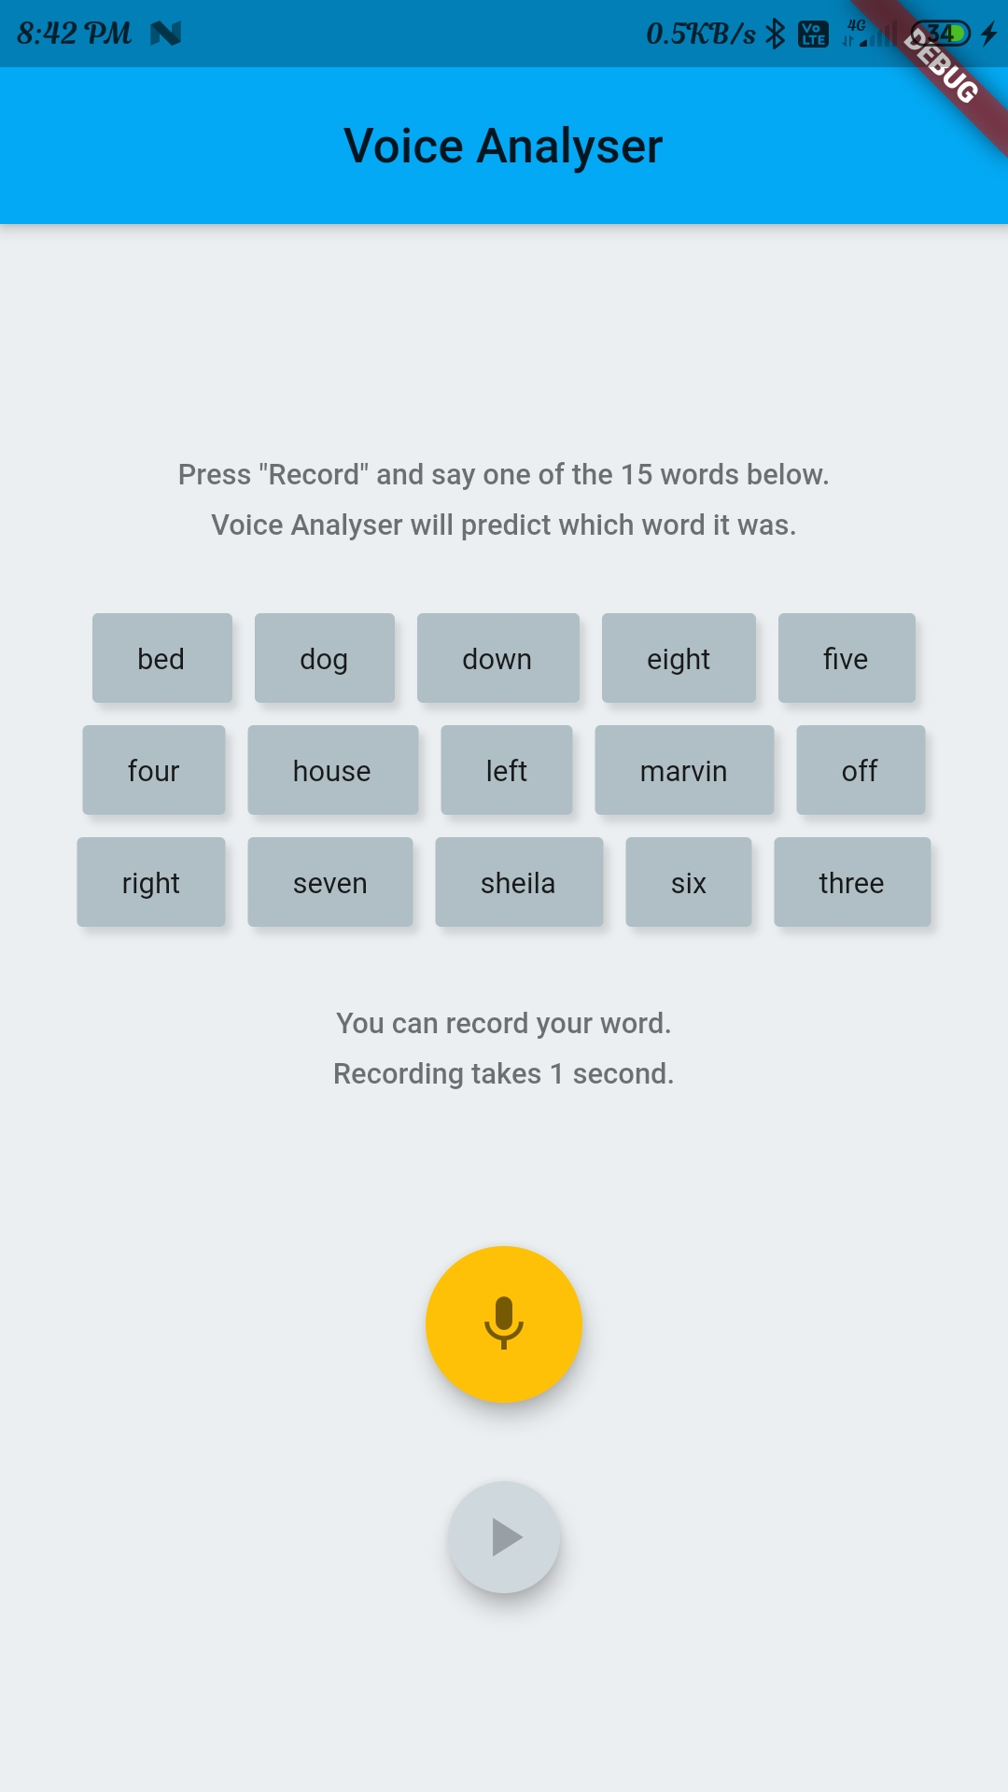
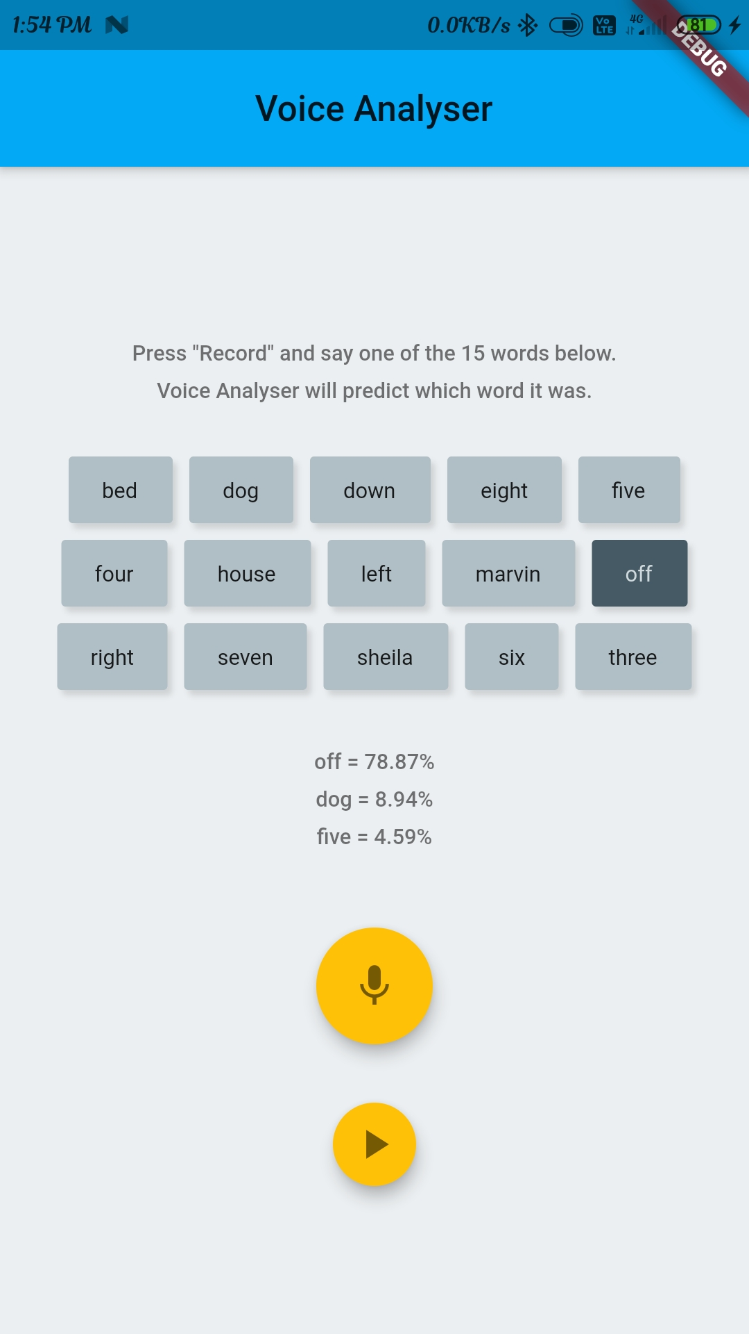
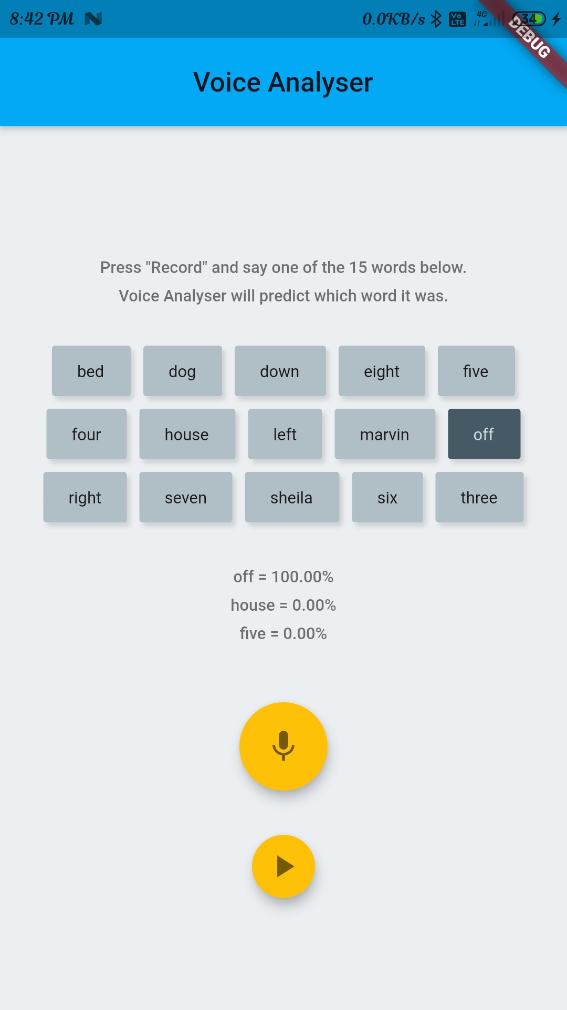
FINAL OUTPUT

Slide 18
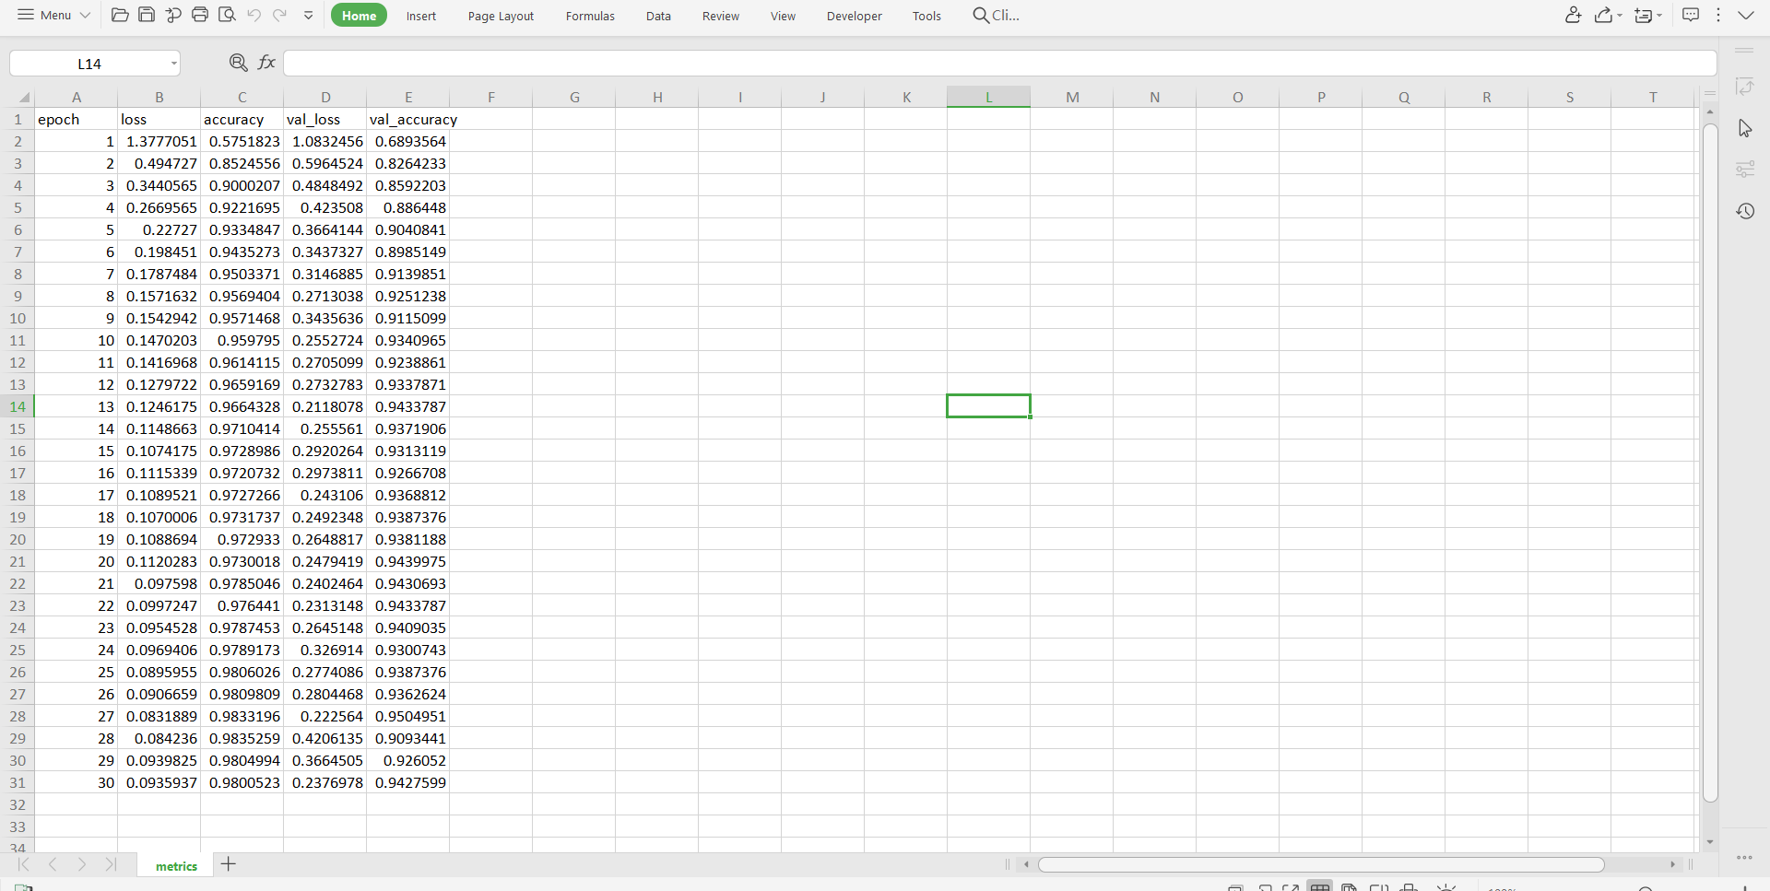
metrics.csv for the built model

Slide 19
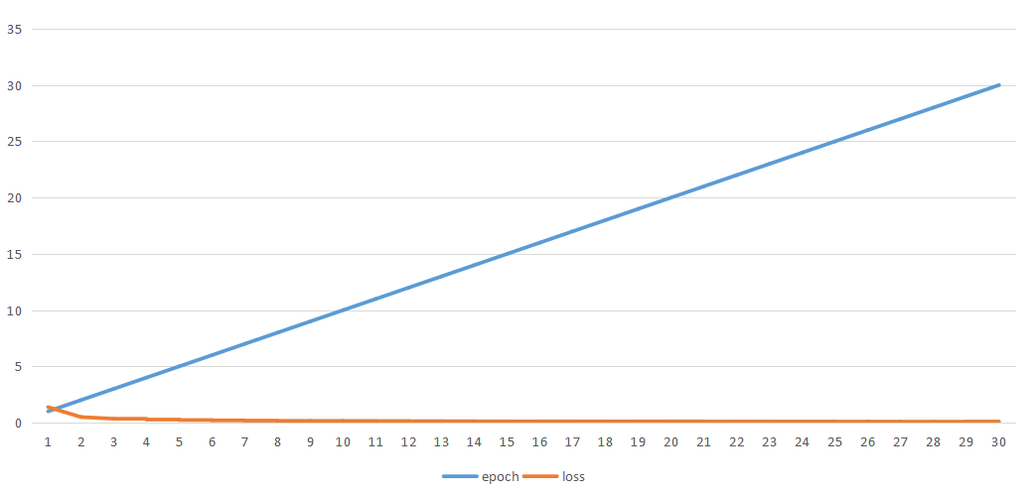
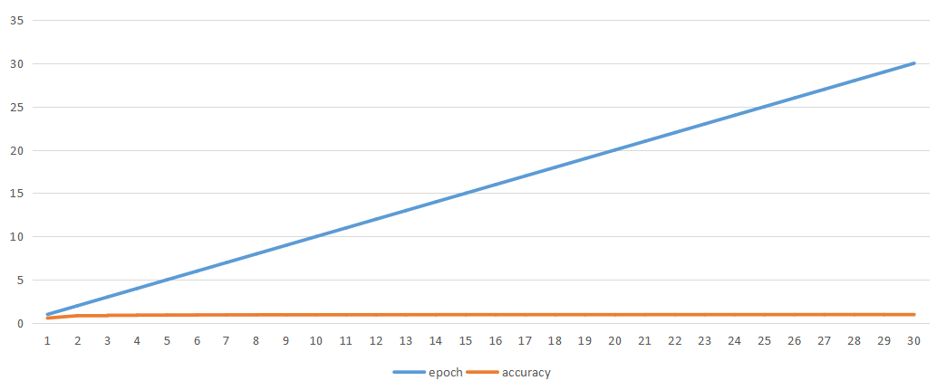
METRICS OF THE MODEL
Epoch vs loss
Epoch vs accuracy

Slide 20
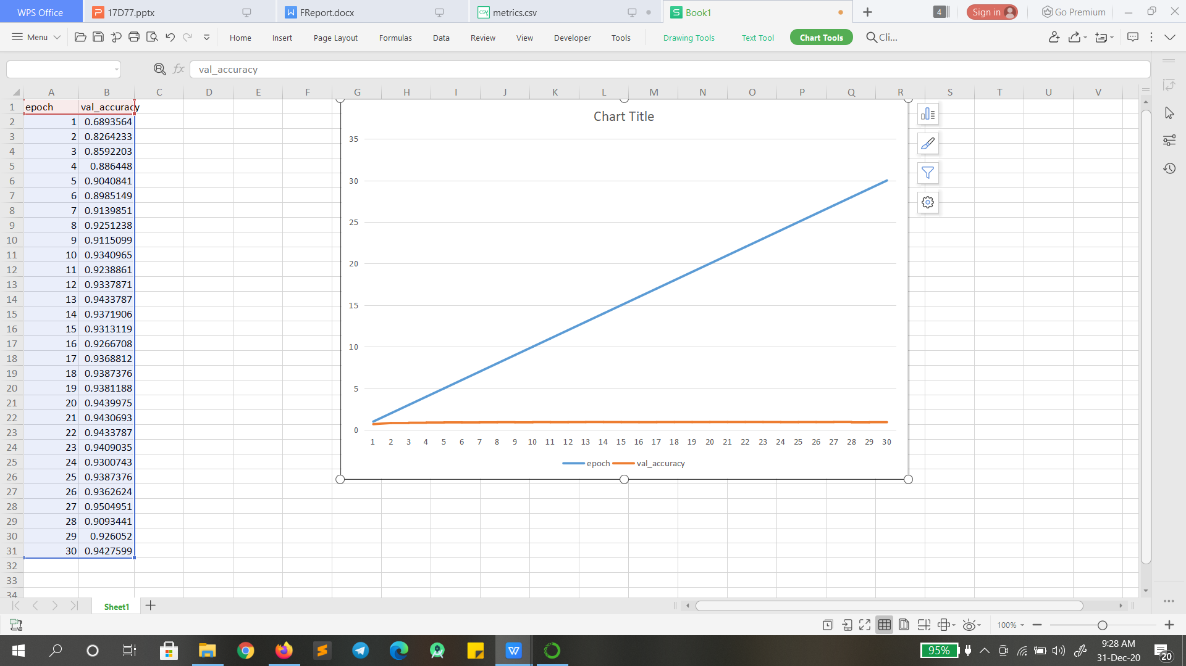
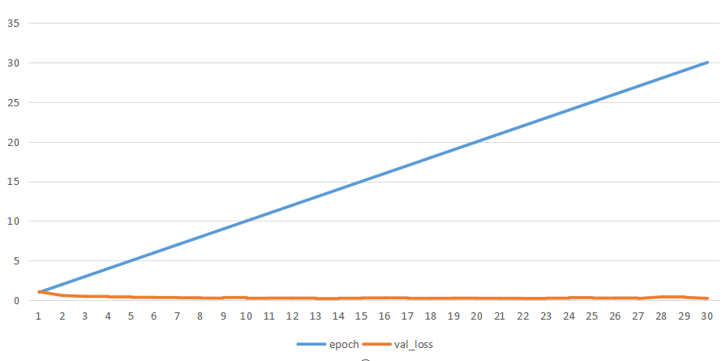
Epoch vs val_loss
Epoch vs val_accuracy

Slide 21
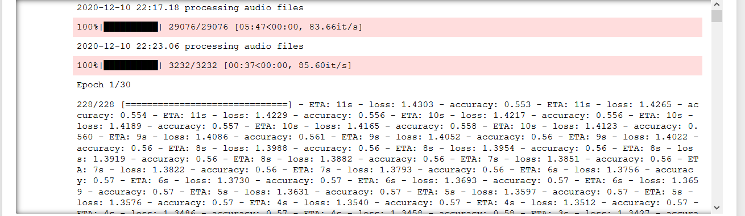
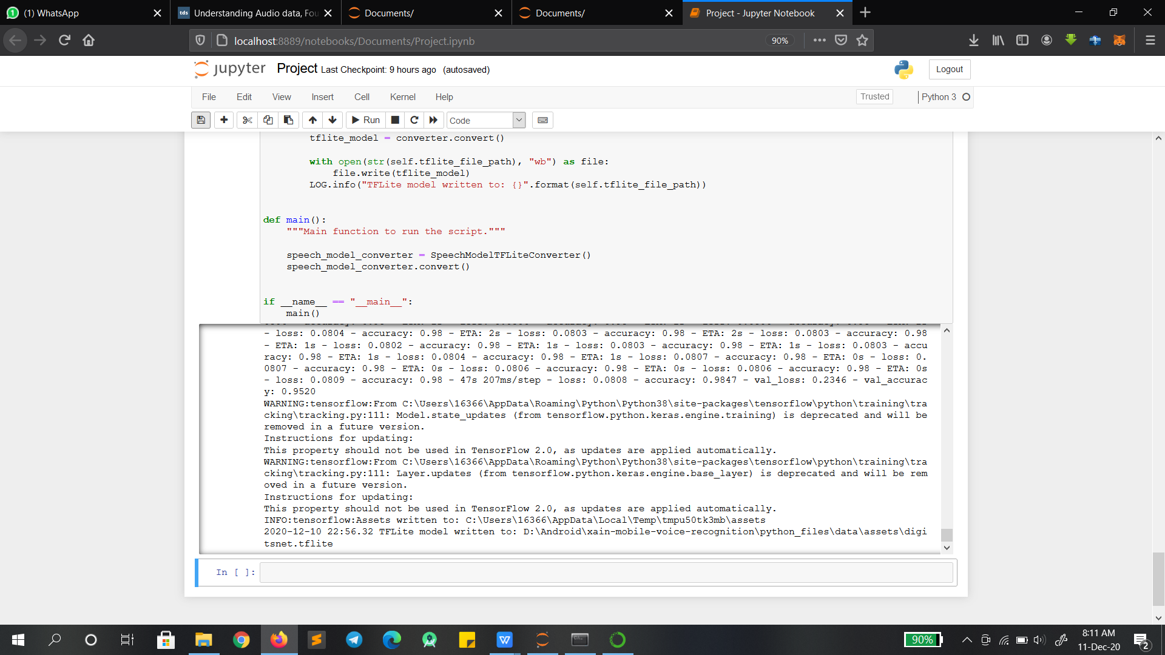
OUTPUT FOR BUILDING ML MODEL

Slide 22
REFERENCES
Witsawakiti et al (2006) have described an e-training tool designed to help hearing impaired children learn and practice words in Thai language more correctly. The tool uses speech to overcome the limitations of the traditional face-to-face speech therapy.
Konstantinidis, et al (2009) have evaluated the implementation of ACALPA platform uses an affective avatar, synthesized speech and multimedia content aiming at supporting and facilitating the teacher-child interaction.
Bastanfard et al (2010) have developed a software system which facilitates the interaction and synchronization of language learning activities for Persian hearingimpaired children.
Toki, E. I., &amp; Pange(2010) introduced an e-learning system for improving articulation in Greek preschoolers.The results of the study on this software showed that children not only improved their articulation but they also increased on language activities success by acquiring new vocabulary.

Slide 23
Continue...
Schipor, O. A et al (2012) presented a tool which contains Children Manager, 3D Articulator Model, and Homework Manager all installed on the child’s PC aiming at improving pre-school children’s articulation.
Robles-Bykbaev et al(2014) have developed an ecosystem of intelligent ICT tools consists of an expert system to support speech and language pathologists, doctors, students, patients and their relatives.

Slide 24
CONCLUSION
Children with communication disorders are affected mentally too.
They become less social, and stay away from public communication.
This may even become a psycological problem.
This app will treat the children in a playful and efficient way.
Children will get competitive because of the 100% display.
“Communication - the human connection - is the key personal and career success”
- Paul J. Meyer
Good communication is never one way!

