Slide 1
Week 3
Notes:
Arrays
What is an array again?
Passing by reference – What does this mean? How is it distinct from passing by value? What does this let us do?
Example of passing an array to other functions.
How arrays are stored, why they are pass by reference rather than value.
Recursion
What is recursion?
How do you write a recursive function?
Example of a recursive function. Contrast with iterative function.
Why use recursion?
Asymptotic Notation
What is this notation for? Explaining how ‘runtime’ is measured.
What does big O really mean?
What are some different classes of runtime? How do they compare?
Examples of algorithms, determining their runtime.

Slide 2
This Week
GDB
Arrays
Recursion
Search
Asymptotic Notation – Big O
Sort

Slide 3
GDB
break – tell the program to ‘pause’ at a certain point (either a function or a line number)
step – ‘step’ to the next executed statement
next – moves to the next statement WITHOUT ‘stepping into’ called functions
continue – move ahead to the next breakpoint
print – display some variable’s value
backtrace – trace back up function calls

Slide 4
Arrays
Set of variables of the same type sharing a name.
Access each individual element in an array using an index value.
Passed by reference, rather than by value.

Slide 5
Passing By Reference
Pass by Value – passing a copy of the data stored in a variable.
Pass by Reference – passing the address at which the original copy of the data is stored.

Slide 6
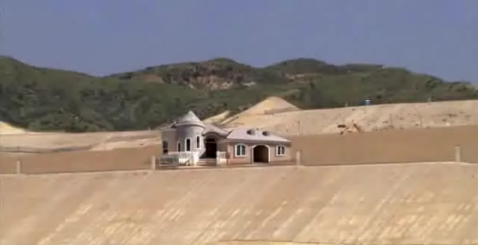
Passing By Reference
Street Address vs. Replica of the House
42 Dunster Street
Cambridge, MA
02138
Reference
Value

Slide 7
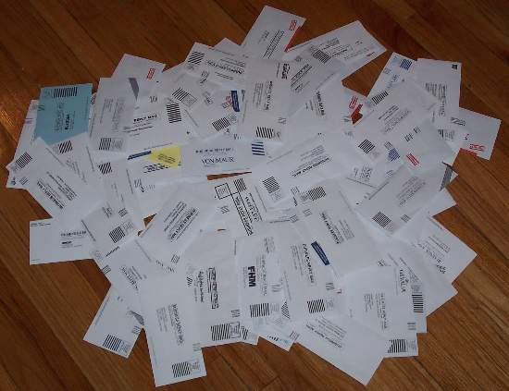
Passing By Reference
Mailing Address vs. Contents of Mailbox
## Kirkland Mail Center
Cambridge, MA
02138
Reference
Value

Slide 8
Arrays
Arrays are passed by reference.
Passing an array gives a function the address of the start of the array.
int numbers[6];
numbers[0]
numbers[1]
numbers[2]
numbers[3]
numbers[4]
numbers[5]
numbers

Slide 9
Arrays
Name of the array refers to starting position.
numbers[i] accesses the i^{th} element
int numbers[6];
numbers[0]
numbers[1]
numbers[2]
numbers[3]
numbers[4]
numbers[5]
numbers

Slide 10
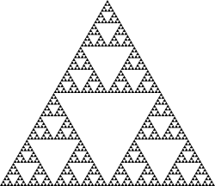

Recursion

Slide 11
What is Recursion?
Recursion - a method of defining functions in which the function being defined is applied within its own definition
A recursive function is a function which calls itself

Slide 12
Components of Recursive Function
Recursive Call – part of function which calls the same function again.
Base Case – part of function responsible for halting recursion when appropriate.

Slide 13
Recursion Example #1
void
countdown(int num)
{
printf(“%d!”, num);
if(num > 0)
countdown(num – 1);
else
return;
}
Recursive Call
Base Case

Slide 14
Recursion Example #1
void
countdown(int num)
{
printf(“%d!”, num);
if(num > 0)
countdown(num – 1);
else
return;
}
void
countdown(int num)
{
while(num > 0)
{
printf(“%d!”, num);
num--;
}
}
Recursive
Non-Recursive

Slide 15
Recursion Example #2
Natural recursive function: Factorial
n! = 1
n * (n-1)!
n <= 1
otherwise

Slide 16
Recursion Example #2
int
factorial (int n)
{
//Base Case
if (n == 1)
return 1;
//Recursive Call
else
return n * factorial(n - 1);
}

Slide 17
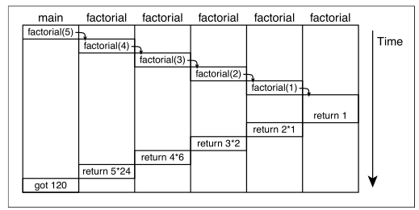
Recursion Example #2

Slide 18
Call Stack
Each call to a functions gets its own stack ‘frame’ containing local variables.
When a function calls a function, it creates a new stack frame.

Slide 19
Call Stack
main()
func1()
func2()
func3()

Slide 20

I N C E P T I O N
Images: “Inception”, Warner Bros. Pictures
We Need To Go Deeper

Slide 21
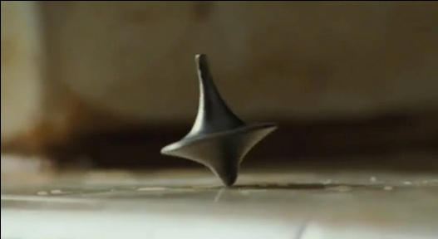

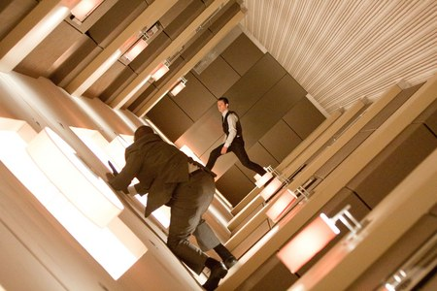
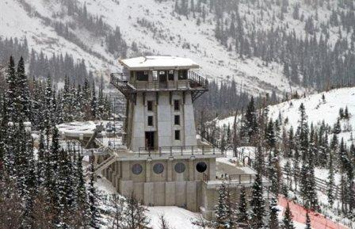
I N C E P T I O N
?
reality
dream1
dream2
“The Kick”
dream3

Slide 22

Linear Search
Want to find a particular element in an array?
Search through each element until we find it!
Have you tried linear search?

Slide 23
Binary Search
Like searching through the phone book.
Identify whether it’s in the first or second half, dividing the problem in two. Repeat until we’re down to one element.
1
2
4
8
16
45
72
83
906
4012

Slide 24
Asymptotic Notation
Used to describe the runtime of an algorithm.
Runtime measured in terms of how the amount of time taken changes as input size increases.

Slide 25
Asymptotic Notation
Big O notation describes an upper bound on runtime.
Ω describes a lower bound on runtime.
θ describes both an upper and lower bound.

Slide 26
Asymptotic Notation
1 – Constant Time
log n – Logarithmic Time
n – Linear Time
n² – Quadratic Time
n^{p} – Polynomial Time
2^{n} – Exponential Time
n! – Factorial Time

Slide 27
Runtime

Slide 28
Runtime

Slide 29
Bubble Sort
Sorting an array of n elements...
Must iterate over up to n elements for each of the n elements.
Worse case gives us O(n²)
Best case gives us Ω(n)
Requires a less-than-naïve implementation.

Slide 30
Selection Sort
Grab the smallest and swap it with whatever is at the front of the array.
Now grab the next smallest and swap with what is in position 2.
Repeat until entire array is sorted.

