Slide 1
Week 2

Slide 2
What’s a Function?
Grouped lines of code with a unified purpose.
A ‘black box’. Accepts input, returns output.
f
x
f(x)

Slide 3
What’s a Function?
Grouped lines of code with a unified purpose.
A ‘black box’. Accepts input, returns output.
int triple(int x)
{
// return input scaled by 3
return x * 3;
}
x
f(x)

Slide 4
Why Use a Function?
Organization – related code ‘encapsulated’.
Reusability – functions can be re-called!

Slide 5
Anatomy of a Function in C
<return type>
<function name> (arg1, ..., argn)
{
// code goes here
}

Slide 6
Anatomy of a Function in C
<return type>
<function name> (arg1, ..., argn)
{
// code goes here
}
Header
Body

Slide 7
Anatomy of a Function in C
int
triple (int x)
{
int y = x * 3;
return y;
}
triple
7
21

Slide 8
Anatomy of a Function in C
int
triple (int x)
{
return x * 3;
}
triple
7
21

Slide 9
Sample Function Call
int
main(int argc, char* argv[])
{
int x = 5;
int y = triple(x);
// what is y now?
}
int
triple(int x)
{
return x * 3;
}

Slide 10
Variable Scope
Two Types of Variables:
Local Variables
Declared inside of a function.
Exist only within that function.
Global Variables
Declared outside of all functions.
May be accessed or changed from anywhere!

Slide 11
Passing Variables to Functions
Variables are passed to functions by value.
int x = 7;
int y = func(7);
7
7
49
x
y
7
func
49

Slide 12
Sample Function Call 2
int
main(int argc, char* argv[])
{
int x = 5;
int y = triple(x);
// what is y now?
// what about x?
}
int
triple(int x)
{
x = x * 3;
return x;
}

Slide 13
Sample Function Call 2
int
main(int argc, char* argv[])
{
int x = 5;
int y = triple(x);
// what is y now?
// what about x?
}
int
triple(int val)
{
val = val * 3;
return val;
}
Local variable is distinct; its name, whether re-used from main or not, is irrelevant!

Slide 14
Magic Numbers
‘Magic number’ – a constant value which is hard-coded into a program.

Slide 15
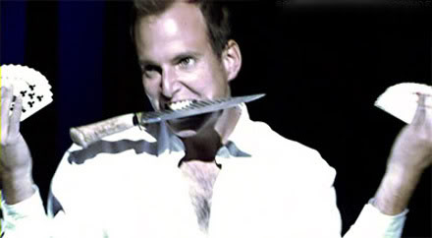
Magic Numbers
Magic is bad.
Image: Arrested Development, Fox

Slide 16
Magic Number
for(int i = 0; i < 8; i++)
{
// do stuff
}
#define num_iters 8
...
for(int i = 0; i < num_iters; i++)
{
// do stuff
}
This is bad.
This is better.

Slide 17
Arrays
Data structures which hold sets of same types of values.
Allows multiple related values to be stored under one name.

Slide 18
Arrays
int numbers[4];
numbers[0] = 7;
numbers[1] = 8;
numbers[3] = 2;
numbers[2] = 5;
?
7
?
8
?
5
?
2
0 1 2 3
numbers

Slide 19
Arrays
Can also initialize an entire array at once:
int numbers[4] = {7, 8, 5, 2};

Slide 20
Multi-Dimensional Arrays
In single-dimensional case, specify particular element of an array using one index value.
With multi-dimensional arrays, elements are specified using multiple index values.

Slide 21

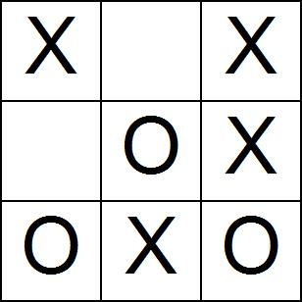
Multi-Dimensional Arrays
Useful when it makes more sense to think of an array in terms of being multi-dimensional.

Slide 22
Multi-Dimensional Arrays
array[0][0]
array[0][1]
array[1][0]
array[1][1]
[][0]
[][1 ]
[0][ ]
[1][ ]

Slide 23
Multi-Dimensional Arrays
We can think of multi-dimensional arrays in geometric terms, but this is irrelevant to the computer.
[][0]
[][1 ]
[0][ ]
0 1 2 3
[1][ ]
array1D[0] == array2D[0][0]
array1D[1] == array2D[0][1]
array1D[2] == array2D[1][0]
array1D[3] == array2D[1][1]
New referencing method, same old data structure!

Slide 24
Passing Arrays to Functions
Arrays are not primitive data types, rather they are data structures which contain them.
An array does not have a ‘value’ in the same sense that a primitive data variable does.
Arrays are passed to functions by ‘reference’, rather than by ‘value’.

Slide 25
Passing Arrays to Functions
Arrays are not primitive data types, rather they are data structures which contain them.
An array does not have a ‘value’ in the same sense that a primitive data variable does.
Arrays are passed to functions by ‘reference’, rather than by ‘value’.

Slide 26

Crypto

Slide 27
Caesar Cipher
Rotate characters by n
A | B | C | D | E | F | G | H | I | J | K | L | M | N | O | P | Q | R | S | T | U | V | W | X | Y | Z
G | H | I | J | K | L | M | N | O | P | Q | R | S | T | U | V | W | X | Y | Z | A | B | C | D | E | F
Example: Rot 6

Slide 28
Vigenere Cipher
Given the ‘key’ xyz:
To encode: Rotate 1st char by x, 2nd by y, 3rd by z, 4th by x, 5th by y…
To decode: Rotate in the reverse direction.
Example: Decode my secret password!
String: “zypkik2”
Key: “secret”
h
u
n
t
e
r
2

