Slide 1
Welcome to Section 2!
This is CS50.

Slide 2
Grading
Correctness
Design
Style
CS 50 is about you

Slide 3
Correctness Improvements
Test your code thoroughly
Compare your output with staff solution, such as
~cs50/pub/solutions/pset1/mario
Read carefully spec and don’t forget to include files

Slide 4
Design Improvements
Are you using more variables than necessary? Any globals?
Are you using functions to structure your code?
Loops: bigger isn’t better. Is there a way to use fewer loops?

Slide 5
Style Improvements
Explain your algorithm – block comment before #include
Variable names
Any nontrivial line of code needs comments
Reference: see page 12 of
http://www.cs50.net/lectures/2/src2.pdf

Slide 6
Office Hours
Holding unofficial office hours for you (our section) on Mon-Wed after lecture and on Sun after section.
Friday 1-4 pm - Science center basement
Don’t be shy to ask questions. The 60 TFs+CAs are here for you ☺
Contact me at hmteodor@cs50.net

Slide 7
Today
Recursion (hands-on)
Complexity – How do we define a good algorithm? (Design)
Sorting

Slide 8
Recursion
A function that calls itself is said to be recursive.
A recursive function has two parts:
Base Case: a simple case in which the solution is known;
Recursive Call (function returns a call to itself)

Slide 9
Factorial
n! = n * (n-1) * (n-2) * (n-3) *…*1
5! = 5 * 4! = 5 * 4 * 3! = 5 * 4 * 3 * 2!=
=5 * 4 * 3 * 2 * 1 = 120
Problem: C doesn’t have the convenient ‘…’

Slide 10
Factorial: Recursive vs Iterative
Iterative = looping
Why does the factorial segfault in recursive case for large numbers, while the iterative factorial doesn’t? [DEMO]

Slide 11
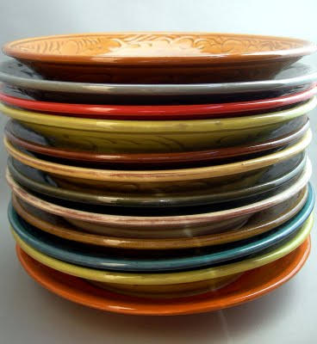
The Stack
Push a plate on top of the stack, or pop a plate from the top of the stack
http://2.bp.blogspot.com/_OcRaBrP1awY/SAelZhj61tI/AAAAAAAAATw/NudzjUumtRk/s400/luncheon_plates_stacks_DSCN4744.JPG

Slide 12
Stack overflow
The stack is limited. Each time you call the recursive function, a new frame corresponding to that function call is pushed onto the stack.
Each frame stores the local variables of the function, as well as the location in the code to return to after the function call is completed.

Slide 13
Design Decisions
While many recursive solutions are more elegant and conceptually easier than their iterative counterparts, recursive functions use a lot more memory by filling the stack with a frame for each function call.

Slide 14
Recursive Calls and the Stack
Think of how you would implement multiplication recursively if you knew addition
What would be the base case?
Multiply() DEMO

Slide 15
Fibonacci Numbers
F[n] = F[n-1] + F[n-2]
1, 1, 2, 3, 5, 8, 13, 21, 34, 55 ...
Base Case?

Slide 16
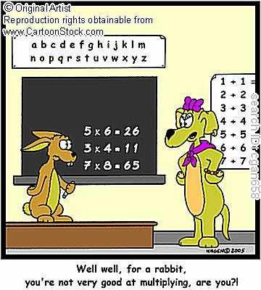
Under the hood
Rabbits like the Fibonacci Series:
F[n] = F[n-1] + F[n-2]

Slide 17
Recursion Exercises
Odd.c
Lol.c
Strings and recursion:
Pset2 Empowering you…

Slide 18
Big-O Notation
Complexity: How does the algorithm ‘scale’ with bigger inputs?
By scale we often refer to how resources get consumed. The resource we will be referring to is time.

Slide 19
Complexity (2)
By input size we refer to, for instance, size of the array that needs to be sorted, or, if we count the number of capital letters in a string, the size of the string we feed to the program.
Denote the input size by n and the number of “atomic” operations on the input as f(n).

Slide 20
Complexity (3)
‘Atomic operation’ = operation whose time does not depend on n
Example: comparing two values (if…) is an atomic operation

Slide 21
Complexity (4)
We care about what happens when n grows arbitrarily large.
Why? To compare the performance of algorithms that have the same result, such as sorting an array.

Slide 22
Complexity (5)
We care only about order of magnitude.
Example:
f(n) = n² +2 * n +5
O(f(n)) = n²

Slide 23
Complexity (6)
Constants don’t matter, and only the highest power of n matters for the class of complexity.
Classes:
O(log n) < O(n) < O(n logn) < O(n²)<O(n^{p>2})
And all are smaller than the exponential O(c^{n}), which in turn is less than O(n!).

Slide 24
Complexity (7)
O(1) denotes constant time
Rules:
O(f*g) = O(f) * O(g)
O(f+g) = max(O(f), O(g))

Slide 25
Complexity (8)
//n = size of array
int index_of_min = 0;
for(int i = 1; i < n; i++)
{
if(array[i] < array[index_of_min])
index_of_min = i;
}

Slide 26
Complexity (9)
//n,m = size of array[][]
for(int i = 0; i < n; i++)
{
for(int j = 0; j < m; j++)
{
//do some operation
//in constant time
}
}

Slide 27
Selection Sort
| 3 5 2 6 4
Scan unsorted part of array to pick smallest value
first time: n steps
| 3 5 2 6 4
2. Swap smallest with first in unsorted array (left of |)
2 | 3 5 6 4
3. Repeat from 1 until array sorted

Slide 28
Selection sort complexity
Step 1 takes n steps first, n-1 after one pass through the array, n-2 after two passes, and so on…
O(n+n-1+n-2+…+1) = ?
DEMO

Slide 29
Bubble Sort
Step through input array; if two adjacent values aren’t sorted, swap them
After full scan, repeat from step 1 if changes have been made.
Input: 3 5 2 6 4
Pass #1: 3 2 5 4 6
Pass #2: 2 3 4 5 6
Pass #3: 2 3 4 5 6
Worst case: have to pass n times and make n swaps.

Slide 30
Merge Sort
If list is of length < 2, it is already sorted. (Base Case)
Divide unsorted list in two sublists
Apply mergesort on each sublist
Merge the two sublists back together
Does this remind you of the phonebook demo? What is the complexity?

Slide 31
Walkthrough
Walkthough tonight Emerson 108, 7 pm.
Walkthrough will include code for the first time, so do attend or watch the video.
CS 50 Office hours in Science Center basement every day, Mon-Fri, 7-11 pm if you need more help.

Slide 32
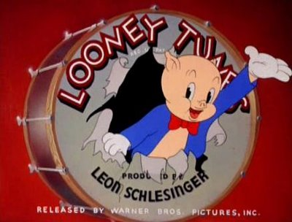
That’s all folks!
http://3.bp.blogspot.com/_xdN0QQwsP1A/Sfspxgi_67I/AAAAAAAABrE/EYSZ_syFwUg/s400/Porky_pig_thats_all_folks.jpg

