Slide 1
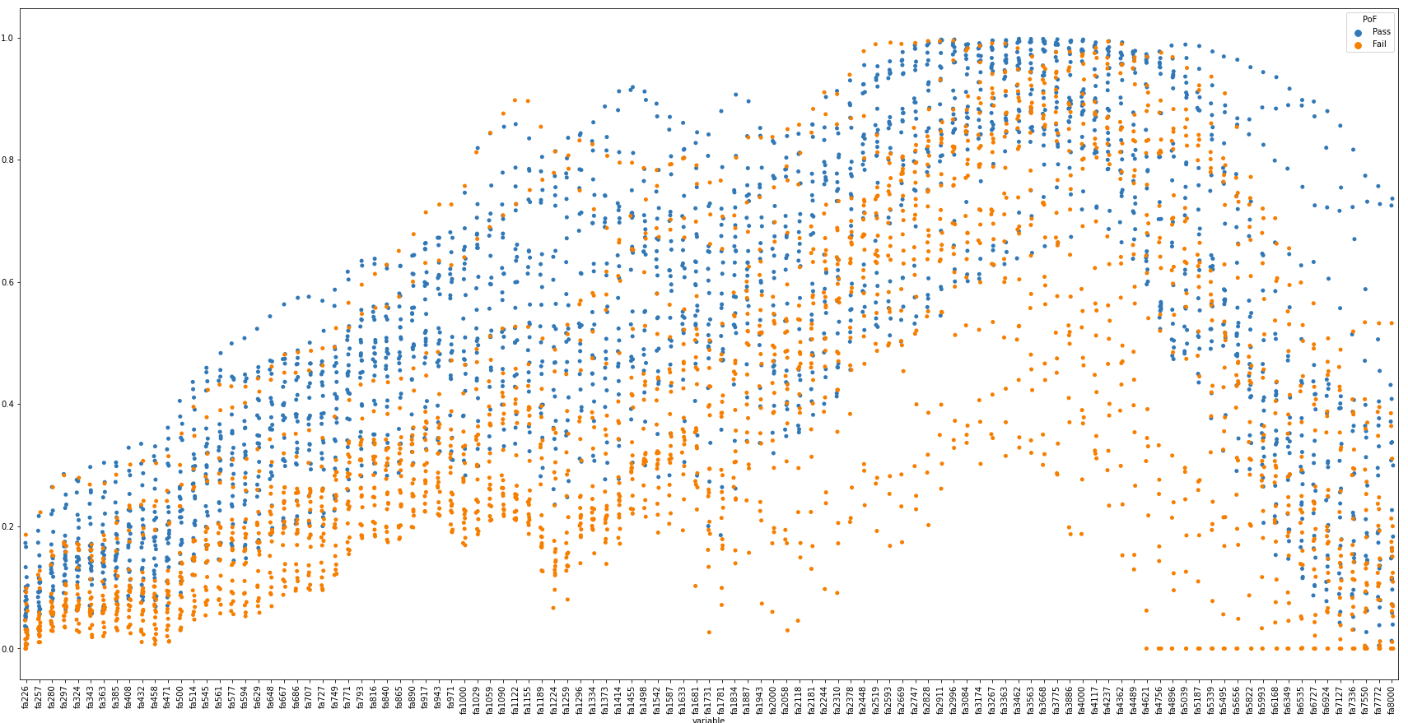
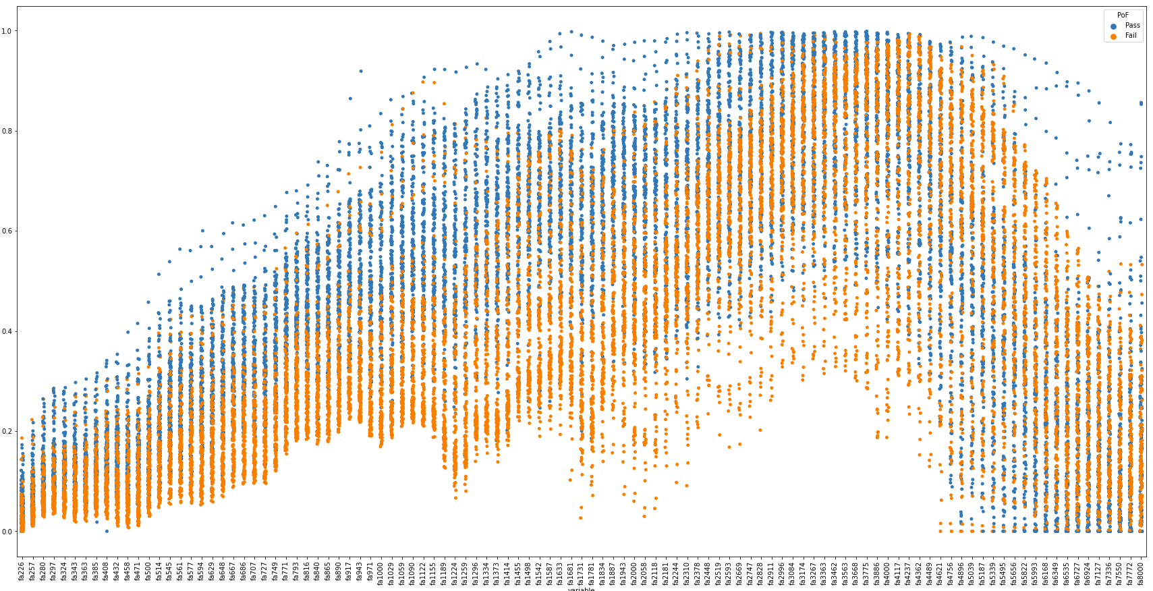


Under sampling
Over sampling minority
Over sampling minority with edited nearest neighbours
Mix-mode over and under sampling

Slide 2
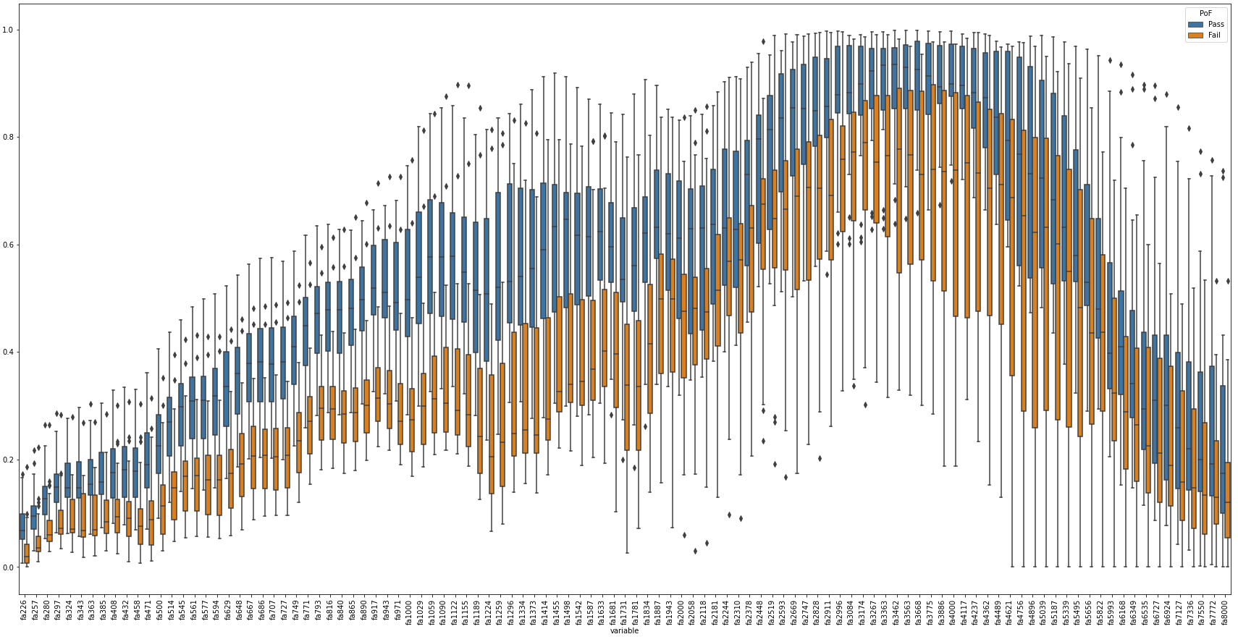

Slide 3
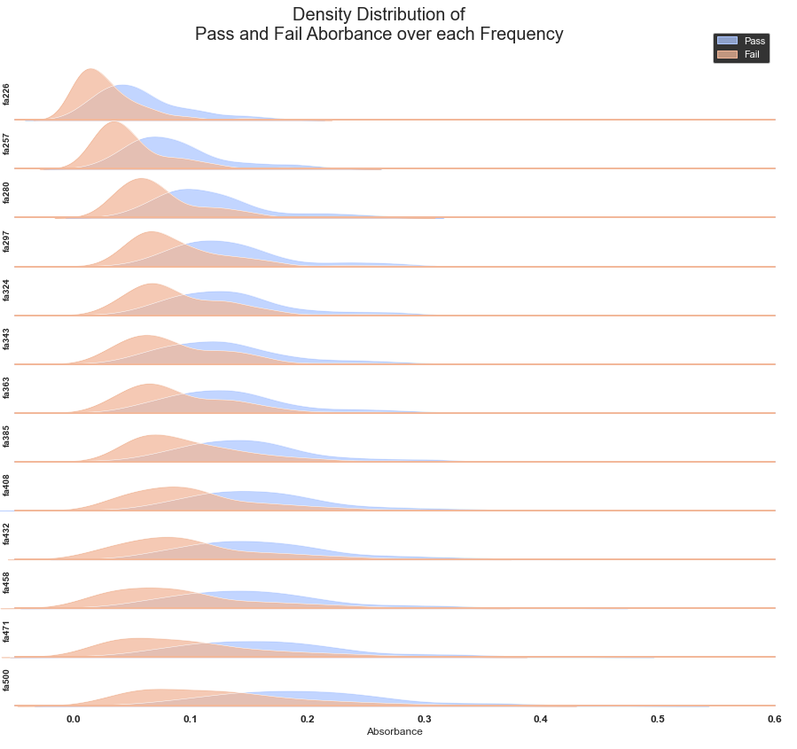
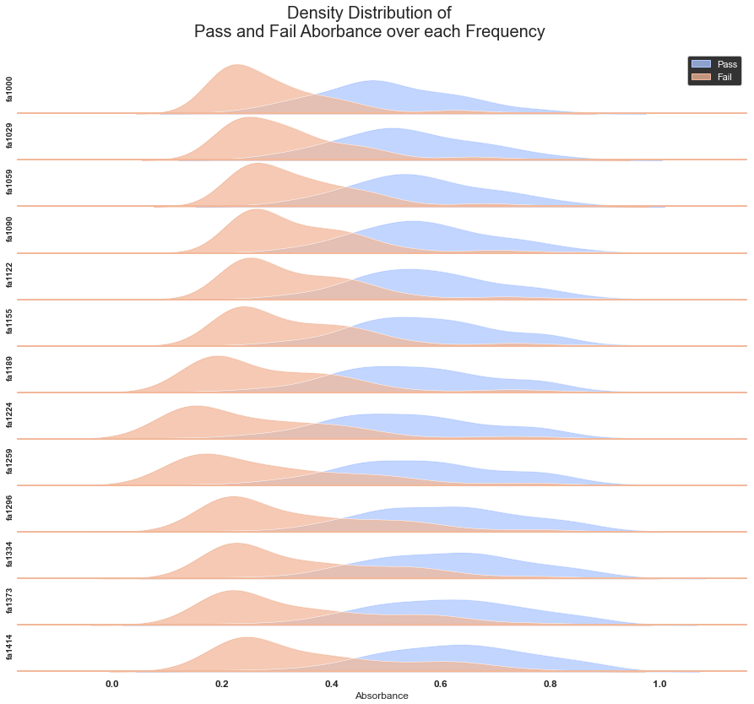
226-500Hz
1000-1414Hz

Slide 4
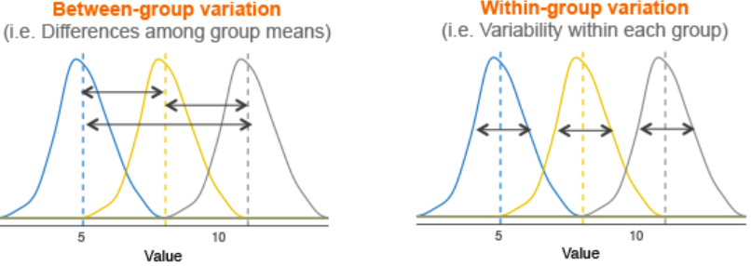

ANOVA (F-test)

Slide 5
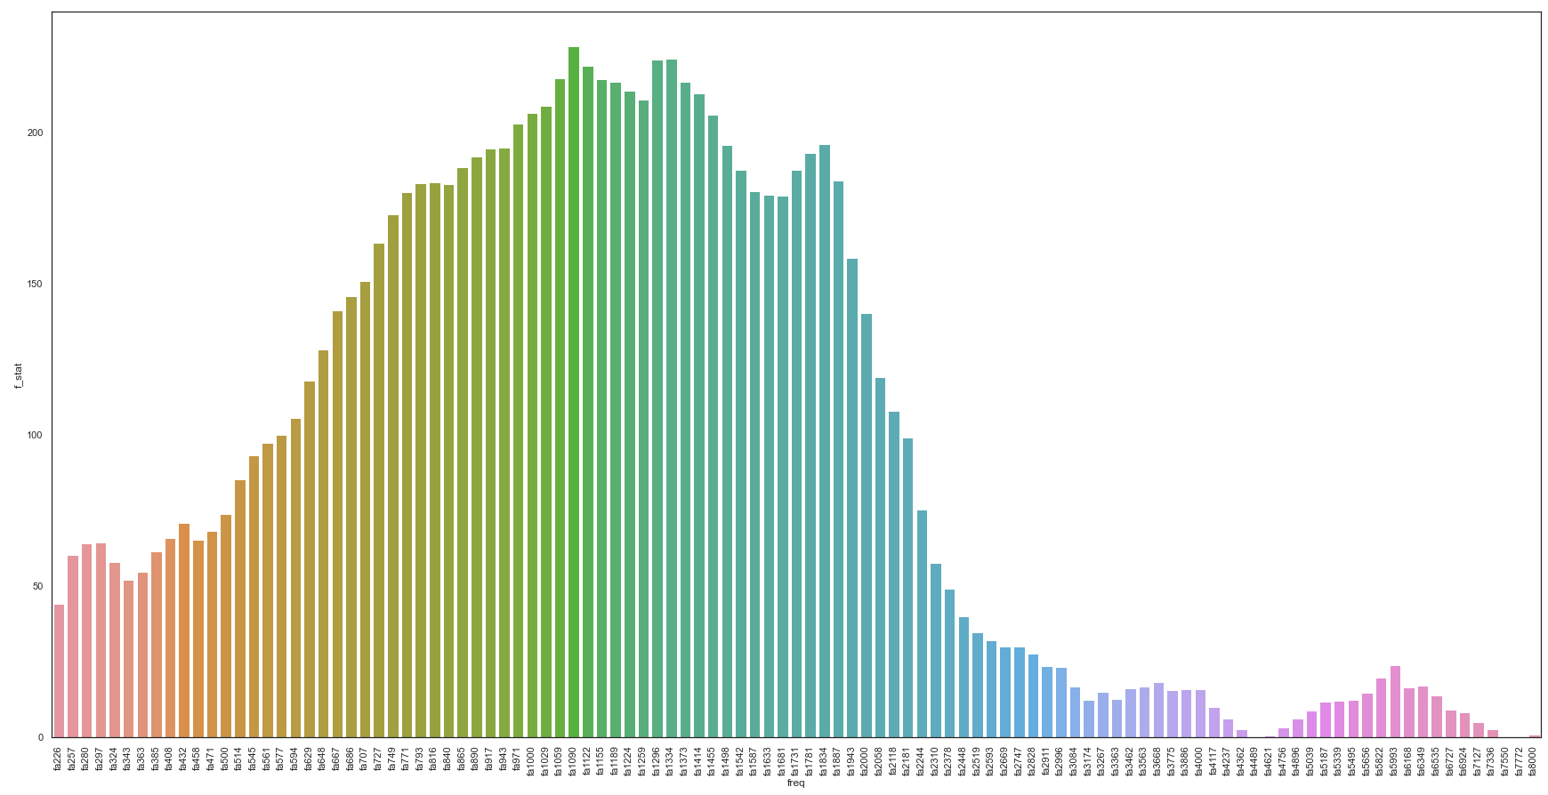
SMOTE F-Scores (Best separation)

Slide 6
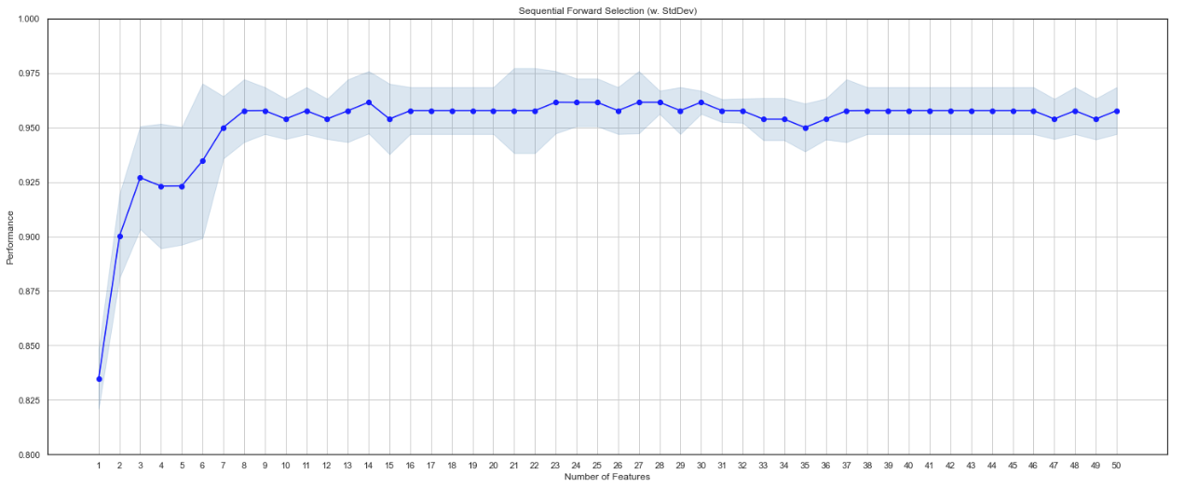
Forward Feature Selection

Slide 7
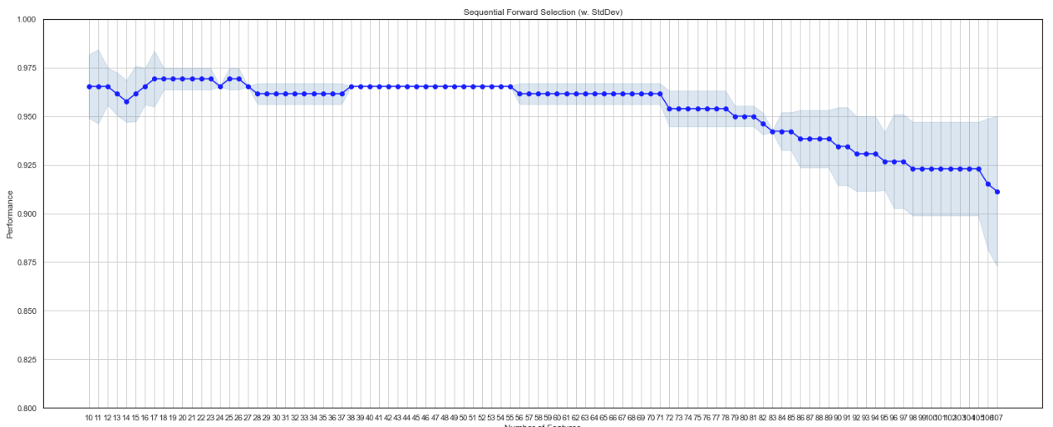
Backward Feature Selection

Slide 8
ANOVA Feature Selection
Sampling | Feature selected
Nearmiss V2 | 'fa727', 'fa749', 'fa771', 'fa793', 'fa816', 'fa840', 'fa865', 'fa890', 'fa917', 'fa1000'
SMOTE | 'fa1059', 'fa1090', 'fa1122', 'fa1155', 'fa1189', 'fa1224', 'fa1296', 'fa1334', 'fa1373', 'fa1414'
SMOTEENN | 'fa1090', 'fa1155', 'fa1189', 'fa1224', 'fa1259', 'fa1296', 'fa1334', 'fa1373', 'fa1414', 'fa1455'
SMOTETomek | 'fa1029', 'fa1059', 'fa1090', 'fa1122', 'fa1155', 'fa1189', 'fa1224', 'fa1259', 'fa1296', 'fa1334'

Slide 9
SVM Linear Classifier
Sampling | Training | Test Score
Nearmiss V2 | 79.55% | 85.42%
SMOTE | 83.85% | 87.50%
SMOTEENN | 87.16% | 81.25%
SMOTETomek | 85.43% | 85.42%

Slide 10
SVM Classifier – Hyperparameter tuned
Sampling | Training | Test Score
Nearmiss V2 | 79.55% | 56.25%
SMOTE | 88.08% | 83.33%
SMOTEENN | 92.20% | 81.25%
SMOTETomek | 92.52% | 85.42%

Slide 11
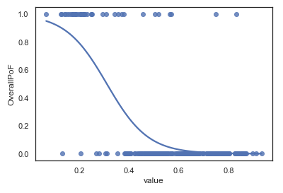
Probability Classifier – Logistic Regression
F1296 Hz – Pass – Fail probability

Slide 12
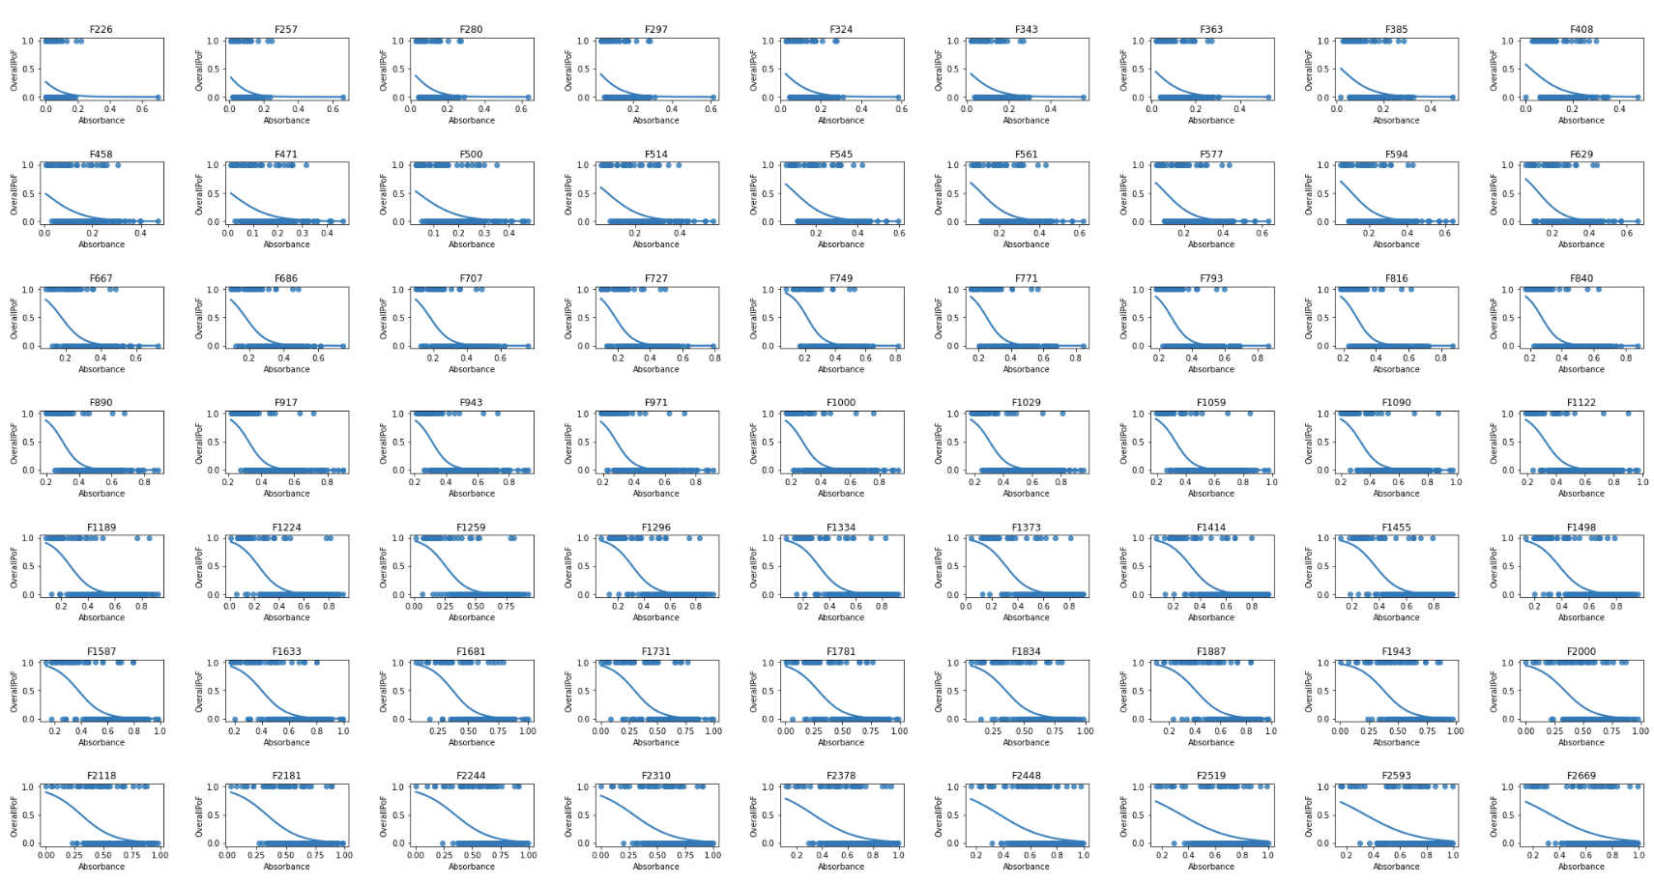
Probability Classifier

Slide 13
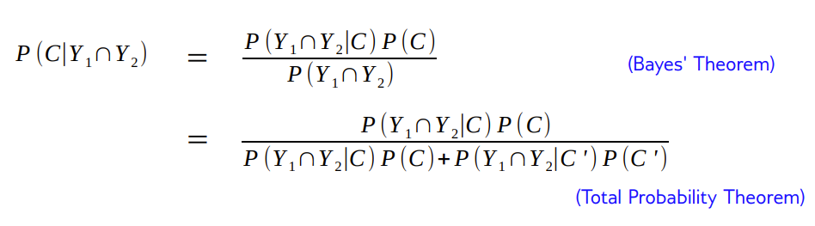
Multiple Independent Test

