Slide 1
Grocery Flyer Generator
STAR BAZAAR • Manager Brief
Generated on October 12, 2025

Slide 2
What this solves
• Create professional, on-brand weekly flyers in minutes. • Uses your product data and images; no AI “special offers”. • Exports print-ready PNGs with consistent layout & colors. • Reusable template: just swap weekly JSON data.

Slide 3
System Architecture
Node.js services and agents:
• CoordinatorAgent – orchestrates flow
• DataParserAgent – parses raw text / JSON
• LayoutAgent – grid planning
• DesignAgent – Handlebars HTML/CSS generation
• ExportAgent – Puppeteer PNG export
Integrations: Handlebars, Puppeteer, optional LLM (Ollama) for structure.

Slide 4
Weekly Workflow
1. Provide data: data/weekly-offers.json (products + saleInfo) 2. Run generator: node index.js data/weekly-offers.json 3. Output: PNG in output/generated-flyers/ 4. Share with print / socials

Slide 5
Design Principles & Symmetry
• Clear visual hierarchy: header banner, grid cards, footer. • 5-column grid with consistent gutters and aligned baselines. • Alternating price badges by column for rhythm & scannability. • Two-line name clamp for neat rows; bottom-aligned price/units. • Brand colors (green/yellow/black) and strong contrast. • Accessible sizes, large tap targets, bold typography.

Slide 6
Key Features
• PNG-only export for reliability on macOS. • Embedded logo and product images. • Weekly banner with single-line dates. • Footer: promo banner, contact bar, accept badge. • Simple inputs; reusable week to week.

Slide 7
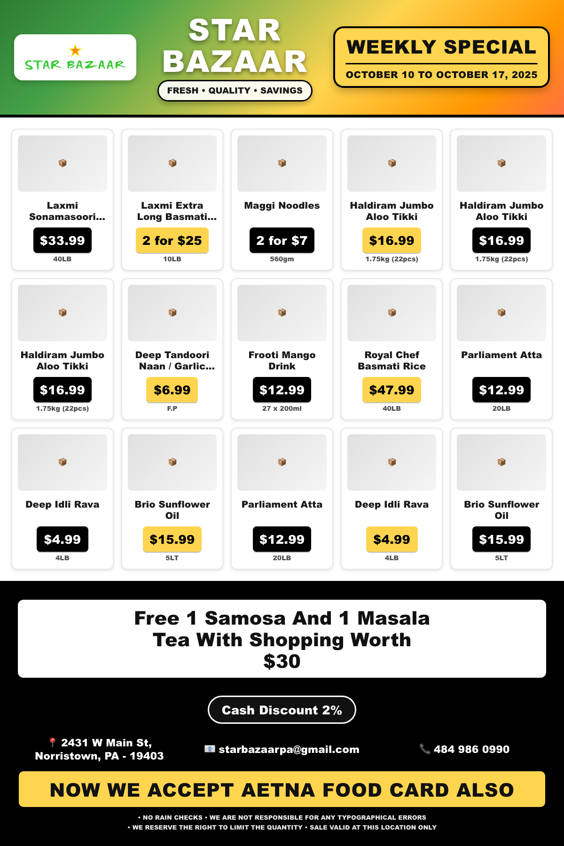
Latest Flyer

Slide 8
Next Steps
• Add promo scheduling & version history. • Multi-language support. • Export presets for social sizes. • Optional price validation rules.

Slide 9
STAR BAZAAR
2431 W Main St, Norristown, PA - 19403 • starbazaarpa@gmail.com • 484 986 0990

