Slide 1
CSC3150 – Operating Systems
Prof. Yeh-Ching Chung
School of Data Science
Chinese University of Hong Kong, Shenzhen

Slide 2
Class Information
Instructor
Dr. Yeh-Ching Chung (ychung@cuhk.edu.hk)
Course TAs
洪士豪 : 220019037@link.cuhk.edu.cn
宁之涵 : 220019176@link.cuhk.edu.cn
陈宇昂 : 219019037@link.cuhk.edu.cn
黄文禹 : 221019014@link.cuhk.edu.cn
张泽银 : 118010430@link.cuhk.edu.cn
申 凯 : 118010254@link.cuhk.edu.cn
Lectures
Tuesday 10:30 – 11:50 AB E101
Thursday 15:30 – 16:50 AB E101
Tutorials
Will be announced by TAs
Homepage
http://www.cs.nthu.edu.tw/~ychung/syllabus/CSC3150-2021-Fall.htm

Slide 3

Textbook
(Textbook)
Operating System Concepts, 9th Edition (International Student Version), John Wiley & Sons, Inc., 2014.
Silberschatz, P. Galvin, and G. Gangne

Slide 4
Course Syllabus
Introduction to the major components of an operating system
Process Management
Memory management
File management
I/O management
Introduction to multi-threaded programming
Introduction to kernel programming
Introduction to multiprocessor architecture

Slide 5
Course Topics
Introduction
Processes and Threads
Multithreaded Programming
Process Scheduling
Process Synchronization
Dead Locks
Memory Management Strategies
Virtual-Memory Management
File Systems
Implementing File Systems
Mass-Storage Structure
I/O Systems

Slide 6
Course Assessment
Class participation (5%)
Programming Projects (70%)
Kernel-Mode Multi-Process Programming
Multi-Thread Programming
Virtual Memory Management
File-Systems
I/O Systems
Final Exam (25%)
If you need to apply for a leave for final exam, send email to me with supporting document beforehand

Slide 7
Learning Outcomes
Upon completing this course, students will be able to
Modify Kernel of OS
Write multi-thread programs
Do memory management on GPU
Do file management on GPU
Do I/O operations on GPU

Slide 8
Academic Honesty
Zero Tolerance
Plagiarism, cheating, misconduct in test/exam will be reported to the School for handing.
Consequences
Zero marks for the concerned assignments/test/exam/whole course, reviewable demerits, non-reviewable demerits, suspension of study, dismissal from University.
University Policy to Academic Honesty
http://www.cuhk.edu.cn/departsite/ar/en/Academic.html

Slide 9
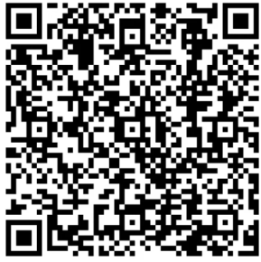
WeChat Group

