Slide 1


Why Program?
Chapter 1
Python for Everybody
www.py4e.com
Notes:
Note from Chuck. If you are using these materials, you can remove the UM logo and replace it with your own, but please retain the CC-BY logo on the first page as well as retain the acknowledgements page(s).

Slide 2

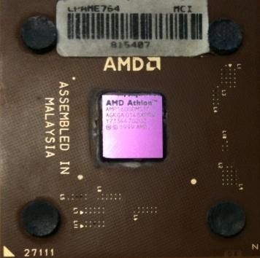
Computers Want to be Helpful...
Computers are built for one purpose - to do things for us
But we need to speak their language to describe what we want done
Users have it easy - someone already put many different programs (instructions) into the computer and users just pick the ones they want to use
What
Next?
What
Next?
What
Next?
What
Next?
What
Next?
What
Next?
What
Next?

Slide 3
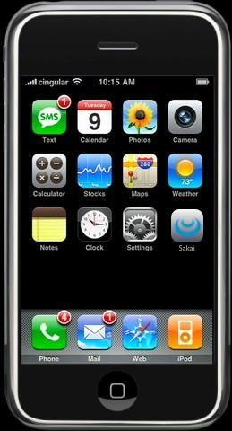
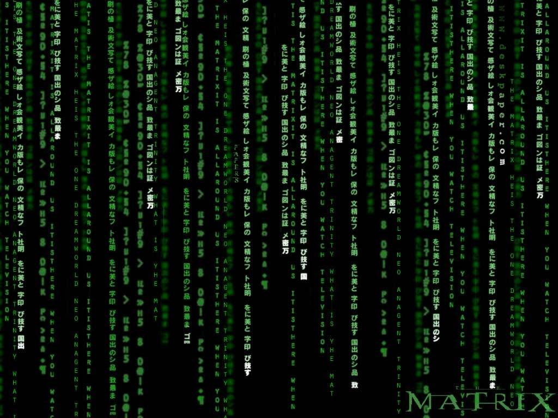
Programmers Anticipate Needs
iPhone applications are a market
iPhone applications have over 3 billion downloads
Programmers have left their jobs to be full-time iPhone developers
Programmers know the ways of the program
Pick
Me!
Pick
Me!
Pick
Me!
Pick
Me!
Pick
Me!
Pay
Me!

Slide 4
Users vs. Programmers
Users see computers as a set of tools - word processor, spreadsheet, map, to-do list, etc.
Programmers learn the computer “ways” and the computer language
Programmers have some tools that allow them to build new tools
Programmers sometimes write tools for lots of users and sometimes programmers write little “helpers” for themselves to automate a task

Slide 5
Why be a Programmer?
To get some task done - we are the user and programmer
- Clean up survey data
To produce something for others to use - a programming job
- Fix a performance problem in the Sakai software
- Add a guestbook to a web site

Slide 6
Why to be a programmer?
1. to earn money
2. get your task done
3. modify open source code to add features

Slide 8
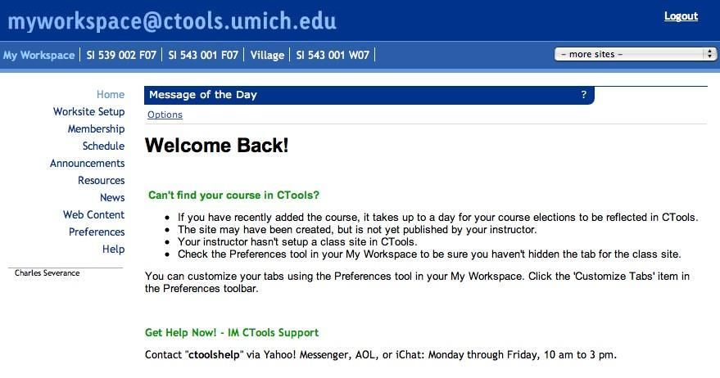

User
Computer
Hardware + Software
Programmer
Data
Information
Networks
....
From a software creator’s point of view, we build the software. The end users (stakeholders/actors) are our masters - who we want to please - often they pay us money when they are pleased. But the data, information, and networks are our problem to solve on their behalf. The hardware and software are our friends and allies in this quest.

Slide 9
What is Code? Software? A Program?
A sequence of stored instructions
- It is a little piece of our intelligence in the computer
- We figure something out and then we encode it and then give it to someone else to save them the time and energy of figuring it out
A piece of creative art - particularly when we do a good job on user experience

Slide 10
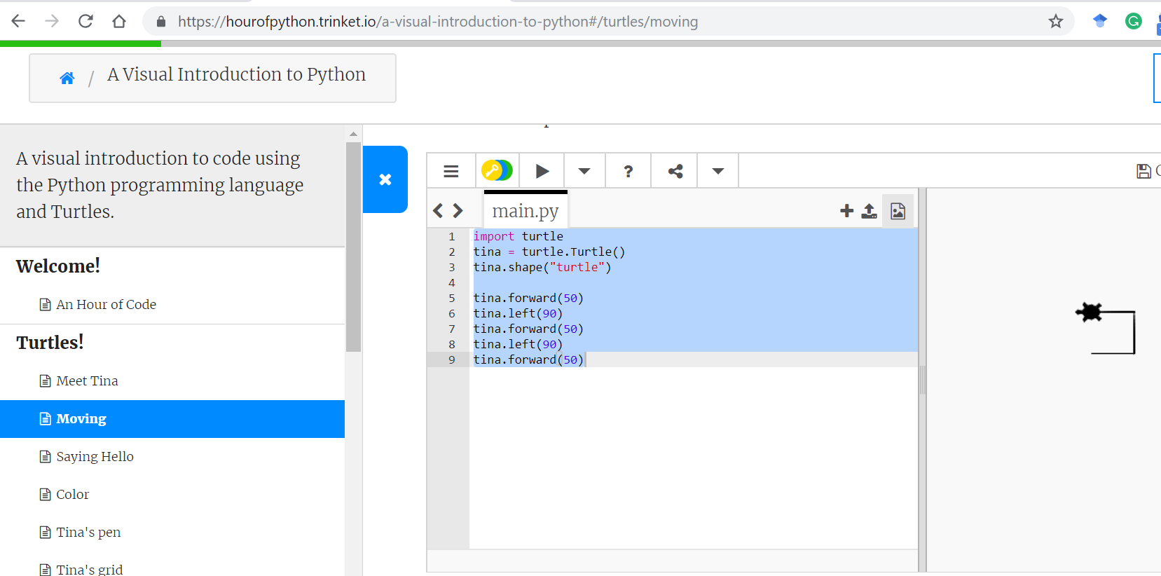

Slide 11
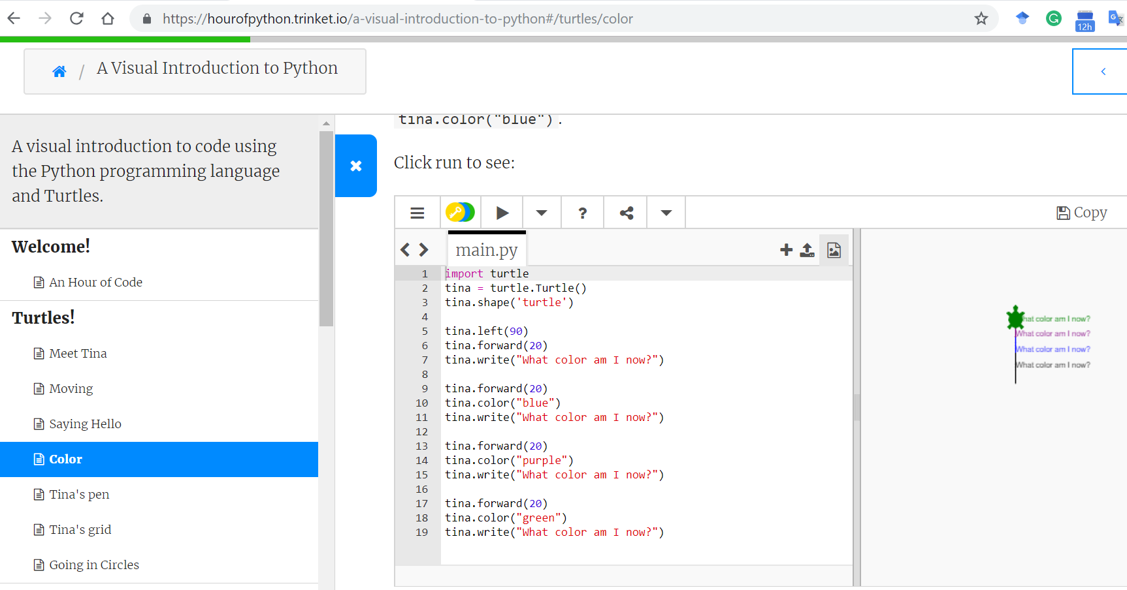

Slide 12
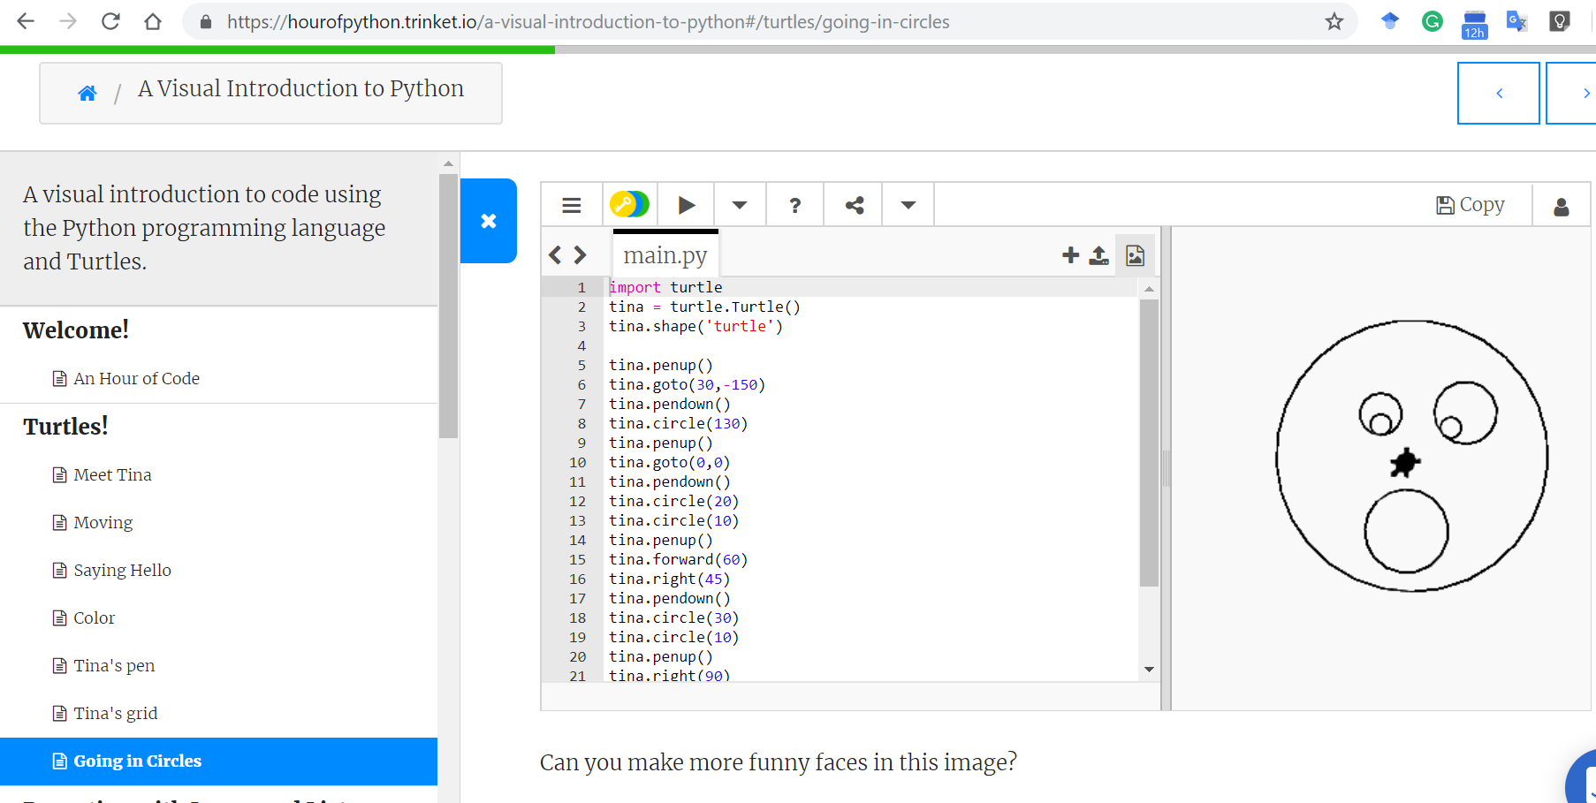

Slide 13
name = input('Enter file:')
handle = open(name)
counts = dict()
for line in handle:
words = line.split()
for word in words:
counts[word] = counts.get(word,0) + 1
bigcount = None
bigword = None
for word,count in counts.items():
if bigcount is None or count > bigcount:
bigword = word
bigcount = count
print(bigword, bigcount)
python words.py
Enter file: words.txt
to 16
python words.py
Enter file: clown.txt
the 7

Slide 14
Hardware Architecture

Slide 15
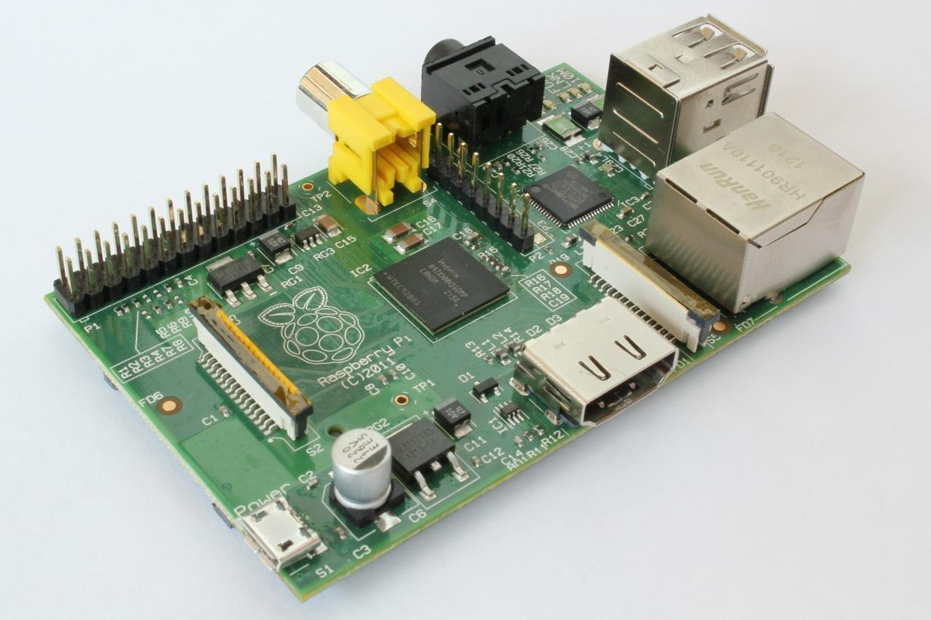
http://upload.wikimedia.org/wikipedia/commons/3/3d/RaspberryPi.jpg

Slide 16
What
Next?
Generic
Computer
Software
Input
and Output
Devices
Central
Processing
Unit
Secondary
Memory
Main
Memory

Slide 17
Definitions
Central Processing Unit: Runs the Program - The CPU is always wondering “what to do next”. Not the brains exactly - very dumb but very very fast
Input Devices: Keyboard, Mouse, Touch Screen
Output Devices: Screen, Speakers, Printer, DVD Burner
Main Memory: Fast small temporary storage - lost on reboot - aka RAM
Secondary Memory: Slower large permanent storage - lasts until deleted - disk drive / memory stick
What
Next?

Slide 18
What
Next?
Generic
Computer
Software
Input
and Output
Devices
Central
Processing
Unit
Secondary
Memory
if x< 3: print
Main
Memory

Slide 19
What
Next?
Generic
Computer
Software
Input
and Output
Devices
Central
Processing
Unit
Secondary
Memory
01001001
00111001
Main
Memory
Machine
Language

Slide 20
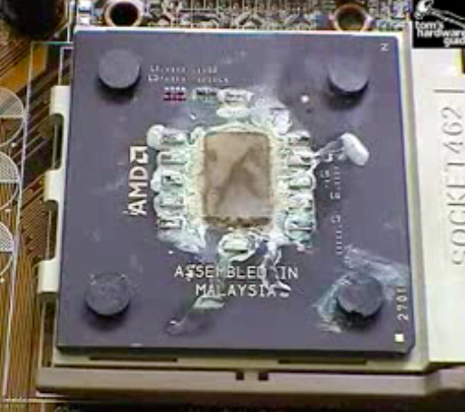
Totally Hot CPU
What
Next?
http://www.youtube.com/watch?v=y39D4529FM4

Slide 21
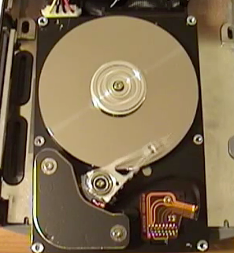
Hard Disk in Action
http://www.youtube.com/watch?v=9eMWG3fwiEU

Slide 22
Python as a Language

Slide 23
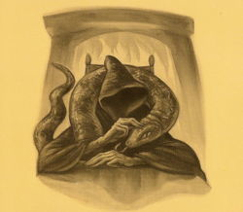
Parseltongue is the language of serpents and those who can converse with them. An individual who can speak Parseltongue is known as a Parselmouth. It is a very uncommon skill, and may be hereditary. Nearly all known Parselmouths are descended from Salazar Slytherin.
http://harrypotter.wikia.com/wiki/Parseltongue

Slide 24
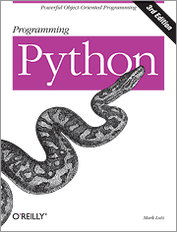
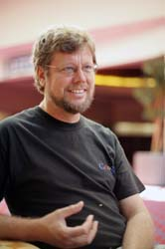
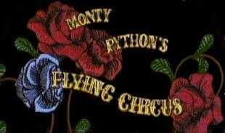
Python is the language of the Python Interpreter and those who can converse with it. An individual who can speak Python is known as a Pythonista. It is a very uncommon skill, and may be hereditary. Nearly all known Pythonistas use software initially developed by Guido van Rossum.

Slide 25
Early Learner: Syntax Errors
We need to learn the Python language so we can communicate our instructions to Python. In the beginning we will make lots of mistakes and speak gibberish like small children.
When you make a mistake, the computer does not think you are “cute”. It says “syntax error” - given that it knows the language and you are just learning it. It seems like Python is cruel and unfeeling.
You must remember that you are intelligent and can learn. The computer is simple and very fast, but cannot learn. So it is easier for you to learn Python than for the computer to learn English...

Slide 26
Talking to Python

Slide 27
csev$ python3
Python 3.5.1 (v3.5.1:37a07cee5969, Dec 5 2015, 21:12:44) [GCC 4.2.1 (Apple Inc. build 5666) (dot 3)] on darwinType "help", "copyright", "credits" or "license" for more information.
>>>
What next?

Slide 28
csev$ python3
Python 3.5.1 (v3.5.1:37a07cee5969, Dec 5 2015, 21:12:44) [GCC 4.2.1 (Apple Inc. build 5666) (dot 3)] on darwinType "help", "copyright", "credits" or "license" for more information.
>>> x = 1
>>> print(x)
1
>>> x = x + 1
>>> print(x)
2
>>> exit()
This is a good test to make sure that you have Python correctly installed. Note that quit() also works to end the interactive session.

Slide 29
What Do We Say?

Slide 30
Elements of Python
Vocabulary / Words - Variables and Reserved words (Chapter 2)
Sentence structure - valid syntax patterns (Chapters 3-5)
Story structure - constructing a program for a purpose

Slide 31
name = input('Enter file:')
handle = open(name)
counts = dict()
for line in handle:
words = line.split()
for word in words:
counts[word] = counts.get(word,0) + 1
bigcount = None
bigword = None
for word,count in counts.items():
if bigcount is None or count > bigcount:
bigword = word
bigcount = count
print(bigword, bigcount)
A short “story” about how to count words in a file in Python
python words.py
Enter file: words.txt
to 16

Slide 32
Reserved Words
You cannot use reserved words as variable names / identifiers
False class return is finally
None if for lambda continue
True def from while nonlocal
and del global not with
as elif try or yield
assert else import pass
break except in raise

Slide 33
Sentences or Lines
x = 2
x = x + 2
print(x)
Assignment statement
Assignment with expression
Print statement
Variable
Operator
Constant
Function

Slide 34
Programming Paragraphs

Slide 35
Python Scripts
Interactive Python is good for experiments and programs of 3-4 lines long.
Most programs are much longer, so we type them into a file and tell Python to run the commands in the file.
In a sense, we are “giving Python a script”.
As a convention, we add “.py” as the suffix on the end of these files to indicate they contain Python.

Slide 36
Interactive versus Script
Interactive
- You type directly to Python one line at a time and it responds
Script
- You enter a sequence of statements (lines) into a file using a text editor and tell Python to execute the statements in the file

Slide 37
Program Steps or Program Flow
Like a recipe or installation instructions, a program is a sequence of steps to be done in order.
Some steps are conditional - they may be skipped.
Sometimes a step or group of steps is to be repeated.
Sometimes we store a set of steps to be used over and over as needed several places throughout the program (Chapter 4).

Slide 38
Sequential Steps
x = 2
Program:
x = 2
print(x)
x = x + 2
print(x)
Output:
2
4
print(x)
x = x + 2
print(x)
When a program is running, it flows from one step to the next. As programmers, we set up “paths” for the program to follow.

Slide 39
Conditional Steps
x = 5
x < 10 ?
Yes
Program:
x = 5
if x < 10:
print('Smaller')
if x > 20:
print('Bigger')
print('Finis')
print('Smaller')
No
Output:
Smaller
Finis
x > 20 ?
Yes
print('Bigger')
No
print('Finis')

Slide 40
Repeated Steps
n = 5
No
n > 0 ?
Yes
Output:
5
4
3
2
1
Blastoff!
Program:
n = 5
while n > 0 :
print(n)
n = n – 1
print('Blastoff!')
print(n)
n = n -1
print('Blastoff')
Loops (repeated steps) have iteration variables that change each time through a loop.

Slide 41
name = input('Enter file:')
handle = open(name, 'r')
counts = dict()
for line in handle:
words = line.split()
for word in words:
counts[word] = counts.get(word,0) + 1
bigcount = None
bigword = None
for word,count in counts.items():
if bigcount is None or count > bigcount:
bigword = word
bigcount = count
print(bigword, bigcount)
Sequential
Repeated
Conditional

Slide 42
name = input('Enter file:')
handle = open(name, 'r')
counts = dict()
for line in handle:
words = line.split()
for word in words:
counts[word] = counts.get(word,0) + 1
bigcount = None
bigword = None
for word,count in counts.items():
if bigcount is None or count > bigcount:
bigword = word
bigcount = count
print(bigword, bigcount)
A short Python “Story” about how to count words in a file
A word used to read data from a user
A sentence about updating one of the many counts
A paragraph about how to find the largest item in a list

Slide 43
Summary
This is a quick overview of Chapter 1
We will revisit these concepts throughout the course
Focus on the big picture

Slide 44
Acknowledgements / Contributions
These slides are Copyright 2010- Charles R. Severance (www.dr-chuck.com) of the University of Michigan School of Information and made available under a Creative Commons Attribution 4.0 License. Please maintain this last slide in all copies of the document to comply with the attribution requirements of the license. If you make a change, feel free to add your name and organization to the list of contributors on this page as you republish the materials.
Initial Development: Charles Severance, University of Michigan School of Information
… Insert new Contributors and Translators here
Continue…

