Slide 1
Making BadUSB
Work For You
Adam Caudill (@adamcaudill)
Brandon Wilson (@brandonlwilson)
Notes:
Hi, I'm Adam Caudill - I'm a developer and independent security researcher, I'm here with Brandon Wilson, and this is "Making BadUSB Work For You" - In this presentation we'll be discussing a few things:
1).The process of reverse engineering the Phison 2251-03 firmware, to allow patching in new functionality
2). How USB thumb drives can easily be updated with new or modified firmware to add new "features"
3). How custom firmware can turn a cheap thumb drive into something completely different
We'll also talk about this type of attack, and the history of using programmable USB devices, and touch on how this could be detected.
So, let me ask a couple questions:
Who here has heard of BadUSB before?
Who is here because you want to use these techniques?
Who is here because you want to find a way to defend against this?
Great, so I'll just assume the rest of you got lost on the way to the restroom :)

Slide 2
What is BadUSB?
NOT a technical flaw
NOT a vulnerability
Notes:
What is BadUSB, really? BadUSB is a set of technical decisions and a flaw in perception.
In reality, BadUSB isn’t a flaw, and it’s not a vulnerability. It’s completely compliant with the USB specification (or as compliant as it wants to be), and it’s decisions made by device manufacturers coupled with a problem with the way people perceive the devices that people connect to their computers.
When somebody looks at a thumb drive, they perceive it to be nothing more than a storage device, but this is an oversimplification. It is a programmable computer, programmable the way any other computer is. It’s this issue with perception that makes the concept of BadUSB possible.
So we have a small programmable device that looks like something a user would trust, that in reality can be programmed or pretend to be any USB device.
So BadUSB is just a concept -- the idea that you can take a device a user perceives as trustworthy, and reprogram it to behave in a completely different way than they would expect.

Slide 3
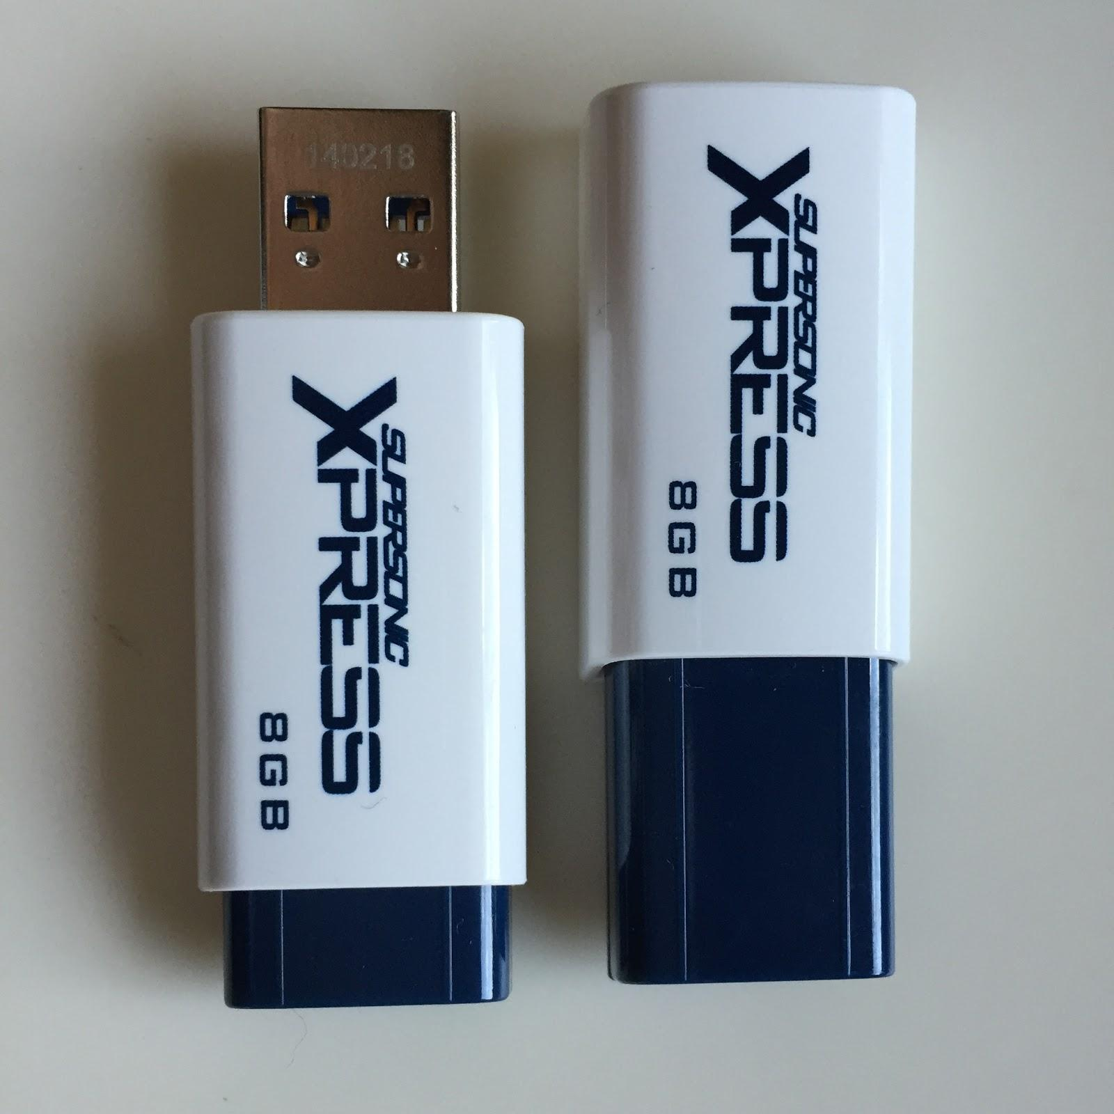
Patriot 8GB Supersonic Xpress
Notes:
For this talk, we have focused on one drive, the Patriot 8GB Supersonic Xpress. It's a USB 3.0 device powered by the Phison 2251-03 controller with a Toshiba NAND chip, and version 1.03.53 of the firmware. This can be ported to other 2251-03 devices without too much pain, and with some effort many of the other Phison controllers should work as well.
We've done this for simplicity - there are a lot of variations from device to device, so to keep it easy, we chose one device to focus on. These go for about $10 from Amazon.

Slide 4
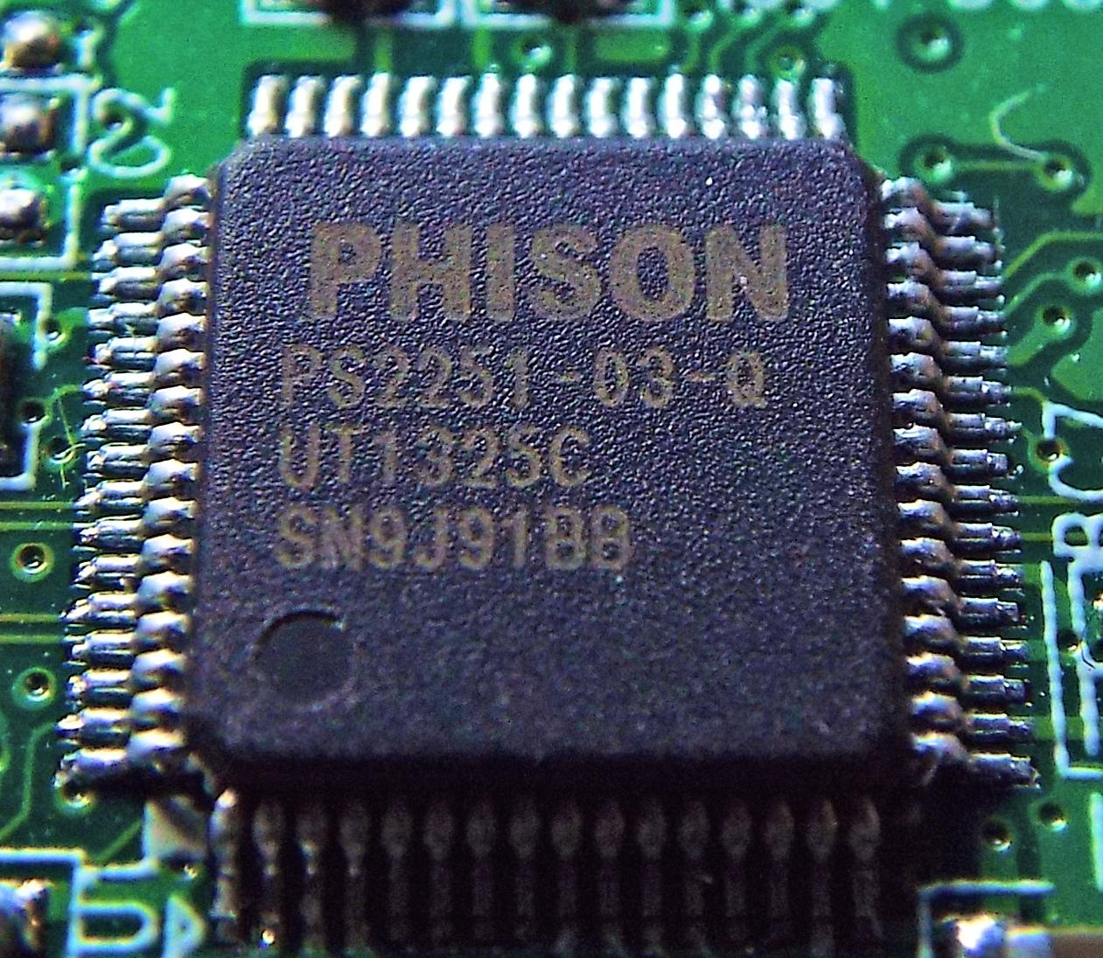
Phison 2251-03
Notes:
This is the Phison 2251-03 controller. It's a system on a chip, so there are multiple hardware components in play when working with this device, but for the purpose of this talk there's only a few that we care about:
* Intel 8051 processor
* 256KB “external” (to the 8051 core) RAM
* USB controller - which seems suspiciously similar to the Cypress EZ-USB, but we've not been able to confirm this
There are 256 bytes of RAM internal to the 8051 processor, and 256KB (we think) of external RAM. There's internal storage for the boot image, though the firmware itself is actually not stored on the controller, but on the NAND chip.
Here's Brandon Wilson to dig into some details of the firmware, and what you need to know if you want to write your own code for it.

Slide 5
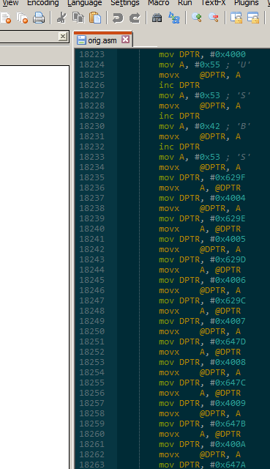
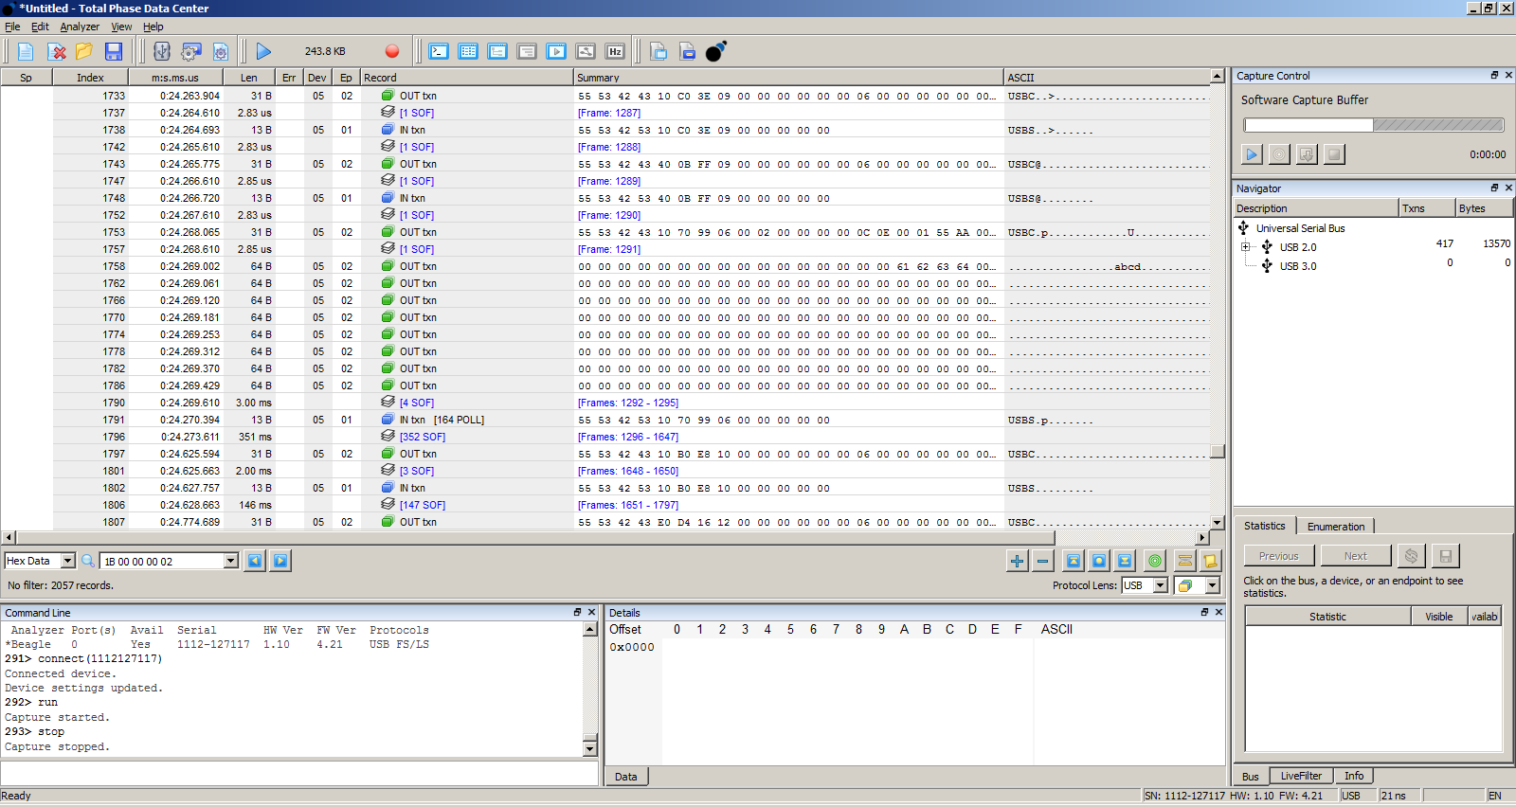
Reverse Engineering
Notes:
I'm Brandon Wilson, to save time, and because I’m not much of a public speaker, I'm going to keep this as brief as I can - we have some pretty neat demos to show you later.
We've reverse engineered *some* of the key parts of the firmware, and analyzed its behavior. Through this, we've learned a few useful things, which we’ll get into.

Slide 6
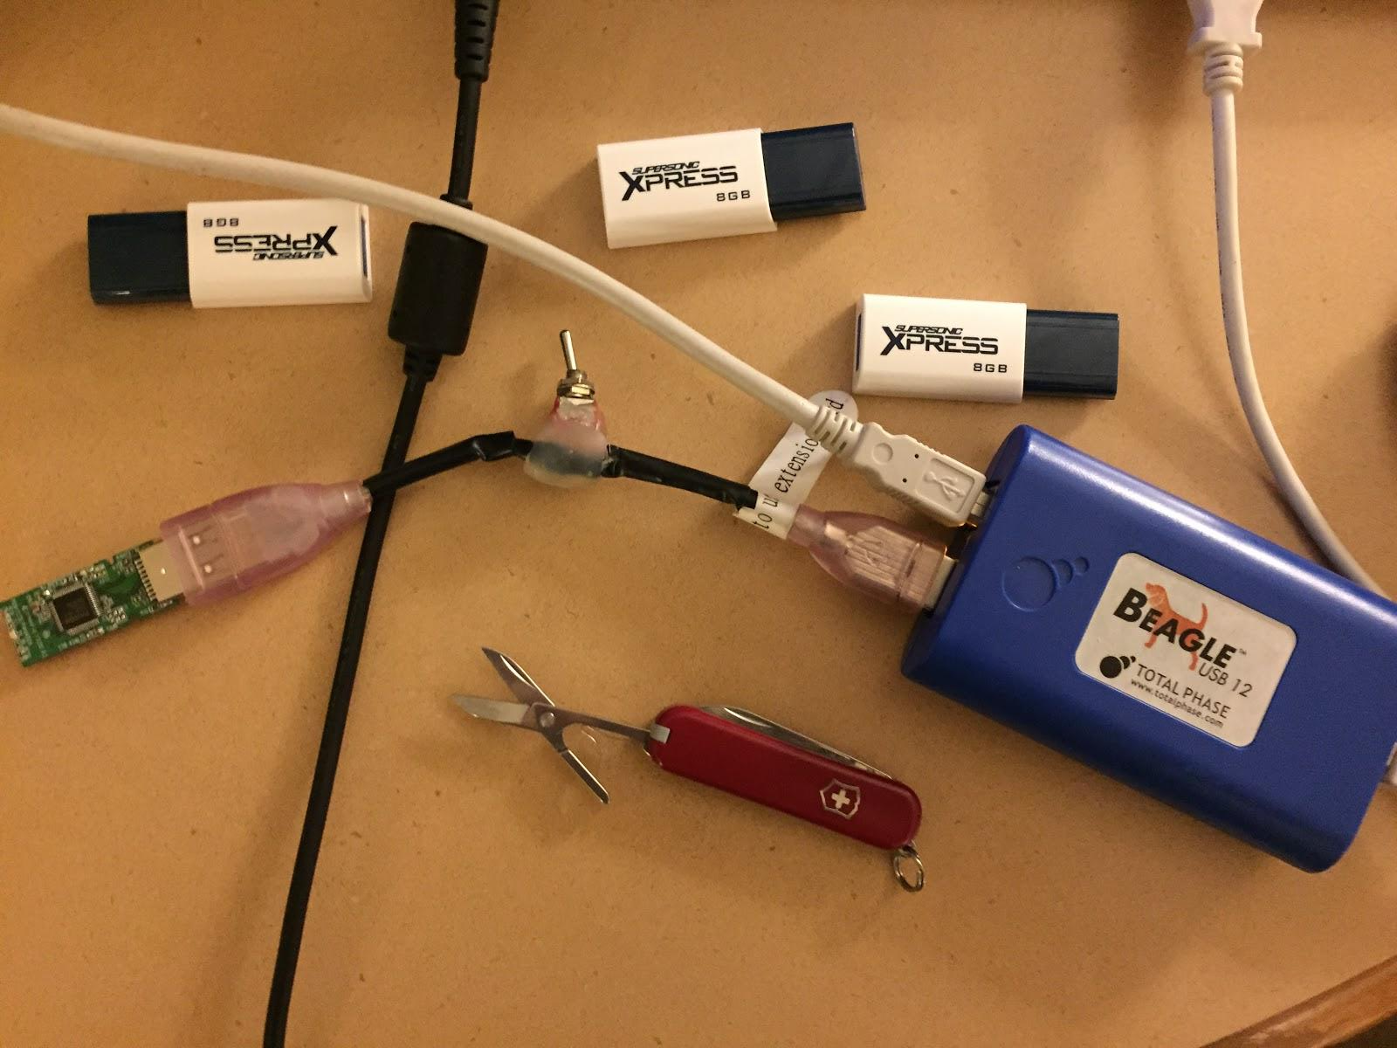
A word of warning...
Notes:
A word of warning...
We've killed several drives in the reverse engineering / development process, so don't mess with drives that have important data on them, because you’re probably going to lose it.

Slide 7
Boot Process
Always starts at boot ROM
Attempts to read firmware from NAND
If successful, first 32KB loaded to XDATA
If not, waits to receive code to RAM and executes it
Notes:
This is a rough overview of the boot process:
First, the boot image is executed from memory on the Phison SOC, it then loads the firmware from the NAND (if it can connect to it), it loads the first 32KB into xdata or external RAM. If it can't connect to the NAND, it goes into "boot" mode, to allow for programming.
Once loaded into memory, the CPU is reset, and it starts executing at xdata address 0x0.

Slide 8
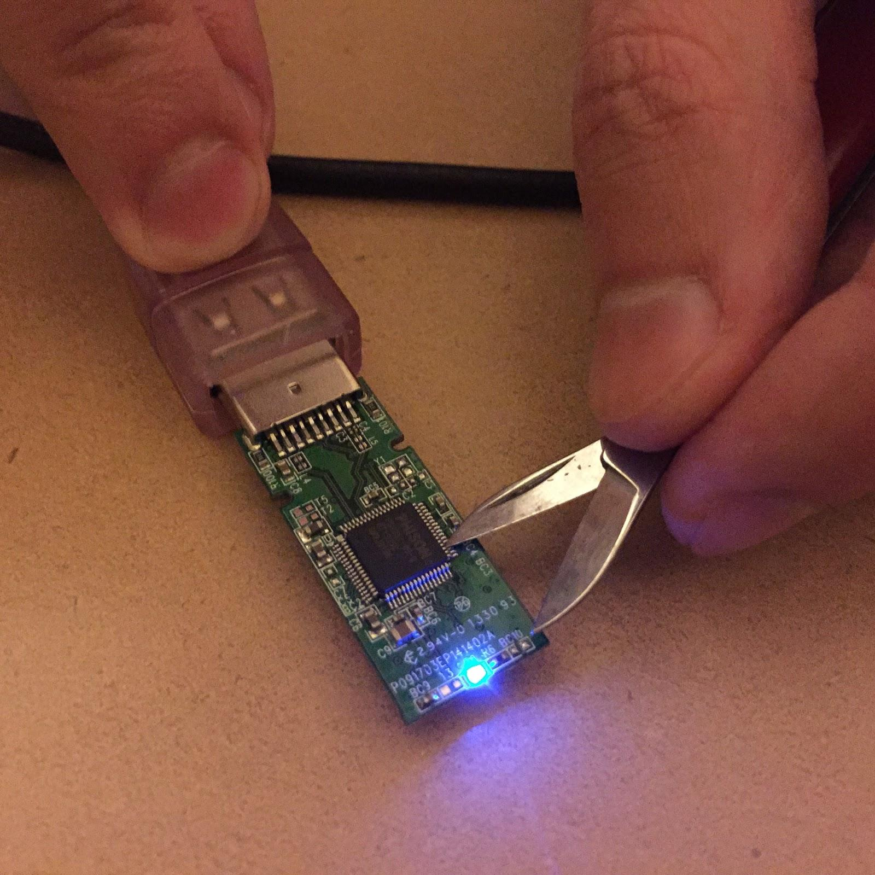
Pin Shorting
Notes:
If you want to avoid booting the firmware, you can short the pins that connect to the NAND to force it into "boot mode" - this is useful if you burn a bad firmware image or if you want to dump potentially dangerous firmware from a drive.
Our DriveCom tool has a feature that allows you to easily dump the firmware, so this is useful for patching, and for analyzing firmware to look for modifications.

Slide 9
0xEFFF
Page 0
Page 1
Page 2
Page A
...
0x5000
Base section
0x0000
Paging
Notes:
To allow for firmware images that are much larger than 32KB on the 8051, the firmware uses a custom paging system.
The first 32KB of the firmware image from NAND is loaded at address 0x0 to 0x7FFF in xdata, with 0x5000 to 0x7FFF being intentionally unused. 16KB pages are swapped into xdata in that section starting at address 0x5000. So the lower 20KB starting at address 0x0 is always available, and the upper 16KB can be swapped by the firmware as needed.
Whenever code needs to call other code on a different page, it lets the base section do it -- so it calls a function on the base page, which saves the current page on the stack, swaps in the new one, transfers control to it, and then once that returns, restores the original page from the stack.
The firmware is separated into up to 16 of these swappable pages, with some pages being completely unused. In our case, we've patched our code into the kilobyte or so of empty space at the end of the base page. So we can patch in code without overwriting anything existing - which makes it that much harder to detect modified firmware, as everything works as expected.
Code can be injected into the other pages as well, but the base page is the most valuable area, since it’s accessible by every other page when swapped in.

Slide 10
Boot ROM
Burner Executable
Firmware
Firmware Update Process
Notes:
The firmware update process is a little bit interesting, as it's a multi-step process, partially handled by the boot image, and partially by a "burner" image that has to be sent to the device. This burner image is basically a very small, simplified version of the firmware that implements just enough functionality to be able to write the new firmware to NAND.
To update the firmware, the device must be in boot mode -- you can enter this mode by sending a special SCSI command they handle, or the scarier route, shorting the pins connecting the controller to the NAND. Once in boot mode, we use a tool we wrote to send the burner image; the burner image will take over execution and will wait for another command. We then send the firmware image using that same tool, and the burner takes the data and writes the image to NAND.
There are no signatures in this process, no checksums, nothing to control what gets written. This is something that anyone with some experience with reverse engineering embedded systems can do - it's just a matter of investing enough time to do it. So the integrity of these devices has been entirely based on obscurity.

Slide 11
Pain Points
Patching existing firmware
Very touchy
Limited RAM available
Writing from-scratch firmware
NAND sucks
Non-standard command sets
Bad block management
Global wear leveling
Lots...and lots...of pin shorting
Notes:
When it comes to actually changing the firmware on the device, we have two options...we can either patch the existing firmware, or write new firmware (and all the functionality it's responsible for) from scratch.
The existing firmware is extremely touchy - it's very easy to destabilize the device, you change the wrong bit in XRAM and you're done. Finding any amount of unused RAM is difficult, compounded with the fact that everything is memory mapped - so some ranges are actual memory, others interact with hardware. Not all of the hardware is understood, at least by us, and is undocumented - so all that can be done is look at how the firmware accesses memory addresses (all of them) and try to guess what they actually are.
NAND access is a special kind of pain, and has complicated matters at every step. (slide)
Because it's so easy to corrupt the state of the device, even the smallest change, can have a dramatic impact on the device.
And of course, no matter which route you go with, you're going to inevitably brick the device at least a dozen times, which means shorting pins to boot from ROM.

Slide 12
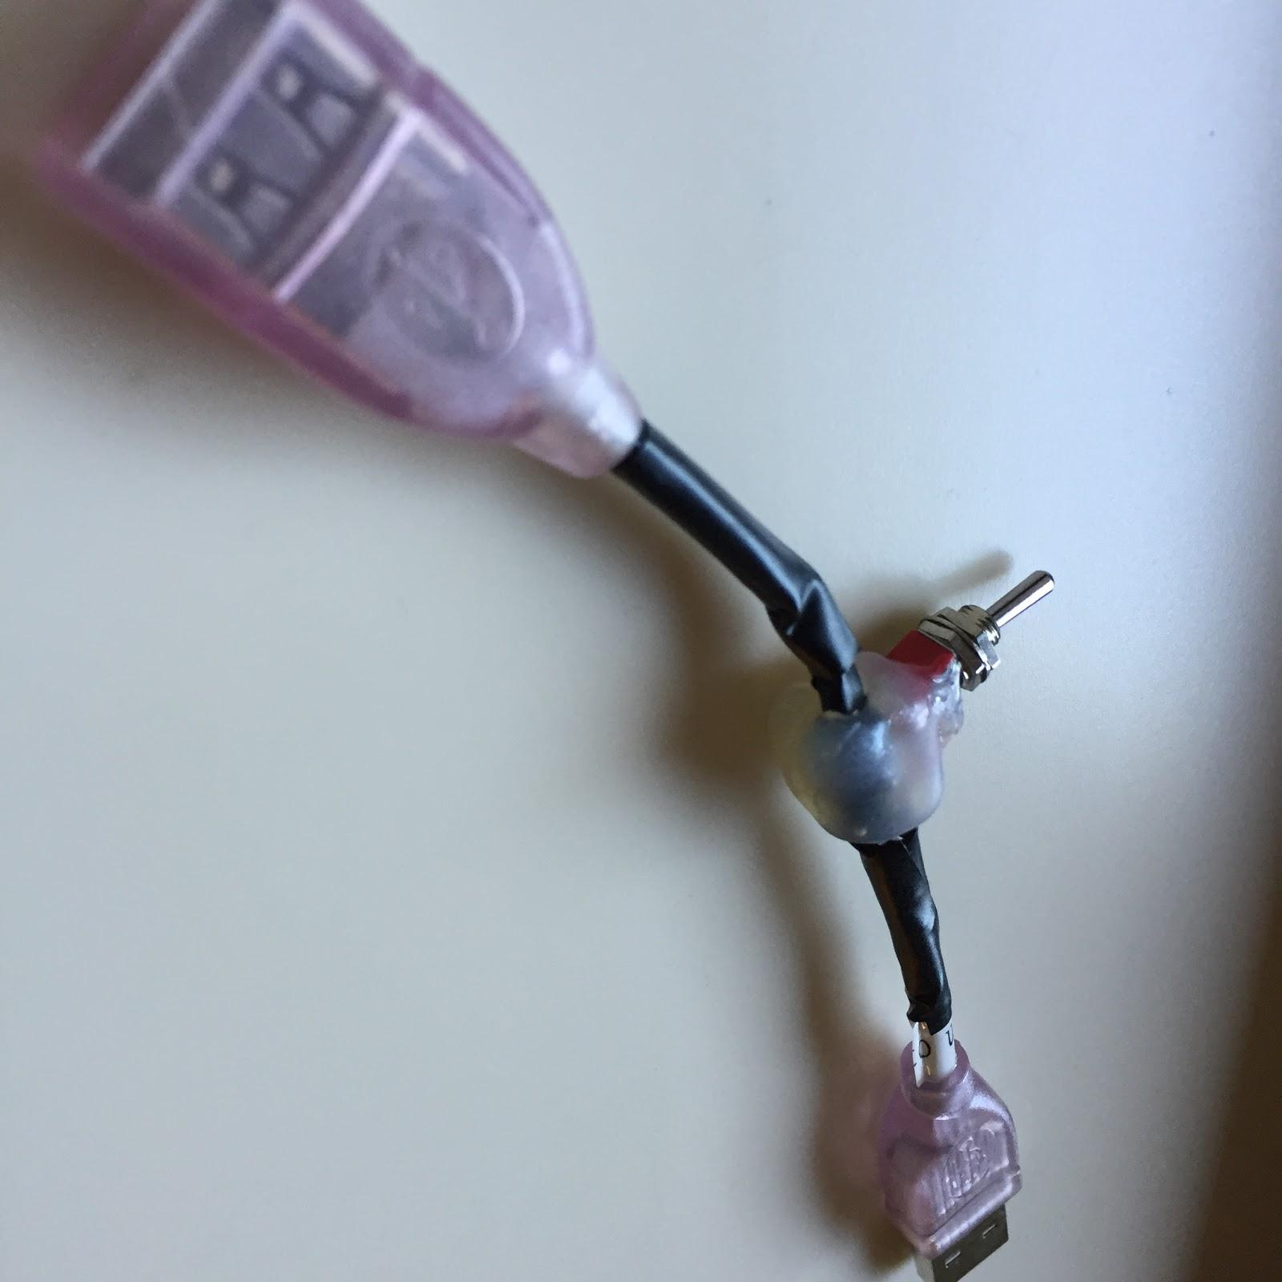
Quick Reset Cable
Notes:
Thanks to some of these pain points, we had to find clever ways to save time - this cable adds a switch on the 5V line, to make it easy to kill power to the device without having to physically remove the device, because you have to keep the pins shorted with your hand *while* you’re plugging it in with the other hand.
I've had to reset the device so many times I've actually broken the pins on several drives already.

Slide 13
New Tools
Desktop Flasher
Firmware Patcher
HID payload injector
Notes:
During this talk we will be releasing a few new tools, and our code for the firmware patches and the custom firmware that we'll be demonstrating in a minute. These are the tools that you'll see us use during the demos, they will be on Github for you to use or modify in a few minutes. So, we're releasing everything we've done here - nothing is being held back.
We firmly believe that this information shouldn't be limited to a select few, as others have treated it, but should be available to the public. It's been understood that such attacks were possible - if it has updatable firmware, there's always some chance it could be updated to be malicious. But the knowledge of how to do this has been limited to those with the resources to reverse engineer the devices’ firmware. While the Phison 2251-03 firmware isn't that complex, 8051 assembly isn't the easiest thing to work with and their hardware and software is a bit touchy.
So there's only so many organizations that have had the resources necessary to make this happen, it's not something that the average pentester would be able to use. For those here that are trying to defend, are the people that would love to steal your data financed well enough to be able to do this? (The answer is yes.) This is the disparity we are trying to eliminate by releasing this information - you can't test your defenses if you don't have access to the same tools that a sophisticated attacker could use.

Slide 14
What We've Done
Custom HID firmware
Hidden partition patch
Password protection bypass patch
Notes:
(Adam) We have three demos for you, the first is a completely custom firmware that turns the device into a programmable keyboard, that accepts standard "Rubber Ducky" payload files.
The second, is a simple way to hide files on a drive - it acts like a normal drive, except a few seconds after you "eject" it, it remounts a different, hidden partition. As far as anyone can tell it's a normal drive. Currently, the drive size is divided in half, though that can be adjusted - the missing space is the only sign that something is up.
The third might just be my favorite; most Phison-based drives support different modes, the main mode most users are familiar with is mode 3 - it's the standard single partition drive. Mode 7 may be familiar to some people here - the drive shows two partitions, one "public", the other encrypted with a user supplied password. We've patched this to change the behavior in a subtle way to eliminate the value of the encryption.

Slide 15
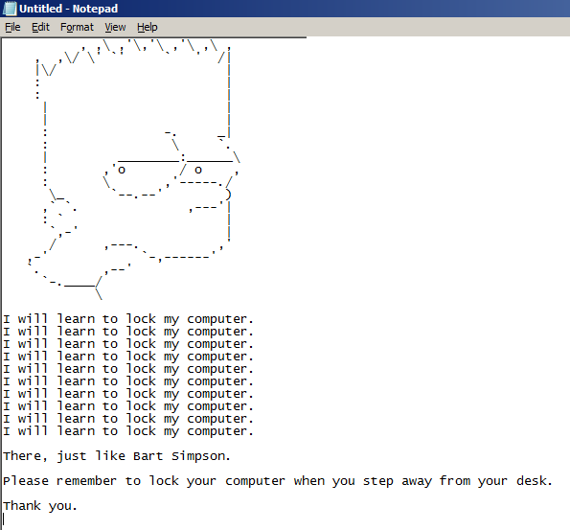
Custom HID Firmware
Notes:
This is completely custom firmware, it doesn't use the stock firmware at all. When inserted, it shows up as a HID device, and immediately starts executing the embedded payload.
It uses the standard inject.bin files that any "Rubber Ducky" user should be familiar with; up to around 16 KB. The payload is embedded in the firmware, and flashed to the device. This is a quick process, and at roughly $10 per drive, it's a cheap option for larger tests.
To simplify updates, it shows up as a composite device, both mass storage and HID - this makes it easy to use the tools to reflash the device with different firmware, although it can certainly work without it.
So what we'll do is take a normal drive, flash the new firmware, and let you see it in action.
<demo>

Slide 16
Hidden Partition Patch
Read Request
(Get LBA 0x00000073)
Patch
(Use hidden area?)
Section 1
(Public)
Section 2
(Hidden)
Notes:
Next up, we'll show you a patch to the existing firmware to add a new feature for data exfiltration - a hidden partition that's only accessible via the right events.
The drive is divided in half, the first half of the drive shows up when you insert the device - if you look at it in "Disk Management" in Windows, you'll only see half the size, format it - half the size, query the device - same thing, half the size. It's still in mode 3, everything looks and acts normal. Format it, do whatever you want. This is hidden entirely in firmware, so the host device doesn't have a way to see what's going on unless the right bit is flipped.
Until you eject the drive - not using the "safely remove hardware' option, but eject - after a few seconds it'll re-enumerate and mount a hidden partition. You can dump whatever data you like here, and either unplug the drive, or hit eject again to get back to the first, original partition a few seconds later.
This is a really simple way to hide data on a drive that appears to be empty. I wouldn't try to use it to get past the NSA, but it'll pass most checks.
<demo>

Slide 17
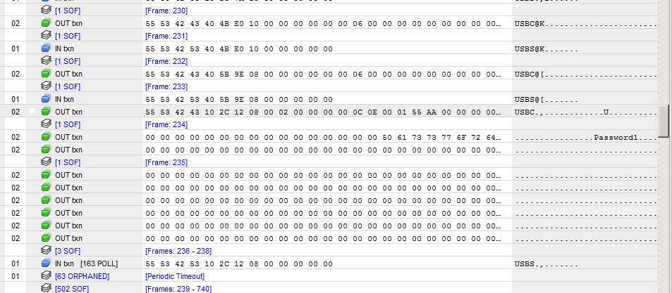
Password Protection Bypass
Notes:
Many drives support a mode that allows the contents to be encrypted by a user supplied password - until you enter the password, you can't see the content of the drive. As many companies have implemented rules to encrypt removable media, this feature is handy.
We've made a very simple patch to the firmware that changes the way that the password is handled once received by the device. So, let me walk you through a scenario: You get a drive, patch the firmware - everything still seems normal, put it in mode 7 so a user can store encrypted data on it and be "secure" - they run the software from the manufacturer to set a password. They then proceed to store all the sensitive data they want, assured that it's safe, and only their password can unlock it.
Except, that's not quite the case.
When the device receives the password via a special SCSI command (in plaintext, mind you), it converts it to 16 "A"s - so any password will now unlock the device. A small, few byte change - and a trusted feature is now nothing more than a thin facade. The only way a user would notice this is if they intentionally put in a bad password - and how often does that happen? Now, obviously, the patched firmware has to be applied before the password is set, otherwise it'll just make it impossible to access the data.
This shows how a simple change in unsigned firmware can drastically change the security profile of the device.
So we'll set a password - and you'll see that any password will then unlock it.
<demo>

Slide 18
Defense & Detection
Composite devices
Modified firmware
?
Notes:
(Brandon) There's been a lot of questions about how to defend against this, so let’s look at the two main categories:
Composite Devices: The "classic" BadUSB attack is a mass storage device that suddenly re-enumerates as a composite device, adding a HID device, network adapter, or whatever. There *may* be some defense, or at least detection, when this happens. On Windows there are APIs available that could be used to monitor connected devices, and detect when a device disconnects and very quickly comes back as something else, such as a composite device. We had hoped to release a proof of concept tool to do this, but there just wasn't time.
So there may be some hope, though it's not going to be bulletproof - it's...better than nothing.
Modified Firmware: Both of the demos we did with patched firmware show up only as a mass storage device, not a composite device - so that won't help detect these types of modifications. Really, there aren't any good options for these - the best you could do is to dump the firmware and compare it to known samples for the same version and see if there are changes, if so - it could be modified, or maybe they just didn't update the version number between changes.
Long story short, there aren't many good options, but there's at least one direction if somebody wants to pursue it.

Slide 19
Source Code & Tools
Drive: bit.ly/badusb4you
Code: github.com/adamcaudill/Psychson
Burner & Stock Firmware:
usbdev.ru/files/phison/
Notes:
(Adam) The source code for our patches, custom firmware, and tools should now be live on Github. There are more links and details for other tools, files, and whatnot on Github.
Pull requests are welcome if you'd like to extend what we've done here. There's a ton of potential, and we've just scratched the surface with what we are releasing today. We'd love to see what ideas you all have to leverage the flexibility of these devices.

Slide 20
Special Thanks
Security Research Labs
Karsten Nohl
Sascha Krißler
Jakob Lell
Notes:
We'd like to thank the SR Labs team for their work on BadUSB, they drew more attention to the risks of this type of unsigned firmware updating than anyone has been able to, at least recently. They weren't involved with what we've done here, and the only contact we've had is a very brief conversation after their BlackHat talk.
While they did a great job of drawing attention to the dangers, they didn't release any of their materials - so despite their warnings, they maintained the status quo, leaving this knowledge in the hands of a select few. It's this decision that led us to shift directions on research we were doing, and release all of this information.

Slide 21
Special Thanks
Richard Harman (@xabean)
ShmooCon 2014
Controlling USB Flash Drive Controllers
bit.ly/1xaNkbP
Notes:
Richard Harman presented a great overview of these devices and what they are capable of, and some of the tools, and history of research. If you want to work with these devices, or want to understand the history, you need to see his talk.
He covers a number of things I wish we had time to talk about now, so just go watch his talk.

Slide 22
Thanks
github.com/adamcaudill/Psychson
Adam Caudill (@adamcaudill)
Brandon Wilson (@brandonlwilson)
Notes:
Thanks everybody - really hope that you got something useful out of this. We don't have time for questions right now, but we'll be around, so feel free to grab us outside with any questions you have.
Thanks!

