Slide 1
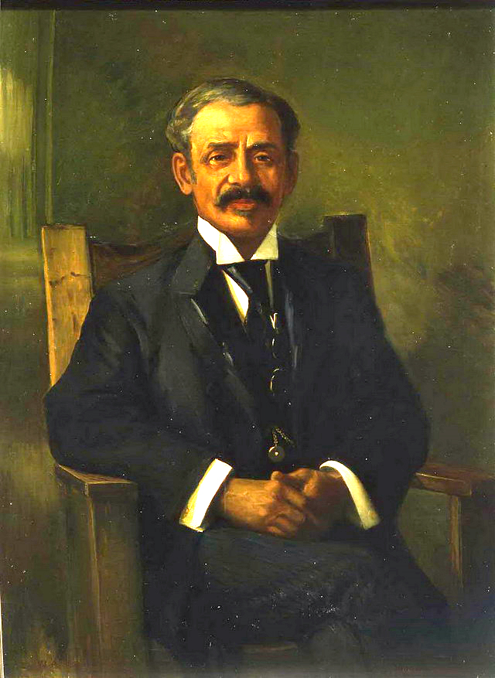
Black History Month
William Peyton Hubbard was an inventor and politician from Toronto. This is a great achievement, as his parents were refugees from slavery in America.
The greatest invention of Hubbard was his commercial baker's oven. This oven was called the Hubbard portable and became well known and widely used. Hubbard was one of the first black politicians elected in Canada and was elected to the Toronto city council a total of 15 times.

