Slide 1
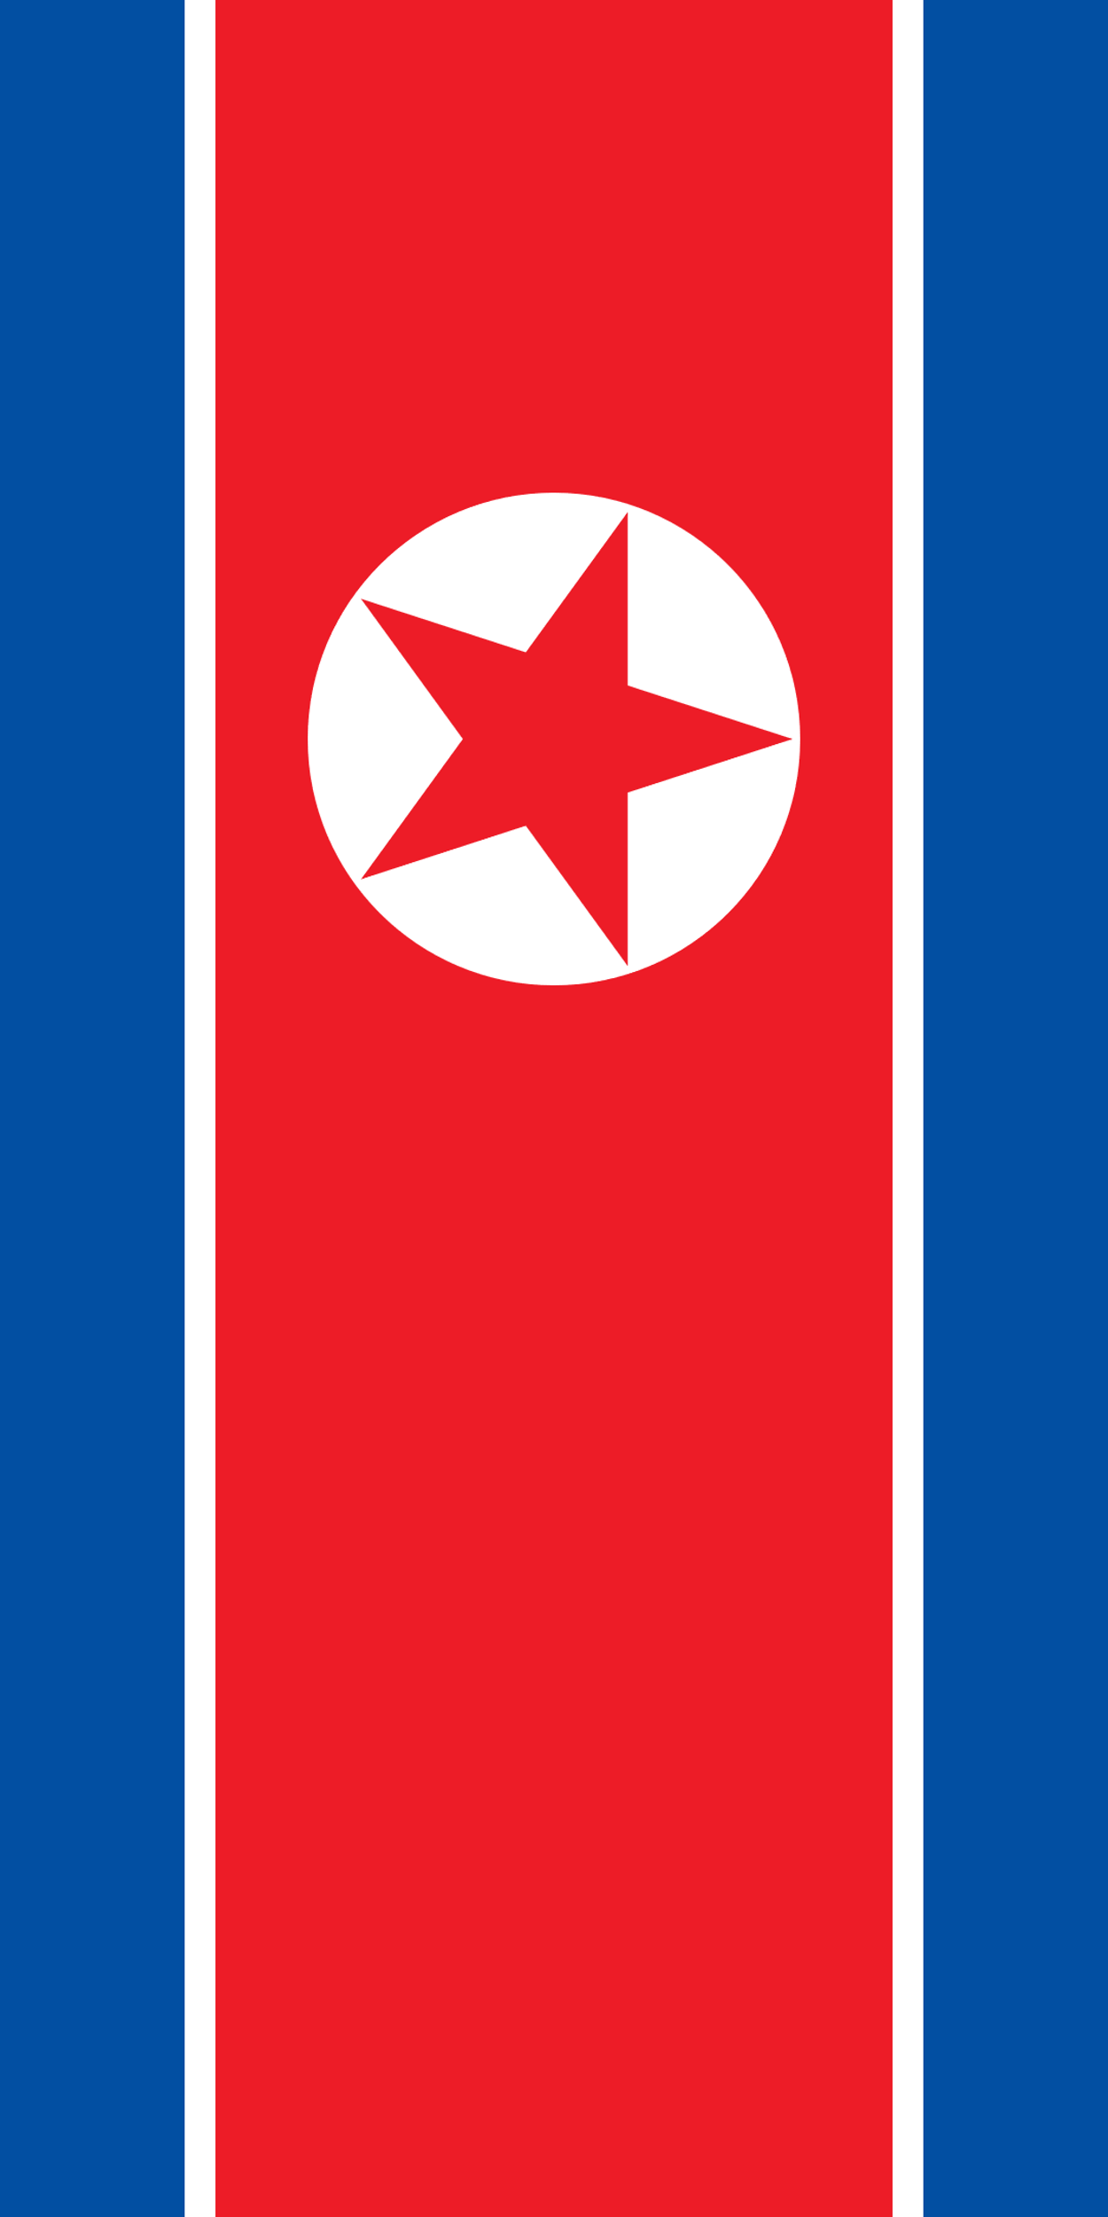
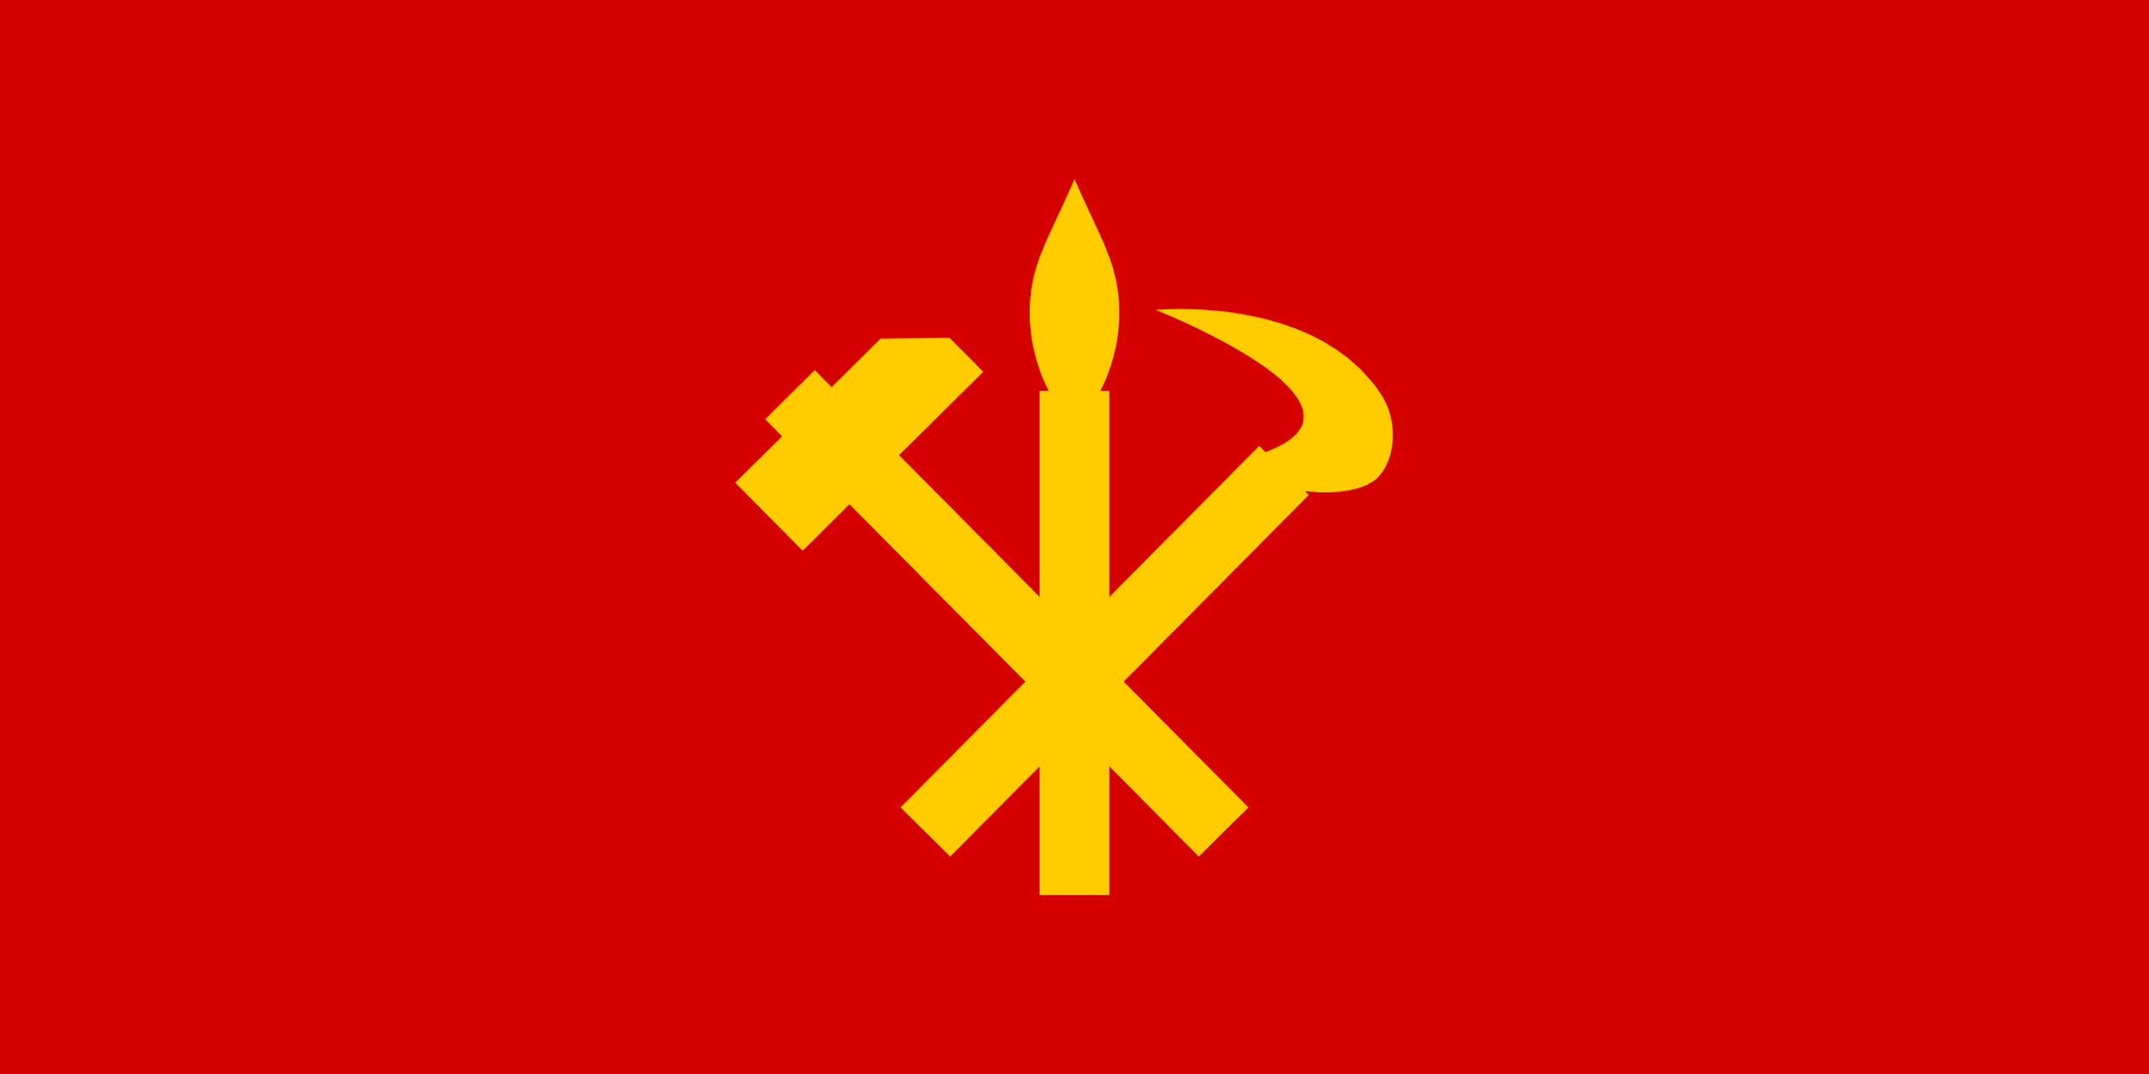
The Democratic People’s Republic of Korea
Economy of the DPRK
Imperialist Lies About the Glorious Democratic People’s Republic Of Korea

