Slide 1

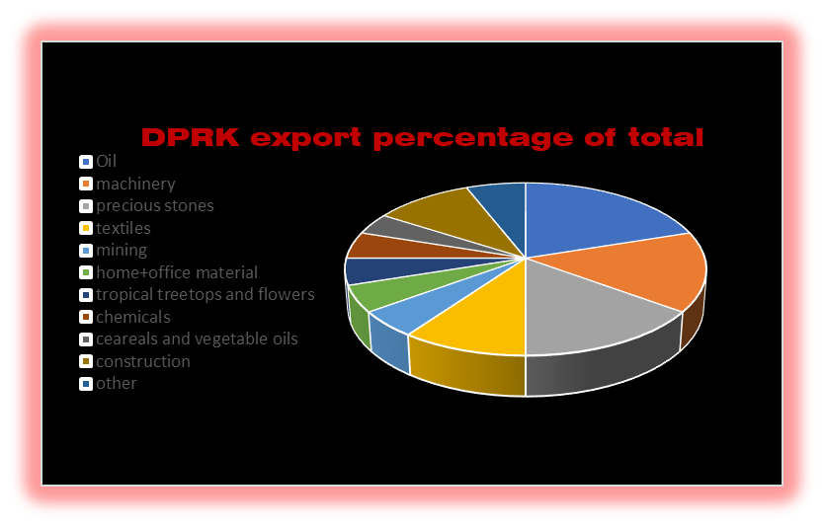




The Democratic People’s Republic of Korea
Economy of the DPRK
Imperialist Lies About the Glorious Democratic People’s Republic Of Korea:
Western media claims our glorious leader Kim Jung-un has had a stroke and died. This is clearly American propaganda and should NOT be believed.

