Slide 1
Consensus without identity: using a block chain
Bitcoin’s consensus algorithm

Slide 2
Bitcoin nodes don’t have long-term identities
1. Identity is hard in a P2P system — Sybil attack
In a P2P system, it's challenging to establish genuine user or node identities because participants can easily create multiple fake identities (Sybil attack) to manipulate the network.
The Sybil attack is a security threat where a single malicious participant creates multiple fake identities to control a significant portion of the network and potentially disrupt the consensus process or gain undue influence.
2. Pseudonymity is a goal of Bitcoin
Bitcoin and many other blockchain systems aim to provide pseudonymity rather than full anonymity or real-world identity.
This means that while users may not reveal their real identities, they have consistent pseudonyms or addresses that can be used to track their transactions

Slide 3
Why having identity is useful for consensus?
Easy Protocol Design: Having identities (like unique IDs) for participants in a consensus protocol makes it simpler to create and manage the rules of the protocol. For example, you can instruct a specific node with a low ID to perform a task.
Pragmatic Reasons: Some protocols require node IDs to work effectively. They might have instructions like, "Now, the node with the lowest ID should do something." Without IDs, these instructions can be tricky to implement.
Security: When we assume that less than 50% of nodes are malicious (acting dishonestly) in a network, having identities can help. If it's challenging to create new node identities, we can make certain assumptions about how many malicious nodes there are. This can be used to prove that the network is secure.

Slide 4
How to overcome lack of identity in Bitcoins?
Weaker Assumption: Selecting a Random Node
Imagine you're in a big group of people, like at a lottery or raffle. You want to choose someone from the group randomly, but you don't know who everyone is.
Analogy: Lottery or Raffle
Think of it like a lottery or raffle where everyone gets a ticket or a token with a number on it. We don't know who has which number, but we want to pick one ticket randomly.
Key Assumptions:
Random Selection: We can pick a token (or ticket) randomly without knowing who it belongs to.
Sybil Nodes: Sometimes, a troublemaker (let's call them an "adversary") might try to cheat by getting multiple tokens. But even if they cheat and get lots of tokens, we want to make sure they can only use one of them when we randomly pick a winner.

Slide 5
Key idea: implicit consensus
In each round (corresponds to a different block in the block chain), random node is picked
This node proposes the next block in the chain
No consensus or voting done by this node!
Other nodes implicitly accept/reject this block
by either extending it
or ignoring it and extending chain from earlier block
Every block contains hash of the block it extends

Slide 6
Consensus algorithm (simplified)
1
New transactions are broadcast to all nodes
2
Each node collects new transactions into a block
3
In each round a random node gets to broadcast its block
4
Other nodes accept the block only if all transactions in it are valid (unspent, valid signatures)
5
Nodes express their acceptance of the block by including its hash in the next block they create

Slide 7

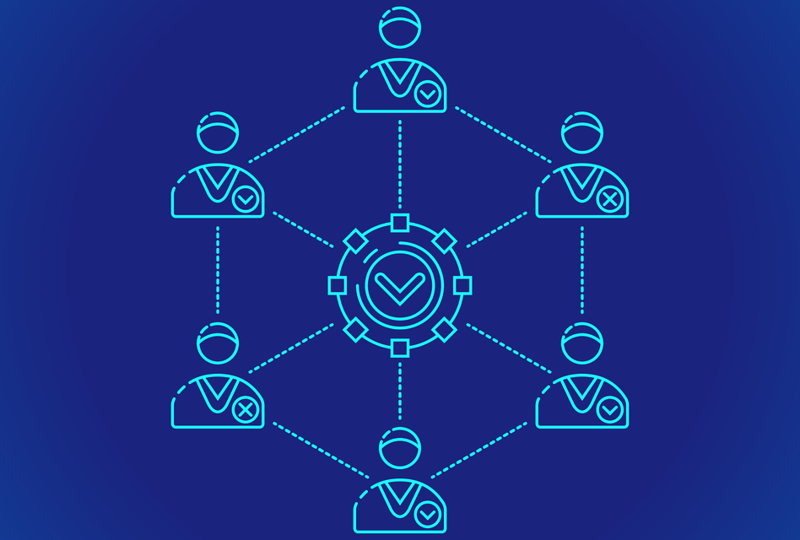
Bitcoin Consensus

