Slide 1
AC自动机
2020.11.7

Slide 2
KMP与AC自动机
KMP：单模字符串匹配
AC自动机：多模字符串匹配

Slide 3
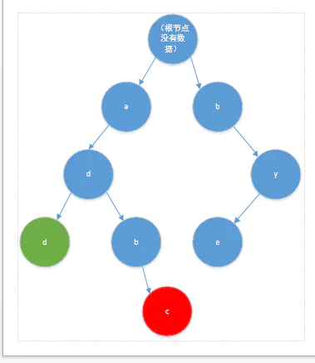
字典树与AC自动机
add
adbc
bye

Slide 4
AC自动机
"ash","shex","bcd","sha"

Slide 5
建树
void insertWords(string s)
{
int root = 0;
for(int i=0; i<s.length(); i++)
{
int cur_c = s[i] - 'a';
if(!trie[root][cur_c])
{
trie[root][cur_c] = ++cnt;
}
root = trie[root][cur_c];
}
cntword[root]++;
}

Slide 6
Fail数组
while(!q.empty())
{
int cur = q.front();
q.pop();
for(int i=0; i<26; i++)
{
if(trie[cur][i])
{
fail[trie[cur][i]] =trie[fail[cur]][i];
q.push(trie[cur][i]);
}
else
{
trie[cur][i] = trie[fail[cur]][i];
}
}
}
}
void getFail()
{
queue<int>q;
for(int i=0; i<26; i++)
{
if(trie[0][i])
{
fail[trie[0][i]] = 0;
q.push(trie[0][i]);
}
}

Slide 7
匹配·
int query(string s)
{
int cur = 0, ans = 0;
for(int i=0; i<s.length(); i++)
{
cur =trie[cur][s[i] - 'a'];
for(int j=cur; j&&cntword[j]!=-1; j=fail[j])
{
ans +=cntword[j];
cntword[j] = -1;
}
}
return ans;
}

