Slide 1
Project-8 Student Reward System

Slide 2
Introduction
STUDENT NAME
Modi Krupesh Pravinkumar
Vaghasiya Parth Mukeshbhai
Shah Kashish Ashishkumar
Garala Devarsh Rameshchandra
Memon Abdullah Munafhusain
STUDENT ID
202312044
202312045
202312033
202312047
202312051

Slide 3
Project Details
INTRODUCTION:
The Student Reward System Database is designed to enhance student motivation and engagement by recognizing and rewarding their academic and non-academic achievements. The system captures various aspects of student performance and participation, allowing teachers to award points for different activities. These points contribute to a student's overall profile, visible on their class dashboard. At the end of each semester, the top-performing students are eligible for prizes.
ASSUMPTIONS:
The system assumes that each course (identified by c_id) has a specific set of subjects and activities associated with it.
Each subject is taught by a teacher (t.id), and teachers are responsible for assessing and awarding points for activities related to their subjects.
Activities (activity_id) can be both academic and non-academic, and the type of activity is specified in the database (activityType).
Students earn points (pointEarned) for each activity, and these points contribute to their overall performance.
The class dashboard (ClassDasboard) provides students with a summary of their performance, including total points and a calculated CGP (Cumulative Grade Points) based on the earned points.
Prizes (Prize) are awarded to the top 5 students at the end of each semester based on their overall performance.

Slide 4
Project Details
ENTITIES
Course(c_id, course, total_sem, total_sub)
StudentDetails(student_id, firstname, lastname, gender, dob, email, contactno, address, c_id, sem )
TeacherDetails(t.id, fname, lname, email, contactNo)
Subject(sub_id, sub_name, t.id, c.id )
Activity(activity_id, activityType, sub_id, activityName )
PointsGiven(point_id, activity_id, t.id, date)
StudentProfile(student_id, point_id, pointEarned, date)
Prize(prize_id, prize_name, descrip, student_id)
ClassDasboard(student_id, firstname, total_points, cgp)
Note: Primary key is displayed by underlining the attribute

Slide 5
RELATIONSHIPS BETWEEN ENTITIES
Each course can have multiple students but each student belongs to only one course.
Course (1 : M) StudentDetails
Each course can have multiple subjects but each subject belongs to only one course.
Course (1:M) Subject
Each teacher can be associated with multiple subjects but each subject has only one teacher.
TeacherDetails (1:M) Subject
Each subject can have multiple, but each activity belongs to only one subject.
Subject (1:M) Activity
Each activity can have multiple points given but each set of points given corresponds to only one activity.
Activity (1:M) PointsGiven
Each set of points given corresponds to a specific student's profile and vice versa.
PointsGiven (1:1) StudentProfile
Each student has a unique profile and vice versa.
StudentDetails (1:1) StudentProfile
Each prize is associated with a specific student's profile and vice versa.
Prize (1:1) StduentProfile
ach student has a corresponding entry in the class dashboard and vice versa.
StudentDetails (1:1) ClassDashboard

Slide 6
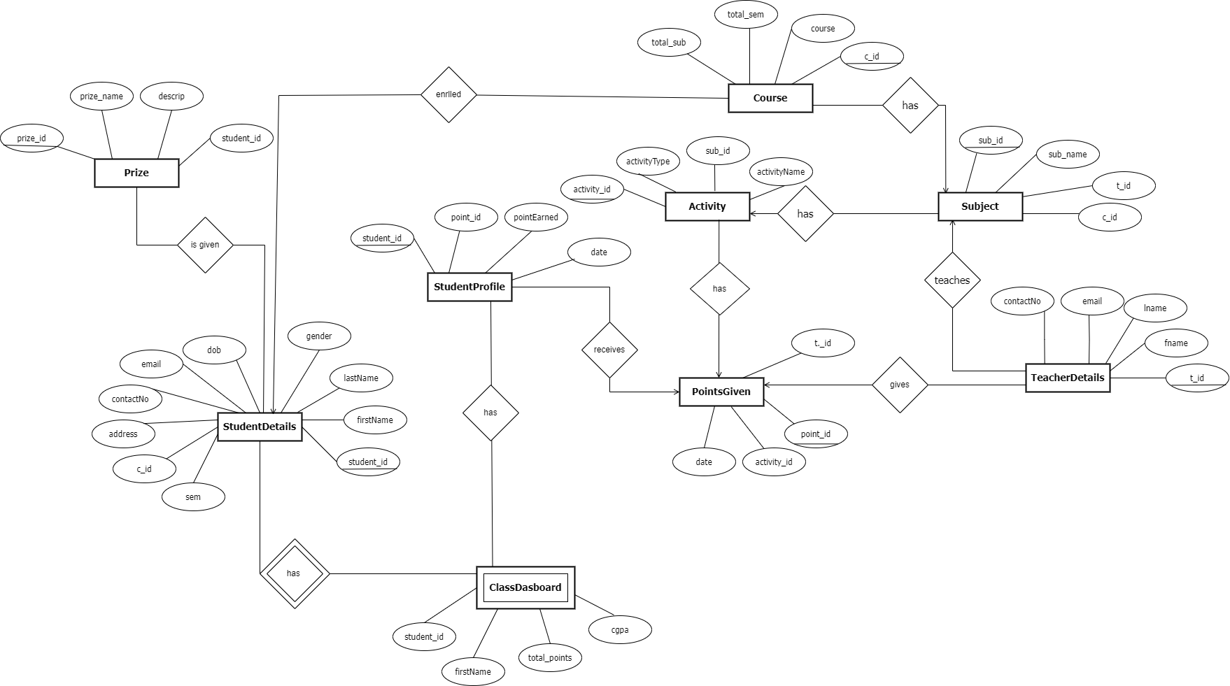
ER Diagram

Slide 7
Description of ER Diagram
Relation
Attribute
Entity
One
One
Many
Many
Many
One
One
Many

Slide 8
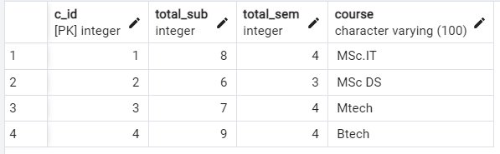
SQL Tables
Course Table

Slide 9
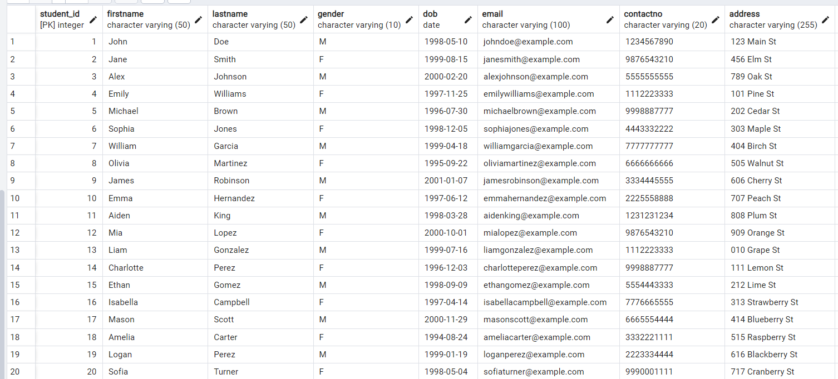
StudentDetails Table

Slide 10
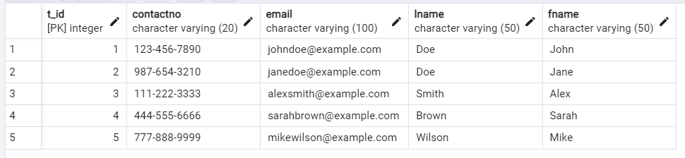
TeacherDetails Table

Slide 11
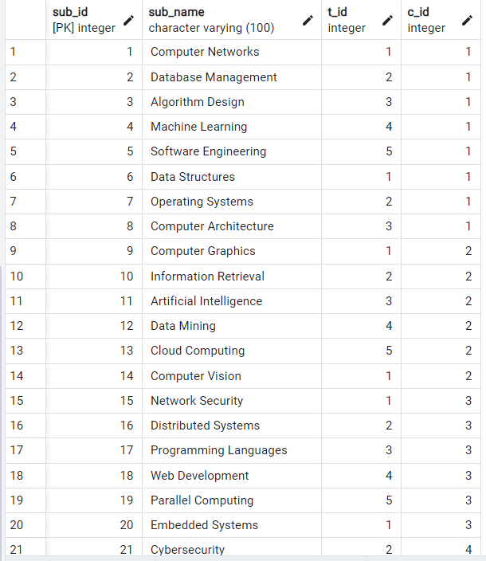
Subject Table

Slide 12
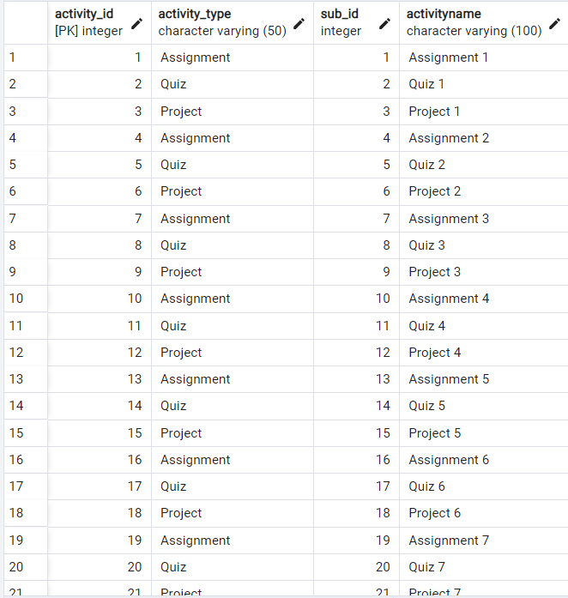
Activity Table

Slide 13
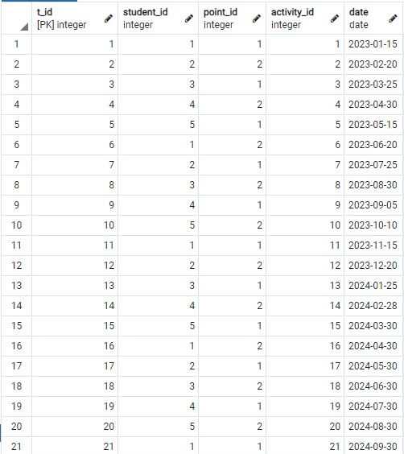
Pointsgiven Table

Slide 14
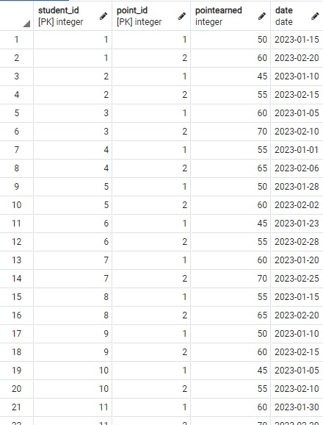
StudentProfile Table

Slide 15
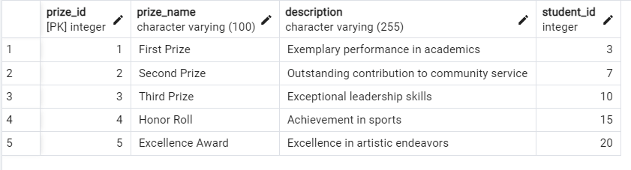
Prizes Table

Slide 16
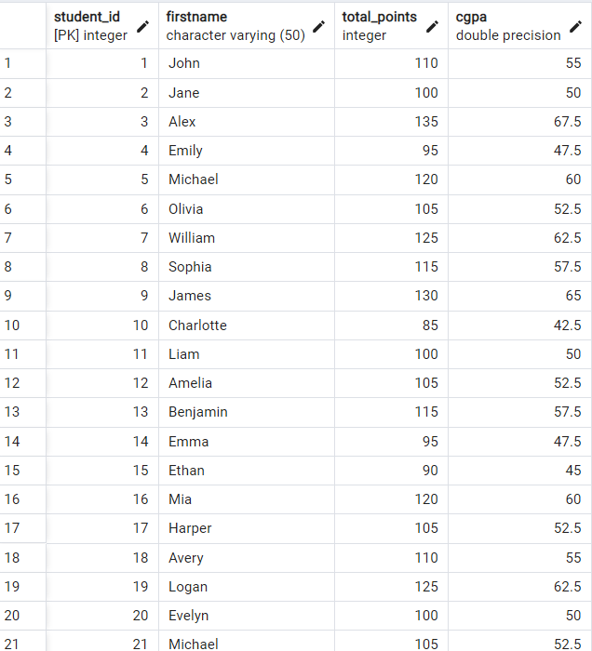
ClassDashborad Table

Slide 17
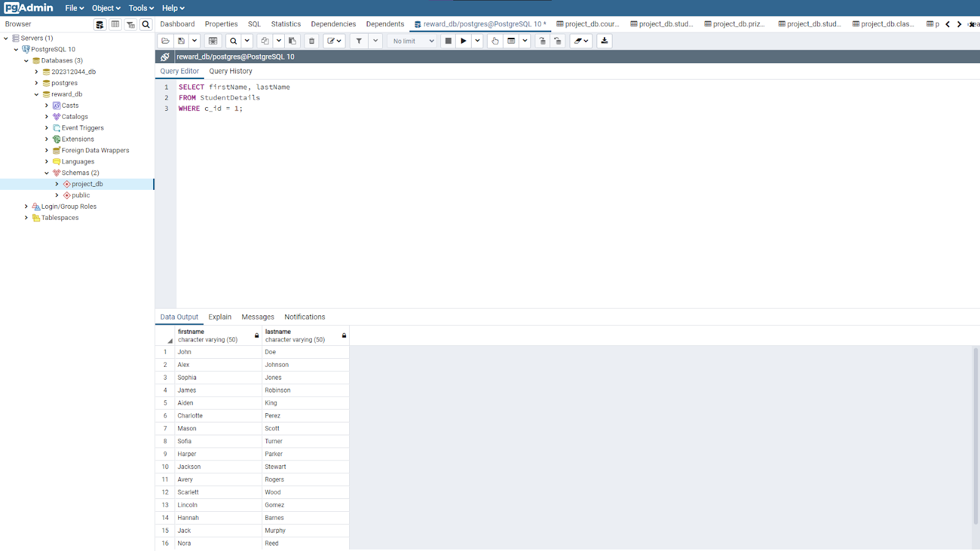
SQL & Relational Queries
1. List All Students in a Specific Course:
SELECT firstName, lastName
FROM StudentDetails
WHERE c_id = 1;
π firstName, lastName
(σ c_id=YourCourseID(StudentDetails))

Slide 18
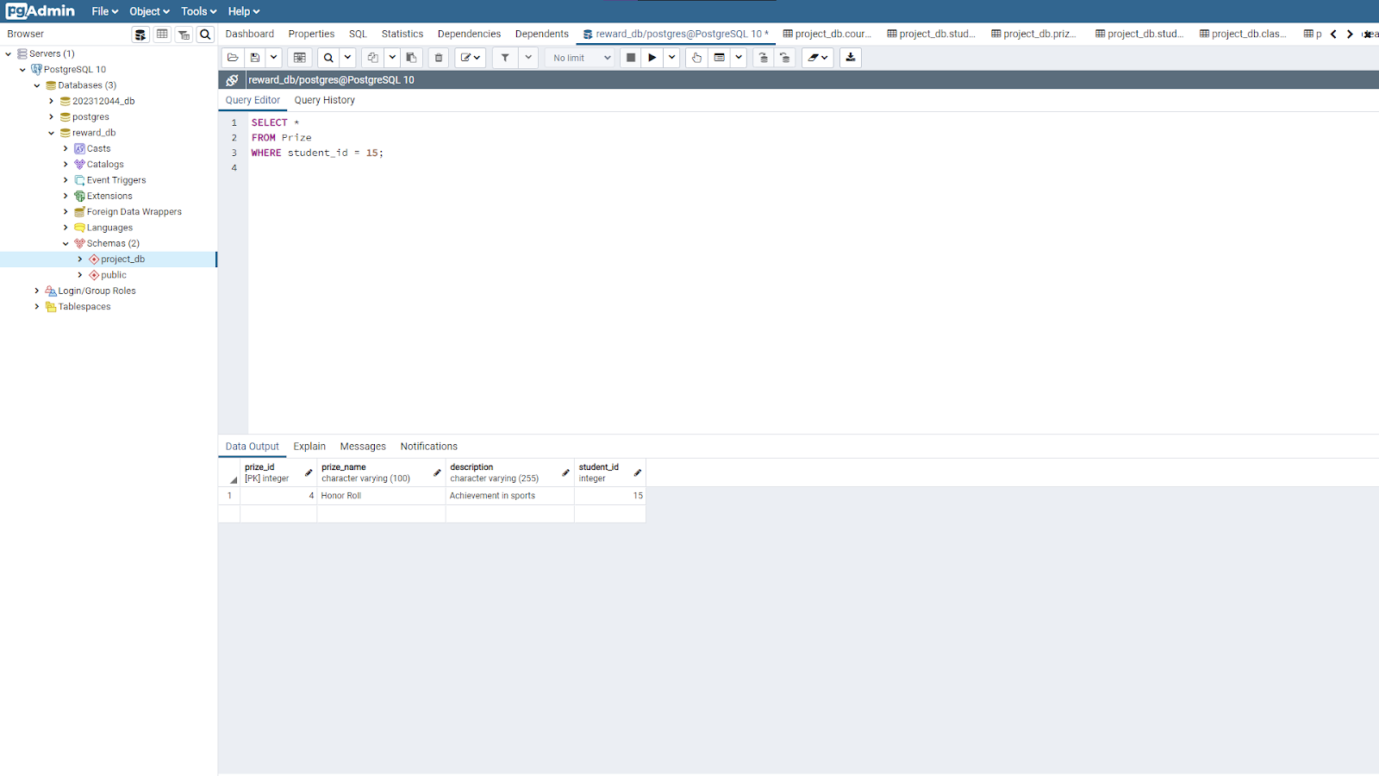
2. Retrieve Prize Information for a Given Student:
SELECT *
FROM Prize
WHERE student_id = 15;
σ student_id=YourStudentID(Prize)

Slide 19
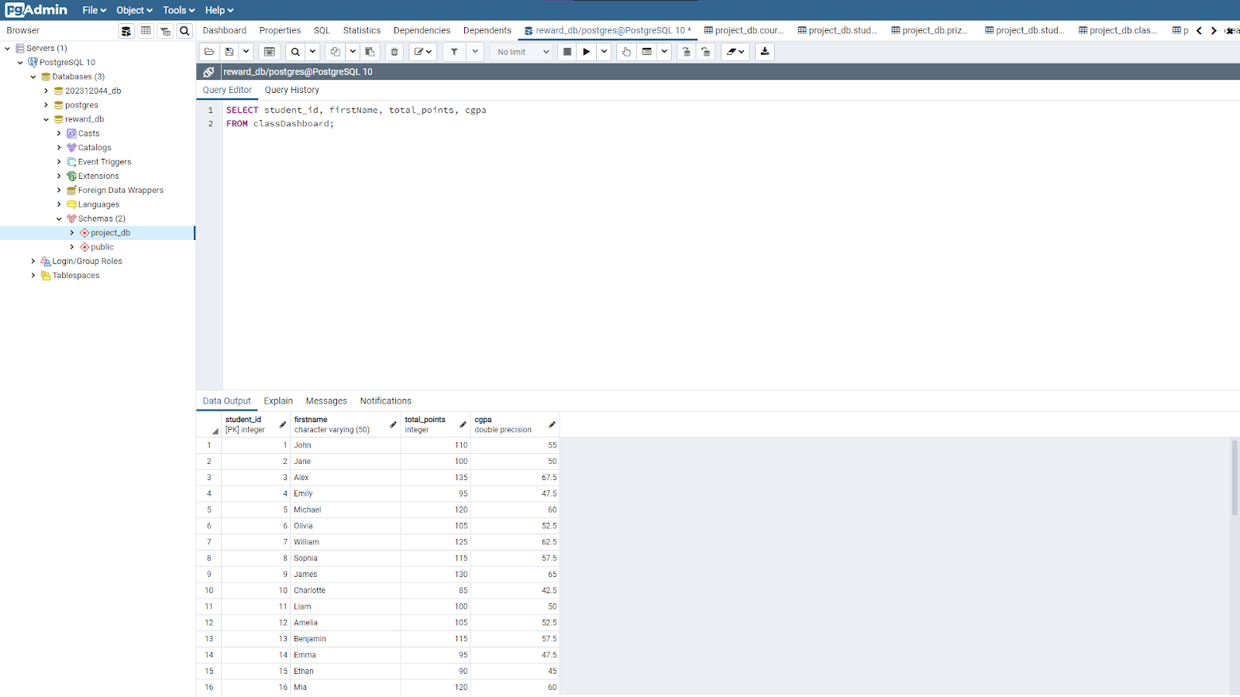
3. Get Total Points and CGPA for Each Student:
SELECT student_id, firstName, total_points, cgpa
FROM classDashboard
π firstName, lastName,
total_points, cgpa(classDashboard)

Slide 20
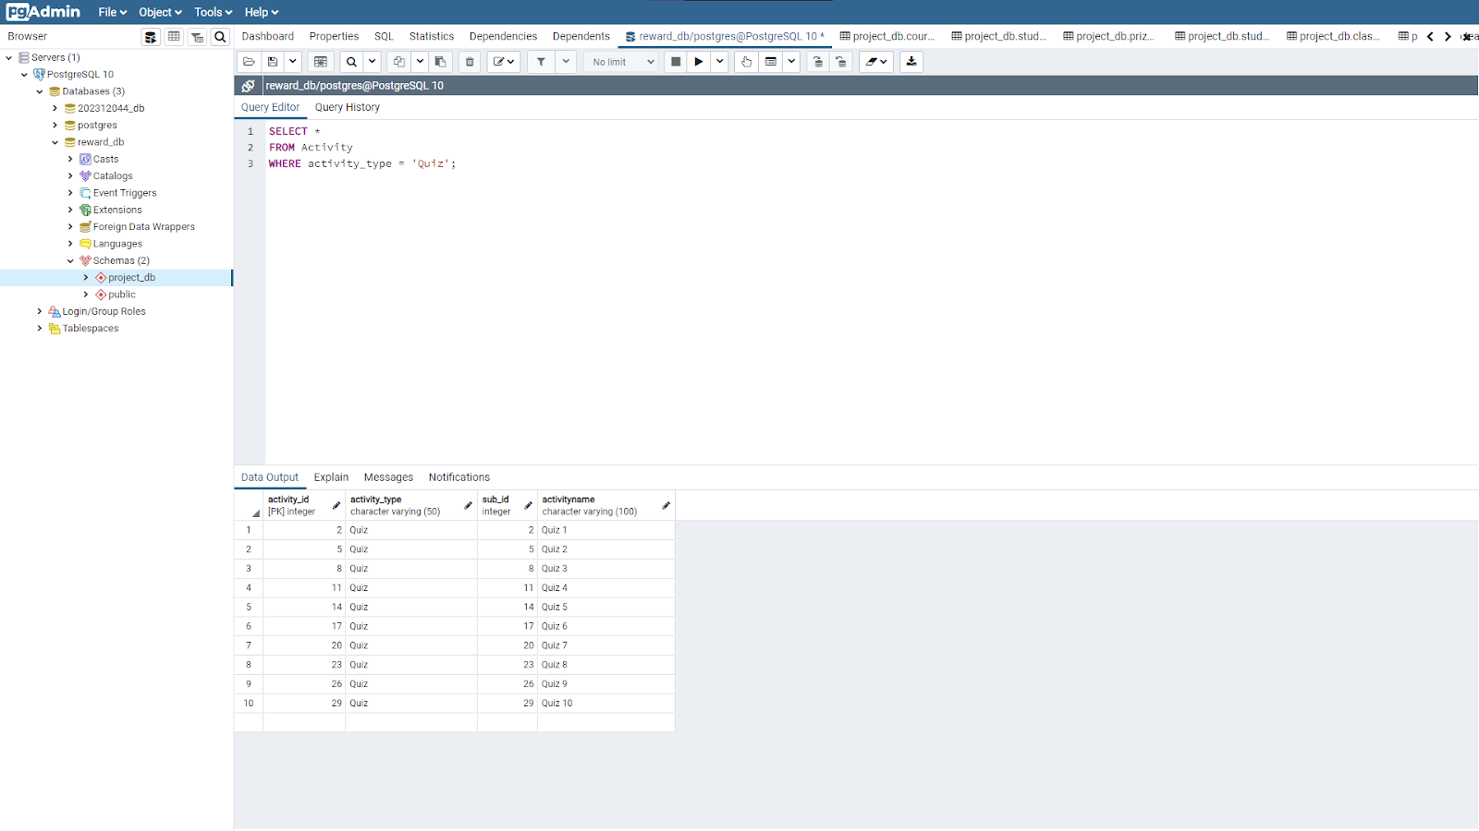
4. List All Activities of a Specific Type:
SELECT *
FROM Activity
WHERE activity_type = 'Quiz’;
σ activity_type= ′YourActivityType ′(Activity)

Slide 21
5. Find Subjects Taught by a Specific Teacher:
SELECT sub_name
FROM Subject
WHERE t_id = 2;
π sub_name(σ t_id=YourTeacherID(Subject))

Slide 22
Complex SQL & Relational Queries
1. Retrieve the Top 3 Students with the Highest CGPA in Each Course: SELECT c.course, cd.student_id, cd.firstName, cd.cgpa
FROM classDashboard cd
JOIN course c ON cd.student_id = c.c_id
WHERE cd.cgpa IN (
SELECT cgpa
FROM classDashboard
WHERE c_id = cd.student_id
ORDER BY cgpa DESC
) LIMIT 3;
π{course, firstName, lastName, cgpa}(σ{rank <= 3}(γ{course, firstName, lastName, cgpa, RANK() OVER (PARTITION BY c_id ORDER BY cgpa DESC) as rank}classDashboard ⨝_{student_id = c_id} course)))

Slide 23
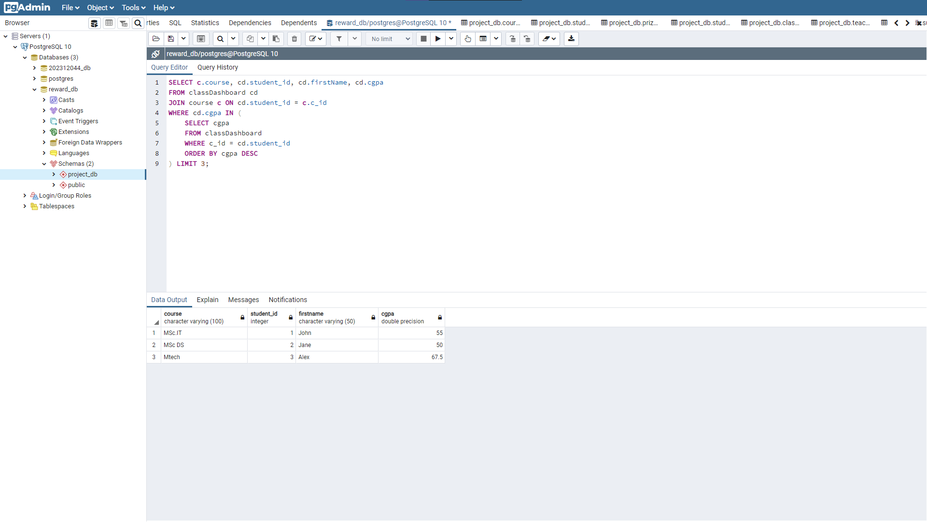

Slide 24
2. Find Students Who Have Won Prizes in All Activity Types:
SELECT sd.firstName, sd.lastName
FROM StudentDetails sd
WHERE NOT EXISTS (
SELECT at.activity_type
FROM Activity at
WHERE NOT EXISTS (
SELECT p.prize_id
FROM Prize p
JOIN StudentProfile sp ON p.student_id = sp.Student_id
JOIN PointsGiven pg ON sp.point_id = pg.point_id
WHERE sp.Student_id = sd.student_id AND at.activity_id = pg.activity_id
)
);
π{firstName, lastName}(σ{NOT EXISTS (π{activity_type}(Activity) - π{activity_type}( π{activity_type}(π{activity_type, p.student_id, sp.Student_id, at.activity_id}( Prize ⨝{p.student_id = sp.Student_id} StudentProfile ⨝_{sp.point_id = pg.point_id} PointsGiven ⨝{at.activity_id = pg.activity_id} Activity ) ) ) )}(StudentDetails sd))

Slide 25
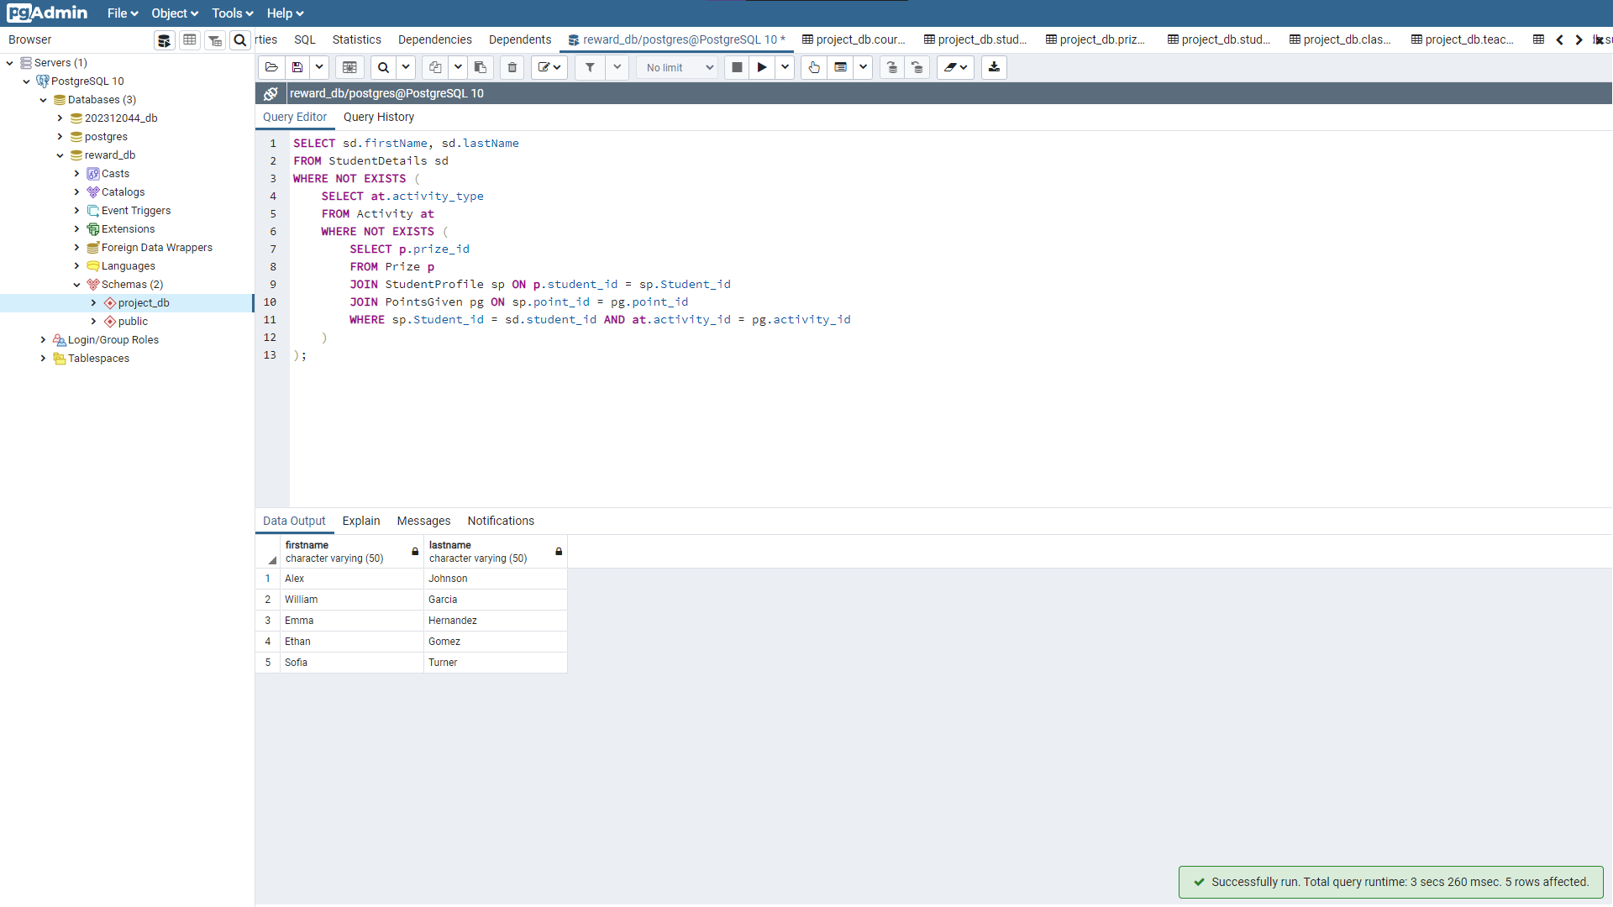

Slide 26
3. Calculate Average Points Earned per Activity Type:
SELECT at.activity_type, ROUND(AVG(sp.pointEarned), 2) as avg_points
FROM Activity at
JOIN PointsGiven pg ON at.activity_id = pg.activity_id
JOIN StudentProfile sp ON pg.point_id = sp.point_id
GROUP BY at.activity_type;
π{activity_type, AVG(pointEarned) as avg_points}(Activity ⨝{activity_id = pg.activity_id} PointsGiven ⨝{point_id = sp.point_id} StudentProfile)

Slide 27
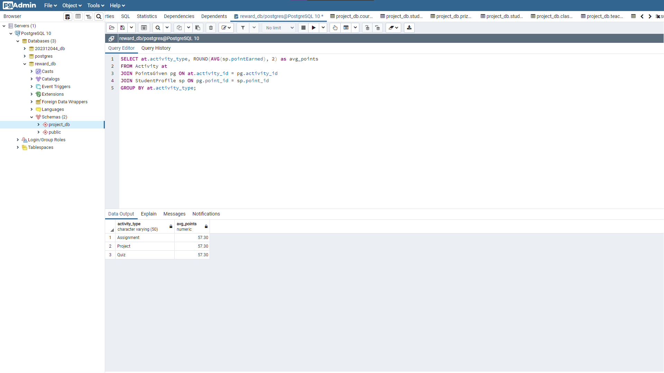

Slide 28
4. List Courses with the Highest Average CGPA:
SELECT c.course, AVG(cd.cgpa) as avg_cgpa
FROM classDashboard cd
JOIN course c ON cd.student_id = c.c_id
GROUP BY c.course
ORDER BY avg_cgpa DESC;
π{course, AVG(cgpa) as avg_cgpa}(classDashboard ⨝{c_id = course} course⨝{course} γ{course, AVG(cgpa) as avg_cgpa}(classDashboard))

Slide 29
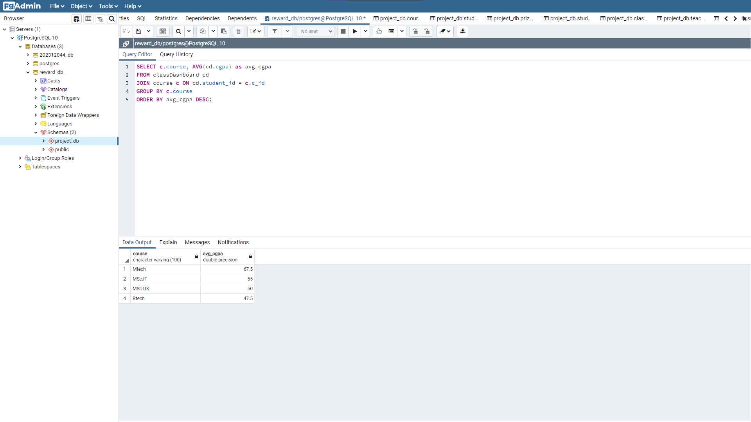

Slide 30
5. Identify Students Who Have Earned Points in All Subjects: SELECT sd.firstName, sd.lastName
FROM StudentDetails sd
WHERE NOT EXISTS (
SELECT s.sub_id
FROM Subject s
WHERE NOT EXISTS (
SELECT pg.point_id
FROM PointsGiven pg
JOIN StudentProfile sp ON pg.point_id = sp.point_id
JOIN Activity a ON pg.activity_id = a.activity_id
WHERE sp.Student_id = sd.student_id AND s.sub_id = a.sub_id
)
);
π{firstName, lastName}(σ{NOT EXISTS (π{sub_id}(Subject) - π{sub_id}(π{sub_id}(π{sub_id, pg.point_id, sp.Student_id, a.sub_id}(PointsGiven ⨝_{pg.point_id = sp.point_id} StudentProfile ⨝_{activity_id = a.activity_id} Activity))))}(StudentDetails sd))

Slide 31
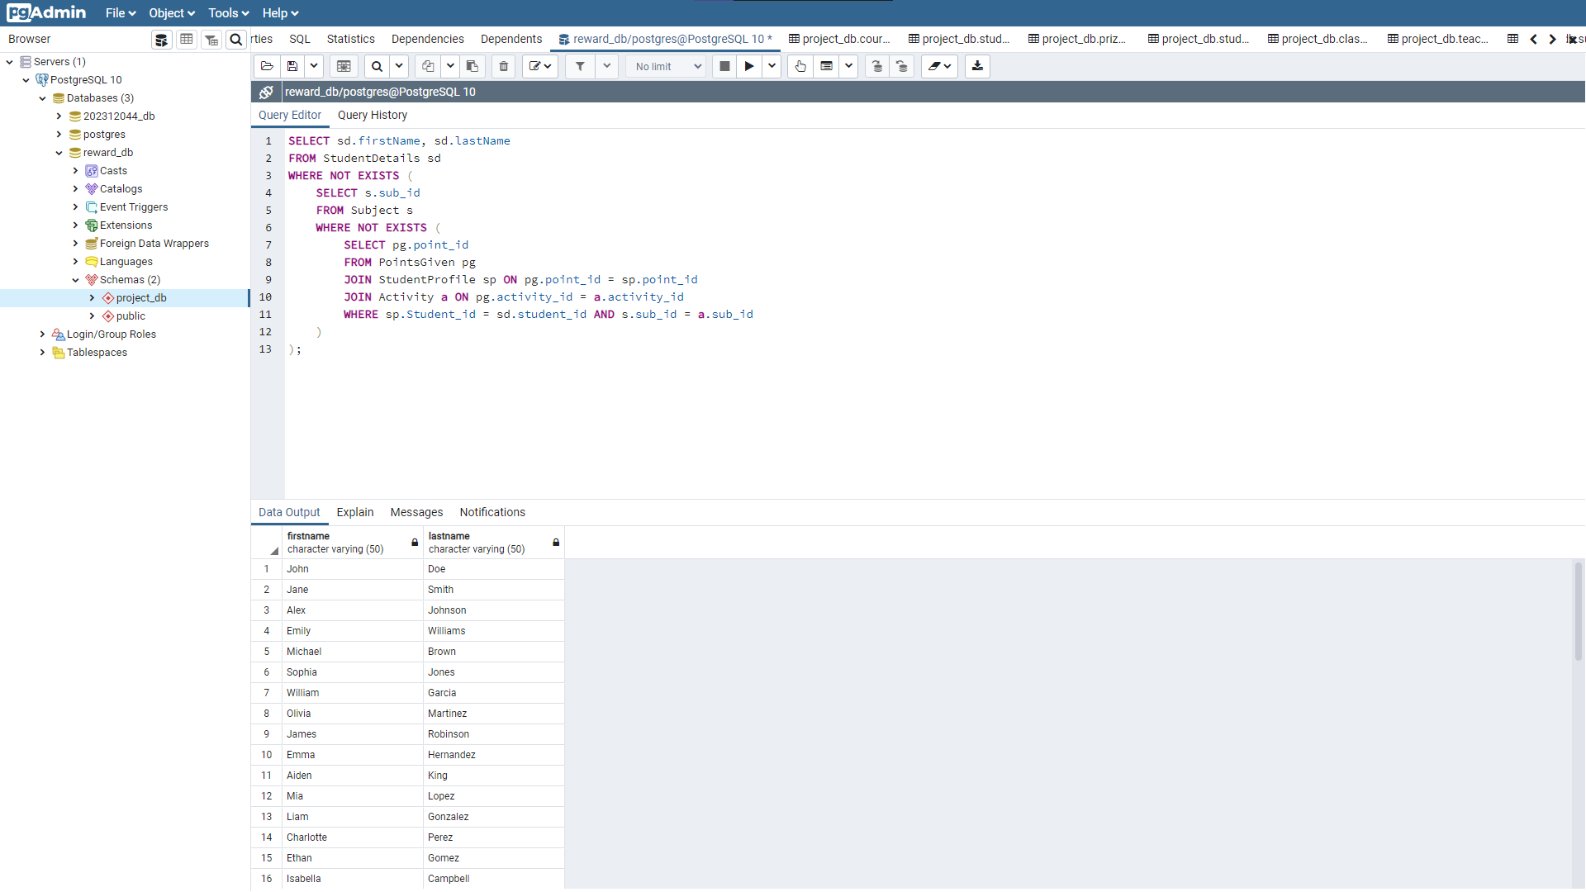

Slide 32
Contribution
DATABASE CREATION AND INSERTION:
Modi Krupesh Pravinkumar
Memon Abdullah Munafhusain
SQL QUERY AND RELATIONAL ALGEBRA:
Vaghasiya Parth Mukeshbhai
Garala Devarsh Rameshchandra
E-R DIAGRAM:
Shah Kashish Ashishkumar
PPT:
Shah Kashish Ashishkumar
Vaghasiya Parth Mukeshbhai

