Slide 1
Components in Convas App
How do you add a Component in a Canvas App?
How do components work together (access data, form submission, etc)?

Slide 2
Components in Convas App
Components in PowerApps
PowerApps is a powerful tool for creating fast prototypes, and small business apps. It offers two types of Components:
built-in components that are useful but often require a lot of configuration if you want more than just the default functions and style.
Custom Components lets you create your own components depending on your need.

Slide 3
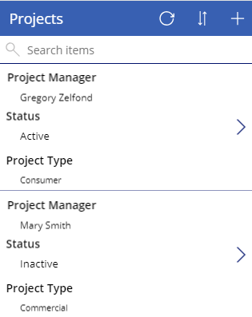
Components in Convas App
1. Screen
is a way to visualize a particular data set
or record
2. GALLERY
A gallery is a way of visualizing data in the app.
It is a template of screens that allows you
to see and navigate the data

Slide 4
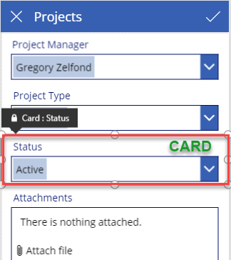
Components in Convas App
3.card
A card is an area on the screen that shows
a given record from your SharePoint list
or any other database you used to build an app
or any other database you used to build an app.
A card would contain all various attributes called Controls
related to the display of the record.
Drop-Down control to enter Status as well as a label called “Status”

Slide 5
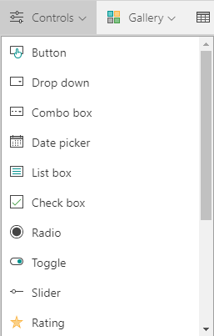
Components in Convas App
4. CONTROL
A controls is what allows you to visualize
and interact with your records
Depending on the type of your field,
you can have different types of controls
(drop-down, radio button, or toggle switch)

Slide 6
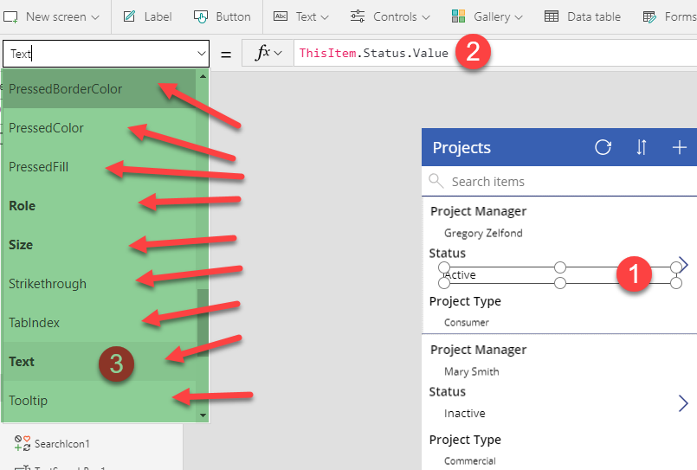
Components in Convas App
5. PROPERTY
Each control has properties
(font size, text color, text box fill color and so on)
. Properties can be accessed and changed
from the Properties drop-down on the left-hand-side
of the screen as well as on the panel on the right-hand-side
once the property is selected.

Slide 7
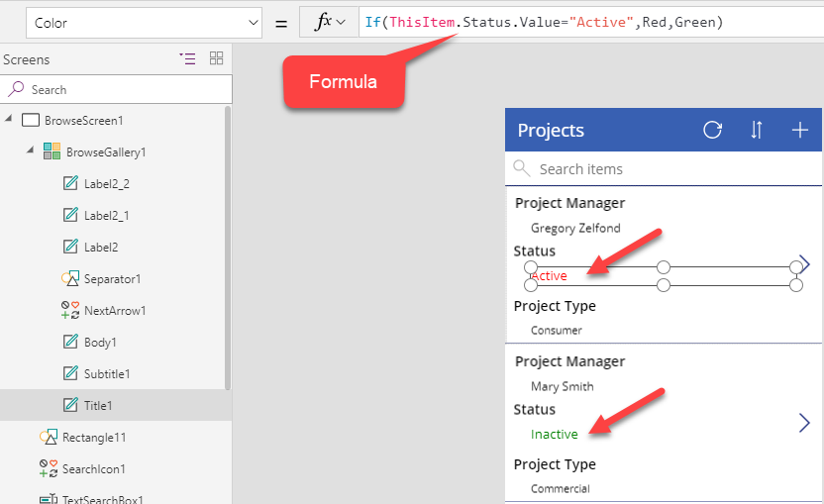
Components in Convas App
6. FUNCTION
Functions is how
you interact with and
change the properties

Slide 8
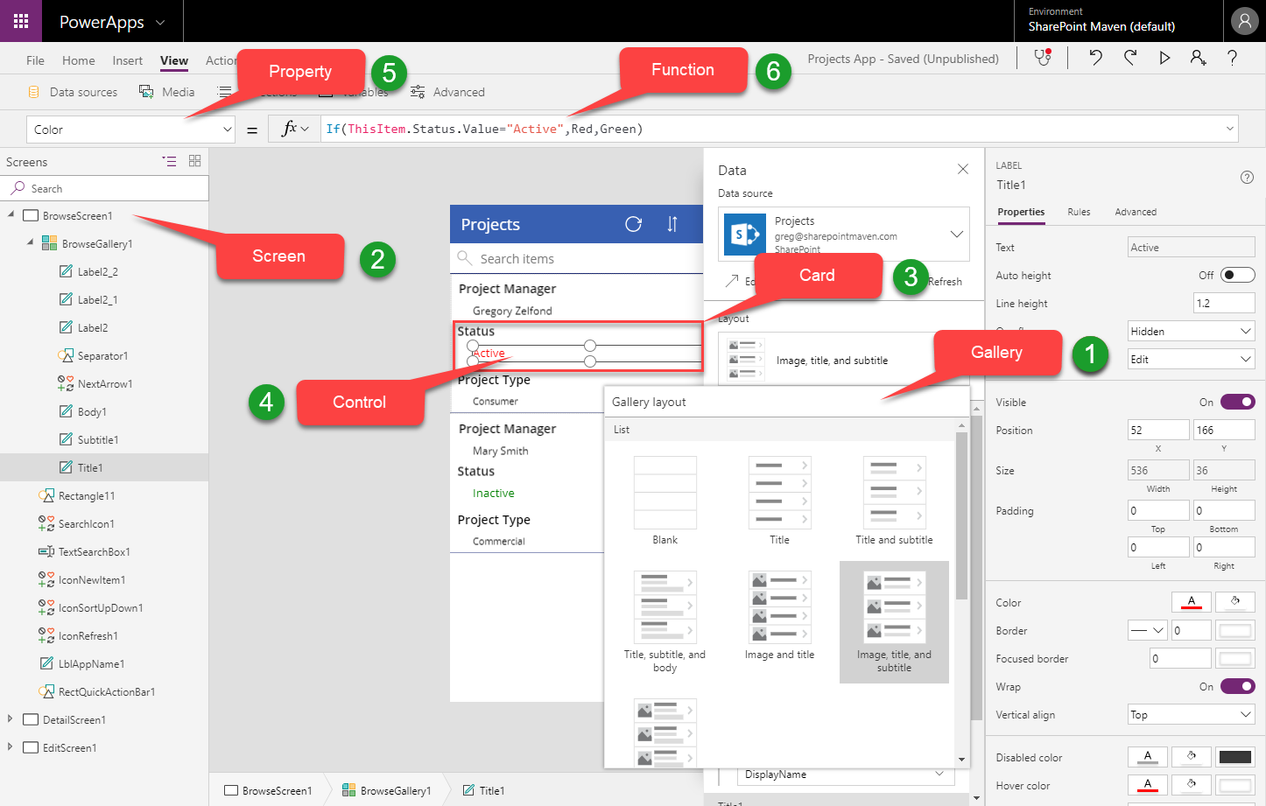
Components in Convas App

Slide 9
Components in Convas App
Custom Components in PowerApps
are useful in building larger apps that have similar control patterns.
let you create your own reusable components
can be exported and imported to different projects,
make maintenance a lot easier for developers.

Slide 10
Components in Convas App
Custom Components in PowerApps
If you update a component definition, all instances in the app reflect your changes.
You can also improve performance by using one or more components because you don’t copy and paste controls, which duplicates overhead.
Components are isolated instances that are decoupled from the app.
That is, custom component can’t access variables declared in the app unless they are parsed as properties into the component.

Slide 11
Components in Convas App
Source: Deepti Shukla/Revature/02/2022
https://docs.google.com/document/d/1IFFWVS2rpfyRojM-weMHqtRJhMjhdwHa7G2HKSmj0EY/edit

