Slide 1

JavaScript Functions
.net

Slide 2
JavaScript (JS) programming language conforms to the ECMAScript specification. JavaScript is a high-level language that is just-in-time compiled, has curly-bracket syntax, dynamic typing, prototype-based object-orientation, and first-class functions.
https://en.wikipedia.org/wiki/JavaScript

Slide 3
Create Sample .html and .js docs
<!DOCTYPE html>
<html lang="en">
<head>
<meta charset="UTF-8">
<meta name="viewport" content="width=device-width, initial-scale=1.0">
<meta http-equiv="X-UA-Compatible" content="ie=edge"> <title>JS Example Document</title> </head>
<body>
<script src="functions.js"></script> </body>
</html>
Create a .html document and create the HTML template inside (use ‘doc’ shortcut).
This can be used to experiment with the examples in the presentation.
The .js file and the .html file should be in the same folder.

Slide 4
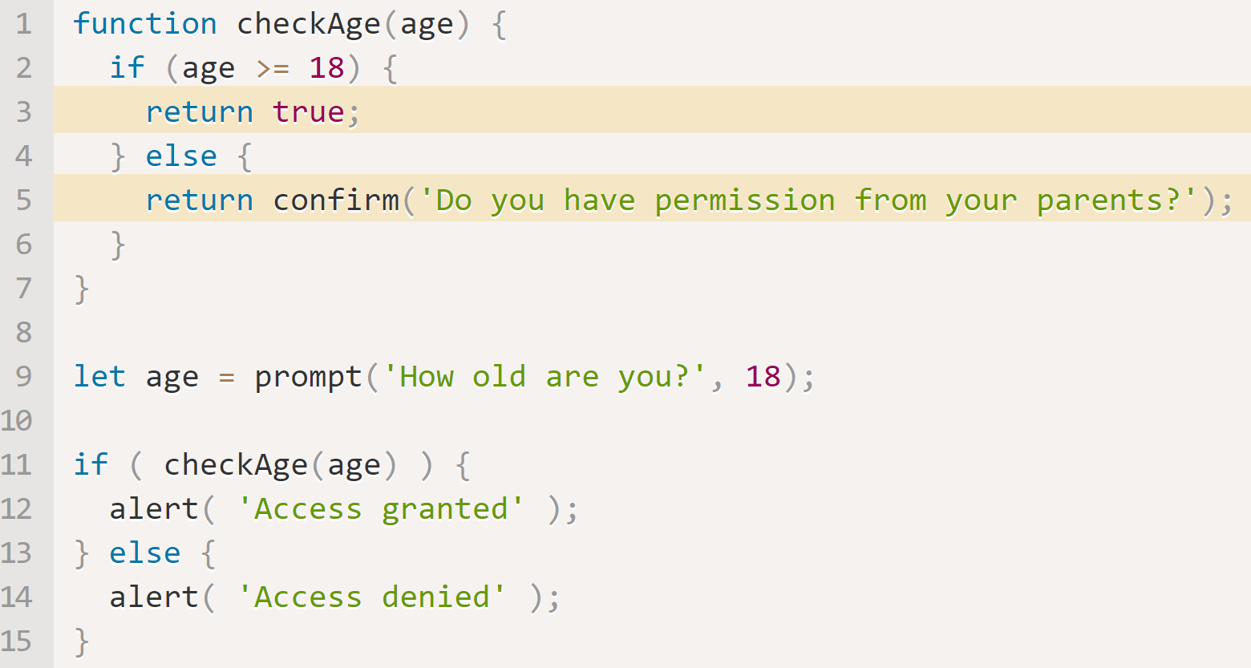
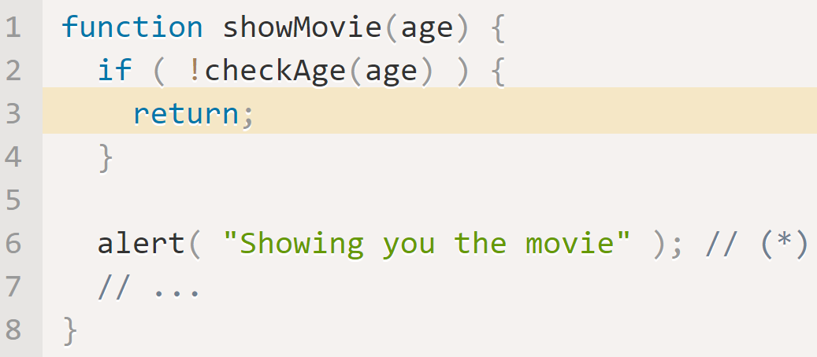
JavaScript – Functions https://javascript.info/function-basics
A function can return a value at any point using return;.
It can also return; without a value.
JS assumes a ; after the keyword return. Never place return data on a separate line.

Slide 5
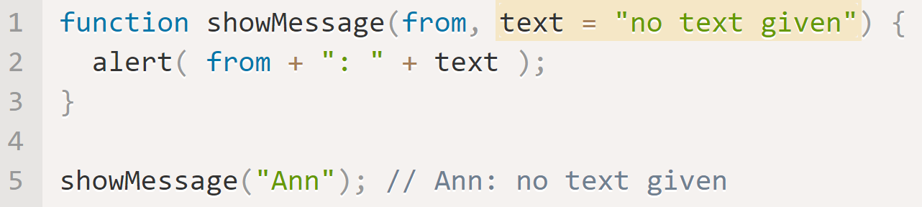
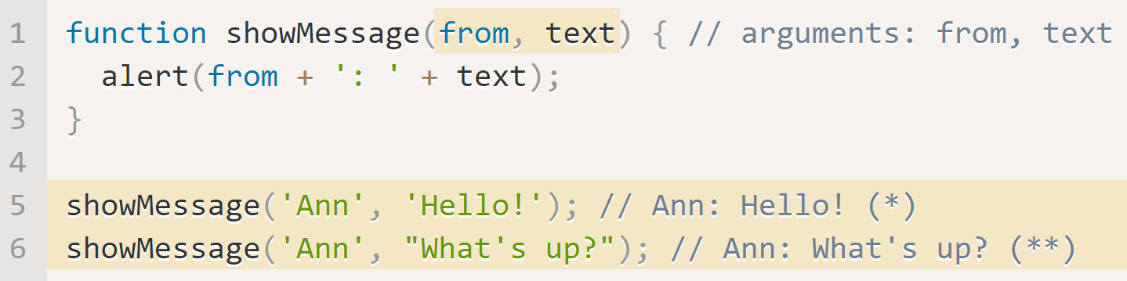
Function Declarations https://javascript.info/function-basics
JS functions can declare variables inside the function scope.
If a functions’ local variable has the same name as a variable outside the function, the local variable shadows the outer variable.
Primitives are passed by value in JS.
Objects are passed by reference.
A function with multiple parameters can be called with fewer arguments than parameters. The unused parameters are shown as undefined.
A parameter can be given a default value.

Slide 6
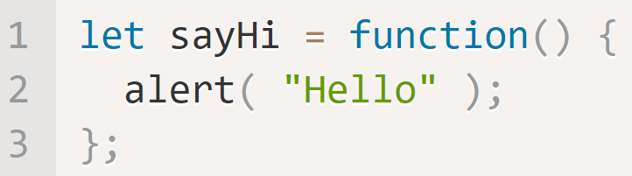
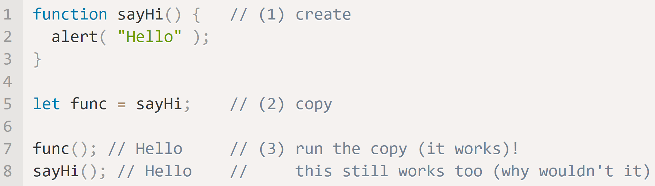
JavaScript – Function Expressions https://javascript.info/function-expressions
In JavaScript, a function is considered a value. Figure 1 shows a function expression.
It’s called sayHi(). It is considered a value. This means the whole function can also be passed to other functions as a callback function.
A Function Expression is created when program execution reaches its declaration. It is usable only from that moment onward.
Figure 1
This Function Declaration:
creates the function called sayHi.
Stores sayHi() in a variable, func.
Now the function can be invoked as both sayHi() and func().
*If there were parentheses after sayHi, func = sayHi() would write the result of the call sayHi() into func.

Slide 7
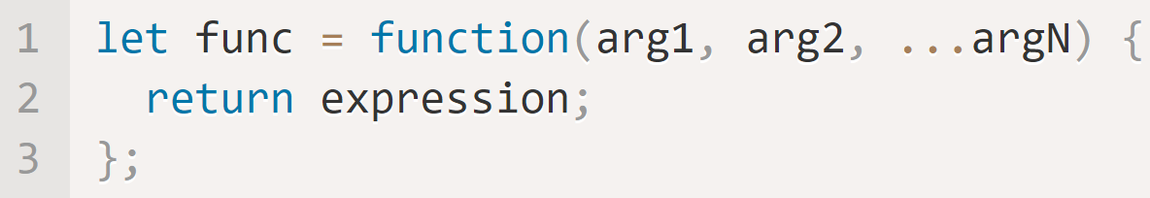
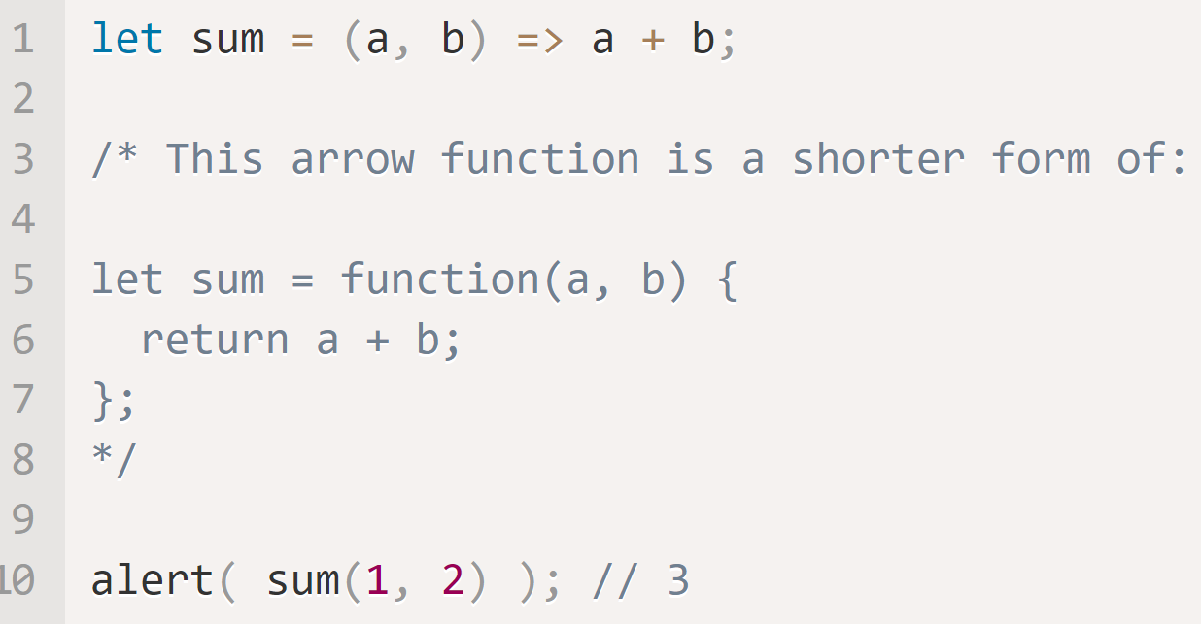
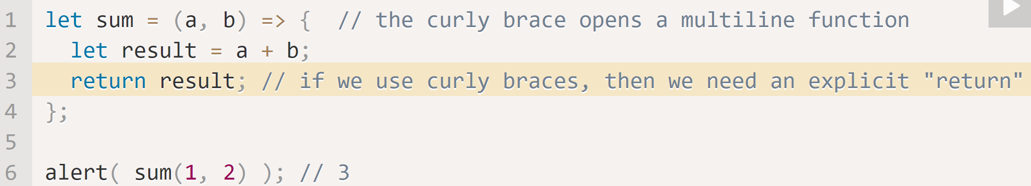
Arrow Functions https://javascript.info/arrow-functions-basics
Arrow Syntax is a simple and concise syntax for creating functions. Both the below expressions create a function that accepts multiple arguments. They both evaluate the expression and return its result into func.
Is the same as…
This function accepts two arguments: a, b. It returns the result of a + b.
With one argument, ( ) are not required. With zero arguments empty ( ) are required.

Slide 8
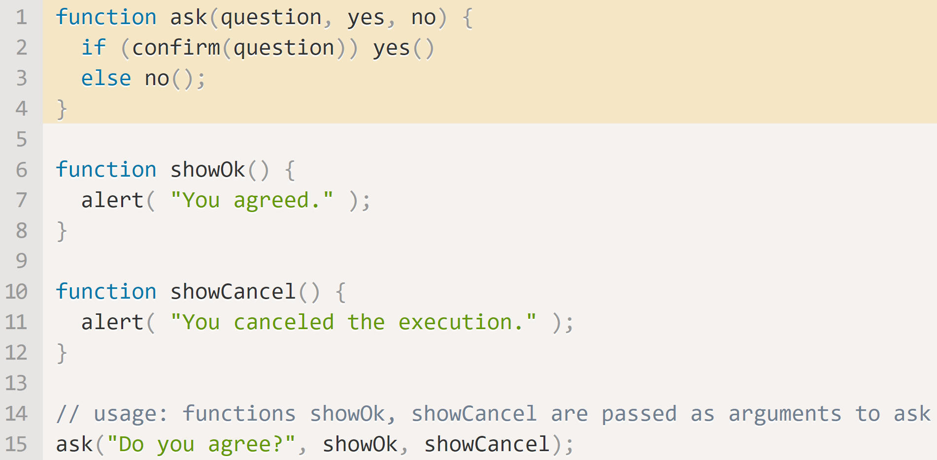
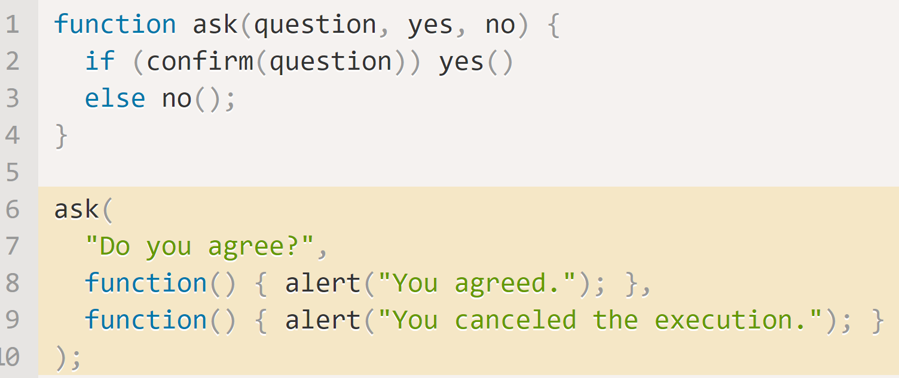
JavaScript – Callback Functions https://javascript.info/function-expressions#callback-functions https://gist.github.com/ericelliott/414be9be82128443f6df
A function passed as a value is a Callback Function. On line 15, the arguments showOk and showCancel of the call to ask() are callback functions.
A function passed can be “called back” later (if necessary). showOk() becomes the callback for a “yes” answer, and showCancel() for a “no” answer.
We can use Function Expressions when calling ask(). It is the same function, but much shorter.
These are called Anonymous Functions

Slide 9
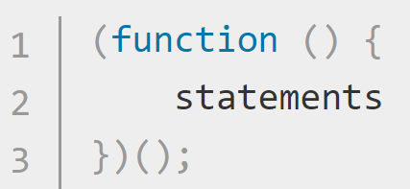
IIFE - Immediately Invoked Function Expression https://developer.mozilla.org/en-US/docs/Glossary/IIFE https://en.wikipedia.org/wiki/Immediately_invoked_function_expression
An Immediately Invoked Function Expression (IIFE, pronounced “iffy”) is a JavaScript function that runs as soon as it is defined. It’s also known as a Self-Executing Anonymous Function.
IIFE‘s contain two major parts:
The first is the anonymous function with lexical scope enclosed within the Grouping Operator (). This prevents accessing variables within the IIFE idiom as well as polluting the global scope.
The second part is another pair of (), which complete the statement. Now, the JavaScript engine will directly interpret the function.
(function() {
alert(‘I am NOT an IIFE.’);
});
(function() {
alert(‘NOW I am an IIFE!’);
})();
(() => alert(‘I am also an IIFE.’)();

Slide 10
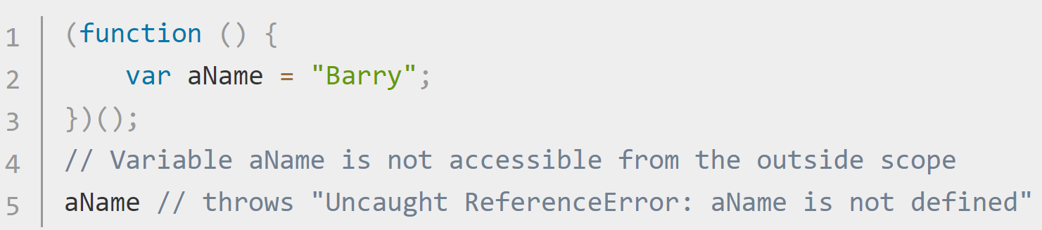
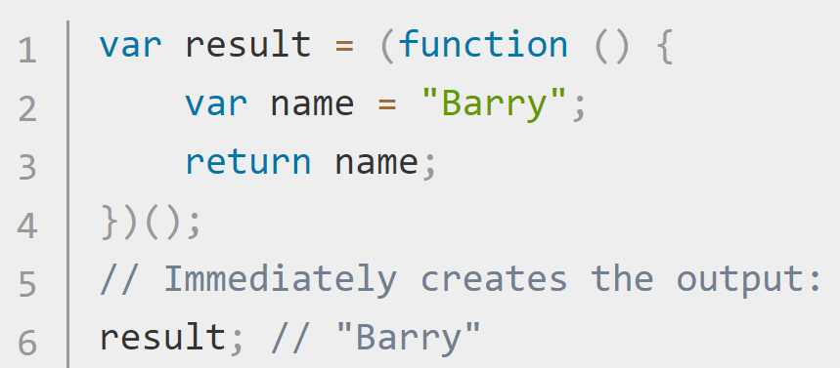
IIFE - Immediately Invoked Function Expression https://developer.mozilla.org/en-US/docs/Glossary/IIFE https://en.wikipedia.org/wiki/Immediately_invoked_function_expression
Any variable declared within an IIFE cannot be accessed from outside it.
Assigning an IIFE to a variable stores the function's return value, not the function definition itself.

Slide 11
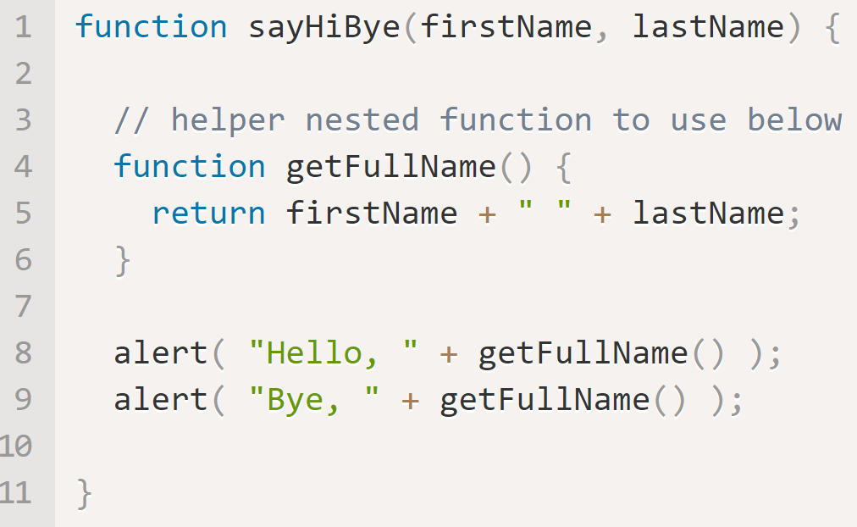
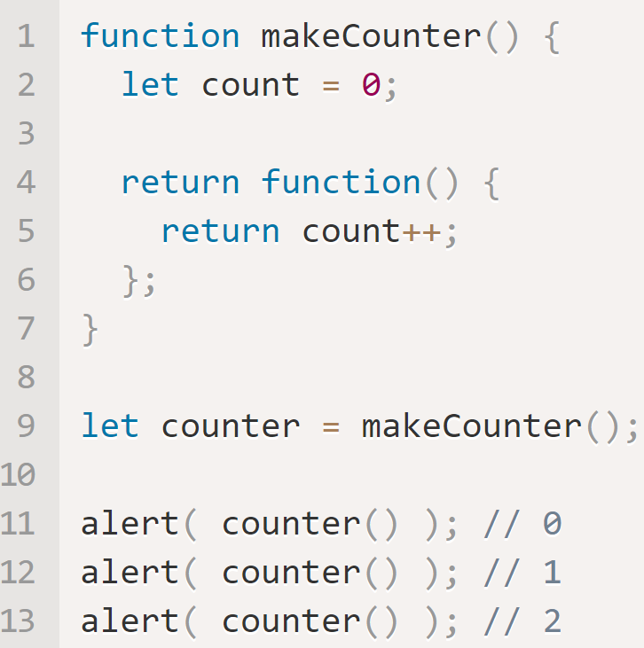
Scope with Nested Functions (and Closure) https://javascript.info/closure
If a variable is declared inside a code block, {...}, it’s only visible inside that block.
A nested function can access variables declared inside it’s code block and inside it’s parent code block.
A nested function can be returned (as a property of a new object or as a result by itself). It can then be used anywhere else, and it will still have access to the same outer variables.

Slide 12
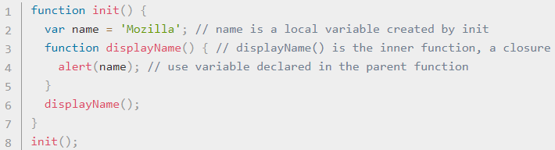
Scope and Closure https://developer.mozilla.org/en-US/docs/Web/JavaScript/Closures
A closure is a function enclosed with references to its surrounding state (the lexical environment). A closure gives access to an outer function’s scope from an inner function.
init() creates local variable (name) and a function, displayName(). displayName() is an inner function defined inside init(). displayName() is available only within the body of init(). displayName() has no local variables.
Because inner functions have access to outer function variables, displayName() accesses the name variable declared in its parent function, init(). This is Lexical Scoping.

Slide 13
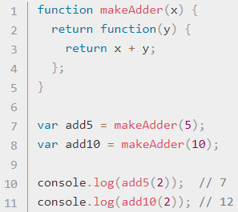
Scope and Closure Example https://developer.mozilla.org/en-US/docs/Web/JavaScript/Closures
makeAdder() takes a single argument, x, and returns a function.
The returned function takes a single argument y and returns (x + y).
add5 and add10 are both closures. They are the function returned by makeAdder() but store different lexical environments.
In add5’s lexical environment, x is 5, while in add10’s, x is 10. When add5 and add10 are invoked, they still have access to the parameter x from makeAdder();

Slide 14
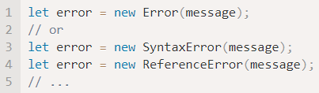
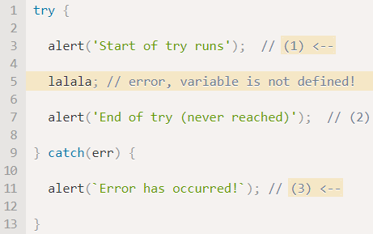
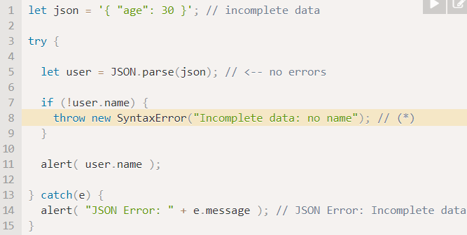
Try/Catch/Finally https://javascript.info/try-catch#the-try-catch-syntax
The JS Try/Catch block works similarly to the C# Try/Catch Block. There is only one ‘error’ object generated. The ‘error’ object has three parts
Name – the Error Name, Like “Reference Error”.
Message – a text message with error details
Stack – a stack trace of the calls that led to the error.
JavaScript has many built-in, standard errors: Error, SyntaxError, ReferenceError, TypeError, and others.
The Finally Block always executes.

Slide 15
Web Storage API https://developer.mozilla.org/en-US/docs/Web/API/Web_Storage_API/Using_the_Web_Storage_API
The Web Storage API provides mechanisms by which browsers can securely store key/value pairs. Storage objects are simple key-value stores, but they stay persist through page loads. The keys and the values are always stored as strings (even Numbers).
The two types of Web Storage are:
sessionStorage - maintains a separate storage area for each given origin that's available for the duration of the page session (as long as the browser is open, including page reloads and restores).
localStorage – same as sessionStorage, but also persists even when the browser is closed and reopened.
The commands to interact with either Storage object are the same. To store an object in the either storage, you do not have to use json.stringify(). You must use json.parse() to access the object using dot notation.

Slide 16
localStorage vs sessionStorage https://blog.logrocket.com/localstorage-javascript-complete-guide/#sessionstoragevslocalstorage https://developer.mozilla.org/en-US/docs/Web/API/Window/localStorage
TODO..
Feature | command
 | .setItem('myCat', 'Tom');
 | const cat = localStorage.getItem('myCat');
 | .removeItem('myCat');
 | .clear();

Slide 17
sessionStorage https://blog.logrocket.com/localstorage-javascript-complete-guide/#sessionstoragevslocalstorage https://developer.mozilla.org/en-US/docs/Web/API/Window/sessionStorage
TODO.. If needed

