Slide 1

Serialization
.net

Slide 2
Serialization is the process of converting an object into a stream of bytes(1010101110) for storage or transfer. Serialization saves the state of an object so that it can be recreated later. The reverse process is called deserialization.
https://docs.microsoft.com/en-us/dotnet/csharp/programming-guide/concepts/serialization/

Slide 3
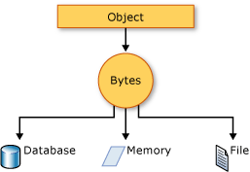
Serialization – Uses https://docs.microsoft.com/en-us/dotnet/csharp/programming-guide/concepts/serialization/#uses-for-serialization
Serialization allows you to save and then recreate the state of an object. This allows storage of objects as well as data exchange. Serialization is useful when:
Sending the object to a remote application by using a web service
Passing an object from one domain to another
Passing an object through a firewall as a JSON or XML string
Maintaining security or user-specific information across applications

Slide 4
JSON - JavaScript Object Notation https://docs.microsoft.com/en-us/dotnet/csharp/programming-guide/concepts/serialization/#json-serialization
JSON is a popular type of serialization provided in .NET by the System.Text.Json namespace.
All public properties are serialized and you can specify which properties to exclude.
JSON is by default ‘minified’, but you can ‘pretty-print’ it.
Casing of JSON names matches the .NET model names. You can customize JSON name casing.
Circular references are detected and exceptions thrown.
Fields are excluded.

Slide 5

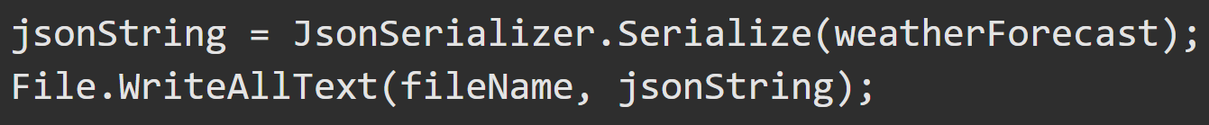
JSON – How-To https://docs.microsoft.com/en-us/dotnet/csharp/programming-guide/concepts/serialization/#json-serialization https://docs.microsoft.com/en-us/dotnet/standard/serialization/system-text-json-how-to
The System.Text.Json namespace contains classes for JSON serialization and deserialization.
JSON Serialization serializes the public properties of an object into a string, byte array, or stream that conforms to the RFC 8259 JSON specification. To control the way JsonSerializer serializes or deserializes an instance of the class:
Use a JsonSerializerOptions object
Apply attributes from the System.Text.Json.Serialization namespace to classes or properties

Slide 6
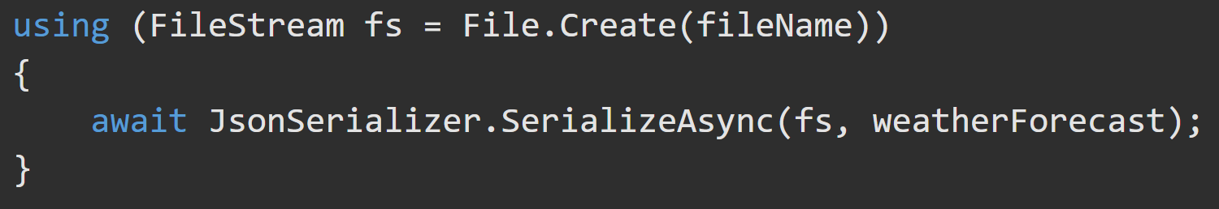
JSON - Serialize Asynchronously https://docs.microsoft.com/en-us/dotnet/csharp/programming-guide/concepts/serialization/#json-serialization https://docs.microsoft.com/en-us/dotnet/standard/serialization/system-text-json-how-to
Use the await keyword and the async version of the method.

Slide 7
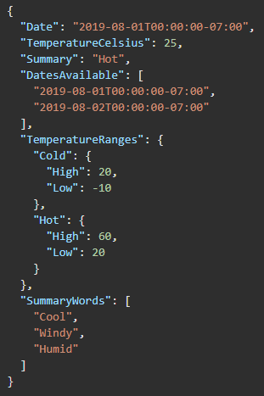
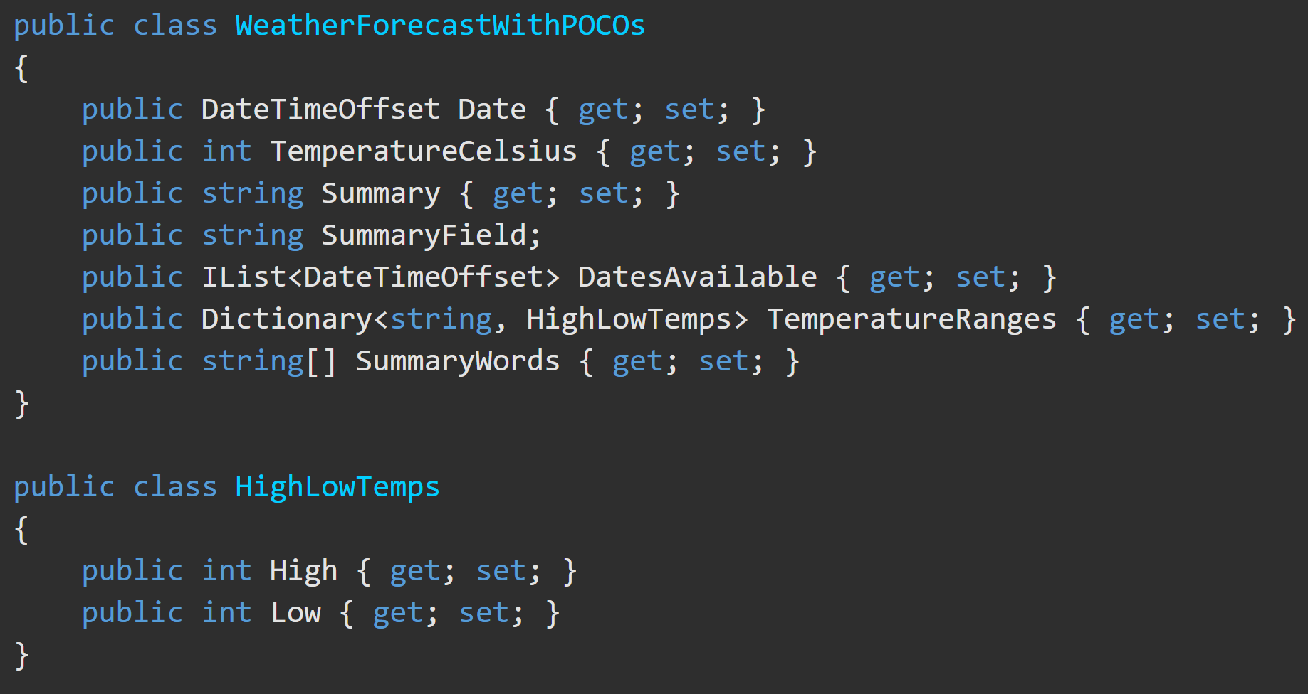
JSON - Serialization https://docs.microsoft.com/en-us/dotnet/csharp/programming-guide/concepts/serialization/#json-serialization https://docs.microsoft.com/en-us/dotnet/standard/serialization/system-text-json-how-to
The JSON output from serializing the (below) class looks like the this.
You can “prettyPrint” JSON by setting the JsonSerializerOptions.WriteIndented to true
*JSON output is minified by default.

Slide 8
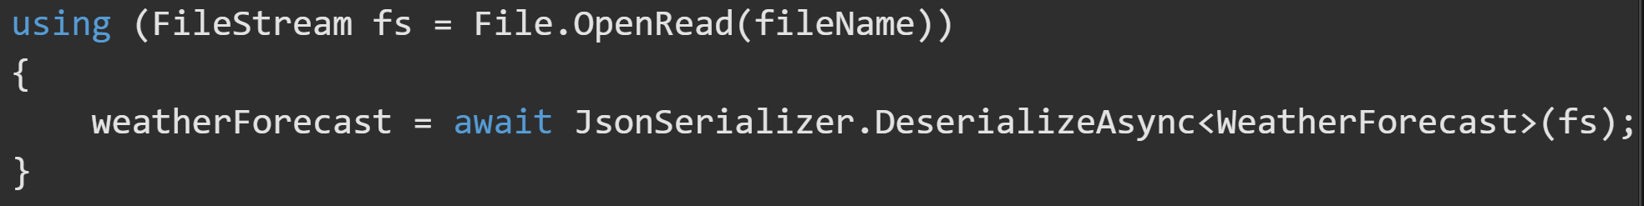
JSON – Deserialization (Sync and Async) https://docs.microsoft.com/en-us/dotnet/standard/serialization/system-text-json-how-to
Deserialize from a file by using synchronous code. Read the file into a string.
To deserialize from a file by using asynchronous code. Call the DeserializeAsync method.

Slide 9
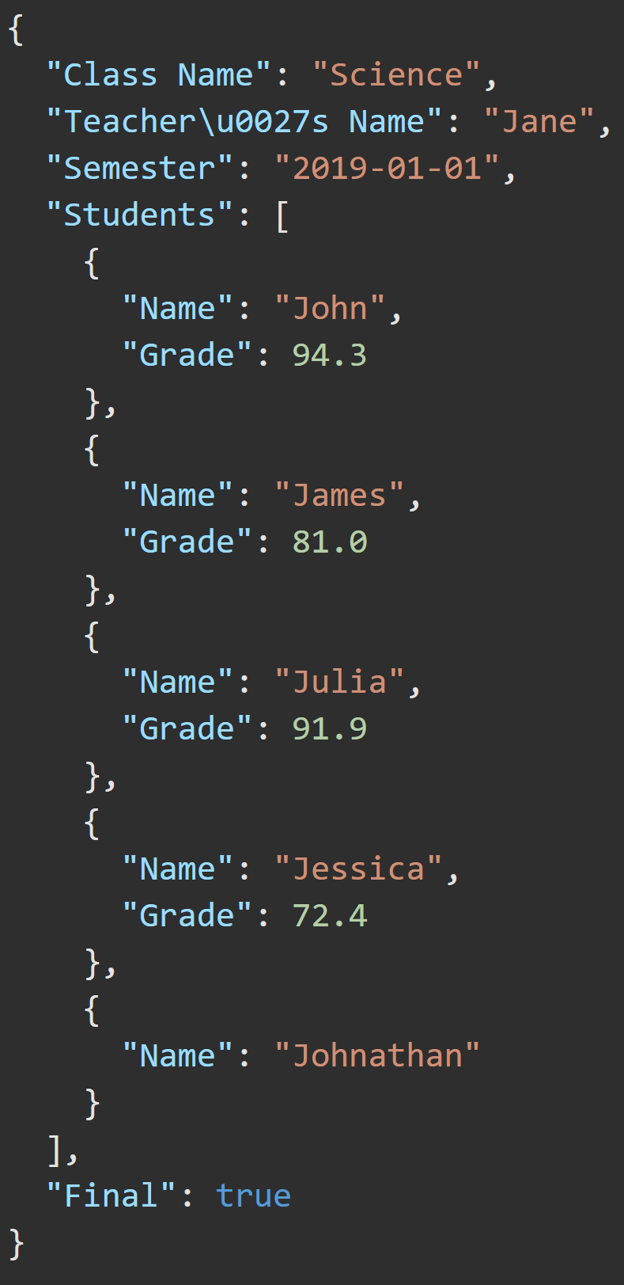
JSON – Deserialization Behavior https://docs.microsoft.com/en-us/dotnet/standard/serialization/system-text-json-how-to#deserialization-behavior
By default, property name matching is case-sensitive. You can specify case-insensitivity.
read-only properties are ignored. No exception is thrown.
Deserialization to reference types without a parameter-less constructor is not supported.
Deserialization to immutable objects or read-only properties isn't supported.
By default, enums are supported as numbers. You can serialize enum names as strings.
Fields aren't supported.
Comments or trailing commas in the JSON throw exceptions. You can explicitly allow comments and trailing commas.
The default maximum depth is 64.
Learn to “Pretty-Print” your JSON → → → → → → → → → →

Slide 10
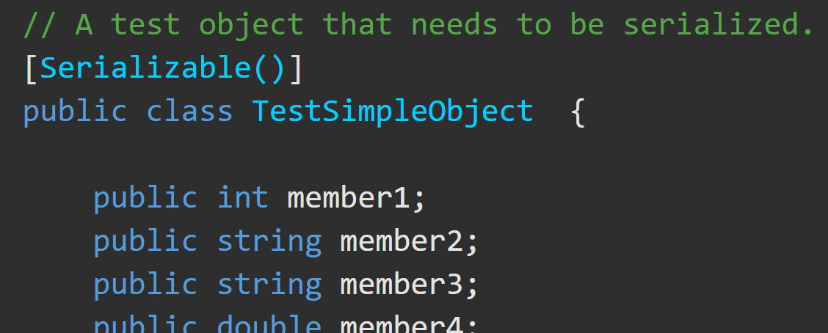
XML Serialization https://docs.microsoft.com/en-us/dotnet/csharp/programming-guide/concepts/serialization/#binary-and-xml-serialization
XML Serialization serializes the public fields and properties of an object (or the parameters and return values of methods) into an XML stream that conforms to a specific XML Schema definition language (XSD) document.
System.Xml.Serialization contains classes for serializing and deserializing XML. You apply attributes to classes and class members to control the way the XmlSerializer serializes or deserializes.
For XML serialization, you need:
to apply the SerializableAttribute attribute
to the type to avoid an exception.
the object which will be serialized
a stream to contain the serialized object
a System.Runtime.Serialization.Formatter instance

Slide 11
XML Serialization https://docs.microsoft.com/en-us/dotnet/csharp/programming-guide/concepts/serialization/#binary-and-xml-serialization https://docs.microsoft.com/en-us/dotnet/standard/serialization/introducing-xml-serialization
Apply the SerializableAttribute attribute to the property/field even if the class also implements the ISerializable interface.
When SerializableAttribute attribute is applied, all private and public fields are serialized.
XML serialization does not include type information.
You can control serialization by implementing the ISerializable interface to override the serialization process.
Exclude fields from serialization by applying NonSerializedAttribute to the field.
If a field of a serializable type contains a data structure that cannot be reconstituted in a different environment, apply the NonSerializedAttribute attribute to that field.

Slide 12
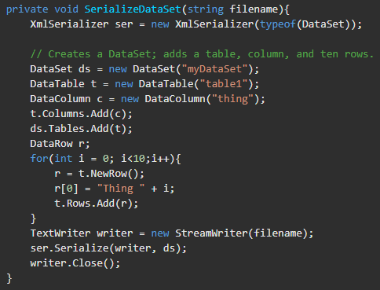
XML Serialization Examples https://docs.microsoft.com/en-us/dotnet/standard/serialization/examples-of-xml-serialization
This example shows how to XML Serialize a DataSet and write it to a file.

Slide 13
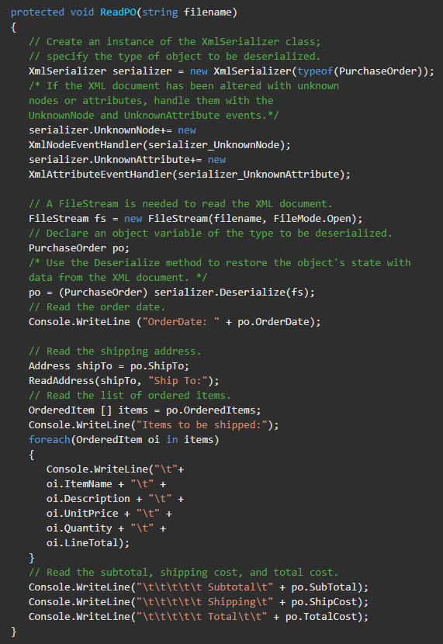
XML Serialization Example https://docs.microsoft.com/en-us/dotnet/standard/serialization/examples-of-xml-serialization
This example shows how to Deserialize from an XML document.

Slide 14
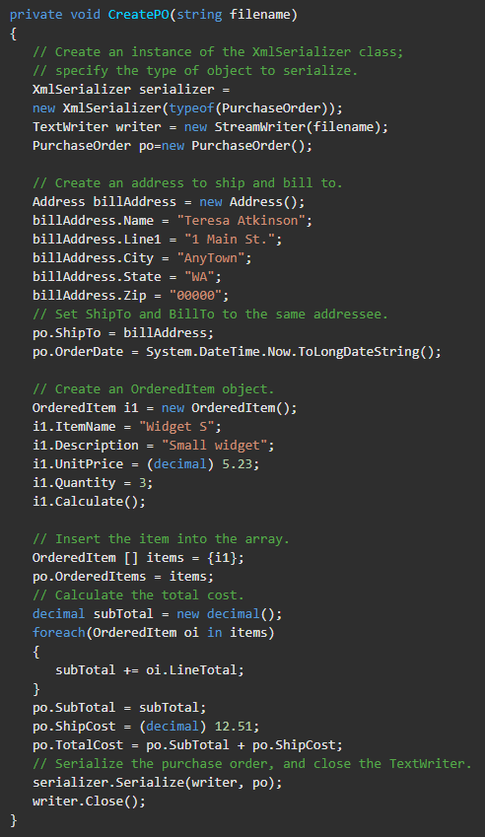
XML Serialization Example https://docs.microsoft.com/en-us/dotnet/standard/serialization/examples-of-xml-serialization
These examples show how to XML Serialize an object and write it to a file.

