Slide 1

ACID (Atomicity, Consistency, Isolation, Durability)
.NET

Slide 2
ACID (atomicity, consistency, isolation, durability) is a set of properties of database transactions intended to guarantee validity even in the event of errors or power failures.
https://en.wikipedia.org/wiki/ACID

Slide 3
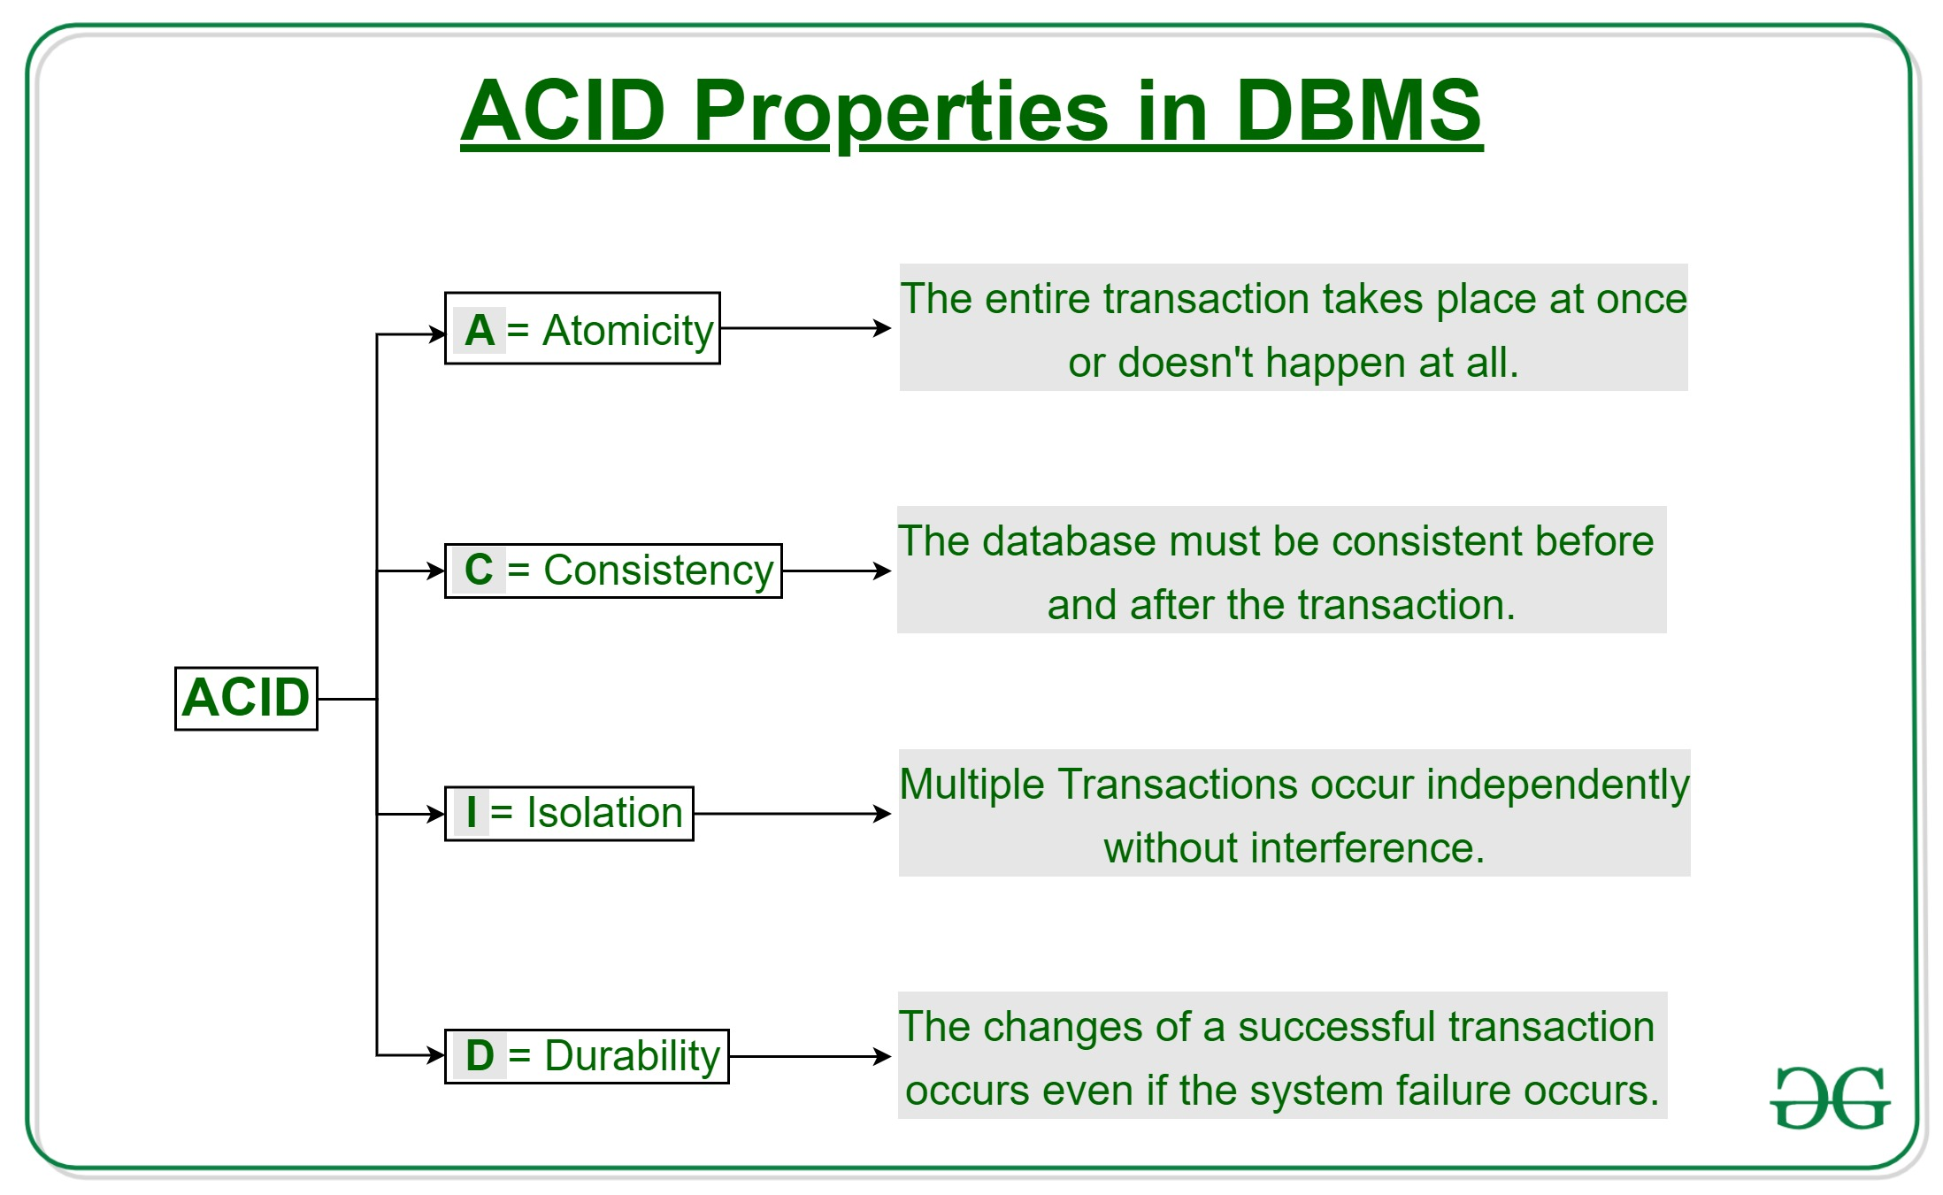
ACID – Atomicity https://docs.microsoft.com/en-us/windows/win32/cossdk/acid-properties
A transaction must execute exactly once and must be atomic.
An Atomic Transaction is indivisible and irreducible. Either all operations occur, or none do.
By performing only a subset of interdependent operations, the overall intent of a transaction would be compromised.
Atomicity eliminates the chance of processing only a subset of operations.

Slide 4
ACID – Consistency https://docs.microsoft.com/en-us/windows/win32/cossdk/acid-properties
A transaction must transform data from one consistent state to another consistent state.
The responsibility for maintaining consistency falls to the application developer.
Referential Integrity must be maintained when transforming one consistent state of data into another consistent state of data.

Slide 5
ACID – Isolation https://docs.microsoft.com/en-us/windows/win32/cossdk/acid-properties
A transaction must be completed in isolation.
Concurrent Transactions should behave as if each were the only transaction running in the system.
A high degree of isolation can limit the number of concurrent transactions.
There are 5 levels of Isolation.

Slide 6
ACID – Durability https://docs.microsoft.com/en-us/windows/win32/cossdk/acid-properties
A transaction must have durability (be recoverable).
If a transaction ‘commits’, its updates will persist even if the system fails immediately after.
Specialized logging allows the system's restart procedure to complete unfinished operations required by the transaction. This makes the transaction durable.

