Slide 1

Transaction Control Language (TCS)
.NET

Slide 2
Software used to maintain relational databases is a Relational Database Management System (RDBMS). Many relational database systems use Structured Query Language (SQL) for querying and maintaining the database.
https://docs.microsoft.com/en-us/sql/t-sql/language-reference?

Slide 3

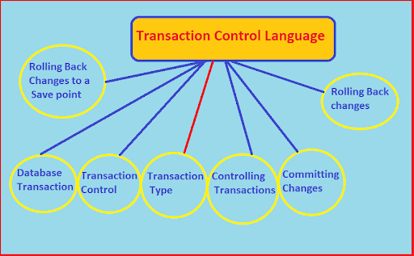
Transaction Control Language (TCL) https://www.databasestar.com/dml-ddl-tcl-commands/ https://www.geeksforgeeks.org/sql-ddl-dml-tcl-dcl/
Transaction Control Language commands are used to manage transactions in the database. These are used to manage the changes made by DML-statements. It also allows statements to be grouped together into logical transactions.

Slide 4
Commit https://www.geeksforgeeks.org/sql-ddl-dml-tcl-dcl/ https://docs.microsoft.com/en-us/sql/t-sql/language-elements/commit-transaction-transact-sql?view=sql-server-ver15
The Commit command is used to permanently save any transaction into the database.
Commit marks the end of a successful implicit or explicit transaction. If @@TRANCOUNT is 1, COMMIT TRANSACTION makes all data modifications since the start of the transaction a permanent part of the database, frees the transaction's resources, and decrements @@TRANCOUNT to 0. When @@TRANCOUNT is greater than 1, COMMIT TRANSACTION decrements @@TRANCOUNT only by 1 and the transaction stays active.
COMMIT [ { TRAN | TRANSACTION } [ transaction_name | @tran_name_variable ] ] [ WITH ( DELAYED_DURABILITY = { OFF | ON } ) ]
[ ; ]

Slide 5
Rollback https://www.geeksforgeeks.org/sql-ddl-dml-tcl-dcl/ https://docs.microsoft.com/en-us/sql/t-sql/language-elements/commit-transaction-transact-sql?view=sql-server-ver15
This command restores the database to last committed state. It is also used with savepoint command to jump to a savepoint in a transaction.
Rollback rolls back an explicit or implicit transaction to the beginning of the transaction, or to a Savepoint inside the transaction. You can use ROLLBACK TRANSACTION to erase all data modifications made from the start of the transaction or to a Savepoint. It also frees resources held by the transaction.
This does not include changes made to local variables or table variables. These are not erased by this statement.
ROLLBACK { TRAN | TRANSACTION }
[ transaction_name | @tran_name_variable
| savepoint_name | @savepoint_variable ]
[ ; ]

Slide 6
Save https://www.geeksforgeeks.org/sql-ddl-dml-tcl-dcl/ https://docs.microsoft.com/en-us/sql/t-sql/language-elements/save-transaction-transact-sql?view=sql-server-ver15
The Save command is used to temporarily save a transaction so that you can rollback to that point whenever necessary.
A user can set a savepoint, or marker, within a transaction. The savepoint defines a location to which a transaction can return if part of the transaction is conditionally canceled. If a transaction is rolled back to a savepoint, it must proceed to completion with more Transact-SQL statements if needed and a COMMIT TRANSACTION statement, or it must be canceled altogether by rolling the transaction back to its beginning. To cancel an entire transaction, use the form ROLLBACK TRANSACTION transaction_name. All the statements or procedures of the transaction are undone.
Duplicate savepoint names are allowed in a transaction, but a ROLLBACK TRANSACTION statement that specifies the savepoint name will only roll the transaction back to the most recent SAVE TRANSACTION using that name.
SAVE { TRAN | TRANSACTION } { savepoint_name | @savepoint_variable }
[ ; ]

