Slide 1

JOIN, UNION and Subqueries
.NET

Slide 2
A JOIN is the means used to combine columns from one or more tables by using values common to both tables.
https://en.wikipedia.org/wiki/Join_(SQL)

Slide 3

SQL JOIN Statements – Overview https://docs.microsoft.com/en-us/sql/relational-databases/performance/joins?view=sql-server-ver15#fundamentals
JOINs tell SQL how to use data from one table to select rows in a different table.
A JOIN statement defines the relationship between the tables by using keywords to:
Specifying the column from each table to be compared for the JOIN.
Specifying a logical operator ( = or <>,) for comparing values from the indicated columns.
Typically, a JOIN condition uses a Foreign Key from one table and its associated Key in the other table.

Slide 4
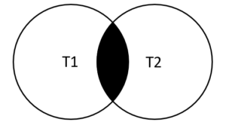
SQL JOIN Statement https://docs.microsoft.com/en-us/sql/relational-databases/performance/joins?view=sql-server-ver15#fundamentals
The JOIN (aka INNER JOIN) combines with the WHERE and HAVING search conditions to control which rows are selected from the tables referenced in the FROM clause. Specifying the JOIN conditions in the FROM clause helps separate them from any other search conditions that may be specified in a WHERE clause. INNER JOINs eliminate the rows that do not match with a row from the other table.
FROM <first_table> <join_type> <second_table> ON <join_condition>
This example:
Specifies 3 unambiguous column names to return from the desired tables,
Specifies the 2 tables to JOIN,
Specifies the columns with shared data ON which to JOIN,
Sets 2 constraints to filter on the results reported
SELECT ProductID, Purchasing.Vendor.BusinessEntityID, Name
FROM Purchasing.ProductVendor JOIN Purchasing.Vendor
ON (Purchasing.ProductVendor.BusinessEntityID = Purchasing.Vendor.BusinessEntityID)
WHERE StandardPrice > $10 AND Name LIKE 'F%'

Slide 5
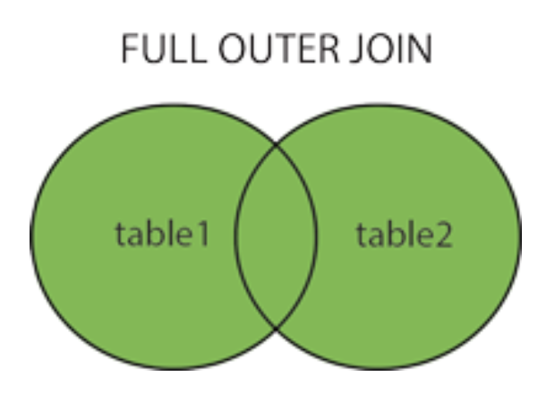
SQL FULL JOIN Statement https://docs.microsoft.com/en-us/sql/relational-databases/performance/joins?view=sql-server-ver15#fundamentals https://www.w3schools.com/sql/sql_join_full.asp
FULL JOINs (aka OUTER JOIN) return all rows from at least one of the tables or views mentioned in the FROM clause, if those rows meet any WHERE or HAVING search conditions.
The first table mentioned in the OUTER JOIN is the "left" table and the second table is the "right" table. When you specify a LEFT or RIGHT OUTER JOIN, you are referring to the order in which the tables were added to the query and to the order in which they appear in the SQL statement in the SQL pane.
This example:
Specifies 2 unambiguous column names to return from the desired tables,
Specifies the 2 tables to FULL OUTER JOIN,
Specifies the columns with shared data ON which to JOIN,
Sets a constraint to order the result by CustomerName of the Customers table, Ascending (default).
SELECT Customers.CustomerName, Orders.OrderID
FROM Customers FULL OUTER JOIN Orders
ON Customers.CustomerID = Orders.CustomerID
ORDER BY Customers.CustomerName;

Slide 6
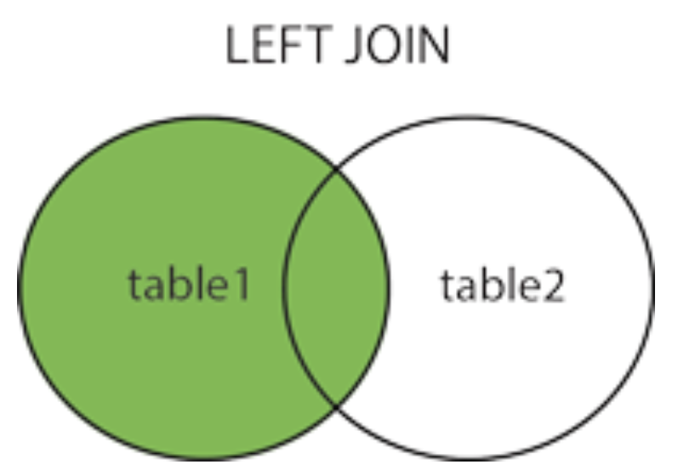
SQL LEFT JOIN Statement https://www.w3schools.com/sql/sql_join_left.asp
When you specify a LEFT or RIGHT JOIN, you are referring to the order in which the tables were written in the query. The first table mentioned in the query is the "left" table and the second table is the "right" table.
The LEFT JOIN keyword returns all records from the left table (table1), and the matched records from the right table (table2). The result is NULL from the right side if there is no match.
This example:
Specifies 2 unambiguous column names to return from the desired tables,
Specifies the 2 tables to LEFT JOIN,
Specifies the columns with shared data ON which to LEFT JOIN,
Sets a constraint to order the result by CustomerName of the Customers table, Ascending (default).
SELECT Customers.CustomerName, Orders.OrderID
FROM Customers LEFT JOIN Orders
ON Customers.CustomerID = Orders.CustomerID
ORDER BY Customers.CustomerName;

Slide 7
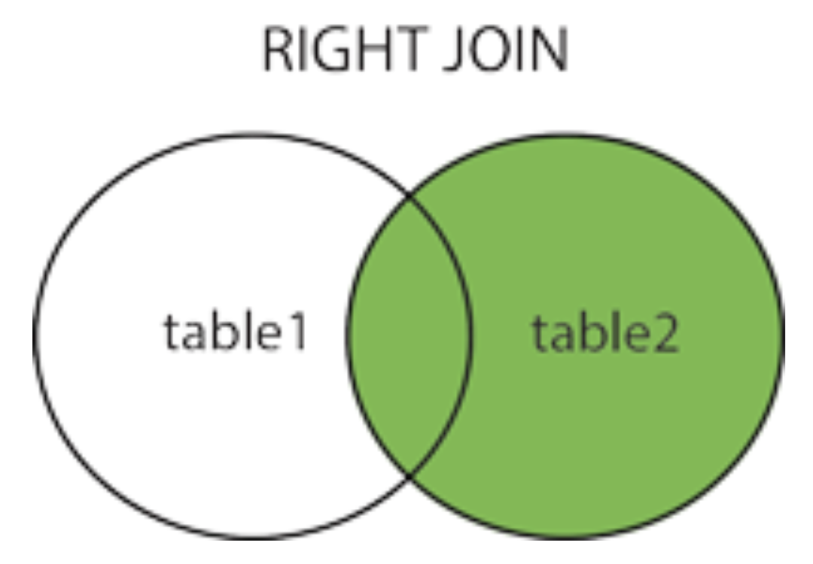
SQL RIGHT JOIN Statement
When you specify a LEFT or RIGHT JOIN, you are referring to the order in which the tables were written in the query. The first table mentioned in the query is the "left" table and the second table is the "right" table.
The RIGHT JOIN keyword returns all records from the right table (table2), and the matched records from the left table (table1). The result is NULL from the left side, if there is no match.
This example:
Specifies 3 unambiguous column names to return from the desired tables,
Specifies the 2 tables to RIGHT JOIN,
Specifies the columns with shared data ON which to RIGHT JOIN,
Sets a constraint to order the result by OrderID of the Orders table, Ascending (default).
SELECT Orders.OrderID, Employees.LastName, Employees.FirstName
FROM Orders RIGHT JOIN Employees
ON Orders.EmployeeID = Employees.EmployeeID
ORDER BY Orders.OrderID;

Slide 8
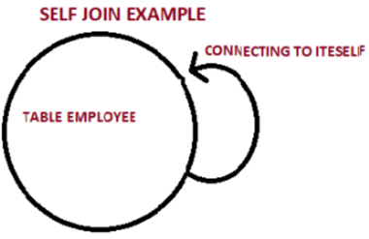
SQL SELF JOIN https://www.w3schools.com/sql/sql_join_self.asp
A SELF JOIN is exactly like a JOIN. The table is joined with a duplicate version of itself and the result generated.
This example:
Specifies 3 unambiguous column names to return from the desired tables. The AS keyword allows you to designate a unique identifier.
Specifies the 2 tables to SELF JOIN. No keywork is required, just a comma between the table names.
Specifies the filter of CustomerID’s that are not equal, but the city is the same.
Sets a constraint to order the result by City name, Ascending (default).
SELECT A.CustomerName AS CustomerName1, B.CustomerName AS CustomerName2, A.City
FROM Customers A, Customers B
WHERE A.CustomerID <> B.CustomerID AND A.City = B.City
ORDER BY A.City;
<> means != (not equal to)

Slide 9
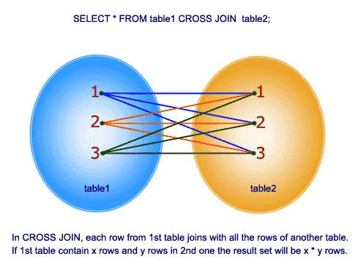
SQL CROSS JOIN https://www.w3resource.com/sql/joins/cross-join.php
CROSS JOIN produces a Cartesian Product. This is a result set which is the number of rows in the first table multiplied by the number of rows in the second table.
If the WHERE clause is used with CROSS JOIN, it functions like an INNER JOIN. You can also use comma-separated column names after SELECT and enter comma-separated table names after the FROM keyword.
This example:
Specifies 4 unambiguous column names from the desired tables.
Specifies the 2 tables FROM which to CROSS JOIN. The first table to multiplied by all items in second table.
SELECT foods.item_name,foods.item_unit,
company.company_name,company.company_city FROM foods CROSS JOIN company;

Slide 10
SQL UNION w3schools.com/sql/sql_union.asp
B, D, E, F
A, B C, D
The UNION operator is used to combine the unique result-set of two or more SELECT statements.
Each SELECT statement within UNION must have the same number of columns.
The columns must also have similar data types.
The columns in each SELECT statement must be in the same order.
UNION selects only distinct values.
E,F
B, D
A, C
This example:
Creates a complete SELECT statement
Uses the UNION keyword
Creates a separate SELECT statement identical to the first but querying a different table
Sets a constraint to order the result by City name, Ascending (default).
SELECT City, Country FROM Customers WHERE Country='Germany' UNION SELECT City, Country FROM Suppliers WHERE Country='Germany' ORDER BY City;

Slide 11
SQL UNION ALL w3schools.com/sql/sql_union.asp
B, D, E, F
A, B C, D
The UNION ALL operator is used to combine the full result-set, including duplicates, of two or more SELECT statements.
Each SELECT statement within UNION ALL must have the same number of columns.
The columns must have similar data types.
The columns in each SELECT statement must be in the same order.
UNION ALL returns duplicate values.
E,F
B, D
A, C
This example:
Creates a complete SELECT statement
Uses the UNION ALL keyword
Creates a separate SELECT statement identical to the first but querying a different table
Sets a constraint to order the result by City name, Ascending (default). This result includes duplicates.
SELECT City, Country FROM Customers WHERE Country='Germany' UNION ALL SELECT City, Country FROM Suppliers WHERE Country='Germany' ORDER BY City;

Slide 12
JOIN vs UNION https://www.geeksforgeeks.org/difference-between-join-and-union-in-sql
JOIN merges 2 tables horizontally.
UNION merges tables vertically.

Slide 13
SQL INTERSECT and EXCEPT https://docs.microsoft.com/en-us/sql/t-sql/language-elements/set-operators-except-and-intersect-transact-sql?view=sql-server-ver15
EXCEPT:
Returns any distinct values from the query left of the EXCEPT operator. Those values return as long as the right query doesn't return those values as well.
INTERSECT:
Returns any distinct values that are returned by both the query on the left and right sides of the INTERSECT operator.
To combine the result sets of two queries that use EXCEPT or INTERSECT, the basic rules are:
The number and the order of the columns must be the same in all queries.
The data types must be compatible (implicitly convertible).
EXCEPT and INTERSECT return the result sets’ column names that are the same as the column names that the query on the operator's left side returns.

Slide 14
SQL INTERSECT and EXCEPT - Examples https://docs.microsoft.com/en-us/sql/t-sql/language-elements/set-operators-except-and-intersect-transact-sql?view=sql-server-ver15
This INTERSECT example returns any distinct values that are returned by both the query on the left (above) and right (below) sides of the INTERSECT operator. This shows all products that have been ordered.
SELECT ProductID FROM Production.Product
INTERSECT
SELECT ProductID FROM Production.WorkOrder ;
This EXCEPT example returns any distinct values from the query left of the EXCEPT operator that are NOT also found on the right query. This shows all products that have NOT been ordered.
SELECT ProductID FROM Production.Product EXCEPT
SELECT ProductID FROM Production.WorkOrder ;

Slide 15
SQL Subquery https://docs.microsoft.com/en-us/sql/relational-databases/performance/subqueries?view=sql-server-ver15
A subquery is a query that is nested inside a SELECT, INSERT, UPDATE, or DELETE statement, or inside another subquery. A subquery can be used anywhere an expression is allowed. The subquery is evaluated then the outer query is evaluated against it.
Many SQL statements that include subqueries can be formulated as JOINs. There is usually no performance difference between a statement with a subquery and an equivalent JOIN.
SELECT Ord.SalesOrderID, Ord.OrderDate,
(SELECT MAX(OrdDet.UnitPrice)
FROM Sales.SalesOrderDetail AS OrdDet
WHERE Ord.SalesOrderID = OrdDet.SalesOrderID) AS MaxUnitPrice
FROM Sales.SalesOrderHeader AS Ord;
In this example, a subquery is used as a column expression named MaxUnitPrice in a SELECT statement. The subquery obtains the maximum price for each unit and them becomes a column in the outer query result.

Slide 16
Subquery https://docs.microsoft.com/en-us/sql/relational-databases/performance/subqueries?view=sql-server-ver15
A subquery nested in an outer SELECT statement has the following components:
A regular SELECT query including the regular select list components.
A regular FROM clause including one or more table or view names.
An optional WHERE clause.
An optional GROUP BY clause.
An optional HAVING clause.
This example shows two queries obtaining an identical result. One uses a subquery and the other uses a JOIN.
SELECT Name
FROM Production.Product
WHERE ListPrice =
(SELECT ListPrice
FROM Production.Product
WHERE Name = 'Chainring Bolts' );
SELECT Prd1.Name
FROM Production.Product AS Prd1
JOIN Production.Product AS Prd2
ON (Prd1.ListPrice = Prd2.ListPrice)
WHERE Prd2.Name = 'Chainring Bolts';

