Slide 1

HTML Fundamentals
.NET

Slide 2
HTML is not a programming language. HTML is a markup language that defines the structure of a webpage. HTML consists of elements which are used to enclose different parts of the page content to make it appear or act a certain way.
https://developer.mozilla.org/en-US/docs/Learn/Getting_started_with_the_web/HTML_basics

Slide 3
Preparation
Create a directory, HtmlAndCssPractice, in your personal repo.
Right-Click the directory to open it in VS Code.
Create a file, HtmlPractice.html.
In VS Code, download the extension ‘Live Server’ by Ritwick Dey
Reload your VS Code window with:
CTRL + Shift + P (open Command Palette)
Type ‘reload window’.
Type ‘doc’ to auto-fill the .html page template.

Slide 4


HTML and CSS https://en.wikipedia.org/wiki/Cascading_Style_Sheets https://www.w3schools.com/html/html_intro.asp https://www.w3schools.com/css/css_intro.asp https://en.wikipedia.org/wiki/HTML
HTML (Hyper Text Markup Language) | CSS (Cascading Style Sheets)
In 1989, Tim Berners-Lee invented the Web with HTML as its publishing language. HTML (Hyper Text Markup Language) was created to allow programmers to structure the content on a website. HTML uses tags to add paragraphs, headers, footers, pictures, bullets, and many other structural components. | CSS was proposed by Hakom Lie and co-created by Bert Bos in 1996 to compliment HTML. It is what gives a website color and styling. CSS is used to change the style of a website rather than providing its content. Changing the font size and color or positioning text and images on a HTML page are examples of styling.

Slide 5
HTML4 vs HTML5: A History https://html.spec.whatwg.org/multipage/introduction.html#is-this-html5?
HTML5 is the result of a collaboration between the World Wide Web Consortium (W3C), and the Web Hypertext Application Technology Working Group (WHATWG).
These organizations partnered in 2006 with the goal of reducing HTML4’s reliance on plugins, improve error handling, and replace scripting with more markups.
In 2011 the groups concluded that they had different goals. The W3C wanted to publish a "finished" version of "HTML5", while the WHATWG wanted to work on a Living Standard for HTML, continuously maintaining the specification rather than freezing it in a state (potentially with problems) and adding new features as needed to evolve the platform.
In 2019, the WHATWG and W3C signed an agreement to collaborate on a single version of HTML going forward.
The result is HTML5. HTML5 greatly simplifies the process of creating web applications. In HTML5, the different browsers work together with an emphasis on accessibility and support for multimedia(without plugins). This results in a more straight-forward process of creating web applications and a more secure, stable user experience.

Slide 6
HTML5 – New Features https://www.w3schools.com/html/html5_intro.asp
New element | Use
<audio> </audio> | Used to imbed audio and video in multiple formats. The browser chooses the format it knows best. Flash is no longer needed.
<video> </video>
<canvas> </canvas> | The canvas scripting API or the WebGL API to draw graphics and animations.
<nav></nav> | Represents a section of a page whose purpose is to provide navigation links.
<header></header> | A container for introductory content or a set of navigational links.
<footer></footer> | Defines a footer for a document or section.
<article></article> | Specifies independent, self-contained content.
<section></section> | Defines sections in a document like chapters, headers, and footers.

Slide 7
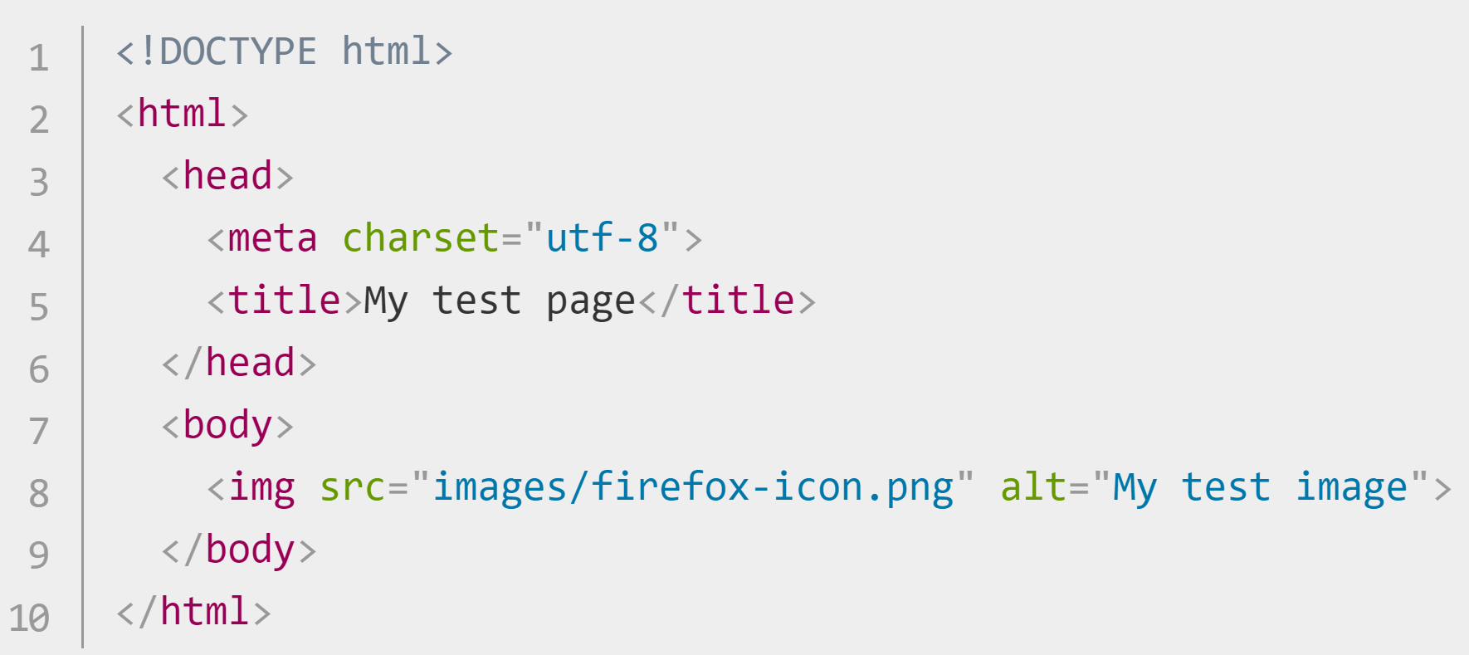
HTML – Anatomy of a Web Page https://developer.mozilla.org/en-US/docs/Learn/Getting_started_with_the_web/HTML_basics
<!--The required HTML5 document type declaration. -->
<!-- <html> wraps all the content on the page. Known as the root element. -->
<!-- <head> is a container for (undisplayed) metadata, or data about the data. -->
<!-- Unicode Transformation Format-8. A large set of all the characters needed for text. -->
<!-- <title> text appears in the browser tab when a page is loaded and in bookmarks. -->
<!-- <body> contains all the content that you want to show web users. (text, images, videos, games, etc) -->

Slide 8
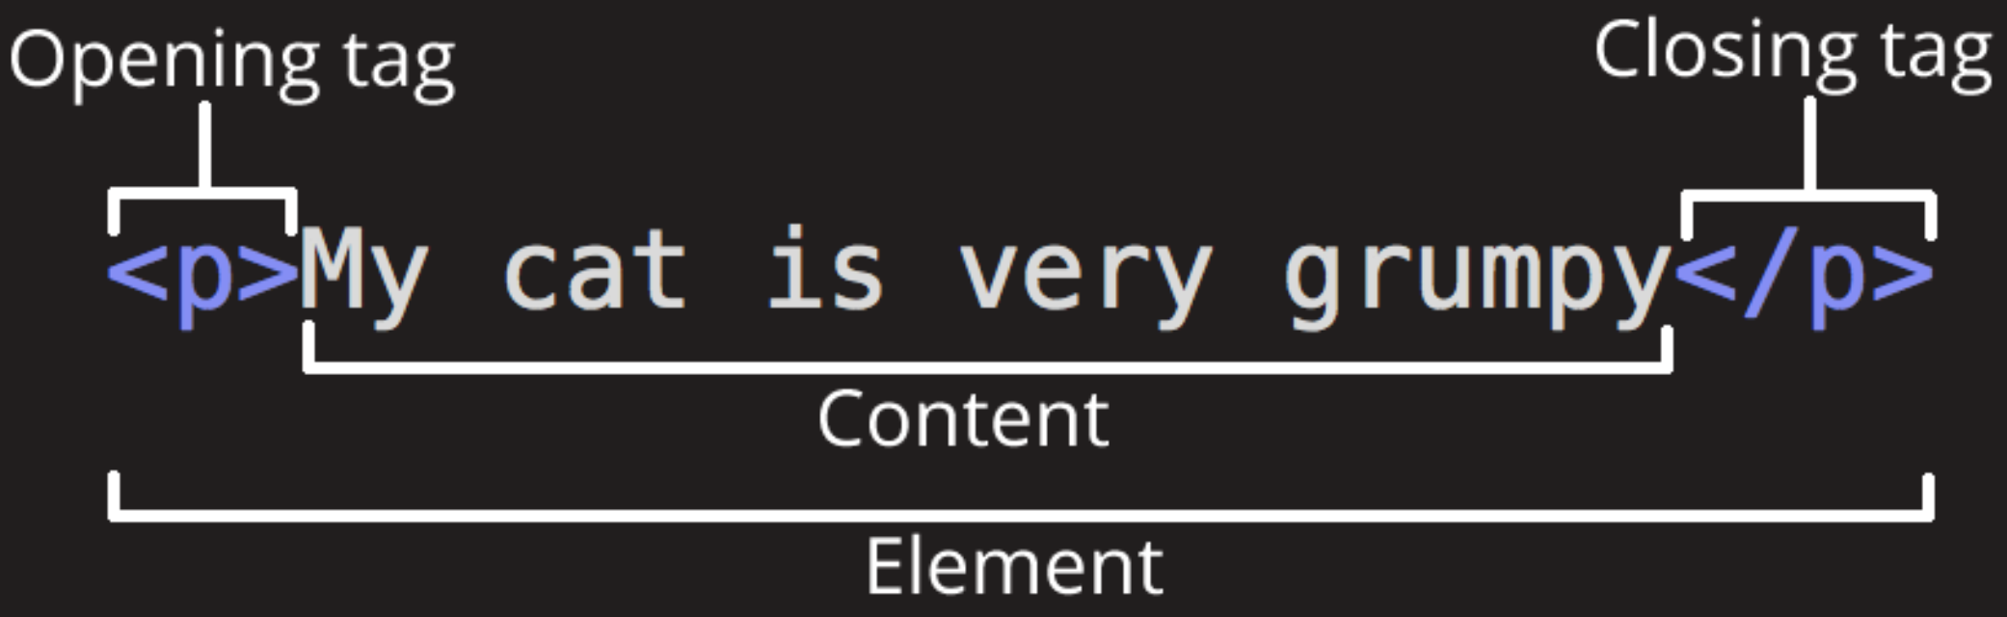
HTML - Anatomy of an Element https://developer.mozilla.org/en-US/docs/Learn/Getting_started_with_the_web/HTML_basics https://devdocs.io/html/
An Element designates a section of HTML for a specific purpose according to the tags on the element. <html> is known as the Root Element.
Text without any tag just prints on the webpage. Text inside element tags will have a purpose and can be given styling.
Between the opening and closing tags is the content. The content is printed to the webpage.
<p> means paragraph. All tags have angle brackets on each side.
The closing tag has a ‘/’ before the closing tag type.
The opening and closing tags, along with everything between them, is the element.
* Some elements don’t have contents or a closing tag. (<img>, <br>, <input>)

Slide 9

HTML – Metadata https://itseeze.com/blog/seo-101-everything-you-need-to-know-about-metadata/
Located in the <head> of an HTML page
<meta> elements provide search engines with information about the content and purpose of pages of a website.
Metadata is data that describes other data.
In webpages, metadata is used for Search Engine Optimization (SEO).
Webpage metadata consists of a page <title> and <meta> description on each .html page.

Slide 10
HTML – Metadata inside <head> https://itseeze.com/blog/seo-101-everything-you-need-to-know-about-metadata/
<meta name="viewport" content="width=device-width, initial-scale=1.0"> | Controls how the browser displays a page.
<meta http-equiv="X-UA-Compatible" content="ie=edge“> | Switches off Microsoft Edge's old-IE-compatibility behaviors.
<meta name=“Tech Lead" content="Nick"> | Gives a name to the web page.
<meta name="description" content="description of this page"> <meta name="keywords" content="search engine keywords"> | These were important for SEO, but no longer.

Slide 11
HTML - Nested Elements https://www.w3schools.com/html/html_elements.asp
You can nest elements inside other elements.
A nested element must be closed before its enclosing element is closed. The below text will display but the <strong> styling will not be applied.

Slide 12
HTML - <span> and <div> Elements https://www.w3schools.com/tags/tag_span.asp https://www.w3schools.com/html/html_blocks.asp
Some of the most used and important elements are <div> and <span>.
<span> | <div>
An inline element. used to group inline elements in a document. provides no styling change by itself. CSS can hook onto a part of the HTML doc using the class or id of a <span>. | A block-level element. defines a division or a section in an HTML document. often used as a container for other HTML elements to style them with CSS or to perform certain tasks with JavaScript.
<p>
Mom has <span style="color:blue">blue</span> eyes.
</p>
<div style="background-color:blue"> <h3>This is a heading</h3> <p>This is a paragraph.</p> </div>

Slide 13
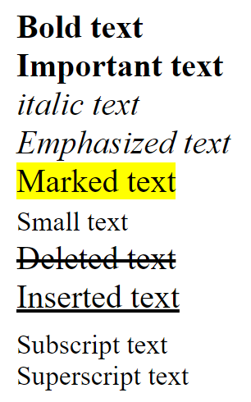
HTML – Basic Text Element Formatting https://www.w3schools.com/html/html_formatting.asp
Elements can be formatted ‘inline’. These tags have default styles that can be manually changed with the style attribute
<b>Bold text </b>
<strong>Important text </strong>
<i>italic text</i>
<em> Emphasized text </em>
<mark>Marked text </mark>
<small>Small text</small>
<del>Deleted text </del>
<ins>Inserted text </ins>
<sub>Subscript text</sub>
<sup>Superscript text</sup>
use <br> to create a line break.

Slide 14
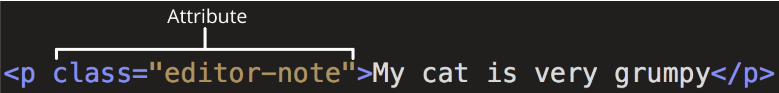
HTML – Attributes https://developer.mozilla.org/en-US/docs/Learn/Getting_started_with_the_web/HTML_basics https://en.wikipedia.org/wiki/HTML_attribute
Attributes are modifiers placed inside the opening tag of the element. An Attribute is a key-value pair. Some HTML Tags have specific Attributes but most share from the four main attributes: id, class, style, and title.
See the complete list of html attributes.

Slide 15
Global Attributes (available on all Tags) https://developer.mozilla.org/en-US/docs/Learn/Getting_started_with_the_web/HTML_basics https://en.wikipedia.org/wiki/HTML_attribute
Attribute | Meaning and usage
id | Provides a document-wide (not application-wide) unique id for an element. <p id=“idGreen”>This is an example of an id</p>
class | Provides a way of classifying similar elements. A class is NOT unique and can be shared with other elements in the same document and in other files. <p class=“classBlue”>This is an example of the ‘class’ attribute</p>
style | Adds styling directly to the element. It is recommended to use an external CSS file for all styling. <p style=“color:red”>This is an example of a ‘style’ attribute</p>
title | Used to attach subtextual explanation to an element. This is the text popup when you hover over something or the default name of a saved tab. <p title="Hypertext Markup Language“>This is an example of the ‘title="Hypertext Markup Language“’ attribute</p>

Slide 16
HTML – Elements inside <body> https://developer.mozilla.org/en-US/docs/Learn/Getting_started_with_the_web/HTML_basics
Element | Description
<p> | The Paragraph element. Used for text.
<h1>, <h2>, <h3>, <h4>, <h5>, <h6> | Heading Element. Controls text size. Largest to smallest
<a href="https://revature.com">Revature</a> | Link to a web page with the Anchor tag.
<img src=“routeToImage" width="100px” alt="My Revature image"> | Link to an Image on your computer or online. ‘alt’ text will display when the image is not found.
<img src=“routeToImage” width=“100px” alt=“My Revature image” /> | This is an alternate XML-style syntax for elements with no closing tag.

Slide 17
HTML – List https://developer.mozilla.org/en-US/docs/Learn/Getting_started_with_the_web/HTML_basics
HTML has special elements for lists. The most common list types are ordered and unordered lists. Items inside the lists are put inside <li> elements.
Unordered lists are wrapped in a <ul> tag and display as bullet points | Ordered Lists display numbered. These are wrapped in an <ol> tag.
<ul> <li>bullet 1</li> <li>bullet 2</li> </ul> | <ol> <li>number 1</li> <li>number 2</li> </ol>

Slide 18
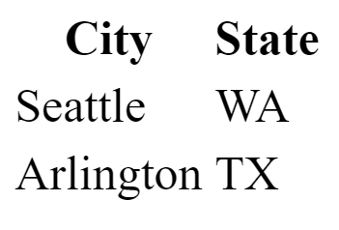
HTML – Table (with comment examples) https://www.w3schools.com/html/html_tables.asp
<table style="width:100%"> <thead> <!--table header section/row --> <th>City</th> <!--table header cell--> <th>State</th> </thead>
<tbody> <!--table body-->
<tr> <td>Seattle</td> <!--table data cell--> <td>WA</td> </tr> <tr> <td>Arlington</td> <td>TX</td> </tr>
<tbody> </table>

Slide 19
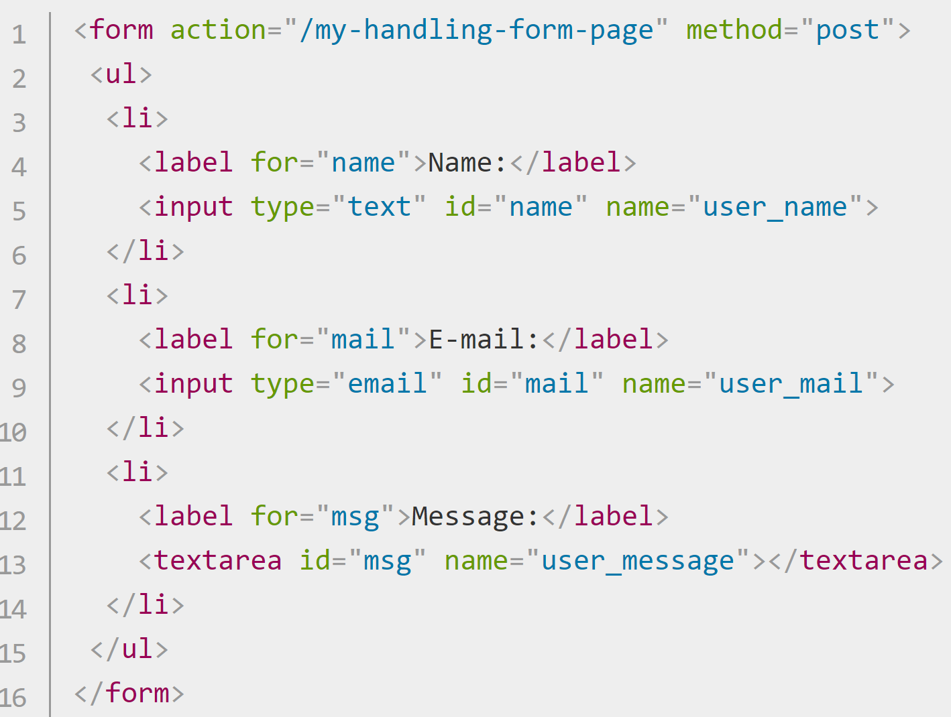
HTML <Form> (1/4) https://developer.mozilla.org/en-US/docs/Learn/Forms https://developer.mozilla.org/en-US/docs/Learn/Forms/Your_first_form
Forms allow users to enter data. The data is sent to a web server for processing or used on the client-side to update the interface.
A form's HTML is made up of one or more form controls and some elements to give structure to the form.
User input is captured using the <input> element, although there are some other elements, too.
Form controls can be used to enforce specific format, value requirements (form validation), or types. They have text labels that describe their purpose.
Controls can be:
Single text fields | multi-line text fields | dropdown boxes | buttons | checkboxes | radio buttons

Slide 20
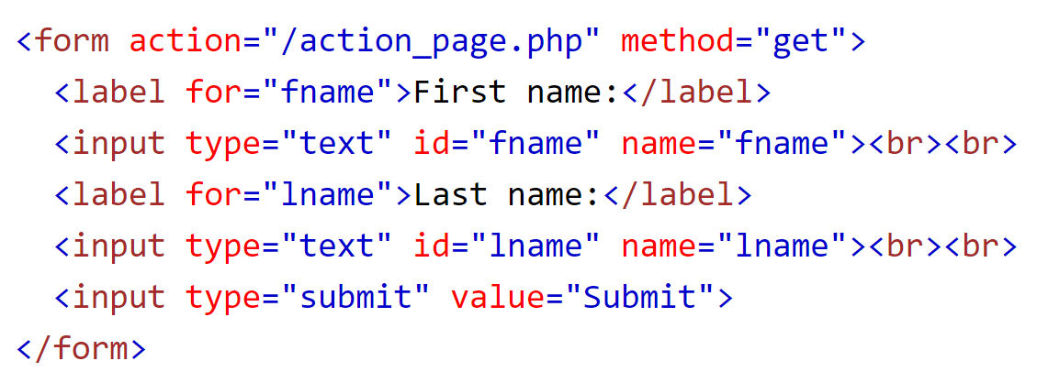
HTML <Form> (2/4) – Method Attribute https://www.w3schools.com/tags/att_form_method.asp
Form data can be sent as URL variables (with method=“GET") or as an HTTP POST transaction (with method=“POST").
method specifies how the form data is sent.
*Only GET and POST are valid for forms.
The action attribute specifies where the form data is sent.

Slide 21
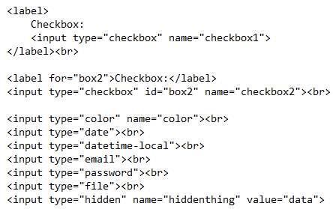
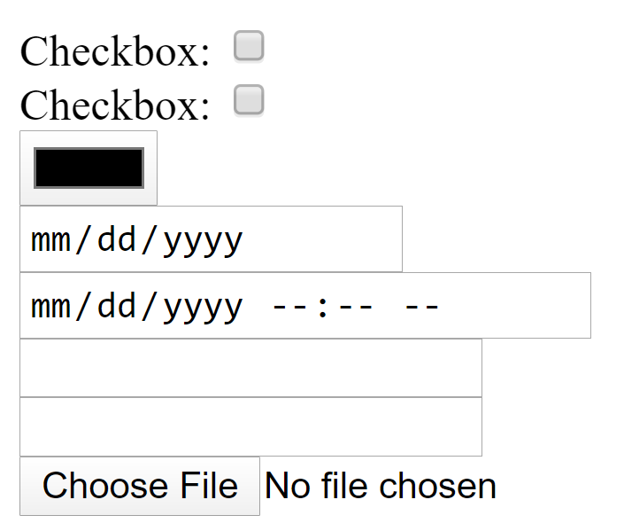
HTML <Form> (3/4) - Input Attribute Types https://www.w3schools.com/html/html_form_input_types.asp
A hidden field lets web devs include data that is not displayed.
*the ‘name’ attribute can be used to access the value.

Slide 22
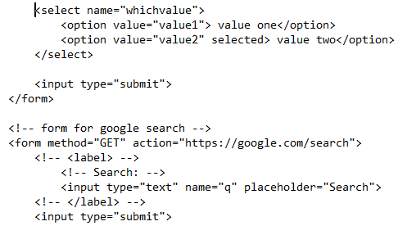
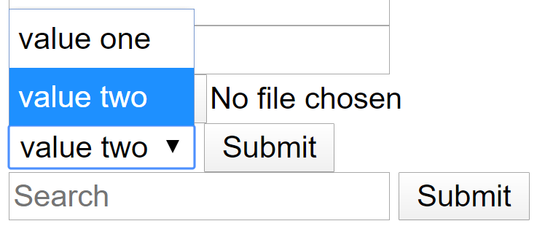
HTML <Form> (4/4)– More Input Attribute Types https://www.w3schools.com/html/html_form_input_types.asp
A Boolean Attribute. Shorthand for selected = “selected”. It creates a default choice.

Slide 23
<input> Attribute Purposes (1/3) https://www.w3schools.com/html/html_form_attributes.asp
Input Attribute | Purpose and Usage
id= “” | Specifies a unique id within the .html file. Ex. <p id="exciting">Very</p>
type=“” | Specifies the type of the <input> element to display to the user. The default type is text. Other types are password, button, checkbox, etc. Ex. <input type="text" id="fname" name="fname">
name=“” | Specifies a name for the element in the DOM. Can be used to reference the element in the .js file. Also used as a reference when the data is submitted. Ex. <form action="" name="formA">…form contents…</form>

Slide 24
<input> Attribute Purposes (2/3) https://www.w3schools.com/html/html_form_attributes.asp
Input Attribute | Purpose and Usage
for=“” | Specifies to which id attribute a <label> is bound. When paired with the <output> tag, it defines the relationship between the result of the calculation, and the elements used in the calculation. Ex. <label for="male">Male</label> <input type="radio" name="gender" id="male" value="male">
placeholder=“” | Gives a sample value or description of the expected input. The value is displayed in the input field before the user enters a value. Works with text, search, url, tel, email, and password. Ex. <input type="tel" id="phone" name="phone" placeholder="123-45-678“>
target=“_blank” | Automatically opens the link in a new tab.

Slide 25
<input> Attribute Purposes (3/3) https://www.w3schools.com/html/html_form_attributes.asp
Input Attribute | Purpose and Usage
value=“” | Specifies an initial value for an input field. <input type="text" id="fname" name="fname" value="John">
readonly | The field cannot be modified. A user can tab to, highlight, and copy text from the field. It’s sent when submitting a form. <input type="textbox" value="Some value" readonly="readonly"/>
disabled | The input field is unusable and un-clickable. The value of the field will not be sent when submitting a form. <input type="checkbox" value="disabled" disabled> disabled </label></p>
Autofocus | Focuses on the field on page load <select id="mySelect" autofocus>

Slide 26
HTML – Entities/Character Codes https://www.toptal.com/designers/htmlarrows/arrows/
Character entities are used to display reserved characters in HTML.
HTML entities have a
Numerical reference,
a Hexadecimal reference, and
an Entity Code for reserved characters.
HTML Entity Code | Numeric Code | Hex Code | Symbol
&lt; | &#60; | &#x3c; | <
&gt; | &#62; | &#x3e; | >
&nbsp; | &#160; | &#xa0; | Non-breaking space
 | &#65504; | &#xFFE0; | ₵
&trade; | &#8482; | &#x2122; | ™
 | &#8508; | &#x213C | ℼ (pi)
&rarr; | &#8594; | &#x2192; | →
&commat; | &#64; | &#x40; | @
*there are many more

Slide 27
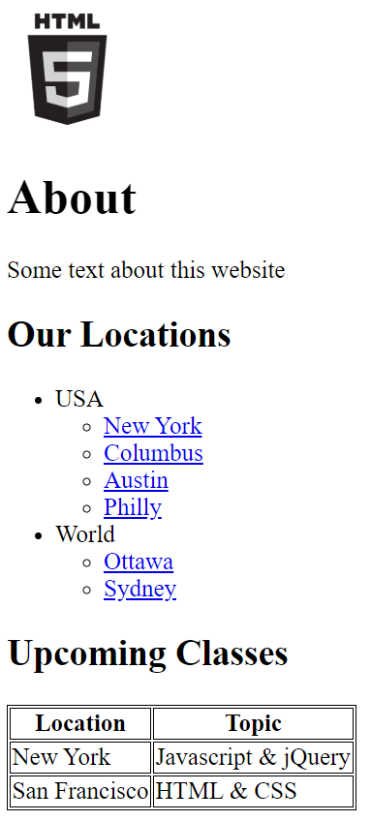
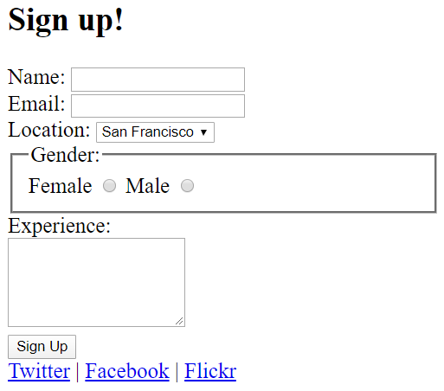
Assignment and Resources
Create a .html file that implements the following html structures.
The two blocks should be on top of each other (one column) with one orange border around the whole.
https://docs.emmet.io/cheat-sheet/
https://code.visualstudio.com/docs/editor/emmet

