Slide 1

Integration Testing
.NEt

Slide 2
Integration tests ensure that an app's components function correctly at a level that includes the app's supporting infrastructure, such as the database, file system, and network.
https://docs.microsoft.com/en-us/aspnet/core/test/integration-tests?view=aspnetcore-5.0

Slide 3
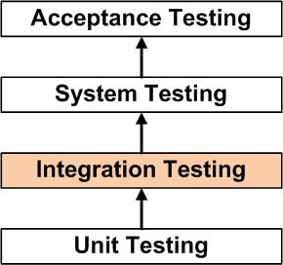
Integration Testing - Overview https://docs.microsoft.com/en-us/aspnet/core/test/integration-tests?view=aspnetcore-5.0#introduction-to-integration-tests
Integration tests are the second level of testing. They evaluate an app's components on a broader level than unit tests.
Unit tests are used to test isolated software components, like methods.
Integration tests confirm that two or more app components work together to produce an expected result.
Broader tests of the app's infrastructure and framework can include everything from UI to DB. A different database or different app settings might be used for the tests.

Slide 4
Integration Tests – Cons https://docs.microsoft.com/en-us/aspnet/core/test/integration-tests?view=aspnetcore-5.0#aspnet-core-integration-tests
Integration tests:
use production components,
require more code and data processing,
take longer to run.
Limit the use of integration tests to the most important infrastructure scenarios.
If a behavior can be tested using both a unit test and an integration test, choose the unit test.

Slide 5
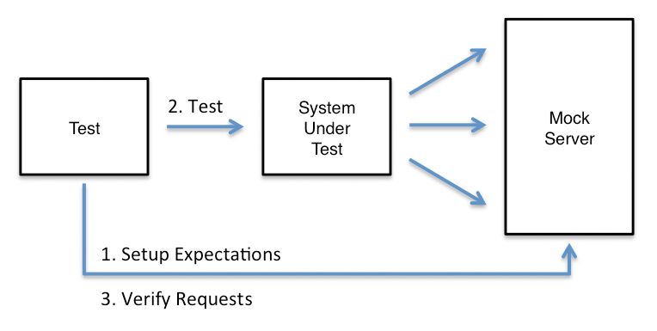
Integration Testing – Requirements/Setup https://docs.microsoft.com/en-us/aspnet/core/test/integration-tests?view=aspnetcore-5.0#aspnet-core-integration-tests
To complete Integration tests in ASP.NET Core, you need:
a test project containing the tests and having a reference to the SUT (System Under Test).
a test web host (created by the test project) for the SUT that uses a test server client to handle requests and responses with the SUT.
a test runner is used to execute the tests and report the test results.
the test app to specify the Web SDK in its project file (<Project Sdk="Microsoft.NET.Sdk.Web">).
the test app to reference the Microsoft.AspNetCore.Mvc.Testing package
The workflow of Integration Testing follows the familiar Arrange/Act/Assert process. Each test:
configures a web host
Creates a test server client
Arrange…
Act…
Assert…

Slide 6
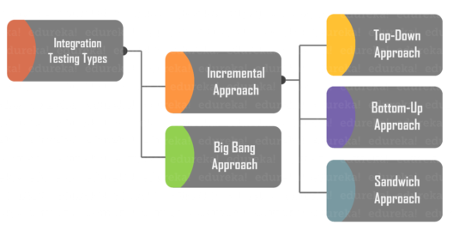
Integration Testing – Requirements/Setup https://docs.microsoft.com/en-us/aspnet/core/test/integration-tests?view=aspnetcore-5.0#aspnet-core-integration-tests
The Microsoft.AspNetCore.Mvc.Testing package handles the following tasks:
Copies the dependencies file (.deps) from the SUT into the test project's bin directory.
Sets the content root to the SUT's project root so that static files and pages/views are found when the tests are executed.
Provides the WebApplicationFactory class to streamline bootstrapping the SUT with TestServer.
You can use a mock database for testing.
In an MVC app, tests are usually organized by Controller classes and named after the Controllers they test.

Slide 7
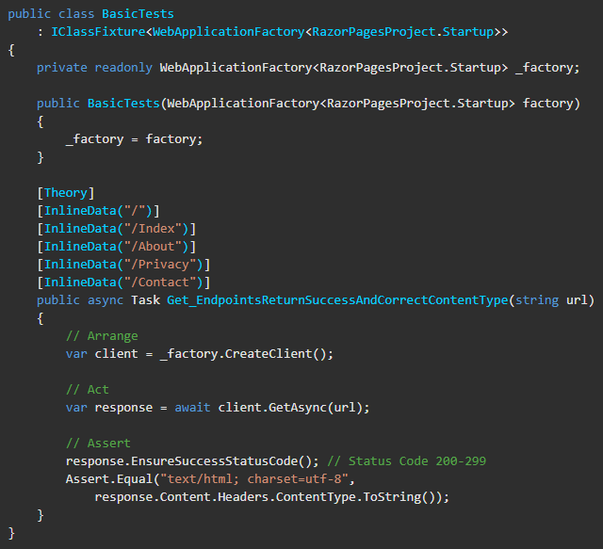
Integration Testing Setup – Step By Step https://docs.microsoft.com/en-us/aspnet/core/test/integration-tests?view=aspnetcore-5.0#aspnet-core-integration-tests https://docs.microsoft.com/en-us/aspnet/core/test/integration-tests?view=aspnetcore-5.0#basic-tests-with-the-default-webapplicationfactory
1) The test project inherits
IClassFixture<WebApplicationFactory<TEntryPoint>>.
“TEntryPoint” is your app entry file, usually Startup.cs.
2) create a property:
private readonly WebApplicationFactory<TEntryPoint> _factory;
3) Inject the WebApplicationFactory<TEntryPoint> into the test project constructor.
4)In each test,
var client = _factory.CreateClient(); //Arrange
var response = await client.MethodToTest(url); //Act
response.EnsureSuccessStatusCode(); //200-299 Assert
Assert.Equal(verify the response was as expected) //Assert

