Slide 1

JavaScript Objects and Classes
.NET

Slide 2
In JavaScript, classes are “special functions”. Just as you can define function expressions and function declarations, the class syntax has two components: class expression and class declaration.
https://developer.mozilla.org/en-US/docs/Web/JavaScript/Reference/Classes

Slide 3
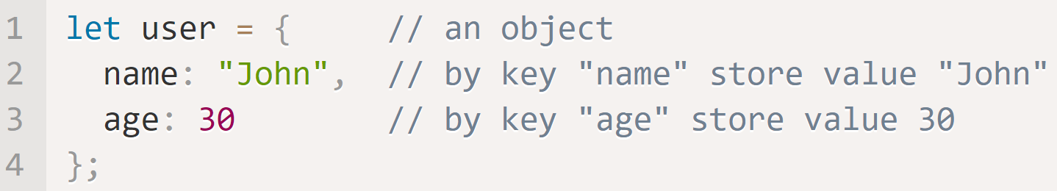
JavaScript objects https://developer.mozilla.org/en-US/docs/Learn/JavaScript/First_steps/A_first_splash https://javascript.info/object
In JavaScript, everything is an object. This means any variable in JS can potentially be used to store properties (key:value pairs) and even more complex entities.
JS objects are stored by reference. The variable holds the memory location of the object on the heap. An empty object can be created in two ways.
An Object Literal is created with properties. Property values are accessible using dot (.) notation.

Slide 4
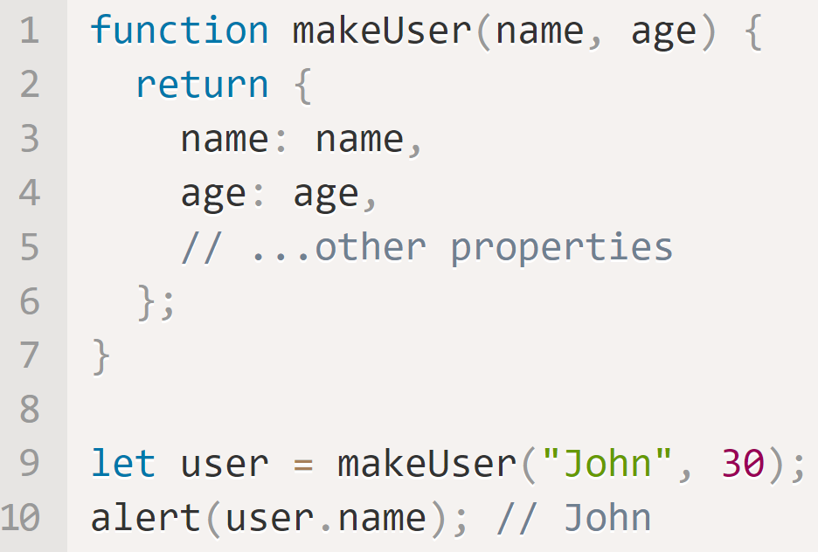
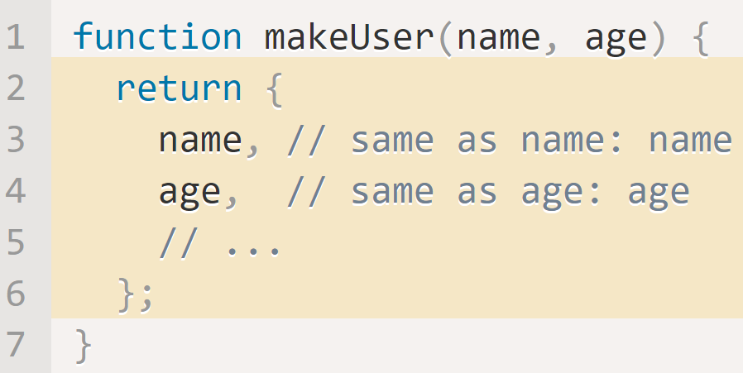
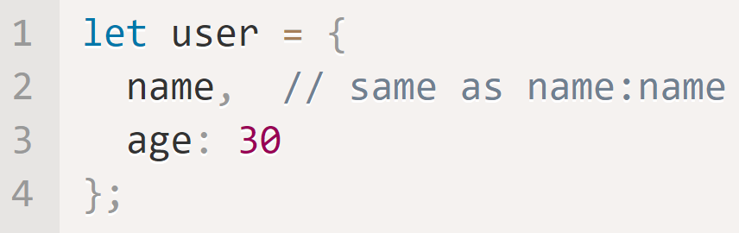
JS Objects – Property Values and Shorthand https://javascript.info/object#property-value-shorthand https://developer.mozilla.org/en-US/docs/Web/JavaScript/Reference/Operators/this#The_bind_method
JavaScript has a shorthand for declaring and setting object variables. The below examples are all equivalent objects but how they are declared determines if you end up with a reusable template for objects.
makeUser is reusable
makeUser is reusable
user is NOT reusable

Slide 5
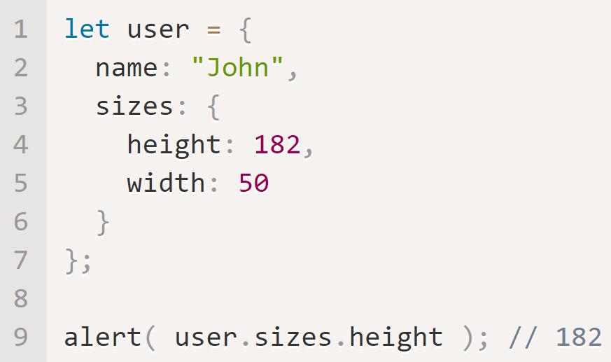
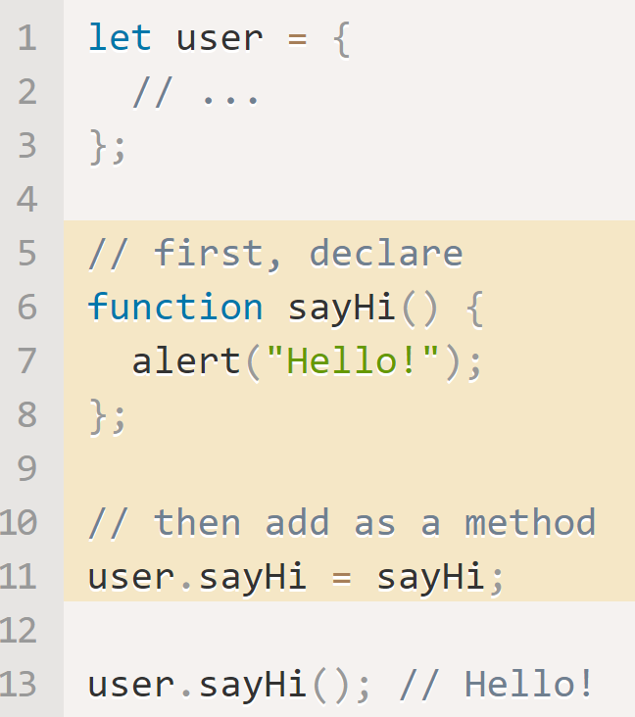
JS Objects – Objects in Objects https://javascript.info/object#cloning-and-merging-object-assign
An object can contain another object. In this example, you would access height with
let height = user.sizes.height
Another object or function can be assigned to an object after creation. Here, user is dynamically assigned the function sayHi() as a new property (also called sayHi).

Slide 6
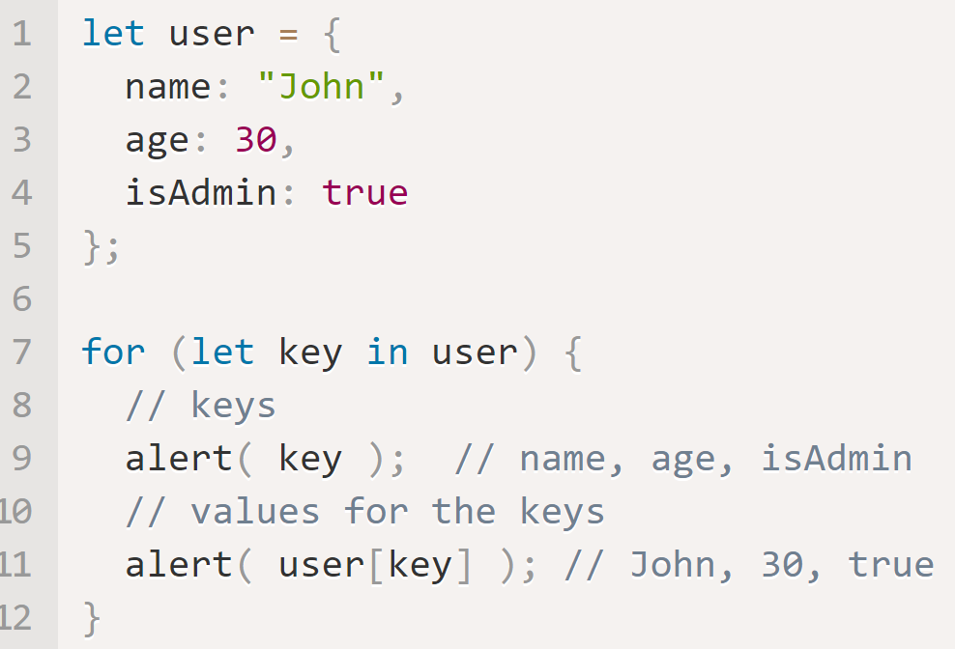
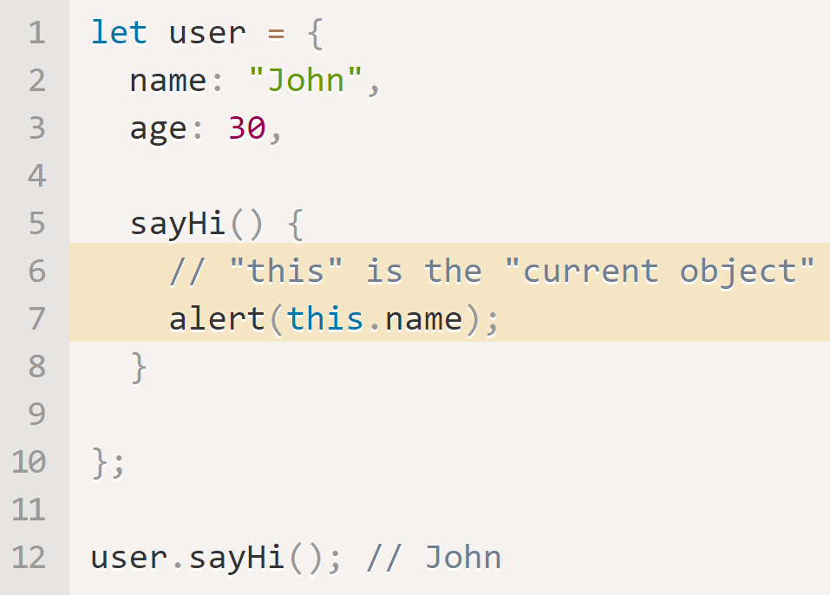
JS Objects - Accessing Properties https://javascript.info/object#property-existence-test-in-operator https://javascript.info/object#the-for-in-loop
It’s possible to access any property of an object. The below will return undefined because the property doesn’t exist.
let value = user.key;
The in operator returns true of the property exists, false if not.
let exists = ‘name’ in user;
Use the for…in loop to access each property of an object in sequence.
The keyword this can be used to specify the containing object to disambiguate variable names.

Slide 7
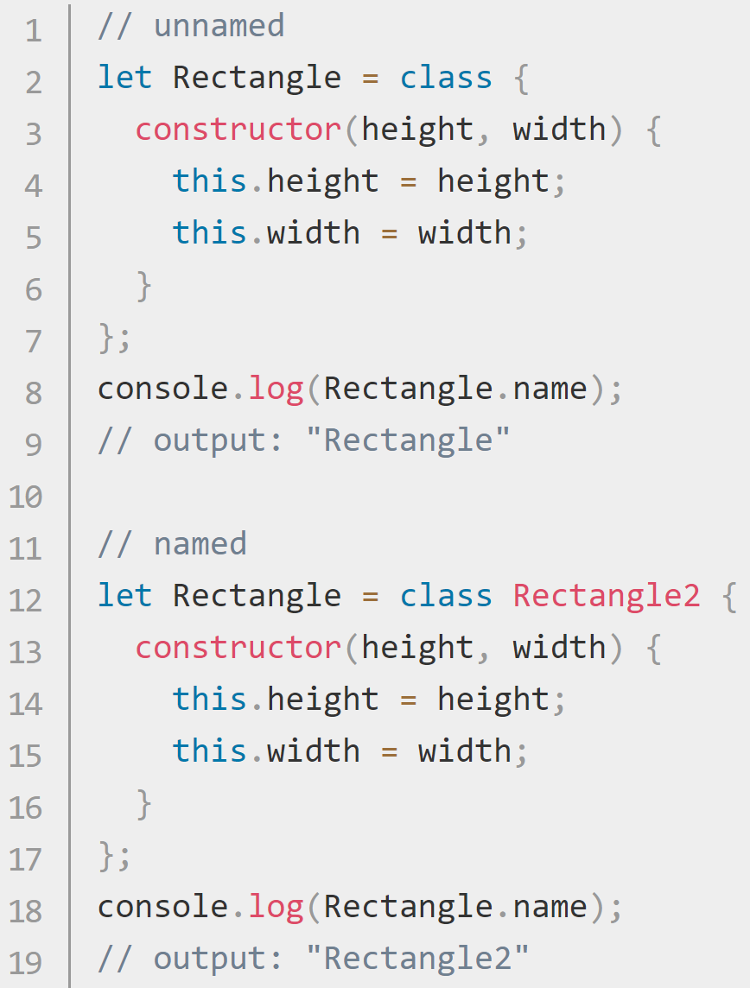
JavaScript Classes https://developer.mozilla.org/en-US/docs/Web/JavaScript/Reference/Classes
The class syntax does not introduce a new object-oriented inheritance model to JavaScript. Classes are "special functions“.
Just as you can define function expressions and function declarations, the class syntax has two components: class expressions and class declarations.
Class Declaration | Class Expression
class Rectangle { constructor(height, width) { this.height = height; this.width = width; } } | Class expressions can be named or unnamed. There is an implicit ‘name’ property in the class object. The name given to a class expression is local to the class's body. It can be retrieved through the class's (not the instance's) name property.
A class must be declared before they can be accessed. (no Hoisting)

Slide 8
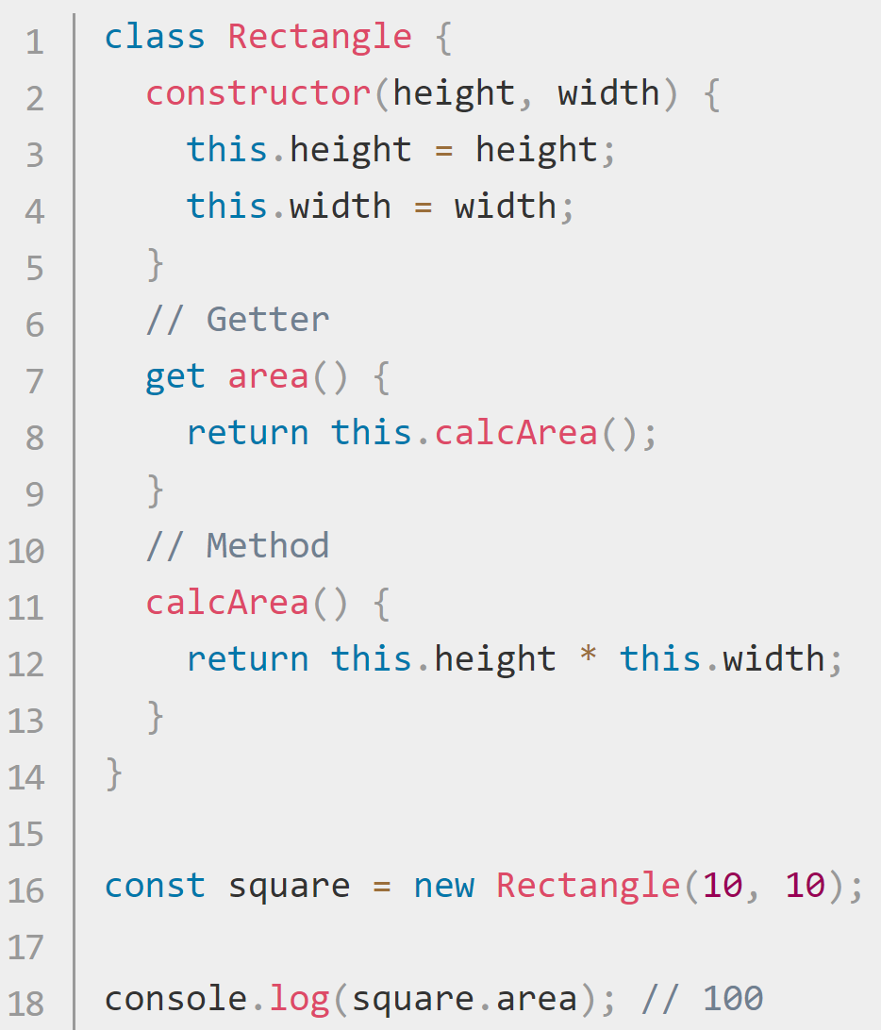
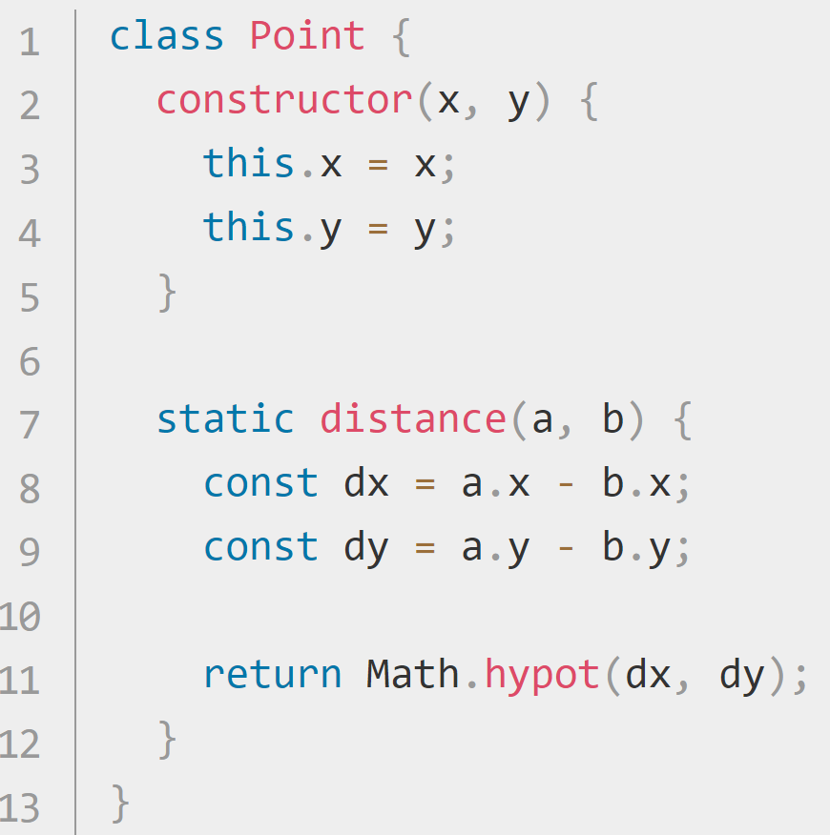
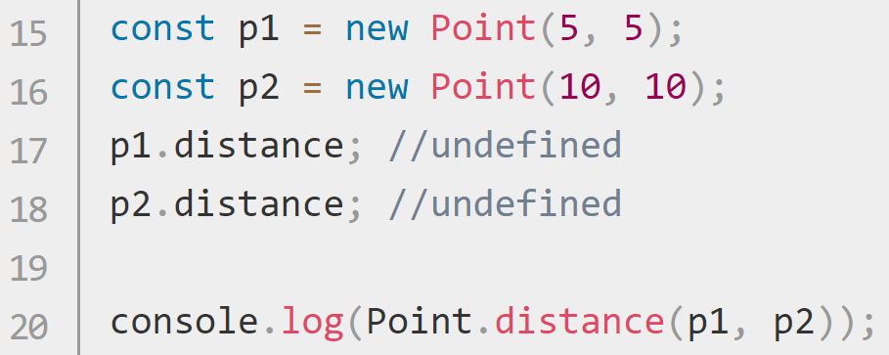
JS Class Parts https://developer.mozilla.org/en-US/docs/Web/JavaScript/Reference/Classes
The constructor method creates and initializes an object created from a class template. There can be only one constructor in each class.
Instance Properties must be defined inside of class methods.
Prototype Methods are declared in the class and are available through an instance of the class.
Static Methods are called without instantiating their class and cannot be called through a class instance. (below)

Slide 9
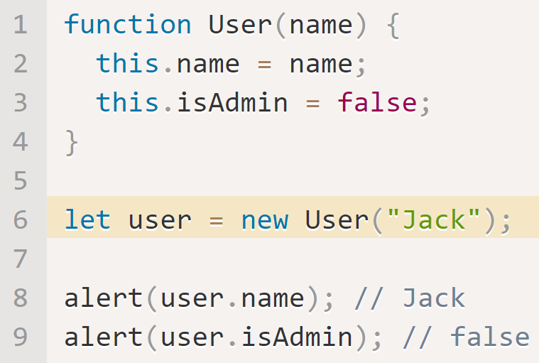
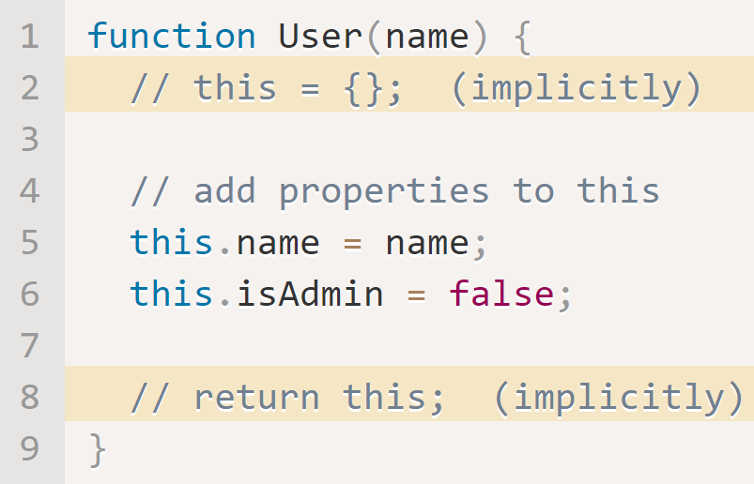
JS Functions – Constructors and ‘new’ https://javascript.info/constructor-new
A constructor function in JavaScript serves the same purpose as a Class constructor in C#.
Constructor functions technically are regular functions.
They have two conventions:
Their names are in Pascal case.
They should be executed only with "new" operator.
When a function is executed with new, it implicitly does the following:
A new empty object is created and assigned to this.
The function body executes. Usually it modifies this, by adding new properties to it.
The value of this is returned.
The main purpose of constructor functions is to implement reusable object creation code.

Slide 10
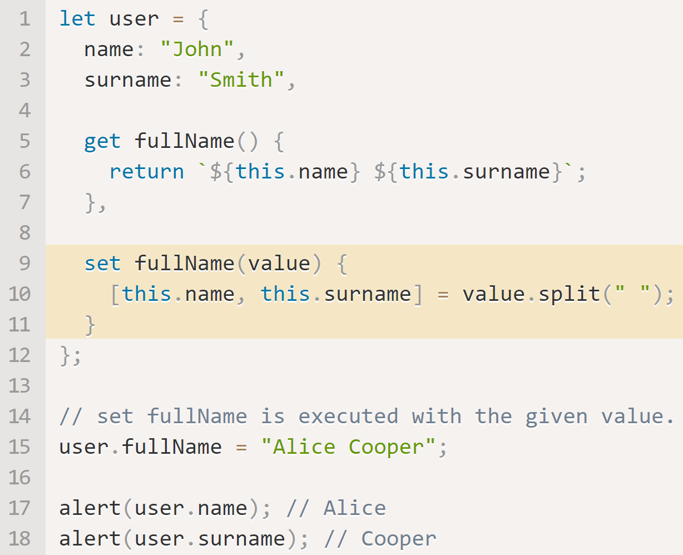
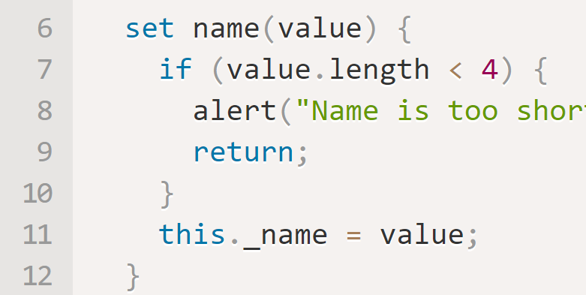
Getters and Setters https://javascript.info/property-accessors#getters-and-setters
Accessor properties (new to JS) are functions that get and set a value but look like regular properties to external code.
Getters and Setters are accessed like properties. (instanceName.getterName).
Getters and Setters allow validation to be written into the class functionality.
Setters must have one parameter.

Slide 11
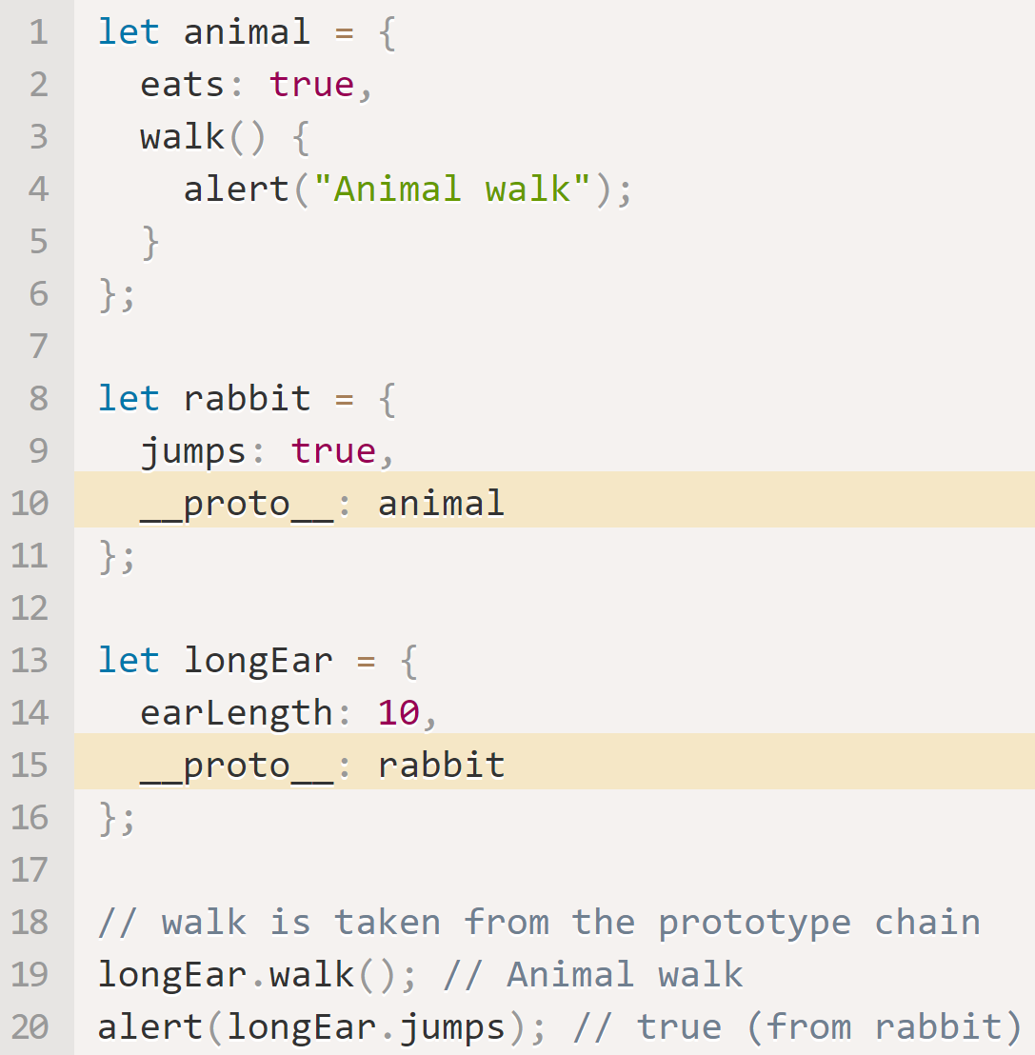
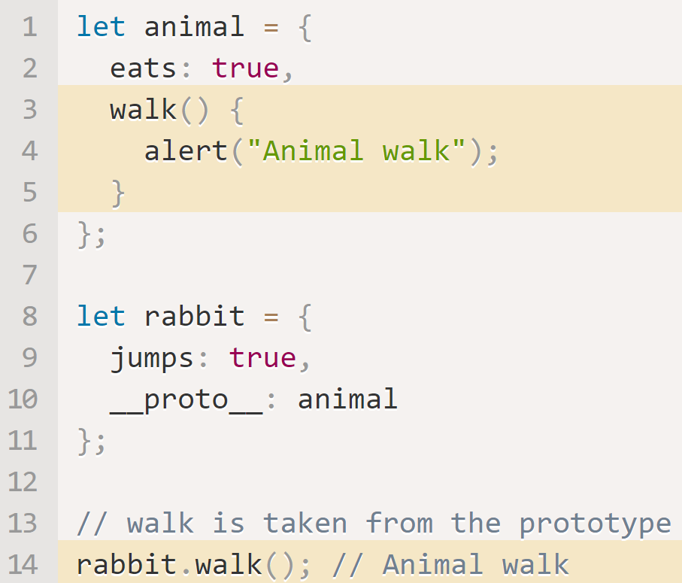
JavaScript [[Prototype]] https://javascript.info/prototype-inheritance
Objects have a hidden property, [[Prototype]], that is either null or references another object. This object is called a “prototype”. When we want to read a property from an object and it isn’t found, it’s taken from the prototype. This is called “prototypal inheritance”. [[Prototype]] is internal and hidden, but you can manually set it.
Hierarchical Inheritance
Multiple prototype inheritance is not allowed.
__proto__ does not support writing or deleting.
Inheritance can be chained.
Inheritance cannot be circular.
Getters/Setters are also inherited.
Inherit Methods

Slide 12
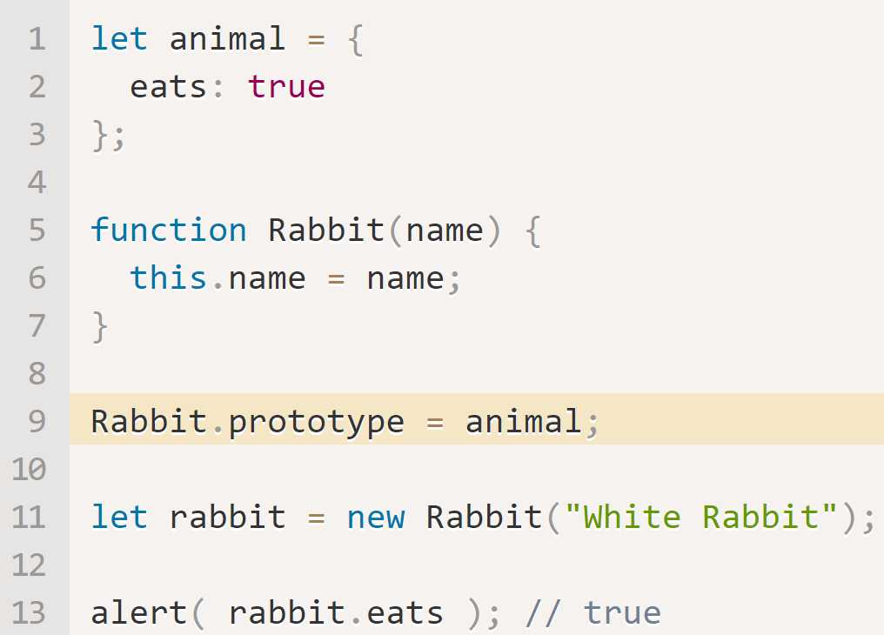
JavaScript Prototypes https://javascript.info/function-prototype https://javascript.info/prototype-methods
Prototypal Inheritance was one of the core features of JS originally, but there was no direct access to it. The only method that worked reliably was a "prototype" property of the constructor function.
There are many scripts that still use __proto__. Remember that prototype is a default property provided in the constructor.
In this example, setting
Rabbit.prototype = animal
sets its prototype to animal.

Slide 13
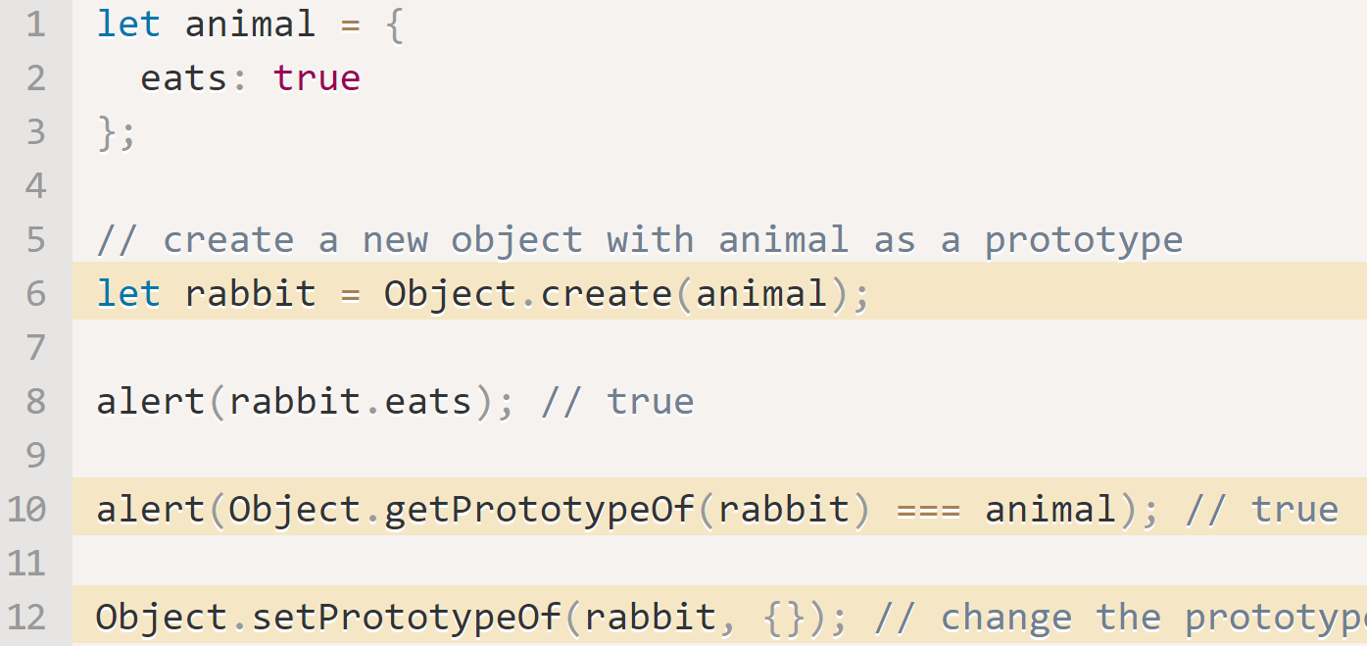
JavaScript Objects without __proto__ https://javascript.info/function-prototype https://javascript.info/prototype-methods
__proto__ is outdated and deprecated.
Instead of __proto__, use:
Object.create(proto class). This creates an empty object with given proto class as [[Prototype]]
Object.create(proto class, {additional descriptors}) adds optional property descriptors.
Object.getPrototypeOf(obj) – returns the [[Prototype]] of obj.
Object.setPrototypeOf(obj, proto) – sets the [[Prototype]] of obj to proto.

Slide 14
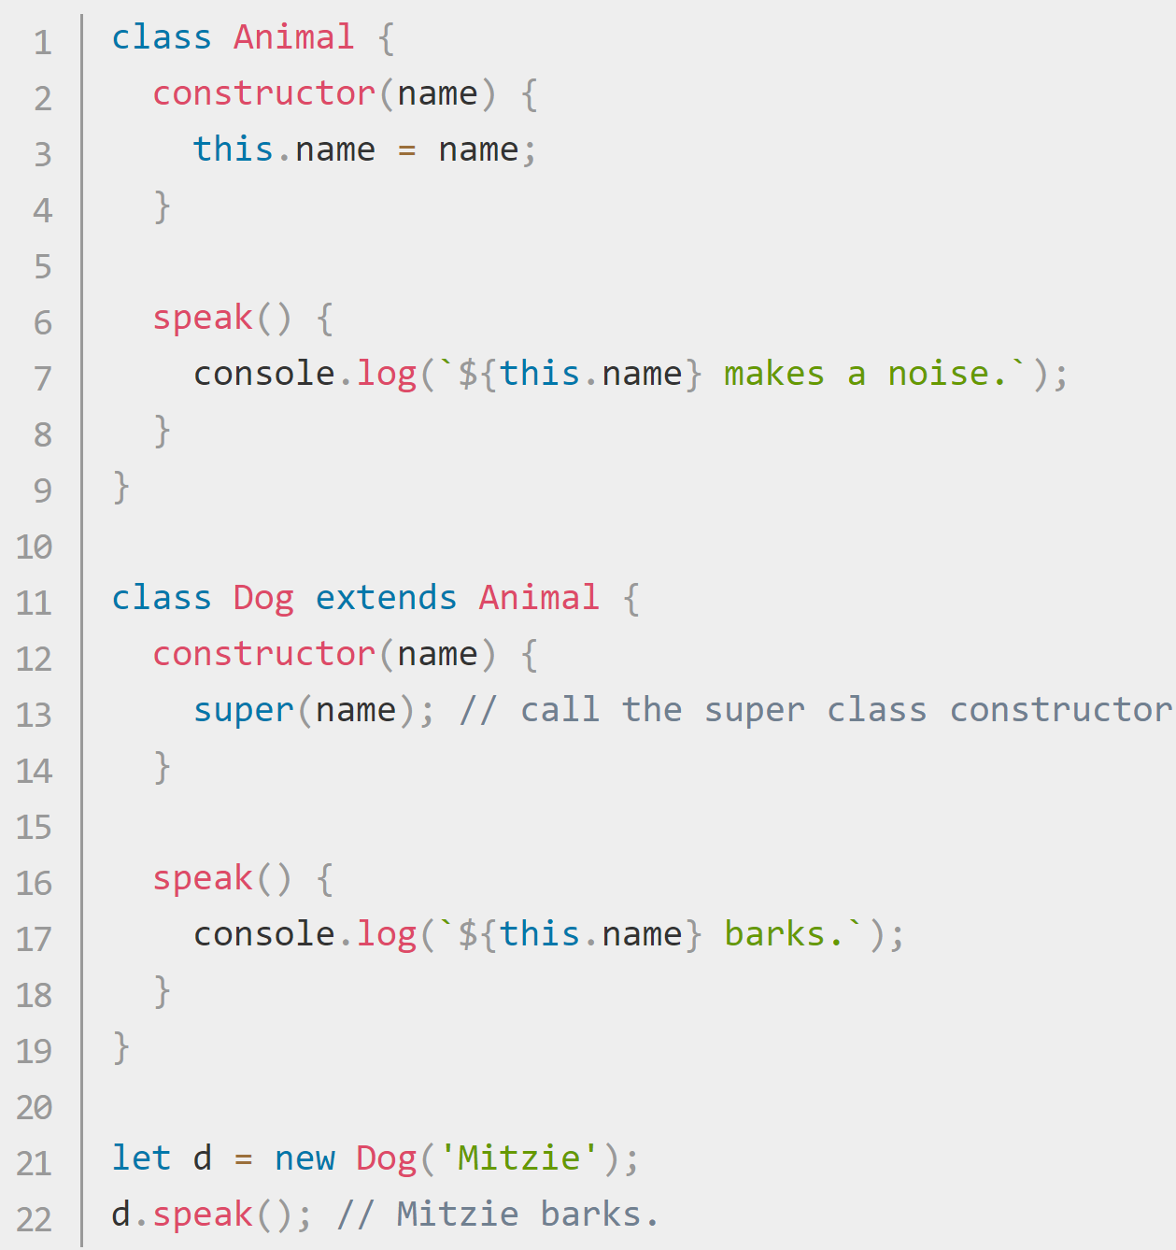
JavaScript Class Inheritance https://developer.mozilla.org/en-US/docs/Web/JavaScript/Reference/Classes https://developer.mozilla.org/en-US/docs/Web/JavaScript/Reference/Classes#Sub_classing_with_extends
The extends keyword is used in class declarations or class expressions to create a class as a child of another class.
If there is a constructor present in the subclass, it needs to first call super() before using "this".
If you want to inherit from a regular object, you can instead use Object.setPrototypeOf()

Slide 15
JS objects – Common Commands https://developer.mozilla.org/en-US/docs/Learn/JavaScript/First_steps/A_first_splash https://javascript.info/object
Command | Usage
delete user.age | Remove a property (age) from an object (user).
myString.split(','); | Divide a string at each comma.
In Progress….

