Slide 1

Test Driven Development
.net

Slide 2
Test-driven development (TDD) is a software development process that relies on the repetition of a very short development cycle. Requirements are turned into very specific test cases. Then the code is improved so that the tests pass. The cycle repeats.
https://en.wikipedia.org/wiki/Test-driven_development

Slide 3

TEST

Slide 4
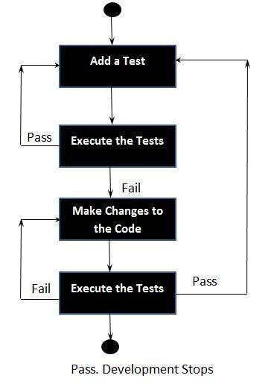
Testing – Traditional Model https://docs.microsoft.com/en-us/visualstudio/cross-platform/tools-for-cordova/debug-test/test-driven-development?view=toolsforcordova-2017#test-driven-development https://www.tutorialspoint.com/software_testing_dictionary/code_driven_testing.htm
Developers who define their role as “writing code” usually jump right into writing methods that handle different kinds of data that might get thrown at them. Then they write tests.
After writing a few tests, they’ll see that some of those tests fail because their methods can’t handle certain code cases. They improve those methods to handle those cases, and write a few more tests, which then reveal additional issues in the unit code.
This puts them into a pattern of bouncing back and forth between thinking about coding and thinking about data for test cases.
This results in missed test cases and faulty code.

Slide 5
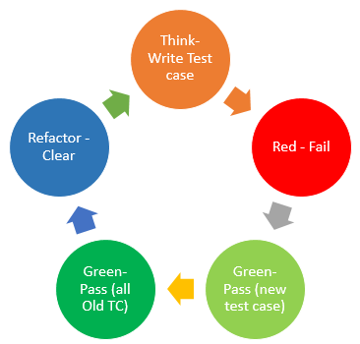
TDD – Test Driven Development https://docs.microsoft.com/en-us/visualstudio/cross-platform/tools-for-cordova/debug-test/test-driven-development?view=toolsforcordova-2017#test-driven-development
Testing is just as important as coding.
Thinking through variations of good and bad data is a different mental process than thinking about how to handle those variations in code.
TTD asks, “How do I challenge the unit-under-test to fail?”
“Coding” asks “How do I write this method to work properly?”

Slide 6
TDD – “Red, Green, Refactor” https://www.whizlabs.com/blog/what-is-tdd-and-its-phases/ https://www.codecademy.com/articles/tdd-red-green-refactor
Create a test case - Write a test case before writing any code. This ensures you write the test to a methods’ expected functionality and the test case is not biased to show code merely works.
Red - Failure of test case. There’s no code. You get a compile error.
Green – Write code so the new test case passes. Write only the minimum required to pass the test case. The “just enough” concept helps ensure that no extra code goes in.
Green - Ensure all old test cases still pass.
Refactor the code to clean it - Ensure that all functionality is intact, and the code is refined.
Repeat the cycle.

Slide 7
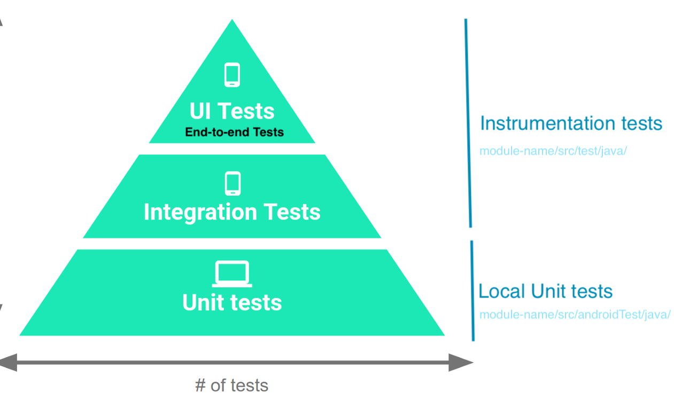
Unit Testing https://docs.microsoft.com/en-us/visualstudio/test/unit-test-basics?view=vs-2019
Unit testing because you break down the functionality of your program into discrete testable behaviors that you can test as individual units.
Use a unit testing framework to create unit tests, run them, and report the results of these tests.
Rerun unit tests when you make changes to test that your code is still working correctly.
Unit testing has the greatest effect on the quality of your code when it's an integral part of your software development workflow.

Slide 8
Unit Testing https://docs.microsoft.com/en-us/dotnet/core/testing/ https://docs.microsoft.com/en-us/dotnet/core/testing/#what-are-unit-tests https://docs.microsoft.com/en-us/visualstudio/test/unit-test-basics?view=vs-2019
Automated tests are a great way to ensure an application does what’s intended. There are multiple types of tests (integration tests, web tests, load tests).
Unit tests:
primarily test methods.
should only test code within the developer’s control.
should not test infrastructure concerns (databases, file systems, network resources).

Slide 9
.NET/Coverlet Code Coverage Reporting. https://docs.microsoft.com/en-us/dotnet/core/testing/unit-testing-code-coverage?tabs=windows
-p:CollectCoverage=true
Give a step-by-step on this.

Slide 10
