Slide 1

xUnit Testing
.NET

Slide 2
xUnit.net is a free, open source, community-focused unit testing tool for the .NET Framework. xUnit.net is part of the .NET Foundation.
https://xunit.net/

Slide 3
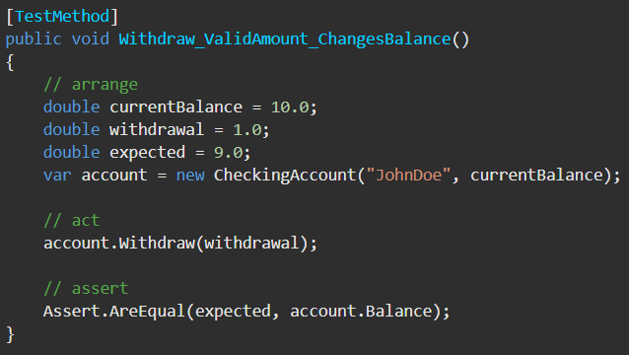
Arrange, Act, Assert https://docs.microsoft.com/en-us/visualstudio/test/unit-test-basics?view=vs-2019
The Arrange-Act-Assert pattern is a common way of writing unit tests.
The Arrange section of a unit test method initializes objects and sets the value of the data that is passed to the method under test.
The Act section invokes the method under test with the arranged parameters.
The Assert section verifies that the action of the method under test behaves as expected.

Slide 4
xUnit Testing Step-By-Step in Visual Studio https://docs.microsoft.com/en-us/dotnet/core/testing/unit-testing-with-dotnet-test#create-a-test https://docs.microsoft.com/en-us/dotnet/core/testing/unit-testing-with-dotnet-test
Open a Solution in Visual Studio.
Right-Click the Solution.
Add >> new project…
Type “xunit” in the template search box.
Select xUnit Test Project(.NET Core).
Name the project whatever you want (VS inserts ‘_’ for spaces).
Right-Click ‘Dependencies’ in the test project.
Click ‘Add Reference’
In the left pane of the Add References window, click ‘Projects’
In the center pane, click to check the Projects containing methods you want to test.
Click ‘OK’
Add your tests to the Test project.

Slide 5
xUnit Testing in VS Code - Step-by-Step https://docs.microsoft.com/en-us/dotnet/core/testing/unit-testing-with-dotnet-test https://stackoverflow.com/questions/45127849/xunit-namespace-could-not-be-found-in-visual-studio-code
Create a .sln and a directory of the same name holding that .sln to which you will add the various projects with
dotnet new sln -o [.sln name] -
2. Enter the new directory with:
cd [newDirectoryName]
Create the App project to be tested. Skip this step if you already have an app project created.
dotnet new console -o [projectName]
Add the App project to the .sln with:
dotnet sln add <relativePathToProject>.csproj
Add code to the project (i.e. methods to test).
Create the testing project with:
dotnet new xunit -o [testingProjectName].Tests
Add the testing project to the solution with
dotnet sln add ./[directoryOfTestingProject]/[NameOfTestingProject].csproj
Add the project as a dependency to the testing project with
dotnet add <relativePathToXunitProj>.csproj reference <relativePathToAppProj>.csproj
Make sure your project classes are public.
Reference the App project inside the Xunit project with
using [App project namespace];
Create tests in the testing project
Enter the testing project folder with
cd TestingProjectFolderName
From the testing project directory, run dotnet test to run the tests.

Slide 6
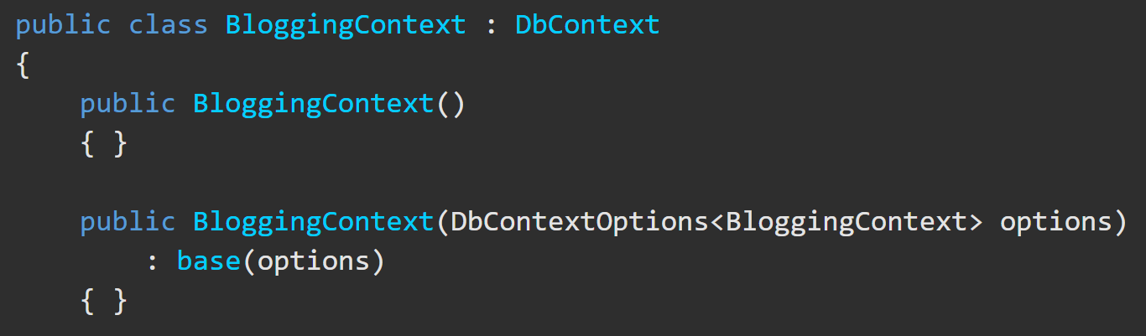
InMemory DB - Step-by-Step https://docs.microsoft.com/en-us/ef/core/miscellaneous/testing/in-memory https://www.thereformedprogrammer.net/using-in-memory-databases-for-unit-testing-ef-core-applications/
EF Core database providers do not have to be relational databases. InMemory is designed to be a general-purpose database for testing. It is not designed to mimic a relational database.
There are a few steps to setting up a InMemory DB.
1. Set up the constructor in your DB Context class to accept a DB configuration parameter called DbContextOptions.

Slide 7
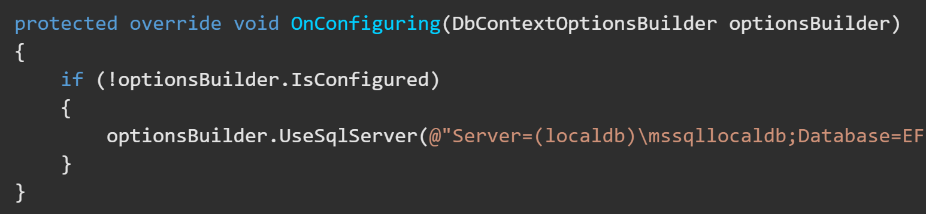
InMemory DB - Step-by-Step https://docs.microsoft.com/en-us/ef/core/miscellaneous/testing/in-memory
2. Alter your DbContext.OnConfiguring() to check for an already configured DB and to not use your production DB if there’s already a DB configured.

Slide 8
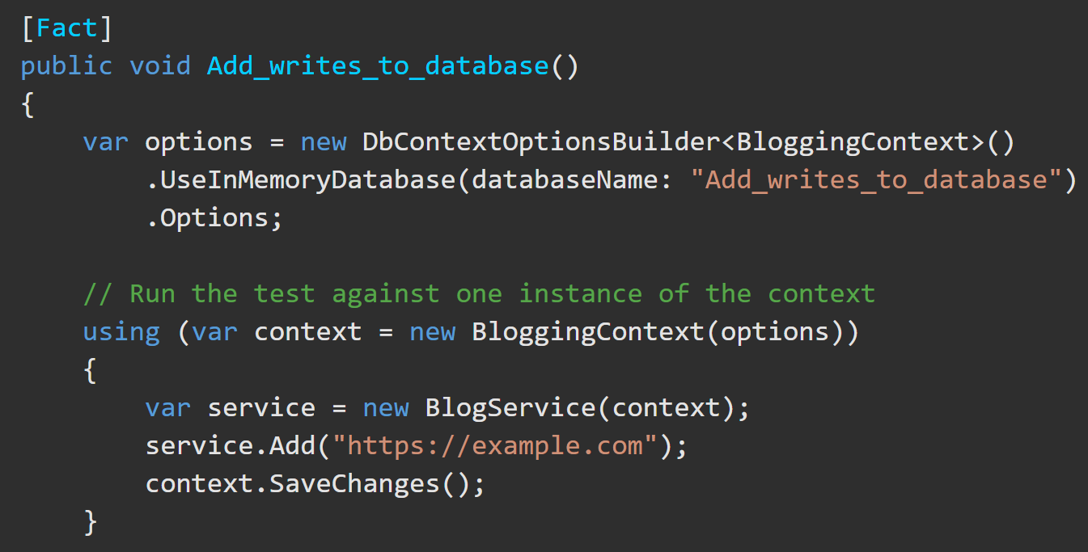
InMemory DB - Step-by-Step https://docs.microsoft.com/en-us/ef/core/miscellaneous/testing/in-memory
Right-click your test project to download the NuGet Package Microsoft.EntityFrameworkCore.InMemory.
In the test project, configure a new, clean context for every test.
Instead of creating a new Database for each test you can create the InMemory Db above all tests, then, in each test, call:
context.Database.EnsureDeleted(); // delete any Db from a previous test
context.Database.EnsureCreated(); // create anew the Db. You will need to seed the Db again.
The configurations for this InMemory DB must be sent to the Database context constructor on instantiation.

Slide 9
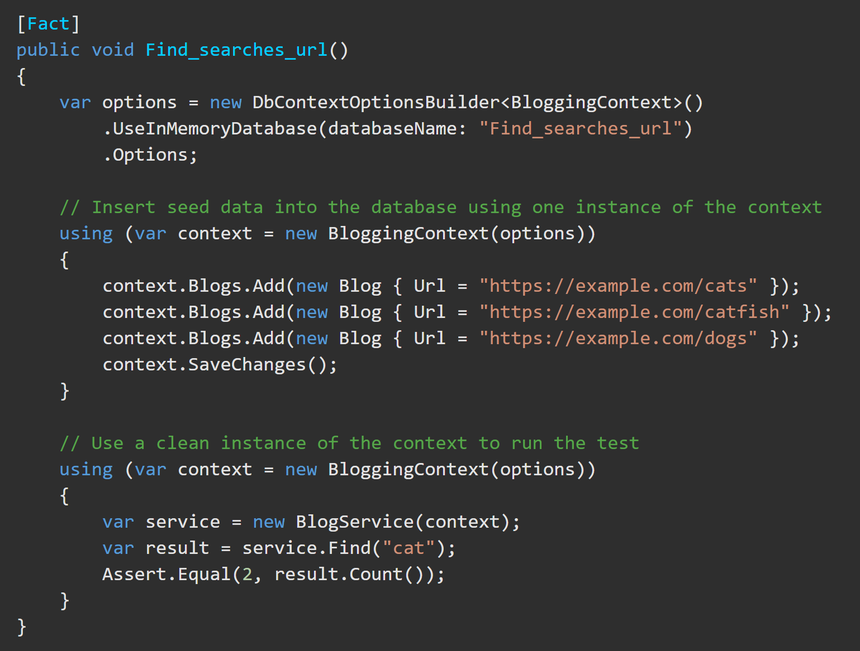
InMemory DB - Step-by-Step https://docs.microsoft.com/en-us/ef/core/miscellaneous/testing/in-memory
Here is a sample test for comparison.
Arrange
Act
Assert

Slide 10
Assert()
Assert.Equal(<expected>,<result>)
Assert.Equal(<expected>,<result>, <roundedToHowManyDecimals>)
Assert.Equal(<expected>,<result>, true) => Set the ignoreCase property to true to be case insensitive.
Assert.Contains(<substring>, <result>); => check is some some string is present
Assert.Contains(<substring>, <result>, StringComparison.InvariantCultureIgnoreCase); => to be case insensitive
Assert.StartsWith(<substring>,<result>); => check if the result begins with some substring
Assert.EndsWith(<substring>,<result>); => check if the result ends with some substring
Assert.Matches(<regEx>, <result>); => check is the result matches a regular expression.

Slide 11
Assert()
Assert.Null(<nullResult>); Passes if the value is true
Assert.NotNull(<result>); Passes if the value is not null
Assert.True(<trueResult>);
Assert.False(<falseResult>);

