Slide 1

Data Annotations
.NET

Slide 2
Data Annotations Attributes enable you to perform validation simply by adding one or more attributes to a Model class property.
https://docs.microsoft.com/en-us/aspnet/mvc/overview/older-versions-1/models-data/validation-with-the-data-annotation-validators-cs

Slide 3
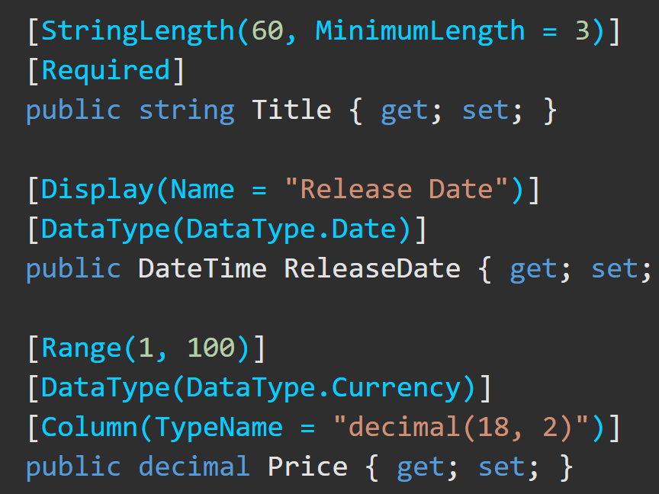
Data Annotations – Overview https://docs.microsoft.com/en-us/aspnet/mvc/overview/older-versions-1/models-data/validation-with-the-data-annotation-validators-cs
The DataAnnotations namespace provides a set of built-in validation attributes that are applied declaratively to a class or property.
DataAnnotations also contains formatting attributes like DataType that help with formatting but don't provide validation.

Slide 4
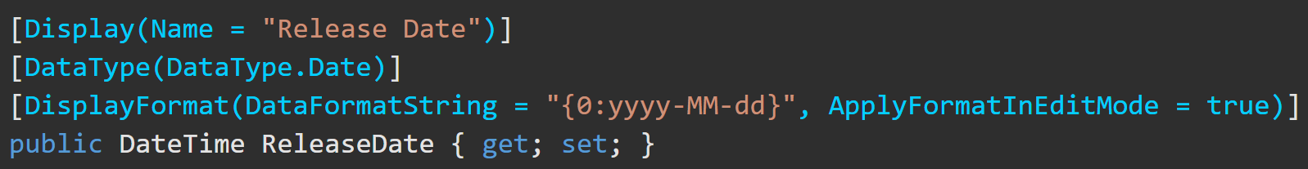
Annotations to Display and Edit
[Display()] | [DataType()]
[Display(Name ="Film Genre")] This gives the View the desired name for Display in the browser | [DataType(DataType.Password)] Displays the types’ text as dots to obscure the actual content.

Slide 5
Annotations for Validation https://docs.microsoft.com/en-us/aspnet/mvc/overview/getting-started/introduction/adding-validation
Annotation | Explanation
[Required] | The property is not allowed to be null
[Range(x,y)] | X is the minimum. Y is the maximum.
[StringLength(x)] | X is the maximum length of the property
[RegularExpression] | [RegularExpression(@"^[A-Z]+[a-zA-Z0-9""'\s-]*$")]
[MinLength(x)] | Minimum length is x. Also sets DB column size min.
[MaxLength(y, ErrorMessage-”This is required”)] | Maximum length is y and this error message is displayed. Also sets DB column size max.
*Custom validation is also possible.

Slide 6
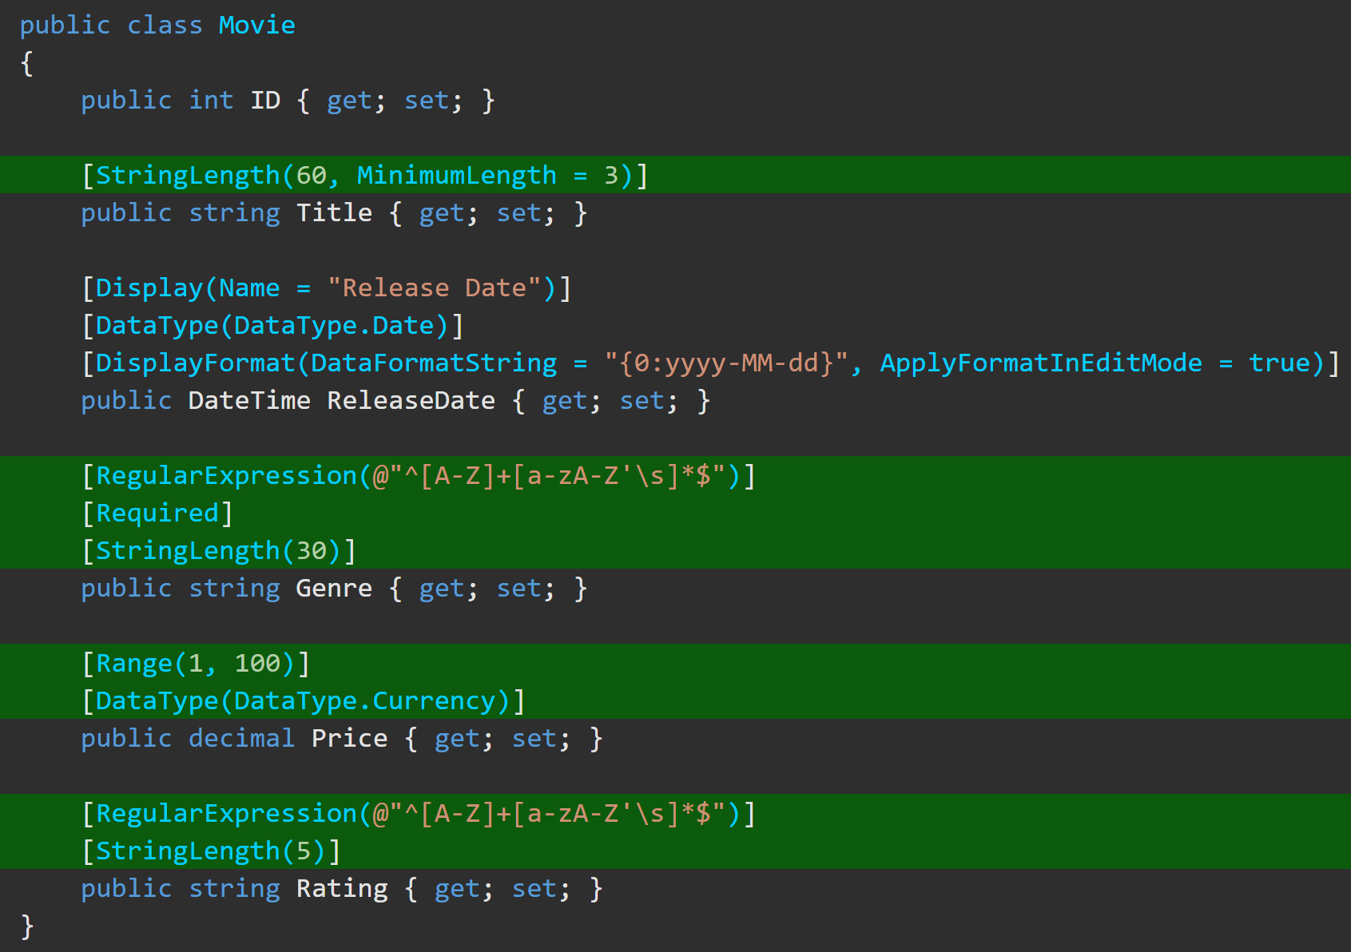
Data Annotations – Examples https://docs.microsoft.com/en-us/aspnet/mvc/overview/getting-started/introduction/adding-validation

Slide 7
EF Code First Data Annotations https://docs.microsoft.com/en-us/ef/ef6/modeling/code-first/data-annotations#the-model
Data Annotation | Explanation
[Key] | Annotates a property as the Key of the entity .
[Column(order=2)] | Used with [Key] to create a composite column. This will be the 2nd key.
[ForeignKey(“FK_ModelName")] | Marks a certain model as the FK for this model.
[Required] | This property will be required in the Db and client-side.
[NotMapped] | This property will not be mapped to the Db.
[ComplexType] | This annotation is placed on a subtype of a model to alert EF that the property on the model has properties of it own.
[ConcurrencyCheck] | Checks of changes between .SaveChanges() calls.
[Table(“TableName")] | Placed above the Model Class name. Allows you to change the name of the table in the Db.
[Column(“ColumnName”)] | Allows you to name a column other than the property name.
*There are many more available

