Slide 1

Routing
.NET

Slide 2
ASP.NET Core controllers use Routing middleware to match the URLs of incoming requests and map them to actions. Route templates are: -defined in startup code or attributes, -describe how URL paths are matched to actions, and -are used to generate URLs for links. Actions are either conventionally routed or attribute routed.
https://docs.microsoft.com/en-us/aspnet/core/mvc/controllers/routing?view=aspnetcore-5.0

Slide 3
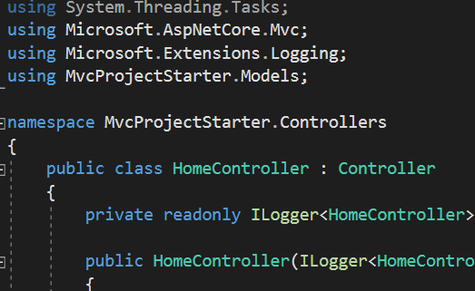
Controllers https://docs.microsoft.com/en-us/aspnet/core/mvc/controllers/actions?view=aspnetcore-5.0
A Controller is a class used to define and group a set of Action methods. Controllers are meant to logically group similar Actions together. This allows routing, caching, and authorization to be applied collectively.
Within the Model-View-Controller or REST pattern, a Controller is responsible for the initial processing of a request. Business decisions should be performed within the Model (Business/Domain) layer.
To be classified as a Controller, at least one of these conditions is true:
The class name is suffixed with Controller.
The class inherits from a class whose name is suffixed with Controller.
The [Controller] attribute is applied to the class.
Controller classes reside in the project's root-level Controllers directory and inherit from Controller or ControllerBase classes.

Slide 4
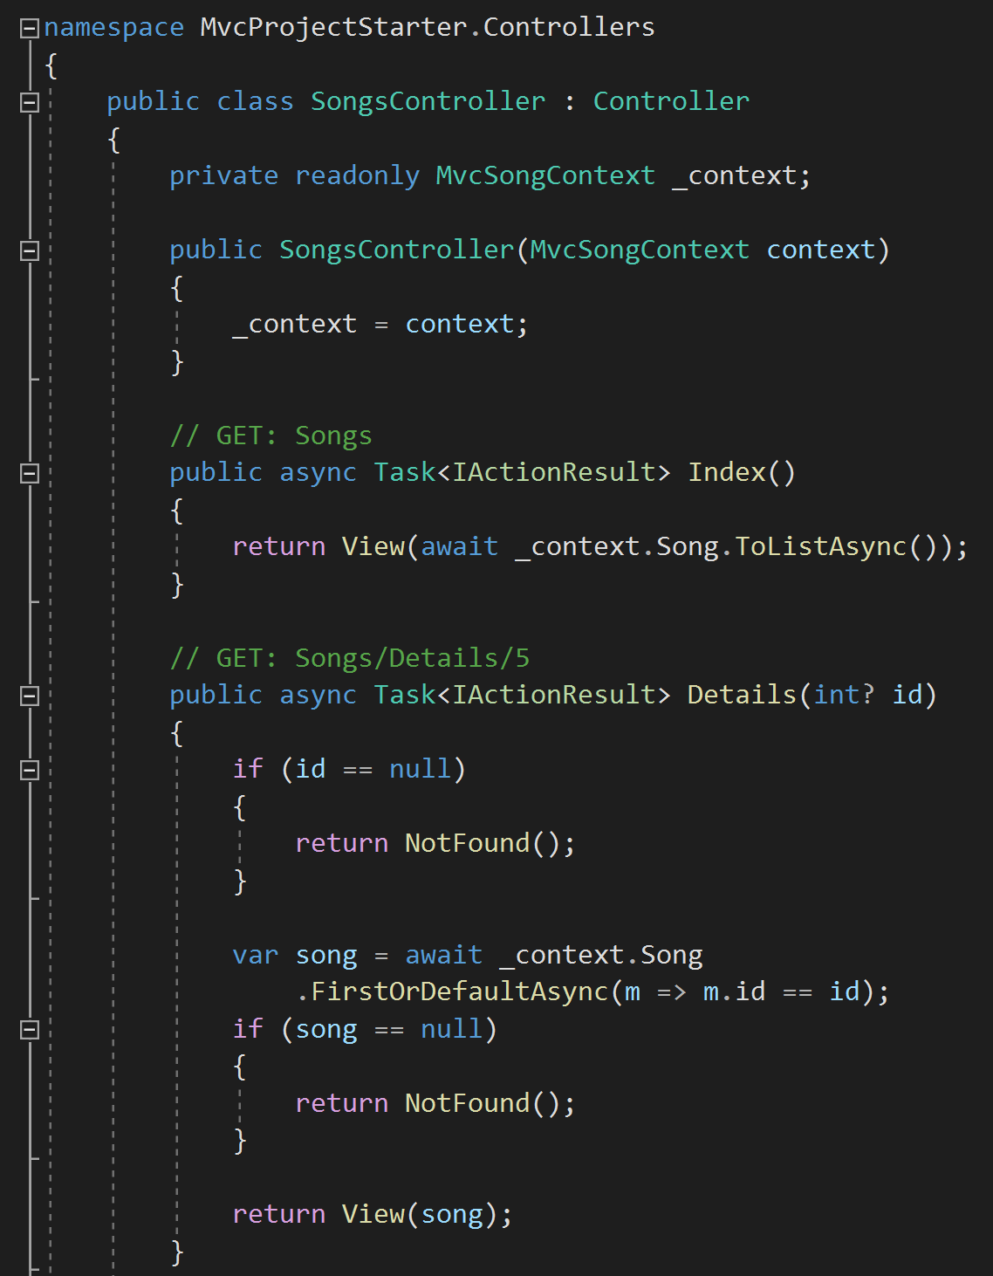
Action Methods https://docs.microsoft.com/en-us/aspnet/core/mvc/controllers/actions?view=aspnetcore-5.0#defining-actions
An Action method is a method in a Controller that handles requests.
All public methods in a Controller (except those with the [NonAction] attribute) are Actions.
Parameters on Actions are bound to request data and are validated using ModelBinding.
Model validation occurs for everything that’s Model-Bound.
The ModelState.IsValid method indicates whether ModelBinding and validation succeeded.
Action methods should contain logic for mapping a request to a business concern.
Business concerns should typically be represented as services that the Controller accesses through Dependency Injection.
Actions can return anything, but usually return an IActionResult or Task<IActionResult> (for async methods).

Slide 5
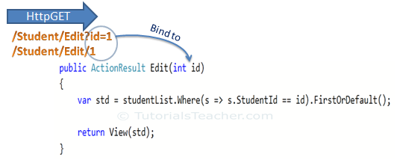
Model Binding https://docs.microsoft.com/en-us/aspnet/core/mvc/models/model-binding?view=aspnetcore-5.0
Controllers and Action methods work with data that comes from HTTP requests. (Ex. POSTed form fields provide values for the properties of the model.)
Writing code to retrieve each of these values and convert them from strings to .NET types would be tedious and error-prone. ModelBinding automates this process.
The ModelBinding system:
Retrieves data from various sources such as route data, form fields, and query strings.
Provides the data to Controllers in Action method parameters and public Properties.
Converts string data to .NET types.
Updates Properties of complex types.

Slide 6
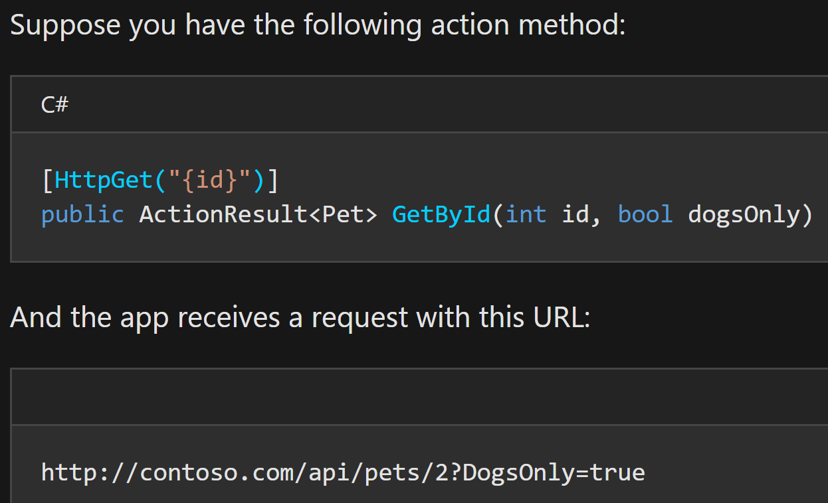
Model Binding https://docs.microsoft.com/en-us/aspnet/core/mvc/models/model-binding?view=aspnetcore-5.0
In this example, ModelBinding goes through the following steps for the request at the bottom.
The routing system selects the correct action method.
It needs the first parameter of GetByID (id) and looks through the HTTP request.
It finds id = "2" in the route data.
The system converts string "2" into integer 2.
It finds the next parameter of GetByID(dogsOnly).
The system finds "DogsOnly=true" in the query string. Name matching is not case-sensitive.
The system converts the string "true" to a boolean true.

Slide 7
Different Controller Helper (Action) Methods https://docs.microsoft.com/en-us/aspnet/core/mvc/controllers/actions?view=aspnetcore-5.0#controller-helper-methods
The Controller provides access to three categories of helper methods.
an empty response body | a non-empty response body with a predefined content type | a non-empty response body formatted in a content type negotiated with the client
HTTP Status Code (ex. BadRequest(), NotFound(), and Ok();) | View() which uses a Model to render HTML. (ex. Return View(Customer);) | This category is better known as Content Negotiation. Content negotiation applies whenever an action returns an ObjectResult type or something other than an IActionResult. (Ex. BadRequest(), CreatedAtRoute();, and Ok();)
Redirect - returns a redirect to an action or destination (Redirect(), LocalRedirect(), RedirectToAction(), or RedirectToRoute();). | Formatted Response - JSON or a similar data exchange format to represent an object, (ex. Json(customer);)

Slide 8
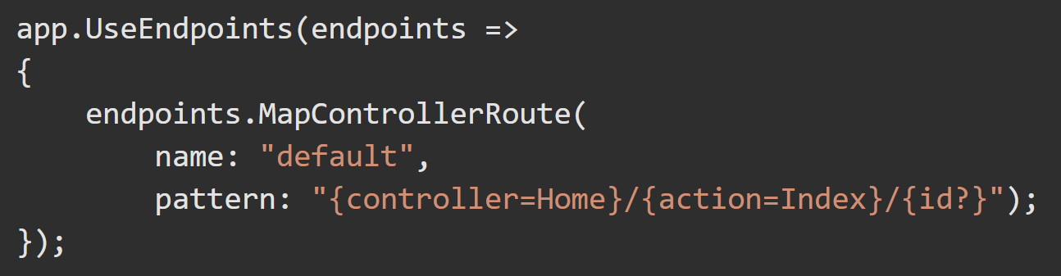
Conventional Routing https://docs.microsoft.com/en-us/aspnet/core/mvc/controllers/routing?view=aspnetcore-5.0#cr
Startup.Configure() typically has code similar to the following when using conventional routing.
Inside the call to UseEndpoints(), .MapControllerRoute() is used to create a route. This single route is named “default”. /Home/Index/<args> being the default route used when a request arrives to the base URL.

Slide 9
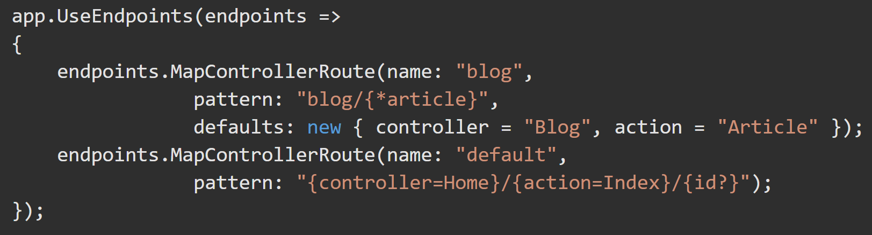
Conventional Routing https://docs.microsoft.com/en-us/aspnet/core/mvc/controllers/routing?view=aspnetcore-5.0#set-up-conventional-route https://docs.microsoft.com/en-us/aspnet/core/mvc/controllers/routing?view=aspnetcore-5.0#multiple-conventional-routes
The route template (in Startup.cs) "{controller=Home}/{action=Index}/{id?}“ matches a URL path like /Products/Details/5.
The route template tokenizes(extracts) the route values:
Controller = Products,
Action = Details,
id = 5
This results in a match if the app has a Controller named ProductsController and an Action called Details. The id value is optional due to the ?.

Slide 10
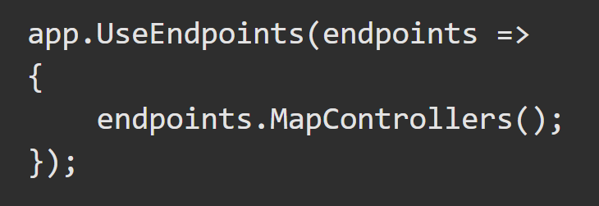
Attribute Routing – REST API’s https://docs.microsoft.com/en-us/aspnet/core/mvc/controllers/routing?view=aspnetcore-5.0#attribute-routing-for-rest-apis
RESTful APIs should use Attribute Routing to model the app's functionality as a set of resources where operations are represented by HTTP verbs.
Attribute Routing uses sets of Attributes on each Controller Action to map Actions directly to route templates. The following StartUp.Configure() code is typical for a RESTful API. .MapControllers() is called inside UseEndpoints() to map attribute routed controllers.

Slide 11
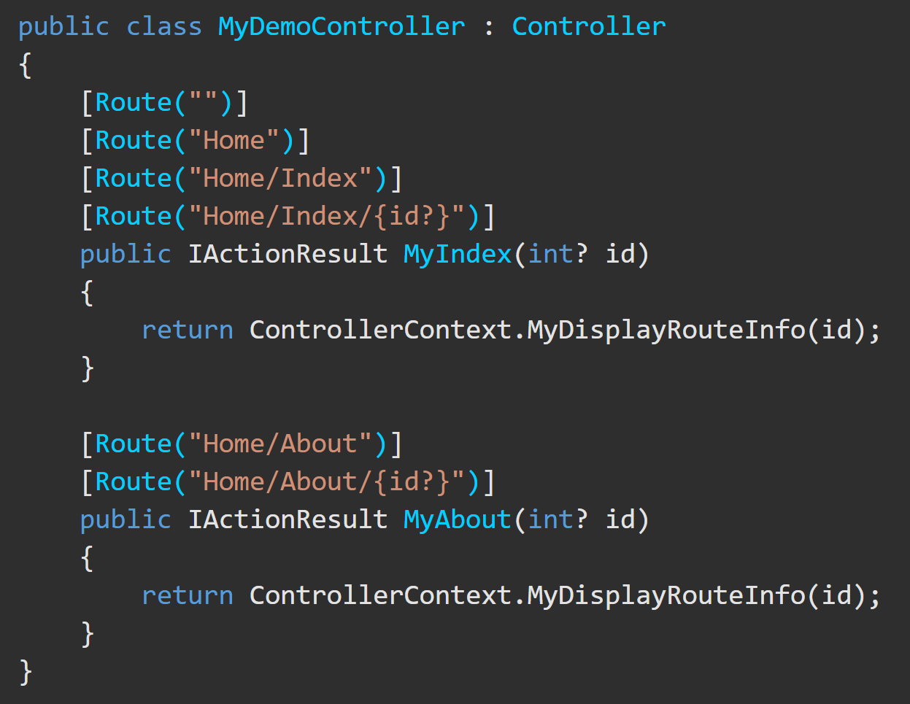
Attribute Routing – REST API’s https://docs.microsoft.com/en-us/aspnet/core/mvc/controllers/routing?view=aspnetcore-5.0#attribute-routing-for-rest-apis
HomeController matches a set of URLs similar to how the default conventional routing matches a Controller Action to {controller=Home}/{action=Index}/{id?}.
Conventional Routing handles routes more succinctly, but Attribute Routing allows (and requires) precise control over which route templates apply to each Action.
With Attribute Routing, the Controller name and Action names no longer play a role in which Action is matched.

Slide 12
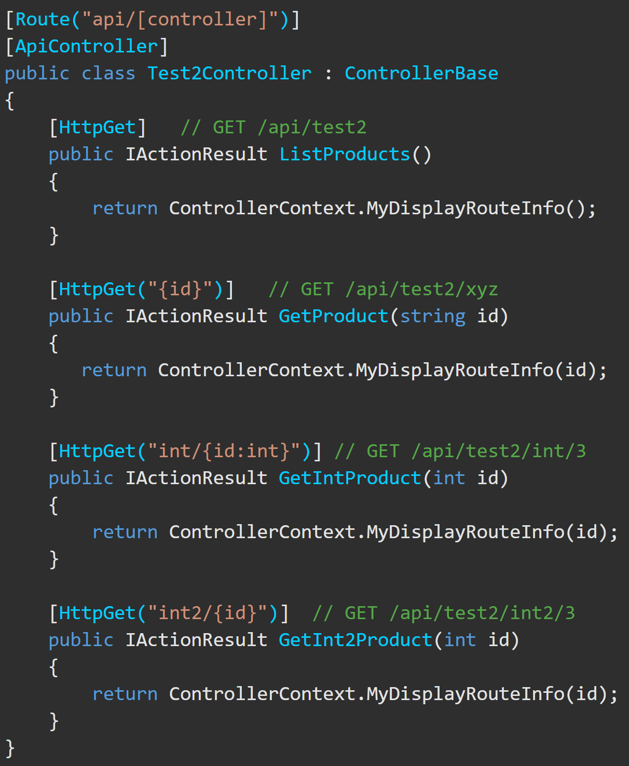
Attribute Routing - HTTP Verb Templates https://docs.microsoft.com/en-us/aspnet/core/mvc/controllers/routing?view=aspnetcore-5.0#http-verb-templates
ASP.NET Core provides these HTTP verb attributes: [HttpGet], [HttpPost], [HttpPut], [HttpDelete], [HttpHead], [HttpPatch].
The GetProduct() Action method includes the "{id}" template, therefore ‘id’ is appended to the "api/[controller]" attribute template above the Controller, so GetProduct() template is "api/test2/{id}".
Therefore, GetProduct(string id) can match GET requests of the form:
/api/test2/{any string}.

