Slide 1

Web Service
.net

Slide 2
The term Web service (WS) refers to a server running on a computer device that is listening for requests at a particular port over a network. Web Services serve web documents (HTML, JSON, XML, and images).
https://en.wikipedia.org/wiki/Web_service

Slide 3
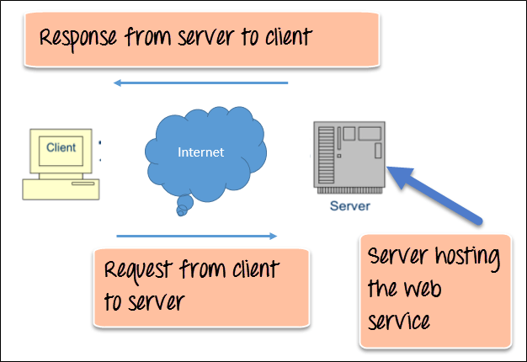
Web Services - Overview https://www.guru99.com/web-service-architecture.html https://docs.microsoft.com/en-us/dotnet/framework/wcf/whats-wcf#features-of-wcf
A Web Service is an application with a standardized communication method. This standardization allows communication between web client and web server applications.
A Web Service could be SOAP or REST.
A Web Service could be SOAP or REST.
The methods of a Web Service are searched for and invoked over a network using Remote Procedure Calls (RPC). RPC’s are written in Extensible Markup Language (XML).
Because RPC’s are standardized to XML, client and server applications can be written in any language.
Response from server to client written in XML
RPC request from client to server written in XML

Slide 4
SOAP Web Service vs API https://nordicapis.com/what-is-the-difference-between-web-services-and-apis/ https://www.guru99.com/api-vs-web-service-difference.html https://www.cleo.com/blog/knowledge-base-web-services
https://stackify.com/soap-vs-rest/

