Slide 1

CORS Cross-Origin Resource Sharing
.NET

Slide 2
Cross-Origin Resource Sharing (CORS) is a mechanism that uses additional HTTP headers to tell browsers to give access to a web application running at one origin to selected resources from a different origin.
https://developer.mozilla.org/en-US/docs/Web/HTTP/CORS

Slide 3
Avoid preflight problems with setting headers and CORS permissions.
Something about preflight rejections.

Slide 4
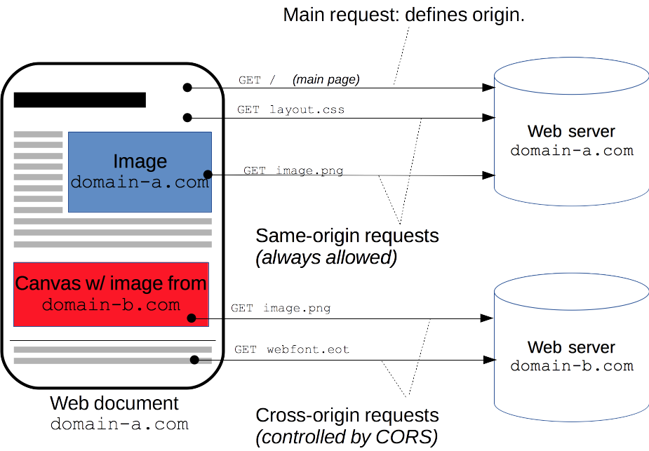
CORS - Overview https://developer.mozilla.org/en-US/docs/Web/HTTP/CORS
The specification for CORS is included as part of the WHATWG's Fetch Living Standard.
CORS is implemented if a document or web page needs resources from more than one source.
This was originally not allowed (for security reasons) but the CORS Standard has put protocols in place to make relax security and make CORS safe.

Slide 5
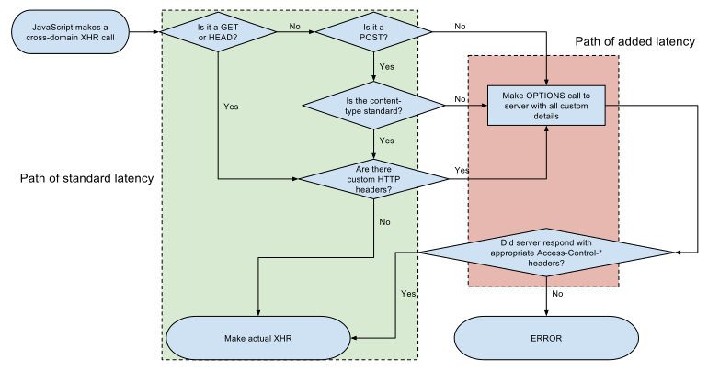
CORS Standard Protocols https://developer.mozilla.org/en-US/docs/Web/HTTP/CORS https://en.wikipedia.org/wiki/Cross-origin_resource_sharing
The CORS Standard adds new HTTP headers
servers describe which origins are permitted to read information from web browsers.
Browsers must "preflight" any requests that can alter data.
Browsers solicit supported methods from the server. Upon "approval" from the server, the browser sends the actual request.

Slide 6
CORS Standard Protocols https://developer.mozilla.org/en-US/docs/Web/HTTP/CORS https://en.wikipedia.org/wiki/Cross-origin_resource_sharing
Servers can inform clients whether "credentials“ like Cookies or HTTP Authentication) should be sent with requests.
CORS failures result in errors (rejected HTTP Requests) but the details are not available on JavaScript for security reasons.
You can see what went wrong in the Browsers Console display.

Slide 7
CORS Simple Example https://en.wikipedia.org/wiki/Cross-origin_resource_sharing https://developer.mozilla.org/en-US/docs/Web/HTTP/CORS (more examples)
A user visits http://www.revature.com. The Revature.com needs to validate the information of the user so it sends a request to another site, http://www.verify_users.com, to verify the data. This is a cross-origin request.
Browsers are the enforcers of CORS. A CORS-compatible browser will attempt to make a cross-origin request to www.verify_users.com.
The browser sends the GET request with an extra Origin: HTTP header to www.verify_users.com. This extra header looks like this - Origin: http://www.revature.com.
Depending on www.verify_users.com’s policies, it can respond in three ways.
With the requested data and another header, Access-Control-Allow-Origin: http://www.revature.com. This response says that only http://www.revature.com is allowed to use the data. Www.verify_users.com uses CORS to permit the browser to authorize www.revature.com to make requests to www.verify_users.com.
With the requested data and another header, Access-Control-Allow-Origin: *. The * is a ‘wildcard’ that allows any other site to access the data.
An error.

Slide 8
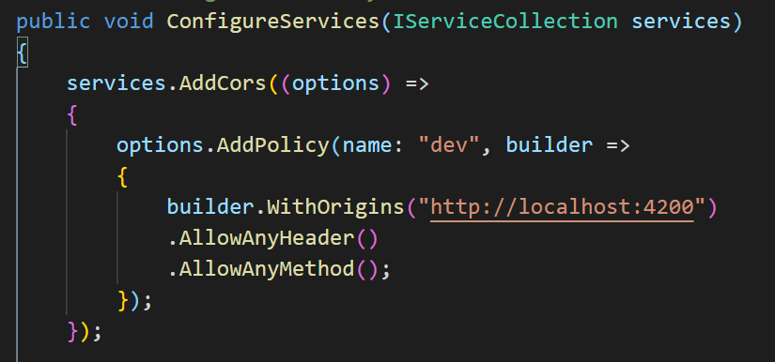
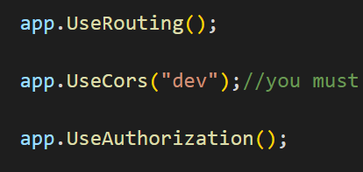
CORS in .NET - Implementation https://docs.microsoft.com/en-us/aspnet/core/security/cors?view=aspnetcore-5.0
In startup.cs. =>

