Slide 1


Team Number: Project title / systems used
Team Members1, member 2, …
…to serve and protect data.

Slide 2
System X
Present in 2-3 slides the main idea behind the systems you have used. Also mention their maturity, popularity, etc.

Slide 3
Your Solution
Present in 5-7 slides how you dealt with implementing the services with the given systems. Give an architecture overview diagram. Important: specify how you dealt with consistency/performance tradeoffs.

Slide 4
Results
Present in 2-3 slides the performance results you have gotten by running the system.

Slide 5
What would you do better?
In a whim: what would you have done better if you had two more months of time.

Slide 6
Some slides that may be useful to you, in order to draw stuff.

Slide 7
A tale of three Cloud services
Service
(stateless) layer
Order service
Payment service
Stock service
Database
(stateful) layer
Database
Database
Database
To checkout: stock & update stock, verify payment, checkout the cart. Atomically!
Notes:
This slide here shows the canonical architecture of a set of microservices. In this case we have a pretty simple example that I love to use: we have an order service that manages the shopping cart and orchestrates making orders. We also have a. payment service that arranges payments and a stock service that keeps a list of products and their available stock.
When a client checks out a shopping cart, we simply have to perform a payment and if it goes through, simply update the stocklist in our warehouse.
Now, note that unless the payment goes through, we should not update the stock; and unless there is stock left, we cannot charge clients for orders that we cannot fulfil. We will get back to the complexity of this example a bit later!
Now, what do we see here? First off, services are stateless. This means that
Services store/retrieve their state from the database through the network. As a result, the database admin can do their job, and each service can scale up and down as needed according to the workload!
In fact, this kind of architecture is really scalable. Microservices architecture appropriate for the cloud; independent development and scaling
Services communicate with the database through costly RPC calls that result and with possibly latency
But developers loved this design for a number of reasons. The one that we care about in this talk, is that they do not have to manage state: the database cares for that. And if a machine fails with any of the service deployments we simply

Slide 8
Services Architecture (1): Easiest Implem.
REST Call
Perform an order iff there is stock available and the payment is cleared.
Services are stateless
Database does the heavy-lifting
High latency, costly state access
No guaranteed messaging
Order
Stock
Business Logic
Business Logic
RPC Call
RPC Call
REST Call
RPC Response
DB
RPC Response
DB
Payment
DB
RPC Call
Business Logic
RPC Response
Notes:
Pros
Service is responsible for its data
Independent teams can develop services
Scale infinitely as soon as the database does not break down.

Slide 9
Services Architecture (2): Embedded State/DB
Order
Stock
Low-latency access to local state
Service calls still expensive
Messaging still not guaranteed
Not obvious how to scale this out
Fault tolerance is hard!
Business Logic
Business Logic
REST Call
DB
DB
REST Call
Payment
Business Logic
DB
Notes:
Sharding and routing
Timeouts and difficult ways of dealing with failures.

Slide 10
Services Architecture (3): Event Sourcing
Order
Stock
Message exchange through an event-log
Guaranteed at-least once delivery!
Services are asynchronous/reactive.
If we lose state, we replay the log and rebuild it.
Time-travel debugging, audits, etc. are easier.
Does not scale!
Business Logic
Business Logic
REST Call
event-log
DB
DB
REST Call
event-log
Payment
Business Logic
DB
Notes:
Pros
Service is responsible for its data
Independent teams can develop services
Cons
High Latency
Medium Latency (REST calls are still expensive)
Eventual Consistency
Have to host DBs in Service containers

Slide 11
Services Architecture (4): Scalable Deployment
Order 1
Stock 1
event-log
Business Logic
DB
Subscribe for Responses
Business Logic
DB
Stock 2
event-log
Order 2
Business Logic
DB
Business Logic
DB
Payment 1
event-log
Order 3
Business Logic
DB
RPC Calls
Business Logic
DB
Notes:
We can scale this out. But we have to manage multiple subsystems, checkpoints, logs, re-scaling and shuffling of state.
Why not use a stream processor for those?

Slide 12
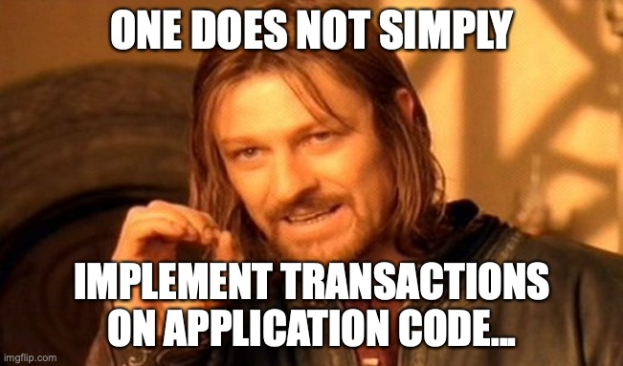
Services Architecture (4): Scalable Deployment
Order 1
Stock 1
event-log
Business Logic
DB
Subscribe for Responses
Business Logic
DB
Stock 2
event-log
Order 2
Business Logic
DB
Business Logic
DB
Payment 1
event-log
Order 3
Business Logic
DB
RPC Calls
Business Logic
DB
Notes:
We can scale this out. But we have to manage multiple subsystems, checkpoints, logs, re-scaling and shuffling of state.
Why not use a stream processor for those?

Slide 13

We live in the stone ages. Building scalable Cloud applications is like programming assembly before compilers were around.
“Two-pizza” dev team in the year 2021.
Notes:
To conclude the motivation part..

Slide 14
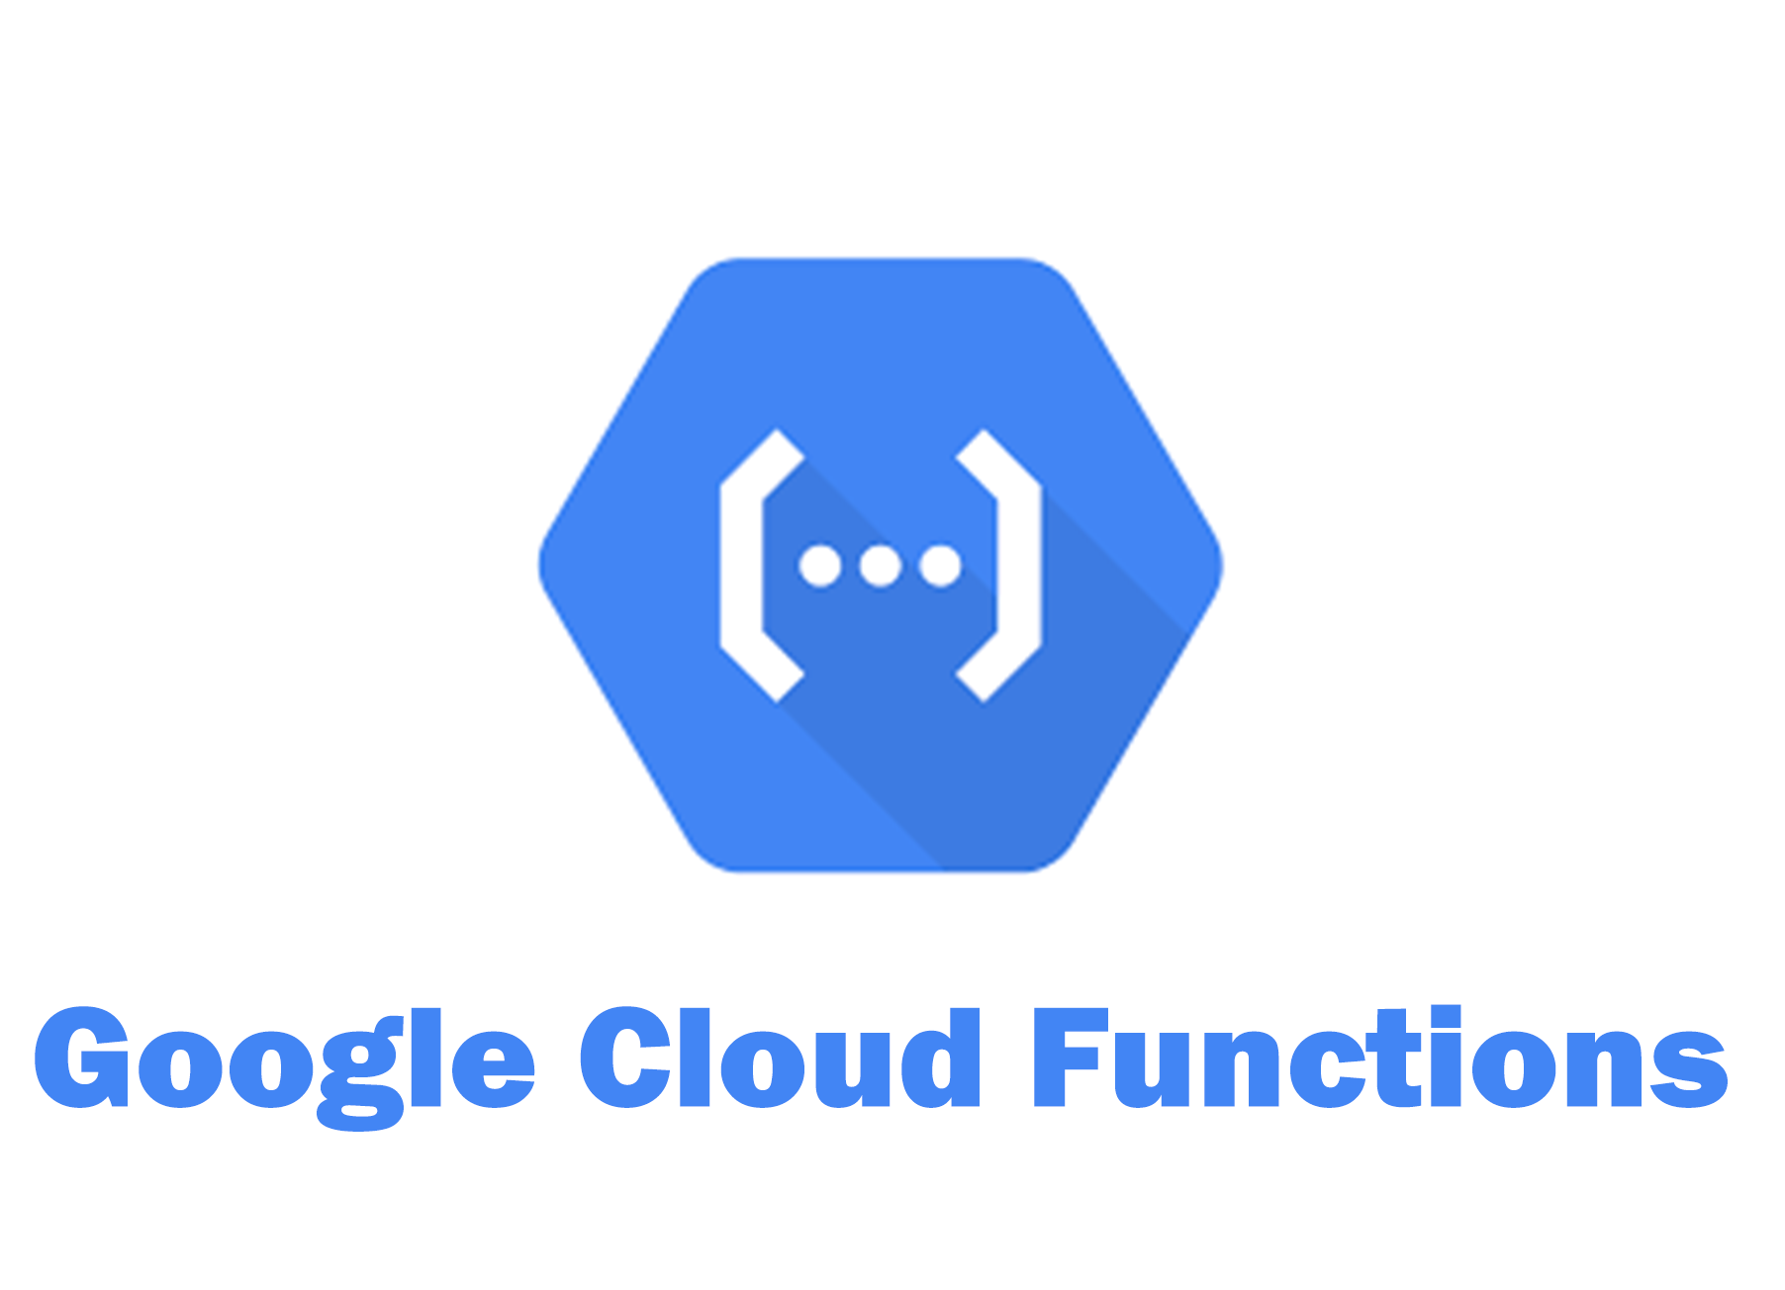
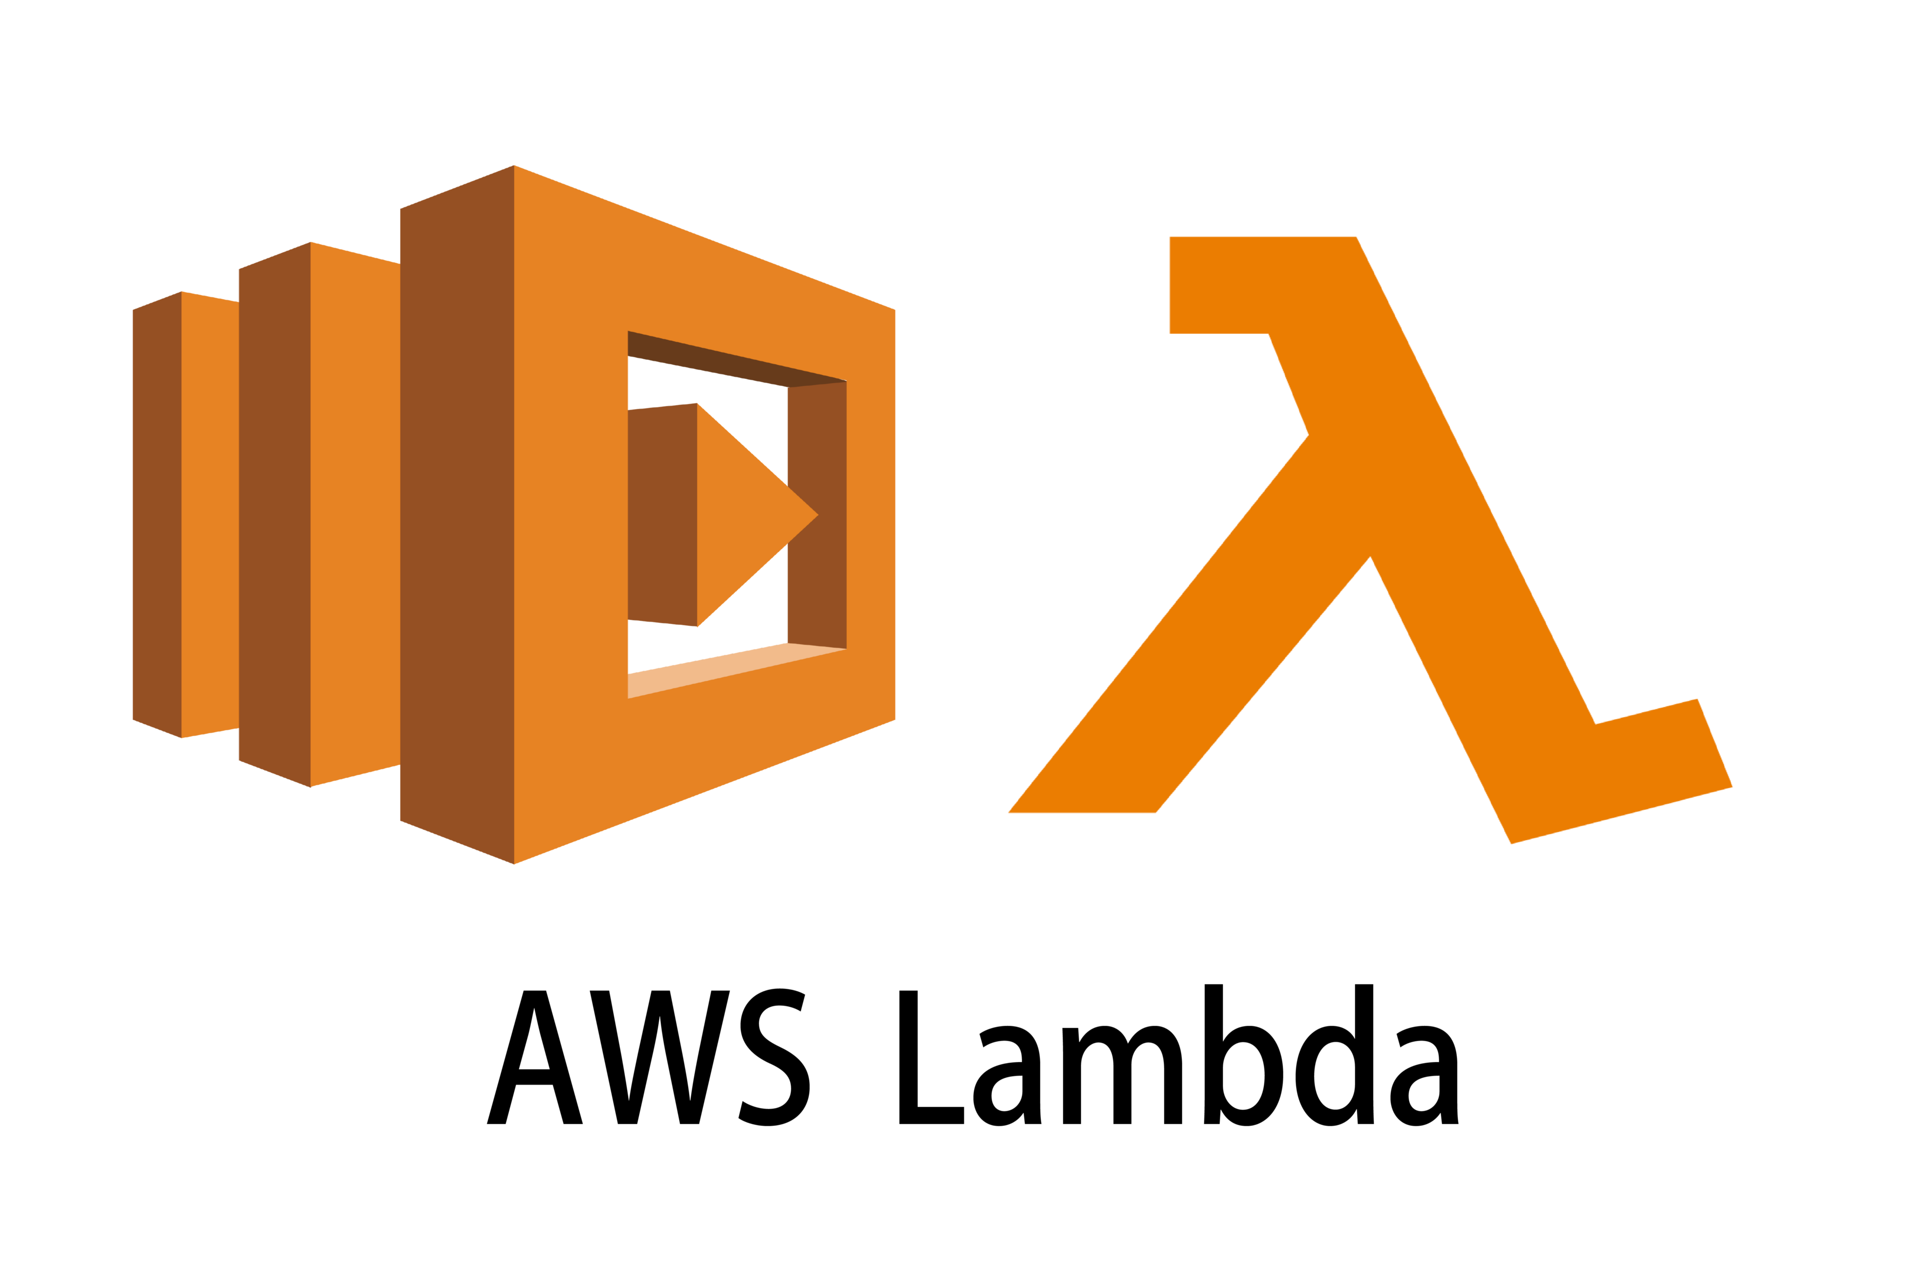
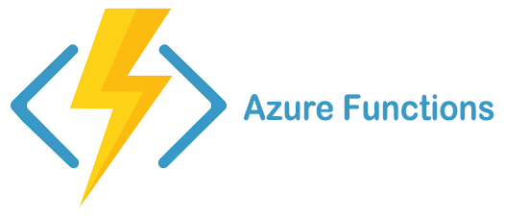
Wait, what about serverless? That should work!
VM
Fn
VM
VM
Managed
Infrastructure (autoscaling, no ops)
Fn
No State
Fn
Fn
Fn
Fn
Fn
Fn-to-fn calls
Fn
Fn
Function-based
programming
model
Transactions
Cloud database

