Slide 1
(1) 序列信号11001发生器设计
module seq_11001 (input clk, output led);
reg [31:0] divclk_cnt = 0;
reg divclk = 0;
reg q0 = 0;
reg q1 = 0;
reg q2 = 0;
always @(posedge clk)
begin
if(divclk_cnt == 25000000)
begin
divclk = ~divclk;
divclk_cnt = 0;
end
else
begin
divclk_cnt = divclk_cnt + 1’b1;
end
end
assign led = ~q1;
always @( posedge divclk)
begin
q0 <= q1&q2; q1 <= ~q1 & q2 | q1&~q2; q2 <= ~q0 & ~q2;
end
endmodule
module sim1( );
reg clk;
wire led;
seq_11001 u1( clk, led);
initial
begin
clk = 0;
end
always #10 clk = ~clk;
endmodule

Slide 2
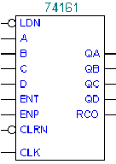
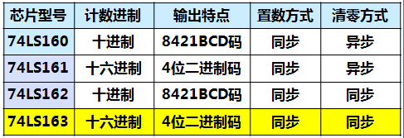
(2) 同步计数器74X163设计
module p74X163(clk, clr, ldn, ent, enp, d, q, rco);
input clk, clr, ldn, ent, enp;
input [3:0] d;
output rco;
output [3:0] q;
reg [3:0] q = 0;
reg rco = 0;
always @(posedge clk)
begin
if( clr == 0) q <= 0;
else if ( ld == 0 ) q <= d;
else if ( (ent == 1) && (enp == 1)) q <= q+1;
else q <= q ;
end
always @( q or ent or enp)
begin
if((ent == 1) && (enp == 1) && (q == 15) rco = 1;
else rco = 0;
end
endmodule
module sim1( );
reg clk = 0;
reg clr = 1;
reg ldn = 1;
reg ent = 1;
reg enp = 1;
reg [3:0] d = 0;
wire [3:0] q;
wire rco;
p74X163 u1(p74X163(clk, clr, ldn, ent, enp, d, q, rco);
always #10 clk = ~clk;
endmodule
74LS163

Slide 3
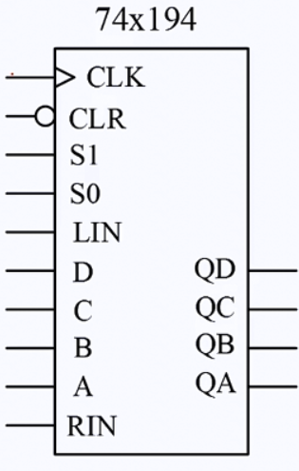
module sim1( );
reg clk = 0;
reg clr = 1;
reg rin = 0;
reg lin = 1;
reg [1:0] s = 3; //载入准备
reg [3:0] d = 4’b0101;
wire [3:0] q;
p74X194 u1 (clk, clr, rin, lin, s, d, q);
Initial begin
#10;
clk = 0;
#10;
clk = 1; //第1个时钟上升沿，执行载入0101
#10;
clk = 0;
s = 2’b10 //左移准备
#10；
clk = 1; //第2个时钟上升沿，执行左移，结果是1011
#10;
clk = 0;
#10；
clk = 1; //第3个时钟上升沿，执行左移，结果是0111
#10;
clk = 0;
#10；
clk = 1; //第4个时钟上升沿，执行左移， 结果是1111
#10;
clk = 0;
s = 2’b01; //右移准备
end
always #10 clk = ~clk; // 此后一直右移
endmodule
(3) 移位寄存器74X194设计
module p74X194(clk, clr, rin, lin, s, d, q);
input clk, clr,rin, lin;
input [3:0] d;
input [1:0] s;
output [3:0] q;
reg [3:0] q = 0;
always @(posedge clk or negdge clr)
begin
if( clr == 0) q <= 0;
else case(s)
0: q <= q; //保持功能
1: q <= {rin, q[3:1]}; // 右移功能
2: q <= {q[2:0], lin}; //左移功能
3: q <= d; //载入功能
default: q <= 4’bX;
endcase
end
endmodule

Slide 4
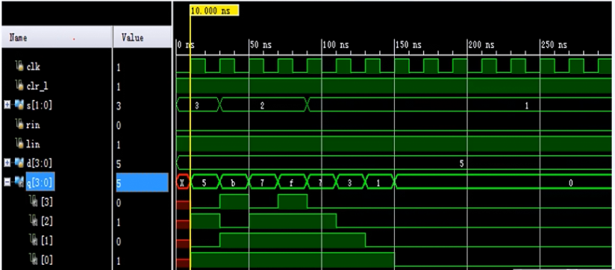

Slide 5
(4) 8位流水灯设计
module lsd(clk,led);
input clk;
output [7:0] led;
reg [7:0] ledtemp = 8'b00000001; // led初值
reg [31:0] div_cnt = 0; // 32位计数器，分频用
reg divclk = 0;
assign led = ledtemp;
always @(posedge clk )
begin
if(div_cnt == 12500000)
begin
divclk = ~divclk;
div_cnt = 0;
end
else
begin
div_cnt = div_cnt +1'b1;
end
end
always @(posedge divclk )
begin
if ( ledtemp[7] == 1)
ledtemp = 8'b00000001; //实现循环移位
else
ledtemp = ledtemp << 1; //左移1位
end
endmodule
状态：需要存储当前的状态，定义8个触发器构成的8位寄存器，ledtemp保存当前的状态， ledtemp的初始值设为 8’b 00000001, divclk的每个上升沿对ledtemp向左移位，当移到8’b 10000000后，再次移位应为8’b 00000001
时钟：需要分频
module test();
reg clk;
wire [7:0] led;
lsd u1(clk, led);
initial clk = 0;
always #10 clk = ~clk;
endmodule

Slide 6
约束文件
set_property PACKAGE_PIN K2 [get_ports {led[0]}]
set_property IOSTANDARD LVCMOS33 [get_ports {led[0]}]
set_property PACKAGE_PIN J2 [get_ports {led[1]}]
set_property IOSTANDARD LVCMOS33 [get_ports led[1]]
set_property PACKAGE_PIN J3 [get_ports {led[2]}]
set_property IOSTANDARD LVCMOS33 [get_ports {led[2]}]
set_property PACKAGE_PIN H4 [get_ports {led[3]}]
set_property IOSTANDARD LVCMOS33 [get_ports {led[3]}]
set_property PACKAGE_PIN J4 [get_ports {led[4]}]
set_property IOSTANDARD LVCMOS33 [get_ports {led[4]}]
set_property PACKAGE_PIN G3 [get_ports {led[5]}]
set_property IOSTANDARD LVCMOS33 [get_ports {led[5]}]
set_property PACKAGE_PIN G4 [get_ports {led[6]}]
set_property IOSTANDARD LVCMOS33 [get_ports {led[6]}]
set_property PACKAGE_PIN F6 [get_ports {led[7]}]
set_property IOSTANDARD LVCMOS33 [get_ports {led[7]}]
## CLK
set_property PACKAGE_PIN P17 [get_ports clk]
set_property IOSTANDARD LVCMOS33 [get_ports clk]

Slide 7
(5) 数码管的动态显示
被选中
被选中
a
a
a
a
a
a
a
a
f
b
f
b
f
b
f
b
f
b
f
b
f
b
f
b
g
g
g
g
g
g
g
g
e
c
e
c
e
c
e
c
e
c
e
c
e
c
e
c
d
d
d
d
d
d
d
d
01 100 000
0 0 1 0
11 110 010
0 0 0 1
段码
位码
段码
位码
①利用高频分时显示，可以看到连续显示效果的数字13
② 必须记录当前显示的是哪个数码管，4个数码管需要2位寄存器存储位置信息，用reg变量 disp_bit存储。每次divclk上升沿，将disp_bit加1，并编程驱动下一个数码管
③ 根据disp_bit的值（0,1,2,3）,使用case语句，将对应拨码开关的值，赋值给reg 变量disp_dat，并驱动对应数码管

Slide 8
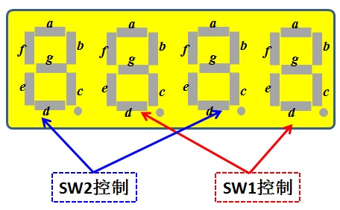
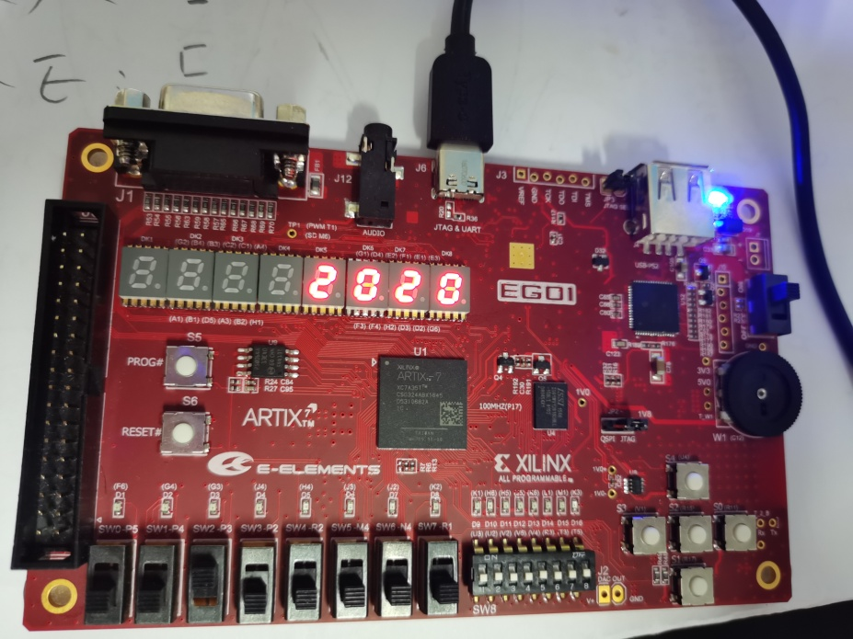
module seg1(clk, sw1, sw2, dm1, wm1);
input clk;
input [3:0] sw1,sw2;
output [7:0] dm1;
output [3:0] wm1;
reg [7:0] dm1 = 0;
reg [3:0] wm1 = 4'b0001;
reg [14:0] div_cnt = 0;
reg divclk = 0;
reg [3:0] disp_dat = 0;
reg [1:0] disp_bit = 0;
parameter maxcnt=25000;
always @(posedge clk )
begin
if(div_cnt == maxcnt)
begin
divclk = ~divclk;
div_cnt = 0;
end
else
begin
div_cnt = div_cnt +1'b1;
end
end
数码管的动态显示
//段码
//位码
//分频用
//存储要显示的数据
//存储当前显示的数码管
分频
SW2
SW1

Slide 9
always @(posedge divclk )
begin
if ( disp_bit >= 3)
disp_bit = 0;
else
disp_bit = disp_bit + 1;
case (disp_bit)
2'b00:
begin
disp_dat = sw1;
wm1 = 4'b0001;
end
2'b01:
begin
disp_dat = sw2;
wm1 = 4'b0010;
end
2'b10:
begin
disp_dat = sw1;
wm1 = 4'b0100;
end
2'b11:
begin
disp_dat = sw2;
wm1 = 4'b1000;
end
default:
begin
disp_dat = 0 ;
wm1 = 4'b0000;
end
endcase
end
a
a
a
a
f
b
f
b
f
b
f
b
g
g
g
g
e
c
e
c
e
c
e
c
d
d
d
d
SW2控制
SW1控制

Slide 10
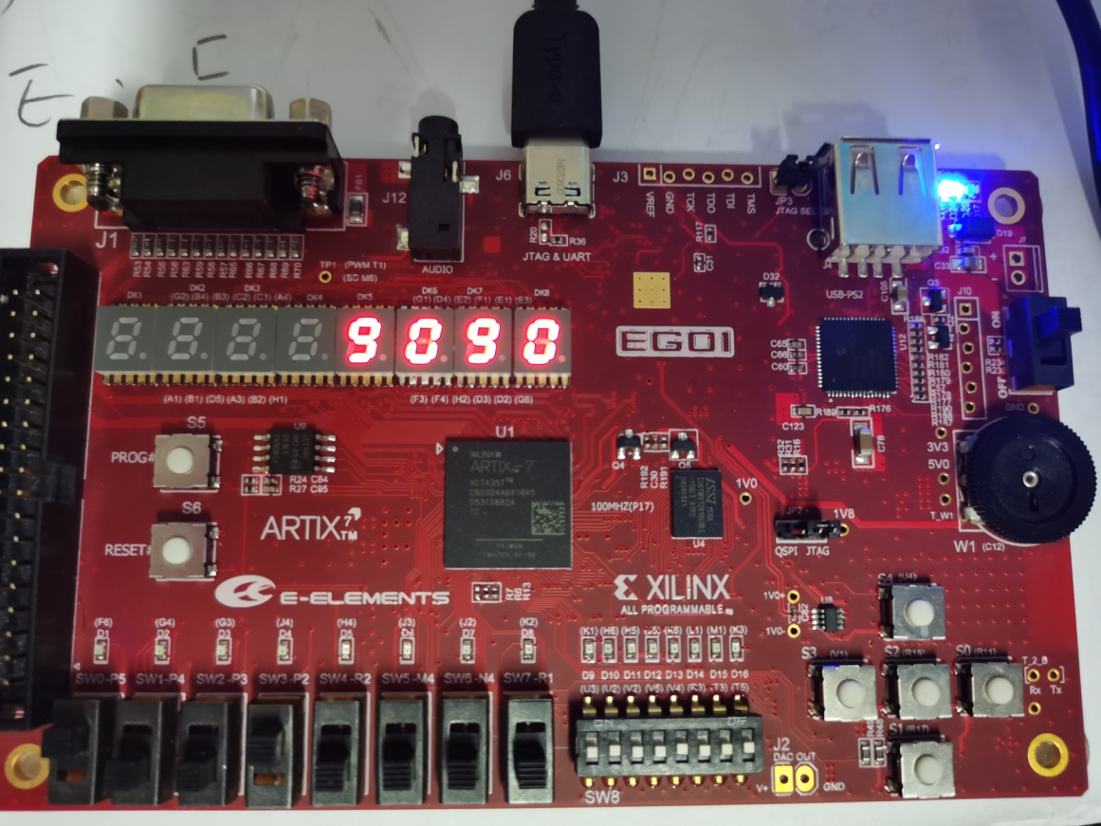
always @(disp_dat)
begin
case (disp_dat)
4'b0000: dm1 = 8'hfc;
4'b0001: dm1 = 8'h60;
4'b0010: dm1 = 8'hda;
4'b0011: dm1 = 8'hf2;
4'b0100: dm1 = 8'h66;
4'b0101: dm1 = 8'hb6;
4'b0110: dm1 = 8'hbe;
4'b0111: dm1 = 8'he0;
4'b1000: dm1 = 8'hfe;
4'b1001: dm1 = 8'hf6;
4'b1010: dm1 = 8'hee;
4'b1011: dm1 = 8'hfe;
4'b1100: dm1 = 8'h9c;
4'b1101: dm1 = 8'h7a;
4'b1110: dm1 = 8'h9E;
4'b1111: dm1 = 8'h8e;
default: dm1 = 8'hfc;
endcase
end
endmodule
disp_dat中存储开关SW1或者SW2的输入，根据输入的二进制数值，显示0 ~ F十六个字形。

Slide 11
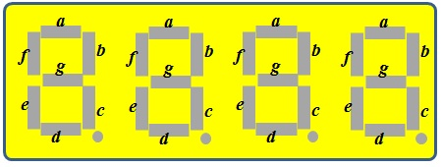
位码对应管脚
数码管的动态显示
G2
C2
H1
C1
G1
F1
E1
G6
a b c d e f g dp
a b c d e f g dp
B4 A4 A3 B1 A1 B3 B2 D5
D4 E3 D3 F4 F3 E2 D2 H2
段码对应管脚
段码对应管脚
约束文件
set_property PACKAGE_PIN G6 [get_ports {wm1[0]}]
set_property IOSTANDARD LVCMOS33 [get_ports {wm1[0]}]
set_property PACKAGE_PIN E1 [get_ports {wm1[1]}]
set_property IOSTANDARD LVCMOS33 [get_ports {wm1[1]}]
set_property PACKAGE_PIN F1 [get_ports {wm1[2]}]
set_property IOSTANDARD LVCMOS33 [get_ports {wm1[2]}]
set_property PACKAGE_PIN G1 [get_ports {wm1[3]}]
set_property IOSTANDARD LVCMOS33 [get_ports {wm1[3]}]
位码
set_property PACKAGE_PIN P17 [get_ports clk]
set_property IOSTANDARD LVCMOS33 [get_ports clk ]
时钟

Slide 12
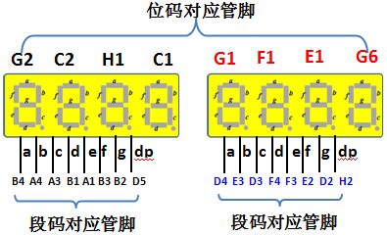
约束文件
set_property PACKAGE_PIN H2 [get_ports {dm1[0]}]
set_property IOSTANDARD LVCMOS33 [get_ports {dm1[0]}]
set_property PACKAGE_PIN D2 [get_ports {dm1[1]}]
set_property IOSTANDARD LVCMOS33 [get_ports {dm1[1]}]
set_property PACKAGE_PIN E2 [get_ports {dm1[2]}]
set_property IOSTANDARD LVCMOS33 [get_ports {dm1[2]}]
set_property PACKAGE_PIN F3 [get_ports {dm1[3]}]
set_property IOSTANDARD LVCMOS33 [get_ports {dm1[3]}]
set_property PACKAGE_PIN F4 [get_ports {dm1[4]}]
set_property IOSTANDARD LVCMOS33 [get_ports {dm1[4]}]
set_property PACKAGE_PIN D3 [get_ports {dm1[5]}]
set_property IOSTANDARD LVCMOS33 [get_ports {dm1[5]}]
set_property PACKAGE_PIN E3 [get_ports {dm1[6]}]
set_property IOSTANDARD LVCMOS33 [get_ports {dm1[6]}]
set_property PACKAGE_PIN D4 [get_ports {dm1[7]}]
set_property IOSTANDARD LVCMOS33 [get_ports {dm1[7]}]
段码

Slide 13
约束文件
set_property PACKAGE_PIN R1 [get_ports {sw1[0]}]
set_property IOSTANDARD LVCMOS33 [get_ports {sw1[0]}]
set_property PACKAGE_PIN N4 [get_ports {sw1[1]}]
set_property IOSTANDARD LVCMOS33 [get_ports {sw1[1]}]
set_property PACKAGE_PIN M4 [get_ports {sw1[2]}]
set_property IOSTANDARD LVCMOS33 [get_ports {sw1[2]}]
set_property PACKAGE_PIN R2 [get_ports {sw1[3]}]
set_property IOSTANDARD LVCMOS33 [get_ports {sw1[3]}]
set_property PACKAGE_PIN P2 [get_ports {sw2[0]}]
set_property IOSTANDARD LVCMOS33 [get_ports {sw2[0]}]
set_property PACKAGE_PIN P3 [get_ports {sw2[1]}]
set_property IOSTANDARD LVCMOS33 [get_ports {sw2[1]}]
set_property PACKAGE_PIN P4 [get_ports {sw2[2]}]
set_property IOSTANDARD LVCMOS33 [get_ports {sw2[2]}]
set_property PACKAGE_PIN P5 [get_ports {sw2[3]}]
set_property IOSTANDARD LVCMOS33 [get_ports {sw2[3]}]
开关

