Slide 1
Chapter 3
Buyer behaviour

Slide 2
Agenda
Models of buyer behaviour
Influences on the decision process
A composite model of buyer behaviour
The adoption and diffusion of new products

Slide 3
Factors influencing buyer behaviour – How do buyers choose?

Slide 4
While group and organisational decisions differ in degree from individual buying decisions, they are the same in kind.

Slide 5
There is a general agreement that individual
behaviour is a function of three factors:
The person’s personality, motivation, cognitive structure, and learning (habit and attitude formation) process.
Their interaction with the environmental situation.
Their preference structure and decision model.
Webster & Wind (1972, p89)

Slide 6
The individual’s “black box”
Personality Perceived role set
Preference structure and
decision model
Behaviour
Stimuli
Motivation Cognitive Learning
structure processes
A simplified model of individual behaviour

Slide 7
Components of the buyer’s ‘black box’
Personality
Role set
Motivation
Cognition
Learning
Attitudes/predispositions
Preference structure
Decision model

Slide 8
Personality
Personality measures can be classified into
three major categories:
Comprehensive
Socially oriented
Intra-person oriented
Notes:
Personality is the dynamic organisation within the individual of those psychological systems that determine an individual’s characteristic behaviour and thought. (Based on Allport, 1961)
Personality will affect intra-personal relationships both in the DMU/Buying Centre and with suppliers
Comprehensive personality measures have been developed to try to predict and explain how personality influences and shapes individual and household buying behaviour. They have had only limited success. Perhaps the only exception is the concept of “self” i.e. self concept. Qv Myers Briggs Type Indication
Socially oriented = Reisman’s inner, other and tradition oriented.
Intra-person include McLelland’s ‘achievement motive’; Allport’s ‘creative becoming’ and Maslow’s ‘self actualisation’i

Slide 9
Major personality attributes – Myers and Briggs
Attribute Description
Locus of control The extent to which an individual believes his or her behaviour has a direct impact on the consequences of that behaviour.
Self-efficacy A person’s beliefs about his or her capabilities to perform a task.
Machiavellianism A personality attribute that results in behaviour directed at gaining power and controlling the behaviour of others.
Self-esteem The extent to which a person believes that he or she is worthwhile and a deserving individual.
Risk propensity The degree to which an individual is willing to take chances and make risky decisions.
Authoritarianism The extent to which an individual believes that power and status are appropriate within hierarchical systems like organizations.
Dogmatism Reflects the rigidity of a person’s beliefs and his or her openness to other viewpoints.

Slide 10
Role
A role is a social position occupied by an individual, including the goals of that position and the behavioural repertoire appropriate to it and to the attainment of those goals.
Webster & Wind (1972,p93)
Notes:
Role includes three distinct components: Prescribed role, i.e. what a person occupying a particular position is expected to do in relation to others. Subjective role is one’s own expectations about behaviour in reference to other positions. Enacted role = actual behaviour’
Persons can have many roles and their behaviour will vary according to the role they feel they are to play

Slide 11
Motivation is an inner state that activates or
moves people towards goals, resulting in
purposive means/ends behaviour.
The lower the satisfaction of the organism, the more search for alternative programmes it will undertake.
The more search, the higher the expected value of reward.
The higher the expected value of reward, the higher
the expected satisfaction.
The higher the expected satisfaction, the higher the
level of aspiration of the organism.
The higher the level of aspiration, the lower the satisfaction.
Adapted from March and Simon (1958)
Notes:
Wishes, needs, desires, goals are synonyms for motivation
NB The ‘expectations gap’ is the sellers paradox – the more you promise the greater the liklihood you will fail.

Slide 12
Maslow’s need hierarchy
Self actualization
Esteem
Love
Safety
Physiological needs
Notes:
While motives may exist at a particular level behaviour is seldom motivated by a single or simple motive. Behaviour is usually the outcome of complex interactions involving both task and non-task variables.
Individuals are also motivated by a desire to reduce uncertainty. Organisational buyers experience 3 significant forms of uncertainty: about the courses of action available; about the outcomes associated with them; about others reactions to his decisions

Slide 13
Cognition is an individual’s understanding
of an object or concept, derived from the individual’s perceptions, attitudes, beliefs, learned behaviour and needs (conscious and sub-conscious).
Notes:
Cognition includes all those mental processes that are involved in developing ‘an organised picture of the world’.

Slide 14
The mental processes that comprise a
person’s cognitive structure fall into two
categories:
Selective
    attention
    perception
    retention
Decision related
Notes:
Selective attention is based partly on selective exposure i.e. what media/communications the buyer uses/avoids. Of these stimuli (messages) to which one is exposed only those favourable to one’s pre-dispositions are likely to attract attention “I know what I like and I like what I know”
Perception is the meaning we attach to stimuli. Perception is selective in that the individual actively assigns meaning to stimuli which is their subjective interpretation of their meaning. Qv Hastorf & Cantril; SHEG.
Selective retention means that people store in memory those bits of information and those evaluations that are most consistent with their pre-dispositions and most favourable to them.
Mention stereotyping, CoO effects.

Slide 15
Most buying decisions are the outcome of a
process involving knowing, feeling and acting.
There are many variants of this hierarchy of
effects’ model. The simplest and best known is
AIDA (Awareness, Interest, Desire, Action )

Slide 16
Hierarchy of effects models:
Cognition Affect Conation
(Thinking) (Feeling) (Action)
A I D A
AI D A
T

Slide 17
An alternative version which incorporates
a feedback loop contains five steps:
Problem recognition
Information search
Evaluation of alternatives
Choice
Post purchase experience

Slide 18
Alternatively the buying decision may
be seen as comprising four stages :
Awareness
Search and evaluation
Decision
Post decisional behaviour

Slide 19
Awareness contains three steps:
Environmental stimuli
Attentional and perceptual filters
Reception and interpretation of stimuli

Slide 20
Search and evaluation also contains three steps:
Information processing involving both the short and long-term memory stores
Brand beliefs
Brand attitudes

Slide 21
Decision
The formation of purchase intentions:
Buy
Defer
Reject

Slide 22
Post decisional behaviour:
Evaluation
Review of beliefs and attitudes
Feedback to memory

Slide 23
Perception is a complex process by which
people select, organize and interpret sensory
stimulation into a meaningful picture of the
world.
Perception is reality

Slide 24
Stimulus factors are neutral (objective), but
are interpreted selectively by the receiver
in terms of their expectations or preparatory
set. This is subjective, and determined by
a person’s attitudes, beliefs, and values.

Slide 25
Attitudes, beliefs and values are acquired through conditioning and learning.
Conditioning may be thought of as developing an habitual response to a given stimulus based on direct experience.
Learning arises from conditioning but may also
be acquired by thinking and memorization.

Slide 26
LEARNING
BEHAVIOUR MEMORY
ATTITUDE

Slide 27
Learning is a process that can comprise all, some, or one of three steps: inventing an original solution to a problem, or thinking; committing a solution to memory, or memorizing; becoming efficient at applying the solution to a problem, or forming a habit.

Slide 28
‘Learning’ is a function of:
Relative advantage
Compatibility
Complexity
Divisibility
Communicability
Notes:
Learning may occur through formal education and/or via direct experience. It influences both the interpretation of stimuli and behavioural response to them. Much buyer behaviour is habitual or ‘conditioned’.

Slide 29
The most direct influence on learning is the
social group to which we belong (family and social class). This, in turn, is strongly influenced by culture.

Slide 30
Culture is a set of learned beliefs, values,
attitudes, habits and forms of behaviour that
are shared by a society, and are transmitted
from generation to generation within that society.

Slide 31
A social group is a social entity which allows individuals to interact with one another in relation to particular phenomena – an aggregate of individuals standing in certain observable relations to each other, e.g. family groups, work group, friendship group.

Slide 32
An attitude is a pre-disposition to behave. For complex activities with high perceived risk, or high involvement, attitude formation usually precedes behaviour. In low involvement situations action/behaviour leads to attitude formation.

Slide 33
It is clear that a purchase decision is an attempt to satisfy a felt need through the evaluation of relevant information in which the selection and interpretation of that information is mediated by the decision-maker’s attitudes, values and beliefs.

Slide 34
Different disciplines – Economics, Psychology,
Sociology – emphasise different factors in
seeking to explain buying behaviour. These
explanations are partial rather than holistic.

Slide 35
A simple composite model of the buying
behaviour may be expressed notationally as:
P = F [S, SP (FN, EC, IS, CBA, BR) PPE]
Source: Baker (2002)

Slide 36
P = a Purchase
F = a Function (unspecified)
S = a Stimulus or stimuli
SP = Selective perception
FN = Felt need (Awareness)
EC = Enabling conditions
IS = Information search (Interest)
CBA = Cost benefit analysis (Desire)
BR = Behavioural response (Action)
PPE = Post purchase evaluation

Slide 37
As it becomes increasingly difficult to develop a sustainable competitive advantage through objective performance factors on which transactions may be negotiated, so the less tangible, subjective, and service factors assume greater importance, and become determinant.
Under these conditions Image, Reputation and Relationships are critical success factors.

Slide 38
While the organisational buyer experiences the
same mental processes as an individual
– motivation, cognition and learning – their
behaviour differs from other situations because:
It is influenced by organizational goals.
It is subject to interpersonal relationships.
It usually has access to much more information, both internal and external.

Slide 39
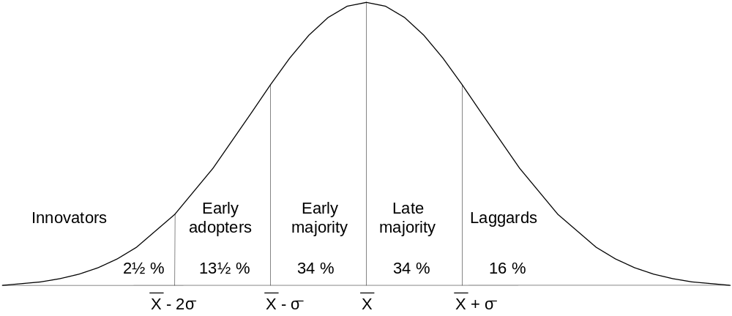
Adopter categories

Slide 40
IT supplier selection/performance items:
Reliable delivery
Satisfactory order processing
Ability to keep promises
Regular communications
Supplier’s believability and honesty
Attractive credit terms
Competitive prices
Attractive discounts

Slide 41
IT supplier selection/performance items:
After-sales service
Assurance about the handling of problems
Existence of a refund policy
Positive attitude towards complaints
R&D capabilities
Technical know-how

Slide 42
IT supplier selection/performance items: (Continued)
IT experience
Existence of IT standards
Adaptability to future IT market requirements
Factor Analysis reduced these to four Principal
Components – Reliability, Competitive Pricing, Service
and Technological Capability
Source: C S Katsikeas et al, Industrial Marketing Management 33 (2004)

