Slide 1
Chapter 4
The product life cycle in theory and practice

Slide 2
Agenda
To introduce the concept of the product life
cycle (PLC).
To explain its use as an analytical framework.
To identify criticisms of the PLC concept.
To suggest how the PLC may be operationalized
and put into practice.
To present deviant variations of the classic PLC.

Slide 3
The product life cycle (PLC) is
‘A generalized model of the sales trend for a product class or category over a period of time, and of related changes in competitive behaviour’.
(Buzzell)

Slide 4
‘Most alert and thoughtful marketing executives are by now familiar with the concept of the product life cycle. Even a handful of uniquely cosmopolitan and up-to-date corporate presidents have familiarized themselves with this tantalizing concept in any strategic way whatever, and pitifully few who used it in any kind of tactical way. It has remained – as have so many fascinating theories in economics, physics and sex – a remarkably durable but almost totally unemployed and seemingly unemployable piece of professional baggage where presence in the rhetoric of professional discussion adds a much coveted but apparently unattainable legitimacy to the idea that marketing management is somehow a profession. There is, furthermore, a persistent feeling that the life cycle concept adds
luster and believability to the insistent claim in certain circles that marketing is close to being some sort of science’.
Ted Levitt, “EXPLOIT the Product Life Cycle”, Harvard Business Review, 1965).

Slide 5
‘The concept of the product life cycle is today
about the stage that the Copernican view of the universe was 300 years ago: a lot of people know about it, but hardly anybody seemed to use it in any effective or productive way’.
(Levitt)
40 years on little has changed!

Slide 6
The product life cycle
Quantity
Maturity
Growth
Decline
Introduction
0
Time

Slide 7
The stretched product life cycle contains seven stages:
Gestation or new product development.
Launch or introduction.
Growth
Maturity
Saturation
Decline
Elimination

Slide 8
Graphically we may represent this as follows
Maturity
Saturation
Quantity
Decline
Growth
Gestation
Elimination
Launch
Time

Slide 9
The concept of the PLC is firmly rooted
in the concepts of the biological
life cycle and of evolution.

Slide 10
It reflects 4 underlying processes.
Competition
Substitution or displacement
The survival of the fittest
The inevitability of change

Slide 11
It also reflects a number of what may be considered useful generalizations if not eternal truths, namely:
Needs are inborn and enduring
Wants are learned and ephemeral
The great majority of actions are motivated
by self-interest
The act of consumption changes the customer

Slide 12
Given this ‘pedigree’ why has the
PLC concept not become the accepted
wisdom and universally endorsed by all?

Slide 13
Because most people mistakenly try to
use it as a predictive device or forecasting tool. Its real value is the insight it
provides and its implications unless managerial intervention can moderate
or modify the process.

Slide 14
When a life cycle reaches a limit of growth three basic options exist:
A way round the limit cannot be found and the process goes into decline.
An equilibrium is established and the life cycle
is stretched or extended.
The limit is broken and a new growth phase
is initiated.

Slide 15
The ‘biological’ life cycle.
Renewed growth
Limit
Extension
Turbulence
Growth
Decline
0
Time

Slide 16
Characteristics of life cycle stages.
Product Introduction Growth Maturity Decline
life-cycle
Characteristics
Sales Low Fast Slow to decline Declining
Profits Negligible Peak levels Begin to decline Declining to zero
Cash flow Negative Moderate High Low
Customers Early adopters Mass market Mass market Laggards
Competitors Few Growing Many ‘me too’ rivals Taking market
Key actions
Strategy Expand market Market penetration Defend share Productivity
Marketing costs High High (declining%) Falling Low
Marketing Product Brand preference Brand loyalty Image
emphasis awareness maintenance
Pricing High Maintain Maintain/increase Rising
Distribution Patchy Intensive Intensive Selective
Product Basic Improved Broaden position Rationalize
Product development
Re-segment
➔➔➔ Brand life ➔➔➔ Generic life ➔➔➔

Slide 17
The conceptual arguments against the PLC are:
Products are not living things, hence the biological metaphor
is entirely misleading.
The life cycle of a product is the dependent variable, being a function of the way in which the product is managed over time.
It is certainly not an independent variable.
The product life cycle cannot be valid for product class, product form and for brands – indeed, an important function of a brand name is to create a franchise that has value over time,
permitting changes to take place in the product formulation.
Trying to fit product life cycle curves into empirical sales data
is a sterile exercise in taxonomy.

Slide 18
The main operative arguments against the PLC include:
The four phases or states in the life cycle are not clearly definable.
It is impossible to determine at any moment in time exactly where a product is in its life cycle hence:
The concept cannot be used as a planning tool.
There is evidence that companies who have tried to use the product life cycle as a planning tool have made costly errors and passed up promising opportunities.

Slide 19
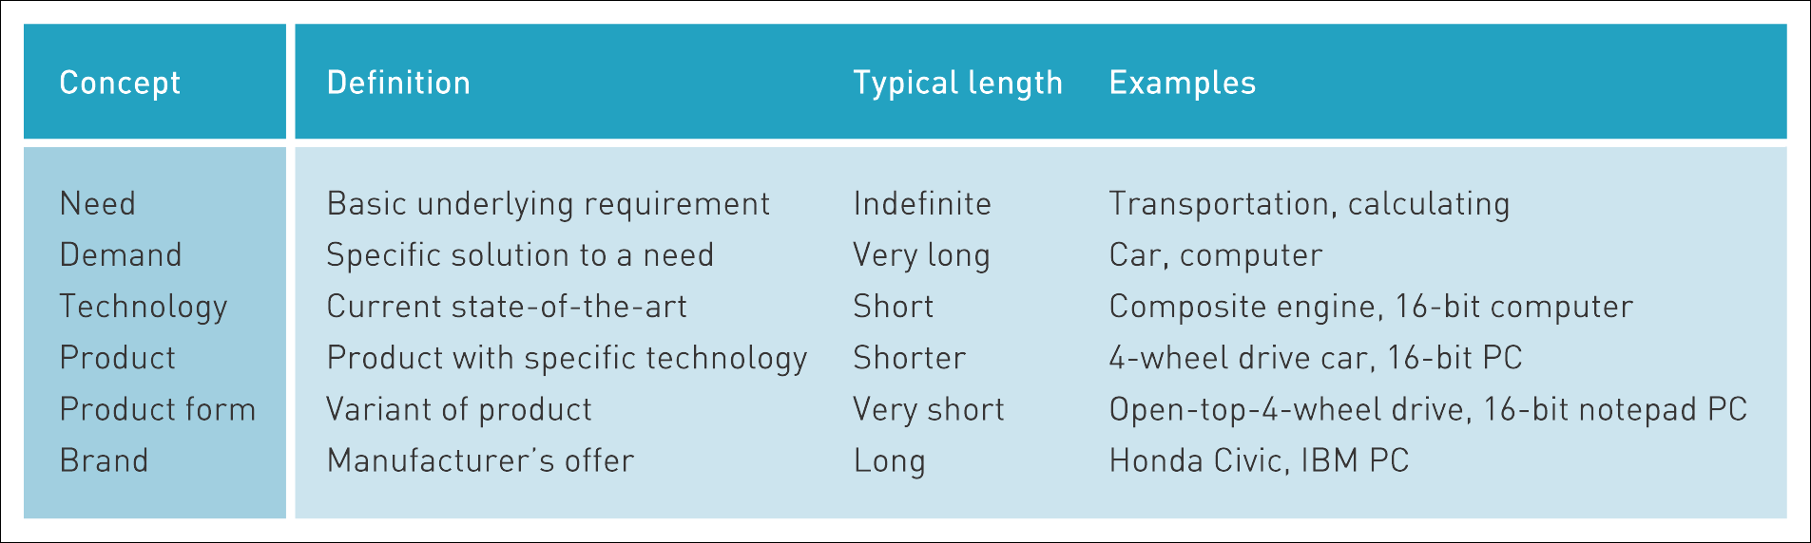
In large measure disagreements about the existence of
PLC’s arise from lack of definition of what, precisely, is a product. Doyle (1999) distinguishes 6 possible levels of definition.
Table 4.2 Doyle’s product life cycle factors
Source: Doyle (1999)

Slide 20
But, even if everyone accepted Doyle’s definitions, the problem remains. Managers are seduced by the consistency of the S-shaped logistic growth curve into the expectation that it can be converted into a precise formula which will predict accurately the behaviour of individual brands in a market.

Slide 21
The persistent belief is ingenuous. The PLC is
a post-facto generalisation about observed outcomes for successful innovations. It cannot tell you in advance which innovation will achieve this status.

Slide 22
The PLC is a tool which encourages strategic insight, policy formulation and long term strategic planning. It is not a tactical device.

Slide 23
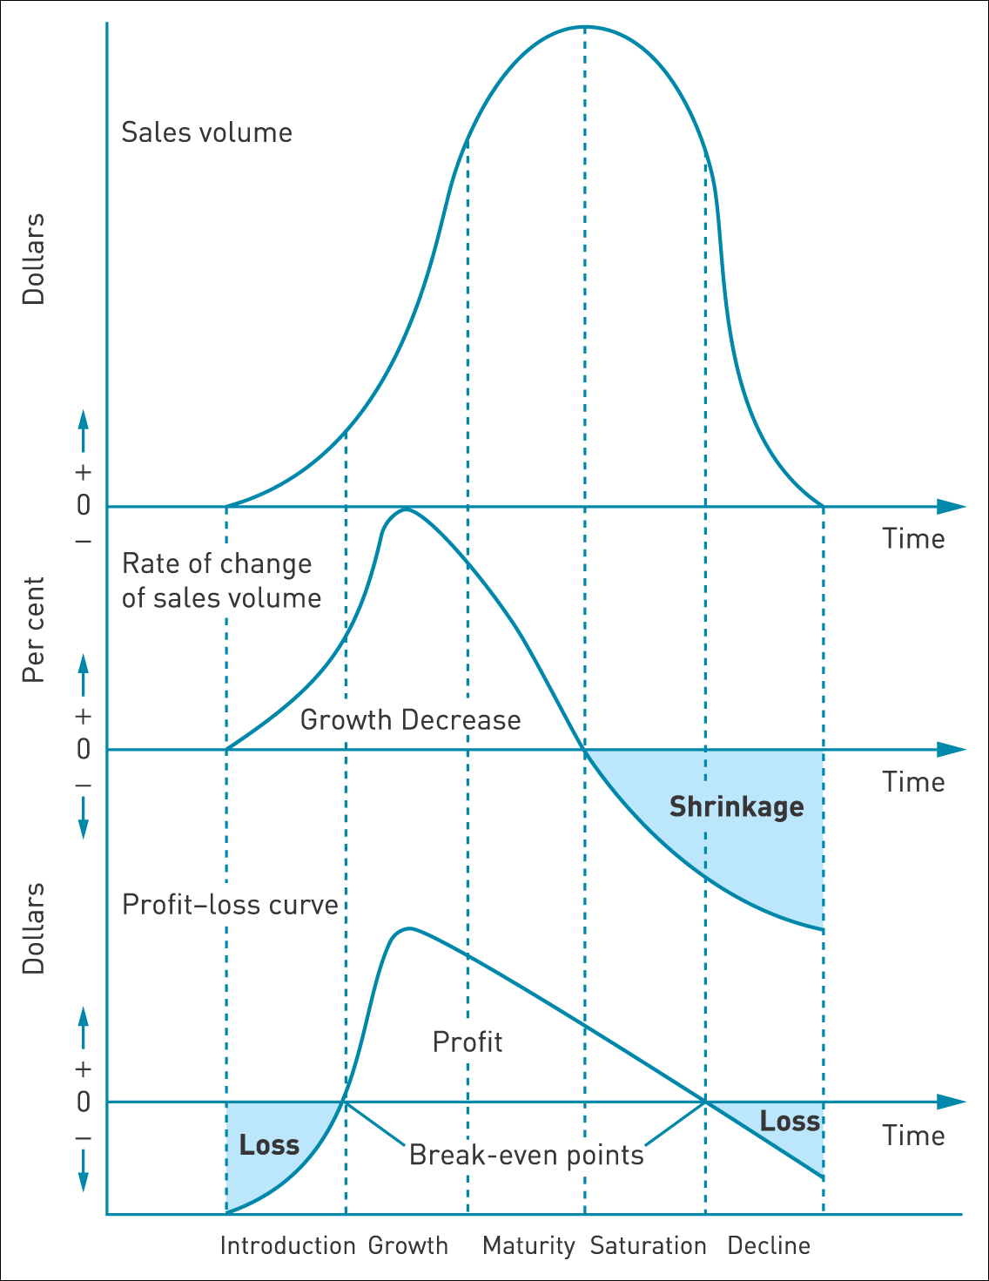
Product’s position on the life cycle
Figure 4.4 Determining a product’s position on the life cycle
source: Scheuing, 1974

Slide 24
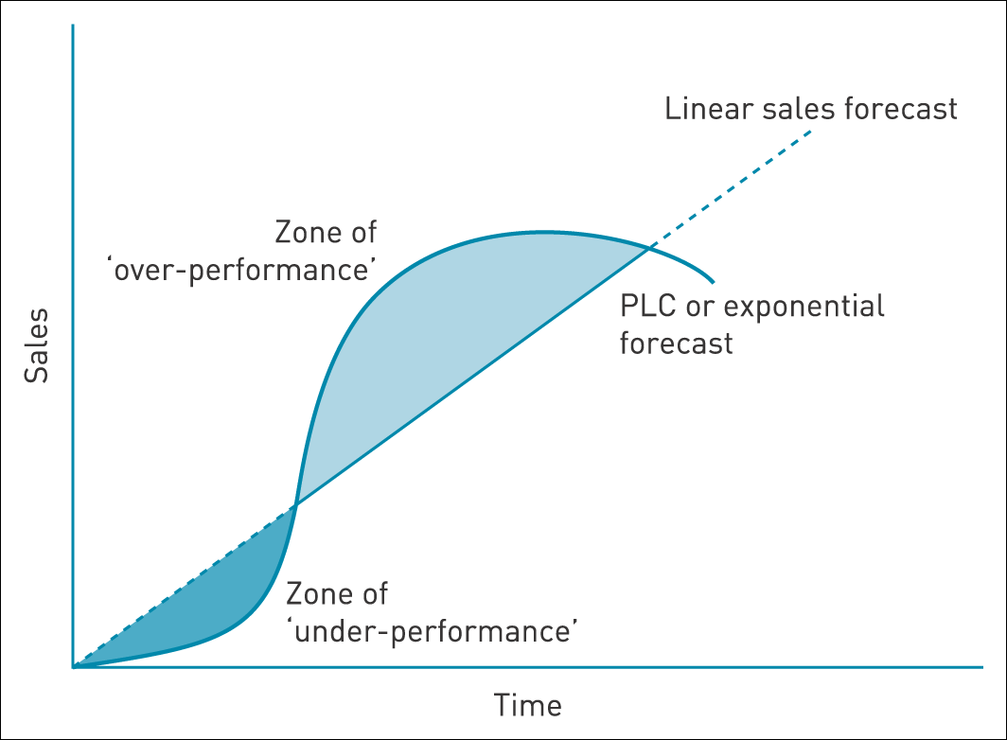
Linear vs exponential sales forecasts
Figure 4.5 Linear vs exponential sales forecasts

Slide 25
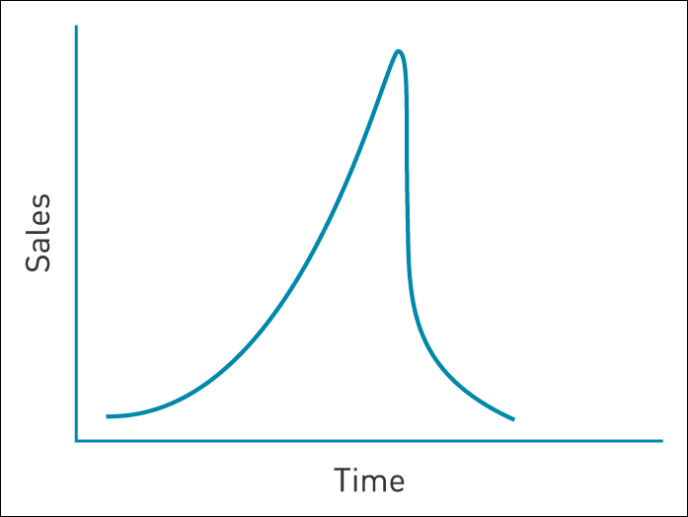
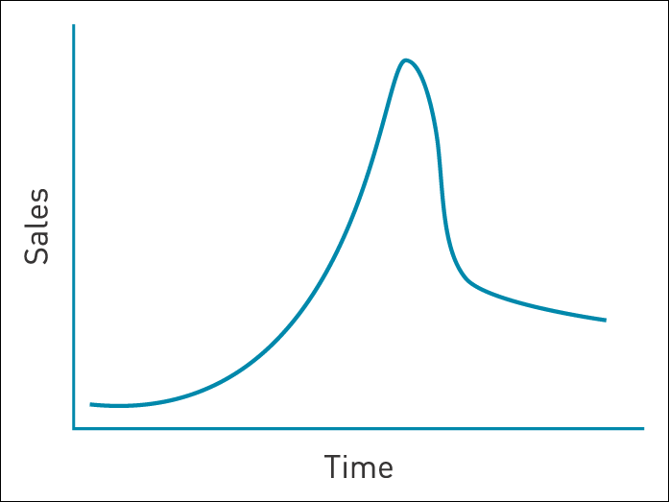
Deviant cases – fads and fashions
Figure 4.6 The classic fashion-good PLC
Figure 4.7 The fad PLC

