Slide 1
Chapter 6
Managing the new product development process

Slide 2
Agenda
Modelling the new product development (NPD) process
* Stage models
* Conversion process models
* Response models
Weaknesses of stage models
Multiple convergent processing

Slide 3
The most widely accepted normative model of the new product development process is that proposed by Booz-Allen Hamilton
in 1982 which conceives of this as a linear sequential process
of the following kind.
Company
objective
Exploration
Screening
Business analysis
Development
Testing
Commercialization
Product
success

Slide 4
While encompassing the tasks involved in NPD the
BAH model fails to capture the complexities of the process which frequently appear to account for
success and failure. Several other models have been proposed which attempt to capture the complex reality which Saren (1984) has classified as follows:
Departmental stage models
Activity-stage models
Decision-stage models
Conversion process models
Response models

Slide 5
Departmental and activity stage models are of the BAH ‘pass the parcel’ configuration and fail to communicate the need for integration.
By contrast decision stage models of the kind proposed by Cooper (1983) suggest the need for integration of functional inputs and feedback loops to achieve this.
Conversion process models seek to avoid the imposed rationality of stage models by adopting a ‘black box’ approach which offers no insight into the process itself.
Finally response models are only really concerned with the initial stage(s) of the NPD process as they focus on organisational response to change, i.e. the catalysts for NPD.

Slide 6
Conceptually stage models appear to offer the most useful representation of the NPD process. This is particularly so when regarded as a critical path with feedback loops.

Slide 7
The implications of iteration in the NPD process are clearly apparent from the figure:
Screening
Concept Test
Reformulate
No–new idea emerges
Successful?
No Modifications possible
No–new opportunity spotted
Business analysis
No–abandon

Slide 8
But stage models, even with feedback loops,
suffer from at least two weaknesses:
The NPD process is idiosyncratic to the individual firm.
There is no clear beginning, middle and end to the NPD process.
Thus, while stage models assume termination if a phase is not completed satisfactorily in reality the iterative nature of the process may suggest both new directions as well as recycling.

Slide 9
As the figure implies it is not essential for discrete activities in the NPD process to be implemented sequentially.
In reality many activities can be carried on simultaneously hence simultaneous engineering, or in parallel hence parallel processing.

Slide 10
The potential of simultaneous engineering and/or parallel processing addresses three key issues which emerge from a review of the NPD literature, all of which have a significant impact on ultimate success or failure:
The need for interdisciplinary inputs.
The need to develop product advantage.
The need for speed in the process.

Slide 11
Symbolically the problem with the concept of
parallelism is obvious.
Parallel lines are separated by an equal distance at
every point and never touch or intersect.
What we need is a concept which conveys a critical path, simultaneity in contributing activities, and integration to achieve a common conclusion, what we need is:

Slide 12
MULTIPLE
CONVERGENT
PROCESSING TM

Slide 13
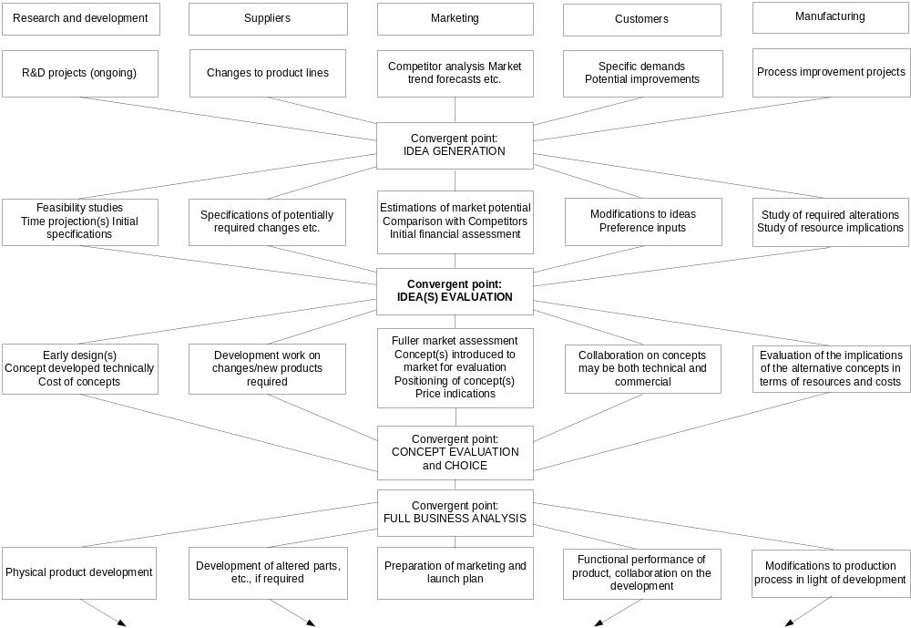
The early stages of the multiple convergent process

Slide 14
As the example illustrates four immediate
advantages of using the phases of a stage model
as points of convergence for multiple simultaneous activities are that:
Iterations among participants within stages are allowed for
The framework can easily accommodate third parties
Mechanisms for real integration throughout the process among different functions are set in the convergent points.
The model can fit into the most appropriate NPD
structures for the company

Slide 15
It is clear that conceptually the MCP model is a direct derivative from network analysis which has resulted in the development of specific techniques such as PERT and CPA. It is to network analysis that we should turn for trial and validation of the new paradigm.
It is proposed that a combination of Auster’s (1990) Analytical Dimensions and Bieman’s (1992) Five characteristics of interaction will provide an appropriate framework for analysis of the new product development process.

Slide 16
The potential for integration is particularly important
as recent work by Biemans (1992) has shown that while networks involving both manufacturers and customers are becoming commonplace in NPD, integration remains problematic.
All three benefits of the MCP model address this particularly through its provision of the opportunity for information sharing which is neglected by other models.

