Slide 1

Managers in the Workplace
1

Slide 2
Learning Objectives
Explain why managers are important to organizations.
Tell who managers are and where they work.
Know how to manage your time.
Describe the functions, roles, and skills of managers.
Describe the factors that are reshaping and redefining the manager’s job.
Develop your skills at being politically aware.
Explain the value of studying management.

Slide 3
Why Are Managers Important?
Organizations need their managerial skills and abilities more than ever in these uncertain, complex, and chaotic times.
Managerial skills and abilities are critical in getting things done.
The quality of the employee/supervisor relationship is the most important variable in productivity and loyalty.
Notes:
Let’s look at three reasons why managers are important to organizations.
First, managers are important because organizations need their managerial skills and abilities more than ever in uncertain, complex, and chaotic
times. As organizations deal with today’s challenges, managers play an important role in identifying critical issues and crafting responses.
Another reason why managers are important to organizations is because they’re critical to getting things done. The job of a manager is to ensure that all the employees are getting their jobs done.
Managers matter. A Gallup poll has found that the single most important variable in employee productivity and loyalty isn’t pay, or benefits, or the workplace environment—it’s the quality of the relationship between employees and their direct supervisors.

Slide 4
Who Are Managers?
Manager – Someone who coordinates and oversees the work of other people so that organizational goals can be accomplished.
Notes:
Managers run large corporations, medium-sized businesses, and entrepreneurial start-ups. They’re found in government departments, hospitals, small businesses, not-for-profit agencies, museums, schools, and even such nontraditional organizations such as political campaigns and music tours. In many organizations, the changing nature of work has blurred the distinction between managers and non-managerial employees. So, how do we define who managers are? A manager is someone who coordinates and oversees the work of other people so that organizational goals can be accomplished.

Slide 5
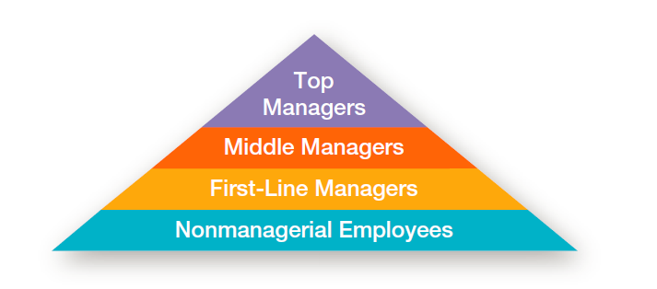
Exhibit 1-1 Levels of Management
Notes:
In traditionally structured organizations (often pictured as a pyramid because more employees are at lower organizational levels than at upper organizational levels), managers can be classified as first-line, middle, or top management.

Slide 6
Classifying Managers
First-line Managers - Individuals who manage the work of non-managerial employees.
Middle Managers - Individuals who manage the work of first-line managers.
Top Managers - Individuals who are responsible for making organization-wide decisions and establishing plans and goals that affect the entire organization.
Notes:
At the lowest level of management, first-line managers manage the work of non-managerial employees who typically are involved with producing the organization’s products or servicing the organization’s customers. First-line managers may be called supervisors or even shift managers, district managers, department managers, or office managers.
Middle managers manage the work of first-line managers and can be found between the lowest and top levels of the organization. They may have titles such as regional manager, project leader, store manager, or division manager.
At the upper levels of the organization are the top managers, who are responsible for making organization-wide decisions and establishing the plans and goals that affect
the entire organization. These individuals typically have titles such as executive vice president, president, managing director, chief operating officer, or chief executive.

Slide 7
Where Do Managers Work?
Organization – A deliberate arrangement of people assembled to accomplish some specific purpose (that individuals independently could not accomplish alone).
Common Characteristics of Organizations
Have a distinct purpose (goal)
Are composed of people
Have a deliberate structure
Notes:
What is an organization? It’s a deliberate arrangement of people to accomplish some specific purpose. Your college or university is an organization; so are fraternities and sororities, government departments, churches, Zynga, your neighborhood grocery store, the United Way, the St. Louis Cardinals baseball team, and the Mayo Clinic, all are considered organizations and have three common characteristics.
First, an organization has a distinct purpose typically expressed through goals the organization hopes to accomplish. Second, each organization is composed of people. It takes people to perform the work that’s necessary for the organization to achieve its goals. Third, all organizations develop a deliberate structure within which members do their work.

Slide 8
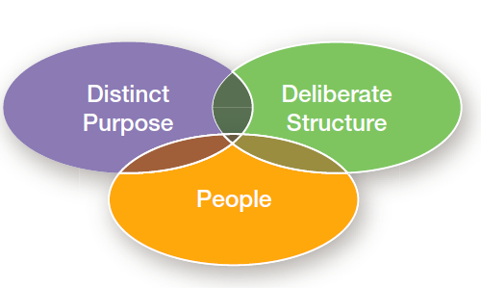
Exhibit 1-2 Characteristics of Organizations

Slide 9
What Do Managers Do?
Management involves coordinating and overseeing the work activities of others so that their activities are completed efficiently and effectively.
Notes:
Management involves coordinating and overseeing the work activities of others so their activities are completed efficiently and effectively. While coordinating and overseeing the work of others is what distinguishes a managerial position from a non-managerial one, this doesn’t mean that managers can do what they want anytime, anywhere, or in any way. Instead, management involves ensuring that work activities are completed efficiently and effectively by the people responsible for doing them, or, at least that’s what managers should be doing.

Slide 10
Effectiveness and Efficiency
Efficiency
Effectiveness
Getting the most output for the
least inputs
Attaining organizational goals
Doing things
right
Doing the right things
Notes:
Efficiency refers to getting the most output from the least amount of inputs or resources. Managers deal with scarce resources—including people, money, and equipment—and want to use those resources efficiently.
Effectiveness is often described as “doing the right things,” that is, doing those work activities that will result in achieving goals.
Whereas efficiency is concerned with the means of getting things done, effectiveness is concerned with the ends, or attainment of organizational goals.

Slide 11
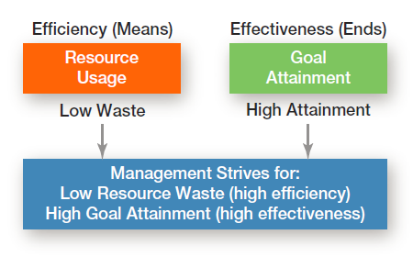
Exhibit 1-3 Efficiency and Effectiveness in Management

Slide 12
The Four Management Functions
Planning – Defining goals, establishing strategies to achieve goals, and developing plans to integrate and coordinate activities
Organizing – Arranging and structuring work to accomplish organizational goals.
Leading – Working with and through people to accomplish goals.
Controlling – Monitoring, comparing, and correcting work.
Notes:
According to the functions approach, managers perform certain activities or functions as they efficiently and effectively coordinate the work of others. What are these
functions? Henri Fayol, a French businessman, first proposed in the early part of the twentieth century that all managers perform five functions: planning, organizing,
commanding, coordinating, and controlling. Today, these functions have been condensed to four: planning, organizing, leading, and controlling (see Exhibit 1-4).

Slide 13
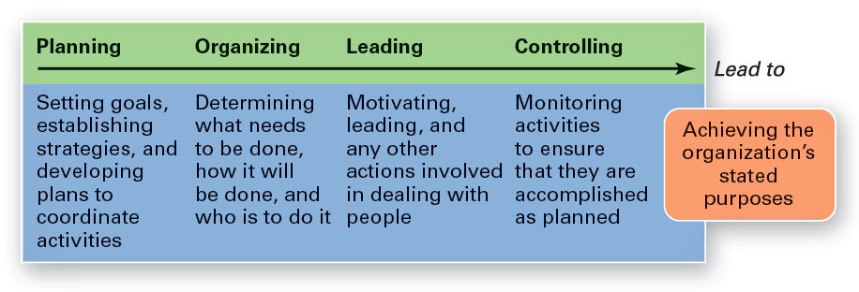
Exhibit 1-4 Four Functions of Management
Notes:
As managers engage in planning, they set goals, establish strategies for achieving those goals, and develop plans to integrate and coordinate activities.
When managers organize, they determine what tasks are to be done, who is to do them, how the tasks are to be grouped, who reports to whom, and where decisions are to be made.
When managers motivate subordinates, help resolve work group conflicts, influence individuals or teams as they work, select the most effective communication
channel, or deal in any way with employee behavior issues, they’re leading. To ensure goals are met and work is done as it should be, managers monitor and evaluate performance. Actual performance is compared with the set goals. If those goals aren’t achieved, it’s the manager’s job to get work back on track.
This process of monitoring, comparing, and correcting is the controlling function.

Slide 14
Management Roles
Roles are specific actions or behaviors expected of a manager.
Mintzberg identified 10 roles grouped around interpersonal relationships, the transfer of information, and decision- making.
Notes:
Henry Mintzberg, a well-known management researcher, studied actual managers at work. In his first comprehensive study, Mintzberg concluded that what managers do can best be described by looking at the managerial roles they engage in at work. The term managerial roles refers to specific actions or behaviors expected of, and exhibited by, a manager.

Slide 15
Three Types of Roles
Interpersonal roles
Figurehead, leader, liaison
Informational roles
Monitor, disseminator, spokesperson
Decisional roles
Entrepreneur, disturbance handler, resource allocator, negotiator
Notes:
As shown in Exhibit 1-5, these 10 roles are grouped around interpersonal relationships, the transfer of information, and decision-making.
The interpersonal roles involve people (subordinates and persons outside the organization) and other ceremonial and symbolic duties. The three interpersonal
roles include figurehead, leader, and liaison. The informational roles involve collecting, receiving, and disseminating information. The three informational roles include monitor, disseminator, and spokesperson. Finally, the decisional roles entail making decisions or choices and include entrepreneur, disturbance handler, resource allocator,
and negotiator.

Slide 16
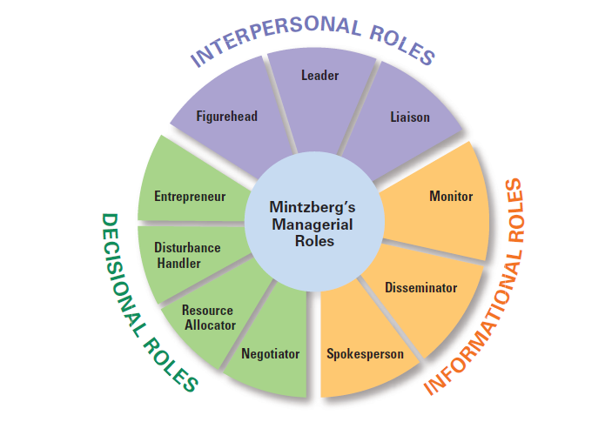
Exhibit 1-5 Mintzberg’s Managerial Roles

Slide 17
Skills Managers Need
Technical skills
Knowledge and proficiency in a specific field
Human skills
The ability to work well with other people
Conceptual skills
The ability to think and conceptualize about abstract and complex situations concerning the organization
Notes:
What types of skills do managers need? Robert L. Katz proposed that managers need three critical skills in managing: technical, human, and conceptual.
Technical skills are the job-specific knowledge and techniques needed to proficiently perform work tasks. These skills tend to be more important for first-line managers because they typically manage employees who use tools and techniques to produce the organization’s products or service the organization’s customers.
Human skills involve the ability to work well with other people both individually and in a group. Because all managers deal with people, these skills are equally important to all levels of management.
Finally, conceptual skills are the skills managers use to think and to conceptualize about abstract and complex situations. Using these skills, managers see the organization
as a whole, understand the relationships among various subunits, and visualize how the organization fits into its broader environment. These skills are most important
to top managers.

Slide 18
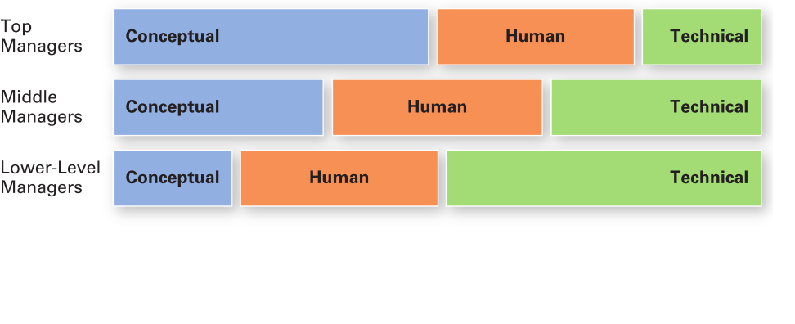
Exhibit 1-6 Skills Needed at Different Managerial Levels

Slide 19
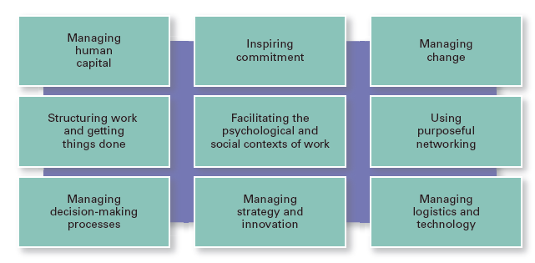
Exhibit 1-7 Important Managerial Levels
Notes:
Other important managerial skills that have been identified are listed in Exhibit 1-7. In today’s demanding and dynamic workplace, employees who want to be valuable assets must constantly upgrade their skills, and developing management skills can be particularly beneficial in today’s workplace.

Slide 20
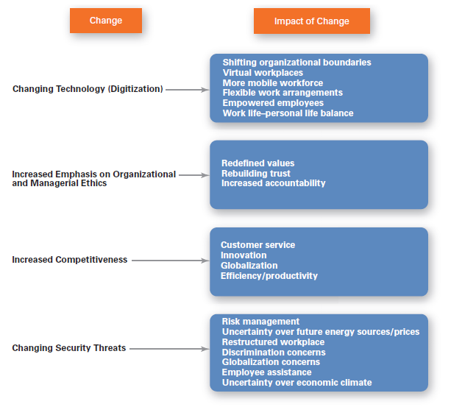
Exhibit 1-8 Changes Facing Managers
Notes:
In today’s world, managers are dealing with global economic and political uncertainties, changing workplaces, ethical issues, security threats, and changing technology. It’s likely that more managers will have to manage under such demanding circumstances, and the fact is that how managers manage is changing. Exhibit 1-8 shows some of the most important changes facing managers.

Slide 21
The Importance of Customers
Customers: the reason that organizations exist
Managing customer relationships is the responsibility of all managers and employees.
Consistent high quality customer service is essential for survival.
Notes:
You need customers. Without them, most organizations would cease to exist. Yet, focusing on the customer has long been thought to be the responsibility of marketing types. Today, the majority of employees in developed countries work in service jobs. Almost 77 percent of the U.S. labor force is employed in service industries.

Slide 22
The Importance of Social Media
Social media
Forms of electronic communication through which users create online communities to share ideas, information, personal messages, and other content.
Notes:
Today, the new frontier is social media, forms of electronic communication through which users create online communities to share ideas, information, personal messages, and other content. “More than a billion people use social platforms such as Facebook, Twitter, YouTube, LinkedIn, and others. Although sources say it’s too early to draw any conclusions, it appears that managers who actively make use of social media have increases in performance.”

Slide 23
The Importance of Innovation
Innovation
Doing things differently, exploring new territory, and taking risks.
Managers should encourage employees to be aware of and act on opportunities for innovation.
Notes:
Innovation means doing things differently, exploring new territory, and taking risks. Innovation isn’t just for high tech or other technologically sophisticated organizations. Innovative efforts can be found in all types of organizations.

Slide 24
The Importance of Sustainability
Sustainability – a company’s ability to achieve its business goals and increase long-term shareholder value by integrating economic, environmental, and social opportunities into its business strategies.
Notes:
What’s emerging in the twenty-first century is the concept of managing in a sustainable way, which has had the effect of widening corporate responsibility not only to managing in an efficient and effective way, but also to responding strategically to a wide range of environmental and societal challenges. From a business perspective, sustainability has been defined as a company’s ability to achieve its business goals and increase long-term shareholder value by integrating economic, environmental, and social opportunities into its business strategies.

Slide 25
Why Study Management?
Universality of Management
The reality that management is needed
in all types and sizes of organizations
at all organizational levels
in all organizational areas
in all organizations, regardless of location
Notes:
We can say with absolute certainty that management is needed in all types and sizes of organizations, at all organizational levels and in all organizational work areas, and in all organizations, no matter where they’re located. This is known as the universality of management (See Exhibit 1-9.)

Slide 26
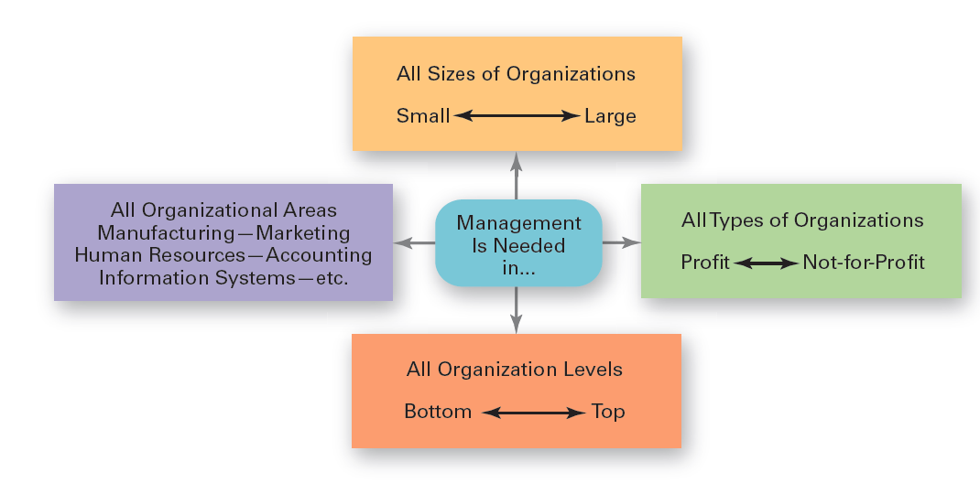
Exhibit 1-9 Universal Need for Management
Notes:
Effective management is universally needed in all organizations, therefore it’s imperative to find ways to improve the way organizations are managed. Why? Because we interact with organizations every single day. Organizations influence every aspect of our lives.

Slide 27
Challenges of Being a Manager
Challenges
Can be a thankless job
May entail clerical type duties
Managers also spend significant amounts of time in meetings and dealing with interruptions
Managers often have to deal with a variety of personalities and have to make do with limited resources
Notes:
There are many challenges to being a manager. It can be a tough and often thankless job. Additionally, a portion of a manager’s job (especially at lower organizational levels) may entail duties that are often more clerical (compiling and filing reports, dealing with bureaucratic procedures, or doing paperwork) than managerial. A large percentage of managers spend significant amounts of time in meetings and deal with interruptions, which can be time consuming and sometimes unproductive. Managers often have to deal with a variety of personalities and have to make do with limited resources. It can be a challenge to motivate workers in the face of uncertainty and chaos, which are constants in management regardless of the field or discipline.

Slide 28
Rewards of Being a Manager
Rewards
Responsible for creating a productive work environment.
Recognition and status in your organization and in the community.
Attractive compensation in the form of salaries, bonuses, and stock options.
Notes:
Despite challenges, being a manager can be rewarding. You’re responsible for creating a work environment in which organizational members can do their work to the best of their ability and thus help the organization achieve its goals. You help others find meaning and fulfillment in their work. You get to support, coach, and nurture others and help them make good decisions. In addition, as a manager, you often have the opportunity to think creatively and use your imagination. You’ll get to meet and work with a variety of people—both inside and outside the organization. Other rewards may include receiving recognition and status in your organization and in the community, playing a role in influencing organizational outcomes, and receiving attractive compensation in the form of salaries, bonuses, and stock options.

Slide 29
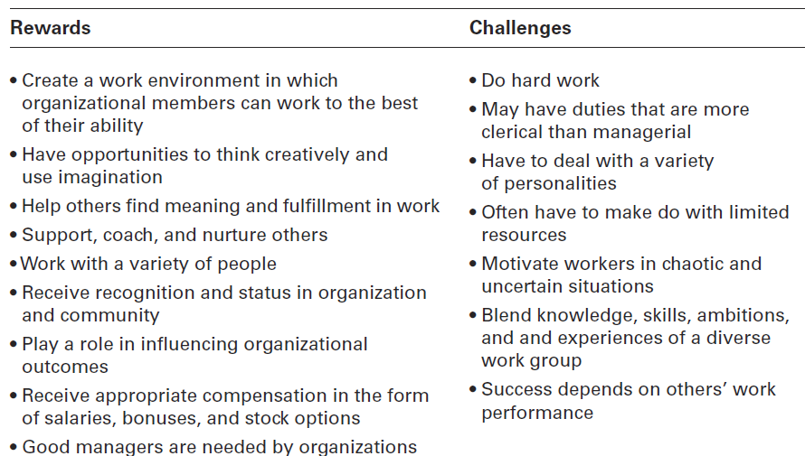
Exhibit 1-10 Rewards and Challenges of Being a Manager

Slide 30
Review Learning OBJECTIVE 1.1
Explain why managers are important to organizations.
Organizations need their managerial skills and abilities in uncertain, complex, and chaotic times.
Managers are critical to getting things done in organizations.
Managers contribute to employee productivity and loyalty.

Slide 31
Review Learning OBJECTIVE 1.2
Tell who managers are and where they work.
Managers coordinate and oversee the work of other people so that organizational goals can be accomplished.
Managers work in an organization, which is a deliberate arrangement of people to
accomplish some specific purpose.
1 – 31

Slide 32
Review Learning OBJECTIVE 1.3
Describe the functions, roles, and skills of managers.
Management involves coordinating and overseeing the efficient and effective completion of others’ work activities.
The four functions of management include planning, organizing, leading, and controlling.

Slide 33
Review Learning OBJECTIVE 1.3 (cont.)
Mintzberg’s managerial roles include:
Interpersonal, involve people and other ceremonial/symbolic duties (figurehead, leader, and liaison).
Informational, collecting, receiving, and disseminating information (monitor, disseminator, and spokesperson).
Decisional, making choices (entrepreneur, disturbance handler, resource allocator, and negotiator).

Slide 34
Review Learning OBJECTIVE 1.3 (cont.)
Katz’s managerial skills include
Technical (job-specific knowledge and techniques)
Human (ability to work well with people)
Conceptual (ability to think and express ideas).

Slide 35
Review Learning OBJECTIVE 1.4
Describe the factors that are reshaping and redefining the manager’s job.
Managers must be concerned with:
Customer service because employee attitudes and behaviors play a big role in customer satisfaction
Social media because these forms of communication are becoming important and valuable tools in managing
Innovation because it is important for organizations to be competitive.
Sustainability as business goals are developed

Slide 36
Review Learning OBJECTIVE 1.5
Explain the value of studying management.
The universality of management – managers are needed in all types and sizes of organizations
The reality of work – you will manage or be managed
Significant rewards and challenges

