Slide 1
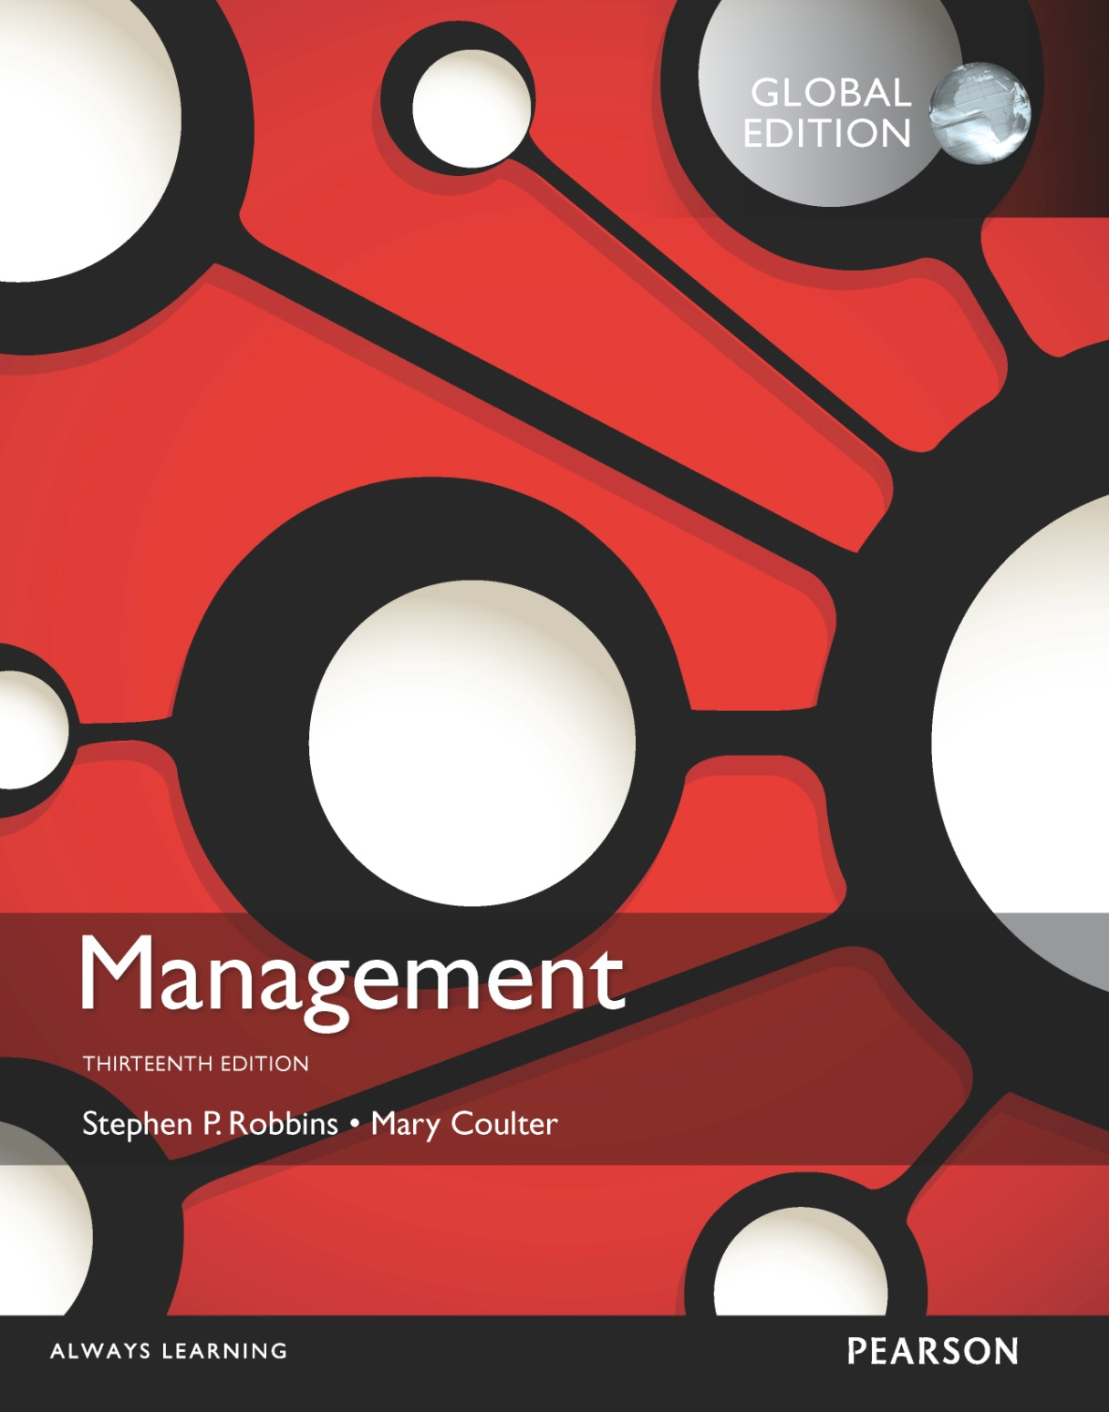
Making Decisions
2

Slide 2
Learning Objectives
Describe the eight steps in the decision-making process.
Develop your skill at being creative.
Explain the four ways managers make decisions.
Classify decisions and decision-making conditions.
Describe different decision-making styles and discuss how biases affect decision-making.
Know how to recognize when you’re using decision-making errors and biases and what to do about it.
Identify effective decision-making techniques.

Slide 3
A key to success in management and in your career is knowing how to be an effective decision-maker.

Slide 4

The Decision-Making Process
Decision – making a choice from two or more alternatives.
Notes:
Managers at all levels and in all areas of organizations make decisions. That is, they make choices. Although decision-making is typically described as choosing among alternatives, this view is too simplistic. Why? Because decision-making is (and should be) a process, not just a simple act of choosing among alternatives.

Slide 5
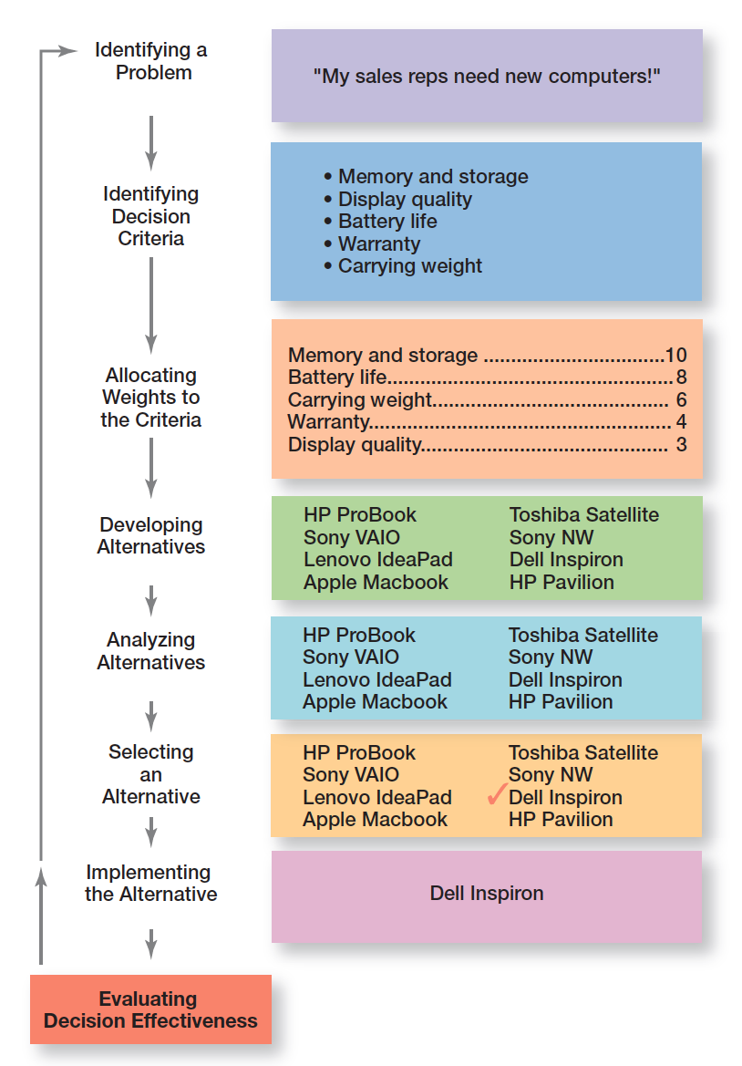
Exhibit 2-1 Decision-Making Process

Slide 6
The Decision-Making Process (cont.)
Step 1: Identify a Problem
Problem – an obstacle that makes it difficult to achieve a desired goal or purpose.
Every decision starts with a problem, a discrepancy between an existing and a desired condition.
Example – Amanda is a sales manager whose reps need new laptops.
Notes:
Every decision starts with a problem, a discrepancy between an existing and a desired condition. For our example, Amanda is a sales manager whose reps need new laptops because their old ones are outdated and inadequate for doing their job. To make it simple, assume it’s not economical to add memory to the old computers and it’s the company’s policy to purchase, not lease. Now we have a problem—a disparity between the sales reps’ current computers (existing condition) and their need to have more efficient ones (desired condition). Amanda has a decision to make.

Slide 7
The Decision-Making Process (cont.)
Step 2: Identify Decision Criteria
Decision criteria are factors that are important (relevant) to resolving the problem.
Example – Amanda decides that memory and storage capabilities, display quality, battery life, warranty, and carrying weight are the relevant criteria in her decision.
Notes:
Once a manager has identified a problem, he or she must identify the decision criteria important or relevant to resolving
the problem. Every decision maker has criteria guiding his or her decisions even if they’re not explicitly stated. In our example,
Amanda decides after careful consideration that memory and storage capabilities, display quality, battery life, warranty, and carrying weight are the relevant criteria in her decision.

Slide 8
The Decision-Making Process (cont.)
Step 3: Allocate Weights to the Criteria
If the relevant criteria aren’t equally important, the decision maker must weight the items in order to give them the correct priority in the decision.
The weighted criteria for our example is shown in Exhibit 2-2.
Notes:
If the relevant criteria aren’t equally important, the decision maker must weight the items in order to give them the correct
priority in the decision. How? A simple way is to give the most important criterion a weight of 10 and then assign weights to the rest using that standard. Of course, you could use any number as the highest weight. The weighted criteria for our example is shown in Exhibit 2-2.

Slide 9
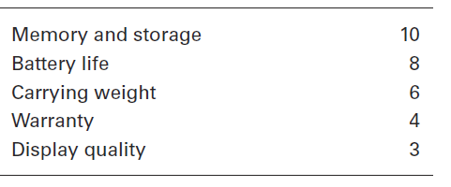
Exhibit 2-2 Important Decision Criteria

Slide 10
The Decision-Making Process (cont.)
Step 4: Develop Alternatives
List viable alternatives that could resolve the problem
Example – Amanda, identifies eight laptops as possible choices. (See Exhibit 2-3.)
Notes:
The fourth step in the decision-making process requires the decision maker to list viable alternatives that could resolve the problem. In this step, a decision maker needs to be creative, and the alternatives are only listed—not evaluated—just yet. Our sales manager, Amanda, identifies eight laptops as possible choices. (See Exhibit 2-3.)

Slide 11
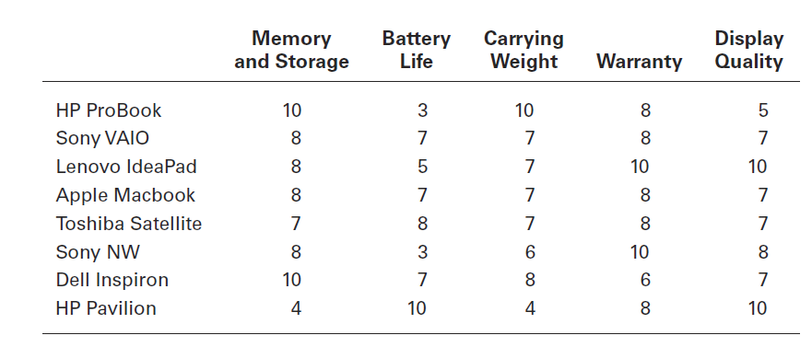
Exhibit 2-3 Possible Alternatives

Slide 12
The Decision-Making Process (cont.)
Step 5: Analyze Alternatives
Appraising each alternative’s strengths and weaknesses.
An alternative’s appraisal is based on its ability to resolve the issues related to the criteria and criteria weight.
Notes:
Once alternatives have been identified, a decision maker must evaluate each one. How? By using the criteria established in Step 2. Exhibit 2-3 shows the assessed values that Amanda gave each alternative after doing some research on them. Keep in mind that this data represents an assessment of the eight alternatives using the decision criteria, but not the weighting. When you multiply each alternative by the assigned weight, you get the weighted alternatives as shown in Exhibit 2-4. The total score for each alternative, then, is the sum of its weighted criteria.
Sometimes a decision maker might be able to skip this step. If one alternative scores highest on every criterion, you wouldn’t need to consider the weights because that alternative would already be the top choice. Or if the weights were all equal, you could evaluate an alternative merely by summing up the assessed values for each one. (Look again at Exhibit 2-3.) For example, the score for the HP ProBook would be 36, and the score for the Sony NW would be 35.

Slide 13
The Decision-Making Process (cont.)
Step 6: Select an Alternative
Choosing the best alternative
The alternative with the highest total weight is chosen.
Notes:
The sixth step in the decision-making process is choosing the best alternative or the one that generated the highest total in Step 5. In our example (Exhibit 2-4), Amanda would choose the Dell Inspiron because it scored higher than all other alternatives (249 total).

Slide 14
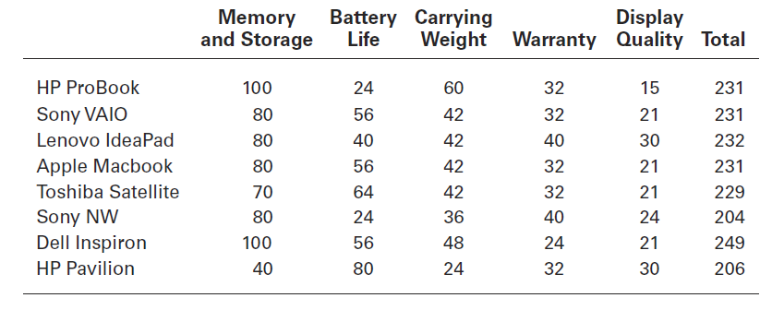
Exhibit 2-4 Evaluation of Alternatives

Slide 15
The Decision-Making Process (cont.)
Step 7: Implement the Alternative
Putting the chosen alternative into action
Conveying the decision to and gaining commitment from those who will carry out the alternative
Notes:
In Step 7 in the decision-making process, you put the decision into action by conveying it to those affected and getting their commitment to it. We know that if the people who must implement a decision participate in the process, they’re more likely to support it than if you just tell them what to do. Another thing managers may need to do during implementation is reassess the environment for any changes, especially if it’s a long-term decision. Are the criteria, alternatives, and choice still the best ones, or has the environment changed in such a way that we need to reevaluate?

Slide 16
The Decision-Making Process (cont.)
Step 8: Evaluate Decision Effectiveness
The soundness of the decision is judged by its outcomes.
How effectively was the problem resolved by outcomes resulting from the chosen alternatives?
If the problem was not resolved, what went wrong?
Notes:
The last step in the decision-making process involves evaluating the outcome or result of the decision to see whether the problem was resolved. If the evaluation shows that the problem still exists, then the manager needs to assess what went wrong. Was the problem incorrectly defined? Were errors made when evaluating alternatives? Was the right alternative selected but poorly implemented? The answers might lead you to redo an earlier step or might even require starting the whole process over.

Slide 17
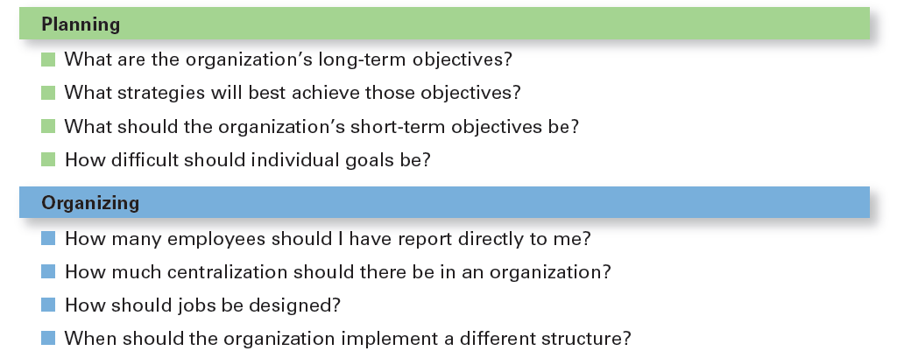
Exhibit 2-5 Decisions Managers May Make
Notes:
Although everyone in an organization makes decisions, decision-making is particularly important to managers. As Exhibit 6-5 shows, it’s part of all four managerial functions. In fact, that’s why we say that decision-making is the essence of management. And that’s why managers—when they plan, organize, lead, and control—are called decision makers.

Slide 18
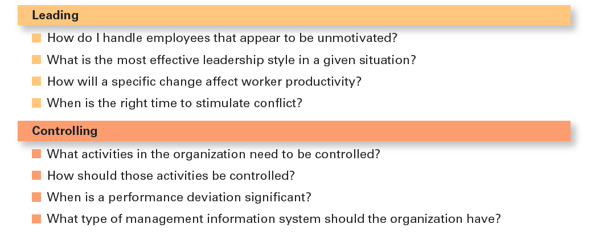
Exhibit 2-5 Decisions Managers May Make (cont.)

Slide 19
Making Decisions: Rationality
Rational Decision-Making – describes choices that are logical and consistent while maximizing value.
Assumptions of Rationality
The decision maker would be fully objective and logical
The problem faced would be clear and unambiguous
The decision maker would have a clear and specific goal and know all possible alternatives and consequences and consistently select the alternative that maximizes achieving that goal
Notes:
We assume that managers will use rational decision-making; that is, they’ll make logical and consistent choices to maximize value. After all, managers have all sorts of tools and techniques to help them be rational decision makers. Managers aren’t always rational. What does it mean to be a “rational” decision maker? A rational decision maker would be fully objective and logical. The problem faced would be clear and unambiguous, and the decision maker would have a clear and specific goal and know all possible alternatives and consequences. Finally, making decisions rationally would consistently lead to selecting the alternative that maximizes the likelihood of achieving that goal.

Slide 20
Making Decisions: Bounded Rationality
Bounded Rationality – decision-making that’s rational, but limited (bounded) by an individual’s ability to process information.
Satisfice – accepting solutions that are “good enough.”
Escalation of commitment – an increased commitment to a previous decision despite evidence it may have been wrong.
Notes:
A more realistic approach to describing how managers make decisions is the concept of bounded rationality, which says that managers make decisions rationally, but are limited (bounded) by their ability to process information. Because they can’t possibly analyze all information on all alternatives, managers satisfice, rather than maximize. That is, they accept solutions that are “good enough.” They’re being rational within the limits (bounds) of their ability to process information.
However, keep in mind that their decision-making is also likely influenced by the organization’s culture, internal politics, power considerations, and by a phenomenon called escalation of commitment, an increased commitment to a previous decision despite evidence that it may have been wrong.

Slide 21

Making Decisions: The Role of Intuition
Intuitive decision- making
Making decisions on the basis of experience, feelings, and accumulated judgment.
Notes:
What is intuitive decision making? It’s making decisions on the basis of experience, feelings, and accumulated judgment. Researchers studying managers’ use of intuitive decision-making have identified five different aspects of intuition, which are described in Exhibit 6-6.

Slide 22
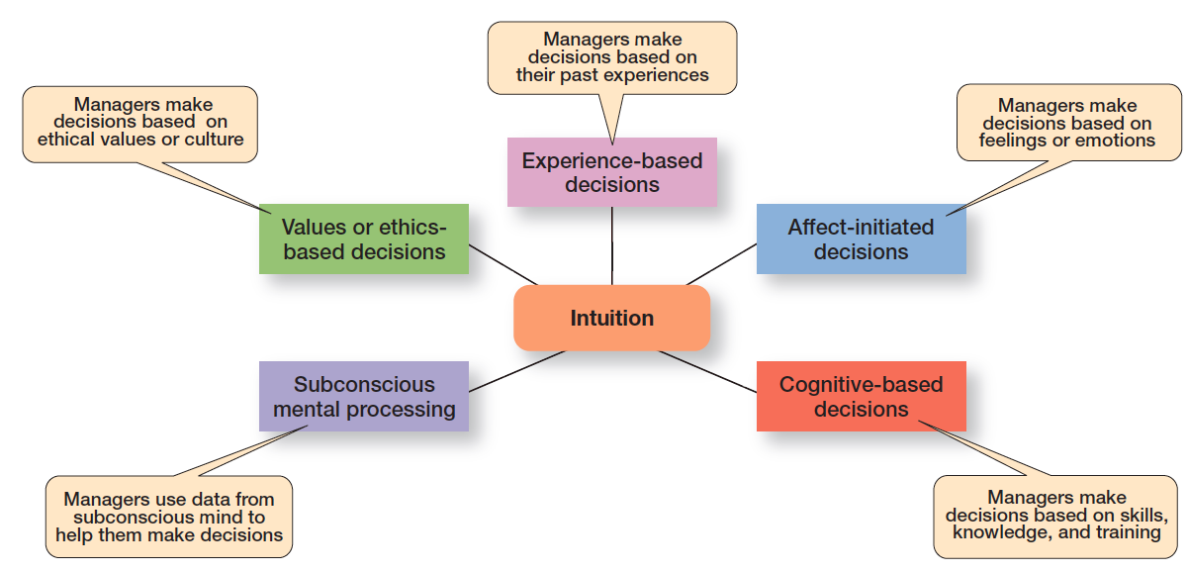
Exhibit 2-6 What Is Intuition?

Slide 23
Making Decisions: The Role of Evidence-Based Management
Evidence-based management (EBMgt) – the systematic use of the best available evidence to improve management practice.
Notes:
“Any decision-making process is likely to be enhanced through the use of relevant and reliable evidence, whether it’s buying someone a birthday present or wondering which new washing machine to buy.” That’s the premise behind evidence-based management (EBMgt), the “systematic use of the best available evidence to improve management practice.
EBMgt is quite relevant to managerial decision-making. The four essential elements of EBMgt are the decision maker’s expertise and judgment; external evidence that’s been evaluated by the decision maker; opinions, preferences, and values of those who have a stake in the decision; and relevant organizational (internal) factors such as context, circumstances, and organizational members.

Slide 24
Structured Problems and Programmed Decisions
Structured Problems – straightforward, familiar, and easily defined problems.
Programmed decision – a repetitive decision that can be handled by a routine approach.
Notes:
Some problems are straightforward. The decision maker’s goal is clear, the problem is familiar, and information about the problem is easily defined and complete. Such situations are called structured problems because they’re straightforward, familiar, and easily defined. Because it’s not an unusual occurrence, there’s probably some standardized routine for handling it. This is what we call a programmed decision, a
repetitive decision that can be handled by a routine approach. Because the problem is structured, the manager doesn’t have to go to the trouble and expense of going through an involved decision process. The “develop-the-alternatives” stage of the decision-making process either doesn’t exist or is given little attention. Why? Because once the structured problem is defined, the solution is usually self-evident or at least reduced to a few alternatives that are familiar and have proved successful in the past.

Slide 25
Structured Problems and Programmed Decisions (cont.)
Procedure – a series of sequential steps used to respond to a well-structured problem.
Rule – an explicit statement that tells managers what can or cannot be done.
Policy – a guideline for making decisions.
Notes:
A procedure is a series of sequential steps a manager uses to respond to a structured problem. The only difficulty is identifying the problem. Once it’s clear, so is the procedure. For instance, a purchasing manager receives a request from a warehouse manager for 15 tablets for the inventory clerks.
A rule is an explicit statement that tells a manager what can or cannot be done. Rules are frequently used because they’re simple to follow and ensure consistency. For example, rules about lateness and absenteeism permit supervisors to make disciplinary decisions rapidly and fairly.
The third type of programmed decisions is a policy, a guideline for making a decision. In contrast to a rule, a policy establishes general parameters for the decision maker rather than specifically stating what should or should not be done. Policies typically contain an ambiguous term that leaves interpretation up to the decision maker.

Slide 26
Unstructured Problems and Nonprogrammed Decisions
Unstructured Problems – problems that are new or unusual and for which information is ambiguous or incomplete.
Nonprogrammed decisions – unique and nonrecurring and involve custom made solutions.
Notes:
Not all the problems managers face can be solved using programmed decisions. Many organizational situations involve unstructured problems, new or unusual problems for which information is ambiguous or incomplete. Whether to build a new manufacturing facility in China is an example of an unstructured problem.

Slide 27
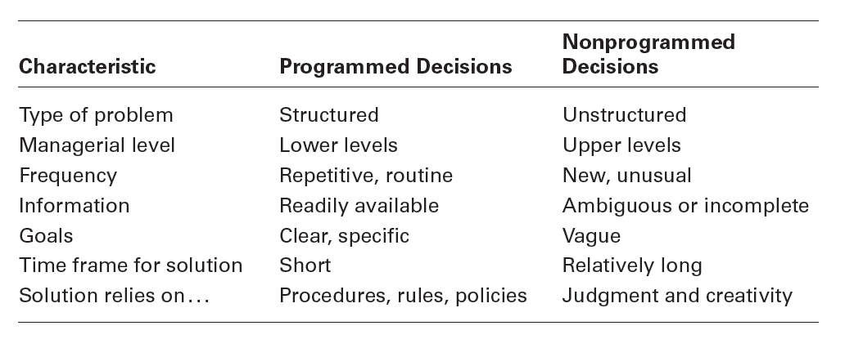
Exhibit 2-7 Programmed Versus Nonprogrammed Decisions
Notes:
Exhibit 2-7 describes the differences between programmed and nonprogrammed decisions. Lower-level managers mostly rely on programmed decisions (procedures, rules, and policies) because they confront familiar and repetitive problems. As managers move up the organizational hierarchy, the problems they confront become more unstructured.

Slide 28
Decision-Making Conditions
Certainty – a situation in which a manager can make accurate decisions because all outcomes are known.
Risk – a situation in which the decision maker is able to estimate the likelihood of certain outcomes.
Uncertainty – a situation in which a decision maker has neither certainty nor reasonable probability estimates available.
Notes:
The ideal situation for making decisions is one of certainty, a situation where a manager can make accurate decisions because the outcome of every alternative is known. For example, when Wyoming’s state treasurer decides where to deposit excess state funds, he knows exactly the interest rate offered by each bank and the amount that will be earned on the funds. He is certain about the outcomes of each alternative. As you might expect, most managerial decisions aren’t like this.
A far more common situation is one of risk, conditions in which the decision maker is able to estimate the likelihood of certain outcomes. Under risk, managers have historical data from past personal experiences or secondary information that lets them assign probabilities to different alternatives.
What happens if you face a decision where you’re not certain about the outcomes and can’t even make reasonable probability estimates? We call this condition uncertainty. Managers face decision-making situations of uncertainty. Under these conditions, the choice of alternative is influenced by the limited amount of available information and by the psychological orientation of the decision maker.

Slide 29
Managing Risk
Managers can use historical data from past experiences or secondary information that lets them assign probabilities to different alternatives.
Managers use this information to help make decisions by calculating the expected value – the expected return from each possible outcome – by multiplying expected revenues by (the probability).
This exercise will give the manager an idea of the average revenue that they can expect over time if everything relative to the probability remains constant.

Slide 30
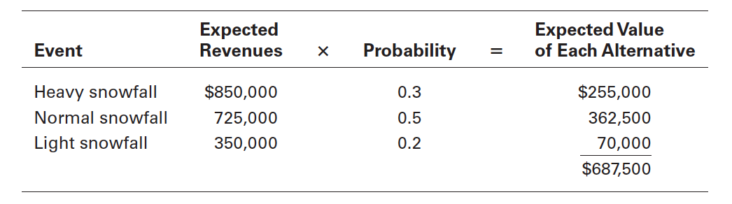
Exhibit 2-8 expected value

Slide 31
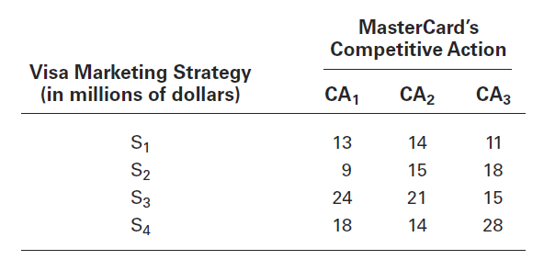
Exhibit 2-9 Payoff Matrix
Notes:
A marketing manager at Visa has determined four possible strategies (S1, S2, S3, and S4) for promoting the Visa card throughout the West Coast region of the United States. The marketing manager also knows that major competitor MasterCard has three competitive actions (CA1, CA2, and CA3) it’s using to promote its card in the same region. For this example, we’ll assume that the Visa manager had no previous knowledge that would allow her to determine probabilities of success of any of the four strategies. She formulates the matrix shown in Exhibit 2-9 to show the various Visa strategies and the resulting profit, depending on the competitive action used by MasterCard.

Slide 32
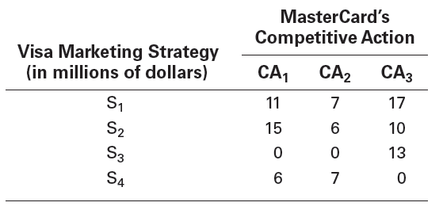
Exhibit 2-10 Regret Matrix

Slide 33
Decision-Making Styles
Linear Thinking Style – a person’s tendency to use external data/facts; the habit of processing information through rational, logical thinking.
Nonlinear Thinking Style – a person’s preference for internal sources of information; a method of processing this information with internal insights, feelings, and hunches.
Notes:
Your thinking style reflects two things: (1) the source of information you tend to use (external data and facts OR internal sources
such as feelings and intuition), and (2) whether you process that information in a linear way (rational, logical, analytical) OR a nonlinear way (intuitive, creative, insightful). These four dimensions are collapsed into two styles. The first, linear thinking style, is characterized by a person’s preference for using external data and facts and processing this information through rational, logical thinking to guide decisions and actions. The second, nonlinear thinking style, is characterized by a preference for internal sources of information (feelings and intuition) and processing this information with internal insights, feelings, and hunches to guide decisions and actions.

Slide 34
Decision-Making Biases and Errors
Heuristics – using “rules of thumb” to simplify decision-making.
Overconfidence Bias – holding unrealistically positive views of oneself and one’s performance.
Immediate Gratification Bias – choosing alternatives that offer immediate rewards and avoid immediate costs.
Notes:
When managers make decisions, they not only use their own particular style, they may use “rules of thumb,” or heuristics, to simplify their decision- making. Rules of thumb can be useful because they help make sense of complex, uncertain, and ambiguous information. Even though managers may use rules of thumb, that doesn’t mean those rules are reliable. Why? Because they may lead to errors and biases in
processing and evaluating information. Let’s look at each.
When decision makers tend to think they know more than they do or hold unrealistically positive views of themselves and their performance, they’re exhibiting the overconfidence bias. The immediate gratification bias describes decision makers who tend to want immediate rewards and to avoid immediate costs. For these individuals, decision choices that provide quick payoffs are more appealing than those with payoffs
in the future.

Slide 35
Decision-Making Biases and Errors (cont.)
Anchoring Effect – fixating on initial information and ignoring subsequent information.
Selective Perception Bias – selecting, organizing and interpreting events based on the decision maker’s biased perceptions.
Confirmation Bias – seeking out information that reaffirms past choices while discounting contradictory information.
Notes:
The anchoring effect describes how decision makers fixate on initial information as a starting point and then, once set, fail to adequately adjust for subsequent information. First impressions, ideas, prices, and estimates carry unwarranted weight relative to information received later. When decision makers selectively organize and interpret events based on their biased perceptions, they’re using the selective perception
bias. This influences the information they pay attention to, the problems they identify, and the alternatives they develop. Decision makers who seek out information that reaffirms their past choices and discount information that contradicts past judgments exhibit the confirmation bias.

Slide 36
Decision-Making Biases and Errors (cont.)
Framing Bias – selecting and highlighting certain aspects of a situation while ignoring other aspects.
Availability Bias – losing decision-making objectivity by focusing on the most recent events.
Representation Bias – drawing analogies and seeing identical situations when none exist.
Randomness Bias – creating unfounded meaning out of random events.
Notes:
The framing bias is when decision makers select and highlight certain aspects of a situation while excluding others. By drawing attention to specific aspects of a situation and highlighting them, while at the same time downplaying or omitting other aspects, they distort what they see and create incorrect reference points. The availability bias happens when decisions makers tend to remember events that are
the most recent and vivid in their memory. The result? It distorts their ability to recall events in an objective manner and results in distorted judgments and probability estimates. When decision makers assess the likelihood of an event based on how closely it resembles other events or sets of events, that’s the representation bias. Managers exhibiting this bias draw analogies and see identical situations where they don’t exist. The randomness bias describes the actions of decision makers who try to create meaning out of random events. They do this because most decision makers have difficulty dealing with chance even though random events happen to everyone, and there’s nothing that can be done to predict them.

Slide 37
Decision-Making Biases and Errors (cont.)
Sunk Costs Errors – forgetting that current actions cannot influence past events and relate only to future consequences.
Self-Serving Bias – taking quick credit for successes and blaming outside factors for failures.
Hindsight Bias – mistakenly believing that an event could have been predicted once the actual outcome is known (after-the-fact).
Notes:
The sunk costs error occurs when decision makers forget that current choices can’t correct the past. They incorrectly fixate on past expenditures of time, money, or effort in assessing choices rather than on future consequences. Instead of ignoring sunk costs, they can’t forget them. Decision makers who are quick to take credit for their successes and to blame failure on outside factors are exhibiting the self-serving bias. Finally, the hindsight bias is the tendency for decision makers to falsely believe that they would have accurately predicted the outcome of an event once that outcome is actually known.

Slide 38
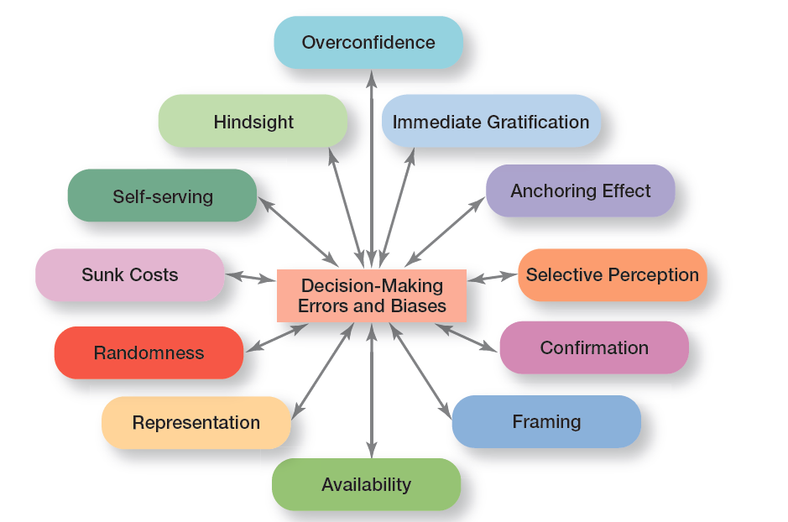
Exhibit 2-11 Common Decision-Making Biases

Slide 39
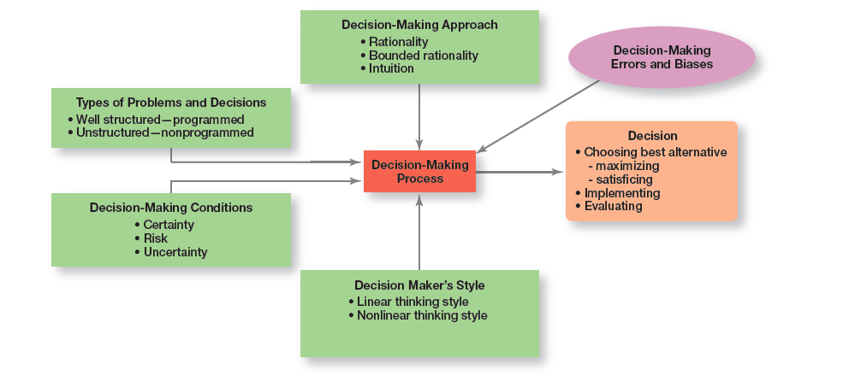
Exhibit 2-12 Overview of Managerial Decision-Making
Notes:
Exhibit 2-12 provides an overview of managerial decision-making. Because it’s in their best interests, managers want to make good
decisions— that is, choose the “best” alternative, implement it, and determine whether it takes care of the problem, which is the reason the decision was needed in the first place.

Slide 40
Guidelines for Making Effective Decisions
Understand cultural differences
Create standards for good decision-making
Know when it’s time to call it quits
Use an effective decision-making process
Build an organization that can spot the unexpected and quickly adapt to the changed environment
Notes:
Decision-making is serious business. Your abilities and track record as an effective decision maker will determine how your organizational work performance is evaluated and whether you’ll be promoted to higher and higher positions of responsibility. Below are some guidelines to help you be a better decision maker.
Understand cultural differences. Managers everywhere want to make good decisions. However, is there only one “best” way worldwide to make decisions? Or does the “best way depend on the values, beliefs, attitudes, and behavioral patterns of the people involved?”
Create standards for good decision making. Good decisions are forward-looking, use available information, consider all available and viable options, and do not create conflicts of interest.
Know when it’s time to call it quits. When it’s evident that a decision isn’t working, don’t be afraid to pull the plug.
Use an effective decision-making process.
Build an organization that can spot the unexpected and quickly adapt to the changed environment.

Slide 41

Design Thinking and Decision Making
Design thinking – approaching management problems as designers approach design problems.
Notes:
The way managers approach decision-making—using a rational and analytical mindset in identifying problems, coming up with alternatives, evaluating alternatives, and choosing one of those alternatives—may not be best and certainly not the only choice in today’s environment. That’s where design thinking comes in. Design thinking has been described as “approaching management problems as designers approach design problems.”
Korean carmaker Hyundai decided to take the design thinking approach in testing the durability and quality of its i30 hatchback family car by letting a group of forty safari park baboons examine it for ten hours. Hyundi hopes that the lessons learned from the excessive wear- and - tear test of the car’s parts and interior can be applied to the research and development of future cars.

Slide 42
Review Learning OBJECTIVE 2.1
Describe the eight steps in the decision-making process.
Identify problem
Identify decision criteria
Weight the criteria
Develop alternatives
Analyze alternatives
Select alternative
Implement alternative
Evaluate decision effectiveness
Notes:
A decision is a choice. The decision-making process consists of eight steps: (1) identify problem; (2) identify decision criteria; (3) weight the criteria; (4) develop alternatives; (5) analyze alternatives; (6) select alternative; (7) implement alternative; and (8) evaluate decision effectiveness.

Slide 43
Review Learning OBJECTIVE 2.2
Explain the four ways managers make decisions.
Assumptions of rationality
The problem is clear and unambiguous
A single, well-defined goal is to be achieved
All alternatives and consequences are known
The final choice will maximize the payoff
Notes:
The assumptions of rationality are as follows: the problem is clear and unambiguous; a single, well-defined goal is to be achieved; all alternatives and consequences are known; and the final choice will maximize the payoff. Bounded rationality says that managers make rational decisions but are bounded (limited) by their ability to process information.

Slide 44
Review Learning objective 2.2 (cont.)
Satisficing – when decision makers accept solutions that are good enough.
Escalation of commitment – managers increase commitment to a decision, even when they have evidence it may have been a wrong decision.
Intuitive decision-making means making decisions on the basis of experience, feelings, and accumulated judgment.
Evidence-based management, a manager makes decisions based on the best available evidence.
Notes:
Satisficing happens when decision makers accept solutions that are good enough. With escalation of commitment, managers increase commitment to a decision, even when they have evidence it may have been a wrong decision. Intuitive decision making means making decisions on the basis of experience, feelings, and accumulated judgment. Using evidence-based management, a manager makes decisions based on the best available evidence.

Slide 45
Review Learning objective 2.3
Classify decisions and decision-making conditions.
Programmed decisions are repetitive decisions that can be handled by a routine approach and are used when the problem being resolved is straightforward, familiar, and easily defined (structured).
Nonprogrammed decisions are unique decisions that require a custom-made solution and are used when the problems are new or unusual (unstructured) and for which information is ambiguous or incomplete.
Notes:
Programmed decisions are repetitive decisions that can be handled by a routine approach and are used when the problem being resolved is straightforward, familiar, and easily defined (structured). Nonprogrammed decisions are unique decisions that require a custom-made solution and are used when the problems are new or unusual (unstructured) and for which information is ambiguous or incomplete.

Slide 46
Review Learning objective 2.3 (cont.)
Classify decisions and decision-making conditions.
Certainty is a situation in which a manager can make accurate decisions because all outcomes are known.
Risk is a situation in which a manager can estimate the likelihood of certain outcomes.
Uncertainty is a situation in which a manager is not certain about the outcomes and can’t even make reasonable probability estimates.
Notes:
Certainty is a situation in which a manager can make accurate decisions because all outcomes are known. Risk is a situation in which a manager can estimate the likelihood of certain outcomes. Uncertainty is a situation in which a manager is not certain about the outcomes and can’t even make reasonable probability estimates. When decision makers face uncertainty, their psychological orientation will determine whether they follow a maximax choice (maximizing the maximum possible payoff); a maximin choice (maximizing the minimum possible payoff); or a minimax choice (minimizing the maximum regret— amount of money that could have been made if a different decision had been made).

Slide 47
Review Learning objective 2.4
Describe different decision-making styles and discuss how biases affect decision-making.
Linear thinking style – characterized by a person’s preference for using external data and processing this information through rational, logical thinking.
Nonlinear thinking style – characterized by a preference for internal sources of information and processing this information with internal insights, feelings, and hunches.
Notes:
A person’s thinking style reflects two things: the source of information you tend to use (external or internal) and how you process that information (linear or nonlinear). These four dimensions were collapsed into two styles. The linear thinking style is characterized by a person’s preference for using external data and processing this information through rational, logical thinking. The nonlinear thinking style is characterized by a preference for internal sources of information and processing this information with internal insights, feelings, and hunches. The 12 common decision-making errors and biases include overconfidence, immediate gratification, anchoring, selective perception, confirmation, framing, availability, representation, randomness, sunk costs, self-serving bias, and hindsight. The managerial decision making model helps explain how the decision-making process is used to choose the best alternative(s), either through maximizing or Satisficing and then implement and evaluate the alternative. It also helps explain what factors affect the decision-making process, including the decision-making approach (rationality, bounded rationality, intuition), the types of problems and decisions (well structured and programmed or unstructured and nonprogrammed), the decision-making conditions (certainty, risk, uncertainty), and the decision maker’s style (linear or nonlinear).

Slide 48
Review Learning objective 2.5
Identify effective decision-making techniques.
An effective decision-making process
Focuses on what’s important
Is logical and consistent
Acknowledges both subjective and objective thinking and blends both analytical and intuitive approaches
Requires only “enough” information as is necessary to resolve a problem
Notes:
Managers can make effective decisions by understanding cultural differences in decision-making, knowing when it’s time to call it quits, using an effective decision-making process, and building an organization that can spot the unexpected and quickly adapt to the changed environment. An effective decision-making process (1) focuses on what’s important; (2) is logical and consistent; (3) acknowledges both subjective and objective thinking and blends both analytical and intuitive approaches; (4) requires only “enough” information as is necessary to resolve a problem.

Slide 49
Review Learning objective 2.5 (cont.)
Encourages and guides gathering relevant information and informed opinions
Is straightforward, reliable, easy to use, and flexible
Design thinking – “approaching management problems as designers approach design problems.”
Notes:
(5) encourages and guides gathering relevant information and informed opinions; and (6) is straightforward, reliable, easy to use, and flexible.
The five habits of highly reliable organizations are (1) not being tricked by their successes; (2) deferring to experts on the front line; (3) letting unexpected circumstances provide the solution; (4) embracing complexity; and (5) anticipating, but also recognizing, limits.
Design thinking is “approaching management problems as designers approach design problems.” It can be useful when identifying problems and when identifying and evaluating alternatives.

