Slide 1

Managing the Environment and the Organization’s Culture
3
3 -1

Slide 2
Learning Objectives
Contrast the actions of managers according to the omnipotent and symbolic views.
Describe the constraints and challenges facing managers in today’s external environment.
Develop your skill at scanning the environment so you can anticipate and interpret changes taking place.
Discuss the characteristics and importance of organizational culture.
Know how to read and assess an organization’s culture.
Describe current issues in organizational culture.
3 - 2

Slide 3
Reading an Organization’s Culture: Find One Where You'll Be Happy
“A key to success in
management and in your
career is knowing how to
“read” an organization’s
culture so you can find one
in which you’ll be happy.”
3 - 3

Slide 4
Scanning the Environment
Do background work. Check out the company’s Web site.
What impression do you get from it? Are corporate values listed? Mission Statement?
Observe the physical surroundings and corporate symbols.
Notice visible symbols of organizational culture, such as, logos, signs, posters, pictures, photos, style of dress, etc.
How would you characterize the people who work there ? Are they formal? Casual? Serious? Jovial? Open?
3 -4

Slide 5
The Manager: Omnipotent or Symbolic?
Omnipotent view of management: The view that managers are directly responsible for an organization’s success or failure.
Symbolic view of management: The view that much of an organization’s success or failure is due to external forces outside managers’ control.
3 - 5

Slide 6
Managerial Constraints
In reality, managers are neither all-powerful nor helpless. But their decisions and actions are constrained.
As you can see in Exhibit 3-1, external constraints come from the organization’s environment and internal constraints come from the organization’s culture.
3 - 6

Slide 7
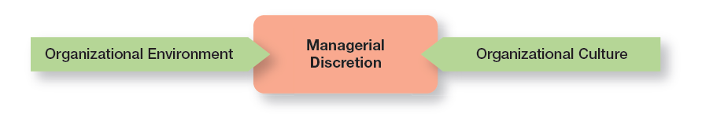
Exhibit 3-1 Constraints on Managerial Discretion
3 - 7

Slide 8
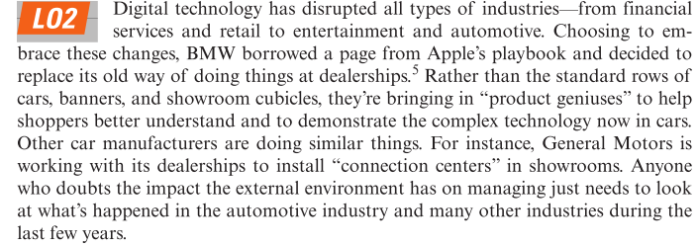
The External Environment: Constraints and Challenges
3 - 8

Slide 9
The External Environment
The External Environment: Those factors and forces outside the organization that affect it’s performance. The external environment includes several different components.
Economic – Encompasses factors such as interest rates, inflation, changes in disposable income, stock market fluctuations, and business cycle stages.
Demographic – Concerned with trends in population characteristics such as age, race, gender, education level, geographic location, income and family composition.
Political/Legal – Concerned with federal, state and local laws, and global laws.
3 - 9

Slide 10
the External Environment (cont.)
Technological – Concerned with scientific or industrial innovations.
The Sociocultural – Concerned with societal and cultural factors such as values, attitudes, trends, traditions and lifestyles, beliefs, tastes, and patterns of behavior.
Global – Encompasses issues associated with globalization and a world economy.
3 - 10

Slide 11
The External Environment (cont.)
The demographic component is concerned with trends in population characteristics such as age, race, gender, education level, geographic location, income, and family composition.
The political/legal component looks at federal, state, and local laws, as well as global laws and laws of other countries. It also includes a country’s political conditions and stability.
3 - 11

Slide 12
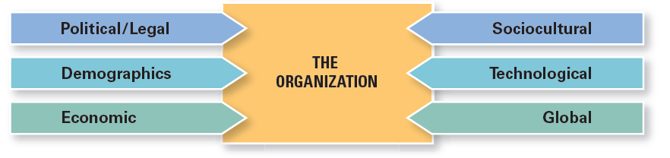
Exhibit 3-2 Components of the External Environment
3 -12

Slide 13
Factors Impacting Global Businesses
Like many global businesses, Nestlé is facing increased commodity (raw materials) costs.
Nestlé, the maker of products from Crunch chocolate bars to Nescafé coffee to Purina pet foods, spends more than $30 billion a year on raw materials.
Commodity costs are just one of the many volatile economic factors facing organizations. Managers need to be aware of the economic context so they can make the best decisions for their organizations.
3 - 13

Slide 14
The Global Economy anD the Economic Context
The lingering global economic challenges – once described as the “Great Recession” by some analysts – began with the turmoil in the United States housing market.
As credit markets collapsed, businesses were impacted.
Credit was no longer readily available to fund businesses.
Economic difficulties spread across the globe.
The fragile economic recovery continues to be a business constraint.
3 - 14

Slide 15
Economic Inequality and the Economic context
As economic growth has languished and sputtered, and as people’s belief that anyone could prosper declined, social discontent over growing income gaps has increased.
Business leaders must realize that societal attitudes in the economic context have the potential to create constraints.
3 - 15

Slide 16
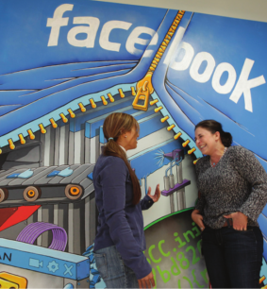
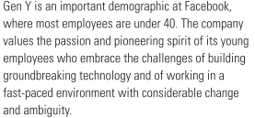
The Demographic Environment
3 – 16

Slide 17
The Demographic Environment (conT.)
The size and characteristics of a country’s population can have a significant effect on what it’s able to achieve in politics, economics, and culture.
Baby Boomers – Born between 1946 and 1964, one of the largest and most influential demographic groups in history.
Gen Y or (Millennials) – Children of Baby Boomers, born between 1978 and 1994, making an impact on technology and the workplace.
Post-Millennials – The youngest group identified age group—basically teens and middle-schoolers. They have also been called the iGeneration because advances in technology have customized everything to the individual.
3 - 17

Slide 18
Assessing Environmental Uncertainty
Environmental uncertainty refers to the degree of change and complexity in an organization’s environment.
The first dimension of uncertainty is change.
Organizations are stable, minimal change
Organizations are dynamic, frequent change
Organizational Complexity refers to the number of components in an organization’s environment and the extent of the organization’s knowledge about those components.
3 - 18

Slide 19
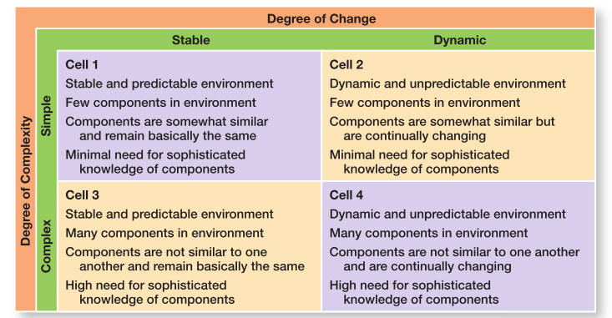
Exhibit 3-3 Environmental Uncertainty Matrix
3 - 19

Slide 20
Managing Stakeholder Relationships
The nature of stakeholder relationships is another way in which the environment influences managers. The more obvious and secure these relationships, the more influence managers will have over organizational outcomes.
Stakeholders – Any constituencies in an organization’s decisions and actions.
Exhibit 3 - 4 identifies some of the organization’s most common stakeholders which includes both internal and external constituent groups.
3 - 20

Slide 21
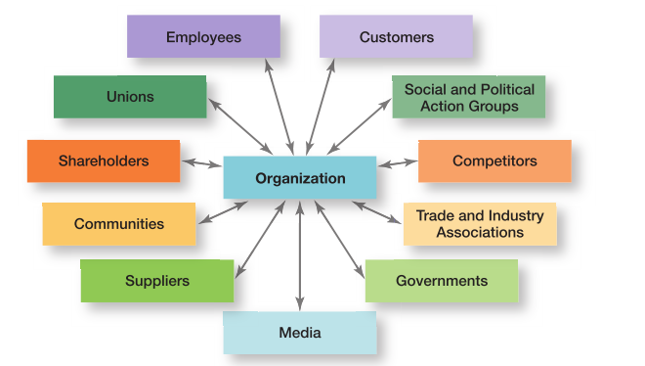
Exhibit 3-4 Organizational Stakeholders
3 - 21

Slide 22
The benefits of good stakeholder relationships
Improved predictability of environmental changes
Increased successful innovations
Increased trust among stakeholders
Greater organizational flexibility to reduce the impact of change
3 -22

Slide 23
Organizational Culture: constraints and Challenges
Just as each individual has a unique personality — traits and characteristics influence the way we act and interact with others. An organization, too, has a personality, which is referred to as organizational culture.
An organization’s culture can make employees feel included, empowered, and supported or it can make them feel the opposite.
3 - 23
Notes:
Because culture can be a very powerful agent in organizations, therefore, it is very important for managers to pay attention to it.

Slide 24
Organizational culture
Organizational Culture —The shared values, principles, traditions, and ways of doing things that influence the way organizational members act and that distinguish the organization from other organizations.
Cultural Values and practices evolve over time.
Organizational Culture is:
Perception — based on employee experience within the organization.
Descriptive — how members describe it.
Shared — employees share perception and experiences.
Research suggests seven dimensions of culture that seem to capture the essence of an organization’s culture. These dimensions are shown in Exhibit 3-5 and range from low to high.
3 -24
Notes:
Describing an organization using these seven dimensions gives a composite picture of the organization’s culture. In many organizations, one cultural dimension often is emphasized more than the others and essentially shapes the organization’s personality and the way the organization works.

Slide 25
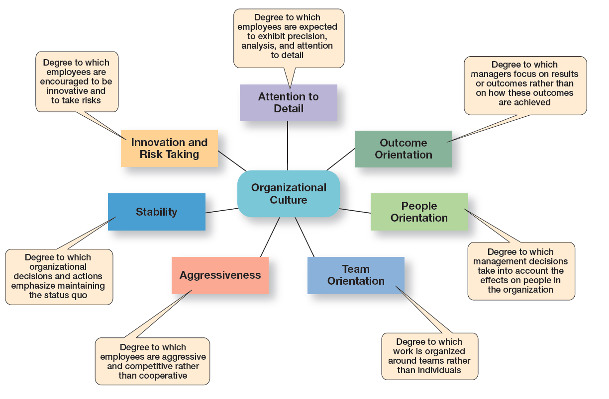
Exhibit 3–5 Dimensions of Organizational culture
3 – 25

Slide 26
Contrasting Organizational culture
In many organizations, one cultural dimension is often emphasized more than others and essentially shapes the organization’s personality and the way the organization works.
For example, Sony Corporation focuses on product innovation and risk-taking. The company “lives and breaths” innovations, and employees’ behaviors support that goal. (Product Orientation).
Conversely, Southwest Airlines focuses on it’s employees and has made them a central focus of it’s culture. (People Orientation).
3 - 26

Slide 27
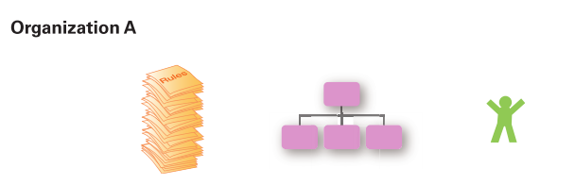
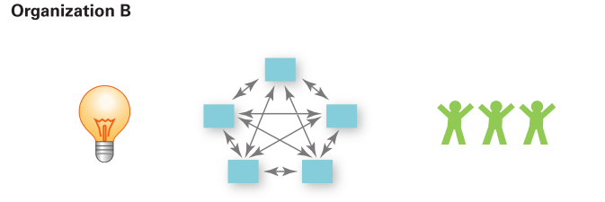
Exhibit 3-6 Contrasting Organizational Culture
Risk-taking and change discouraged
Creativity discouraged
Close managerial supervision
Work activities designed around the individual employee
Risk-taking and change rewarded
Creativity and innovation rewarded
Management trusts employees
Work designed around teams
3 - 27

Slide 28
Contrasting Cultural Values (cont.)
Exhibit 3-6 illustrates how the dimensions of culture can create significantly different cultures.
Both Organization A and Organization B are manufacturing firms, but each company emphasizes a different dimension that have shaped organizational culture.
3 - 28

Slide 29
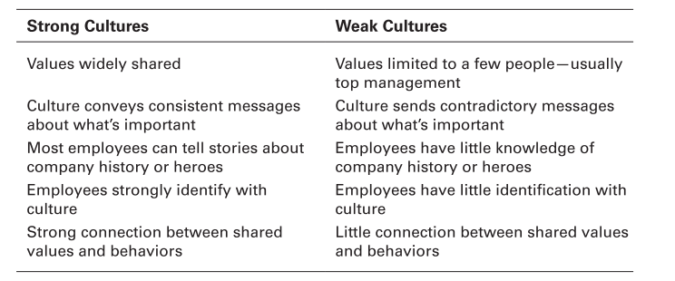
Exhibit 3-7 Strong Versus Weak Cultures
3 - 29

Slide 30
Strong Cultures
All organizations have cultures, but not all cultures equally influence employees’ behaviors and actions.
Strong Cultures—Organizational cultures in which the key values are intensely held and widely shared.
The more employees accept the organization's key values and greater their commitment to those values, the stronger the culture.
The stronger the culture becomes, the more it affects the way managers plan, organize, lead, and control.
Strong Cultures are associated with high organizational performance.
.
3 - 30

Slide 31

Strong Cultures
Apple’s strong culture of product innovation and customer-service reflects the core values of it’s visionary cofounder, Steve Jobs. Jobs instilled these core values in all employees, from top executives to sales associates, such as the Genius Bar employee shown here training a customer at the Apple Store in Manhattan.
3 - 31

Slide 32
Where Culture Comes From and How it Continues
Exhibit 3-8 illustrates how an organization’s culture is established and maintained.
Organizational Culture usually reflects the vision of the founder.
The small size of most new organizations makes it easier to establish organizational culture.
Once culture is established, organizational practices help to maintain it.
3 - 32
Notes:
The actions of top managers also have a major impact on the organization’s culture. Former IBM CEO, Sam Palmisano, wanted employees to value teamwork so he chose to take several million dollars from his yearly bonus and give it to his top executives based on their teamwork.

Slide 33
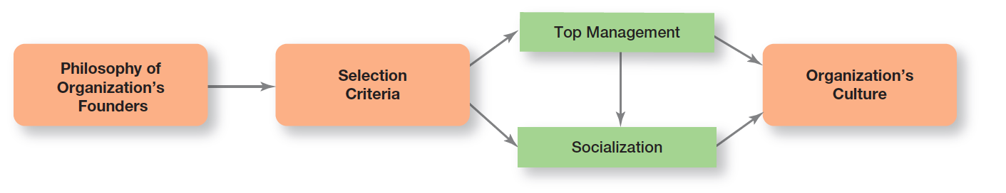
Exhibit 3-8 Establishing and Maintaining Culture
3 - 33

Slide 34
How Employees learn culture
Employees “learn” an organization’s culture in a number of ways. The most common are stories, rituals, material symbols, and language.
Stories — organizational stories abut significant events in the life of the company help keep culture alive.
Rituals — repetitive sequences of activities that express and reinforce important organizational values and goals.
3 - 34

Slide 35
How Employees learn culture (cont.)
Material Artifacts and Symbols — convey to employees what is important and the kinds of expected behaviors, ex. Risk-taking, etc.
Language — many organizations or units of an organization use language to identify and unite members of a culture. New employees are frequently overwhelmed with acronyms and jargon that quickly becomes a part of their language.
3 - 35

Slide 36
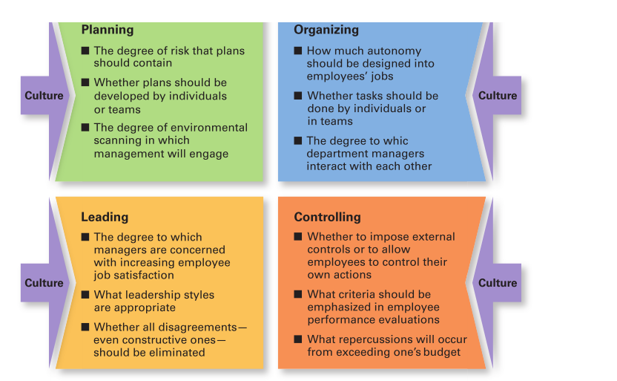
Exhibit 3-9 Types of Managerial Decisions Affected by Culture
3 - 36
Notes:
As shown in Exhibit 3-9, a manager’s decisions are influenced by the culture in which he or she operates. An organization’s culture, especially a strong one, influences and constrains the way managers plan, organize, organize, lead, and control.

Slide 37
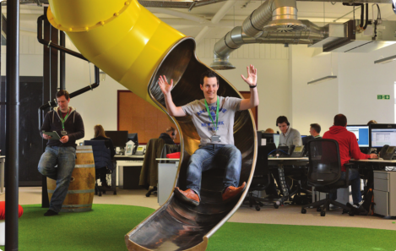
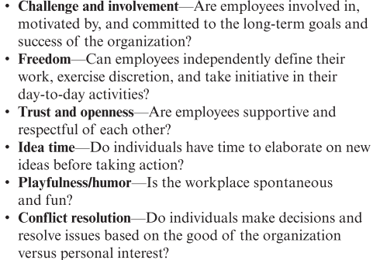
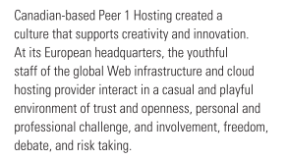
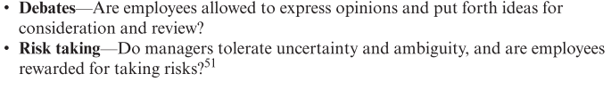
Creating an Innovative Culture
3 - 37

Slide 38
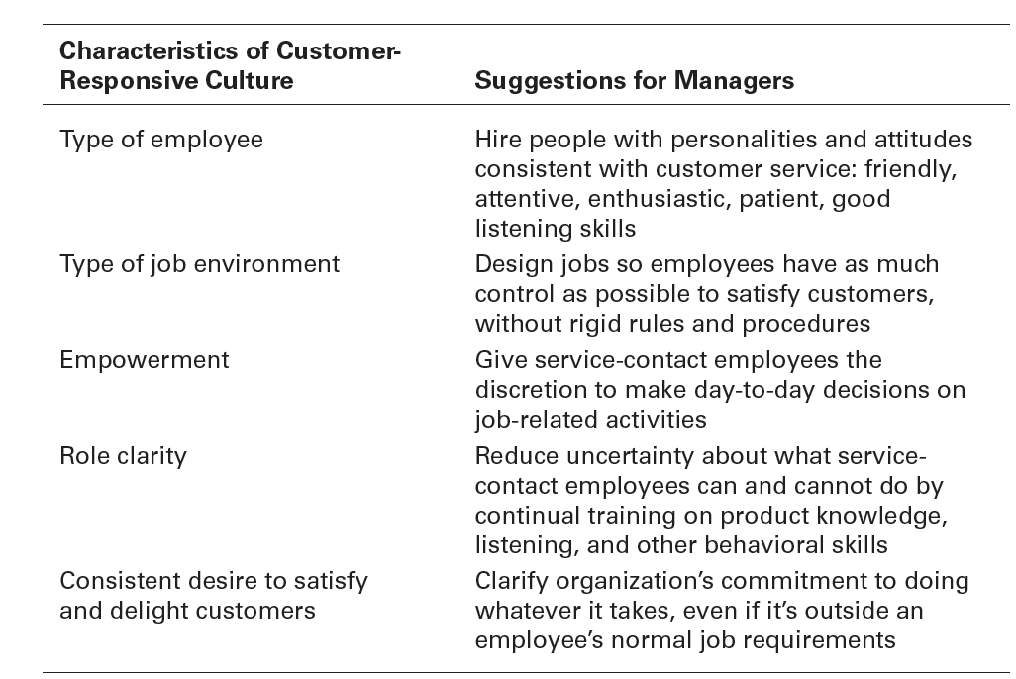
Exhibit 3-10 Creating a Customer-Responsive Culture
3 - 38

Slide 39
Creating a Customer-Responsive Culture (Cont.)
Research shows that customer satisfaction is directly related to customer spending and consumption.
Satisfied customers will be repeat customers for businesses.
3 - 39

Slide 40
Spiritually and organizational culture
Workplace Spiritually — A culture where organizational values promote a sense of purpose through meaningful work that takes place in the context of community.
Organizations with a spiritual culture recognize that people:
Have a mind and spirit.
Seek to find meaning and purpose in their work.
Desire to connect with others and be a part of a community.
3 - 40

Slide 41
Five cultural characteristics of spiritual organizations
Research indicates that Spiritual Organizations have five characteristics:
Strong sense of purpose, culture built around meaningful purpose.
Focus on individual development, recognize worth and value of individuals.
Trust and openness, characterized by mutual trust, honesty, and openness.
Employee empowerment, managers trust employees to make good decisions.
Tolerance of employee expression, employees free to express emotions.
3 - 41

Slide 42
Review of Learning objective 3.1
Contrast the actions of managers according to the omnipotent and symbolic views.
Omnipotent View — Managers are directly responsible for the organization’s success or failure.
Symbolic View — Much of the organization’s success or failure is due to external forces outside of the manager’s control.
The two constraints on managers' discretion are organizational culture (internal) and the environment (external).
3 - 42

Slide 43
Review of Learning objective 3.2
Describe the constraints and challenges facing managers in today’s external environment.
The external environment includes those factors and forces outside the organization that affect its performance.
The main components of the external environment are, economic, demographic, political/legal, Sociocultural, technological, and global.
Managers face constraints and challenges from these components because they have an impact on jobs, environmental uncertainty, and stakeholder relationships.
3 - 43

Slide 44
Review of Learning objective 3.3
Discuss the characteristics and importance of organizational culture.
The seven dimensions of culture are: attention to detail, outcome orientation, people orientation, team orientation, aggressiveness, stability, innovation and risk taking.
The stronger the culture, the greater the impact on the way managers plan, organize, lead, and control.
The original source of the organizational culture reflects the founder’s vision.
Culture is transmitted through stories, rituals, material symbols, and language.
3 - 44

Slide 45
Review of Learning objective 3.4
Describe current issues in organizational culture.
The characteristics of an innovative culture are challenge and involvement, freedom, trust and openness, idea time, playfulness/humor, conflict resolution, debates, and risk taking.
A customer responsive culture has five characteristics: outgoing and friendly employees; jobs with few rigid rules, procedures, and regulations; empowerment; clear roles and expectations; and employees who are conscientious in their desire to please the customer.
Spiritual organizations have five characteristics: strong sense of purpose, focus on individual development, trust and openness, employment, and toleration of employee expression.
3 - 45

