Slide 1

Managing Diversity
5

Slide 2
Learning objectives
Define workplace diversity and explain why managing it is so important.
Develop your skill at valuing and working with diverse individuals and teams.
Describe the changing workplaces in the United States and around the world.
Explain the different types of diversity found in workplaces.
Discuss the challenges managers face in managing diversity.

Slide 3
Learning objectives (CONT.)
Describe various workplace diversity.
Know how to find a great sponsor/mentor and be a great protégé.

Slide 4
What Is Workplace Diversity?
Workforce Diversity:
the ways in which people in an organization
are different from and similar to one another.
Notes:
Diversity has been “one of the most popular business topics over the last two decades.” It ranks with modern business disciplines such as quality, leadership, and ethics. Despite this popularity, it’s also one of the most controversial and least understood topics. With its basis in civil rights legislation and social justice, the word diversity often invokes a variety of attitudes and emotional responses in people.
So, what’s our definition of workplace diversity? We’re defining it as the ways in which people in an organization are different from and similar to one another. Notice that our definition not only focuses on the differences, but the similarities, of employees. This reinforces our belief that managers and organizations should view employees as having qualities in common as well as differences that separate them.

Slide 5
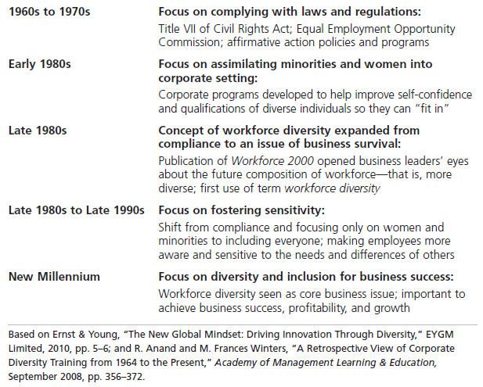
Exhibit 5-1 Timeline of the Evolution of Workforce Diversity
Notes:
Diversity has traditionally been considered a term used by human resources departments, associated with fair hiring practices, discrimination, and inequality. But diversity today is considered to be so much more. Exhibit 5-1 illustrates an historical overview of how the concept and meaning of workforce diversity has evolved.

Slide 6
What Is Workplace Diversity? (cont.)
Surface
-level diversity –
Easily perceived differences that may trigger certain stereotypes, but do not necessarily reflect the ways people think or feel.
Deep-level diversity –
Differences in values, personality, and work preferences.
Notes:
The demographic characteristics that we tend to think of when we think of diversity—age, race, gender, ethnicity, and so on—are just the tip of the iceberg. These demographic differences reflect surface-level diversity, which are easily perceived differences that may trigger certain stereotypes but that do not necessarily reflect the ways people think or feel. Such surface-level differences in characteristics can affect the way people perceive others, especially when it comes to assumptions or stereotyping.
As people get to know one another, these surface-level differences become less important and deep-level diversity—differences in values, personality, and work preferences—becomes more important. These deep-level differences can affect the way people view organizational work rewards, communicate, react to leaders, negotiate, and generally behave at work.

Slide 7
Why Is Managing Workforce Diversity So Important?
People Management – diversity is, after all, about people, both inside and outside the organization.
Organizational Performance – cost savings include reducing employee turnover, absenteeism, and the chance of lawsuits.
Strategic – workforce diversity is a key to extracting the best talent performance, market share, and suppliers from a diverse country and world.
Notes:
Diversity is, after all, about people, both inside and outside the organization. The people management benefits that organizations get because of their workforce diversity efforts revolve around attracting and retaining a talented workforce.
Performance benefits that organizations get from workforce diversity include cost savings and improvements in organizational functioning. The cost savings can be significant when organizations that cultivate a diverse workforce reduce employee turnover, absenteeism, and the chance of lawsuits.
Organizations also benefit strategically from a diverse workforce. You have to look at managing workforce diversity as the key to extracting the best talent, performance, market share, and suppliers from a diverse country and world. One important strategic benefit is that with a diverse workforce, organizations can better anticipate and respond to changing consumer needs. Diverse employees bring a variety of points of view and approaches to opportunities, which can improve how the organization markets to diverse consumers.

Slide 8
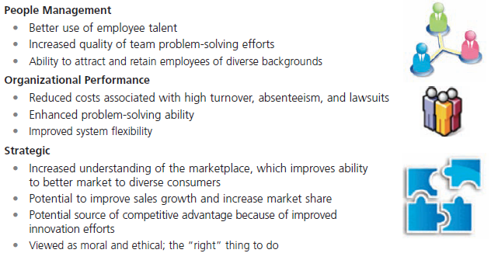
Exhibit 5-2 Benefits of Workforce Diversity
Notes:
Many companies are experiencing the benefits that diversity can bring. Exhibit 5-2 looks at why workforce diversity is so important to organizations. The benefits fall into three main categories: people management, organizational performance, and strategic.

Slide 9
The Changing Workplace
Characteristics of the U.S. Population – Total population of the United States projected to increase to 438 million by the year 2050
Racial/ethnic groups – changes in the percentages of the Hispanic and white population
Aging population – median age of 36.9 years up from 36.2 years in 2001
Notes:
Total population of the United States: The total population is projected to increase to 438 million by the year 2050, up from 296 million in 2005; 82 percent of that increase will be due to immigrants and their U.S.-born descendants. Nearly one in five Americans will be an immigrant in 2050, compared with one in eight in 2005.
In addition to total population changes, the components of that population are projected to change as well. The main changes will be in the percentages of the Hispanic and white population. But the data also indicates that the Asian population will almost double. The median age of the U.S. population stands at 36.9 years, up from 36.2 years in 2001. By 2050, one in every five persons will be aged 65 or over.

Slide 10
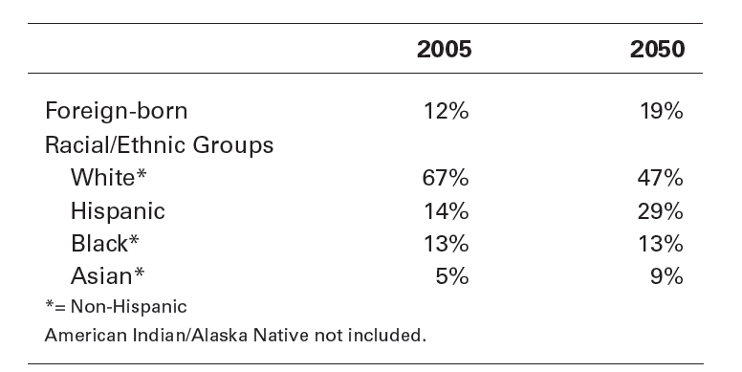
Exhibit 5-3 Changing Population Makeup of the United States
Notes:
Exhibit 5-3 provides the projected population breakdown as it is projected to change by 2050.

Slide 11
The Changing Workplace (cont.)
Global Workforce Changes
Total world population – estimated at over almost 7.023 billion
An aging population – aging at an unprecedented rate
Notes:
Total world population. The total world population in 2012 is estimated at over almost 7.023 billion individuals. However, that number is forecasted to hit 9 billion by 2050, at which point the United Nations predicts the total population will either stabilize or peak after growing for centuries at an ever-accelerating rate.
An aging population. This demographic trend is one of critical importance for organizations. How critical? The world’s population is now aging at an unprecedented rate.

Slide 12
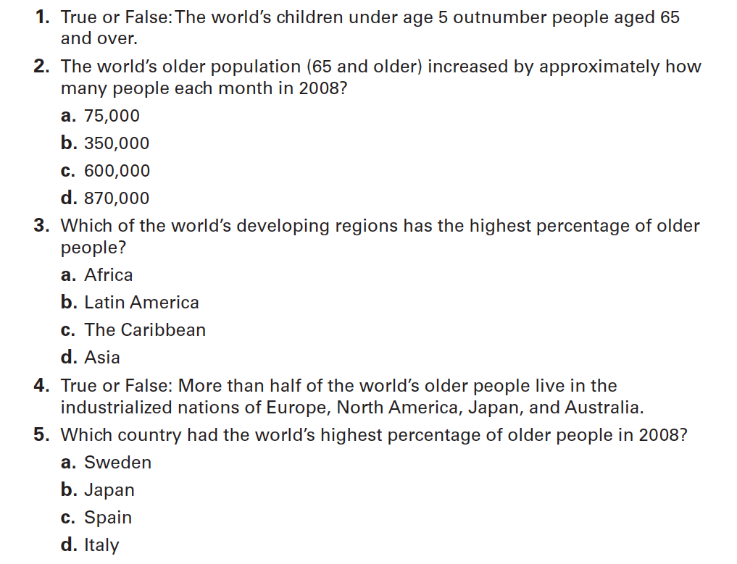
Exhibit 5-4 Global Aging: How Much Do You Know?
Notes:
How much do you know about global aging? (Our guess is . . . probably not much!) Take the quiz in Exhibit 5-4—no peeking at the answers beforehand—and see how well you scored.

Slide 13
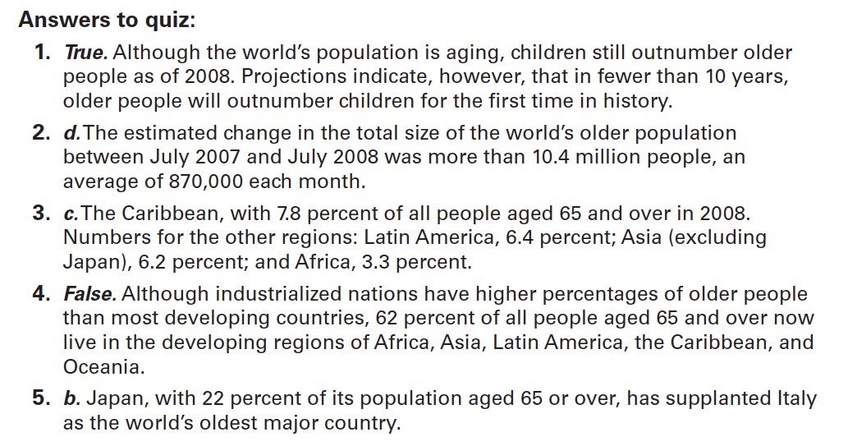
Exhibit 5-4 Global Aging: How Much Do You Know? (cont.)
Notes:
Are you surprised by some of the answers?

Slide 14
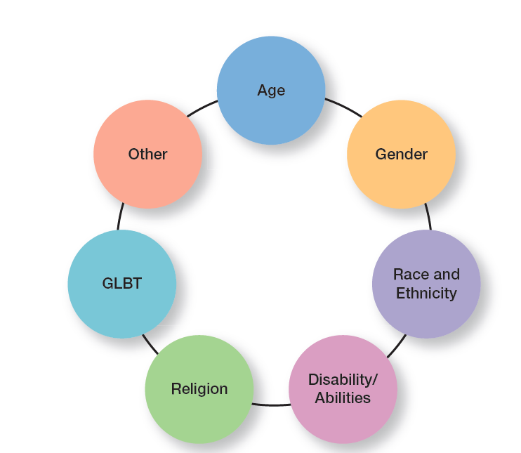
Exhibit 5-5 Types of Diversity Found in Workplaces
Notes:
Diversity is a big issue, and an important issue, in today’s workplaces. What types of dissimilarities—that is, diversity—do we find in those workplaces? Exhibit 5-5 shows several types of workplace diversity.

Slide 15
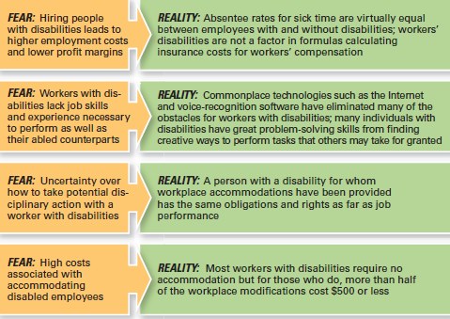
Exhibit 5-6 Employers’ Fears About Disabled Workers

Slide 16
Types of Workplace Diversity (cont.)
GLBT: Sexual Orientation and Gender Identity – U.S. federal law does not prohibit discrimination against employees on the basis of sexual orientation
Other Types of Diversity – Diversity refers to any dissimilarities or differences that might be present in a workplace
Notes:
The acronym GLBT—which refers to gay, lesbian, bisexual, and transgender people— is used more frequently and relates to the diversity of sexual orientation and gender identity. There are an estimated 7 million GLBT employees in the U.S. private sector. Sexual orientation has been called the “last acceptable bias.” We want to emphasize that we’re not condoning this perspective, but what this comment refers to is that most people understand that racial and ethnic stereotypes are “off-limits,” but it’s not unusual to hear derogatory comments about gays or lesbians.
Diversity refers to any dissimilarities or differences that might be present in a workplace. Other types of workplace diversity that managers might confront and have to deal with include socioeconomic background (social class and income-related factors), team members from different functional areas or organizational units, physical attractiveness, obesity/thinness, job seniority, or intellectual abilities.

Slide 17
Challenges in Managing Diversity
Personal Bias
Bias – A tendency or preference toward a particular perspective or ideology.
Prejudice – A pre-conceived belief, opinion, or judgment toward a person or a group of people.
Notes:
Despite the benefits that we know workforce diversity brings to organizations, managers still face challenges in creating accommodating and safe work environments for diverse employees.
Bias is a term that describes a tendency or preference toward a particular perspective or ideology. It’s generally seen as a “one-sided” perspective. Our personal biases cause us to have preconceived opinions about people or things. Such preconceived opinions can create all kinds of inaccurate judgments and attitudes. One outcome of our personal biases can be prejudice, a preconceived belief, opinion, or judgment toward a person or a group of people. Our prejudice can be based on all the types of diversity we discussed: race, gender, ethnicity, age, disability, religion, sexual orientation, or even other personal characteristics.

Slide 18
Challenges in Managing Diversity (cont.)
Stereotyping – judging a person based on a prejudicial perception of a group to which that person belongs.
Discrimination – when someone acts out their prejudicial attitudes toward people who are the targets of their prejudice.
Glass Ceiling – the invisible barrier that separates women and minorities from top management positions.
Notes:
A major factor in prejudice is stereotyping, which is judging a person on the basis of one’s perception of a group to which he or she belongs. For instance, “Married persons are more stable employees than single persons” is an example of stereotyping. Keep in mind, though, that not all stereotypes are inaccurate. However, many stereotypes aren’t factual and distort our judgment.
Both prejudice and stereotyping can lead to someone treating others who are members of a particular group unequally. That’s discrimination, which is when someone acts out their prejudicial attitudes toward people who are the targets of their prejudice.
In the 1980s, the term glass ceiling, first used in a Wall Street Journal article, refers to the invisible barrier that separates women and minorities from top management positions. The idea of a “ceiling” means something is blocking upward movement and the idea of “glass” is that whatever’s blocking the way isn’t immediately apparent.

Slide 19
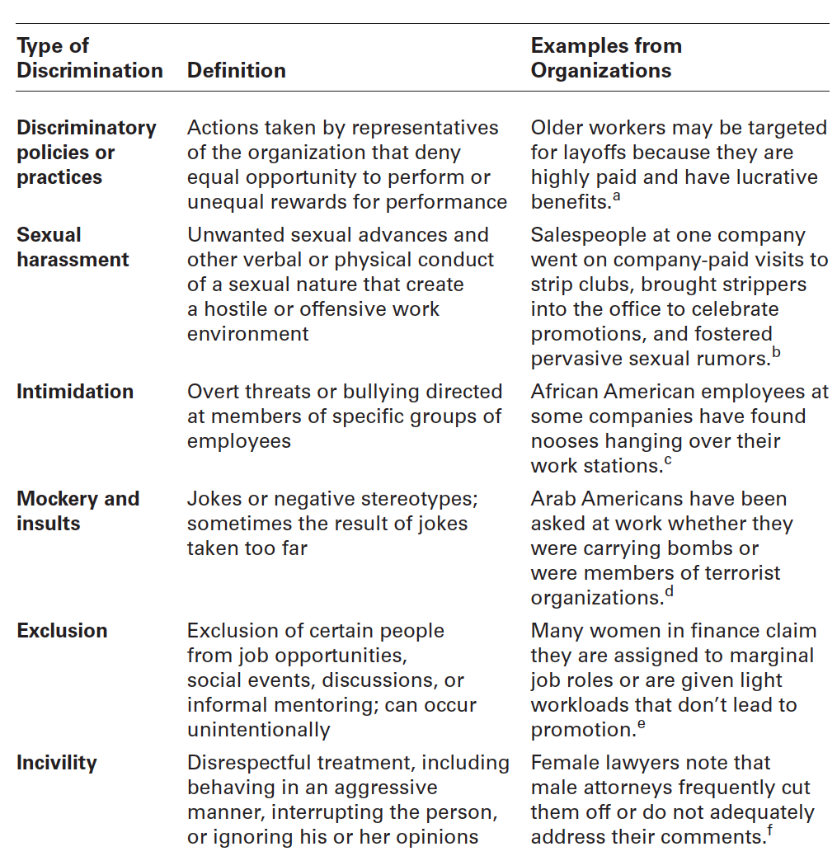
Exhibit 5-7 Forms of Discrimination

Slide 20
The Legal Aspect of Workplace Diversity
Federal laws have contributed to some of the social change we’ve seen over the last 50-plus years.
Workplace diversity needs to be more than understanding and complying with federal laws.
Organizations that are successful at managing diversity use additional diversity initiatives and programs.
Notes:
The fact is that federal laws have contributed to some of the social change we’ve seen over the last 50-plus years. Failure to comply with federal laws, can be costly and damaging to an organization’s bottom line and reputation. It’s important that managers know what they can and cannot do legally and ensure that all employees understand as well.
However, effectively managing workplace diversity needs to be more than understanding and complying with federal laws. Organizations that are successful at managing diversity use additional diversity initiatives and programs.

Slide 21
Top Management Commitment to Diversity
Mentoring – a process whereby an experienced organizational member (a mentor) provides advice and guidance to a less-experienced member (a protégé).
Diversity Skills Training – specialized training to educate employees about the importance of diversity and to teach them skills for working in a diverse workplace.
Notes:
A sustainable diversity and inclusion strategy must play a central role in decision-making at the highest leadership level and filter down to every level of the company.
Mentoring is a process whereby an experienced organizational member (a mentor) provides advice and guidance to a less-experienced member (a protégé). Mentors usually provide two unique forms of mentoring functions: career development and social support.
The challenge for organizations is to find ways for employees to be effective in dealing with others who aren’t like them. Diversity skills training is specialized training to educate employees about the importance of diversity and teach them skills for working in a diverse workplace.

Slide 22
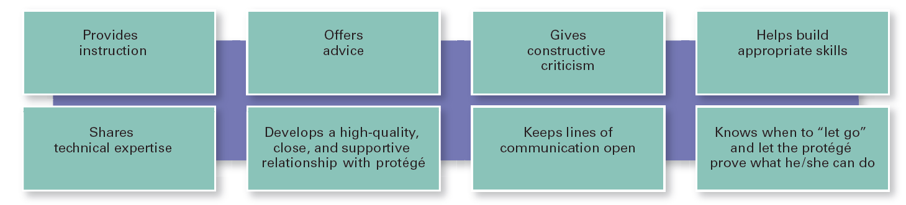
Exhibit 5-9 What a Good Mentor Does

Slide 23
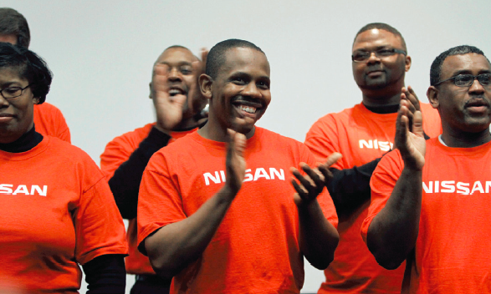
Top Management Commitment to Diversity (cont.)
Employee Resource Groups – groups made up of employees connected by some common dimension of diversity.
Notes:
Employee resource groups are made up of employees connected by some common dimension of diversity. Such groups typically are formed by the employees themselves, not the organizations. However, it’s important for organizations to recognize and support these groups.

Slide 24
Review Learning objective 5.1
Define workplace diversity and explain why managing it is so important.
Workplace diversity is the ways in which people in an organization are different from and similar to one another.
It’s important for three reasons:
People management benefits
Organizational performance benefits
Strategic benefits
Notes:
Workplace diversity is the ways in which people in an organization are different from and similar to one another. Managing workforce diversity is important for three reasons:
(1) people management benefits—better use of employee talent, increased quality of team problem-solving efforts, and ability to attract and retain diverse employees.
(2) organizational performance benefits—reduced costs, enhanced problem-solving ability, and improved system flexibility.
(3) strategic benefits—increased understanding of diverse marketplace, potential to improve sales and market share, competitive advantage because of improved innovation efforts, and viewed as moral and ethical.

Slide 25
Review Learning objective 5.2
Describe the changing workplaces in the United States and around the world.
United States
Total increase population
Changing components of racial/ethnic groups
An aging population
The World
Total world population
Aging of that population
Notes:
The main changes in the workplace in the United States include the total increase in the population; the changing components of the population, especially in relation to racial/ethnic groups; and an aging population. The most important changes in the global population include the total world population and the aging of that population.

Slide 26
Review Learning objective 5.3
Explain the different types of diversity found in workplaces.
Age (older workers and younger workers)
Gender (male and female)
Race and ethnicity (racial and ethnic classifications)
Disability/abilities (people with a disability that limits major life activities)
Notes:
The different types of diversity found in workplaces include age (older workers and younger workers), gender (male and female), race and ethnicity (racial and ethnic classifications), disability/abilities (people with a disability that limits major life activities)

Slide 27
Review Learning objective 5.3 (cont.)
Religion (religious beliefs and religious practices)
Sexual orientation and gender identity (gay, lesbian, bisexual, and transgender)
Other (for instance, socioeconomic background, team members from different functional areas, physical attractiveness, obesity, job seniority, and so forth)
Notes:
Religion (religious beliefs and religious practices), sexual orientation and gender identity (gay, lesbian, bisexual, and transgender), and other (for instance, socioeconomic background, team members from different functional areas, physical attractiveness, obesity, job seniority, and so forth).

Slide 28
Review Learning objective 5.4
Discuss the challenges managers face in managing diversity.
Bias is a tendency or preference toward a particular perspective or ideology.
Prejudice, which is a preconceived belief, opinion, or judgment toward a person or a group of people.
Glass ceiling refers to the invisible barrier that separates women and minorities from top management positions.
Notes:
The two main challenges managers face are personal bias and the glass ceiling. Bias is a tendency or preference toward a particular perspective or ideology. Our biases can lead to prejudice, which is a preconceived belief, opinion, or judgment toward a person or a group of people; stereotyping, which is judging a person on the basis of one’s perception of a group to which he or she belongs; and discrimination, which is when someone acts out their prejudicial attitudes toward people who are the targets of their prejudice.
The glass ceiling refers to the invisible barrier that separates women and minorities from top management positions.

Slide 29
Review Learning objective 5.5
Describe various workplace diversity management initiatives.
Some of the federal laws on diversity include:
Title VII of the Civil Rights Act
The Americans with Disabilities Act
Age Discrimination in Employment Act
Workplace diversity initiatives to diversity include mentoring, diversity skills training, and employee resource groups.
Notes:
It’s important to understand the role of federal laws in diversity. Some of these laws include Title VII of the Civil Rights Act, the Americans with Disabilities Act, and Age Discrimination in Employment Act. Workplace diversity management initiatives include top management commitment to diversity; mentoring, which is a process whereby an experienced organizational member provides advice and guidance to a less experienced member; diversity skills training; and employee resource groups, which are groups made up of employees connected by some common dimension of diversity.

