Slide 1

Managing Social Responsibility and Ethics
6

Slide 2
Learning objectives
Discuss what it means to be socially responsible and what factors influence that decision.
Explain green management and how organizations can go green.
Discuss the factors that lead to ethical and unethical behavior.
Develop your skill at creating trust in work groups.
Describe management’s role in encouraging ethical behavior.
Know how to make good decisions about ethical dilemmas.
Discuss current social responsibility and ethics issues.

Slide 3
From Obligation to Responsiveness to Responsibility
Social Obligation – the obligation of a business to meet its economic and legal responsibilities and nothing more.
Classical view – the view that management’s only social responsibility is to maximize profits.
Notes:
The concept of social responsibility has been described in different ways. For instance, it’s been called “profit making only,” “going beyond profit making,” “any discretionary corporate activity intended to further social welfare,” and “improving social or environmental conditions.” We can understand it better if we first compare it to two similar concepts: social obligation and social responsiveness. Social obligation is when a firm engages in social actions because of its obligation to meet certain economic and legal responsibilities. The organization does what it’s obligated to do and nothing more. This idea reflects the classical view of social responsibility, which says that management’s only social responsibility is to maximize profits. The most outspoken advocate of this approach is economist and Nobel laureate Milton Friedman. He argued that managers’ primary responsibility is to operate the business in the best interests of the stockholders, whose primary concerns are financial.

Slide 4
From Obligation to Responsiveness to Responsibility (cont.)
Socioeconomic view – the view that management’s social responsibility goes beyond making profits to include protecting and improving society’s welfare.
Social responsiveness – when a firm engages in social actions in response to some popular social need.
Notes:
The socioeconomic view says that managers’ social responsibilities go beyond making profits to include protecting and improving society’s welfare. This view is based on the belief that corporations are not independent entities responsible only to stockholders, but have an obligation to the larger society. Organizations around the world have embraced this view as shown by a survey of global executives in which 84 percent said that companies must balance obligations to shareholders with obligations to the public good.
Social responsiveness is when a company engages in social actions in response to some popular social need. Managers are guided by social norms and values and make practical, market-oriented decisions about their actions. For instance, Ford Motor Company became the first automaker to endorse a federal ban on sending text messages while driving.

Slide 5

From Obligation to Responsiveness to Responsibility (cont.)
Social responsibility – a business’s intention, beyond its legal and economic obligations, to do the right things and act in ways that are good for society.
Notes:
A socially responsible organization goes beyond what it’s obligated to do or chooses to do because of some popular social need and does what it can to help improve society because it’s the right thing to do. We define social responsibility as a business’s intention, beyond its legal and economic obligations, to do the right things and act in ways that are good for society. A socially responsible organization does what is right because it feels it has an ethical responsibility to do so.

Slide 6
Should Organizations Be Socially Involved?
Social Screening – applying social criteria (screens) to investment decisions.
SRI funds usually will not invest in companies involved in liquor, gambling, tobacco, nuclear power weapons, price fixing, fraud, or in companies that have poor product safety, employee relations, and environmental track records.
Notes:
Another way to view social involvement and economic performance is by looking at socially responsible investing (SRI) funds, which provide a way for individual investors to support socially responsible companies. (You can find a list of SRI funds at [www.socialfunds.com].) Typically, these funds use some type of social screening; that is, they apply social and environmental criteria to investment decisions.

Slide 7
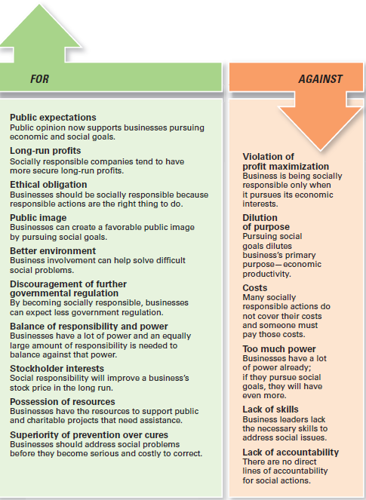
Exhibit 6-1 Arguments For and Against Social Responsibility

Slide 8
Green Management and Sustainability
Green Management – managers consider the impact of their organization on the natural environment.
Notes:
Until the late 1960s, few people (and organizations) paid attention to the environmental consequences of their decisions and actions. However, a number of environmental disasters brought a new spirit of environmentalism to individuals, groups, and organizations. Increasingly, managers have begun to consider the impact of their organization on the natural environment, which we call green management.

Slide 9
How Organizations Go Green
Legal (or Light Green) Approach – firms simply do what is legally required by obeying laws, rules, and regulations willingly and without legal challenge.
Market Approach – firms respond to the preferences of their customers for environmentally friendly products.
Notes:
Managers and organizations can do many things to protect and preserve the natural environment. Some do no more than what is required by law; that is, they fulfill their social obligation. The first approach, the legal (or light green) approach, is simply doing what is required legally. In this approach, which illustrates social obligation, organizations exhibit little environmental sensitivity. They obey laws, rules, and regulations without legal challenge and that’s the extent of their being green.
As an organization becomes more sensitive to environmental issues, it may adopt the market approach and respond to environmental preferences of customers. Whatever customers demand in terms of environmentally friendly products will be what the organization provides.

Slide 10
How Organizations Go Green (cont.)
Stakeholder Approach – firms work to meet the environmental demands of multiple stakeholders—employees, suppliers, and the community.
Activist Approach – firms look for ways to respect and preserve the environment and be actively socially responsible.
Notes:
In the stakeholder approach, an organization works to meet the environmental demands of multiple stakeholders such as employees, suppliers, or community.
Finally, if an organization pursues an activist (or dark green) approach, it looks for ways to protect the earth’s natural resources. The activist approach reflects the highest degree of environmental sensitivity and illustrates social responsibility.

Slide 11
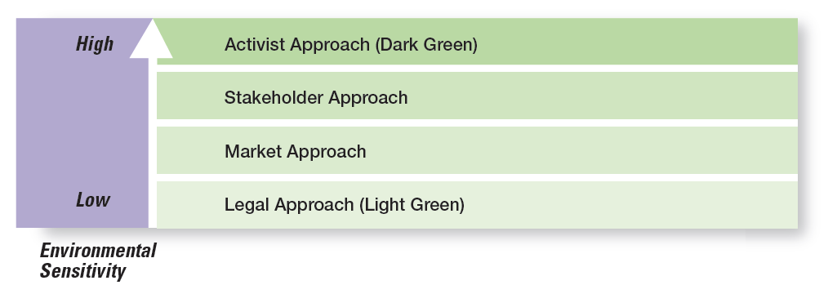
Exhibit 6-2 Green Approaches
Notes:
Exhibit 6-2 illustrates the shades of green model to describe the different environmental approaches that organizations may take.

Slide 12
Managers and Ethical Behavior
Ethics – principles, values, and beliefs that define right and wrong behavior.
Many decisions managers make require them to consider both the process and who’s affected by the result.
Notes:
What do we mean by ethics? We’re defining it as the principles, values, and beliefs that define right and wrong decisions and behavior. Many decisions managers make require them to consider both the process and who’s affected by the result. To better understand the ethical issues involved in such decisions, let’s look at the factors that determine whether a person acts ethically or unethically.

Slide 13
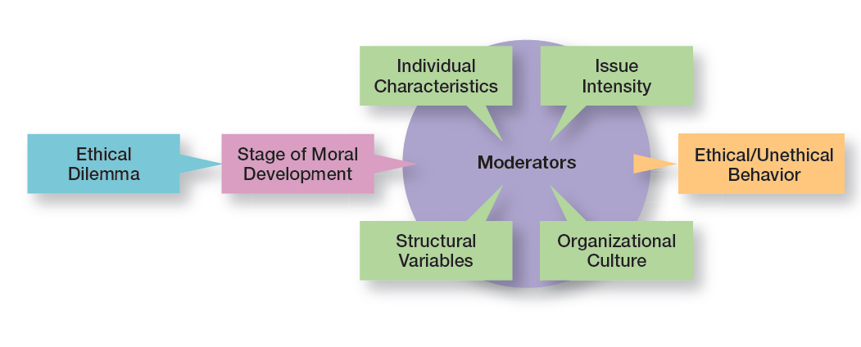
Exhibit 6-3 Factors That Determine Ethical and Unethical Behavior
Notes:
Exhibit 6-3 shows several factors that influence whether someone behaves ethically or unethically when faced with an ethical dilemma.

Slide 14
Factors That Determine Ethical and Unethical Behavior
of Moral Development
Preconvention level – a person’s choice between right or wrong is based on personal consequences.
Conventional level, ethical decisions rely on living up to the expectations of others.
Principled level, individuals define moral values apart from the authority of the groups or society in general.
Stage
Notes:
Research divides moral development into three levels, each having two stages. At each successive stage, an individual’s moral judgment becomes less dependent on outside influences and more internalized.
At the first level, the preconventional level, a person’s choice between right or wrong is based on personal consequences from outside sources, such as physical punishment, reward, or exchange of favors.
At the second level, the conventional level, ethical decisions rely on maintaining expected standards and living up to the expectations of others.
At the principled level, individuals define moral values apart from the authority of the groups to which they belong or society in general.

Slide 15
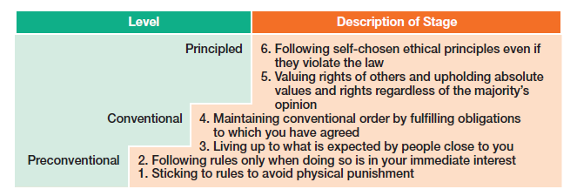
Exhibit 6-4 Stages of Moral Development
Notes:
The three levels and six stages are described in Exhibit 6-4.

Slide 16
Factors That Determine Ethical and Unethical Behavior (cont.)
Characteristics
Values – basic convictions about what is right and wrong.
Ego Strength – a personality measure of the strength of a person’s convictions.
Locus of Control – a personality attribute that measures the degree to which people believe they control their own fate.
Individual
Notes:
Two individual characteristics—values and personality— play a role in determining whether a person behaves ethically. Each person comes to an organization with a relatively entrenched set of personal values, which represent basic convictions about what is right and wrong. Our values develop from a young age based on what we see and hear from parents, teachers, friends, and others.
Two personality variables have been found to influence an individual’s actions according to his or her beliefs about what is right or wrong: ego strength and locus of control. Ego strength measures the strength of a person’s convictions. People with high ego strength are likely to resist impulses to act unethically and instead follow their convictions. Locus of control is the degree to which people believe they control their own fate. People with an internal locus of control believe they control their own destinies. They’re more likely to take responsibility for consequences and rely on their own internal standards of right and wrong to guide their behavior.

Slide 17
Factors That Determine Ethical and Unethical Behavior (cont.)
Culture
Organization’s culture consists of the shared organizational values. These values reflect what the organization stands for and what it believes in as well as create an environment that influences employee behavior ethically or unethically.
Values-based management – the organization’s values guide employees in the way they do their jobs.
Organization’s
Notes:
An organization’s culture consists of the shared organizational values. These values reflect what the organization stands for and what it believes in as well as create an environment that influences employee behavior ethically or unethically. When it comes to ethical behavior, a culture most likely to encourage high ethical standards is one that’s high in risk tolerance, control, and conflict tolerance. Employees in such a culture are encouraged to be aggressive and innovative, are aware that unethical practices will be discovered, and feel free to openly challenge expectations they consider to be unrealistic or personally undesirable.
Because shared values can be powerful influences, many organizations are using values-based management, in which the organization’s values guide employees in the way they do their jobs. For instance, Timberland is an example of a company using values-based management. With a simple statement, “Make It Better,” employees at Timberland know what’s expected and valued; that is, they find ways to “make it better”—whether it’s creating quality products for customers, performing community service activities, designing employee training programs, or figuring out ways to make the company’s packaging more environmentally friendly.

Slide 18
Factors That Determine Ethical and Unethical Behavior (cont.)
– six characteristics determine issue intensity or how important an ethical issue is to an individual:
Greatness of harm
Consensus of wrong
Probability of harm
Immediacy of consequences
Proximity to victim(s)
Concentration of effect
Issue Intensity
Notes:
Six characteristics determine issue intensity or how important an ethical issue is to an individual: greatness of harm, consensus of wrong, probability of harm, immediacy of consequences, proximity to victim(s), and concentration of effect. These factors suggest that (a) the larger the number of people harmed, the more agreement that the action is wrong; (b) the greater the likelihood that the action will cause harm, the more immediately the consequences of the action will be felt; and (c) the closer the person feels to the victim(s) and the more concentrated the effect of the action on the victim(s), the greater the issue intensity or importance. When an ethical issue is important, employees are more likely to behave ethically.

Slide 19
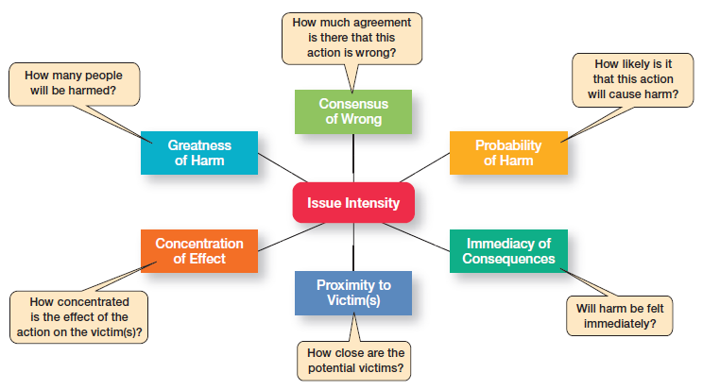
Exhibit 6-5 Issue Intensity
Notes:
As Exhibit 6-5 shows, the six characteristics determine issue intensity or how important an ethical issue is to an individual.

Slide 20
Ethics in an International Context
Ethical standards are not universal
Social and cultural differences determine acceptable behaviors.
Foreign Corrupt Practices Act
It is illegal to corrupt a foreign official, yet “token” payments to officials are permissible when doing so is an accepted practice in that country.
Notes:
Are ethical standards universal? Although some common moral beliefs exist, social and cultural differences between countries are important factors that determine ethical and unethical behavior. In the case of payments to influence foreign officials or politicians, U.S. managers are guided by the Foreign Corrupt Practices Act (FCPA), which makes it illegal to knowingly corrupt a foreign official. However, even this law doesn’t always reduce ethical dilemmas to black and white. In some countries, government bureaucrat salaries are low because custom dictates that they receive small payments from those they serve. Payoffs to these bureaucrats “grease the machinery” and ensure that things get done.

Slide 21
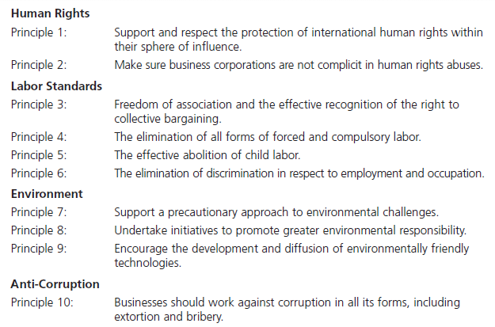
Exhibit 6-6 The Ten Principles of the United Nations Global Compact
Notes:
Exhibit 6-6 provides a guide to being ethical in international business according to the United Nations Global Compact, which is an initiative created by the United Nations outlining principles for doing business globally in the areas of human rights, labor, the environment, and anti-corruption.

Slide 22
Encouraging Ethical Behavior
Employee Selection – an opportunity to learn about an individual’s level of moral development, personal values, ego strength, and locus of control.
Code of ethics – a formal statement of an organization’s primary values and the ethical rules it expects its employees to follow.
Notes:
The selection process (interviews, tests, background checks, and so forth) should be viewed as an opportunity to learn about an individual’s level of moral development, personal values, ego strength, and locus of control. However, a carefully designed selection process isn’t foolproof and, even under the best circumstances, individuals with questionable standards of right and wrong may be hired.
A code of ethics, a formal statement of an organization’s values and the ethical rules it expects employees to follow, is a popular choice for reducing that ambiguity. Research shows that 97 percent of organizations with more than10,000 employees have a written code of ethics. Even in smaller organizations, nearly 93 percent have one.

Slide 23
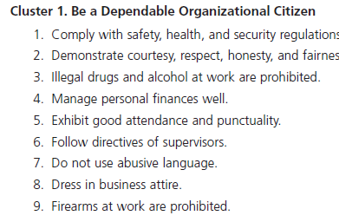
Exhibit 6-7 Codes of Ethics
Notes:
A survey of companies’ codes of ethics found their content tended to fall into three categories as shown in Exhibit 6-7.

Slide 24
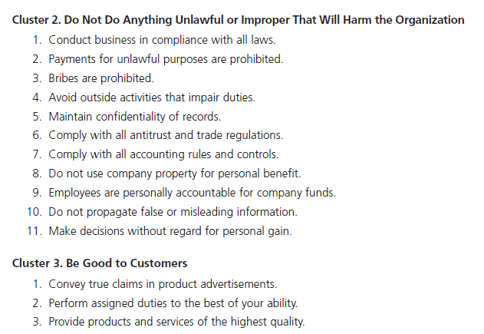
Exhibit 6-7 Codes of Ethics (cont.)

Slide 25
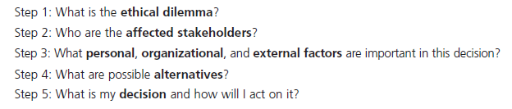
Exhibit 6-8 A Process for Addressing Ethical Dilemmas
Notes:
Managers should use the five-step process presented in Exhibit 6-8 to guide employees when faced with ethical dilemmas.

Slide 26
Encouraging Ethical Behavior (cont.)
– doing business ethically requires a commitment from top managers because:
they’re the ones who uphold the shared values and set the cultural tone.
they’re role models in terms of both words and actions.
what they do is far more important than what they say.
Leadership
Notes:
Doing business ethically requires a commitment from top managers. Why? Because they’re the ones who uphold the shared values and set the cultural tone. They’re role models in terms of both words and actions, though what they do is far more important than what they say. Top managers also set the tone by their reward and punishment practices. The choices of whom and what are rewarded with pay increases and promotions send a strong signal to employees.

Slide 27
Encouraging Ethical Behavior (cont.)
Goals and Performance Appraisal
Unrealistic goals provide stress which may pressure ethical employees to do whatever is necessary to meet those goals.
If performance appraisals focus only on economic goals, ends will begin to justify means.
To encourage ethical behavior, both ends and means should be evaluated.
Job
Notes:
Under the stress of unrealistic goals, otherwise ethical employees may feel they have no choice but to do whatever is necessary to meet those goals. Also, goal achievement is usually a key issue in performance appraisal. If performance appraisals focus only on economic goals, ends will begin to justify means. To encourage ethical behavior, both ends and means should be evaluated. For example, a manager’s annual review of employees might include a point-by-point evaluation of how their decisions measured up against the company’s code of ethics as well as how well goals were met.

Slide 28
Encouraging Ethical Behavior (cont.)
Ethics Training – seminars, workshops, and similar ethics training programs to encourage ethical behavior.
Independent Social Audits – evaluate decisions and management practices in terms of the organization’s code of ethics.
Protective Mechanisms – allow employees who face ethical dilemmas to do what’s right without fear of reprimand.
Notes:
More organizations are setting up seminars, workshops, and similar ethics training programs to encourage ethical behavior.
Such training programs aren’t without controversy as the primary concern is whether ethics can be taught. Critics stress that the effort is pointless because people establish their individual value systems when they’re young. However, proponents note several studies that have shown that values can be learned after early childhood. In addition, they cite evidence that shows that teaching ethical problem solving can make an actual difference in ethical behaviors; that training has increased individuals’ level of moral development; and that, if nothing else, ethics training increases awareness of ethical issues in business.
The fear of being caught can be an important deterrent to unethical behavior. Independent social audits, which evaluate decisions and management practices in terms of the organization’s code of ethics, increase that likelihood. Such audits can be regular evaluations or they can occur randomly with no prior announcement.
Employees who face ethical dilemmas need protective mechanisms so they can do what’s right without fear of reprimand. An organization might designate ethical counselors for employees facing an ethics dilemma. These advisors also might advocate the ethically “right” alternatives. Other organizations have appointed ethics officers who design, direct, and modify the organization’s ethics programs as needed.

Slide 29
Social Responsibility and Ethics Issues in Today’s World
Ethical Lapses and Social Irresponsibility
One survey reported that among 5,000 employees: 45 percent admitted falling asleep at work and 22 percent said they spread a rumor about a coworker.
Another showed that 26 percent of college and university business majors admitted to “serious cheating” on exams and 54 percent admitted to cheating on written assignments.
Managing
Notes:
Even after public outrage over the Enron-era misdeeds, irresponsible and unethical practices by managers in all kinds of organizations haven’t gone away. One survey reported that among 5,000 employees: 45 percent admitted to falling asleep at work; 22 percent said they spread a rumor about a coworker; 18 percent said they snooped after hours; and 2 percent said they took credit for someone else’s work.
Unfortunately, it’s not just at work that we see such behaviors. Studies conducted by the Center for Academic Integrity showed that 26 percent of college and university business majors admitted to “serious cheating” on exams and 54 percent admitted to cheating on written assignments. But business students weren’t the worst cheaters—that distinction belonged to journalism majors, of whom 27 percent said they had cheated.

Slide 30
Social Responsibility and Ethics Issues in Today’s World (cont.)
Ethical Leadership – managers must provide ethical leadership. What managers do has a strong influence on employees’ decisions whether to behave ethically.
Protection of Employees Who Raise Ethical Issues:
Whistle-Blower – individuals who raise ethical concerns or issues to others
Notes:
What managers do has a strong influence on employees’ decisions whether to behave ethically. When managers cheat, lie, steal, manipulate, take advantage of situations or people, or treat others unfairly, what kind of signal are they sending to employees (or other stakeholders)? Probably not the one they want to send.
It’s important for managers to assure employees who raise ethical concerns or issues that they will face no personal or career risks. These individuals, often called whistleblowers, can be a key part of any company’s ethics program. For example, Sherron Watkins, who was a vice president at Enron, clearly outlined her concerns about the company’s accounting practices in a letter to chairman Ken Lay.

Slide 31
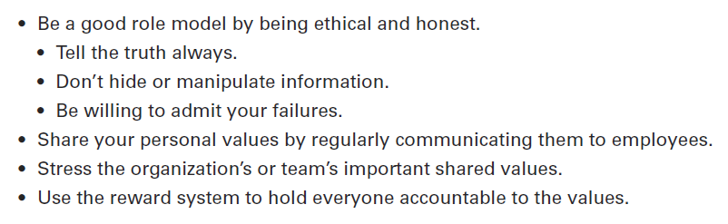
Exhibit 6-9 Being an Ethical Leader

Slide 32
Social Responsibility and Ethics Issues in Today’s World (cont.)
Social
Entrepreneur – an individual or organization who seeks out opportunities to improve society by using practical, innovative, and sustainable approaches.
Corporate Philanthropy – can be an effective way for companies to address societal problems.
Employee Volunteering Efforts – a popular way for businesses to be involved in promoting social change.
Notes:
A social entrepreneur, an individual or organization who seeks out opportunities to improve society by using practical, innovative, and sustainable approaches. What business entrepreneurs are to the economy, social entrepreneurs are to social change. Social entrepreneurs want to make the world a better place and have a driving passion to make that happen.
Corporate philanthropy can be an effective way for companies to address societal problems. For instance, the breast cancer “pink” campaign and the global AIDS Red campaign (started by Bono) are ways that companies support social causes.
Employee volunteering is another popular way for businesses to be involved in promoting social change. For instance, Dow Corning sent a small team of employees to rural India to help women “examine stitchery and figure out prices for garments to be sold in local markets.” Molson-Coors’ eleven-member executive team spent a full day at their annual team-building retreat building a house in Las Vegas with Habitat for Humanity. PricewaterhouseCoopers employees renovated an abandoned school in Newark, New Jersey. Every Wachovia employee is given six paid days off from work each year to volunteer in his or her community.

Slide 33
Review Learning Objective 6.1
Discuss what it means to be socially responsible and what factors influence that decision.
Social obligation – a firm engages in social actions because of its obligation to meet certain economic and legal responsibilities.
Social responsiveness – when a firm engages in social actions in response to some popular social need.
Notes:
Social obligation, which reflects the classical view of social responsibility, is when a firm engages in social actions because of its obligation to meet certain economic and legal responsibilities.
Social responsiveness is when a firm engages in social actions in response to some popular social need. Social responsibility is a business’s intention, beyond its economic and legal obligations, to pursue long-term goals that are good for society. Both of these reflect the socioeconomic view of social responsibility. Determining whether organizations should be socially involved can be done by looking at arguments for and against it. Other ways are to assess the impact of social involvement on a company’s economic performance and evaluate the performance of SRI funds versus non-SRI funds. We can conclude that a company’s social responsibility doesn’t appear to hurt its economic performance.

Slide 34
Review Learning objective 6.2
Explain green management and how organizations can go green.
Different approaches
Light green
Market approach
Stakeholder approach
Activist or dark green approach
Notes:
Green management is when managers consider the impact of their organization on the natural environment. Organizations can “go green” in different ways.
The light green approach is doing what is required legally, which is social obligation. Using the market approach, organizations respond to the environmental preferences of their customers.
Using the stakeholder approach, organizations respond to the environmental demands of multiple stakeholders. Both the market and stakeholder approaches can be viewed as social responsiveness.
With an activist or dark green approach, an organization looks for ways to respect and preserve the earth and its natural resources, which can be viewed as social responsibility.
Green actions can be evaluated by examining reports that companies compile about their environmental performance, by looking for compliance with global standards for environmental management (ISO 14000), and by using the Global 100 list of the most sustainable corporations in the world.

Slide 35
Review Learning objective 6.3
Discuss the factors that lead to ethical and unethical behavior.
Factors that affect ethical and unethical behavior include
an individual’s level of moral development
individual characteristics
structural variables
organizational culture
issue intensity
Notes:
Ethics refers to the principles, values, and beliefs that define right and wrong decisions and behavior. The factors that affect ethical and unethical behavior include an individual’s level of moral development (preconventional, conventional, or principled), individual characteristics (values and personality variables—ego strength and locus of control), structural variables (structural design, use of goals, performance appraisal systems, and reward allocation procedures), organizational culture (shared values and cultural strength), and issue intensity (greatness of harm, consensus of wrong, probability of harm, immediacy of consequences, proximity to victims, and concentration of effect). Since ethical standards aren’t universal, managers should know what they can and cannot do legally as defined by the Foreign Corrupt Practices Act. It’s also important to recognize any cultural differences and to clarify ethical guidelines for employees working in different global locations. Finally, managers should know about the principles of the Global Compact and the Anti-Bribery Convention.

Slide 36
Review Learning objective 6.4
Describe management’s role in encouraging ethical behavior.
The behavior of managers is the single most important influence on an individual’s decision to act ethically or unethically.
Other ways include employee selection, a code of ethics, using means and ends for goals and performance appraisal and ethics training.
Notes:
The behavior of managers is the single most important influence on an individual’s decision to act ethically or unethically. Some specific ways managers can encourage ethical behavior include paying attention to employee selection, having and using a code of ethics, recognizing the important ethical leadership role they play and how what they do is far more important than what they say, making sure that the performance appraisal process doesn’t reward goal achievement without taking into account how those goals were achieved, using ethics training and independent social audits, and establishing protective mechanisms.

Slide 37
Review Learning objective 6.5
Discuss current social responsibility and ethics issues.
Ethical leaders also are honest, share their values, stress important shared values, and use the reward system appropriately.
Managers can protect whistle-blowers (employees who raise ethical issues or concerns) by encouraging them to come forward.
Notes:
Managers can manage ethical lapses and social irresponsibility by being strong ethical leaders and by protecting employees who raise ethical issues. The example set by managers has a strong influence on whether employees behave ethically. Ethical leaders also are honest, share their values, stress important shared values, and use the reward system appropriately. Managers can protect whistle-blowers (employees who raise ethical issues or concerns) by encouraging them to come forward, by setting up toll-free ethics hotlines, and by establishing a culture in which employees can complain and be heard without fear of reprisal. Social entrepreneurs play an important role in solving social problems by seeking out opportunities to improve society by using practical, innovative, and sustainable approaches. Social entrepreneurs want to make the world a better place and have a driving passion to make that happen. Businesses can promote positive social change through corporate philanthropy and employee volunteering efforts.

