Slide 1
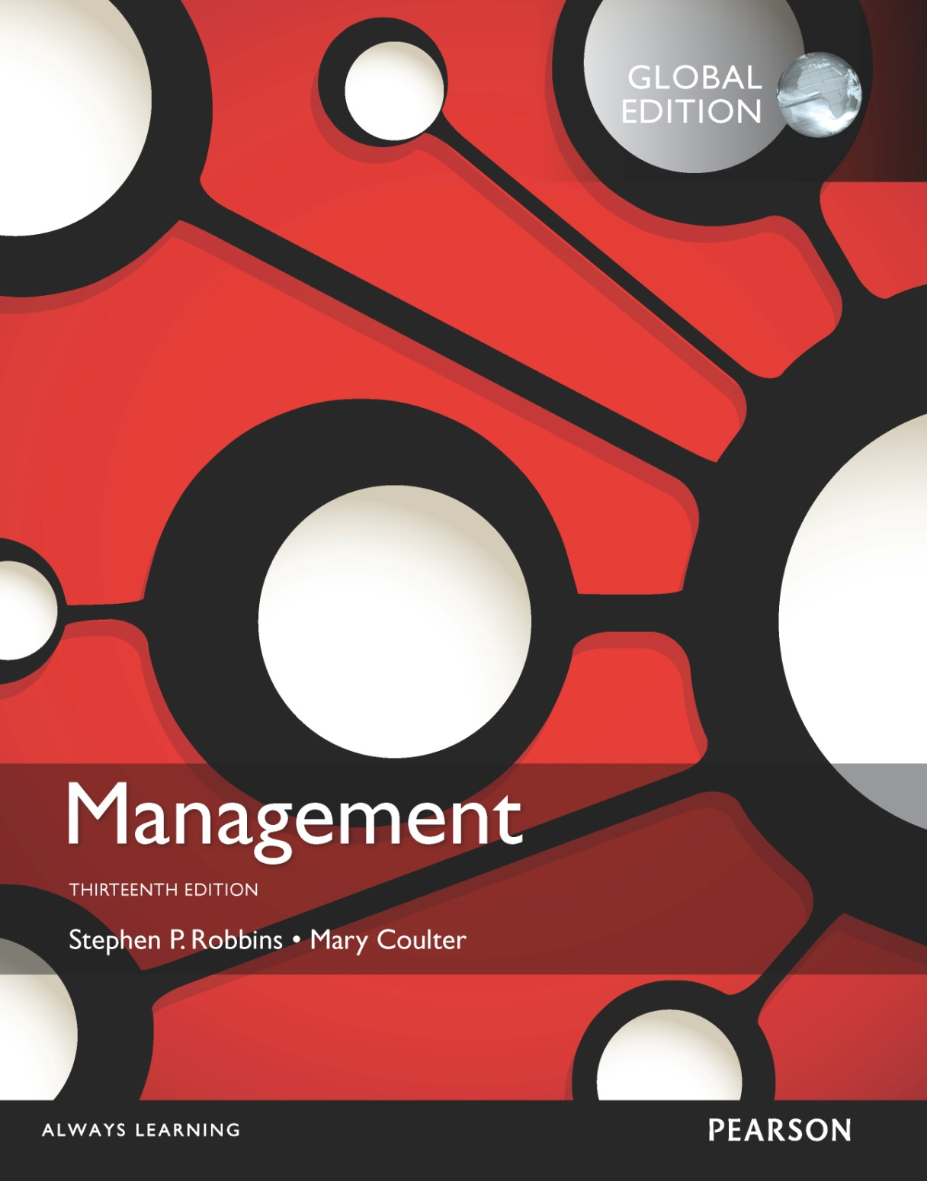
Planning work activities
8

Slide 2
Learning Objectives
Define the nature and purposes of planning.
Classify the types of goals organizations might have and the plans they use.
Compare and contrast approaches to goal-setting and planning.
Know how to set goals personally and create a useful, functional to-do list.
Develop your skill at helping your employees set goals.
Discuss contemporary issues in planning.

Slide 3
What Is Planning?
Planning – defining the organization’s goals, establishing strategies for achieving those goals, and developing plans to integrate and coordinate work activities.
Formal planning
Specific goals covering a specific time period
Written and shared with organizational members
Notes:
Planning involves defining the organization’s goals, establishing strategies for achieving those goals, and developing plans to integrate and coordinate work activities. It’s concerned with both ends (what) and means (how).
When we use the term planning, we mean formal planning. In formal planning, specific goals covering a specific time period are defined. These goals are written and shared with organizational members to reduce ambiguity and create a common understanding about what needs to be done. Finally, specific plans exist for achieving these goals.

Slide 4
Why Do Managers Plan?
Four reasons for planning
Provides direction
Reduces uncertainty
Minimizes waste and redundancy
Sets the standards for controlling
Notes:
So why should managers plan? We can give you at least four reasons.
First, planning provides direction to managers and nonmanagers alike. When employees know what their organization or work unit is trying to accomplish and what they must contribute to reach goals, they can coordinate their activities, cooperate with each other, and do what it takes to accomplish those goals.
Next, planning reduces uncertainty by forcing managers to look ahead, anticipate change, consider the impact of change, and develop appropriate responses. Although planning won’t eliminate uncertainty, managers plan so they can respond effectively.
In addition, planning minimizes waste and redundancy. When work activities are coordinated around plans, inefficiencies become obvious and can be corrected or eliminated.
Finally, planning establishes the goals or standards used in controlling. When managers plan, they develop goals and plans. When they control, they see whether the plans have been carried out and the goals met.

Slide 5
Planning and Performance
Positive financial results – higher profits, higher return on assets, and so forth.
The quality of planning and implementation affects performance more than the extent of planning.
The external environment can reduce the impact of planning on performance.
The planning-performance relationship seems to be influenced by the planning time frame.
Formal planning is associated with:
Notes:
Numerous studies have shown generally positive relationships between planning and performance.
Formal planning is associated with positive financial results—higher profits, higher return on assets, and so forth.
Doing a good job of planning and implementing those plans plays a bigger part in high performance than how much planning is done.
In those studies where formal planning didn’t lead to higher performance, the external environment often
was the culprit. When external forces—think governmental regulations or powerful labor unions—constrain managers’ options, it reduces the impact planning has on an organization’s performance.
Finally, the planning-performance relationship seems to be influenced by the planning time frame. It seems that at least four years of formal planning is required before it begins to affect performance.

Slide 6
Goals and Plans
(objectives) – desired outcomes or targets.
Plans – documents that outline how goals are going to be met.
Goals
Notes:
Goals (objectives) are desired outcomes or targets. They guide management decisions and form the criterion against which work results are measured. That’s why they’re often described as the essential elements of planning. You have to know the desired target or outcome before you can establish plans for reaching it.
Plans are documents that outline how goals are going to be met. They usually include resource allocations, schedules, and other necessary actions to accomplish the goals. As managers plan, they develop both goals and plans.

Slide 7
Types of Goals
Financial Goals – related to the expected internal financial performance of the organization.
Strategic Goals – related to the performance of the firm relative to factors in its external environment (e.g., competitors).
Notes:
We can classify most company’s goals as either strategic or financial. Financial goals are related to the financial performance of the organization, while strategic goals are related to all other areas of an organization’s performance. For instance, McDonald’s states that its financial targets are 3 to 5 percent average annual sales and revenue growth; 6 to 7 percent average annual operating income growth; and returns on invested capital in the high teens. Here’s an example of a strategic goal from Bloomberg L.P.: “We want to be the world’s most influential news organization.”

Slide 8
Types of Goals (cont.)
Stated Goals – official statements of what an organization says, and what it wants its various stakeholders to believe its goals are.
Real goals – goals that an organization actually pursues, as defined by the actions of its members.
Notes:
Stated goals are official statements of what an organization says, and what it wants its stakeholders to believe, its goals are. However, stated goals—which can be found in an organization’s charter, annual report, public relations announcements, or in public statements made by managers—are often conflicting and influenced by what various stakeholders think organizations should do.
If you want to know an organization’s real goals—those goals an organization actually pursues—observe what organizational members are doing. Actions define priorities.

Slide 9
Types of Plans
Strategic plans – plans that apply to the entire organization and establish the organization’s overall goals.
Operational plans – plans that encompass a particular operational area of the organization.
Notes:
The most popular ways to describe organizational plans are breadth (strategic versus operational), time frame (short-term versus long-term), specificity (directional versus specific), and frequency of use (single use versus standing).
Strategic plans are plans that apply to the entire organization and establish the organization’s overall goals. Plans that encompass a particular operational area of the organization are called operational plans. These two types of plans differ because strategic plans are broad while operational plans are narrow.

Slide 10
Types of Plans (cont.)
Long-term plans – plans with a time frame beyond three years.
Short-term plans – plans covering one year or less.
Specific plans – plans that are clearly defined and leave no room for interpretation.
Directional plans – plans that are flexible and set out general guidelines.
Notes:
We define long-term plans as those with a time frame beyond three years. Short-term plans cover one year or less. Any time period in between would be an intermediate plan. Although these time classifications are fairly common, an organization can use any planning time frame it wants.
Specific plans are clearly defined and leave no room for interpretation. A specific plan states its objectives in a way that eliminates ambiguity and problems with misunderstanding.
Directional plans are flexible plans that set out general guidelines. They provide focus but don’t lock managers into specific goals or courses of action.

Slide 11
Types of Plans (cont.)
Single-use plan – a one-time plan specifically designed to meet the needs of a unique situation.
Standing plans – ongoing plans that provide guidance for activities performed repeatedly.
Notes:
Some plans that managers develop are ongoing while others are used only once. A single-use plan is a one-time plan specifically designed to meet the needs of a unique situation.
In contrast, standing plans are ongoing plans that provide guidance for activities performed repeatedly. Standing plans include policies, rules, and procedures.

Slide 12
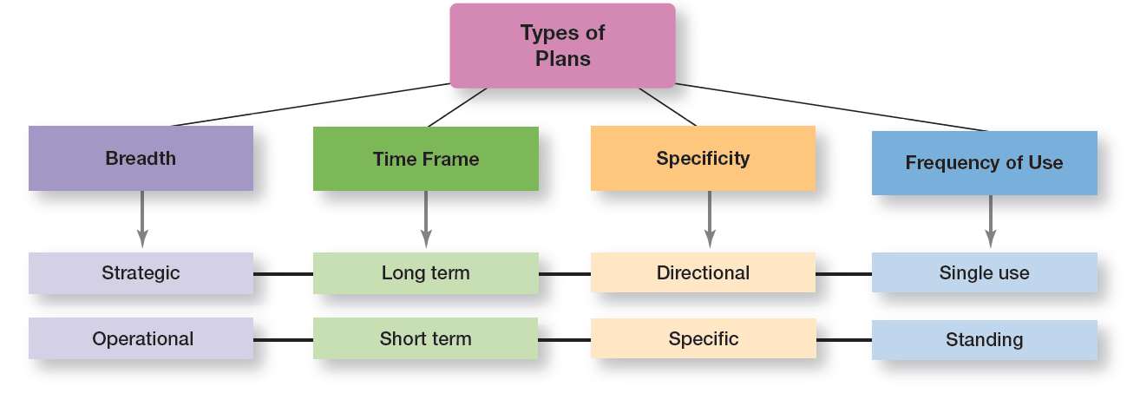
Exhibit 8-1 Types of Plans
Notes:
As Exhibit 8-1 shows, these types of plans aren’t independent. That is, strategic plans are usually long-term, directional, and single use, whereas operational plans are usually short-term, specific, and standing.

Slide 13
Approaches to Setting Goals
Traditional goal-setting – an approach to setting goals in which top managers set goals that then flow down through the organization and become subgoals for each organizational area.
Means-ends chain – an integrated network of goals in which the accomplishment of goals at one level serves as the means for achieving the goals, or ends, at the next level.
Notes:
In traditional goal-setting, goals set by top managers flow down through the organization and become subgoals for each organizational area. This traditional perspective assumes that top managers know what’s best because they see the “big picture.” And the goals passed down to each succeeding level guide individual employees as they work to achieve those assigned goals.
When the hierarchy of organizational goals is clearly defined it forms an integrated network of goals, or a means-ends chain.
Higher-level goals (or ends) are linked to lower-level goals, which serve as the means for their accomplishment. In other words, the goals achieved at lower levels become the means to reach the goals (ends) at the next level. And the accomplishment of goals at that level becomes the means to achieve the goals (ends) at the next level and on up through the different organizational levels. That’s how traditional goal-setting is supposed to work.

Slide 14
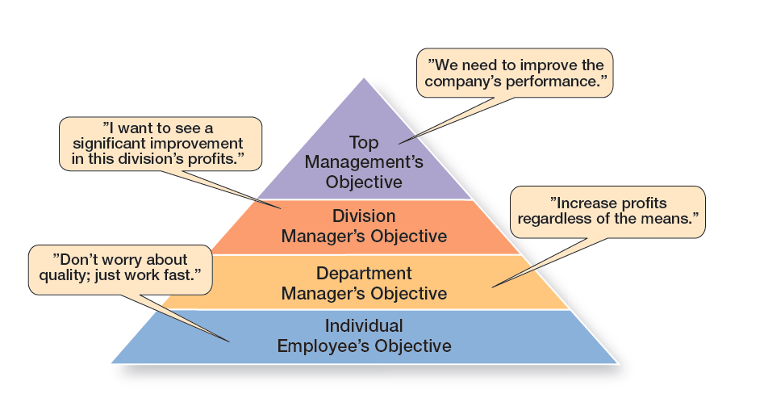
Exhibit 8-2 The Downside of Traditional Goal-Setting
Notes:
A problem with traditional goal-setting is that when top managers define the organization’s goals in broad terms—such as achieving “sufficient” profits or increasing “market leadership”—these ambiguous goals have to be made more specific as they flow down through the organization. Managers at each level define the goals and apply their own interpretations and biases as they make them more specific. However, what often happens is that clarity is lost as the goals make their way down from the top of the organization to lower levels. Exhibit 8-2 illustrates what can happen.

Slide 15
Approaches to Setting Goals (cont.)
by objectives (MBO) – a process of setting mutually agreed upon goals and using those goals to evaluate employee performance.
Management
Notes:
Instead of using traditional goal-setting, many organizations use management by objectives (MBO), a process of setting mutually agreed-upon goals and using those goals to evaluate employee performance. MBO programs have four elements: goal specificity, participative decision-making, an explicit time period, and performance feedback.
Instead of using goals to make sure employees are doing what they’re supposed to be doing, MBO uses goals to motivate them as well. The appeal is that it focuses on employees working to accomplish goals they’ve had a hand in setting.

Slide 16
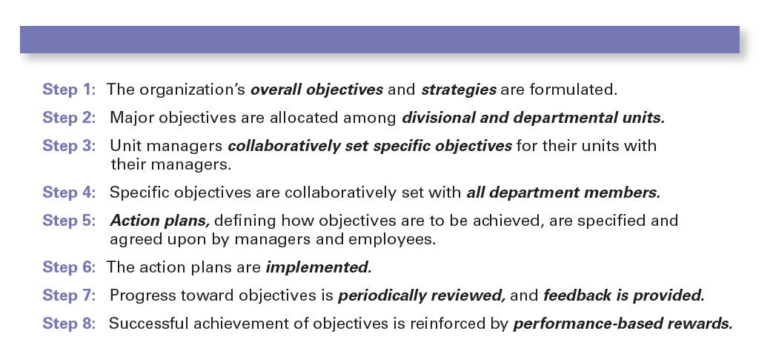
Exhibit 8-3 Steps in MBO
Notes:
Exhibit 8-3 lists the steps in a typical MBO program.

Slide 17
Steps in Goal-Setting
Review the organization’s mission, or purpose.
Evaluate available resources.
Determine the goals individually or with input from others.
Write down the goals and communicate them to all who need to know.
Review results and whether goals are being met.
Notes:
Managers should follow five steps when setting goals.
Review the organization’s mission, or purpose. A mission is a broad statement of an organization’s purpose that provides an overall guide to what organizational members think is important. Managers should review the mission before writing goals because goals should reflect that mission.
Evaluate available resources. You don’t want to set goals that are impossible to achieve given your available resources. Even though goals should be challenging, they should be realistic. After all, if the resources you have to work with won’t allow you to achieve a goal no matter how hard you try or how much effort is exerted, you shouldn’t set that goal.
Determine the goals individually or with input from others. The goals reflect desired outcomes and should be congruent with the organizational mission and goals in other organizational areas. These goals should be measurable, specific, and include a time frame for accomplishment.
Write down the goals and communicate them to all who need to know. Writing down and communicating goals forces people to think them through. The written goals also become visible evidence of the importance of working toward something.
Review results and whether goals are being met. If goals aren’t being met, change them as needed. Once the goals have been established, written down, and communicated, a manager is ready to develop plans for pursuing the goals.

Slide 18
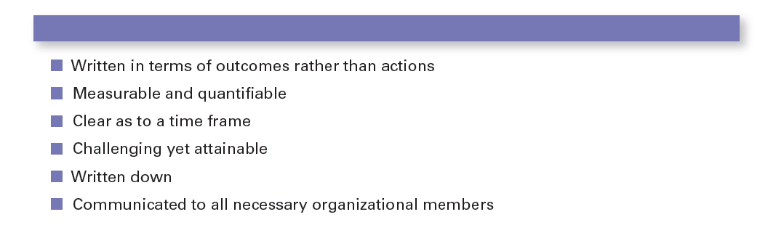
Exhibit 8-4 Well-Written Goals
Notes:
Managers should be able to write well-written goals. What makes a “well-written” goal?” Exhibit 8-4 lists the characteristics.

Slide 19
Contingency Factors in Planning
of future commitments
Commitment Concept: Current plans affecting future commitments must be sufficiently long-term in order to meet those commitments.
Length
Notes:
Three contingency factors affect the choice of plans: organizational level, degree of environmental uncertainty, and length of future commitments.

Slide 20
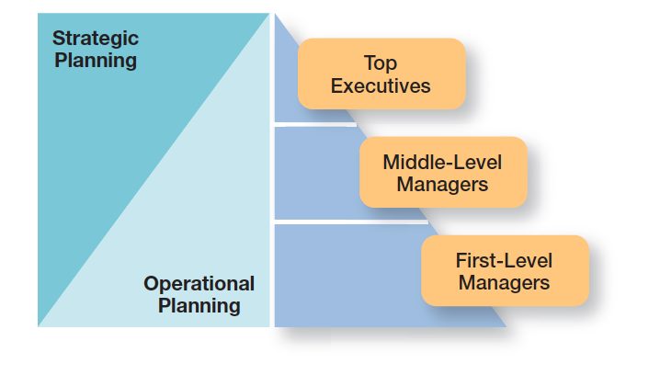
Exhibit 8-5 Planning and Organizational Level
Notes:
Exhibit 8-5 shows the relationship between a manager’s level in the organization and the type of planning done. For the most part, lower-level managers do operational planning while upper-level managers do strategic planning.

Slide 21
Contingency Factors in Planning (cont.)
Uncertainty
When uncertainty is high, plans should be specific, but flexible.
Managers must be prepared to change or amend plans as they’re implemented.
At times, they may even have to abandon the plans.
Environmental
Notes:
The second contingency factor is environmental uncertainty. When uncertainty is high, plans should be specific, but flexible. Managers must be prepared to change or amend plans as they’re implemented. At times, they may even have to abandon the plans.

Slide 22
Approaches to Planning
the traditional approach, planning is done entirely by top-level managers, often assisted by a formal planning department.
Formal planning department – a group of planning specialists whose sole responsibility is helping to write organizational plans.
In
Notes:
In the traditional approach, planning is done entirely by top-level managers who are often assisted by a formal planning department, a group of planning specialists whose sole responsibility is to help write the various organizational plans. Under this approach, plans developed by top-level managers flow down through other organizational levels, much like the traditional approach to goal-setting. As they flow down through the organization, the plans are tailored to the particular needs of each level.
Although this approach makes managerial planning thorough, systematic, and coordinated, all too often the focus is on developing “the plan”—a thick binder (or binders) full of meaningless information that’s stuck on a shelf and never used by anyone for guiding or coordinating work efforts

Slide 23
Contemporary Issues in Planning
Can Managers Plan Effectively in Dynamic Environments?
In an uncertain environment, managers should develop plans that are specific, but flexible.
Managers need to recognize that planning is an ongoing process.
How
Notes:
In an uncertain environment, managers should develop plans that are specific, but flexible. Although this may seem contradictory, it’s not. To be useful, plans need some specificity, but the plans should not be set in stone. Managers need to recognize that planning is an ongoing process. The plans serve as a road map although the destination may change due to dynamic market conditions. They should be ready to change directions if environmental conditions warrant.

Slide 24
Contemporary Issues in Planning (cont.)
How Can Managers Use Environmental Scanning?
Environmental scanning – screening information to detect emerging trends.
Competitor intelligence – gathering information about competitors that allows managers to anticipate competitors’ actions rather than merely reacting to them.
Notes:
A manager’s analysis of the external environment may be improved by environmental scanning, which involves screening information to detect emerging trends. One of the fastest-growing forms of environmental scanning is competitor intelligence, gathering information about competitors that allows managers to anticipate competitors’ actions rather than merely reacting to them. It seeks basic information about competitors: Who are they? What are they doing? How will what they’re doing affect us?

Slide 25
Review Learning Objective 8.1
Define the nature and purposes of planning.
Planning involves defining the organization’s goals, establishing an overall strategy for achieving those goals, and developing plans for organizational work activities.
The four purposes of planning include providing direction, reducing uncertainty, minimizing waste and redundancy, and establishing the goals or standards used in controlling.
Notes:
Planning involves defining the organization’s goals, establishing an overall strategy for achieving those goals, and developing plans for organizational work activities. The four purposes of planning include providing direction, reducing uncertainty, minimizing waste and redundancy, and establishing the goals or standards used in controlling. Studies of the planning-performance relationship have concluded that formal planning is associated with positive financial performance, for the most part; it’s more important to do a good job of planning and implementing the plans than doing more extensive planning; the external environment is usually the reason why companies that plan don’t achieve high levels of performance; and the planning-performance relationship seems to be influenced by the planning time frame.

Slide 26
Review Learning objective 8.2
Classify the types of goals organizations might have and the plans they use.
Goals are desired outcomes.
Plans are documents that outline how goals are going to be met.
Strategic plans apply to the entire organization while operational plans encompass a particular functional area.
Notes:
Goals are desired outcomes. Plans are documents that outline how goals are going to be met. Goals might be strategic or financial and they might be stated or real. Strategic plans apply to the entire organization while operational plans encompass a particular functional area.

Slide 27
Review Learning objective 8.2 (cont.)
Long-term plans are those with a time frame beyond three years. Short-term plans cover one year or less.
Specific plans are clearly defined and leave no room for interpretation.
Directional plans are flexible and set out general guidelines.
Notes:
Long-term plans are those with a time frame beyond three years. Short-term plans cover one year or less. Specific plans are clearly defined and leave no room for interpretation. Directional plans are flexible and set out general guidelines.

Slide 28
Review Learning objective 8.2 (cont.)
A single-use plan is a one-time plan designed to meet the needs of a unique situation.
Standing plans are ongoing plans that provide guidance for activities performed repeatedly.
Notes:
A single-use plan is a one-time plan designed to meet the needs of a unique situation. Standing plans are ongoing plans that provide guidance for activities performed repeatedly.

Slide 29
Review Learning objective 8.3
Compare and contrast approaches to goal-setting and planning.
In traditional goal-setting, goals are set at the top of the organization and then become subgoals for each organizational area.
MBO (management by objectives) is a process of setting mutually agreed-upon goals and using those goals to evaluate employee performance.
Notes:
In traditional goal-setting, goals are set at the top of the organization and then become subgoals for each organizational area. MBO (management by objectives) is a process of setting mutually agreed-upon goals and using those goals to evaluate employee performance.

Slide 30
Review Learning objective 8.3 (cont.)
Well-written goals have six characteristics:
Written in terms of outcomes.
Measurable and quantifiable.
Clear as to time frame.
Challenging but attainable.
Written down.
Communicated to all organizational members who need to know them.
Notes:
Well-written goals have six characteristics: (1) written in terms of outcomes, (2) measurable and quantifiable, (3) clear as to time frame, (4) challenging but attainable, (5) written down, and (6) communicated to all organizational members who need to know them.

Slide 31
Review Learning objective 8.3 (cont.)
Goal-setting involves these steps:
Review the organization’s mission
Evaluate available resources
Determine the goals individually or with input from others
Write down the goals and communicate them to all who need to know them
Review results and change goals as needed
Notes:
Goal-setting involves these steps: review the organization’s mission; evaluate available resources; determine the goals individually or with input from others; write down the goals and communicate them to all who need to know them; and review results and change goals as needed.

Slide 32
Review Learning objective 8.3 (cont.)
The two main approaches to planning include:
The traditional approach, which has plans developed by top managers that flow down through other organizational levels and which may use a formal planning department.
The other approach is to involve more organizational members in the planning process.
Notes:
The two main approaches to planning include the traditional approach, which has plans developed by top managers that flow down through other organizational levels and which may use a formal planning department. The other approach is to involve more organizational members in the planning process.

Slide 33
Review Learning objective 8.4
Discuss contemporary issues in planning.
Dynamic environments – usually means developing plans that are specific but flexible.
Contemporary planning issue involves using environmental scanning to help do a better analysis of the external environment.
One form of environmental scanning, competitive intelligence, can be especially helpful in finding out what competitors are doing.
Notes:
One contemporary planning issue is planning in dynamic environments, which usually means developing plans that are specific but flexible. Also, it’s important to continue planning, even when the environment is highly uncertain. Finally, because there’s little time in a dynamic environment for goals and plans to flow down from the top, lower organizational levels should be allowed to set goals and develop plans. Another contemporary planning issue involves using environmental scanning to help do a better analysis of the external environment. One form of environmental scanning, competitive intelligence, can be especially helpful in finding out what competitors are doing.

