Slide 1
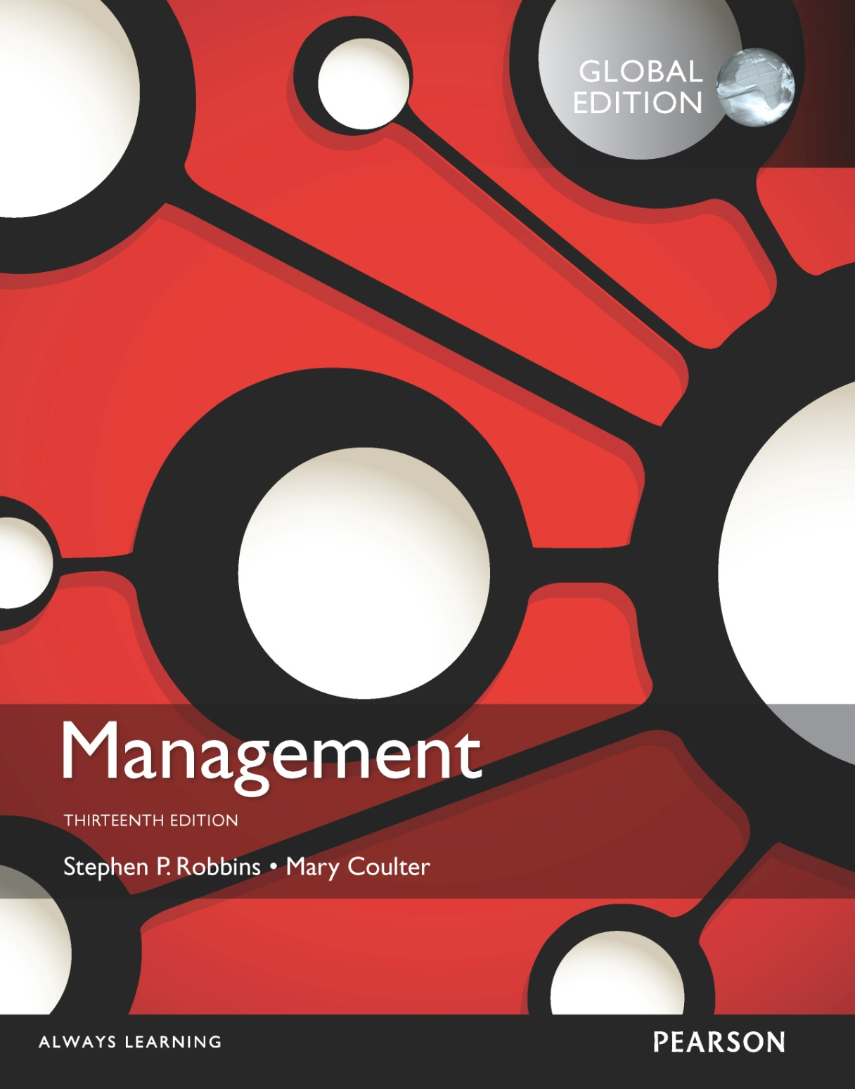
Managing Strategy
9

Slide 2
Learning Objectives
Define strategic management and explain why it’s important.
Explain what managers do during the six steps of the strategic management process.
Know how to identify your own personal strengths and weaknesses and deal with them.
Develop your skill at strategic planning.
Describe the three types of corporate strategies.
Describe competitive advantage and the competitive strategies organizations use to get it.
Discuss current strategic management issues.

Slide 3
What Is Strategic Management?
management – what managers do to develop the organization’s strategies.
Strategies – the plans for how the organization will do what it’s in business to do, how it will compete successfully, and how it will attract and satisfy its customers in order to achieve its goals.
Business model – how a company is going to make money.
Strategic
Notes:
Strategic management is what managers do to develop the organization’s strategies. It’s an important task involving all the basic management functions—planning, organizing, leading, and controlling. What are an organization’s strategies? They’re the plans for how the organization will do whatever it’s in business to do, how it will compete successfully, and how it will attract and satisfy its customers in order to achieve its goals.
One term often used in strategic management is business model, which simply is how a company is going to make money. It focuses on two things: (1) whether customers will value what the company is providing, and (2) whether the company can make any money doing that.

Slide 4
Why Is Strategic Management Important?
It results in higher organizational performance.
It requires that managers examine and adapt to business environment changes.
It coordinates diverse organizational units, helping them focus on organizational goals.
Notes:
Why is strategic management so important? There are three reasons. The most significant one is that it can make a difference in how well an organization performs. In other words, it appears that organizations that use strategic management do have higher levels of performance. And that fact makes it pretty important for managers.
Another reason it’s important has to do with the fact that managers in organizations of all types and sizes face continually changing situations. They cope with this uncertainty by using the strategic management process to examine relevant factors and decide what actions to take.
Finally, strategic management is important because organizations are complex and diverse. Each part needs to work together toward achieving the organization’s goals; strategic management helps do this.

Slide 5
The Strategic Management Process
management process – a six-step process that encompasses strategic planning, implementation, and evaluation.
Strategic
Notes:
The strategic management process (see Exhibit 9-1) is a six-step process that encompasses strategy planning, implementation, and evaluation. Although the first four steps describe the planning that must take place, implementation and evaluation are just as important! Even the best strategies can fail if management doesn’t implement or evaluate them properly.

Slide 6
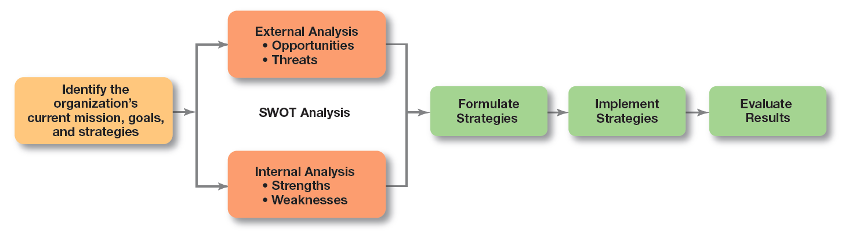
Exhibit 9-1 Strategic Management Process

Slide 7
The Strategic Management Process (cont.)
Identifying the organization’s current mission, goals, and strategies:
Mission: a statement of the purpose of an organization.
The scope of its products and services
Goals: the foundation for further planning.
Measurable performance targets
Step 1:
Notes:
Every organization needs a mission—a statement of its purpose. Defining the mission forces managers to identify what it’s in business to do. But sometimes that mission statement can be too limiting. For example, the co-founder of the leading Internet search engine Google says that while the company’s purpose of “organizing the world’s information and making it universally accessible and useful” has served them well, they failed to see the whole social side of the Internet and have been playing catch-up.

Slide 8
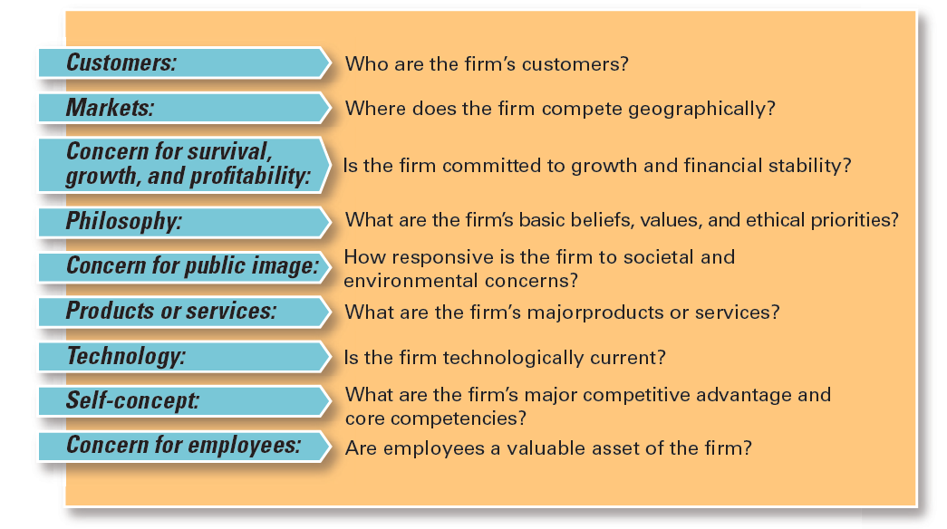
Exhibit 9-2: Components of a Mission Statement
Notes:
What should a mission statement include? Exhibit 9-2 describes some typical components.

Slide 9
The Strategic Management Process (cont.)
: Doing an external analysis
The environmental scanning of specific and general environments.
Focuses on identifying opportunities and threats
Step 2
Notes:
Analyzing that environment is a critical step in the strategic management process. Managers do an external analysis so they know, for instance, what the competition is doing, what pending legislation might affect the organization, or what the labor supply is like in locations where it operates. In an external analysis, managers should examine the economic, demographic, political/legal, sociocultural, technological, and global components to see the trends and changes.
Once they’ve analyzed the environment, managers need to pinpoint opportunities that the organization can exploit and threats that it must counteract or buffer against. Opportunities are positive trends in the external environment; threats are negative trends.

Slide 10
The Strategic Management Process (cont.)
Doing an internal analysis
Assessing organizational resources, capabilities, and activities:
Strengths create value for the customer and strengthen the competitive position of the firm.
Weaknesses can place the firm at a competitive disadvantage.
Steps 2 and 3 combined are called a SWOT analysis. (Strengths, Weaknesses, Opportunities, and Threats)
Step 3:
Notes:
The internal analysis provides important information about an organization’s specific resources and capabilities. An organization’s resources are its assets—financial, physical, human, and intangible—that it uses to develop, manufacture, and deliver products to its customers. They’re “what” the organization has. On the other hand, its capabilities are its skills and abilities in doing the work activities needed in its business—“how” it does its work. The major value-creating capabilities of the organization are known as its core competencies.
After completing an internal analysis, managers should be able to identify organizational strengths and weaknesses. Any activities the organization does well or any unique resources that it has are called strengths. Weaknesses are activities the organization doesn’t do well or resources it needs but doesn’t possess.

Slide 11
SWOT Analysis
analysis – an analysis of the organization’s strengths, weaknesses, opportunities, and threats.
Resources – an organization’s assets that are used to develop, manufacture, and deliver a product to its customers.
Capabilities – an organization’s skills and abilities in doing the work activities needed in its business.
SWOT
Notes:
The combined external and internal analyses are called the SWOT analysis, an analysis of the organization’s strengths, weaknesses, opportunities, and threats. After completing the SWOT analysis, managers are ready to formulate appropriate strategies—that is, strategies that (1) exploit an organization’s strengths and external opportunities, (2) buffer or protect the organization from external threats, or (3) correct critical weaknesses.

Slide 12
Strengths and Weaknesses
- any activities the organization does well or any unique resources that it has.
Weaknesses – activities the organization does not execute well or needed resources it does not possess.
Core competencies – the organization’s major value-creating capabilities that determine its competitive weapons.
Strengths

Slide 13
The Strategic Management Process (cont.)
: Formulating strategies
Develop and evaluate strategic alternatives.
Select appropriate strategies for all levels in the organization that provide relative advantage over competitors.
Match organizational strengths to environmental opportunities.
Correct weaknesses and guard against threats.
Step 4
Notes:
As managers formulate strategies, they should consider the realities of the external environment and their available resources and capabilities in order to design strategies that will help an organization achieve its goals. The three main types of strategies managers will formulate include corporate, competitive, and functional.

Slide 14
The Strategic Management Process (cont.)
Step 5: Implementing strategies
Implementation – effectively fitting organizational structure and activities to the environment.
The environment dictates the chosen strategy; effective strategy implementation requires an organizational structure matched to its requirements.
Step 6: Evaluating results
How effective have strategies been?
What adjustments, if any, are necessary?
Notes:
Once strategies are formulated, they must be implemented. No matter how effectively an organization has planned its strategies, performance will suffer if the strategies aren’t implemented properly.
The final step in the strategic management process is evaluating results. How effective have the strategies been at helping the organization reach its goals? What adjustments are necessary?

Slide 15
What Is Corporate Strategy?
Corporate strategy – an organizational strategy that determines what businesses a company is in or wants to be in, and what it wants to do with those businesses.
Strategic Business Unit (SBU) – the single independent businesses of an organization that formulate their own competitive strategies.
Notes:
A corporate strategy is one that determines what businesses a company is in or wants to be in and what it wants to do with those businesses. It’s based on the mission and goals of the organization and the roles that each business unit of the organization will play.
When an organization is in several different businesses, those single businesses that are independent and that have their own competitive strategies are referred to as strategic business units (SBUs).

Slide 16
Types of Corporate Strategies
Growth – expansion into new products and markets.
Stability – maintenance of the status quo.
Renewal – examination of organizational weaknesses that are leading to performance declines.
Notes:
The three main types of corporate strategies are growth, stability, and renewal. Let’s look at each type.

Slide 17
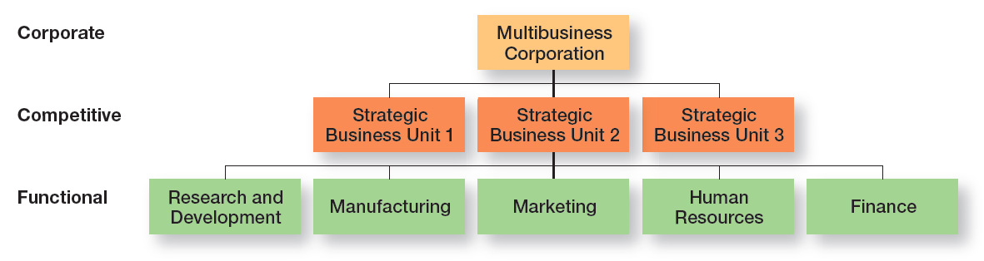
Exhibit 9-3 Types of Organizational Strategies

Slide 18
Growth Strategies
Growth Strategy – a corporate strategy that’s used when an organization wants to expand the number of markets served or products offered, through either its current business(es) or new business(es).
Notes:
A growth strategy is when an organization expands the number of markets served or products offered, either through its current business(es) or through new business(es). Because of its growth strategy, an organization may increase revenues, number of employees, or market share. Organizations grow by using concentration, vertical integration, horizontal integration, or diversification.

Slide 19
Types of Growth Strategies
Concentration – focuses on its primary line of business and increases the number of products offered or markets served in this primary business.
Vertical integration
Backward vertical integration – the organization becomes its own supplier.
Forward vertical integration – the organization becomes its own distributor.
Notes:
An organization that grows using concentration focuses on its primary line of business and increases the number of products offered or markets served in this primary business.
A company also might choose to grow by vertical integration, either backward, forward, or both. In backward vertical integration, the organization becomes its own supplier so it can control its inputs. In forward vertical integration, the organization becomes its own distributor and is able to control its outputs.

Slide 20
Types of Growth Strategies (cont.)
Horizontal integration – a company grows by combining with competitors.
Diversification
Related diversification – when a company combines with other companies in different, but related industries.
Unrelated diversification – when a company combines with firms in different and unrelated industries.
Notes:
In horizontal integration, a company grows by combining with competitors. Finally, an organization can grow through diversification, either related or unrelated. Related diversification happens when a company combines with other companies in different, but related industries. Unrelated diversification is when a company combines with firms in different and unrelated industries.

Slide 21
Corporate Strategies (cont.)
– a corporate strategy in which an organization continues to do what it is currently doing.
Stability Strategy
Notes:
A stability strategy is a corporate strategy in which an organization continues to do what it is currently doing. Examples of this strategy include continuing to serve the same clients by offering the same product or service, maintaining market share, and sustaining the organization’s current business operations. The organization doesn’t grow, but doesn’t fall behind, either.

Slide 22
Corporate Strategies (cont.)
– a corporate strategy designed to address declining performance.
Retrenchment strategy – a short-run renewal strategy used for minor performance problems.
Turnaround strategy – when an organization’s problems are more serious, more drastic action is needed.
Renewal Strategy
Notes:
When an organization is in trouble, something needs to be done. Managers need to develop strategies, called renewal strategies, that address declining performance. The two main types of renewal strategies are retrenchment and turnaround strategies. A retrenchment strategy is a short-run renewal strategy used for minor performance problems. This strategy helps an organization stabilize operations, revitalize organizational resources and capabilities, and prepare to compete once again. When an organization’s problems are more serious, more drastic action—the turnaround strategy—is needed. Managers do two things for both renewal strategies: cut costs and restructure organizational operations. However, in a turnaround strategy, these measures are more extensive than in a retrenchment strategy.

Slide 23
How Are Corporate Strategies Managed?
BCG matrix – a strategy tool that guides resource allocation decisions on the basis of market share and growth rate of SBUs.
Four Categories
Stars
Cash Cows
Question Marks
Dogs
Notes:
The BCG matrix— was developed by the Boston Consulting Group and introduced the idea that an organization’s various businesses could be evaluated and plotted using a 2 × 2 matrix to identify which ones offered high potential and which were a drain on organizational resources. The horizontal axis represents market share (low or high), and the vertical axis indicates anticipated market growth (low or high). A business unit is evaluated using a SWOT analysis and placed in one of the four categories, which are as follows:
• Stars: High market share/High anticipated growth rate
• Cash Cows: High market share/Low anticipated growth rate
• Question Marks: Low market share/High anticipated growth rate
• Dogs: Low market share/Low anticipated growth rate

Slide 24
Competitive Strategies
Competitive strategy – an organizational strategy for how an organization will compete in its business(es).
Competitive advantage – what sets an organization apart; its distinctive edge.
Quality as a Competitive Advantage
Design Thinking as a Competitive Advantage
Sustaining Competitive Advantage
Notes:
Developing an effective competitive strategy requires an understanding of competitive advantage, which is what sets an organization apart—that is, its distinctive edge

Slide 25
Five Forces Model
Five forces determine industry attractiveness and profitability:
Threat of new entrants. How likely is it that new competitors will come into the industry?
Threat of substitutes. How likely is it that other industries’ products can be substituted for our industry’s products?
Notes:
In any industry, five competitive forces dictate the rules of competition. Together, these five forces determine industry attractiveness and profitability, which managers assess using these five factors.
Threat of new entrants. How likely is it that new competitors will come into the industry?
Threat of substitutes. How likely is it that other industries’ products can be substituted for our industry’s products?

Slide 26
Five Forces Model (cont.)
Bargaining power of buyers. How much bargaining power do buyers (customers) have?
Bargaining power of suppliers. How much bargaining power do suppliers have?
Current rivalry. How intense is the rivalry among current industry competitors?
Notes:
3. Bargaining power of buyers. How much bargaining power do buyers (customers) have?
4. Bargaining power of suppliers. How much bargaining power do suppliers have?
5. Current rivalry. How intense is the rivalry among current industry competitors?

Slide 27
Choosing a Competitive Strategy
Cost leadership strategy – when an organization competes on the basis of having the lowest costs (costs or expenses, not prices) in its industry.
Differentiation strategy – a company that competes by offering unique products that are widely valued by customers.
Notes:
When an organization competes on the basis of having the lowest costs (costs or expenses, not prices) in its industry, it’s following a cost leadership strategy. A low-cost leader is highly efficient. Overhead is kept to a minimum, and the firm does everything it can to cut costs.
A company that competes by offering unique products that are widely valued by customers is following a differentiation strategy. Product differences might come from exceptionally high quality, extraordinary service, innovative design, technological capability, or an unusually positive brand image. Practically any successful consumer product or service can be identified as an example of the differentiation strategy.

Slide 28
Choosing a Competitive Strategy (cont.)
Focus strategy – involves a cost advantage (cost focus) or a differentiation advantage (differentiation focus) in a narrow segment or niche.
Stuck in the middle – when costs are too high to compete with the low-cost leader or when its products and services aren’t differentiated enough to compete with the differentiator.
Notes:
Although these two competitive strategies are aimed at the broad market, the final type of competitive strategy—the focus strategy—involves a cost advantage (cost focus) or a differentiation advantage (differentiation focus) in a narrow segment or niche. Segments can be based on product variety, customer type, distribution channel, or geographical location.
What happens if an organization can’t develop a cost or a differentiation advantage? Porter called that being stuck in the middle and warned that’s not a good place to be. An organization becomes stuck in the middle when its costs are too high to compete with the low-cost leader or when its products and services aren’t differentiated enough to compete with the differentiator. Getting unstuck means choosing which competitive advantage to pursue and then doing so by aligning resource, capabilities, and core competencies.

Slide 29
Functional Strategy
– the strategies used by an organization’s various functional departments to support the competitive strategy.
Functional strategy
Notes:
Functional strategies are the strategies used by an organization’s various functional departments to support the competitive strategy.

Slide 30
Current Strategic Management Issues
Strategic leadership – the ability to anticipate, envision, maintain flexibility, think strategically, and work with others in the organization to initiate changes that will create a viable and valuable future for the organization.
Notes:
An organization’s strategies are usually developed and overseen by its top managers. An organization’s top manager is typically the CEO (chief executive officer). This individual usually works with a top management team that includes other executive or senior managers such as a COO (chief operating officer), CFO (chief financial officer), CIO (chief information officer), and other individuals who may have various titles. Traditional descriptions of the CEO’s role in strategic management include being the “chief ” strategist, structural architect, and developer of the organization’s information/control systems. Strategic leadership is the ability to anticipate, envision, maintain flexibility, think strategically, and work with others in the organization to initiate changes that will create a viable and valuable future for the organization.

Slide 31
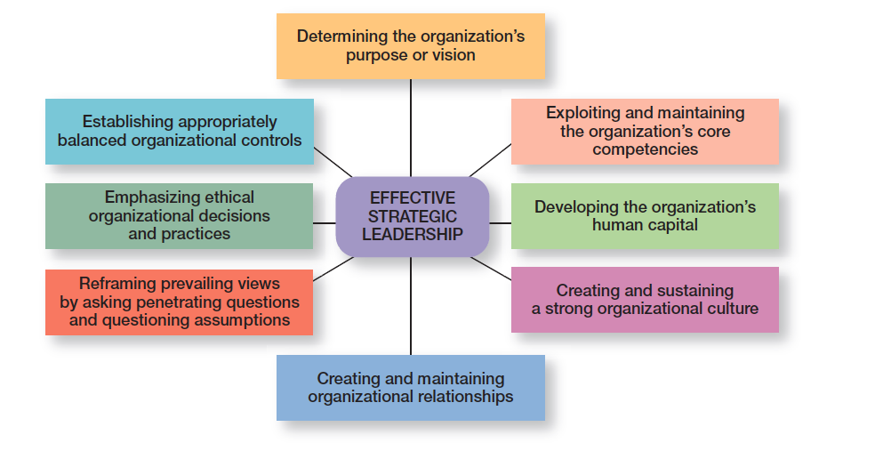
Exhibit 9-4 Effective Strategic Leadership
Notes:
How can top managers provide effective strategic leadership? Eight key dimensions have been identified. (See Exhibit 9-4.) These dimensions include determining the organization’s purpose or vision, exploiting and maintaining the organization’s core competencies, developing the organization’s human capital, creating and sustaining a strong organizational culture, creating and maintaining organizational relationships, reframing prevailing views by asking penetrating questions and questioning assumptions, emphasizing ethical organizational decisions and practices, and establishing appropriately balanced organizational controls. Each dimension encompasses an important part of the strategic management process.

Slide 32
Current Strategic Management Issues (cont.)
flexibility – the ability to recognize major external changes, to quickly commit resources, and to recognize when a strategic decision was a mistake.
Strategic
Notes:
Strategic flexibility is the ability to recognize major external changes, to quickly commit resources, and to recognize when a strategic decision isn’t working. Given the highly uncertain environment that managers face today, strategic flexibility seems absolutely necessary!

Slide 33
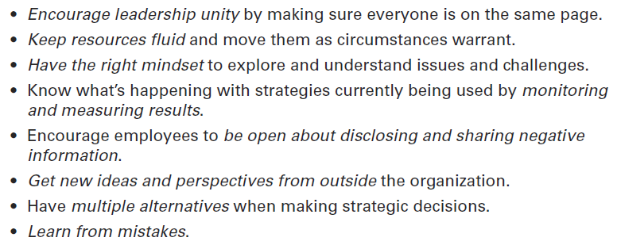
Exhibit 9-5 Developing Strategic Flexibility

Slide 34
Important Organizational Strategies for Today’s Environment
e-Business strategies
Cost Leadership – online activities: bidding, order processing, inventory control, recruitment and hiring.
Differentiation – Internet-based knowledge systems, online ordering and customer support.
Focus – chat rooms and discussion boards, targeted Web sites.
Notes:
Managers use e-business strategies to develop a sustainable competitive advantage. Cost leaders can use e-business to lower costs in a variety of ways. For instance, it might use online bidding and order processing to eliminate the need for sales calls and to decrease sales force expenses; it could use Web-based inventory control systems that reduce storage costs; or it might use online testing and evaluation of job applicants. A differentiator needs to offer products or services that customers perceive and value as unique. For instance, a business might use Internet-based knowledge systems to shorten customer response times, provide rapid online responses to service requests, or automate purchasing and payment systems so that customers have detailed status reports and purchasing histories. Finally, because the focuser targets a narrow market segment with customized products, it might provide chat rooms or discussion boards for customers to interact with others who have common interests, design niche Web sites that target specific groups with specific interests, or use Web sites to perform standardized office functions such as payroll or budgeting.

Slide 35
Important Organizational Strategies for Today’s Environment (cont.)
Customer Service Strategies – companies emphasizing excellent customer service need strategies that cultivate that atmosphere from top to bottom.
Innovation Strategies
First Mover – an organization that brings a product innovation to the market or uses new process innovations.
Notes:
Having an effective customer communication system is an important customer service strategy. Managers should know what’s going on with customers. They need to find out what customers liked and didn’t like about their purchase encounter—from their interactions with employees to their experience with the actual product or service. It’s also important to let customers know if something is going on with the company that might affect future purchase decisions. Finally, an organization’s culture is important to providing excellent customer service. This typically requires that employees be trained to provide exceptional customer service.
Innovation strategies aren’t necessarily focused on just the radical, breakthrough products. They can include applying existing technology to new uses. And organizations have successfully used both approaches. What types of innovation strategies do organizations need in today’s environment? Those strategies should reflect their innovation philosophy, which is shaped by two strategic decisions: innovation emphasis and innovation timing.
An organization that’s first to bring a product innovation to the market or to use a new process innovation is called a first mover. Being a first mover has certain strategic advantages and disadvantages as shown in Exhibit 9-6.

Slide 36
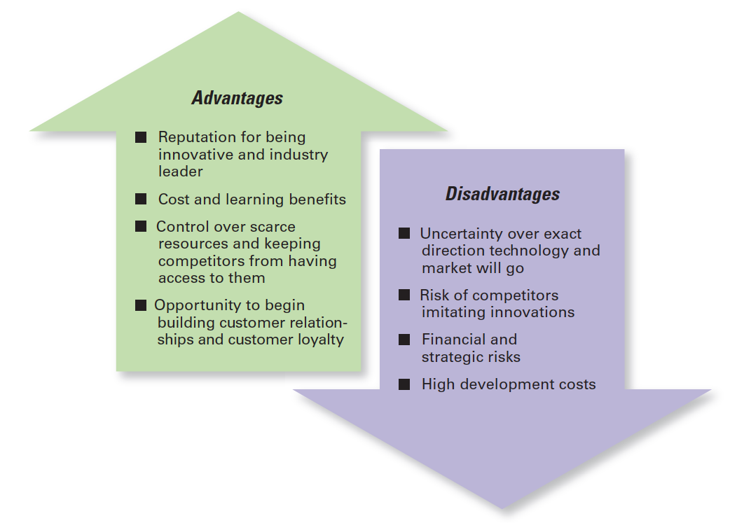
Exhibit 9-6 First-Mover Advantages and Disadvantages

Slide 37
Review Learning objective 9.1
Explain strategic management and explain why it’s important.
Strategies are the plans for how the organization will do whatever it’s in business to do, how it will compete successfully, and how it will attract and satisfy its customers in order to achieve its goals.
A business model is how a company is going to make money.
Notes:
Strategic management is what managers do to develop the organization’s strategies. Strategies are the plans for how the organization will do whatever it’s in business to do, how it will compete successfully, and how it will attract and satisfy its customers in order to achieve its goals. A business model is how a company is going to make money. Strategic management is important for three reasons. First, it makes a difference in how well organizations perform. Second, it’s important for helping managers cope with continually changing situations. Finally, strategic management helps coordinate and focus employee efforts on what’s important.

Slide 38
Review Learning objective 9.2
Explain what managers do during the six steps of the strategic management process.
Identify the current mission, goals, and strategies.
Do an external analysis.
Do an internal analysis (steps 2 and 3 collectively are known as SWOT analysis).
Formulate strategies.
Implement strategies.
Evaluate strategies.
Notes:
The six steps in the strategic management process encompass strategy planning, implementation, and evaluation. These steps include the following: (1) identify the current mission, goals, and strategies; (2) do an external analysis; (3) do an internal analysis (steps 2 and 3 collectively are known as SWOT analysis); (4) Formulate strategies; (5) implement strategies; and (6) evaluate strategies.

Slide 39
Review Learning objective 9.2 (cont.)
Weaknesses – activities the organization doesn’t do well or resources it needs.
Opportunities are positive trends in the external environment.
Strengths – any activities the organization does well or its unique resources.
Threats are negative trends.
Notes:
(4) Formulate strategies; (5) implement strategies; and (6) evaluate strategies.
Strengths are any activities the organization does well or its unique resources. Weaknesses are activities the organization doesn’t do well or resources it needs. Opportunities are positive trends in the external environment. Threats are negative trends.

Slide 40
Review Learning objective 9.3
Describe the three types of corporate strategies.
Growth strategy – when an organization expands the number of markets served or products offered, either through current or new businesses.
Concentration, vertical integration (backward and forward), horizontal integration, and diversification (related and unrelated).
Notes:
A growth strategy is when an organization expands the number of markets served or products offered, either through current or new businesses. The types of growth strategies include concentration, vertical integration (backward and forward), horizontal integration, and diversification (related and unrelated).

Slide 41
Review Learning objective 9.3 (cont.)
Stability strategy – when an organization makes no significant changes in what it’s doing.
Renewal strategies—retrenchment and turnaround – address organizational weaknesses leading to performance declines.
Notes:
Stability strategy is when an organization makes no significant changes in what it’s doing. Both renewal strategies—retrenchment and turnaround—address organizational weaknesses leading to performance declines.

Slide 42
Review Learning objective 9.3 (cont.)
The BCG matrix is a way to analyze a company’s portfolio of businesses by looking at a business’s market share and its industry’s anticipated growth rate. The four categories of the BCG matrix are:
Cash cows
Stars
Question marks
Dogs
Notes:
The BCG matrix is a way to analyze a company’s portfolio of businesses by looking at a business’s market share and its industry’s anticipated growth rate. The four categories of the BCG matrix are cash cows, stars, question marks, and dogs.

Slide 43
Review Learning objective 9.4
Describe competitive advantage and the competitive strategies organizations use to get it.
Competitive advantage is what sets an organization apart, its distinctive edge.
Porter’s five forces model assesses the five competitive forces that dictate competition in an industry:
Threat of new entrants, threat of substitutes, bargaining power of buyers, bargaining power of suppliers, and current rivalry
Notes:
An organization’s competitive advantage is what sets it apart, its distinctive edge. A company’s competitive advantage becomes the basis for choosing an appropriate competitive strategy. Porter’s five forces model assesses the five competitive forces that dictate the rules of competition in an industry: threat of new entrants, threat of substitutes, bargaining power of buyers, bargaining power of suppliers, and current rivalry.

Slide 44
Review Learning objective 9.4 (cont.)
Porter’s three competitive strategies are as follows:
Cost leadership (competing on the basis of having the lowest costs in the industry).
Differentiation (competing on the basis of having unique products that are widely valued by customers).
Focus (competing in a narrow segment with either a cost advantage or a differentiation advantage).
Notes:
Porter’s three competitive strategies are as follows: cost leadership (competing on the basis of having the lowest costs in the industry), differentiation (competing on the basis of having unique products that are widely valued by customers), and focus (competing in a narrow segment with either a cost advantage or a differentiation advantage).

Slide 45
Review Learning objective 9.5
Discuss current strategic management issues.
Strategic leadership is the ability to anticipate, envision, maintain flexibility, think strategically, and work with others in the organization to initiate changes that will create a viable and valuable future for the organization.
Notes:
Managers face three current strategic management issues: strategic leadership, strategic flexibility, and important types of strategies for today’s environment. Strategic leadership is the ability to anticipate, envision, maintain flexibility, think strategically, and work with others in the organization to initiate changes that will create a viable and valuable future for the organization and includes eight key dimensions.

Slide 46
Review Learning objective 9.5 (cont.)
Strategic flexibility – that is, the ability to recognize major external environmental changes, to quickly commit resources, and to recognize when a strategic decision isn’t working.
Managers can use e-business strategies to reduce costs, to differentiate their firm’s products and services, to target (focus on) specific customer groups, or to lower costs by standardizing certain office functions.
Notes:
Strategic flexibility—that is, the ability to recognize major external environmental changes, to quickly commit resources, and to recognize when a strategic decision isn’t working—is important because managers often face highly uncertain environments.
Managers can use e-business strategies to reduce costs, to differentiate their firm’s products and services, to target (focus on) specific customer groups, or to lower costs by standardizing certain office functions. Another important e-business strategy is the clicks-and-bricks strategy, which combines online and traditional, stand-alone locations. Strategies managers can use to become more customer oriented include giving customers what they want, communicating effectively with them, and having a culture that emphasizes customer service. Strategies managers can use to become more innovative include deciding their organization’s innovation emphasis (basic scientific research, product development, or process development) and its innovation timing.

