Slide 1

Designing organizational structure—Basic Designs
10
10 - 1

Slide 2
Learning objectives
Describe six key elements in organizational design.
Know how to delegate work to others and develop your skill at delegating.
Contrast mechanistic and organic structures.
Discuss the contingency factors that favor either the mechanistic model or the organic model of organizational design.
Describe traditional organizational designs.
10 - 2

Slide 3
Designing Organizational Structure
Organizing – arranging and structuring work to accomplish an organization’s goals.
Organizational Structure – the formal arrangement of jobs within an organization.
10 - 3
Notes:
Organizing is arranging and structuring work to accomplish organizational goals. It’s an important process during which managers design an organization’s structure. Organizational structure is the formal arrangement of jobs within an organization.

Slide 4
Designing Organizational Structure
Organizational chart – the visual representation of an organization’s structure.
Organizational Design – a process involving decisions about six key elements:
Work specialization
Departmentalization
Chain of command
Span of control
Centralization and decentralization
Formalization
10 - 4
Notes:
Structure can be shown visually in an organizational chart. (See Exhibit 10-1.) When managers create or change the structure, they’re engaged in organizational design, a process that involves decisions about six key elements: work specialization, departmentalization, chain of command, span of control, centralization and decentralization, and formalization.

Slide 5
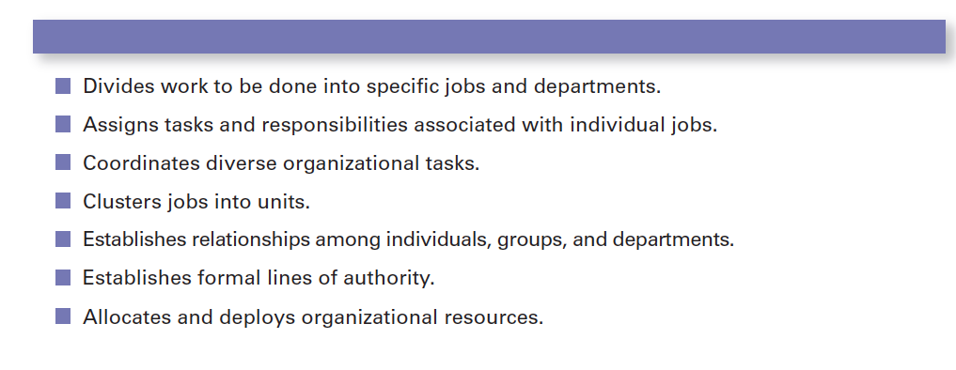
Exhibit 10-1 Purposes of Organizing
10 - 5

Slide 6
Organizational Structure
– dividing work activities into separate job tasks.
Early proponents of work specialization believed it could lead to great increases in productivity.
Overspecialization can result in human diseconomies such as boredom, fatigue, stress, poor quality, increased absenteeism, and higher turnover.
Work specialization
10 - 6
Notes:
Work specialization is dividing work activities into separate job tasks. Individual employees “specialize” in doing part of an activity rather than the entire activity in order to increase work output. It’s also known as division of labor. Work specialization makes efficient use of the diversity of workers skills.
Early proponents of work specialization believed it could lead to great increases in productivity. At the beginning of the twentieth century, that generalization was reasonable. Because specialization was not widely practiced, its introduction almost always generated higher productivity.
But, as Exhibit 10-2 illustrates, a good thing can be carried too far. At some point, the human diseconomies from division of labor—boredom, fatigue, stress, low productivity, poor quality, increased absenteeism, and high turnover—exceed the economic advantages.

Slide 7
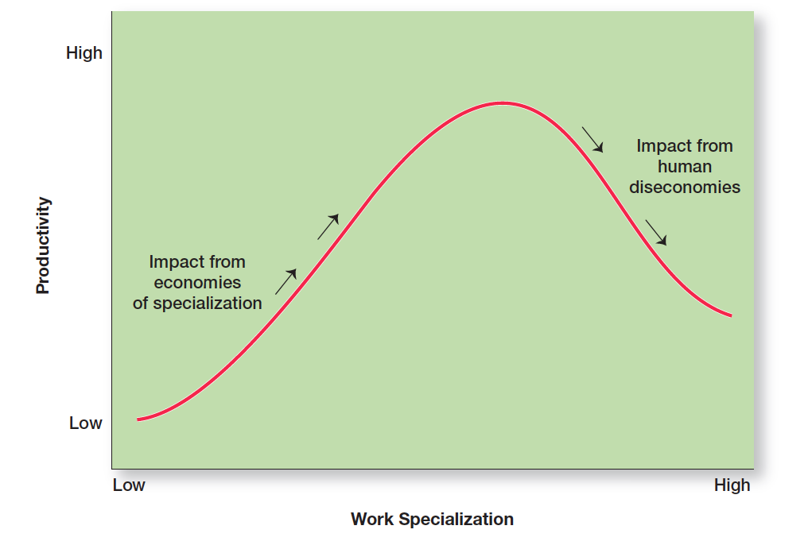
Exhibit 10-2 Economies and Diseconomies of Work Specialization
10 - 7

Slide 8
Departmentalization
– the basis by which jobs are grouped together.
Departmentalization
Functional
Grouping jobs by functions performed
Product
Grouping jobs by product line
Geographical
Grouping jobs on the basis of territory or geography
Process
Grouping jobs on the basis of product or customer flow
Customer
Grouping jobs by type of customer and needs
10 - 8
Notes:
How jobs are grouped together is called departmentalization. Five common forms of departmentalization are used, although an organization may develop its own unique classification. Exhibit 10-3 illustrates each type of departmentalization as well as the advantages and disadvantages of each.

Slide 9
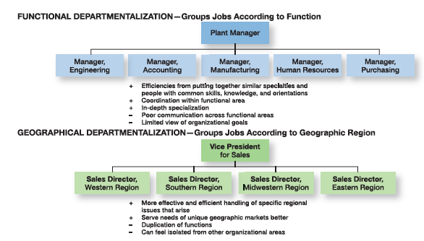
Exhibit 10-3 The Five Common Forms of Departmentalization
10 - 9

Slide 10
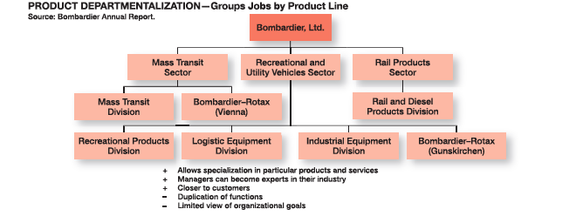
Exhibit 10-3 The Five Common Forms of Departmentalization (CONT.)
10 - 10

Slide 11
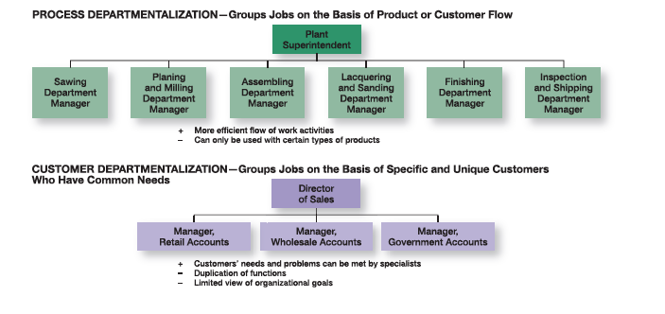
Exhibit 10-3 The Five Common Forms of Departmentalization (CONT.)
10 - 11

Slide 12
Departmentalization Trends
Increasing use of customer departmentalization
Cross-functional team – a work team composed of individuals from various functional specialties.
10 - 12
Notes:
One popular departmentalization trend is the increasing use of customer departmentalization. Because getting and keeping customers is essential for success, this approach works well because it emphasizes monitoring and responding to changes in customers’ needs.
Another popular trend is the use of teams, especially as work tasks have become more complex and diverse skills are needed to accomplish those tasks.
One specific type of team that more organizations are using is a cross-functional team, a work team composed of individuals from various functional specialties.

Slide 13
Chain of Command
– the continuous line of authority that extends from upper levels of an organization to the lowest levels of the organization—clarifies who reports to whom.
Chain of Command
10 - 13
Notes:
The chain of command is the line of authority extending from upper organizational levels to lower levels, which clarifies who reports to whom. Managers need to consider it when organizing work because it helps employees with questions such as “Who do I report to?” or “Who do I go to if I have a problem?” To understand the chain of command, you have to understand three other important concepts: authority, responsibility, and unity of command. Let’s look first at authority.

Slide 14
Authority
– the rights inherent in a managerial position to tell people what to do and to expect them to do it.
Acceptance theory of authority – the view that authority comes from the willingness of subordinates to accept it.
Authority
10 - 14
Notes:
Authority refers to the rights inherent in a managerial position to tell people what to do and to expect them to do it. Managers in the chain of command have authority to do their job of coordinating and overseeing the work of others. Authority can be delegated downward to lower-level managers, giving them certain rights while also prescribing certain limits within which to operate.
Chester Barnard, proposed another perspective on authority. This view, the acceptance theory of authority, says that authority comes from the willingness of subordinates to accept it. If an employee didn’t accept a manager’s order, there was no authority.

Slide 15
Authority (cont.)
Line authority – authority that entitles a manager to direct the work of an employee.
Staff authority – positions with some authority that have been created to support, assist, and advise those holding line authority.
10 - 15
Notes:
Line authority entitles a manager to direct the work of an employee. It is the employer–employee authority relationship that extends from the top of the organization to the lowest echelon, according to the chain of command, as shown in Exhibit 10-4. As a link in the chain of command, a manager with line authority has the right to direct the work of employees and to make certain decisions without consulting anyone.
As organizations get larger and more complex, line managers find that they do not have the time, expertise, or resources to get their jobs done effectively. In response, they create staff authority functions to support, assist, advise, and generally reduce some of their informational burdens. For instance, a hospital administrator who cannot effectively handle the purchasing of all the supplies the hospital needs creates a purchasing department, which is a staff function.

Slide 16
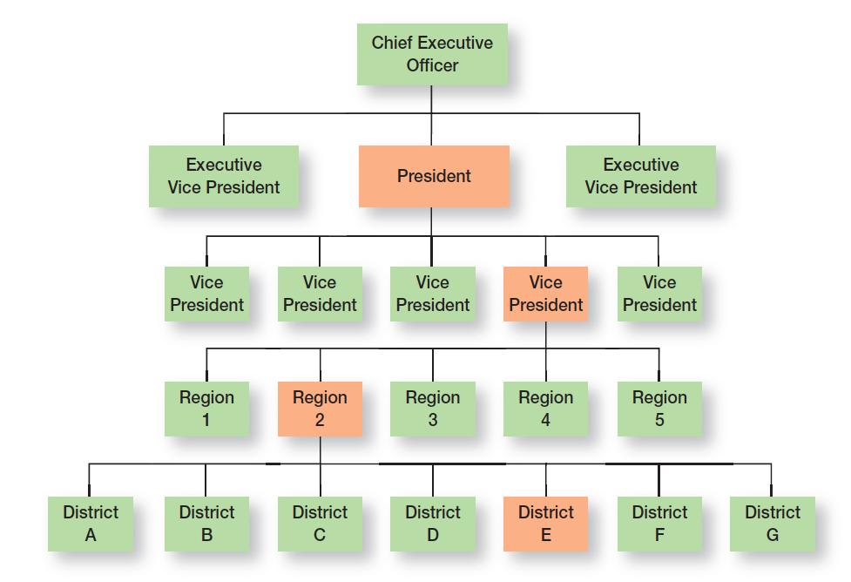
Exhibit 10-4 Chain of Command and Line Authority
10 - 16

Slide 17
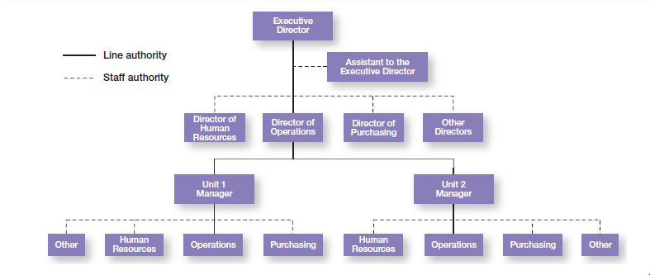
Exhibit 10-5 Line Versus Staff Authority
10 - 17

Slide 18
Responsibility and Unity of Command
Responsibility – the obligation or expectation to perform.
Unity of command – the management principle that each person should report to only one manager.
10 - 18
Notes:
When managers use their authority to assign work to employees, those employees take on an obligation to perform those assigned duties. This obligation or expectation to perform is known as responsibility. And employees should be held accountable for their performance! Assigning work authority without responsibility and accountability can create opportunities for abuse. Likewise, no one should be held responsible or accountable for work tasks over which he or she has no authority to complete.
Finally, the unity of command principle (one of Fayol’s 14 management principles) states that a person should report to only one manager. Without unity of command, conflicting demands from multiple bosses may create problems.

Slide 19
Span of Control
– the number of employees who can be effectively and efficiently supervised by a manager.
Span of control
10- 19
Notes:
How many employees can a manager efficiently and effectively manage? That’s what span of control is all about. The traditional view was that managers could not—and should not—directly supervise more than five or six subordinates. Determining the span of control is important because to a large degree, it determines the number of levels and managers in an organization—an important consideration in how efficient an organization will be. All other things being equal, the wider or larger the span, the more efficient the organization.
Assume two organizations both have approximately 4,100 employees. As Exhibit 10-6 shows, if one organization has a span of four and the other a span of eight, the organization with the wider span will have two fewer levels and approximately 800 fewer managers.

Slide 20
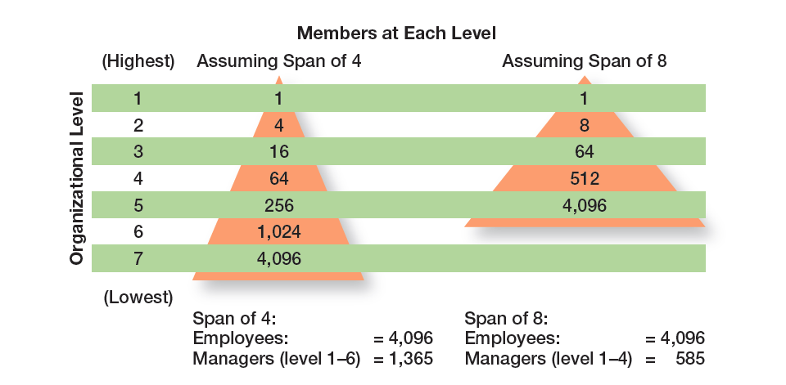
Exhibit 10-6 Contrasting Spans of Control
10 - 20

Slide 21
Centralization and Decentralization
Centralization – the degree to which decision-making is concentrated at the upper levels of the organization.
Decentralization – the degree to which lower-level employees provide input or actually make decisions.
Employee empowerment – giving employees more authority (power) to make decisions.
10 - 21
Notes:
“At what organizational level are decisions made?” Centralization is the degree to which decision-making takes place at the upper levels of the organization. If top managers make key decisions with little input from below, then the organization is more centralized. On the other hand, the more that lower-level employees provide input or actually make decisions, the more decentralization there is. Keep in mind that centralization-decentralization is not an either-or concept. The decision is relative, not absolute—that is, an organization is never completely centralized or decentralized.
As organizations have become more flexible and responsive to environmental trends, there’s been a distinct shift toward decentralized decision-making. This trend, also known as employee empowerment, gives employees more authority (power) to make decisions.

Slide 22
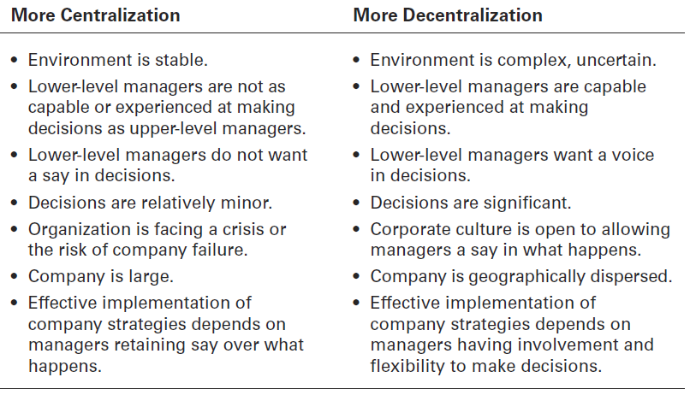
Exhibit 10-7 Centralization or Decentralization
10 - 22
Notes:
Exhibit 10-7 lists some of the factors that affect an organization’s use of centralization or decentralization.

Slide 23
Formalization
– the degree to which jobs within the organization are standardized and the extent to which employee behavior is guided by rules and procedures.
Highly formalized jobs offer little discretion over what is to be done.
Low formalization means fewer constraints on how employees do their work.
Formalization
10 - 23
Notes:
Formalization refers to how standardized an organization’s jobs are and the extent to which employee behavior is guided by rules and procedures. In highly formalized organizations, there are explicit job descriptions, numerous organizational rules, and clearly defined procedures covering work processes. Employees have little discretion over what’s done, when it’s done, and how it’s done. However, where formalization is low, employees have more discretion in how they do their work.

Slide 24
Mechanistic and Organic Structures
Mechanistic organization – an organizational design that’s rigid and tightly controlled.
Organic organization – an organizational design that’s highly adaptive and flexible.
10 - 24
Notes:
The mechanistic organization (or bureaucracy) was the natural result of combining the six elements of structure. Adhering to the chain-of-command principle ensured the existence of a formal hierarchy of authority, with each person controlled and supervised by one superior. Keeping the span of control small at increasingly higher levels in the organization created tall, impersonal structures. As the distance between the top and the bottom of the organization expanded, top management would increasingly impose rules and regulations. Because top managers couldn’t control lower-level activities through direct observation and ensure the use of standard practices, they substituted rules and regulations.
The organic organization is a highly adaptive form that is as loose and flexible as the mechanistic organization is rigid and stable. Rather than having standardized jobs and regulations, the organic organization’s loose structure allows it to change rapidly as required. It has division of labor, but the jobs people do are not standardized. Employees tend to be professionals who are technically proficient and trained to handle diverse problems. They need few formal rules and little direct supervision because their training has instilled in them standards of professional conduct.

Slide 25
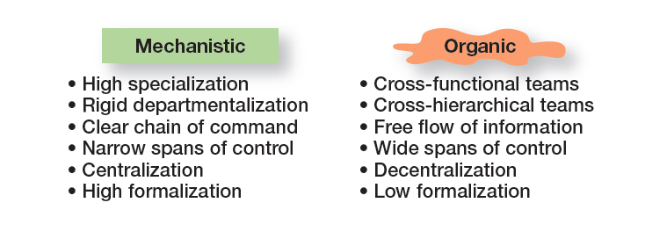
Exhibit 10-8 Mechanistic Versus Organic Organizations
10 - 25
Notes:
Basic organizational design revolves around two organizational forms, described in Exhibit 10-8.

Slide 26
Contingency Factors Affecting Structural Choice
and Structure
Changes in corporate strategy should lead to changes in an organization’s structure that support the strategy.
Certain structural designs work best with different organizational strategies.
The organic structure works well for organizations pursuing meaningful and unique innovations.
The mechanistic organization works best for companies wanting to tightly control costs.
Strategy
10 - 26
Notes:
An organization’s structure should facilitate goal achievement. Because goals are an important part of the organization’s strategies, it’s only logical that strategy and structure are closely linked.
Research has shown that certain structural designs work best with different organizational strategies. For instance, the flexibility and free-flowing information of the organic structure works well when an organization is pursuing meaningful and unique innovations. The mechanistic organization with its efficiency, stability, and tight controls works best for companies wanting to tightly control costs.

Slide 27
Contingency Factors (cont.)
Size and Structure – as an organization grows larger, its structure tends to change from organic to mechanistic with increased specialization, departmentalization, centralization, and rules/regulations.
10 - 27
Notes:
There’s considerable evidence that an organization’s size affects its structure. Large organizations—typically considered to be those with more than 2,000 employees— tend to have more specialization, departmentalization, centralization, and rules and regulations than do small organizations. However, once an organization grows past a certain size, size has less influence on structure. Why? Essentially, once there are around 2,000 employees, it’s already fairly mechanistic. Adding another 500 employees won’t impact the structure much. On the other hand, adding 500 employees to an organization with only 300 employees is likely to make it more mechanistic.

Slide 28
Contingency Factors (cont.)
and Structure
Organizations adapt their structures to their technology.
Woodward’s classification of firms based on the complexity of the technology employed:
Unit production of single units or small batches.
Mass production of large batches of output.
Process production in continuous process of outputs.
Technology
10 - 28
Notes:
Every organization uses some form of technology to convert its inputs into outputs. The initial research on technology’s effect on structure can be traced to Joan Woodward, who studied small manufacturing firms in southern England to determine the extent to which structural design elements were related to organizational success. She couldn’t find any consistent pattern until she divided the firms into three distinct technologies that had increasing levels of complexity and sophistication. The first category, unit production, described the production of items in units or small batches. The second category, mass production, described large batch manufacturing. Finally, the third and most technically complex group, process production, included continuous-process production. A summary of her findings is shown in Exhibit 10-9.

Slide 29
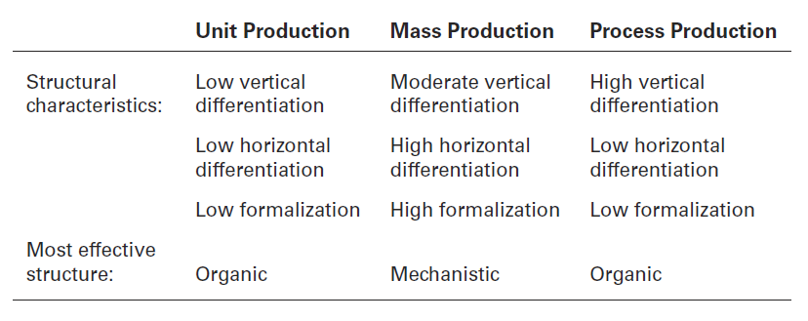
Exhibit 10-9 Woodward’s Findings on Technology and Structure
10 - 29

Slide 30
Contingency Factors (cont.)
Uncertainty and Structure
Mechanistic organizational structures tend to be most effective in stable and simple environments.
The flexibility of organic organizational structures is better suited for dynamic and complex environments.
Environmental
10 - 30
Notes:
Some organizations face stable and simple environments with little uncertainty; others face dynamic and complex environments with a lot of uncertainty. Managers try to minimize environmental uncertainty by adjusting the organization’s structure. The evidence on the environment-structure relationship helps explain why so many managers today are restructuring their organizations to be lean, fast, and flexible. Worldwide economic downturns, global competition, accelerated product innovation by competitors, and increased demands from customers for high quality and faster deliveries are examples of dynamic environmental forces. Mechanistic organizations are not equipped to respond to rapid environmental change and environmental uncertainty. As a result, we’re seeing organizations become more organic.

Slide 31
Traditional Organizational Designs
Simple structure – an organizational design with low departmentalization, wide spans of control, centralized authority, and little formalization.
Functional structure – an organizational design that groups together similar or related occupational specialties.
Divisional structure – an organizational structure made up of separate, semiautonomous units or divisions.
10 - 31
Notes:
Most companies start as entrepreneurial ventures using a simple structure, an organizational design with low departmentalization, wide spans of control, authority centralized in a single person, and little formalization. As employees are added, however, most don’t remain as simple structures. The structure tends to become more specialized and formalized.
A functional structure is an organizational design that groups similar or related occupational specialties together. You can think of this structure as functional departmentalization applied to the entire organization.
The divisional structure is an organizational structure made up of separate business units or divisions. n this structure, each division has limited autonomy, with a division manager who has authority over his or her unit and is responsible for as an external overseer to coordinate and control the various divisions, and often provides support services such as financial and legal.

Slide 32
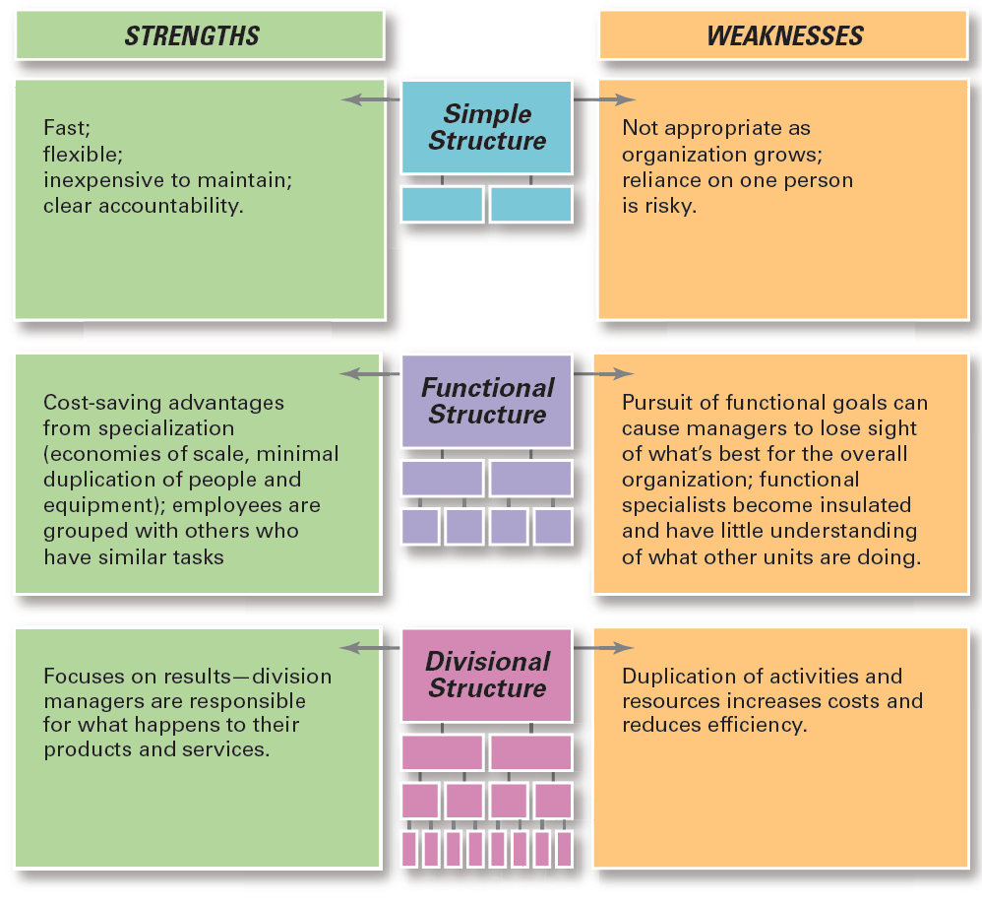
Exhibit 10-10 Traditional Organizational Designs
10 - 32
Notes:
When designing a structure, managers may choose one of the traditional organizational designs. These structures tend to be more mechanistic in nature. A summary of the strengths and weaknesses of each can be found in Exhibit 10-10.

Slide 33
Review Learning objective 10.1
Describe six key elements in organizational design.
The key elements in organizational design are:
Work specialization
Chain of command
Span of control
Departmentalization
Centralization-decentralization
Formalization
10 - 33
Notes:
The key elements in organizational design are work specialization, chain of command, span of control, departmentalization, centralization-decentralization, and formalization. Traditionally, work specialization was viewed as a way to divide work activities into separate job tasks. Today’s view is that it is an important organizing mechanism but it can lead to problems. The chain of command and its companion concepts—authority, responsibility, and unity of command—were viewed as important ways of maintaining control in organizations. The contemporary view is that they are less relevant in today’s organizations. The traditional view of span of control was that managers should directly supervise no more than five to six individuals. The contemporary view is that the span of control depends on the skills and abilities of the manager and the employees and on the characteristics of the situation.
The various forms of departmentalization are as follows: Functional groups – jobs by functions performed; product groups – jobs by product lines; geographical groups – jobs by geographical region; process groups – jobs on product or customer flow; and customer groups – jobs on specific and unique customer groups.
Authority refers to the rights inherent in a managerial position to tell people what to do and to expect them to do it. The acceptance view of authority says that authority comes from the willingness of subordinates to accept it. Line authority entitles a manager to direct the work of an employee. Staff authority refers to functions that support, assist, advise, and generally reduce some of managers’ informational burdens. Responsibility is the obligation or expectation to perform assigned duties. Unity of command states that a person should report to only one manager. Centralization-decentralization is a structural decision about who makes decisions—upper-level managers or lower-level employees. Formalization concerns the organization’s use of standardization and strict rules to provide consistency and control.

Slide 34
Review Learning objective 10.2
Contrast mechanistic and organic structures.
Mechanistic organization – a rigid and tightly controlled structure.
Organic organization – highly adaptive and flexible.
10 - 34
Notes:
A mechanistic organization is a rigid and tightly controlled structure. An organic organization is highly adaptive and flexible.

Slide 35
Review Learning Objective 10.3
Discuss the contingency factors that favor either the mechanistic model or the organic model of organizational design.
Structural decisions are influenced by:
Overall strategy of the organization
Size of the organization
Technology use employed by the organization
Degree of environmental uncertainty
10 - 35
Notes:
An organization’s structure should support the strategy. If the strategy changes, the structure should also change. An organization’s size can affect its structure up to a certain point. Once an organization reaches a certain size (usually around 2,000 employees), it’s fairly mechanistic. An organization’s technology can affect its structure. An organic structure is most effective with unit production and process production technology. A mechanistic structure is most effective with mass production technology. The more uncertain an organization’s environment, the more it needs the flexibility of an organic design.

Slide 36
Review Learning objective 10.4
Describe traditional organizational designs.
Simple structure – low departmentalization, wide spans of control, authority centralized in a single person, and little formalization.
Functional structure – groups similar or related occupational specialties together.
Divisional structure – made up of separate business units or divisions.
10 - 36
Notes:
A simple structure is one with low departmentalization, wide spans of control, authority centralized in a single person, and little formalization. A functional structure groups similar or related occupational specialties together. A divisional structure is made up of separate business units or divisions.

