Slide 1
Chapter 5 – The Performance of Feedback Control Systems
The ability to adjust the transient and steady-state response of a feedback control system is a beneficial outcome of the design of control systems.
One of the first steps in the design process is to specify the measures of performance.
In this chapter we introduce the common time-domain specifications such as percent overshoot, settling time, time to peak, time to rise, and steady-state tracking error.
We will use selected input signals such as the step and ramp to test the response of the control system.
The correlation between the system performance and the location of the system transfer function poles and zeros in the s-plane is discussed.
We will develop valuable relationships between the performance specifications and the natural frequency and damping ratio for second-order systems.
Relying on the notion of dominant poles, we can extrapolate the ideas associated with second-order systems to those of higher order.

Slide 2
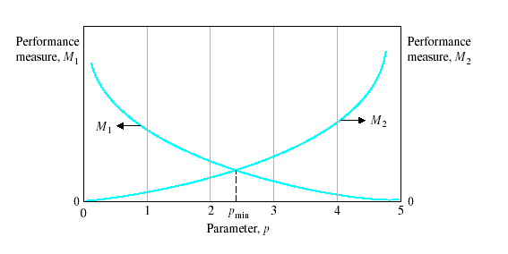
Introduction
Steady-State: exists a long time following any input signal initiation
Transient Response: disappears with time
Design Specifications: normally include several time-response indices for a specified input command as well as a desired steady-state accuracy.
Specifications are seldom a rigid set of requirements, but rather a first attempt at listing a desired performance
The effective compromise and adjustment of specifications are graphically illustrated in Figure

Slide 3
Test Input Signals
The time-domain performance specifications are important indices because control systems are inherently time-domain systems
The system transient or time performance is the response of prime interest for control systems
It is necessary to determine initially whether the system is stable.
If the system is stable, the response to a specific input signal will provide several measures of the performance
However, because the actual input signal of the system is usually unknown, a standard test input signal is normally chosen.
This approach is quite useful because there is a reasonable correlation between the response of a system to a standard test input and the system's ability to perform under normal operating conditions.
Using a standard input allows the designer to compare several competing designs.

Slide 4
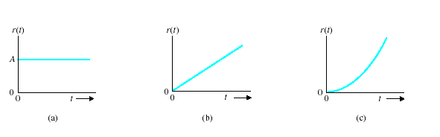
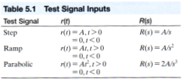


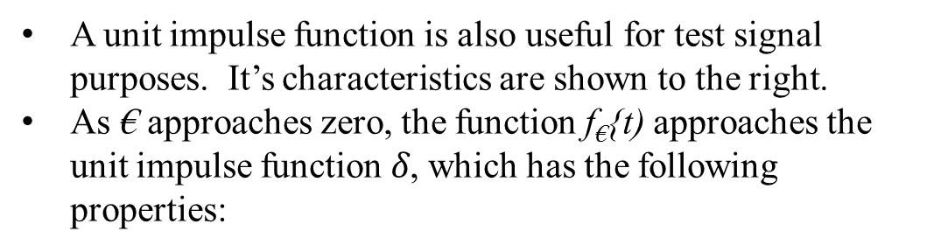
Test Input Signals
A unit impulse function is also useful for test signal purposes. It’s characteristics are shown to the right.
As € approaches zero, the function f€{t) approaches the unit impulse function $δ$, which has the following properties:

Slide 5
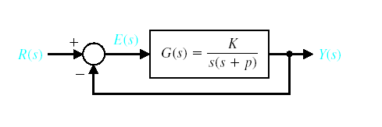
Performance of a Second-Order System
ζ is the damping ratio

Slide 6
Some Relevant Laplace transform Pairs [See Table 2.3 for details]

Slide 7
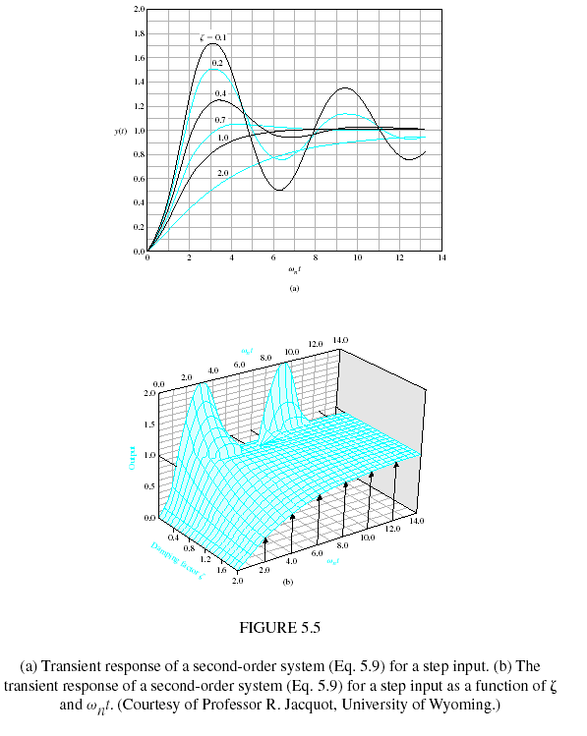
Performance of a Second-Order System

Slide 8
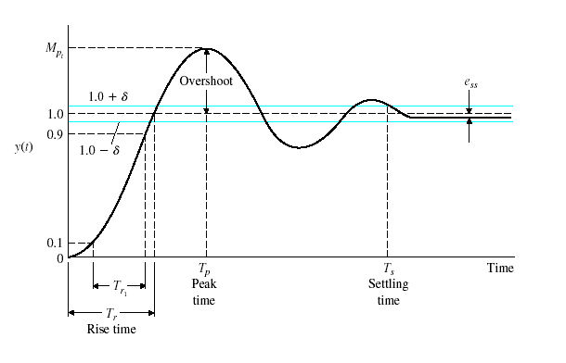

Performance of a Second-Order System
Rise Time, T_{r}
Peak Time, T_{o}
Percentage Overshoot, P.O.
Settling Time, T_{s}
Normalized Rise Time T_{r1}

Slide 9
Performance of a Second-Order System
Standard performance measures are usually defined in terms of the step response of a system.
The transient response of a system may be described using two factors, the swiftness and the closeness of the response to the desired response.
The swiftness of the response is measured by the rise time (T_{r}) and the peak time (T_{p}).
Underdamped systems: 0-100% rise time is used
Overdamped systems: 10-90% rise time is used
In overdamped scenario, T_{p} is not normally measured

Slide 10
Example
We seek to determine the time T_{s} for which the response remains within 2% of the final value.
Hence, we will define the settling time as four time constants of the dominant roots of the characteristic equation
The transient response of the system may be described in terms of two factors:
The swiftness of response, as represented by the rise time and the peak time.
The closeness of the response to the desired response, as represented by the overshoot and settling time.

Slide 11

To obtain an explicit relation for M_{pt} and T_{p} as a function of ζ, one can differentiate the transient output [ ] as obtained by the Laplace transform table and set it equal to zero.
Alternatively, one can utilize the differentiation property of the Laplace transform, which may be written as:
Taking the inverse transform of the right side of Equation, we obtain Equation, which is equal to zero when

Slide 12
Performance of a Second-Order System

Slide 13
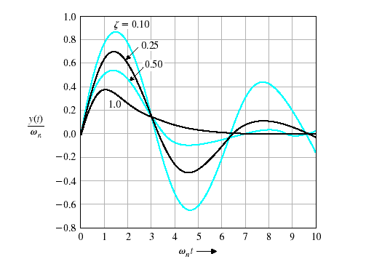

Performance of a Second-Order System

Slide 14
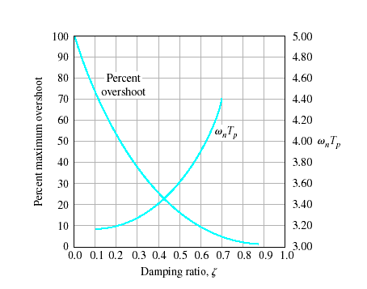

Performance of a Second-Order System
Naturally these two performance measures are in opposition and a compromise must be made.

Slide 15
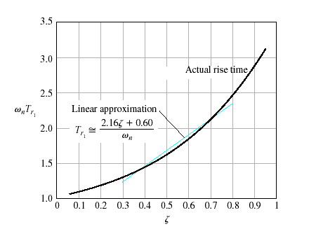

Performance of a Second-Order System

Slide 16
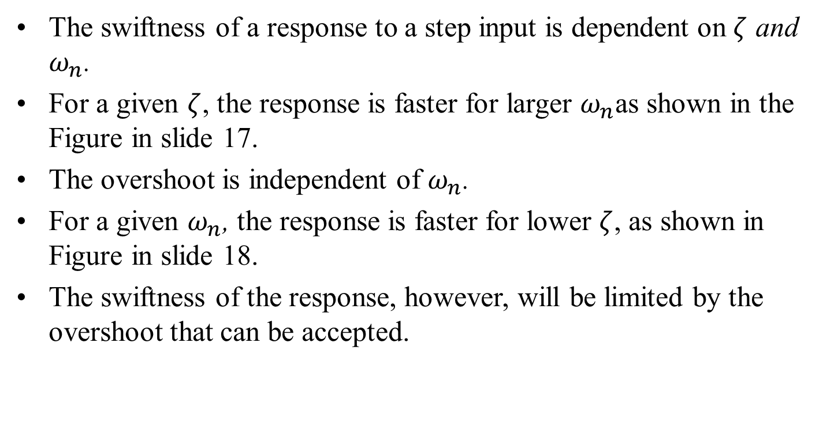
Performance of a Second-Order System
The swiftness of a response to a step input is dependent on $ζ$ and $ω_{n}$.
For a given $ζ$, the response is faster for larger $ω_{n}$as shown in the Figure in slide 17.
The overshoot is independent of $ω_{n}$.
For a given $ω_{n}$, the response is faster for lower $ζ$, as shown in Figure in slide 18.
The swiftness of the response, however, will be limited by the overshoot that can be accepted.

Slide 17
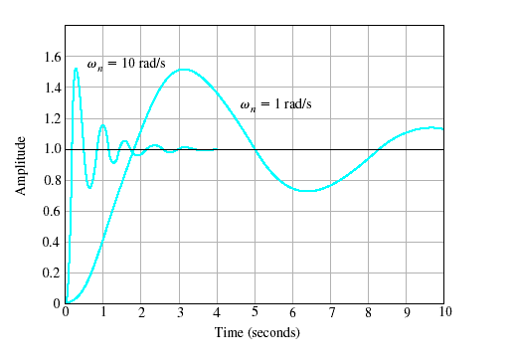

Performance of a Second-Order System

Slide 18
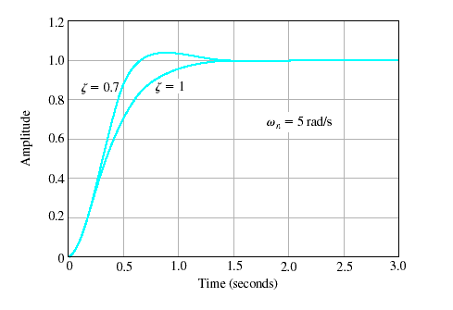

Performance of a Second-Order System

Slide 19
Effects of a Third Pole and Zero on the Second-Order System
The curves presented in Figure in slide 14 are exact only for the second-order system
However, they provide a remarkably good source of data because many systems possess a dominant pair of roots, and the step response can be estimated by utilizing the figure.
This approach, although an approximation, avoids the evaluation of the inverse Laplace transformation in order to determine the percent overshoot and other performance measures.
For Example, for a third-order system with a closed-loop transfer function

Slide 20
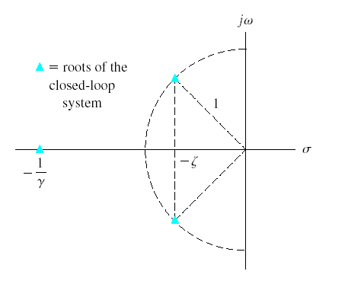

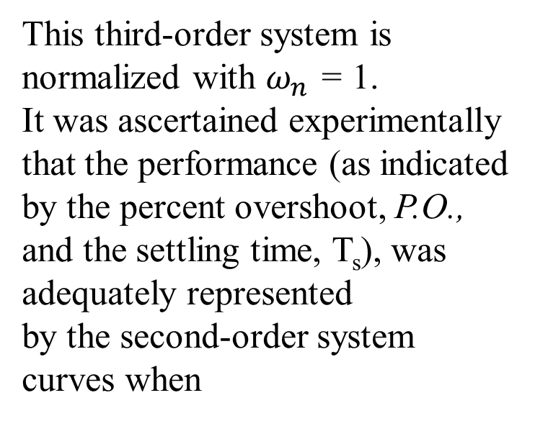
Effects of a Third Pole and Zero on the Second-Order System
This third-order system is normalized with $ω_{n}$ = 1.
It was ascertained experimentally that the performance (as indicated
by the percent overshoot, P.O., and the settling time, T_{s}), was adequately represented
by the second-order system curves when
In other words, the response of a third-order system can be approximated by the dominant roots of the second-order system as long as the real part of the dominant roots is less than one tenth of the real part of the third root

Slide 21
The performance measures of Figure in slide 14 are correct only for a transfer function without finite zeros. If the transfer function of a system possesses finite zeros and they are located relatively near the dominant complex poles, then the zeros will materially affect the transient response of the system

Slide 22
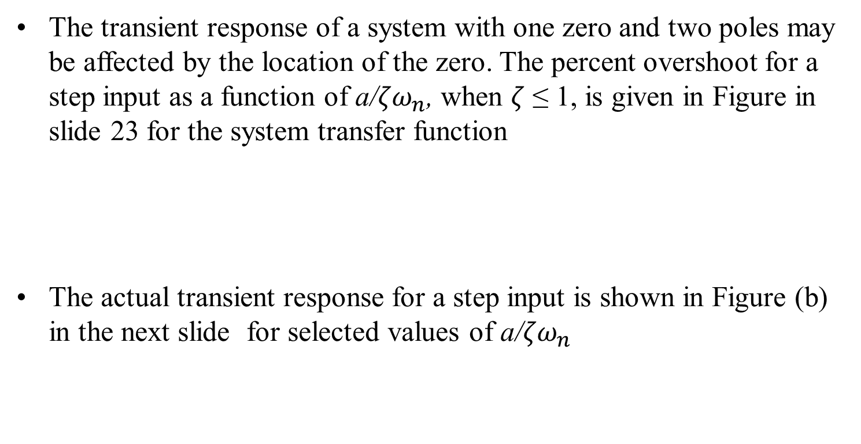
Effects of a Third Pole and Zero on the Second-Order System
The transient response of a system with one zero and two poles may be affected by the location of the zero. The percent overshoot for a step input as a function of a/${ζω}_{n}$, when $ζ$ ≤ 1, is given in Figure in slide 23 for the system transfer function
The actual transient response for a step input is shown in Figure (b) in the next slide for selected values of a/${ζω}_{n}$

Slide 23
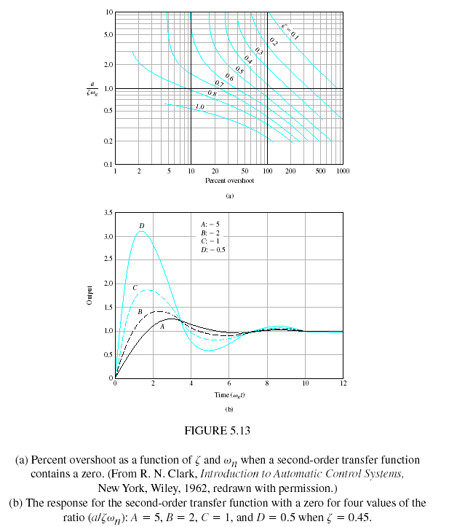
Effects of a Third Pole and Zero on the Second-Order System

Slide 24
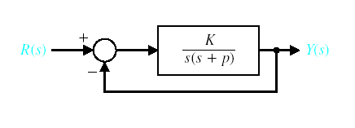
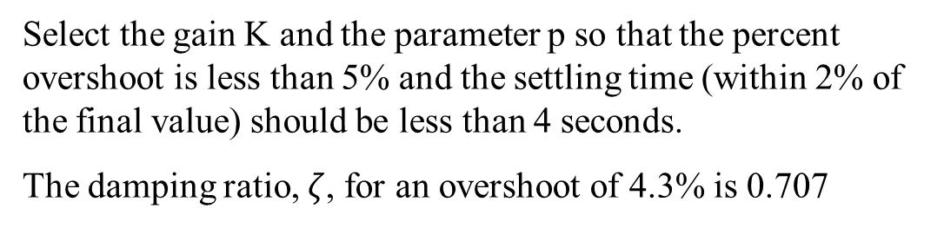
Effects of a Third Pole and Zero on the Second-Order System
Example 5.1 - Parameter Selection
Select the gain K and the parameter p so that the percent overshoot is less than 5% and the settling time (within 2% of the final value) should be less than 4 seconds.
The damping ratio, $ζ$, for an overshoot of 4.3% is 0.707

Slide 25
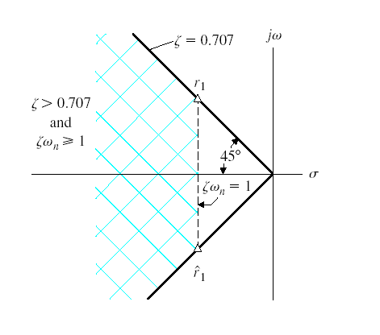
Effects of a Third Pole and Zero on the Second-Order System
Example 5.1 - Parameter Selection

Slide 26
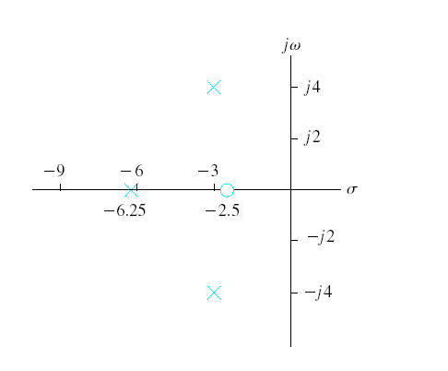
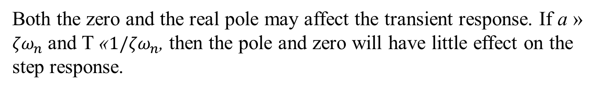
Effects of a Third Pole and Zero on the Second-Order System
Example 5.2 – Dominant Poles of T(s)
Consider a system with a closed-loop transfer function
Both the zero and the real pole may affect the transient response. If a » ${ζω}_{n}$ and T «${1/ζω}_{n}$, then the pole and zero will have little effect on the step response.

Slide 27
Effects of a Third Pole and Zero on the Second-Order System
Example 5.2 – Dominant Poles of T(s)
Slide 23

Slide 28
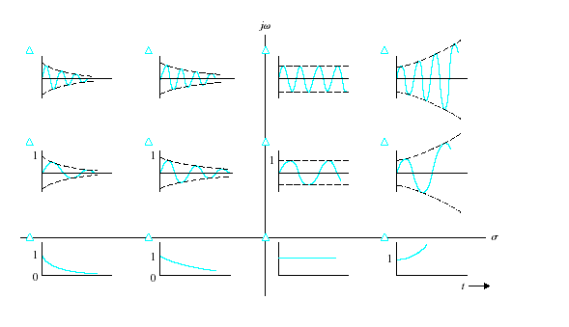

The s-Plane Root Location and The Transient Response

Slide 29
Steady-State Error of Feedback Control Systems
For
Step Input - Position Error Constant
Ramp Input - Velocity Error Constant
Acceleration Input - Acceleration Error Constant

Slide 30
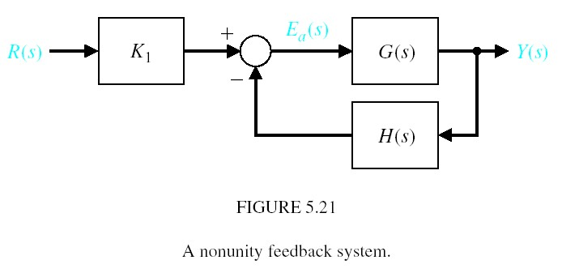
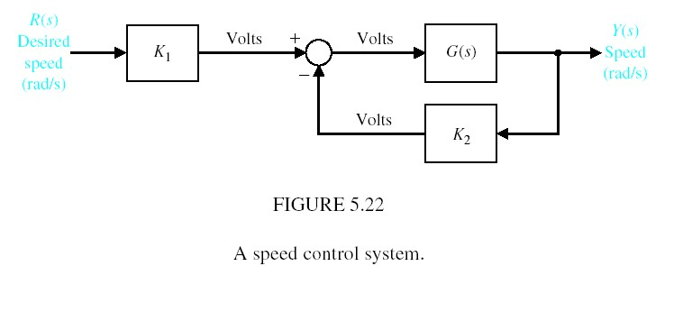
The Steady-State Error of Nonunity Feedback Systems
For a system in which the feedback is not unity (Fig 5.21), the units of the output are usually different from the output of the sensor. In Fig. 5.22, K1 and K2 convert from rad/s to volts.

Slide 31
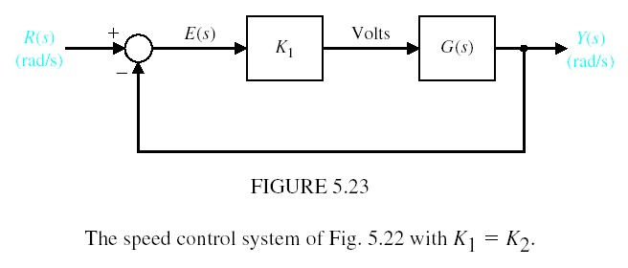
The Steady-State Error of Unity Feedback Systems

Slide 32
The loop transfer function is written in general form as
where π. denotes the product of the factors and z_{i} != 0, p_{k} # 0 for any 1 < i < M and i < k < Q. Therefore, the loop transfer function as s approaches zero depends on the number of integrations, N. If N is greater than zero, then lim Gc(s)G(s) approaches infinity, and the steady-state error approaches zero. The number of integrations is often indicated by labeling a system with a type number that simply is
equal to N.

Slide 34
Performance Indices
A performance index is a quantitative measure of the performance of a system and is chosen so that emphasis is given to the important system specifications.
A system is considered an optimum control system when the system parameters are adjusted so that the index reaches an extremum value, commonly a minimum value.

Slide 35
Performance Indices
There are several performance indices:
Integral of the square of the error, ISE
Integral of the absolute magnitude of the error, IAE
Integral of time multiplied by absolute error, ITAE
Integral of time multiplied by the squared error, ITSE

Slide 36
Optional Slides

Slide 37
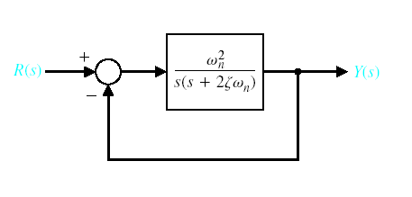

System Performance Using MATLAB and Simulink

Slide 38
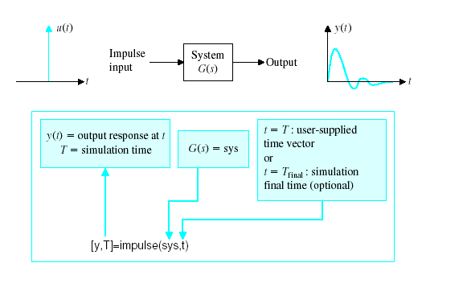

System Performance Using MATLAB and Simulink

Slide 39
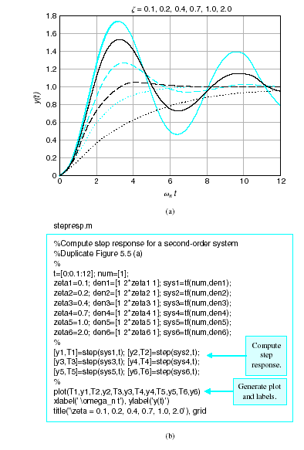

System Performance Using MATLAB and Simulink

Slide 40
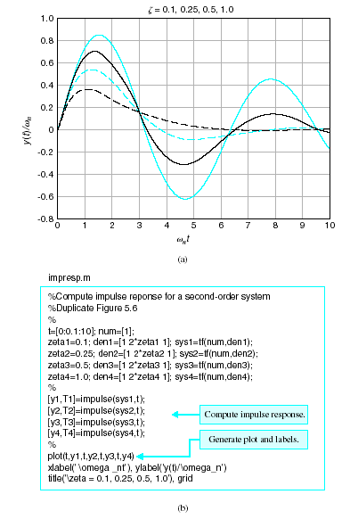

System Performance Using MATLAB and Simulink

Slide 41
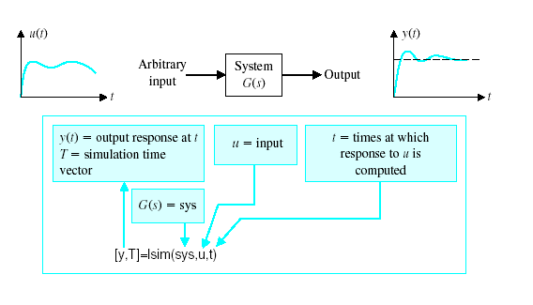

System Performance Using MATLAB and Simulink

Slide 42
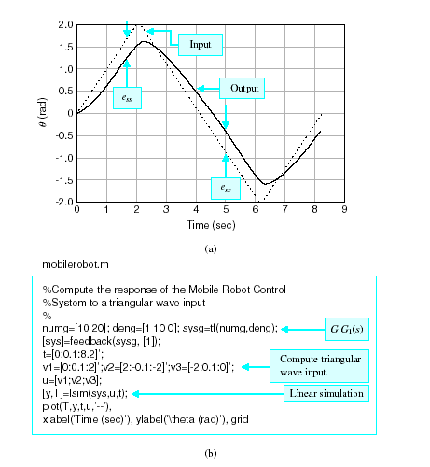

System Performance Using MATLAB and Simulink

Slide 43
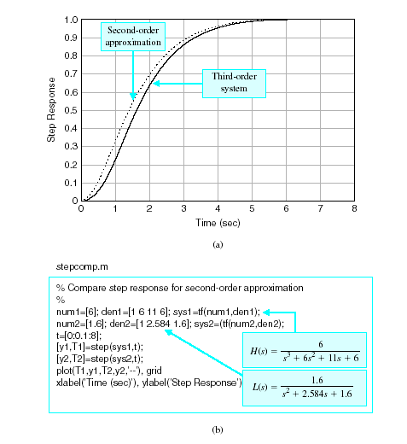

System Performance Using MATLAB and Simulink

Slide 44
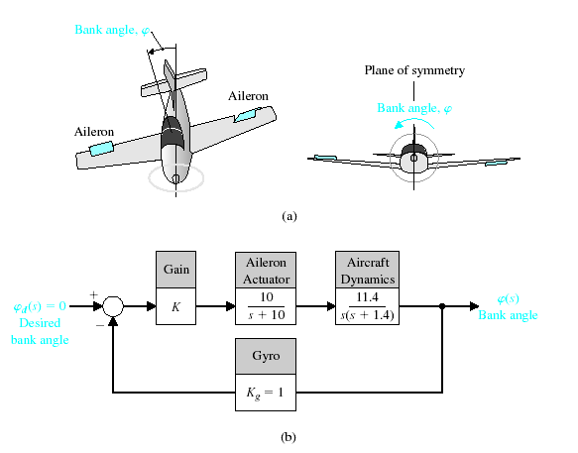
System Performance Using MATLAB and Simulink

Slide 45
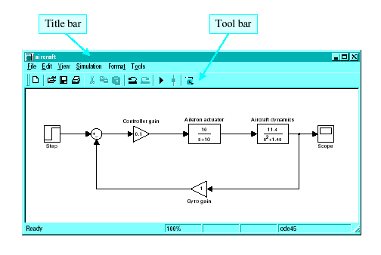
System Performance Using MATLAB and Simulink

Slide 46
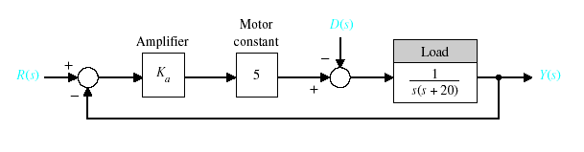
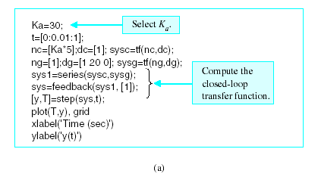
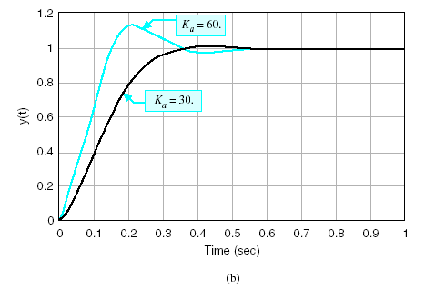

System Performance Using MATLAB and Simulink

Slide 47
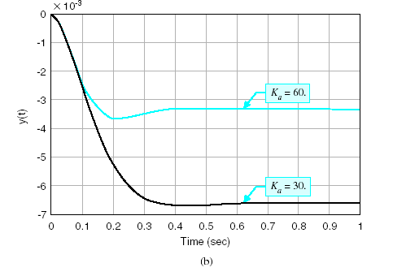
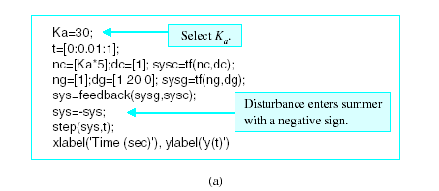

System Performance Using MATLAB and Simulink

