Slide 1


Consistency when executing operations concurrently & under failures
CSP-2025
IPADS, Shanghai Jiao Tong University
https://www.sjtu.edu.cn

Slide 2
The topics of today’s lecture
What is consistency model & why we need it
The eventual consistency model
Implementing eventual consistency w/ various timestamps
  Non-trivial when considering user experience.
4. The drawback of eventual consistency & strong consistency models (strict, linearizability, etc.)
5. Consistency under failure & the requirement of atomicity

Slide 3

Motivation case: ChatAPP

Slide 4




Root cause: data mismatches caused by operations order mismatches
Alice
Post (xxx 文件）
Post (是这个文件吗（ref xxx））
Data: the rendered chat history
Operations:
  Post: add an item to the history
  Read: read the history and render it on a device

Slide 5


Root cause: data mismatches caused by operations
Alice
Post (xxx 文件）
Post (是这个文件吗（ref xxx））
Bob
Post (是这个文件吗（ref xxx））
Read (xxx）
Post (xxx 文件）

Slide 6
Question: how does order mismatch happens?
Depends on how the ChatAPP is implemented

Slide 7
Implementing a ChatAPP: a centralized approach
Use a centralized server to coordinate the chats (The most simple one!)
  Data structure: a list of items, each item can be a file or a sentence
Centralized
Chat server
  [ file_a, “是这个文件吗”, … ]

Slide 8
Implementing a ChatAPP: a (naïve) centralized approach
System model: use a centralized server to coordinate the chats
  Data structure: a list of sentences (or files)
  Operations: post(msg/file), read(聊天记录/文件) via RPC
Post (xxx 文件）
Post (是这个文件吗（ref xxx））
Post: append to the tail
Centralized
Chat server
[file ]
  [ file, “是这个文件吗”, …]
Read (聊天记录）

Slide 9
Question: can centralized approach reorder operations?
No, as long as we have a single server, and each users strictly use server’s response as the completion of the requests
Post (xxx 文件）
Post (是这个文件吗（ref xxx））
Centralized
Chat server
[file ]
  [ file, “是这个文件吗”, …]
Read (聊天记录）

Slide 10
But, what are the cost of not exposing reordered ops?
In practice, we rarely see ChatAPP adopts this implementation
Issues #1: Long response time, must wait for the server acks for each request
Post (xxx 文件）
Post (是这个文件吗（ref xxx））
Response
Centralized
Chat server
[file ]
  [ file, “是这个文件吗”, …]
Read (聊天记录）

Slide 11
But, what are the cost of not exposing reordered ops?
In practice, we rarely see ChatAPP adopts this implementation
Issues #2: Slow upon reads, especially when the history is long
Post (xxx 文件）
Post (是这个文件吗（ref xxx））
Centralized
Chat server
[file ]
  [ file, “是这个文件吗”, …]
  [ file_a, “是这个文件吗”, …]
Read (聊天记录）

Slide 12

But, what are the cost of not exposing reordered ops?
In practice, we rarely see ChatAPP adopts this implementation
Issues #3: Cannot work with offline
Post (xxx 文件）
Post (是这个文件吗（ref xxx））
Centralized
Chat server
[file ]
  [ file, “是这个文件吗”, …]

Slide 13
But, what are the cost of not exposing reordered ops?
In practice, we rarely see ChatAPP adopts this implementation
Issues #4: Cannot deal with server failures
Post (xxx 文件）
Post (是这个文件吗（ref xxx））
Centralized
Chat server
[file ]
  [ file, “是这个文件吗”, …]

Slide 14
Existing systems (like WeChat) replicates the data
Stores a chat on every participants (Replicated list)
  I.e., users, devices of a user, and the server
The list is replicated to enhance reliability + support offline operations
[ ]
[ ]
…
[ ]
[ ]

Slide 15
Question: how to implement read in this system?
Most efficient: read the local copy
  Pros: can work with offline
  Cons: may miss the most up-to-date data
Read(） // can work with offline
[ ]
[ ]
…
[ ]
[ ]

Slide 16

Question: how to implement read in this system?
A common solution: read the local copy + periodically sync
  e.g., periodically heartbeat, e.g., per 10 seconds
  Or via service provider, e.g., Apple Push Notification service; batch multiple sync together
Read(）
Sync()
Read(）
[ ]
[ ]
[“你好”， ]
[ ]
[ “你好”， ]
[ “你好”， ]
…
[ ]
After some interactions
Talked later
[“你好”， ]
[“你好”， ]
[ ]
[ “你好”， ]
[ “你好”， ]

Slide 17
Sync in a system with replicated data
Challenges
  How many servers to sync?
  Sync what? Operations or the data?

Slide 18
Sync in a system with replicated data
Common approach: sync with only a few servers
  Using operations instead of the data, because we cannot determine which data to choose
Read(）
Read(）w/ sync
[ ]
[ ]
[“你好”，“谢谢”]
[ ]
[ “你好”， ]
[ “你好”， ]
…
[ ]
After some interactions
Talked later
[“谢谢”， ]
[“你好”， ]
[ ]
[ “你好”， ]
[ “你好”， ]

Slide 19
Question: how to implement post in this system?
Most efficient: only update the local data
  Problem: how to synchronize data across replicated data?
Post(你好）
[ ]
[“你好”， ]
[ ]
[ ]
…
The data becomes inconsistent!
[ ]
[ ]
[ ]
[ ]

Slide 20
Post(Write) in a system with replicated data
Data synchronization problem: how many data replica do we need sync
  Approach#1: sync with all the servers
Issue: no availability & the performance is slow
Post(你好）
[ ]
[“你好”， ]
[“你好”， ]
[ ]
[ ]
[ “你好”， ]
…
[ ]
[ ]
[“你好”， ]
[ ]
[ ]
[ “你好”， ]

Slide 21
Post(Write) in a system with replicated data
Data synchronization problem: how many data replica do we need sync
Common approach (like sync)
  Contact a few servers, reply if some acknowledged the post
Post(你好）
[ ]
[ ]
[”你好”， ]
[ ]
[ “你好”， ]
…
[ ]
[ ]
[ ]
[ ]

Slide 22
Question: can replicated approach reorder operations?
Alice
Post (xxx 文件）
Post (是这个文件吗（ref xxx））
Bob
Post (是这个文件吗（ref xxx））
Read (xxx）
Post (xxx 文件）

Slide 23
Question: can replicated approach reorder operations?
Post(xxx 文件）
Post(是这个文件吗（ref xxx） ）
[ file， ]
[ file，”是…” ]
[ ]
[ ]
[ file， ]
…
[”是…” ]
[ ]
[ ]
[”是…” ]
Sync()
23

Slide 24
Since reordering can happen in practice, we need a model to describe what can and cannot happen
Application developers typically assume a centralized setups
  The simplest form
For the underlying system (e.g., the replicated list of items), it is desirable to provide a model on what can happen & what cannot happen
  The model is called consistency model
The developers can then develop methods to cope with reordering
  Or choose a model that prevents reordering happens, e.g., a centralized approach (or replication with a centralized abstraction)

Slide 25
Consistency model
Consistency model defines rules for the apparent order and
visibility of updates (by different observers) , and it is a continuum with tradeoffs.
        - Todd Lipcon
No Right or Wrong consistency models
  Tradeoffs between ease of programmability & performance
Consistency is hard in (distributed) systems
  Data replication (& caching)
  Concurrency (multi-core & multi-host)
  Failures (e.g., single-machine & multi-machines )

Slide 26
Spectrum of Consistency Models
Better performance/
Fault tolerance
Sequential
Strict
Eventual
Causal
Linearizability
Easy to use
Note that many other models exists

Slide 27
The question now becomes: what is the desired model of a system? And is it possible to implement?

Slide 28
Back to our example (ChatAPP)
What is the desired model of our replicated list?
Post(xxx 文件）
Post(是这个文件吗（ref xxx） ）
[ file， ]
[ file，”是…” ]
[ ]
[ ]
[ file， ]
…
[”是…” ]
[ ]
[ ]
[”是…” ]
Sync()
28
28

Slide 29
Goal #1: always on
If my phone is connected to the network, we should send the message!
Post(xxx 文件）
Post(是这个文件吗（ref xxx） ）
[ file， ]
[ file，”是…” ]
[ ]
[ ]
[ file， ]
…
[”是…” ]
[ ]
[ ]
[”是…” ]
Sync()
29
29
29

Slide 30
Goal #2: read consistency?
i.e., each read always represents the latest & same results at the point
Post(xxx 文件）
Post(是这个文件吗（ref xxx） ）
[ file， ]
[ file，”是…” ]
[ ]
[ ]
[ file， ]
…
[”是…” ]
[ ]
[ ]
[”是…” ]
Sync()
i.e., can we allow this happen?
30
30
30
30

Slide 31
Goal #2: read consistency?
1. Not possible (consider CAP in previous lectures); 2. ChatAPP can tolerate temporal inconsistency
Post(xxx 文件）
Post(是这个文件吗（ref xxx） ）
[ file， ]
[ file，”是…” ]
[ ]
[ ]
[ file， ]
…
[”是…” ]
[ ]
[ ]
[”是…” ]
Sync()
31
31
31
31

Slide 32
Goal #2: eventual data consistency
Eventually all the data becomes the same
What is the desired model of our system?
Post(xxx 文件）
Post(是这个文件吗（ref xxx） ）
[ file， ]
[ file，”是…” ]
[ file，”是…” ]
[ ]
[ file， ]
[ file，”是…” ]
[ ]
…
[”是…” ]
[ file，”是…” ]
[ ]
[ ]
[”是…” ]
[ file，”是…” ]
Sync()
32
32

Slide 33
Eventual consistency
A specific weak consistency model, informally:
  All servers eventually receive all writes, and servers holding the same set of writes will have the same data contents
  Thus, if no new updates are made to the data, eventually all accesses will return the last update value
No restrictions on read/write, can freely choose the solution for “always-on” experience!
  Read: return the latest local copies of the data
  Write: write locally (and directly returns), propagate the writes to all the servers in background (e.g., upon sync), which is the optimal

Slide 34
Implementing an eventually consistency system
A specific of weak consistency model, informally:
  All servers eventually receive all writes, and servers holding the same set of writes will have the same data contents
  Thus, if no new updates are made to the data, eventually all accesses will return the last update value
The servers periodically sync w/ each other

Slide 35
Syncing: exchange received posts so far
X
Y
Client
SRV1
SRV2
iPhone
Post X
Post Y
sync
X (pos=10)
Y (pos=10)
Y (pos=11)
Time
X (pos=11)
Will Server1 show X in front of Y, and Server2 show Y in front of X?
Challenge: how to decide the ordering?

Slide 36
Solution: deterministic sort all posts upon syncing
Syncing: ensure both nodes have the same updates in log
Ordered list of updates at each node
  Record the updates in a log, and sort it according to the same order
X
Y
Client
SRV1
SRV2
iPhone
Post x
Post Y
sync
Post X
Post Y
Post Y
Time
Post X
Log
Log
Notes:
不能直接apply；要delay
sync：保证大家的write都一样了；然后再apply
讲动画

Slide 37
Solution: deterministic sort all posts upon syncing
Syncing: ensure both nodes have the same updates in log
Ordered list of updates at each node
  Record the updates in a log, and sort it according to the same order
X
Y
Client
SRV1
SRV2
iPhone
Post X
Post Y
Sort
sync
Sort
Post X
Post X
Post Y
Time
Post Y
Log
Log
Notes:
不能直接apply；要delay
sync：保证大家的write都一样了；然后再apply
讲动画

Slide 38
Solution: deterministic sort all posts upon syncing
Syncing: ensure both nodes have the same updates in log
Ordered list of updates at each node
  Record the updates in a log, and sort it according to the same order
Re-apply sorted updates after the sync
X
Y
Client
SRV1
SRV2
iPhone
Post X
Post Y
sync
Post X
X
X
Post X
Post Y
Y
Time
Y
Post Y
Notes:
不能直接apply；要delay
sync：保证大家的write都一样了；然后再apply
讲动画

Slide 39
Issue#1: local updates break the sorted order
Upon receive posts, we need to update the local copy
  i.e., user needs to see their messages posted
But the local state to be applied by the log may be different on devices
X
Y
Client
SRV1
SRV2
iPhone
Post X
Post Y
Post X
Post X
X
Y
Post Y
Time
Post Y
Y
X
Log
Log
39

Slide 40
Solution: Rollback and Replay
Rollback all the updates before the sync
  Essentially clean the storage to an empty state
Re-run all update functions, starting from empty storage state
  After syncing, Srv1 and Srv2 have same set of updates (ordered logs)
  Srv1 and Srv2 arrive at same final state

Slide 41
Issue #2: how to sort the updates? Does the order matter?
Syncing: ensure both nodes have the same updates in log
Ordered list of updates at each node
  Record the updates in a log, and sort it according to the same order
X
Y
Client
SRV1
SRV2
iPhone
Post X
Post Y
Sort
sync
Sort
Post X
Post X
Post Y
Time
Post Y
Log
Log
Notes:
不能直接apply；要delay
sync：保证大家的write都一样了；然后再apply
讲动画

Slide 42
Some questions about the ordering
Can we use the time T as the sort key?
  e.g., getTimeOfDay() on the local device

Slide 43
No. We need a total order among operations
Sort key: <time T, node ID> （Break the tie of using T alone)
<10, Srv1>: message X at 10th or 11th position for chat#1
<20, Srv2>: message Y at 10th or 11th position for chat#1
X
Y
iPad
SRV1
SRV2
iPhone
Post X
Post Y
sync
<10, SRV1> Post X
X (pid=10)
X (pid=10)
<10, SRV1> Post X
<20, SRV2> Post Y
Y (pid=11)
Time
Y (pid=11)
<20, SRV2> Post Y
Log
Log
Notes:
对于stable和不stable的排序算法而言，都不work

Slide 44
Some questions about the ordering
Can we use the time T as the sort key? No.
Can we use <node ID, time T> as the sort key?
Can <time T, node ID> as the key prevents the following thing happen:
  List becomes: [ “请看文件 ref (file_a)”， fila_a]

Slide 45
Some questions about the ordering
Why do we need the “node ID” as the sort key?
Can we use <node ID, time T> as the sort key?
Can <time T, node ID> as the key prevents the following thing happen:
  List becomes: [ “请看文件 ref (file_a)”， fila_a]
If the goal is to support eventual consistency, the question is Yes. But for user experience, it is no.
  Why? Consider the question #3 listed above. The answer is Yes. Do you think it is an ideal result?

Slide 46
How inappropriate orders can happen upon sync
Time=11
Time=8
X
X
iPad
SRV1
SRV2
iPhone
Post (file_a)
Sees fila_a
sync
Fila_a <10, Srv1>
Note that we assume updates apply to local storage immediately
  So that we can see the latest results
  Inconsistency will be rollback and replay later

Slide 47
How inappropriate orders can happen upon sync
Time=12
Time=9
X
iPad
SRV1
SRV2
iPhone
Post (file_a)
Post(“请看文件 ref (file_a)”)
Fila_a <10, Srv1>
Srv2 re-run “post(file_a)”
Post(“请看文件 ref (file_a)”)

Slide 48
How inappropriate orders can happen upon sync
Time=13
Time=10
X
iPad
SRV1
SRV2
iPhone
Post (file_a)
Post(“请看文件 ref (file_a)”)
sync
Fila_a <10, Srv1>
post(file_a)
Post(“请看文件 ref (file_a)”)
Post(“请看文件 ref (file_a)”)
post(file_a)
Post(“请看文件 ref (file_a)”)
Sync again
post(file_a)

Slide 49
Why can such ordering happen? unsynchronized clock time
Goal: clock time reflect the (real wall clock time) update order
Will update order be consistent with wall-clock time?
  E.g., if I first post a message on iPhone, and later post a message on iPad, the iphone’s time will be smaller
However, the clock time between nodes is not synchronized
Srv1 went first in wall-clock time with <10, Srv1>
Srv2 could still generate update ID <9, Srv2>

Slide 50

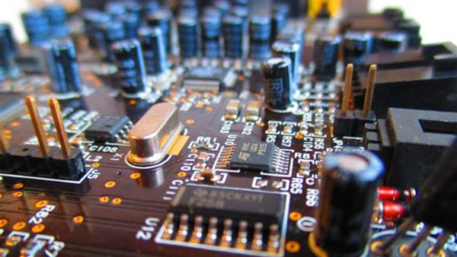
Timing: a key building block in distributed systems
How computer measure times?
  Computer has a reasonably-fixed-frequency oscillator
    E.g., quartz crystal
  Represent time interval as a count of oscillator's cycles
    time period = count / frequency
    e.g., with a 1MHz oscillator, 1000 cycles means 1msec

Slide 51
Time measuring & unsynchronized clocks
What happens when turn off the computer?
  "Real-Time Clock" (RTC) chip remains powered, with battery / capacitor
  Stores current calendar time, has an oscillator that increments periodically
Maintaining accurate time
  Accuracy: for calendar time, need to set the clock correctly at some point
  Precision: need to know oscillator frequency (drift due to age, temp, etc.)
However, the frequency is different across computing devices!

Slide 52
Order matters, and timing on a device alone is insufficient
Time=13
Time=10
X
iPad
SRV1
SRV2
iPhone
Post (file_a)
Post(“请看文件 ref (file_a)”)
sync
Fila_a <10, Srv1>
post(file_a)
Post(“请看文件 ref (file_a)”)
Post(“请看文件 ref (file_a)”)
post(file_a)
Post(“请看文件 ref (file_a)”)
Sync again
post(file_a)

Slide 53
Ideal order: causal ordering
Definition of causal relationship: X -> Y iff
  X,Y is created on the same node and X happens before Y (single-thread)
  X, Y created by node_{i} and node_{j}, and X “causes” Y
  Example
    X is add message, Y is the reference of this messages
  There exists Z, such that X -> Z -> Y

Slide 54
Causal ordering
<Time, ID> does not preserve the causal ordering
  Why? The lock on different nodes is unsynchronized
Goal
  Clock should reflect the causal order
Idea
  Sync clock using the events dependencies
  Why possible? Because we don’t sync w/ wall clock time (doesn’t exist)

Slide 55
Solution: Lamport clock & happen before
We need causality timestamp
Lamport clock: a logical clock used to assign timestamps to events at each node, with the following goal
  If event #1 and event #2 are created on the same node, and event #1 is before event #2 (is before = < if not else mentioned)
  → TS(event #1) < TS(event #2)
  If event #1 “cause” event #2,
  → TS(event #1) < TS(event #2)
How to model event #1 causes event #2? Receiving messages!

Slide 56
Lamport clock algorithms
Lamport logical clock
  Each server keeps a clock T
  Increments T as real time passes, e.g., one second per second (or upon events)
  Modify T = Max(T, T’+1)
  if sees T’ from another server
Srv1: Post X with <10, Srv1>, Suppose T₁ = 10
Srv2: Sees “add X”, then update T₂ = Max(T₂, 11)
Srv2: Refs. X with <11, Srv2>
Now, causality preserving!

Slide 57
Questions on Lamport clock
If TS(event #1) < TS(event #2), what does it say about event #1 (create on node #1) and event #2 (created on node #2)?
  Event #1 occurred at a physical time earlier than event #2
  Node #1 must have communicated with Node #2
  If event #1 has been synced to node #2, then event #1 must have occurred at a physical time earlier than event #2
Notes:
No
No
Yes

Slide 58
Put it all together: Lamport clock for eventual consistency
Time=11
Time=12
X
X
iPad
SRV1
SRV2
iPhone
Post (file_a)
Sees fila_a
sync
Fila_a <10,>
Srv2 re-run “post(file_a)”
Note that we assume updates apply to local storage immediately
  So that we can see the latest results
  Inconsistency will be rollback and replay later

Slide 59
Put it all together: Lamport clock for eventual consistency
Time=11
Time=12
X
X
iPad
SRV1
SRV2
iPhone
Post (file_a)
Sees fila_a
sync
Fila_a <10,>
Srv2 re-run “post(file_a)”
Note that we assume updates apply to local storage immediately
  So that we can see the latest results
  Inconsistency will be rollback and replay later

Slide 60
Put it all together: Lamport clock for eventual consistency
Time=12
Time=12
X
iPad
SRV1
SRV2
iPhone
Post (file_a)
Post(“请看文件 ref (file_a)”)
Fila_a <10,>
Srv2 re-run “post(file_a)”
Post(“请看文件 ref (file_a)”) <13,>

Slide 61
Put it all together: Lamport clock for eventual consistency
Time=13
Time=10
X
iPad
SRV1
SRV2
iPhone
Post (file_a)
Post(“请看文件 ref (file_a)”)
sync
Fila_a <10, >
Srv2 re-run “post(file_a)”
Post(“请看文件 ref (file_a)”)
Fila_a <10, >
Post(“请看文件 ref (file_a)”) ,<13>
Causality preserving

Slide 62
One more question on the Lamport clock
Can Lamport clock replace the <time T, node ID> as the timestamp for reordering to implement eventual consistency?
No, because there is no total order !
  i.e., given e1 & e2, T(e1) < T(e2) or T(e1) > T(e2)
Why total ordering is ideal?
  If replicas apply writes according to total ordering, then replicas converge
Quick fix: we can trivially break the tie by adding an additional order:
  E.g., <Logical time, node ID>
  The total ordering ensures eventual consistency, while lamport clock preserves the causality of operations

Slide 63
Quiz: can this happen?
Assuming using Lamport Clock to implement Eventual Consistency

Slide 64
Recap of today’s lecture
What is consistency model & why we need it
The eventual consistency model
Implementing eventual consistency w/ various timestamps
  Non-trivial if consider user experience
Question: is eventual consistency so far desirable for various application scenarios?

Slide 65

Motivating case: 接龙
#接龙
第一个街上的人有100奖金
Post_{A}
Read
Alice
A: #接龙
第一个街上的人有100奖金
  Which output is desired?
B: #接龙
第一个街上的人有100奖金
Bob
Post_{B}
Time

Slide 66
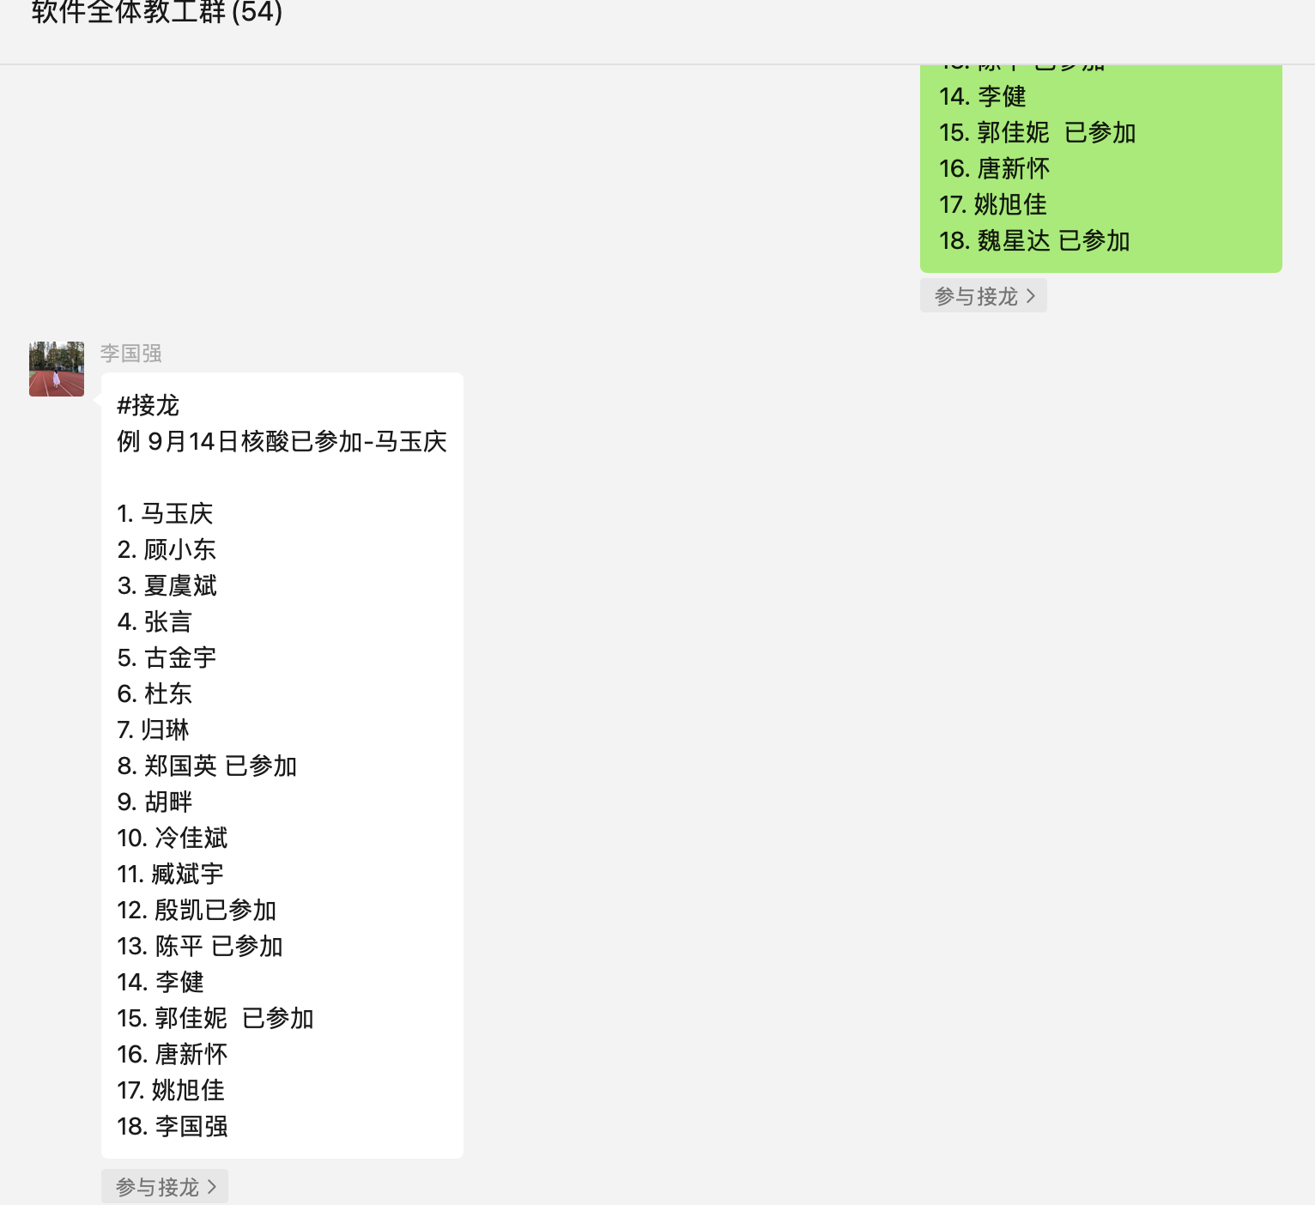
Question: can the following view happen?
#接龙
第一个街上的人有100奖金
#接龙
第一个街上的人有100奖金
A: #接龙
第一个街上的人有100奖金
B: #接龙
第一个街上的人有100奖金
Post_{A}
Read
Read
Alice
B: #接龙
第一个街上的人有100奖金
A: #接龙
第一个街上的人有100奖金
Bob
Post_{B}
Time

Slide 67
Problem: some applications require a strong ordering
And reading the temporal results that can be reordered is not desirable
  E.g., 接龙
Two solutions for our 接龙
  If we cannot determine the order of events, e.g., no casual relationship, let the application reorder them instead of directly order them
  We choose a consistency model that cannot expose reordered events

Slide 68
Motivating case: 接龙
#接龙
第一个街上的人有100奖金
Post_{A}
Read
Alice
A: #接龙
第一个街上的人有100奖金
Key problem: operations don’t have order, yet our Lamport clock gives them a total order
  Which output is desired?
B: #接龙
第一个街上的人有100奖金
Bob
Post_{B}
Time

Slide 69
Lamport clock gives a total order to events
For every pair of events, we can compare their time
  i.e., T(e1) < T(e2) or T(e1) > T(e2)
Problem: too strong
  The order may disagree with the external observer, especially for un-related events
  Sometimes we may need to identify unrelated events, e.g., in 接龙

Slide 70
Requirement: partial order
Consider two events e1 & e2, they may have
  T(e1) < T(e2)
  T(e2) < T(e1)
  Incomparable!
< means happen before
#接龙
第一个街上的人有100奖金
Post_{A}
Read
Alice
A: #接龙
第一个街上的人有100奖金
Key problem: operations don’t have order, yet our Lamport clock gives them a total order
  Which output is desired?
B: #接龙
第一个街上的人有100奖金
Bob
Post_{B}
Time

Slide 71
Realizing partial order: vector clock
Clocks are represented as a vector (one entry per server)
  Each entry corresponds to a local lamport clock on the server, and cached copies of clocks on other servers
[1, 2]
[1, 2]
Server0
Server1

Slide 72
Realizing partial order: vector clock
Clocks are represented as a vector (one entry per server)
  Each entry corresponds to a local lamport clock on the server, and cached copies of clocks on other servers
  Increments local T as real time passes, e.g., one second per second
[2, 2]
[1, 2]
Server0
Server1

Slide 73
Realizing partial order: vector clock
Clocks are represented as a vector (one entry per server)
  Each entry corresponds to a local lamport clock on the server
  Increments local T as real time passes, e.g., one second per second
Suppose we have two independent events here
Srv0: Add X with [2, 2]
Srv1: Add Y with [1, 3]
Incomparable!
[2, 2]
[1, 3]
Server0
Server1

Slide 74
Realizing partial order: vector clock
Clocks are represented as a vector (one entry per server)
  Each entry corresponds to a local lamport clock on the server
  Increments local T as real time passes, e.g., one second per second
  Modify T_{i} = Max(T_{i}, T_{i}’+1)
  if sees T from another server
Srv0: Add X with [2, 2]
Srv1: Add Y with [1, 3]
Sync
[2, 3]
[1, 3]
Server0
Server1

Slide 75
Realizing partial order: vector clock
Clocks are represented as a vector (one entry per server)
  Each entry corresponds to a local lamport clock on the server
  Increments local T as real time passes, e.g., one second per second
  Modify T_{i} = Max(T_{i}, T_{i}’+1)
  if sees T from another server
Srv0: Add X with [2, 2]
Srv1: Add Y with [1, 3]
Srv0: Ref X with [3, 4]
Sync
[3, 4]
[1, 3]
Server0
Server1

Slide 76
Lamport clock vs. Vector clock
Both capture the causal relationships between events
In comparison:
  Lamport clock: total order
  Vector clock: partial order
Once detected incomparable, let application itself to fix the problem
  Widely used in eventual consistency systems like Amazon’s dynamo
Dynamo: Amazon’s Highly Available Key-value Store, SOSP’07

Slide 77
Problem: some applications require a strong ordering
And reading the temporal results that can be reordered is not desirable
  E.g., 接龙
Two solutions for our 接龙
  If we cannot determine the order of events, e.g., no casual relationship, let the application reorder them instead of directly order them
  We choose a consistency model that cannot expose reordered events
Drawback: require application modifications

Slide 78
Choosing a stronger consistency model
Better performance/
Fault tolerance
Sequential
Strict
Eventual
Casual
Linearizability
Easy to use
Note that many other models exists

Slide 79



What does a strong consistency model presents?
From a developer’s perspective
  Everything has one copy
  The overall operations executed by the system corresponds to a serial execution
Time
The system
Reads/writes are executed concurrently
Replicated list
Time
From any observers
One logical list

Slide 80
Question: which order is the equivalence order?
Different order observed impact user experience
  E.g., If Alice post first, it should be present earlier in the list
Bob 接龙
Time
Alice 接龙
The system
Reads/writes are executed concurrently
Replicated list
Time
From any observers
One logical list

Slide 81
The desired order for 接龙: Ordered by the issue time
i.e., the order of operations is ordered by the issue time of the operation
Issue time, i.e., when the user press the button
Post_{A}
Read
Alice
Post_{B}
Bob
Desirable:
Post_{A}
Post_{B}
Read
The ordered by the issue time is called strict consistency

Slide 82
Question: how to implement a strong consistency model?
Implementation goals (e.g., for strict consistency)
  Everything has one copy (in a logical view)
  The overall operations executed by the system corresponds to a serial execution, and the order matches the issue time
One possible approach: centralized design!
Post (xxx 文件）
Post (是这个文件吗（ref xxx））
Centralized
Chat server
Post: append to the tail

Slide 83
Question: can we implement strict consistency?
Assuming we implement strict consistency using a centralized KVS
  The simplest setup we can get in a distributed setting
Question: how can the server determine to process Post_{A} first?
Post_{A}
Post_{B}

Slide 84
Challenge#1: unsynchronized clocks for the issue time
Without information, the server cannot order operations!
Question: can we add information for server to order operations?
  E.g., using the timestamp of machine at the issue time
Post_{A} + GetTimeOfDay()
Post_{B} + GetTimeOfDay()

Slide 85
Challenge#2: unbounded wait
Even with synchronized clock, is our implementation efficient?
  No, because the server needs to wait for out-of-order requests!
  And we even don’t know how many to wait! (e.g., what about packet loss?)
Post_{A} + GetTimeOfDay()
Wait
Post_{B} + GetTimeOfDay()

Slide 86
Strict consistency: strong but not practical
What is the order maintained by our centralized design?
  The order is determined by how server process the requests
Post (A）
Post (A）done
Centralized
Chat server
[A, ]
  [ A, B]
Post (B）
Post (B）done

Slide 87
Order maintained by the centralized design
For requests concurrently executed, we are unaware of the order
  E.g., whether post (A) and post (B) is executed is totally determined by when server has received the requests
Post (A）
Post (A）done
Centralized
Chat server
[A, ]
  [ A, B]
Post (B）
Post (B）done

Slide 88
Order maintained by the centralized design
For requests with known completion->issue relationship, we know the order. Why? A completion indicates an operation is done
  In this example, post(C) must be ordered after post (B)
Post (A）
Post (A）done
Post (C）
Post (C）done
Centralized
Chat server
[A, ]
  [ A, B]
Post (B）
Post (B）done

Slide 89
Strong consistency model: what is the order provided?
#1. Global issuing order (strict consistency)
#2. Global "completion-to-issuing" order (linearizability)
  Given by our centralized approach
Why linearizability is important?
  It can be implemented in a distributed setup!
  The strongest consistency model practically implemented in a distributed setup
  In contrast, the strict consistency cannot be practical implemented

Slide 90
Implementing linearizability in replicated data storage
Setup: the data (e.g., Chat history) is replicated on multiple servers
Operations submitted by different processes (e.g., phone, pad, server)
  Read: read the current data
  Write: update the current data
Goal: all observables observes a single serial execution
P0
P1

Slide 91
Implementing reads/writes in a linearizable system
Can write be processed locally, and then reorder under sync?
  No, because different device can view different orders!
Solution & principle: one writer rule
  Only one process is allowed to do the read/write
  The write order is then propagated to other processes
P0
P1

Slide 92
Primary-backup model (Minick centralized approach)
For each object, Clients send all reads/writes at a designated machine
For writes
  Primary forwards writes to all the replicas
  M0 executes writes locally (in order)
  Respond OK
Primary
Write(x,1)
Write locally
Done
P0
forward
forward
P1
Update local copy

Slide 93
What does the 「in order」 mean?
Suppose we have two writes send to the primary
  Due to network problem, the message may reorder
  If the reorder happens, it is possible that two replicas apply the same writes in a different order!
Primary
Write(x,1)
Write(x,2)
P0
1
2
forward
P1
2
1

Slide 94
In order updates: primary must use some seq number
Seq number: orders of update
  Possible implementation: a global counter
  Incremented upon receive a write request
All replica apply writes in the order of seq number
  Delay writes if the previous write has not been finished
Primary
Write(x,1)
Write(x,2)
P0
1
2
1
2
Forward <2, 1>
Forward <1, 1>
P1
0
1
2

Slide 95
Drawback of primary-backup?
Performance issues
  Fallback a centralized design, with even lower performance
    E.g., extra roundtrip, etc.
Reliability issues
  If primary crashes, others cannot work
  We will come back to the reliability issue future lectures
Notes:
性能 ：其实本质上fallback到了centralized KVS (除了对primary的访问）
可靠性：分为两部分：
1. primary挂了，没法访问了
2. backup挂了，primary没法support write了（和最初的naive approach #2一样）

Slide 96
Question: can we optimize the implementation
e.g., read only return the local copy
  Unfortunately, it is not linearizable (see the below example)
This model is sequential consistency
  Per-process issuing/completion order
Read(x)
Primary
Write(x,2)
1
Done
P0
Read(x)
Read(x)
1
2
P1

Slide 97
Choosing a stronger consistency model
Better performance/
Fault tolerance
Sequential
Strict
Eventual
Causal
Linearizability
Easy to use
Note that many other models exists

Slide 98
Eventual vs. Linearizability
Scalability
  Still have a single primary (but operations are much lightweight)
Ease of programming
  Not so easy: update function & anomalies
Fault tolerance
  As long as a single replica is up, client can work
Scalability
Ease of
programming
Performance
Consistency
Fault tolerance

Slide 99
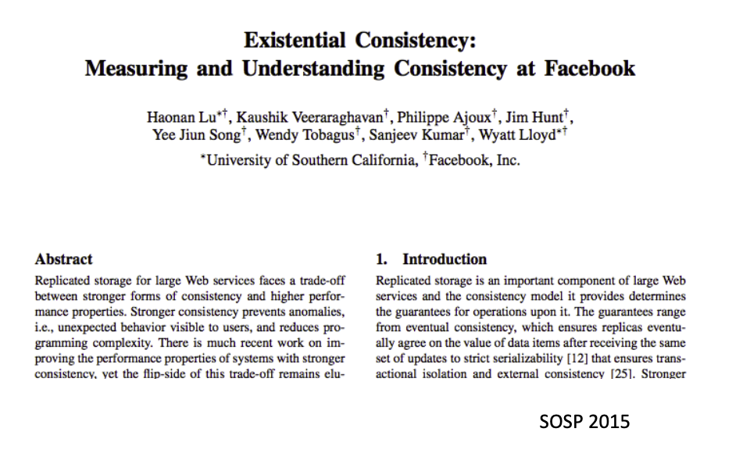
Does eventual consistency anomalies matter?
It depends on the application scenarios
  Frequencies of the anomalies
  Importance of the anomalies
Facebook has conducted a research to measure the frequencies of anomalies under eventual consistency. Some highlights are:
  Per-Object Results: 1 anomaly per million reads (user should see their writes)
  A social networking website can tolerate many anomalies
However, many scenarios (e.g., Bank) require stronger models (even linearizability is insufficient)

Slide 100
Summary of today’s lecture so far
What is consistency model & why we need it
The eventual consistency model
Implementing eventual consistency w/ various timestamps
  Non-trivial if consider user experience
Strong consistency models, strict consistency & linearizability
Note that we use a ChatAPP as our example, but the model generalize
  The data can be any data structure
  The operations can be any operations updating the data

Slide 101
Consistency under single-machine faults

Slide 102
Recall: what is a strong consistency model
It's easy for users to reason about correctness assuming
  Everything has only one-copy
  The overall behavior is equivalent to some serial behavior
What about failure? Can it cause consistency issues?

Slide 103
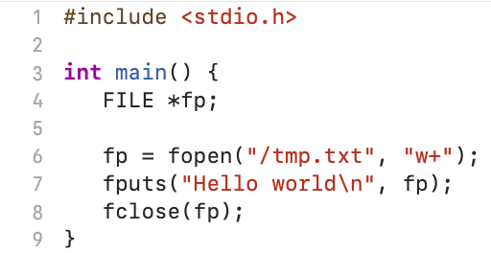
Example: failure leaves operations in a partial state
e.g., writing to a file
  Question: what happen to fputs under crash?
What happens to fputs?
  Not started (in OS’s in-memory cache)
  Doing (writing a large data, not finished yet)
  Done (fine)
Application should deal with the fact that a single write could fail.
Otherwise, may affect the correctness of the applications!

Slide 104
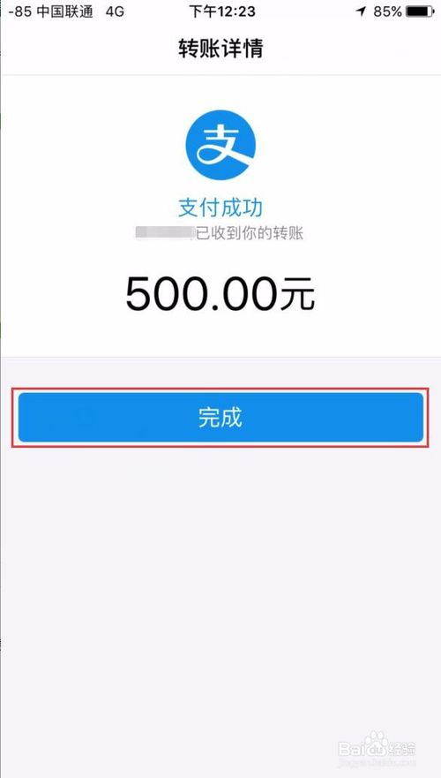
Example: bank transfer
Suppose bank accounts are stored in a single file
  The transfer is executed on a single machine with a single thread
  So it follows linearizability by default
transfer(bank, a, b, amt):
bank[a] = bank[a] – amt
bank[b] = bank[b] + amt
Application invariant (consistency) that must preserve:
bank(a) + bank(b) never changes

Slide 105
Example: bank transfer
Implementation (Simplified)
transfer(bank, a, b, amt):
records = mmap(bank, ...)
records[a] = records[a] – amt
records[b] = records[b] + amt
fsync(bank, ...)
What if an error happens during the execution of fsync?

Slide 106
Deconstructing fsync (SYNC)
transfer(bank, a, b, amt): // amt=10
records = mmap(bank, ...)
records[a] = records[a] – amt
records[b] = records[b] + amt
fsync(bank, ...)
a:
10
b:
10
Page cache
Disk

Slide 107
Deconstructing fsync (SYNC)
transfer(bank, a, b, amt): // amt=10
records = mmap(bank, ...)
records[a] = records[a] – amt
records[b] = records[b] + amt
fsync(bank, ...)
a:
10
b:
10
a:
10
B:
10
records
Page cache
Disk

Slide 108
Deconstructing fsync (SYNC)
transfer(bank, a, b, amt): // amt=10
records = mmap(bank, ...)
records[a] = records[a] – amt
records[b] = records[b] + amt
fsync(bank, ...)
a:
10
b:
10
a:
0
B:
10
records
Page cache
Disk

Slide 109
Deconstructing fsync (SYNC)
transfer(bank, a, b, amt): // amt=10
records = mmap(bank, ...)
records[a] = records[a] – amt
records[b] = records[b] + amt
fsync(bank, ...)
a:
10
b:
10
a:
0
B:
20
records
Page cache
Disk

Slide 110
Deconstructing fsync (SYNC)
transfer(bank, a, b, amt): // amt=10
records = mmap(bank, ...)
records[a] = records[a] – amt
records[b] = records[b] + amt
fsync(bank, ...)
Write(A)
Write(B)
a:
10
b:
10
a:
0
B:
20
records
Page cache
Disk

Slide 111
Deconstructing fsync (SYNC)
transfer(bank, a, b, amt): // amt=10
records = mmap(bank, ...)
records[a] = records[a] – amt
records[b] = records[b] + amt
fsync(bank, ...)
Write(A)
Write(B)
a:
0
b:
10
B:
20
records
Page cache
Disk
Pages are flushed to disk one-by-one

Slide 112

Deconstructing fsync (SYNC)
transfer(bank, a, b, amt): // amt=10
records = mmap(bank, ...)
records[a] = records[a] – amt
records[b] = records[b] + amt
fsync(bank, ...)
Write(A)
Write(B)
a:
0
b:
10
B:
20
records
Page cache
Consistency is broken after the machine failure!
Disk
Application invariant that must preserve:
bank(a) + bank(b) never changes

Slide 113
What is a strong consistency model (continued)
It's easy for users to reason about correctness assuming
  Everything has only one-copy
  The overall behavior is equivalent to some serial behavior
  The operations that need to be executed in an atomic unit (usually called operations belonging to a transaction) are executed on a machine that happens completely or not at all (all-or-nothing atomicity)
All-or-nothing atomicity makes it much easier to reason about failures
  Need to think about the consequences of the action happening or not happening, but not about the action partially happening

Slide 114
Achieving atomicity: shadow copy
Ensure a set of operations written to a file is all-or-nothing
  E.g., writes records a & b to the bank file
High-level idea (copy-on-write):
  Do not modify the old copy (there is always a consistent copy)
  Replace the origin file with the updates only if all the writes to are successful
Original
Shadow copy
transfer(bank, a, b, amt):
records = mmap(bank, ...)
records[a] = records[a] – amt
records[b] = records[b] + amt
fsync(bank, ...)
transfer(bank, a, b, amt):
fcopy(bank, bank_temp)
records = mmap(bank_temp, ...)
records[a] = records[a] – amt
records[b] = records[b] + amt
fsync(bank_temp, ...)
rename(bank_temp,bank)

Slide 115
Shadow copy: analysis
Shadow copy
transfer(bank, a, b, amt):
fcopy(bank, bank_temp)
records = mmap(bank_temp, ...)
records[a] = records[a] – amt
records[b] = records[b] + amt
fsync(bank_temp, ...)
rename(bank_temp,bank)
Question: what happen if a crash happens during fcopy or fsync?
  The origin bank file is always consistent
  We can just remove the bank_temp, so the transfer not happens

Slide 116
Shadow copy: analysis
Shadow copy
transfer(bank, a, b, amt):
fcopy(bank, bank_temp)
records = mmap(bank_temp, ...)
records[a] = records[a] – amt
records[b] = records[b] + amt
fsync(bank_temp, ...)
rename(bank_temp,bank)
Question: what happen if a crash happens during rename?
  For the bank transfer, it is consistent
What about the filesystem state?
  Depends on the internal implementation of the filesystem!

Slide 117
rename(temp_bank, bank)
Directory data blocks:
  filename "bank" → inode 12
  filename " temp_bank " → inode 13
inode 12:
  data blocks: 3, 4, 5
  refcount: 1
inode 13:
  data blocks: 6, 7, 8
  refcount: 1

Slide 118
rename(temp_bank, bank)
Directory data blocks:
  filename "bank" → inode 13
  filename " temp_bank " → inode 13
inode 12:
  data blocks: 3, 4, 5
  refcount: 1
inode 13:
  data blocks: 6, 7, 8
  refcount: 1
Time

Slide 119
rename(temp_bank, bank)
Directory data blocks:
  filename "bank" → inode 13
  filename " temp_bank " → inode 13
inode 12:
  data blocks: 3, 4, 5
  refcount: 1
inode 13:
  data blocks: 6, 7, 8
  refcount: 2
Time

Slide 120
rename(temp_bank, bank)
Directory data blocks:
  filename "bank" → inode 13
  filename " temp_bank " → inode 13
inode 12:
  data blocks: 3, 4, 5
  refcount: 0
inode 13:
  data blocks: 6, 7, 8
  refcount: 2
Time

Slide 121
rename(temp_bank, bank)
Directory data blocks:
  filename "bank" → inode 13
  filename " temp_bank " → inode 13
inode 12:
  data blocks: 3, 4, 5
  refcount: 0
inode 13:
  data blocks: 6, 7, 8
  refcount: 2
Time

Slide 122
rename(temp_bank, bank)
Directory data blocks:
  filename "bank" → inode 13
  filename " temp_bank " → inode 13
inode 12:
  data blocks: 3, 4, 5
  refcount: 0
inode 13:
  data blocks: 6, 7, 8
  refcount: 1
Time

Slide 123
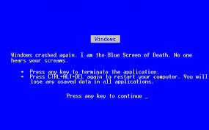
If crash, what step will cause problem?

Slide 124

Problem
Directory data blocks:
  filename "bank" → inode 13
  filename ”temp_bank" → inode 13
inode 12:
  data blocks: 3, 4, 5
  refcount: 1
inode 13:
  data blocks: 6, 7, 8
  refcount: 1
Time
Two names point to fnew’s inode, but refcount is 1
  which reference is the correct one?

Slide 125
Naïve solution
Ask application to remove the unnecessary inodes
  i.e., the application knows that "bank_temp" should be removed
Typically, not a good idea
  Problem #1. The filesystem consistency depends on the application. What if the application is buggy or malicious?
  Problem #2. What about more complex applications?
Ideal semantic: the application’s recovery method should be decoupled from the filesystem recovery method

Slide 126
Goal: file system ensures the rename is atomic
To decouple the atomicity of shadow copy from the application
Key idea: journaling

Slide 127
Journaling overview
Logging
  A concept from database (and will talk about more details in this lecture)
Record before update
  Record changes in journal
  Commit journal
  Update
Crash before commit:
- No data is changed
- Discard journal
Crash after commit:
- Journal is complete
- Redo changes in journal

Slide 128
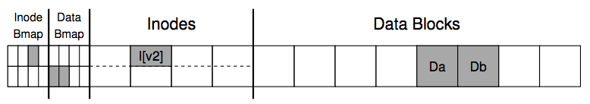
Rename via journaling
Directory data blocks:
  filename "bank" → inode 12 -> 13
  filename " temp_bank " → inode 13
Inside of 12
  data blocks: 3, 4, 5
  refcount: 1 -> 0
Inside of 13
  data blocks: 6, 7, 8
  refcount: 1
Directory data blocks:
“bank” -> inode 13
Delete ”temp_bank”
Inode 12: refcount = 0
Inode 13: refcount = 1
COMMITTED
12
13

Slide 129
Append a File via Journaling
Inside of Inode:
  owner : yubin
  permissions : read-write
  size : 1
  pointer : 4
  pointer : null
  pointer : null
lnode:
size: 1=>2
2nd pointer: null => 5
Db:
Old-data… => Appended-data…
COMMITTED
=> 2
=> 5
Journal

Slide 130

Journaling Drawbacks
Everything is written to the disk twice
  Once in the journal
  The other at the home location
Become problematic when the files are large

Slide 131
Mitigating Journaling Drawbacks
Observation:
  Not everything in file system has equal importance
  Usually, the metadata is more important
    E.g., which blocks belong to the inode
Mitigation:
  Only protect metadata via Journaling
    Data is written only once
  What if data is also important?
    Ext4 options: data=journal/ordered/writeback
    Application can also handle the write itself, e.g., wait for fsync to flush the data synchronously before proceed to the next
Notes:
Ordered: file data is written before the metadata is changed

Slide 132
What if crash during commit journal?
Assume that writing to one sector on disk is all-or-nothing
  Disk saves enough energy to complete one sector write
    Small capacitor suffices to power disk for a few microsecond
    Assumption: time spent writing a sector is small
  If write did not start, no need to complete it
    Still all-or-nothing
So write to the journal is always all-or-nothing
But wait, what if the logged data is larger than the sector?
  We need a generalized method than journaling ☺

Slide 133
Back to shadow copy
Write to a copy of data, atomically switch to new copy
Switching can be done with one all-or-nothing operation
  Rename with journaling
Only requires a simple recovery procedure of the file system
  i.e., remove the temporal file after the recovery
  The filesystem itself is kept consistent via journaling
    i.e., the filesystem itself has a recovery process

Slide 134
Drawbacks of shadow copy
Question: what would happen if multiple clients share the same file?
Example:
Client 0
Client 1
transfer(bank, a, b, amt):
fcopy(bank, bank_temp)
records = mmap(bank_temp, ...)
records[a] = records[a] – amt
records[b] = records[b] + amt
fsync(bank_temp, ...)
rename(bank_temp,bank)
transfer(bank, c, d, amt):
fcopy(bank, bank_temp)
records = mmap(bank_temp, ...)
records[a] = records[c] – amt
records[b] = records[d] + amt
fsync(bank_temp, ...)
rename(bank_temp,bank)

Slide 135
Drawbacks of shadow copy
Question: what would happen if multiple clients share the same file?
  Client 0 transfers 100 from a to b
a = 100
b = 100
c = 100
d = 100
a = 100
b = 100
c = 100
d = 100
Bank
Bank_temp
Time
Create shadow file
Update a

Slide 136
Drawbacks of shadow copy
Question: what would happen if multiple clients share the same file?
  Client 0 transfers 100 from a to b
a = 100
b = 100
c = 100
d = 100
a = 100
b = 100
c = 100
d = 100
a = 0
b = 100
c = 100
d = 100
Bank
Bank_temp
Cache
Time
Create shadow file
Update a

Slide 137
Drawbacks of shadow copy
Question: what would happen if multiple clients share the same file?
  Client 0 transfers 100 from a to b
  Client 1 transfers 100 from c to d
a = 100
b = 100
c = 100
d = 100
a = 100
b = 100
c = 100
d = 100
a = 0
b = 100
c = 100
d = 100
Bank
Bank_temp
Cache
Question: can client 1 directly create a new bank_temp?
Time
Create shadow file
Update a

Slide 138
Drawbacks of shadow copy
Question: what would happen if multiple clients share the same file?
  Client 0 transfers 100 from a to b
  Client 1 transfers 100 from c to d
a = 100
b = 100
c = 100
d = 100
a = 100
b = 100
c = 100
d = 100
a = 0
b = 100
c = 100
d = 100
Bank
Bank_temp
Cache
No. Because it will overwrite client 0’s results.
We can only reuse existing file
Time
Create shadow file
Update a

Slide 139
Drawbacks of shadow copy
Question: what would happen if multiple clients share the same file?
  Client 0 transfers 100 from a to b
  Client 1 transfers 100 from c to d
a = 100
b = 100
c = 100
d = 100
a = 100
b = 100
c = 100
d = 100
a = 0
b = 100
c = 0
d = 200
Bank
Bank_temp
Cache
Client 0 stuck, e.g., due to interrupts
Time
Create shadow file
Update a
Update c,d

Slide 140
Drawbacks of shadow copy
Question: what would happen if multiple clients share the same file?
  Client 0 transfers 100 from a to b
  Client 1 transfers 100 from c to d
a = 100
b = 100
c = 100
d = 100
a = 0
b = 100
c = 0
d = 200
a = 0
b = 100
c = 0
d = 200
Bank
Bank_temp
Cache
Time
Create shadow file
Update a
Update c,d
fsync

Slide 141
Drawbacks of shadow copy
Question: what would happen if multiple clients share the same file?
  Client 0 transfers 100 from a to b
  Client 1 transfers 100 from c to d
a = 0
b = 100
c = 0
d = 200
Bank
Client 1 writes client 0’s intermediate
results. So it must wait…
Time
Create shadow file
Update a
Update c,d
fsync
Client 1 done

Slide 142
Drawbacks of shadow copy
  Only one operation can happen at a time
    Naively executing concurrent transfer can cause consistency issue
    Even these operations in principle can run concurrently
  Hard to generalize to multiple files or directories
    Have to place all files in a single directory, or rename subdirs
  Requires copying the entire file for any (small) change

