Slide 1
A [128,4096]
Embedded input
[19,1,4096] (FP16)
step-1：LN0
RMSNorm
RMSNorm
LN_k: [1,4096]
LN_bias: [4096]
step-2：MVMBN0(Q)
32个head一起
B [128,4096]
step-4：MVMBN0(K)
32个head一起
RMSNorm output
[19,1,4096] (FP16)
MVM_BN _{(x 32)}
W^{Q}: [4096,128]
Scale: [32,128]
MVM_BN _{(x 8)}
W^{K}: [4096,128]
Scale: [32,128]
MVM_BN _{(x 8)}
W^{V}: [4096,128]
Scale: [32,128]
step-3：EMB(Q)
Pos_EMB
32个head一起
执行1次
C
step-5：EMB(K)
Pos_EMB
32个head一起
执行1次
MVM_Q_output_{(x 32)}
[19,1,128]
MVM_K_output _{(x 8)}
[19,1,128]
Value _{(x 8)}
[19,1,128]
RMSNorm
LN_k: [1,128]
LN_bias: [128]
RMSNorm
LN_k: [1,128]
LN_bias: [128]
D
Query_{(x 32)}
[19,1,128]
Key _{(x 8)}
[19,1,128]
rotary_pos_emb
rotary_pos_emb
step-9：MVMBN0(V)
32个head一起
step-6：KV2HBM
EmbQuery_{(x 32)}
[19,1,128]
Emb_Key_{(x 8)}
[19,1,128]
step-7：TRP
MVM_after_TRP
rsqrt为定值，用寄存器配置送入
32个feature_head一起, 执行1次
KV2HBM
KV2HBM
step-10：
KV2HBM
MVM_after_TRP
这两个地方需要cache，也即KV cache
step-8：softmax
32个feature_head一起, 执行1次
scores _{(x 32)}
[19, 19]
E
step-11：F2W
MVM_after_F2W
32个feature_head一起, 执行1次
MVM_after_F2W
Softmax
F
scores _{(x 32)}
[19，19]
Attention out _{(x 32)}
[19,128]
G

Slide 2
阅读模式，KV_cache_mode=0
A
Embedded input [19,1,4096]
G
Attention output _{(x 32)}
[19,128]
step-12：MVMBN1
MVM
[4096,4096]
output
[19,1,4096]
step-13：
ELEMENTWISE0
elementwise_Add
[19,1,4096]
H
Res_output
[19,1,4096]
post_attention_rmsnorm
[4096]
step-14：LN1
RMSNorm
I
post_norm_output
[19,1,4096]
step-15：MVMBN2
dense_h_to_4h_0(MVM)
[4096,12288]
dense_h_to_4h_0(MVM)
[4096,12288]
step-17：
MVMBN3
J
Dense_4h_output
[19,1,12288]
Dense_4h_output
[19,1,12288]
step-16：
Silu
step-18：
elementwise
multiply
Silu (ACT)
elemnetwise multiply
K
ACT_output
[19,1,12288]
output
[19,1,12288]
dense_4h_to_h_0(MVM)
[12288,4096]
step-19：MVMBN4
L
Attention Scores
[19,1,4096]
Next Embedded input
[20,1,4096]
CPU处理

Slide 3
Embedded input
[19,1,4096]
output_layer (MVM)
[4096, 151936]
QWen3Block
x36
1次MVM_BN算子
Attention Scores
[19,1,4096]
Output
[19,1, 151936]
final_layernorm
LN_k: [1,4096] (FP16)
LN_bias: [4096] (FP16)
1次LayerNorm算子
hidden_states
[19,1,4096]

Slide 4
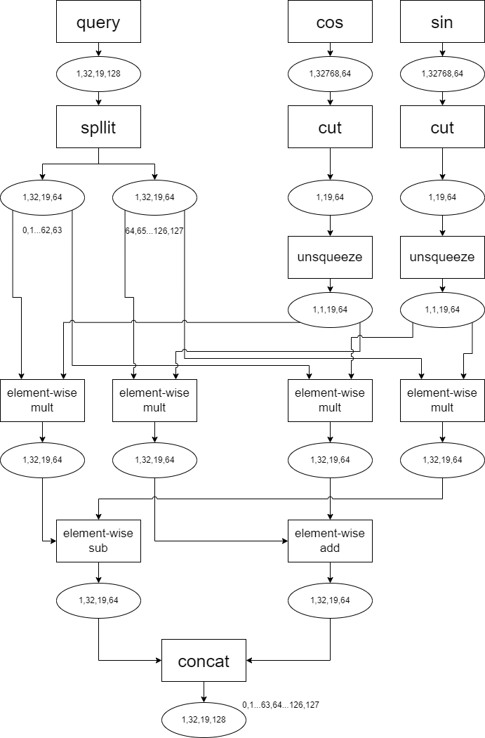
LLaMA2-7B RotaryEmbedding

