Slide 1

A Guide to Advanced Java
Faculty:Nguyen Ngoc Tu

Slide 2



Concurrent programming in Java
How to make all things run-able?

Slide 3

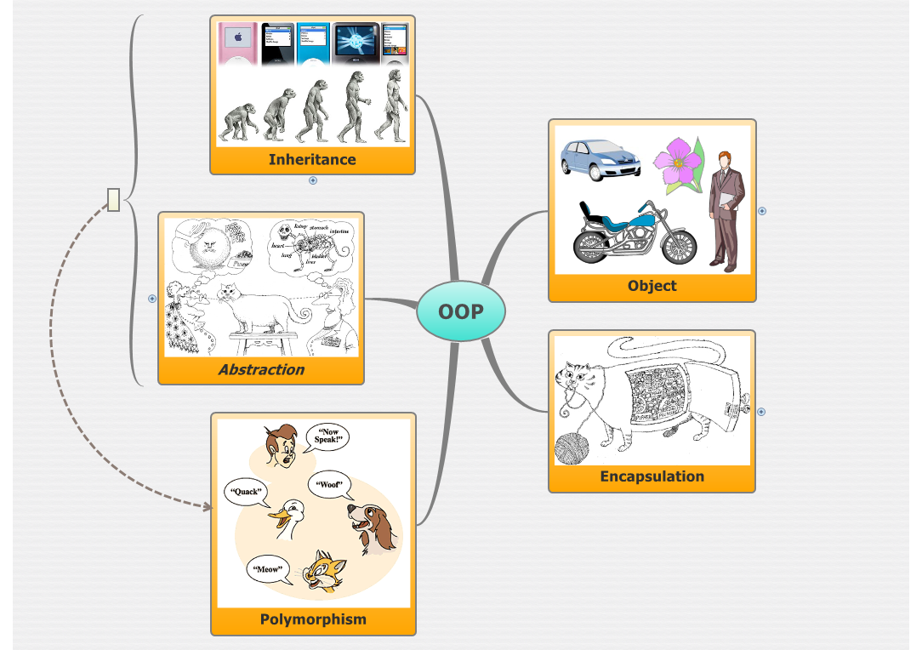
Object Oriented Programming

Slide 4

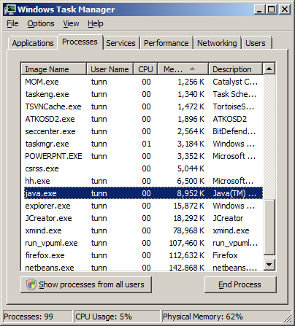
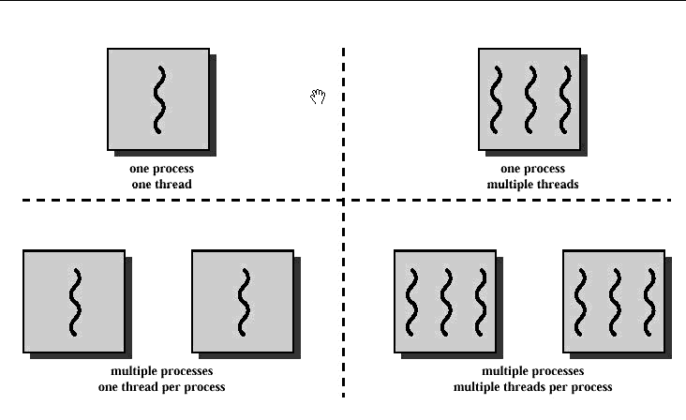
When a modern operating system wants to start running a program, it creates a new process
A process is a program that is currently executing
Every process has at least one thread running within it
We can think of a thread as basically a lightweight process
http://www.cs.cf.ac.uk/Dave/C/node29.html

Slide 5

public class HelloWorld {
public static void main(String[] args) {
System.out.println("I want to say...");
System.out.println("...Hello World!");
}
}
C:\java HelloWorld ↵
I want to say…
…Hello World!

Slide 6

OS run HelloWorld program
The Main Thread
New Process
(new instance of JVM)
Begin
main()
{
System.out.println(“I want to say…”)
System.out.println(“…Hello World!”)
}
Background Threads
End
(the garbage collection thread for example)
Even a simple Java program that only prints Hello World to System.out is running in a multithreaded environment

Slide 7

Better Interaction with the User
Simulation of Simultaneous Activities
Exploitation of Multiple Processors
Do Other Things While Waiting for Slow I/O Operations
Simplify Object Modeling

Slide 8

A thread has it own complete set of basic run-time resources to run it dependently.
So, It’s not always a good idea to add more threads to the design of a program. Threads are not free; they carry some resource overhead.
For example: in a pc game, there’re a thousand behavior of a thousand objects happening at the same time. Don’t use Multiple thread!

Slide 9

Which way you can create a thread?
  Inherits the Thread class?
  Implements the Runnable interface?

Slide 10

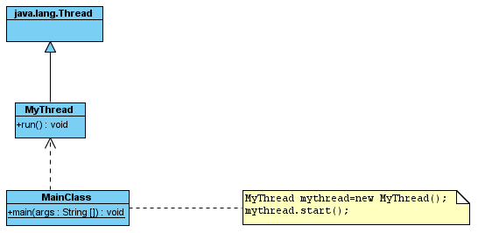
Step 1: Create a class that extends the java.lang.Thread class
Step2: Overrides the run() method of the Thread class in that subclass
Step3: Create an instance of this new class
Step4: Start the new thread by invoke the start() method on the instance.

Slide 11

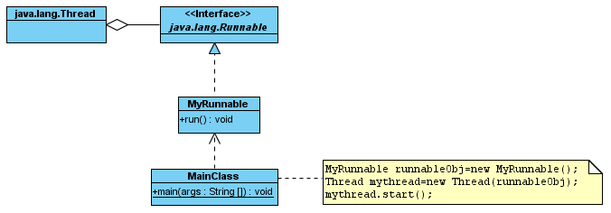
Step1: Create new class that implements the java.lang.Runnable interface
Step2: Implements the run() method on this class
Step3: Create an instance of this new class
Step4: Start the new thread by invoke the start() method on the instance.

Slide 12

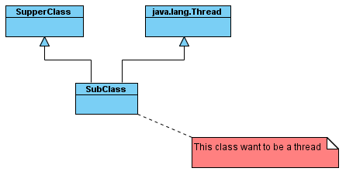
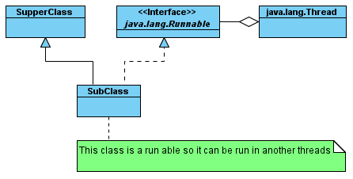

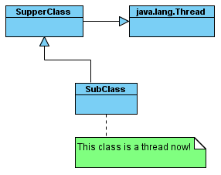
Solution
Problem!!!
Solution

Slide 13

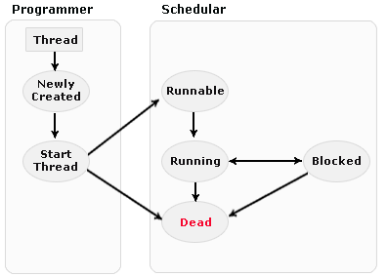
Difference state of a thread are:
1. New state
2. Runnable (Ready-to-run) state
3. Running state
4. Blocked
5. Dead state

Slide 14

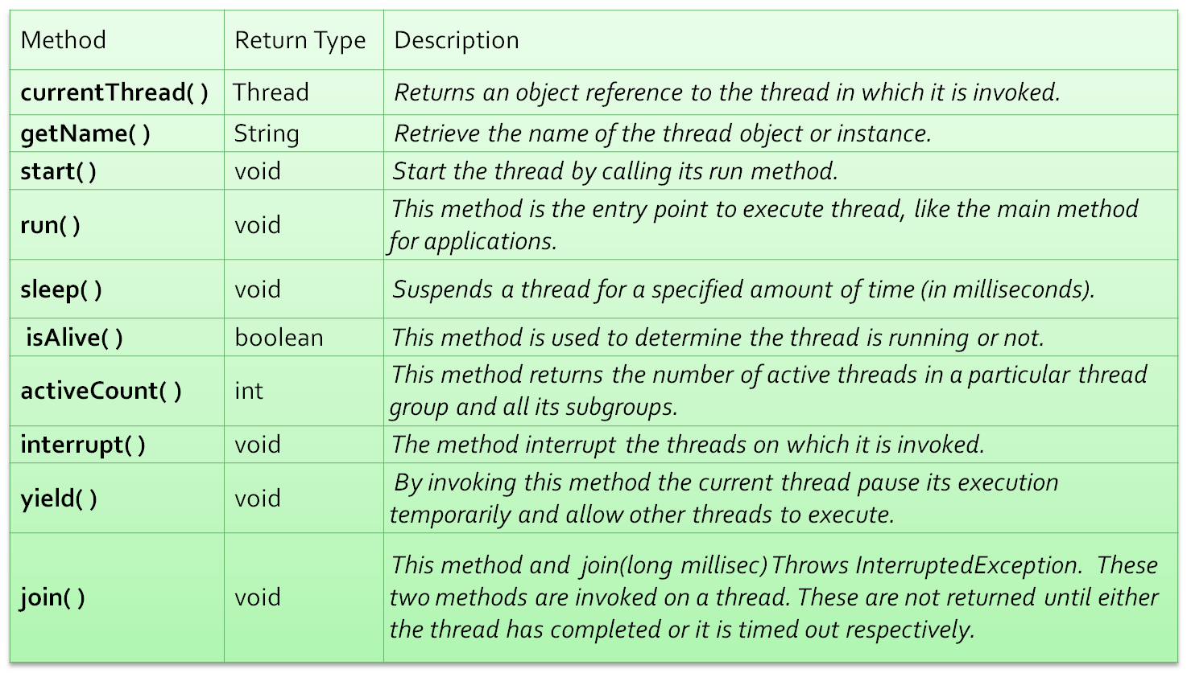

Slide 15

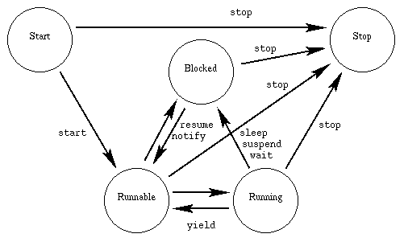

Slide 16

Java allows you to give each of the threads running in a virtual machine a priority.
Higher-priority threads generally get more of a chance to run than lower-priority threads.
Thread Priority Constants:
  Thread.MAX_PRIORITY
  Thread.MIN_PRIORITY
  Thread.NORM_PRIORITY
Getter/Setter for priority:
  setPriority()
  getPriority()

Slide 17

The characteristics of daemon threads are:
Daemon threads work in the background providing services to other threads.
They are fully dependent on user threads
If any non-daemon thread is still alive, the VM will not exit.

Slide 18

Daemon threads are used for background supporting tasks and are only needed while normal, non-daemon threads are still running.
Daemon threads are designed as low-level background threads that perform some tasks such as mouse events for java program.

Slide 19

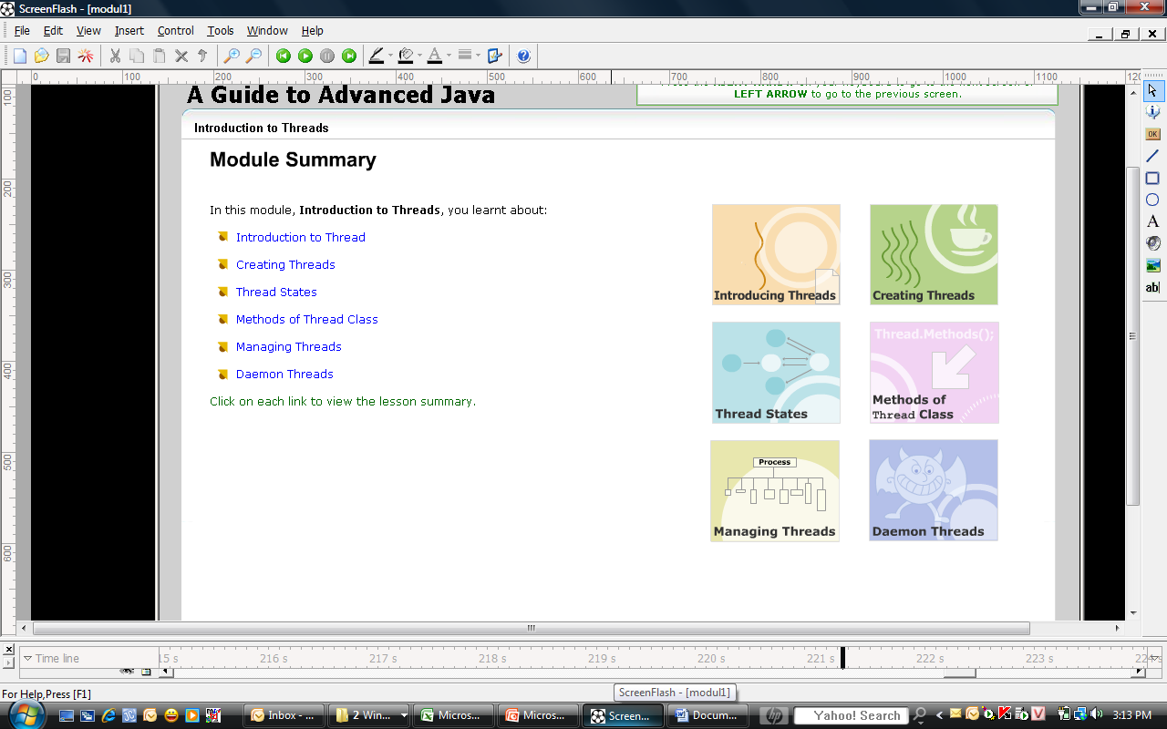

Slide 20

A Guide to Advanced Java

Slide 21

Java Thread Programming by Paul Hyde
http://java.sun.com/docs/books/tutorial/essential/concurrency/
http://www.javaworld.com/javaworld/jw-04-1996/jw-04-threads.html
http://www.javapassion.com/javaintro/index.html#Threading_Basics

