Slide 1

A Guide to Advanced Java
Faculty:Nguyen Ngoc Tu

Slide 2



Concurrent programming in Java
How to make all things run-able?

Slide 3

In previous session you leant about:
  What is a Thread?
  How to create a Thread?
  Life cycle of the Thread
  Explores the java.lang.Thread class and java.lang.Runnable interface
  Daemon Thread?

Slide 4

Thread & Multi-threading
Thread Synchronization
  The Race Conditions
  Wait-notify mechanism
  Deadlock
java.lang package

Slide 5

A thread performs a certain task and is the smallest unit of executable code in a program.
Multithreading can be defined as the concurrent running of the two or more parts of the same program.

Slide 6




Operating System
Application #1
Local Memory
Application #2
Local Memory
Application #3
Local Memory
Shared Memory
Processes in a multitasking environment

Slide 7







Operating System
Application #1
Local Memory
Application #2
Local Memory
Shared Memory
Local Memory
Java Virtual Machine #1
Daemon Thread #1
Local Memory
Main Thread #2
Local Memory
Global Memory
Local Memory
Your Thread #3
Threads in a multithreaded environment

Slide 8

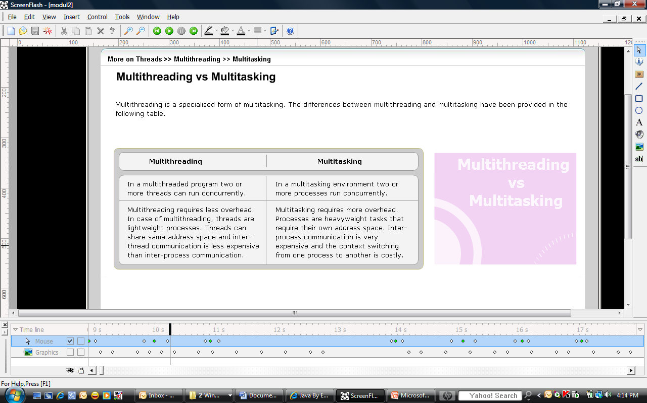

Slide 9

Multithreading is needed for the following reasons:
  Multithreading increases performance of single-processor systems, as it reduces the CPU idle time.
  Multithreading encourages faster execution of a program when compared to an application with multi processes, as threads share the same data whereas processes has it own sets of data.
  Multithreading introduces the concept of parallel processing of multi threads in an application which services a huge number of users.

Slide 10

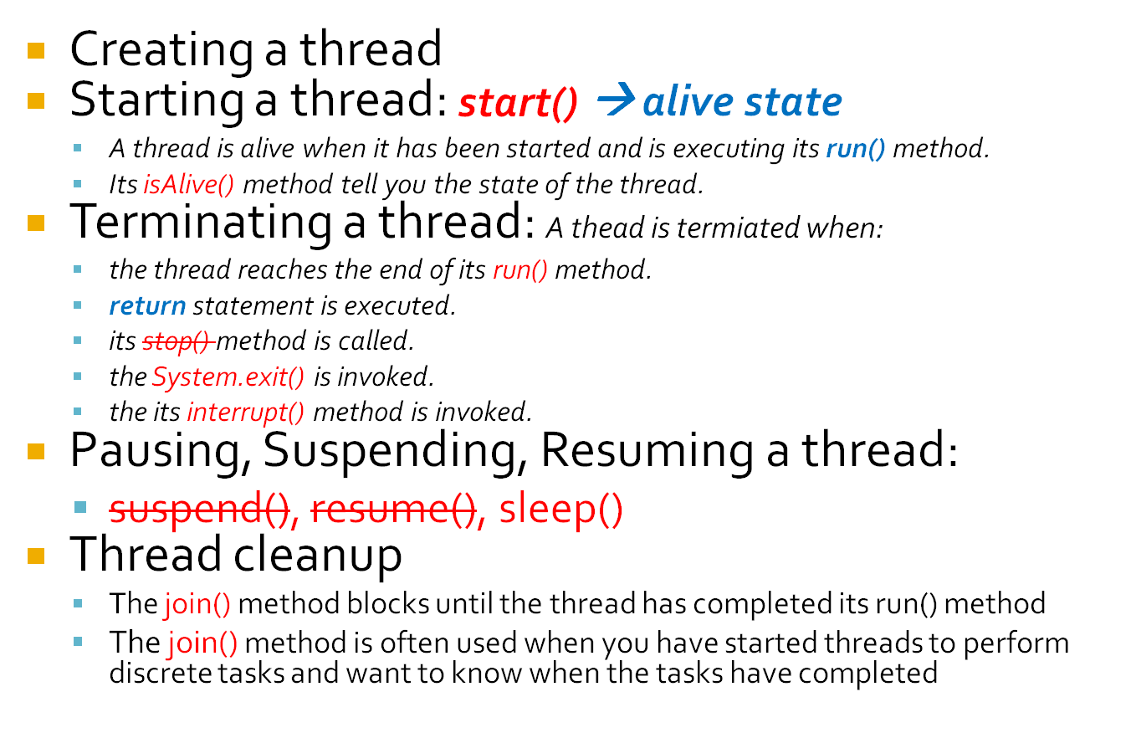

Slide 11

public class JoinDemo {
public static void main(String[] args) {
Job job = new Job();
Thread jobthread = new Thread(job);
jobthread.start();
try {
startOtherJobAtTheSameTime();
// the current thread will wait until the job
//done
jobthread.join();
}
catch(Exception e){
}
System.out.println("Job done");
// do something else
}
private static void startOtherJobAtTheSameTime() {
for (int i=1; i<=200; i++ ){
System.out.print("A" + i + ", ");
}
}
}
}
public class Job implements Runnable {
public void run(){
for (int i=1; i<=200; i++ ){
System.out.print("B" + i + ", ");
}
}
}
http://www.coderanch.com/t/231948/Threads-Synchronization

Slide 12

The Race Conditions:
  Two or more threads shares the same data between them
  Two or more threads try to read and write the shared data simultaneously
The race conditions can be avoided by using synchronized blocks.
Demo the race conditions

Slide 13

Synchronized blocks are used to prevent the race conditions.
A lock is assigned to the object qualified by synchronized keyword. A lock allow only one thread at a time to access the code.

Slide 14

synchronized Method Modifier
    synchronized method() {
    }
synchronized Statement Block
    synchronized(object) {
    }
    Class-Level Lock in a synchronized Statement:
      synchronized ( ClassName.class ) { // body }

Slide 15















wait()
Thread A
Thread A
Thread A
Thread A
object
object
object
object
reference
object
synchronized
notify()
reference
Thread B
Thread B
Thread B
Thread B
object
object
object
object
Time line

Slide 16

Example:
private boolean value = false;
private Object valueLock = new Object();
try {
synchronized ( valueLock ) {
while ( value != true ) {
valueLock.wait();
}
// value is now true
}
} catch ( InterruptedException x ) {
System.out.println(“interrupted while waiting”);
}

Slide 17

synchronized ( valueLock ) {
value = true;
valueLock.notify(); // notifyAll() might be safer...
}

Slide 18

For controlling shared resources ("pooling") such as database connections. If all resources are currently in use, one thread can wait to be notified that a resource has become available.
For background execution or coordinating multi-threaded execution: the controlling thread can wait for other threads to notify it of completion of a task.
For creating thread pools or job queues on a server: a fixed number of threads would sit waiting to be notified that a new job had been added to the list.

Slide 19

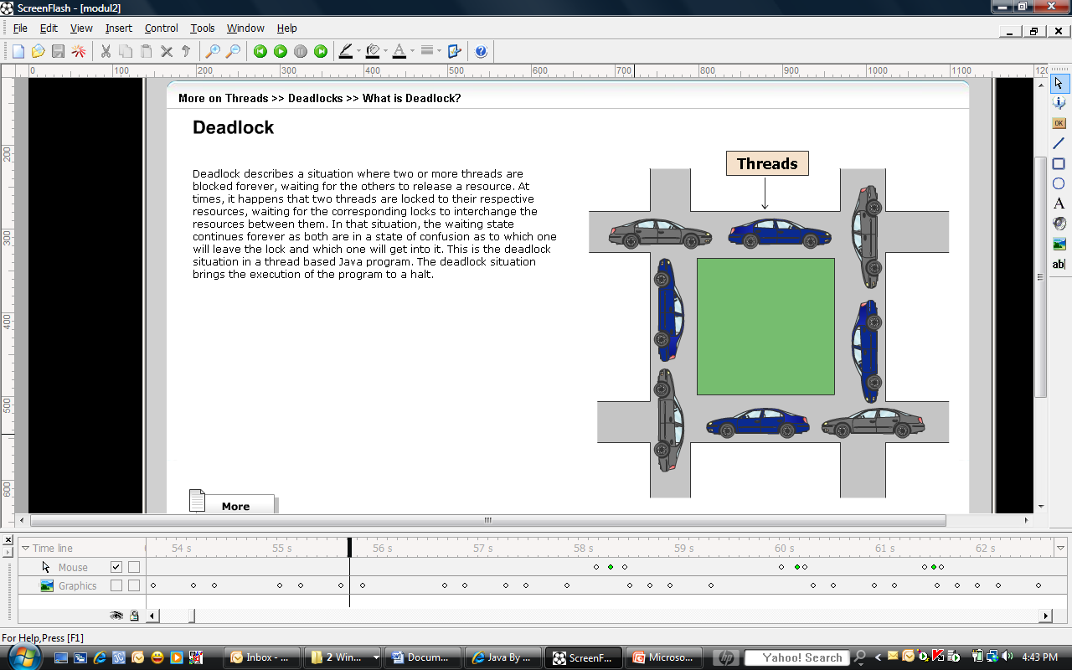
Deadlock describes a situation where two or more threads are block forever, waiting for the other to release a resource

Slide 20

Hold locks for only the minimal amount of time necessary. Consider using synchronized statement blocks instead of synchronizing the whole method.
Try to write code that does not need to hold more than one lock at a time. If this is unavoidable, try to make sure that threads hold the second lock only for a brief period of time.
Create and use one big lock instead of several small ones.

Slide 21

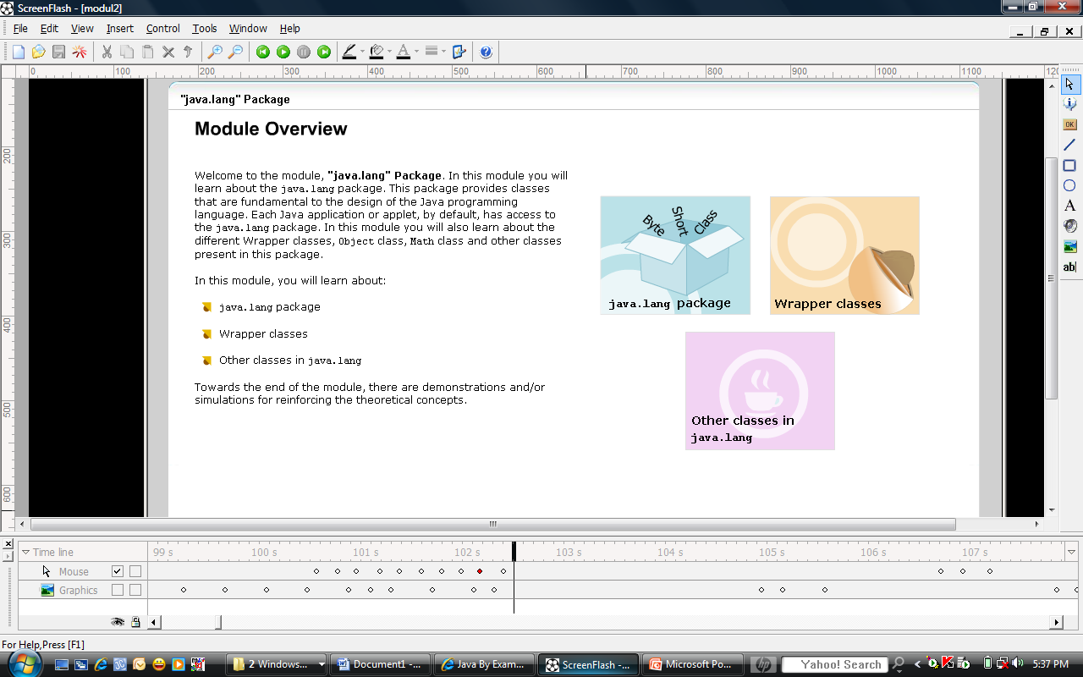

Slide 22

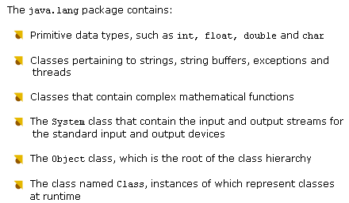

Slide 23

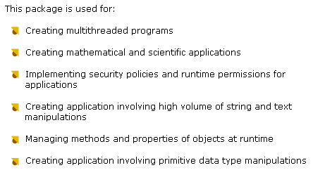

Slide 24

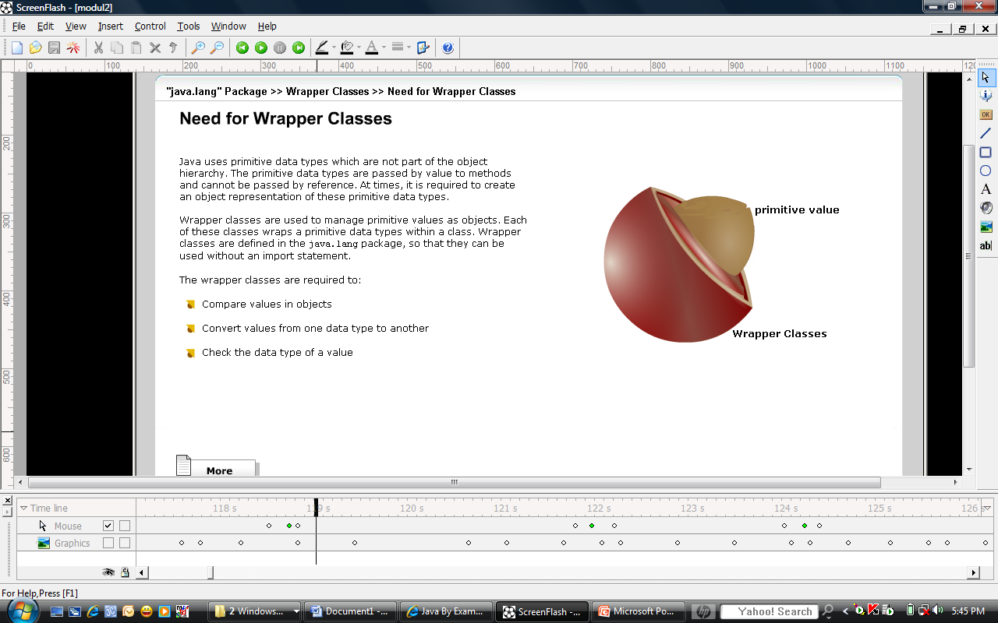
Type of Wrapper class: Character, Byte, Integer, Short, Long, Float, Double and Boolean

Slide 25
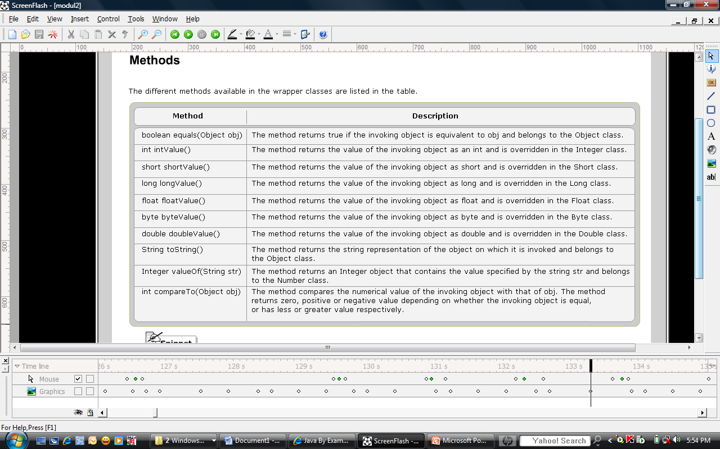

Slide 26

Constant: E and PI
Power function
Exponential function
Logarithmic function
Trigonometric function: sin(), cos() and tan() method
Arithmetic function: ceil(), floor(), round(), random() and sqrt() method

Slide 27

Standard input and output devices
Getting environment properties
Garbage Collection

Slide 28

The Object class is the super class of all classes
Some methods:
  equals()
  finalize()
  notify()
  notifyAll()
  toString()
  wait()

Slide 29

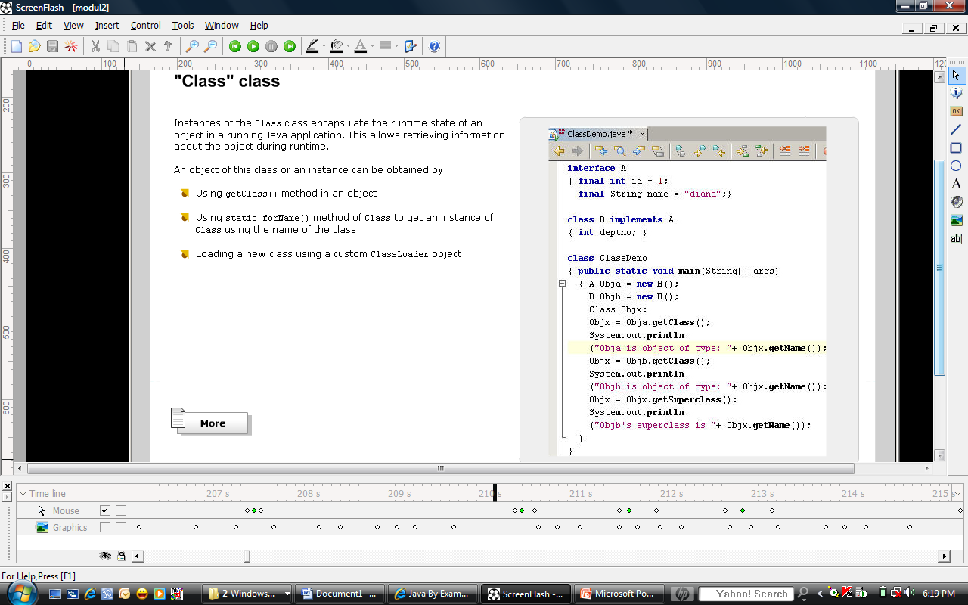

Slide 30

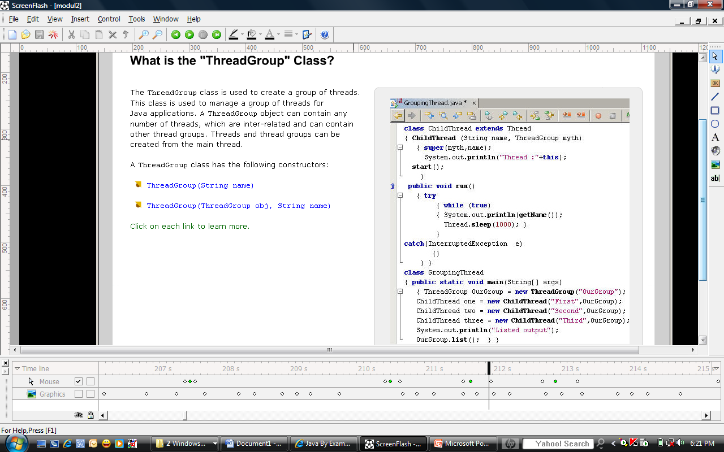

Slide 31

The Runtime class encapsulates the runtime environment
This class is used for memory management and executing additional processes
Methods:
  exit()
  freeMemory()
  totalMemory()
  getRuntime()
  gc()
  exec()
  availableProcessor()

Slide 32



Slide 33


A Guide to Advanced Java

Slide 34

Java Thread Programming by Paul Hyde
Java Threads, Third Edition By Scott Oaks, Henry Wong
Java 1.4 Game Programming by Andrew Mulholland and Glen Murphy
http://java.sun.com/docs/books/tutorial/essential/concurrency/
http://www.javaworld.com/javaworld/jw-04-1996/jw-04-threads.html
http://www.javapassion.com/javaintro/index.html#Threading_Basics

